Slide 1

Kibana
Dima Ionut Daniel

Slide 2
Contents
What is Kibana ?
Features
Arhitecture
Concepts
Elasticsearch
Core
Conclusions
Bibliography

Slide 3

What is Kibana ?
Kibana is a proprietary data visualization dashboard for Elasticsearch.
It can create different types of charts on top of large volumes of data.
The combination of Elasticsearch, Logstash and Kibana is referred as "Elastic Stack", formerly ELK stack.
Logstash provides an input stream to Elasticsearch for storage and search and Kibana accesses the data for visualizations.

Slide 4
Features
Search, observe, and protect your data
Analyze data
Manage, monitor, and secure the Elastic Stack
Kibana works with all types of data

Slide 5
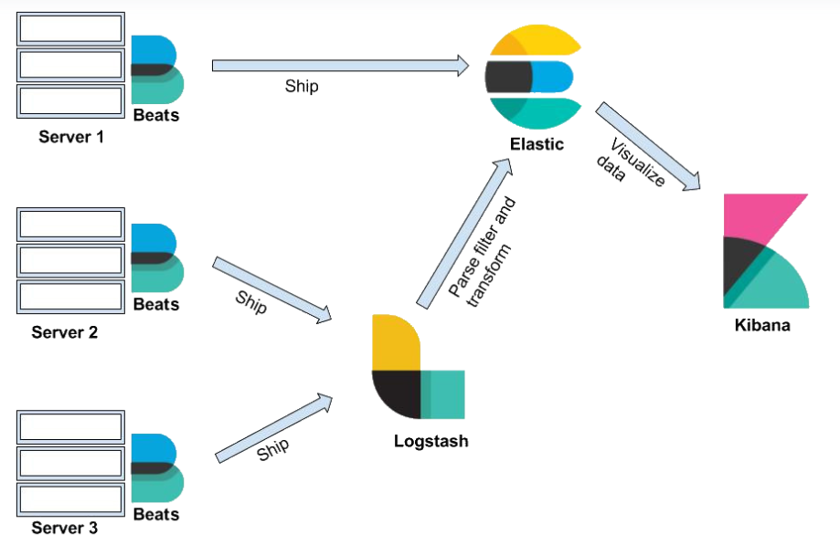
Arhitecture

Slide 6
Concepts
Field is the smallest single unit of data stored in Elasticsearch. Every document contains key-value pairs which are referred to as fields. The field type is responsible for specifying which type of data can be stored in a particular field: integer, string, date, etc.
Document is the simplest unit of information stored in Elasticsearch in JSON format. It's a collection of fields.
Type contains a list of fields which is defined for every document. A type is a logical segregation of indexes.
Index is a collection of documents. An index has a mapping used to define multiple types.
MySQL => Databases => Tables => Columns/Rows
Elasticsearch => Indexes => Types => Documents with Fields

Slide 7
Concepts (cont.)
ID represents the identifier of a document and must be unique for each document.
Mappings are like schemas. Every document in an index has a type. A mapping defines the fields, the data type for each field.
Node represents the running instance of Elasticsearch. Each node is part of a cluster.
Cluster is a collection of nodes and has 1 or multiple nodes, sharing a single cluster name.

Slide 8
Concepts (cont.)
Sharding. An index cand store any amount of data that can split index into multiple pieces.
Elasticsearch is responsible for distributing shards among nodes.
It allows horizontal scaling of the content volume and improves performance by providing parallel operations across various shards.

Slide 9
Concepts (cont.)
Types of shards:
primary shard: every document is stored within a primary index. By default, every index has 5 primary shards.
The number of primary shards defined in an index cannot be altered once the index is created.
replica shard: provide high availability across nodes in the cluster. By default, every primary shard has 1 replica shard. A replica shard is never kept on the same node as that of the primary shard.
Inverted index is used to provide has full-text search.
Instead of searching text, it searches for an index. It creates an index that lists unique words occurring in a document along with the document list in which each word occurs.

Slide 10
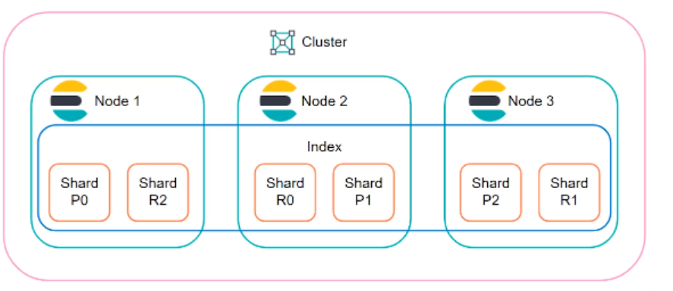
Concepts (cont.)
Elasticsearch distributes data around the cluster.

Slide 11
Elasticsearch
Elasticsearch is document oriented
insert documents
delete documents
retrieve documents
analyze documents
search documents

Slide 12
Elasticsearch (cont.)
From Elasticsearch version 7, the type parameter will be deprecated.
To index a document:
PUT /{find}/{type}/{id}
{
"field1" : "value1",
"field2" : "value2"
...
}
PUT /vehicles/car/2
{
"make" : "Cielo",
“milage” : 10000,
"color" : "white"
}

Slide 13
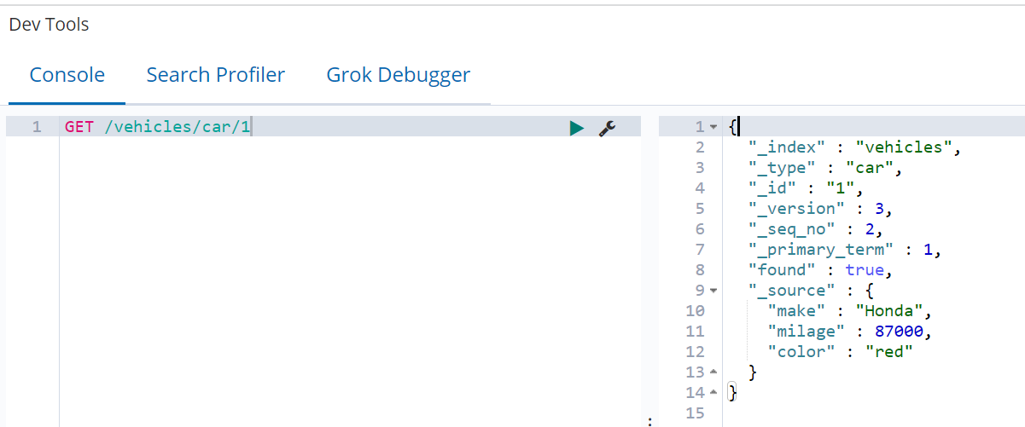
Elasticsearch (cont.)
From Elasticsearch version 6, only one type is supported.
To retrieve a document, we need to use GET /vehicles/car/1
To delete a document, we use DELETE /vechicles/car/1

Slide 14
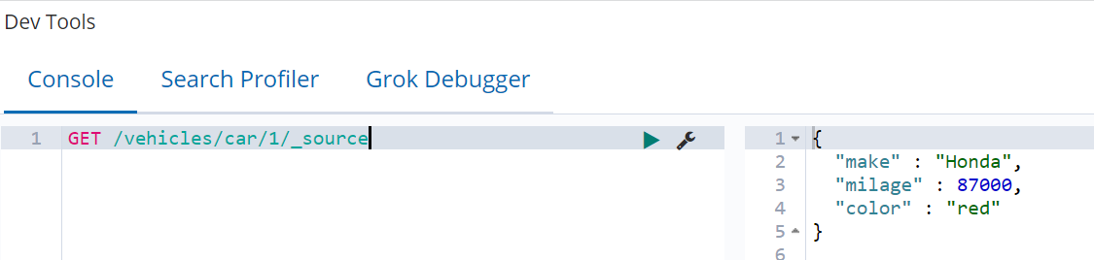
Elasticsearch (cont.)
Fields with "_" (underscore) are considered meta fields and are managed by Elasticsearch.
When retrieving the index, we can filter more the fields (like _source field)

Slide 15
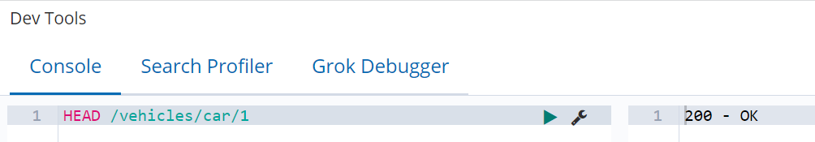
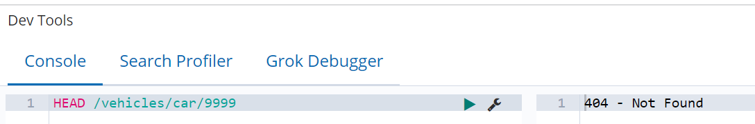
Elasticsearch (cont.)
In order to check if a document exists from an index, we need to use HEAD /vechicles/car/1

Slide 16
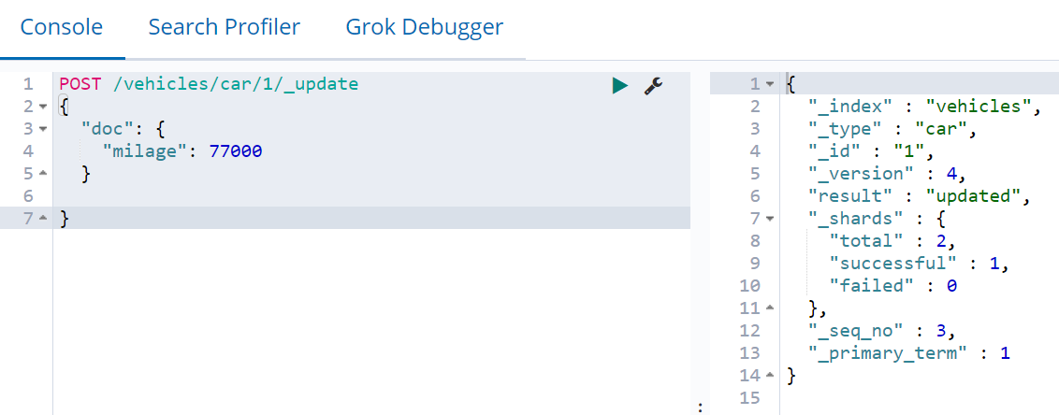
Elasticsearch (cont.)
In Elasticsearch documents are immutable.
Every time the document is updated, the _version meta field is increased.
In order to update a document, we need to use POST method using the _update at the end of the URL.
Elasticseach reads the document, updates the changed field (or can add/remove other fields), then re-index the document increasing the version.

Slide 17
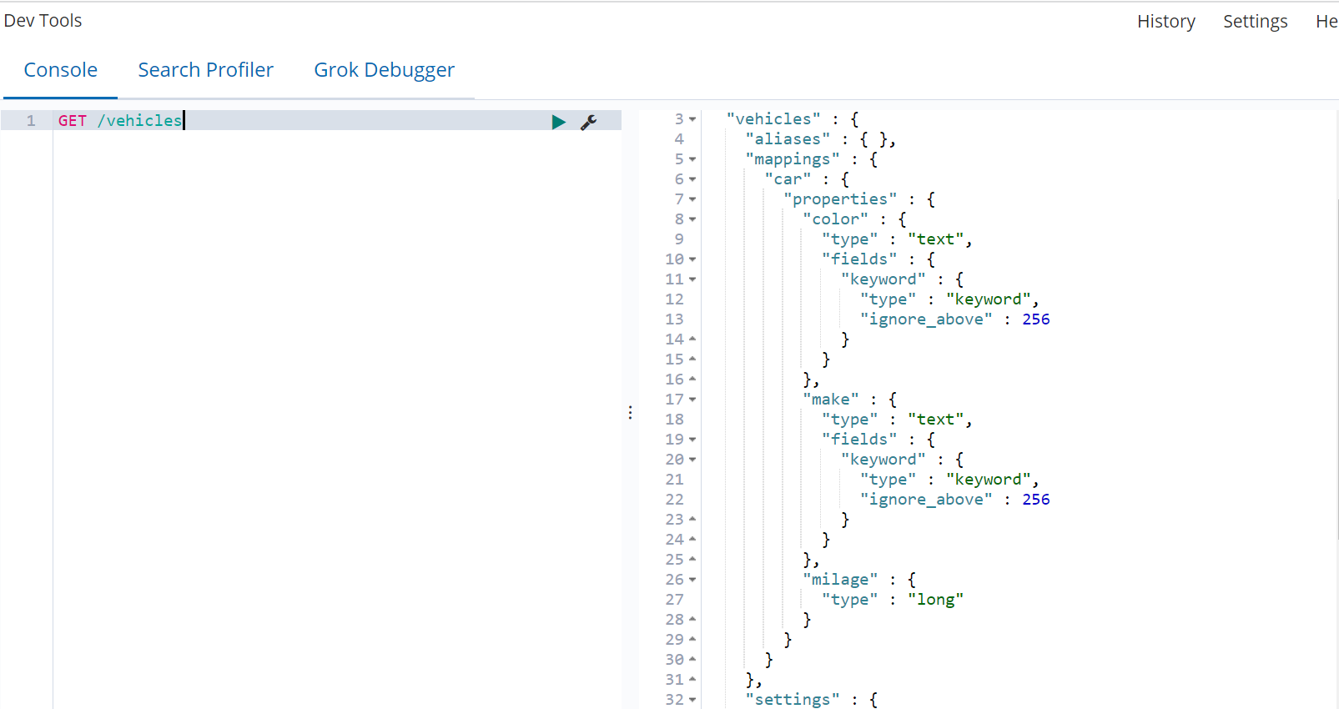
Elasticsearch (cont.)
We can obtain the structure of an index using GET /{index}
To delete the index, we need to issue DELETE /{index}

Slide 18
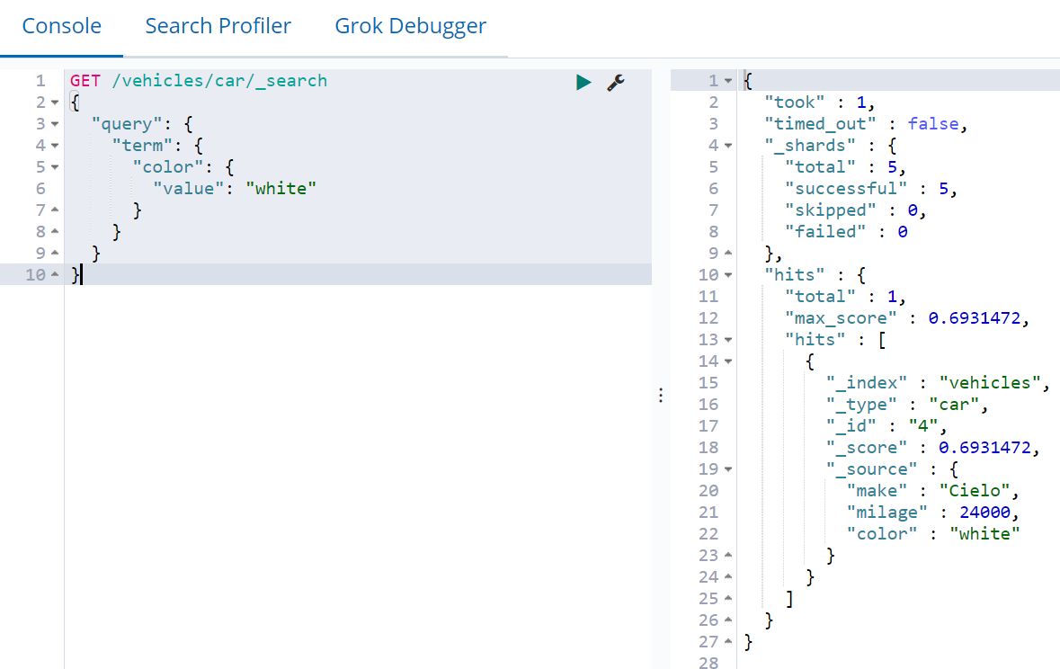
Elasticsearch (cont.)
In order to search data, we can use the _search endpoint like GET /vehicles/car/_search.
We can do a term query by specifying certain terms (key/value criteria)
To get the total count of elements from the index run GET /vehicle/car/_count.

Slide 19
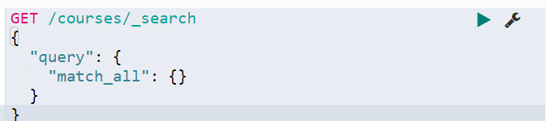
Elasticsearch (cont.)
Match_all query type returns all data related to index.

Slide 20
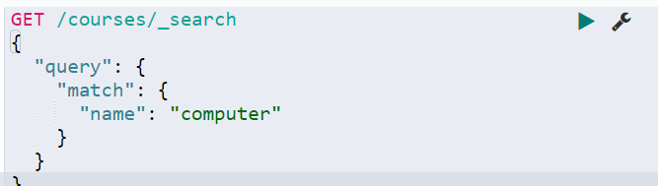
Elasticsearch (cont.)
Match query type returns data based on the name field from the index.

Slide 21
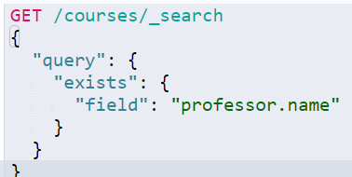
Elasticsearch (cont.)
We can check if certain fields are set using the exists type of query.

Slide 22
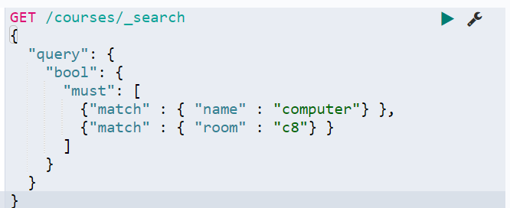
Elasticsearch (cont.)
To search for several fields, the must search criteria must be used. Must is like and operator.
To exclude fields, must_not search criteria can be used.

Slide 23
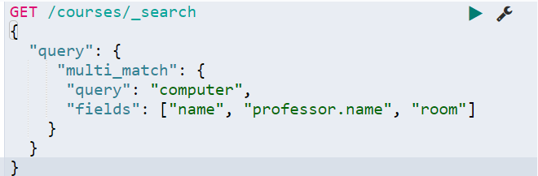
Elasticsearch (cont.)
The multi_match search criteria will look for certain queries in multiple fields.

Slide 24
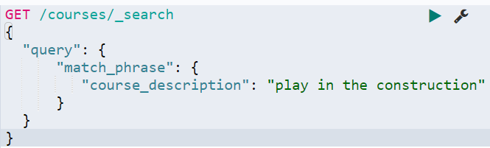
Elasticsearch (cont.)
The match_phrase search criteria will look for a certain phrase.
Partial tokens can be matched using match_phrase_prefix search criteria.

Slide 25
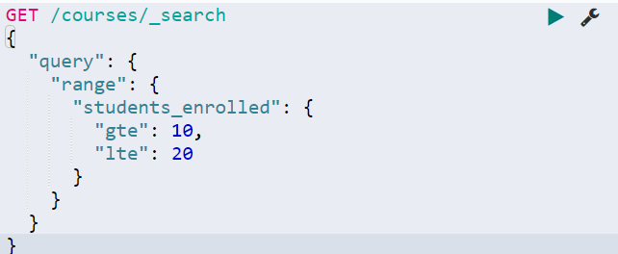
Elasticsearch (cont.)
The range search criteria can be applied for numeric and date fields to search between a range.

Slide 26
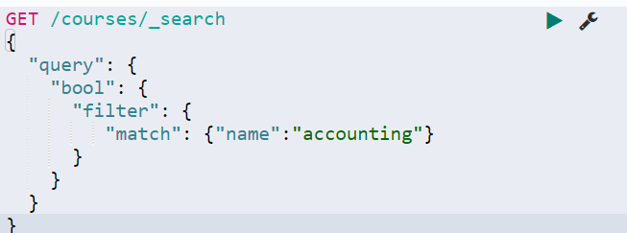
Elasticsearch (cont.)
The filter does NOT use relevancy score, when the results/hits are returned.

Slide 27
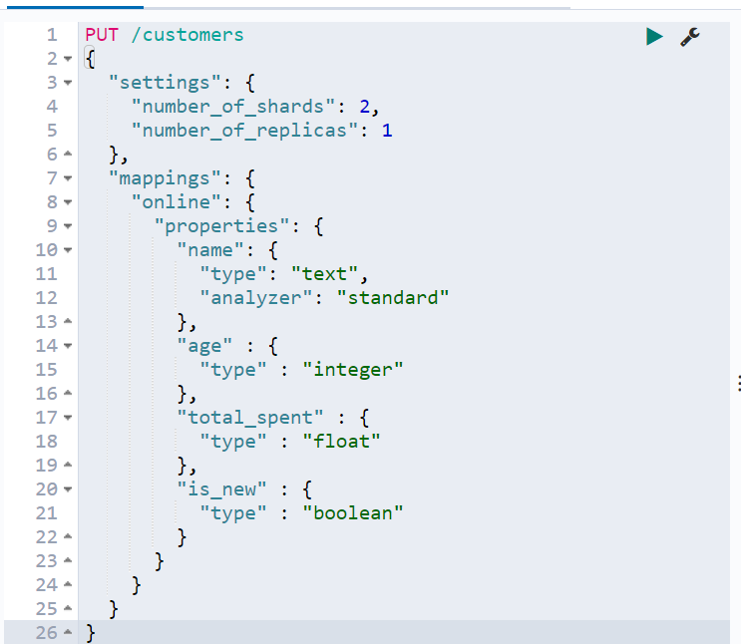
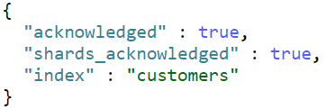
Elasticsearch (cont.)
To create an index structure, we use the PUT /${index} method.

Slide 28
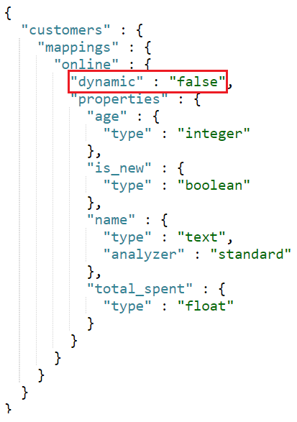
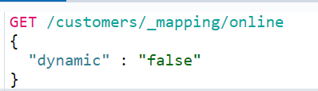
Elasticsearch (cont.)
To enforce the index structure, we need to specify during index creation.
dynamic:
if set false, then indexing field will be ignored
if set to strict, then indexing will throw error

Slide 29
Elasticsearch (cont.)
Elasticsearch ships with a wide range of built-in analyzers, which can be used in any index.
standard: divides text into terms on word boundaries.
simple: divides text into terms whenever it encounters a character which is not a letter.
whitespace: divides text into terms whenever it encounters any whitespace character.
stop: it like the simple analyzer, but also supports removal of stop words.
keyword: is a "noop" analyzer that accepts whatever text it is given.
pattern: users a regular expression to split the text into terms.
language: provides many language-specific analyzers like english or french.
fingerprint: creates a fingerprint which can be used for duplicate detection.

Slide 30
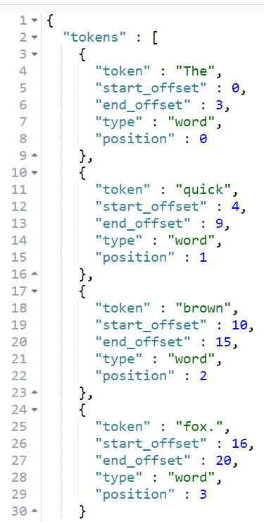
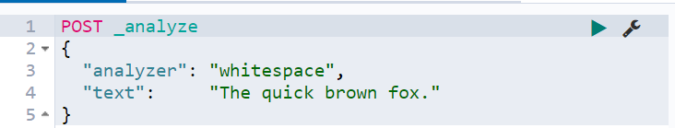
Elasticsearch (cont.)
The analyze API is an important tool for viewing terms produces by an analyzer.

Slide 31
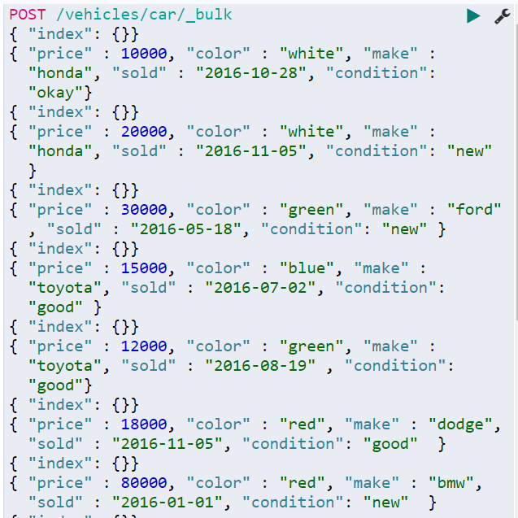
Elasticsearch (cont.)
The bulk API performs multiple indexing or delete operations in a single API call.
This reduces overhead and can greatly increase indexing speed.

Slide 32
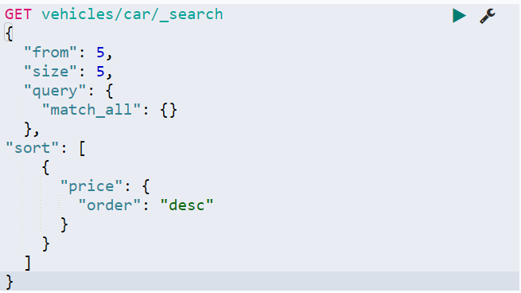
Elasticsearch (cont.)
The size parameter can limit the results.
The from parameter can be used for pagination.
The sort parameters can be used for sorting, specifying the sort parameters.

Slide 33
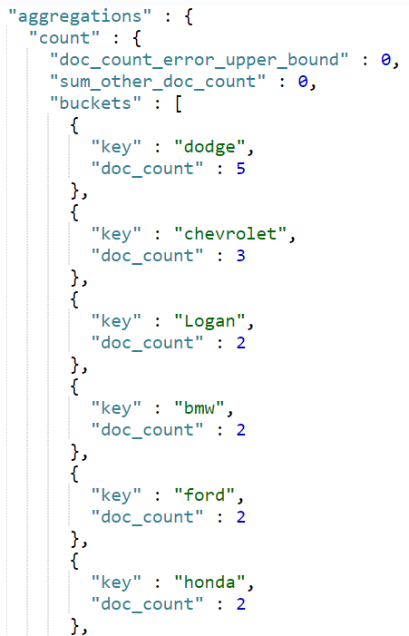
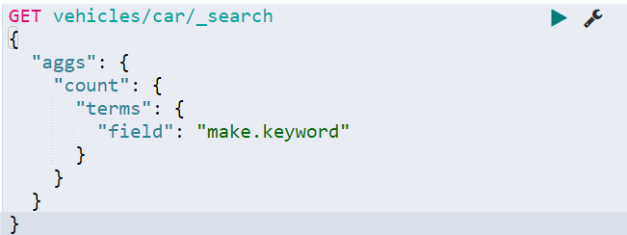
Elasticsearch (cont.)
For aggregations we need to use "aggs".

Slide 34
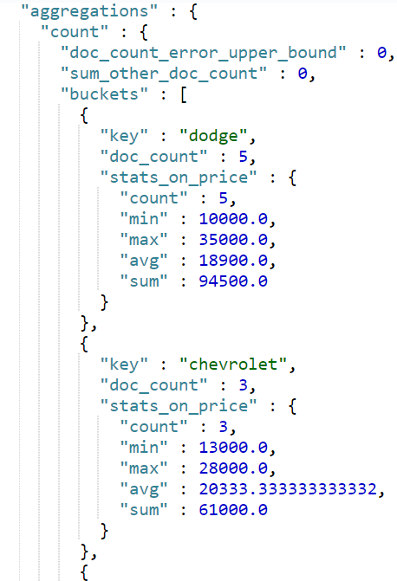
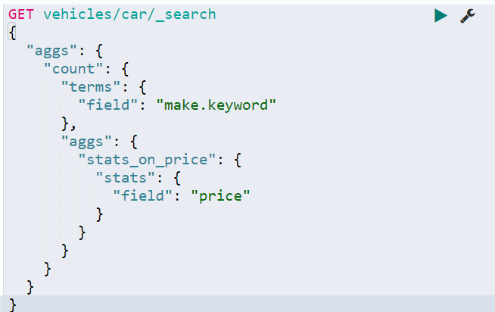
Elasticsearch (cont.)
The “stats” aggregation gives stats info about a numeric field: min, max, avg, sum.

Slide 35
Core
Kibana acts as an over-the-top layer of Elasticsearch, providing beautiful visualizations for
data (structured or nonstructured) stored in it.
It provides a web-based interface that can easily handle a large amount of data.
It helps create dashboards that are easy to create and helps query data in real time.
Dashboards are nothing but an interface for underlying JSON documents.

Slide 36
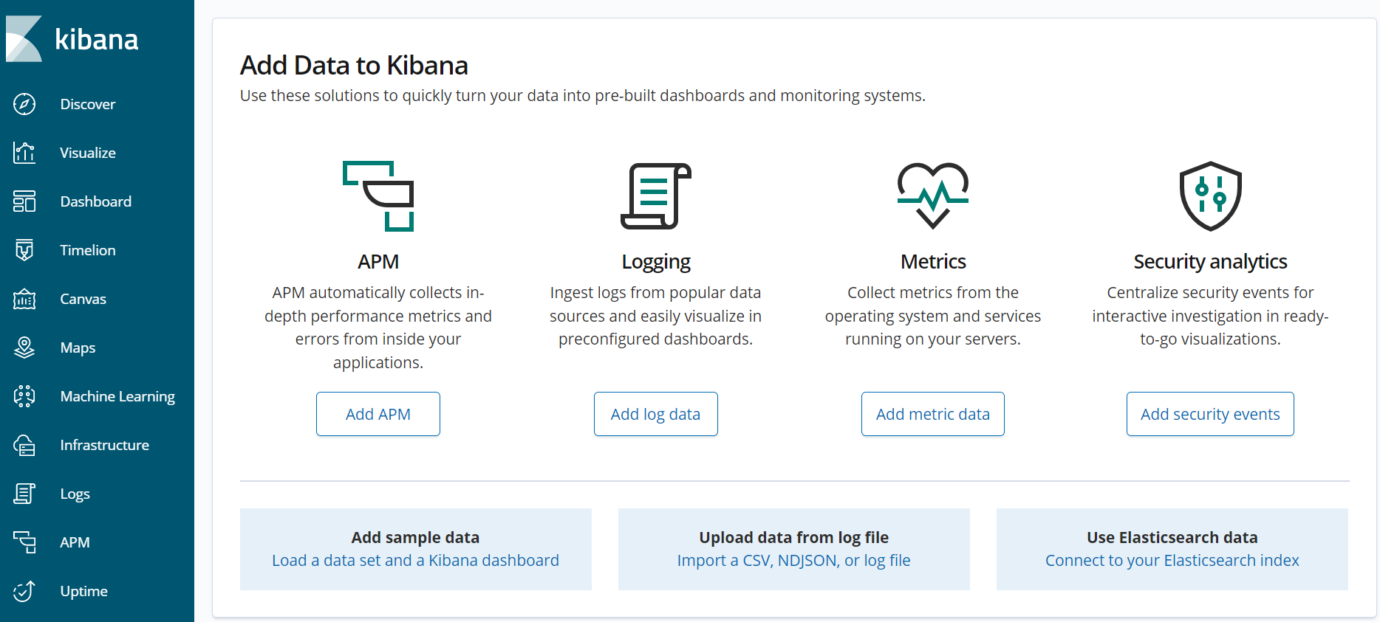
Core (cont.)
Once Kibana is installed open a browser at http://localhost:5601

Slide 37
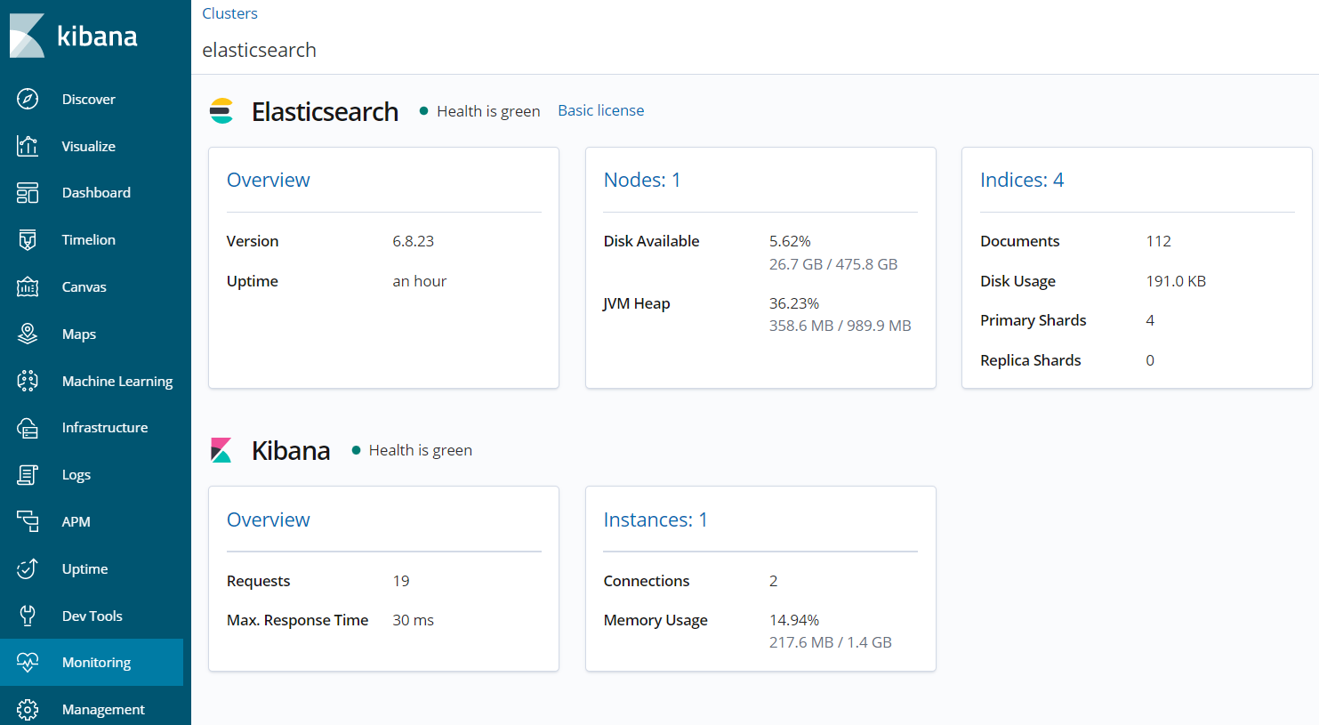
Core (cont.)
We can turn on Monitoring features of Kibana that checks the status of an Elasticsearch cluster.

Slide 38
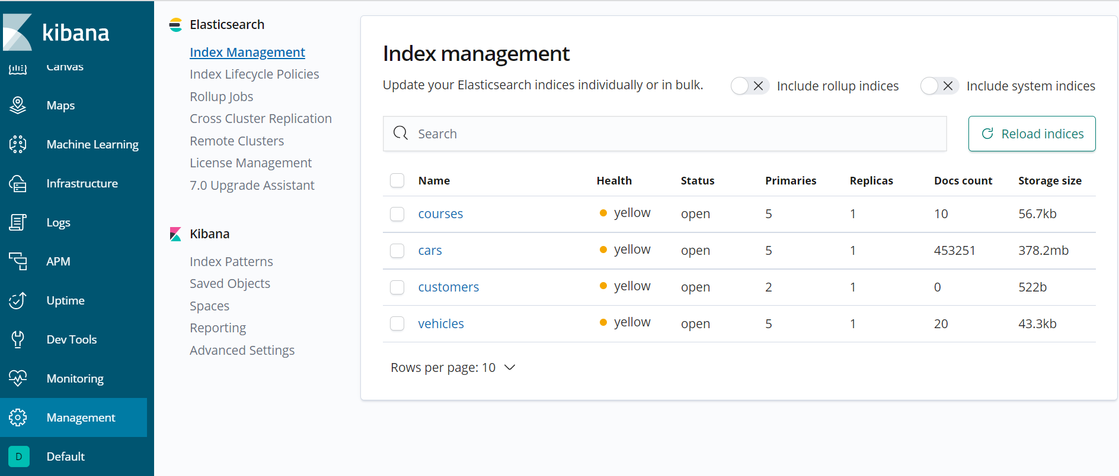
Core (cont.)
In the Management screen we can see details about indexes.

Slide 39
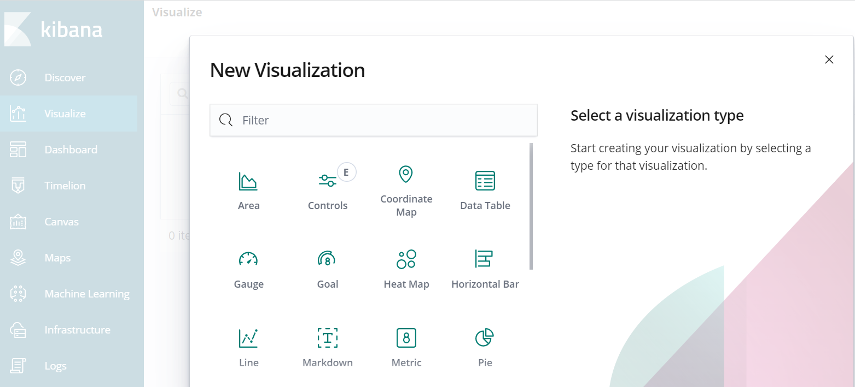
Core (cont.)
In the Visualize screen we can create new charts.

Slide 40
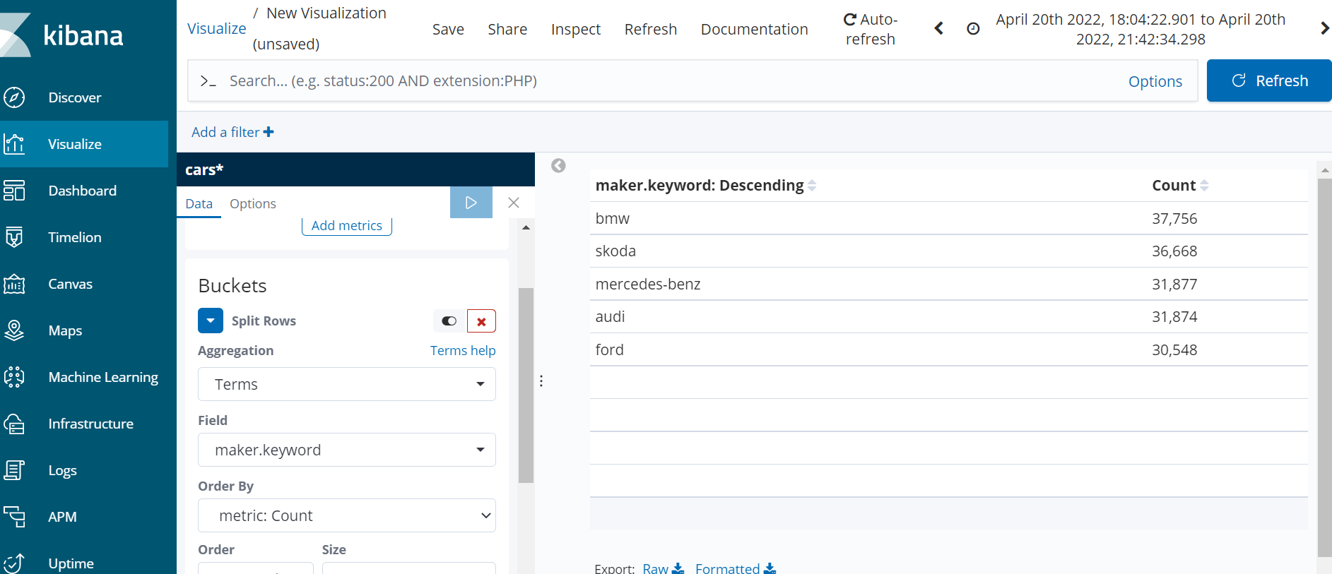
Core (cont.)
After creating a new visualization, it must be saved for later use.

Slide 41
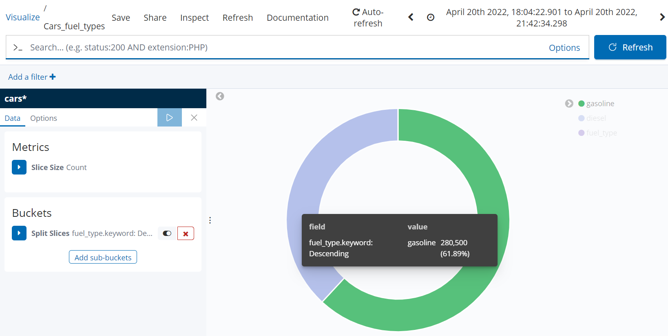
Core (cont.)
We can create lots of charts, bellow example is a pie-chart based on fuel type.

Slide 42
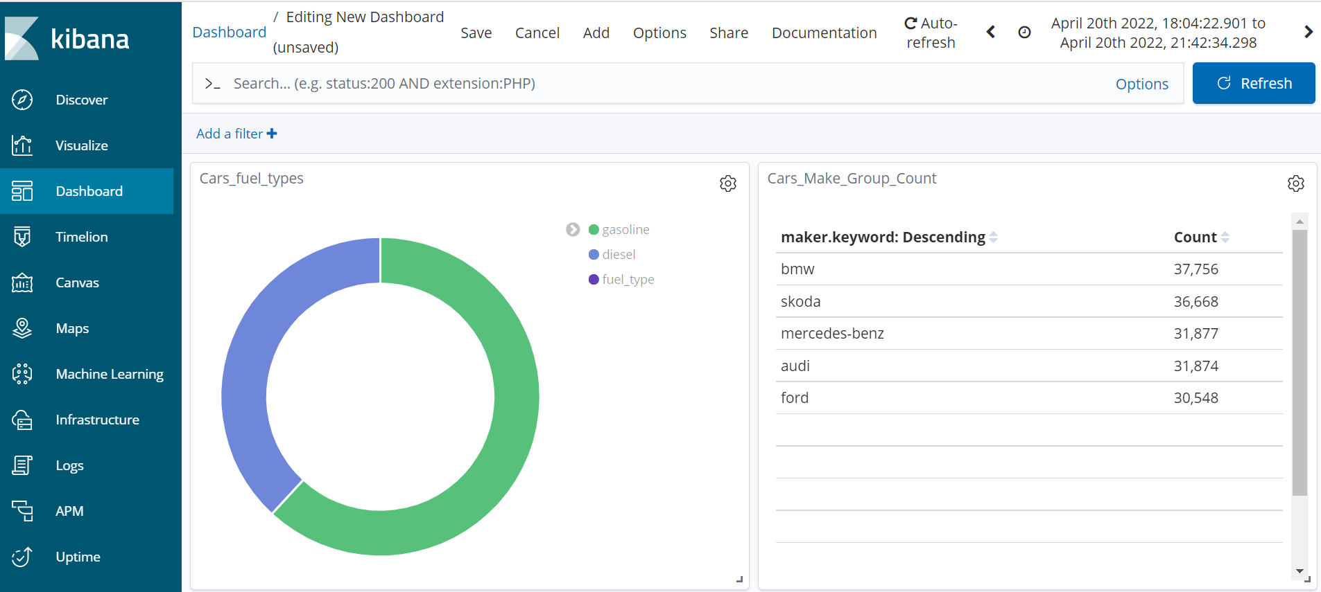
Core (cont.)
In the Dashboard screen we can add visualizations, and at the end we need to save the dashboard.

Slide 43
Conclusions
Easy to setup
Free
Dev Tools
Has Charts
Can build dashboards

Slide 44

Bibliography
https://en.wikipedia.org/wiki/Kibana
Packt Publishing – Kibana Essentials

