Slide 1

Logstash
Dima Ionut Daniel

Slide 2
Contents
What is Logstash ?
Architecture
Features
Core
Events
Scalability
Conclussion
Bibliography

Slide 3

What is Logstash ?
Logstash is a tool for managing events and logs, collect, process, and forward events and log messages.
Logstash is free and open source (Apache 2.0 licensed) and developed by American developer, Jordan Sissel and the team from Elastic.
It’s easy to set up, performant, scalable and easy to extend.

Slide 4
What is Logstash ? (cont.)
Collection is accomplished via configurable input plugins including raw socket/packet communication, file tailing, and several message bus clients.
Once an input plugin has collected data it can be processed by any number of filters which modify and annotate the event data.
Finally, logstash routes events to output plugins which can forward the events to a variety of external programs including Elasticsearch, local files and several message bus implementations.

Slide 5
What is Logstash ? (cont.)
Logstash is written in JRuby and runs in a Java Virtual Machine (JVM).
Its architecture is message-based and very simple.
Logstash has a single agent that is configured to perform different functions in combination with other open-source components.

Slide 6
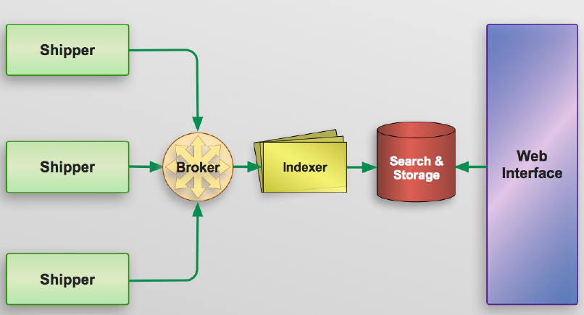
Architecture
Logstash architecture

Slide 7
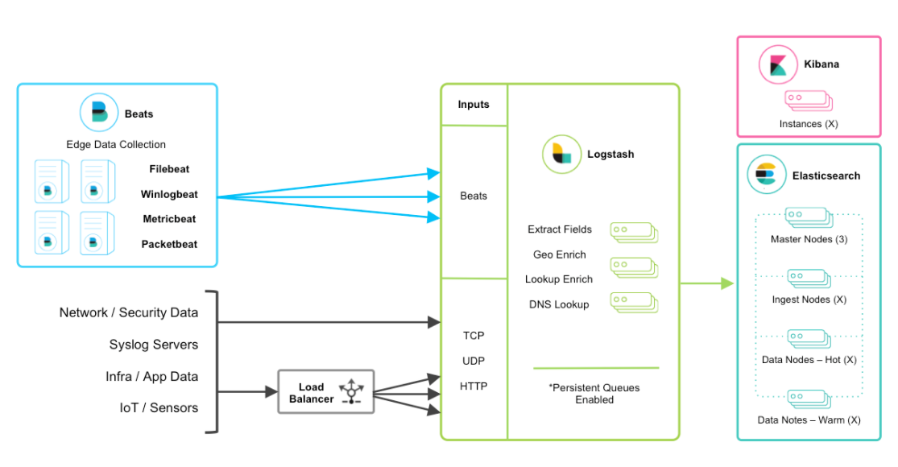
Architecture (cont.)

Slide 8
Architecture (cont.)
In the Logstash ecosystem there are 4 components:
Shipper: Sends events to Logstash. Your remote agents will generally only run this component.
Broker and Indexer: Receives and indexes the events.
Search and Storage: Allows you to search and store events.
Web Interface: A Web-based interface to Logstash called Kibana.

Slide 9
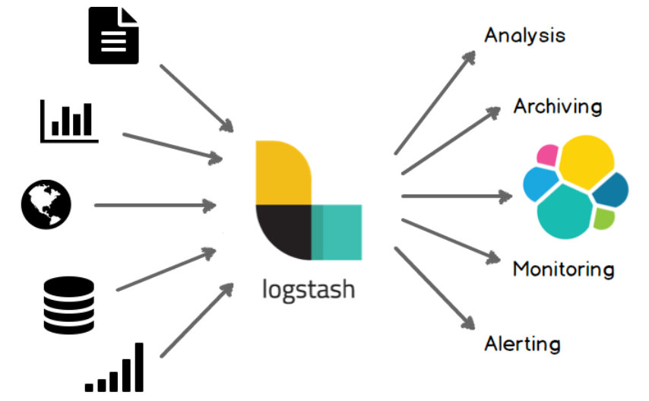
Features
Pluggable pipeline architecture
Community-extensible and developer-friendly plugin ecosystem
Logs and metrics
The Web
Data stores and streams

Slide 10
Features (cont.)
Analysis
Elasticsearch
MongoDb
Riak
Archiving
HDFS
S3
Google Cloud Storage

Slide 11
Features (cont.)
Monitoring
Nagios
Ganglia
Zabbix
Graphite
Datadog
CloudWatch
Alerting
Watcher
Email
IRC
SNS

Slide 12
Core
Each type configures a different portion of the Logstash agent:
inputs - How events get into Logstash.
filters - How you can manipulate events in Logstash.
outputs - How you can output events from Logstash.

Slide 13
Core (cont.)
In the Logstash world events enter via inputs, they are manipulated, mutated or changed in filters and then exit Logstash via outputs.
In the input block the stdin plugin which controls event input from STDIN.
In the output block the stdout plugin, which outputs events to STDOUT.

Slide 14
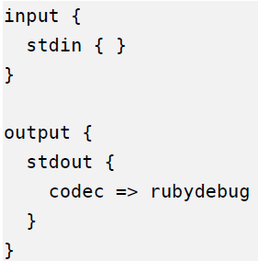
Core (cont.)
To start logstash we run the logstash command: logstash --debug -f sample.conf
The parameter –e is used to send directly the pipeline configuration.
bin\logstash –e “input { stdin { }} output { stdout {} }”

Slide 15
Core (cont.)
A pipeline is an orchestration of plugins.
Plugins receive, manipulate and ship data.
Pipeline = input + (filter) + output
Processed events are sent to stashes (destinations) like Elasticsearch/Kafka.
Logstash is not limited to processing logs, it can handle XML, CSV, JSON, etc.

Slide 16
Core (cont.)
Bellow pipeline defined 2 inputs: HTTP and JSON, and as output the stdout and file.
input {
stdin {
codec => json
}
http {
host => “127.0.0.1”
port => 8080
}
}
output {
stdout {
codec => rubydebug
}
file {
path => “output.txt”
}
}

Slide 17
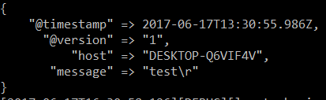
Core (cont.)
Every time you change your Logstash configuration you will need to restart Logstash so it can pick up the new configuration.
The --debug flag turns on debug logging and -f which specifies the configuration file Logstash should start with.

Slide 18
Core (cont.)
A basic event has only the following elements:
@timestamp: An ISO 8601 timestamp.
message: The event’s message. Here testing as that’s what we put into STDIN.
@version: The version of the event format. This current version is 1.
Additionally, many of the plugins we’ll use add additional fields.

Slide 19
Core (cont.)
An input plugin is used to configure a set of events to be fed to Logstash.
The file plugin is used to stream events and log lines files to Logstash.
It automatically detects file rotations and reads from the point last read by it.
The Logstash file plugin maintains sincedb files to track the current positions in files being monitored.
By default, it writes sincedb files at $HOME/.sincedb* path.
input{
file {
path => "/path/to/logfiles"
}
}

Slide 20
Core (cont.)
Configuration options
add_field: used to add a field to incoming events, its value type is Hash(default value is {}.)
add_field => { "input_time" => "%{@timestamp}" }
codec: used to specify a codec, which can decode a specific type of input.
delimiter: used to specify a delimiter, which identifies separate lines(default: "\n".)
exclude: exclude certain types of files from the input path, the data type is array.
path: specifies an array of path locations from where to read logs and events.

Slide 21
Core (cont.)
sincedb_path: specifies the location where to write the sincedb files, which keeps track of the current position of files being monitored.
sincedb_write_interval: specifies how often (number in seconds), the sincedb files that keep track of the current position of monitored files, are to be written.(Default 15 seconds)
start_position: It has two values: "beginning" and "end". It specifies where to start reading incoming files from. The default value is "end".

Slide 22
Core (cont.)
The type option is helpful to process the different type of incoming streams using Logstash.
tags: specifies the array of tags that can be added to incoming events. Adding tags to your incoming events helps with processing later, when using conditionals.
If we specify "processed" in tags: tags =>["processed"]
In filter, we can check in conditionals:
filter { if "processed" in tags[]{} }

Slide 23
Core (cont.)
We can force logstash to reload the pipeline configuration without the need of restart using the --config.reload.automatic parameter.
bin\logstash –f config/pipeline.conf –config.reload.automatic.
input {
file {
path => “/absolute/path/input.txt”
start_position => “beginning”
}
}

Slide 24
Core (cont.)
Grok is a filter plugin that can parse unstructured log data into a structure.
%{SYNTAX:SEMANTIC}
To check grok patterns: https://github.com/logstash-plugins/logstash-patterns-core
filter {
grok {
match => { “message” => “%{IP:ip_address} %${USER:identity}” }
}
}

Slide 25
Core (cont.)
Date is a filter plugin that can be use for parsing dates from field.
filter {
date {
match => [ “timestamp”, “dd/MMM/yyyy:HH:mm:ss Z”]
}
}

Slide 26
Core (cont.)
useragent is a filter plugin that can parse user agent strings into structured data
filter {
useragent {
source => “agent”
target => “ua”
}
}

Slide 27
Core (cont.)
Conditional expressions can be used for input, filter, output plugins.
If EXPR {
…
} else if EXPR {
….
} else {
…
}
Example:
If [type] == “vale” {
…
}

Slide 28
Core (cont.)
Operand types:
Equality: ==, !=, <, >, <=, >=
Regexp: =~, !~
Inclusion: in, not in
Boolean: and, or
Unary: !

Slide 29
Core (cont.)
Logstash supports the following patterns wherever glob patterns are allowed:
* → match any file
** → match directories recursively
? → match one character
[set] → match any one character in a set
{p,q} → match either literal p or literal q

Slide 30
Core (cont.)
We can drop the event if the path parameter contains the “admin” value.
If [path] =~ /admin/ {
drop {}
}
Elasticsearch output plugin provides real-time search and analytics for all types of data:
output {
elasticsearch {
hosts => [ https://localhost:9200 ]
document_type => “default”
http_compression => true
}
}

Slide 31
Core (cont.)
The stdin plugin is used to stream events and log lines from standard input.
Whatever we type in the console will go as input to the Logstash event pipeline.
The lumberjack plugin is useful to receive events via the lumberjack protocol that is used in Logstash forwarder.

Slide 32
Core (cont.)
Logstash provides a wide variety of output plugins that help integrate incoming events with almost any type of destination.
The email plugin is a very important output plugin as it is very useful to send e-mails for certain events and failure scenarios.
The csv plugin is used to write a CSV file as output, specifying the fields in csv and the path of the file.
The basic configuration of the csv output plugin looks like:
csv {
fields => ["date","open_price","close_price"]
path => "/path/to/file.csv"
}

Slide 33
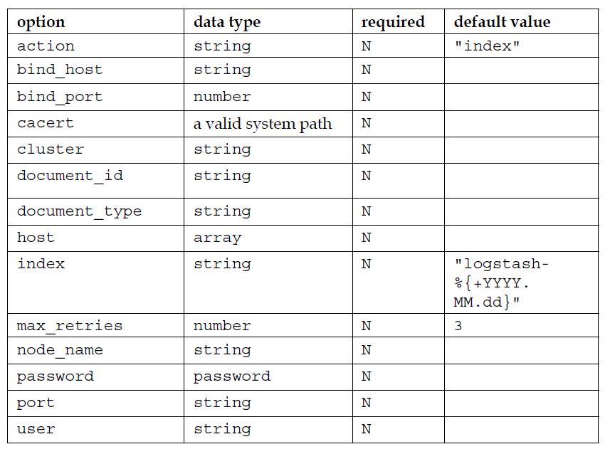
Core (cont.)
The elasticsearch plugin is the most important plugin used in ELK Stack, because it's where you will want to write your output to be stored to analyze later in Kibana.

Slide 34
Core (cont.)
Ganglia is a monitoring tool that is used to monitor the performance of a cluster of machines in a distributed computing environment.
Ganglia makes uses of a daemon called Gmond, which is a small service that is installed on each machine that needs to be monitored.
The ganglia output plugin in Logstash is used to send metrics to the gmond service based on events in logs.

Slide 35
Core (cont.)
The kafka output plugin is used to write certain events to a topic on kafka. It uses the Kafka Producer API to write messages to a topic on the broker.
The redis plugin is used to send events to a redis instance.
The rabbitmq plugin pushes the events from logs to the RabbitMQ exchange.
The stdout plugin writes the output events to the console.

Slide 36
Core (cont.)
Filter plugins are used to do intermediate processing on events read from an input plugin and before passing them as output via an output plugin.
The csv filter is used to parse the data from an incoming CSV file and assign values to fields.
The drop filter is used to drop everything that matches the conditionals for this filter.
The geoip filter is used to add the geographical location of the IP address present in the incoming event.
The mutate filter is an important filter plugin that helps rename, remove, replace, and modify fields in an incoming event.

Slide 37
Core (cont.)
Codec plugins are used to encode or decode incoming or outgoing events from Logstash acting as stream filters in input and output plugins.
Important codec plugins are:
avro
json
line
multiline
plain
rubydebug
spool

Slide 38
Core (cont.)
The multiline codec plugin will collapse multiline messages and merge them into a single event.
file {
path => “/absolute/path/event_errors.log
start_position => “beginning”
codec => multiline {
pattern => “^(\s+|\t)|(Caused by:)”
what => “previous”
}
}

Slide 39
Core (cont.)
In logstash there is a special field called @metadata.
The contents of @metadata are not part of any events at output time, which makes it great to use for conditionals, or extending and building event fields with field reference.
filter {
mutate { add_field => { “[@metadata][test]” => “hello”}}
}
The rubydebug codec can display the contents of @metadata fields:
stdout {
codec => rubydebug {
metadata => true
}
}

Slide 40
Core (cont.)
The best way to have multiple pipelines, is to have them run within one Logstash instance.
Pipelines are configured within a file named config/pipelines.yml.
- pipeline.id: user1
pipeline.batch.size: 50
path.config: “/path/to/pipeline”
- pipeline.id: user2
pipeline.batch.size: 10
config.string: “input { http {} } output { stdout {} }”

Slide 41
Core (cont.)
The beats input plugin is listening by convention on port 5044
input {
beats {
port => 5044
host => "0.0.0.0"
}
}
output {
stdout {
codec => rubydebug {
metadata => true
}
}
}

Slide 42

Core (cont.)
Logstash plugin management is done through the install script that is shipped with the Logstash installation: $LOGSTASH_HOME/bin/logstash-plugin.
To install a plugin, we can use the command: $bin/logstash-plugin install <plug_in_name>.
plug_in_name is the name of the plugin as mentioned in the gem name in https://rubygems.org/ or in the Logstash plugin repository.

Slide 43
Core (cont.)
To update a previously installed plugin, we can issue the command: $bin/logstash-plugin update <plug_in_name>.
To uninstall a plugin, we can issue the following command: $bin/logstash-plugin uninstall <plug_in_name>.
Logstash plugins are selfcontained RubyGems.

Slide 44
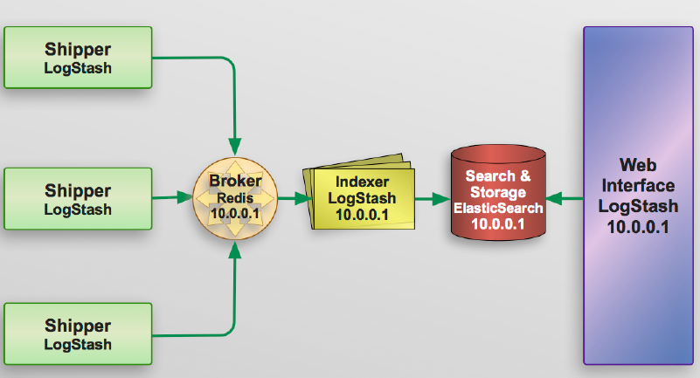
Events
The Logstash agent on our remote hosts collects and sends a log event to our central server.
A Redis instance receives the log event on the central server and acts as a buffer.
The Logstash agent takes the log event from our Redis instance and indexes it.
The Logstash agent sends the indexed event to Elasticsearch.
Elasticsearch stores and renders the event searchable.
The Kibana web interface queries the event from Elasticsearch.

Slide 45
Scalability
Logstash is horizontally scalable and can form groups of nodes running the same pipeline.
Beats should load balance across a group of Logstash nodes.
A minimum of two Logstash nodes are recommended for high availability.
It’s common to deploy just one Beats input per Logstash node, but multiple Beats inputs can also be deployed per Logstash node to expose independent endpoints for different data sources.

Slide 46
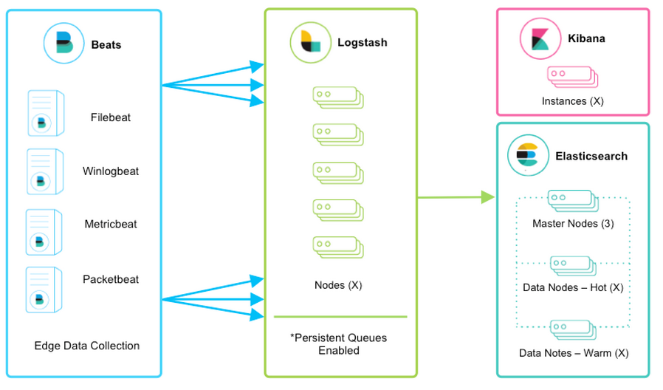
Scalability (cont.)

Slide 47
Conclusion
Logstash (part of the ELK Stack) is very easy to start using out-of-the-box.

Slide 48

Bibliography
https://www.elastic.co/guide/en/logstash/current/index.html
https://wikitech.wikimedia.org/wiki/Logstash
James Turnbull - The Logstash book

Slide 49
Questions ?

