Slide 1

Mockito
Dima Ionut Daniel

Slide 2
Contents
What is Mockito?
TDD
Core
Conclusions
Bibliography

Slide 3

What is Mockito?
Mockito is an open-source testing framework for Java under MIT license.
Mockito allows creation of mock objects in automated unit tests for the purpose of TDD(Test Driven Developement) or BDD(Behaviour Drive Development).

Slide 4
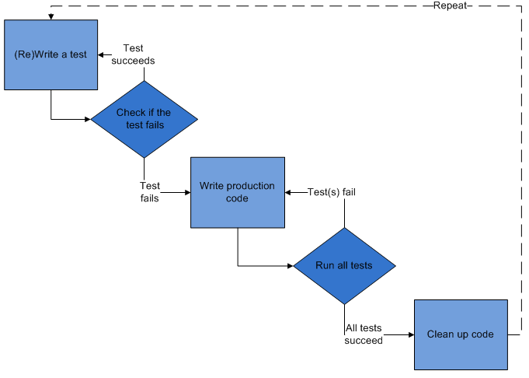
TDD
TDD stands for Test-Driven Development and it’s an evolutionary development approach.
Example of TDD testing frameworks: SpryTest, Jtest, JUnit, TestNG.
TDD is a software development process that relies on the repetition of a very short circle: writing of automated test case then produces the minimum amount of code to pass that test and finally refactors the new code to acceptable standards.

Slide 5
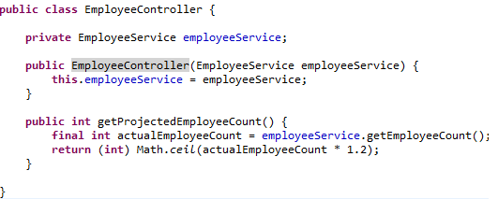
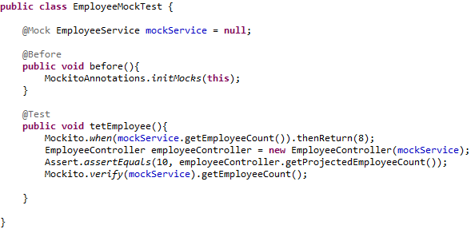
Core
We use @Mock annotations to create mocks.
Before running the tests, we need to call the initMocks() method from MockitoAnnotation or annotate the class with @RunWith(MockitoJUnitRunner.class).
Mockito class is useful because we can instruct mock objects how to react when called.
The verify method verifies that certain methods from mock object is called or not.

Slide 6
Core

Slide 7
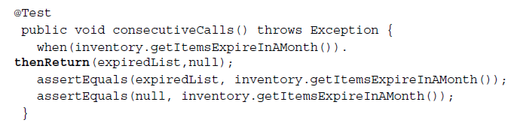
Core (cont.)
The thenReturn(objects...) takes variable arguments and comma separated return values as bellow.
Bellow the getItemsExpireInAMonth will return first the expiredList object and then null.

Slide 8

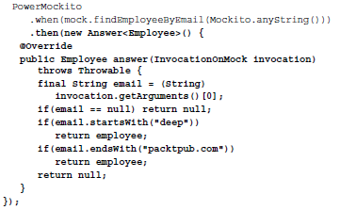
Core (cont.)
Answer interface could be very handy.

Slide 9
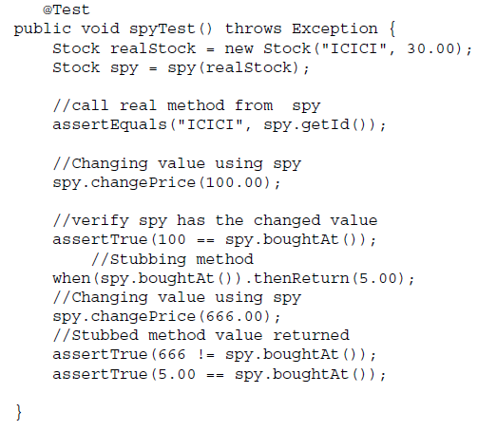
Core (cont.)
Using Mockito, we can create spies of real objects.
Unlike stubbing, when we use the spy then the real methods are called (unless a method was stubbed).

Slide 10
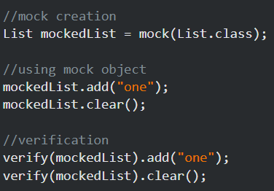
Core (cont.)
Using a mock or spy object we can verify using verify method, if certain methods are invoked.

Slide 11
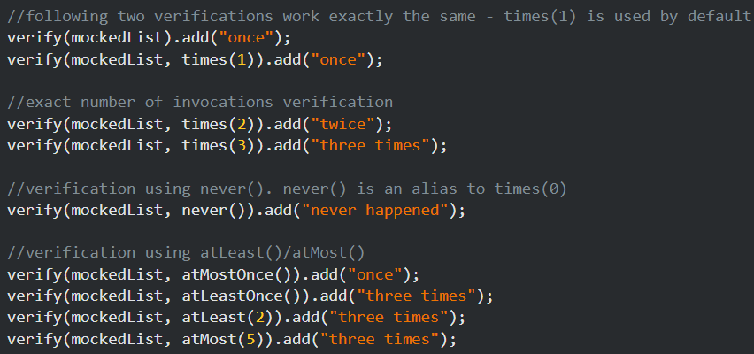
Core (cont.)
We can verify the exact number of invocation using times(), never(), atLeats(), atMost() methods.

Slide 12
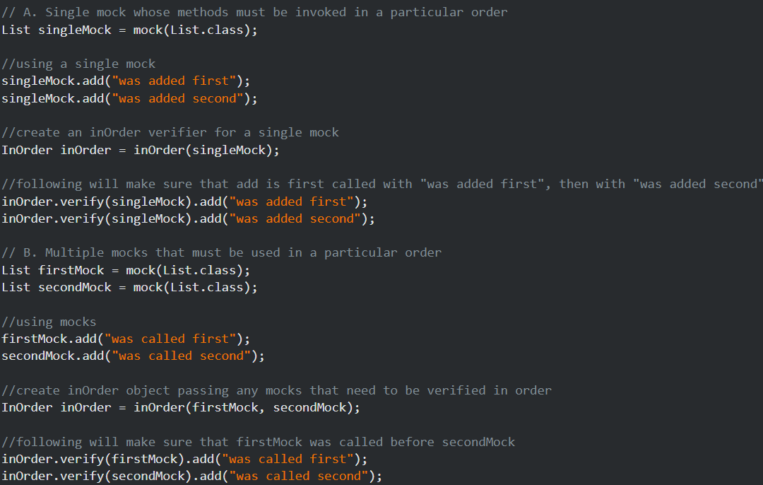
Core (cont.)
We can verify that mocks are invoked in a particular order, using InOder.

Slide 13
Core (cont.)
Since Mockito 2.1.0, Mockito can now mock final types, enums and final methods.
Previously they were considered unmockable, preventing the user from mocking.
The mock maker is turned off by default.
The feature can be activated setting /mockito-extensions/org.mockito.plugins.MockMaker the value "mock-maker-inline".

Slide 14
Core (cont.)
Mockito can mock static methods since version 3.4.0.
To make sure a static mock remains temporary, it is recommended to define the scope within a try-with-resources construct.
assertEquals("foo", Foo.method());
try (MockedStatic mocked = mockStatic(Foo.class)) {
mocked.when(Foo::method).thenReturn("bar");
assertEquals("bar", Foo.method());
mocked.verify(Foo::method);
}
assertEquals("foo", Foo.method());

Slide 15
Core (cont.)
From Mockito version 3.5.0, we can mock object construction within the current thread and a user-defined scope.
To make sure a constructor mocks remain temporary, it is recommended to define the scope within a try-with-resources construct.
assertEquals("foo", new Foo().method());
try (MockedConstruction mocked = mockConstruction(Foo.class)) {
Foo foo = new Foo();
when(foo.method()).thenReturn("bar");
assertEquals("bar", foo.method());
verify(foo).method();
}
assertEquals("foo", new Foo().method());

Slide 16
Conclusions
Mockito is a powerful testing framework easy to use.

Slide 17

Bibliography
PacktPublisher - Test-Driven Development with Mockito
http://en.wikipedia.org/wiki/Mockito
http://mockito.org/

