Slide 1

Open SSL
Dima Ionut Daniel

Slide 2
Contents
What is OpenSSL?
Features
History
SSL Basics
Core
Conclusions
Bibliography

Slide 3

What is OpenSSL ?
OpenSSL is a software library for applications that secure communications over computer networks
OpenSSL contains an open-source implementation of the SSL and TLS protocols.
OpenSSL is available for most Unix-like operating systems (including Linux, macOS, and BSD) and Microsoft Windows.

Slide 4
History
The OpenSSL project was founded in 1998 to provide a free set of encryption tools for the code used on the Internet.
It is based on a fork of SSLeay (open-source SSL implementation) by Eric Andrew Young and Tim Hudson.
The project has a budget of less than one million USD per year and relies primarily on donations.
Development of TLS 1.3 is sponsored by Akamai.

Slide 5
History (cont.)
Version 1.0.1 was released on 14 March 2012 an includes major features:
Supported until 31 December 2016
RFC 6520 TLS/DTLS heartbeat support
SCTP support
RFC 5705 TLS key material exporter
RFC 5764 DTLS-SRTP negotiation
Next Protocol Negotiation
PSS signatures in certificates, requests and certificate revocation lists (CRL)
Support for password-based recipient info for CMS
Support TLS 1.2 and TLS 1.1
Preliminary FIPS 140 capability for unvalidated 2.0 FIPS module
Secure Remote Password protocol (SRP) support

Slide 6
History (cont.)
Version 1.0.2 was released on 22 January 2015 an includes major features:
Supported until 31 December 2019 (Long Term Support)
Suite B support for TLS 1.2 and DTLS 1.2
Support for DTLS 1.2
TLS automatic elliptic curve (EC) selection
API to set TLS supported signature algorithms and curves
SSL_CONF configuration API
TLS Brainpool support
ALPN support
CMS support for RSA-PSS, RSA-OAEP, ECDH and X9.42 DH
FIPS 140 support

Slide 7
History (cont.)
Version 1.1.0 was released on 25 August 2016 an includes major features:
Supported until 11 September 2019
Support for BLAKE2 (RFC 7693)
Support for ChaCha20-Poly1305 (RFC 7539)
Support for X25519 (RFC 7748)
Support for DANE and Certificate Transparency
Support for CCM Ciphersuites
Support for extended master secret
SSLv2 removed
Kerberos ciphersuite support removed
RC4 and 3DES removed from DEFAULT ciphersuites in libssl
Remove DSS, SEED, IDEA, CAMELLIA, and AES-CCM from the DEFAULT cipherlist
40 and 56 bit cipher support removed from libssl
FIPS 140 support removed

Slide 8
History (cont.)
Version 1.1.1 was released on 11 September 2018 an includes major features:
Supported until 11 September 2023 (Long Term Support)
Support for TLS 1.3
Support for SHA-3
Support for X448 and Ed448 (RFC 7748)
Support for SipHash
Support for ARIA
Support for multi-prime RSA (RFC 8017)
Support for SM2, SM3 and SM4
Heartbeat removed
QNX support removed

Slide 9
History (cont.)
Version 3.0.0 was released on 7 September 2021 an includes major features:
Relicensing to the Apache License 2.0
Restoring FIPS 140 support

Slide 10
Features
Supports several different cryptographic algorithms:
Ciphers: AES, Blowfish, Camellia, Chacha20, Poly1305, SEED, CAST-128, DES, IDEA, RC2, RC4, RC5, Triple DES, GOST 28147-89, SM4
Cryptographic hash functions: MD5, MD4, MD2, SHA-1, SHA-2, SHA-3, RIPEMD-160, MDC-2, GOST R 34.11-94,BLAKE2, Whirlpool, SM3
Public-key cryptography: RSA, DSA, Diffie–Hellman key exchange, Elliptic curve, X25519, Ed25519, X448, Ed448, GOST R 34.10-2001, SM2

Slide 11
SSL Basics
Goals of Cryptography:
Confidentiality (secrecy): data is kept secret from those without the proper credentials.
Integrity (anti-tampering): determine whether any modifications are made over a period of time.
Authentication: cryptography can help establish identity for authentication purposes.
Snooping (passive eavesdropping): an attacker watches network traffic as it passes and records interesting data.
Tampering: an attacker monitors network traffic and maliciously changes data in transit.
Spoofing: an attacker forges network data, appearing to come from a different network address than
he comes from.
Hijacking: once a legitimate user authenticates, a spoofing attack can be used to "hijack" the
connection.
Capture-replay: an attacker can record and replay network transactions to ill effect.

Slide 12
SSL Basics (cont.)
There are many types of algorithms :
Symmetric key encryption
Public key encryption
Cryptographic hash functions
Message authentication codes
Digital signatures

Slide 13
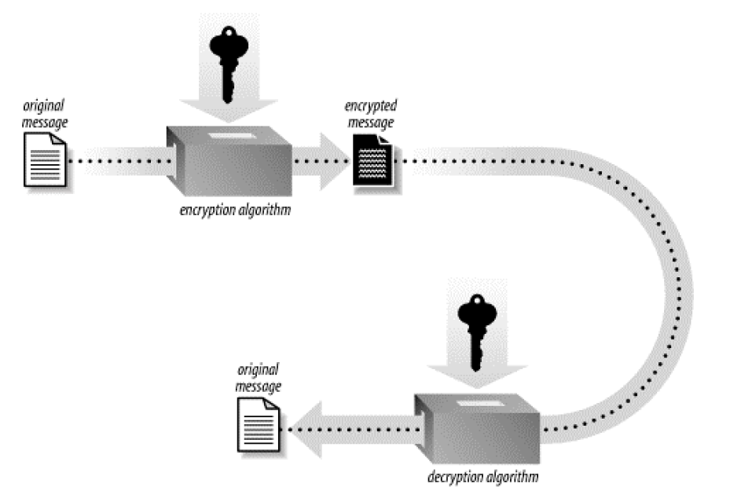
SSL Basics (cont.)
Symmetric key algorithms encrypt and decrypt data using a single key.
The primary disadvantage of symmetric key algorithms is that the key must remain secret at all
times.

Slide 14
SSL Basics (cont.)
One solution to the key distribution problem is to use a cryptographic key exchange protocol.
OpenSSL provides the Diffie-Hellman protocol for this purpose.
Triple DES (3DES, or DES3) is the most conservative symmetric cipher available.

Slide 15
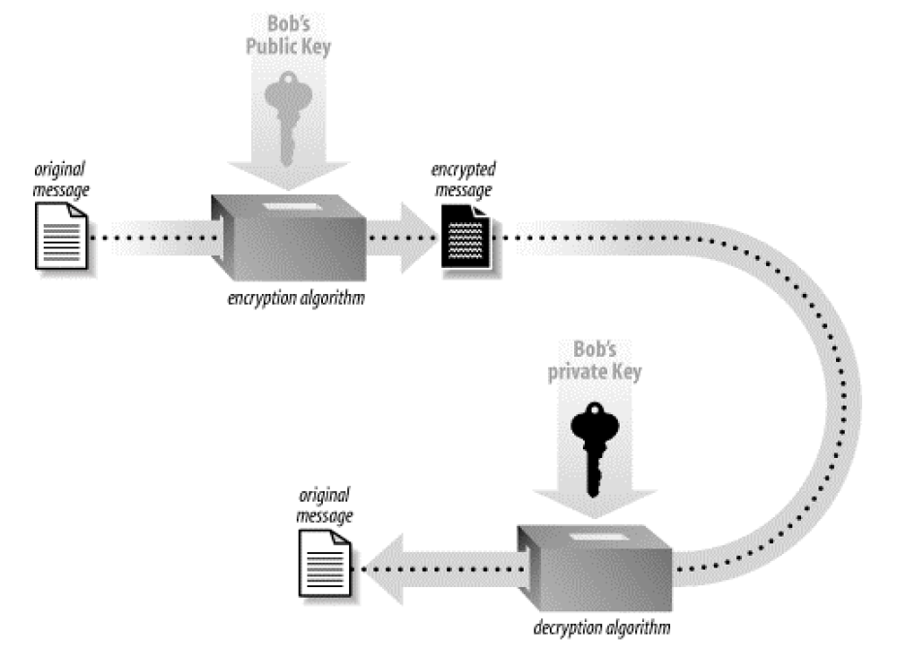
SSL Basics (cont.)
Public key cryptography suggests a solution to the key distribution problem.
Each party has2 keys, one that must remain secret (the private key) and one that can be freely distributed (the
public key).

Slide 16
SSL Basics (cont.)
In practice, public keys are passed around with a bunch of supporting information called a certificate, and those certificates are validated by trusted third parties.
Public key cryptography has a significant drawback: it’s slow for large messages.
RSA is the most popular public key encryption algorithm.
The Diffie-Hellman key exchange protocol is based on public key technology

Slide 17
SSL Basics (cont.)
Cryptographic hash functions(message digest) are essentially checksum algorithms with special properties.
Passing identical data into the hash function twice will always produce identical results.
The result gives away no information about the data input to the function.
MACs (Message Authentication Codes) are often used to provide message integrity for general-purpose data transfer.

Slide 18
SSL Basics (cont.)
DSA (Digital Signature Algorithm) doesn't operate on the entire message to be signed.
The message is cryptographically hashed, and then the hash of the message is signed.
Signature schemes are still expensive.
Digital signatures are widely used is in certificate management.

Slide 19
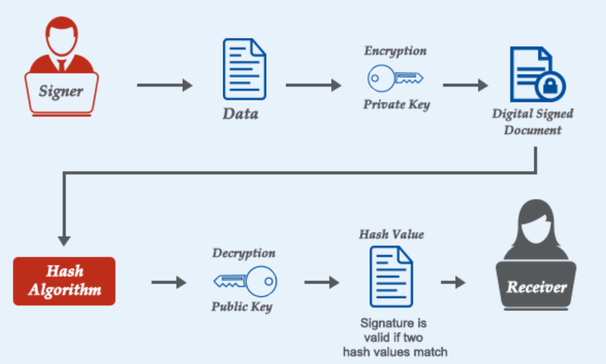
SSL Basics (cont.)
DSA (Digital Signature Algorithm) scheme typically consists of three algorithms:
A key generation algorithm that selects a private key uniformly at random from a set of possible private keys.
A signing algorithm that, given a message and a private key, produces a signature.
A signature verifying algorithm that, given the message, public key and signature, either accepts or rejects the message's claim to authenticity.

Slide 20
SSL Basics (cont.)
An SSL transaction starts with the client sending a handshake to the server.
In the server's response, it sends its certificate (that contains the public key and other information).
During the connection process, the server will prove its identity by using its private key to successfully decrypt a challenge that the client encrypts with the server's public key.
The client needs to receive the correct unencrypted data to proceed.
Additionally, during certificate validation, a party can go to the Certification Authority for Certificate Revocation Lists (CRLs) to ensure that certificates that appear valid haven't been stolen.

Slide 21
SSL Basics (cont.)
Both the client and the server need to generate random data for keys and other secrets.
The data must be generated in such a way that a knowledgeable attacker cannot guess anything about it.
SSL implementations usually generate such data using a pseudorandom number generator (PRNG).
PRNGs are deterministic algorithms that produce a series of random-looking numbers.
A seed is a piece of data fed to the PRNG to get it going.
Given a single, known seed at startup, the PRNG should produce a predictable set of outputs.
Entropy is a measurement of how much unguessable information exists in data from the point of view of an attacker ("man in the middle").

Slide 22
SSL Basics (cont.)
There are 2 types of symmetric ciphers:
block
stream
Block ciphers are the most popular, as they operate by breaking up data into fixed-size blocks and then encrypts each block individually.
Leftover data is padded to that the length of the plaintext is a multiple of the cipher block size.
Stream ciphers are cryptographic pseudorandom number generators.
They use a starting seed as a key to produce a stream of random bits known as the keystream.
To encrypt data, one takes the plaintext and simply XORs it with the keystream.

Slide 23
SSL Basics (cont.)
Cryptographic one-way hashes take arbitrary binary data as an input and produce a fixed-size binary string as an output, called the hash value or the message digest.
Passing the same message through a single hash function always yields the same result.
Hash functions aren't often good for security purposes.
A good use of hashes is to ensure the message integrity of encrypted data, by encrypting the hash of a message along with the message itself.
This is a primitive version of a message authentication code (MAC).

Slide 24
Core
The core library, written in the C programming language, implements basic cryptographic functions and provides various utility functions.
Wrappers allowing the use of the OpenSSL library in a variety of computer languages are available.

Slide 25
Core (cont.)
OpenSSL program (command line) is divided into following modules:
asn1parse - ASN.1 parsing tool
ca - sample minimal CA application
crl2pkcs7 - Create a PKCS#7 structure from a CRL and certificates.
crl - CRL utility
dgst, md5, md4, md2, sha1, sha, mdc2, ripemd160 - message digests
dhparam - DH parameter manipulation and generation
dsa - DSA key processing
dsaparam - DSA parameter manipulation and generation
ec - EC key processing
ecparam - EC parameter manipulation and generation
enc - symmetric cipher routines
gendsa - generate a DSA private key from a set of parameters
genrsa - generate an RSA private key
ocsp - Online Certificate Status Protocol utility
passwd - compute password hashes

Slide 26
Core (cont.)
pkcs7 - PKCS#7 utility
pkcs8 - PKCS#8 format private key conversion tool
pkcs12 - PKCS#12 file utility
rand - generate pseudo-random bytes
req - PKCS#10 certificate request and certificate generating utility.
rsa - RSA key processing tool
rsautl - RSA utility
s_client - SSL/TLS client program
s_server - SSL/TLS server program
sess_id - SSL/TLS session handling utility
smime - S/MIME utility
speed - test library performance
spkac - SPKAC printing and generating utility
verify - Utility to verify certificates.
x509 - Certificate display and signing utility
x509v3_config - X509 V3 certificate extension configuration format

Slide 27
Core (cont.)
The command-line tool executable is: openssl on Unix, and openssl.exe on Windows.
It has two modes of operation: interactive and batch.
When the program is started without any options, it will enter interactive mode.
When operating in interactive mode, a prompt is displayed indicating that it is ready to process your command.

Slide 28
Core (cont.)
openssl dgst -sha1 file.txt
Computes an SHA1 hash for the file named file.txt and write it to stdout in hexadecimal form.
openssl sha1 -out digest.txt file.txt
Computes an SHA1 hash for the file named file.txt and write it in hexadecimal form to the file named digest.txt.
openssl dgst -dss1 -sign dsakey.pem -out dsasign.bin file.txt
Signs the SHA1 (DSS1) hash of the file named file.txt using the DSA private key in the file dsakey.pem and write the signature out to the file dsasign.bin.
openssl dgst -dss1 -prverify dsakey.pem -signature dsasign.bin file.txt
Verifies the signature of the file named file.txt that is contained in the file dsasign.bin using the SHA1 (DSS1) message digest algorithm and the DSA private key from the file dsakey.pem.

Slide 29
Core (cont.)
OpenSSL supports a wide variety of symmetric ciphers.
The basic ciphers supported by the command-line tool are Blowfish, CAST5, DES, 3DES (Triple DES), IDEA, RC2, RC4, and RC5, AES.
Most of the supported symmetric ciphers support a variety of different modes, including CBC, CFB, ECB, and OFB.
For each cipher, the default mode is always CBC if a mode is not explicitly specified.

Slide 30
Core (cont.)
The enc command is the main command for accessing symmetric ciphers.
In addition to providing encryption and decryption of data with symmetric ciphers, the base64 command or option to the enc command can also be used for encoding and decoding of data in base64.
Normally, data is read from stdin and written to stdout, but input and output files may be specified.
Each of the ciphers requires a key when encryption or decryption is performed.

Slide 31
Core (cont.)
openssl enc -des3 -salt -in plaintext.doc -out ciphertext.bin
Encrypts the contents of the file plaintext.doc using DES3 in CBC mode and places the
resulting ciphertext into ciphertext.bin.
openssl enc -des3 -d -in ciphertext.bin -out plaintext.doc -pass pass:changeit
Decrypts the contents of the file ciphertext.bin using DES3 and places the resulting plaintext into plaintext.doc.
openssl base64 -in ciphertext.bin -out base64.txt
Encodes the contents of the file ciphertext.bin in base64 and writes the result to the file base64.txt.
openssl base64 -d -in base64.txt -out decrypted.txt
Decrypts using base64

Slide 32
Core (cont.)
openssl x509 -in t1.cer -out t1.der -outform DER
Conversts a certificate from CER format to DER (binary format)
openssl x509 -in t1.cer -out t1.pem -outform PEM
Conversts a certificate from CER format to PEM (base64 format)

Slide 33
Core (cont.)
The Digital Signature Algorithm (DSA) is used for creating and verifying digital signatures.
It provides authentication but cannot be used for encryption or secrecy.
DSA is frequently used in combination with Diffie-Hellman.
openssl dsaparam -out dsaparam.pem 1024
Generates a new set of DSA parameters and writes them to the file dsaparam.pem.
openssl gendsa -out dsaprivatekey.pem -des3 dsaparam.pem
Generates a new DSA private key using the parameters from the file dsaparam.pem, encrypts the newly generated private key with the 3DES cipher.
openssl dsa -in dsaprivatekey.pem -pubout -out dsapublickey.pem
Computes the public key that corresponds to the private key contained in the file dsaprivatekey.pem and writes the public key out to the file dsapublickey.pem.

Slide 34
Core (cont.)
RSA is the most popular public key algorithm currently in use.
Unlike Diffie-Hellman and DSA, the RSA algorithm does not require parameters to be generated before keys can be generated.
OpenSSL's genrsa command is used to generate a new RSA private key
openssl genrsa -out rsaprivatekey.pem -passout pass:changeit -des3 1024
generates a 1,024-bit RSA private key, encrypts it using 3DES and a password of "changeit.
openssl rsa -in rsaprivatekey.pem -passin pass:changeit -pubout -out rsapublickey.pem
reads an RSA private key from the file rsaprivatekey.pem, decrypts it using the password "changeit", and writes the corresponding public key to the file rsapublickey.pem.

Slide 35
Core (cont.)
S/MIME (Secure Multipurpose Internet Mail Exchange) is a competing standard to PGP (Pretty Good Privacy) for the secure exchange of email.
It provides authentication and encryption of email messages using public key cryptography, as does PGP.
One of the primary differences in the two standards is that S/MIME uses a public key infrastructure to establish trust, whereas PGP does not.
PGP has become an open standard known as OpenPGP and is documented in RFC 2440.

Slide 36
Core (cont.)
openssl smime -encrypt -in mail.txt -des3 -out mail.enc cert.pem
Obtains a public key from the X.509 certificate in the file cert.pem and encrypts the contents of the file mail.txt using that key and 3DES.
penssl smime -decrypt -in mail.enc -recip cert.pem -inkey key.pem -out mail.txt
Obtains the recipient's public key from the X.509 certificate in the file cert.pem and decrypts the S/MIME message from the file mail.enc using the private key from the file key.pem.

Slide 37
Core (cont.)
Public Key Infrastructure (PKI) provides the means to establish trust by binding public keys and identities.
Using public key cryptography, we can be sure that only the encrypted data can be decrypted with the corresponding private key.
We combine this with the use of a message digest algorithm to compute a signature, we can be sure that the encrypted data has not been tampered with.
At the heart of PKI is something called a certificate.
In simple terms, a certificate binds a public key with a distinguished name.
By signing a certificate with the issuer's private key, anyone that has the issuer's public key can verify its authenticity.

Slide 38
Core (cont.)
A Certification Authority (CA) is an organization or company that issues certificates.
CA has a huge responsibility to ensure that the certificates it issues are legitimate.
A CRL (Certificate Revocation List) contains a list of all the revoked certificates a CA has issued that have yet to expire.
When a certificate is revoked, the CA declares that the certificate should no longer be trusted.

Slide 39
Core (cont.)
The Online Certificate Status Protocol (OCSP), formally specified in RFC 2560, is a relatively new addition to PKI.
Its primary aim is to address some of the distribution problems that have traditionally plagued CRLs.
Using OCSP, an application makes a connection to an OCSP responder and requests the status of a certificate by passing the certificate's serial number. The responder replies "good," "revoked," or "unknown“.

Slide 40
Conclusions
Good licensing terms
Availability of source codes
platform independence and wide functionality

Slide 41

Bibliography
O'Reilly - Network Security with OpenSSL
https://en.wikipedia.org/wiki/OpenSSL

