Slide 1

Big Data
Dima Ionut Daniel

Slide 2
Contents
What is Big Data?
Characteristics
Core
Storage
Bibliography

Slide 3

What is Big Data?
Big data is a term for data sets that are so large or complex that traditional data processing application software is inadequate to deal with them.
Big data challenges include capturing data, data storage, data analysis, search, sharing, transfer, visualization, querying, updating and information privacy.

Slide 4
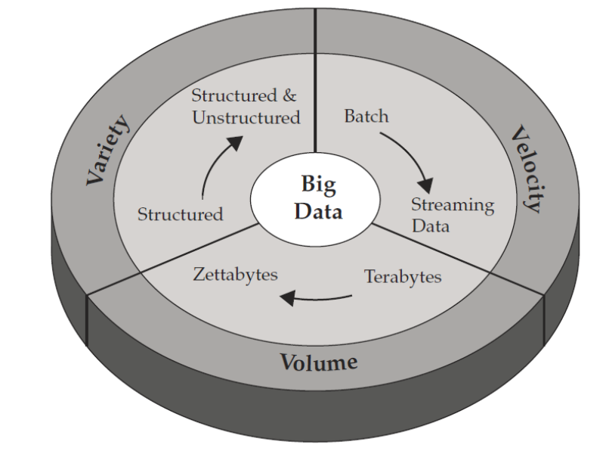
What is Big Data? (cont.)
Big data is similar to small data, but bigger in size.
Big data generates value from the storage and processing of very large quantities of digital information that cannot be analyzed with traditional computing techniques

Slide 5
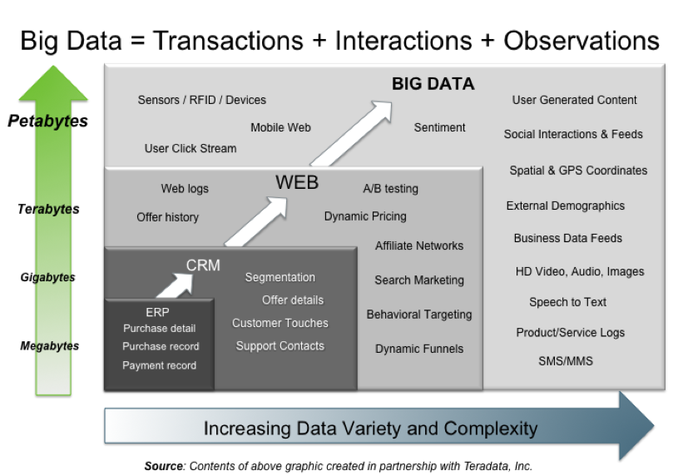
What is Big Data? (cont.)

Slide 6
Characteristics
Volume
The quantity of generated and stored data. The size of the data determines the value and potential insight- and whether it can actually be considered big data or not.
Variety
The type and nature of the data. This helps people who analyze it to effectively use the resulting insight.
Velocity
In this context, the speed at which the data is generated and processed to meet the demands and challenges that lie in the path of growth and development.
Variability
Inconsistency of the data set can hamper processes to handle and manage it.
Veracity
The quality of captured data can vary greatly, affecting the accurate analysis.

Slide 7
Characteristics (cont.)
The structure of the big data can be explained by the following:
Structured: The structured mostly includes the traditional sources of information.
Semi-structured: The semi-structured includes many sources of the big data.
Unstructured: The unstructured includes the information like video data and audio data.

Slide 8
Characteristics (cont.)
The applications of the big data are in the following fields:
Government
International development
Manufacturing
Cyber-physical models
Media
Technology
Private sector
Science
Science and research

Slide 9
Core
The MapReduce framework is introduced as a simple and powerful programming model that enables easy development of scalable parallel applications to process vast amounts of data on large clusters.
The MapReduce framework uses the computation using two functions: map and reduce.
The map function takes an input pair and produces a set of intermediate key/value pairs.
The reduce function receives an intermediate key I with its set of values and merges them together.
Zero or one output value is produced per reduce invocation.
It allows large computations to be easily parallelized and re-executed to be used as the primary mechanism for fault tolerance.

Slide 10
Core (cont.)
Hadoop is an open-source Java library that supports data-intensive distributed applications by realizing the implementation of the MapReduce framework.
On the implementation level, the map invocations of a MapReduce job are distributed across multiple machines by automatically partitioning the input data into a set of M splits.
The input splits can be processed in parallel by different machines.

Slide 11
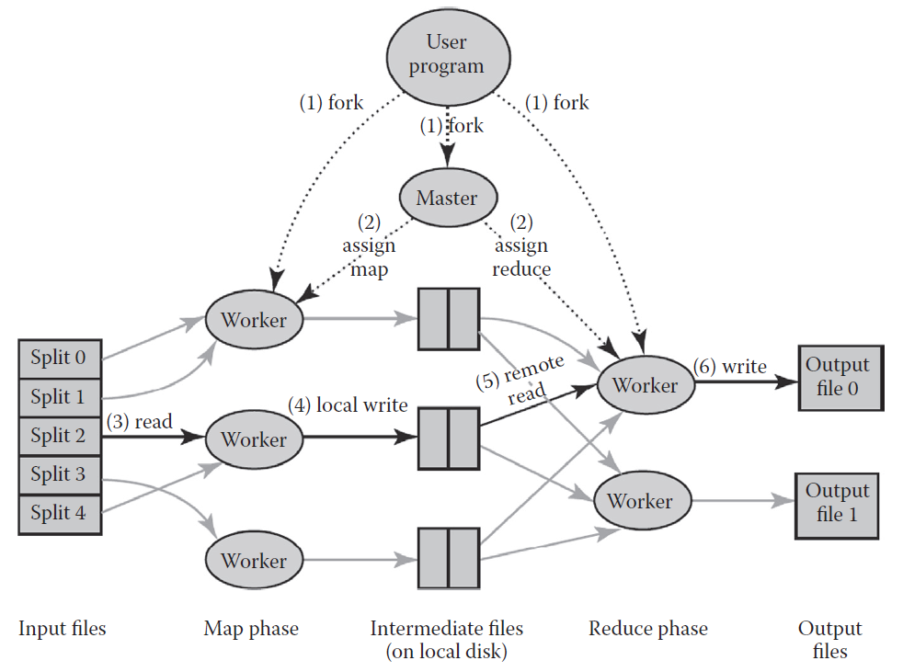
Core (cont.)
Overview of the flow of execution a MapReduce Operation

Slide 12
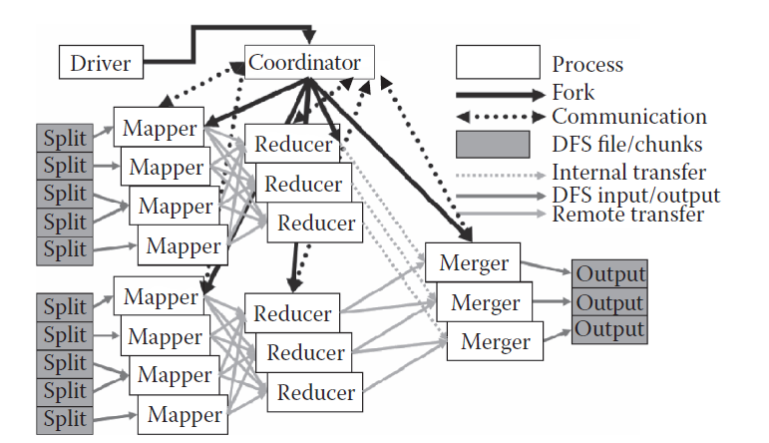
Core (cont.)
Overview of the map–reduce–merge framework

Slide 13
Core (cont.)
The HaLoop system is designed to support iterative processing on the MapReduce framework by extending the basic MapReduce framework with 2 main functionalities:
Caching the invariant data in the first iteration and then reusing them in later iterations.
Caching the reducer outputs, which makes checking for a fixpoint more efficient, without an extra MapReduce job.

Slide 14
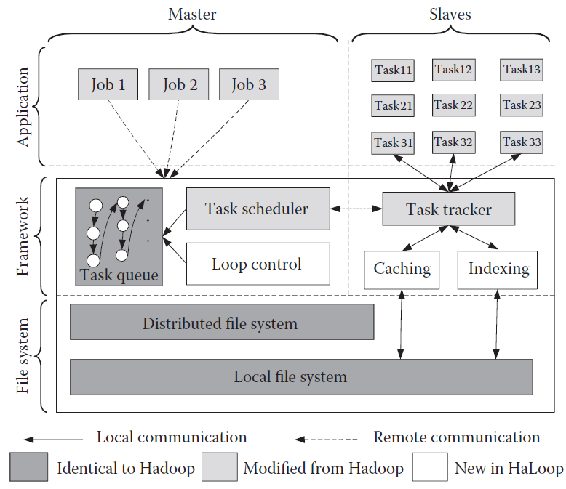
Core (cont.)
HaLoop architecture

Slide 15
Core (cont.)
Sawzall is a scripting language used at Google on top of MapReduce.
A Sawzall program defines the operations to be performed on a single record of the data.
Pig Latin is implemented in the scope of the Apache Pig project and is used by programmers at Yahoo! for developing data analysis tasks.
Writing a Pig Latin program is similar to specifying a query execution plan.

Slide 16
Core (cont.)
The Hive project is an open-source data warehousing solution that has been built by the Facebook Data Infrastructure Team on top of the Hadoop environment.
The main goal of this project is to bring the familiar relational database concepts (e.g., tables, columns, partitions) and a subset of SQL to the unstructured world of Hadoop while still maintaining the extensibility and flexibility that Hadoop provides.

Slide 17
Core (cont.)
The HadoopDB project† is a hybrid system that tries to combine the scalability advantages of MapReduce with the performance and efficiency advantages of parallel databases.
The basic idea behind HadoopDB is to connect multiple single-node database systems (Post-greSQL) using Hadoop as the task coordinator and network communication layer.
Queries are expressed in SQL but their execution are parallelized across nodes using the MapReduce framework.

Slide 18
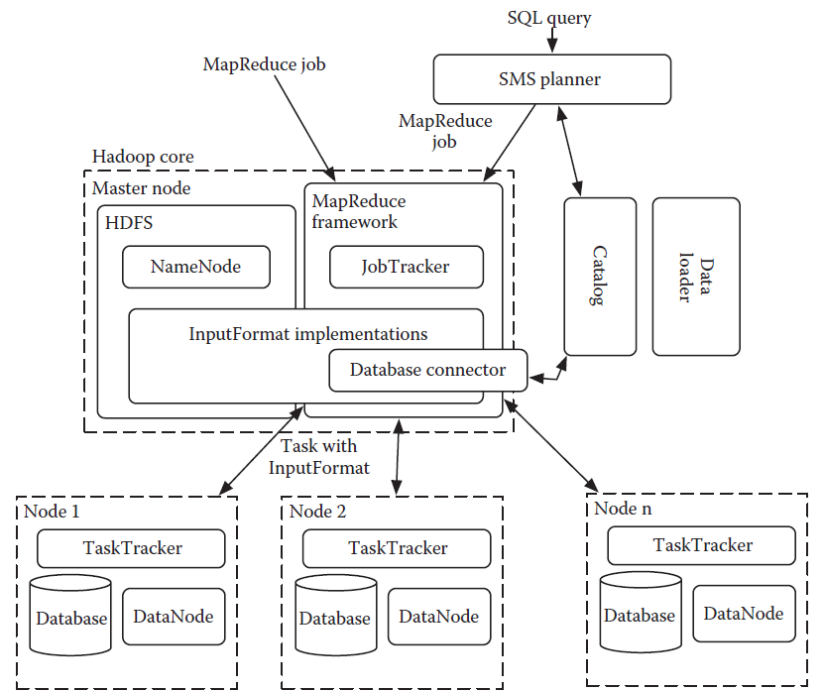
Core (cont.)
HadoopDB Architecture

Slide 19
Core (cont.)
The Spark system has been proposed to support the applications that need to reuse a working set of data across multiple parallel operations while retaining the scalability and fault tolerance of MapReduce.
To achieve these goals, Spark introduces an abstraction called resilient distributed data sets (RDDs).
An RDD is a read-only collection of objects partitioned across a set of machines that can be rebuilt if a partition is lost.
Spark is implemented in the Scala programming language and it's built on top of Mesos, a cluster operating system that lets multiple parallel framework.

Slide 20
Core (cont.)
The Apache Flume project is designed to gather data, logs by running agents on the source machines that pass the data updates to collectors which then aggregate them into large chunks that that can be efficiently written as HDFS files.
Apache Oozie is a job control system, exclusively focused on Hadoop.
Oozie supports a complex language for describing job flows, allowing you to make runtime decisions about exactly which steps to perform, all described in XML files.

Slide 21
Storage
Large-scale data processing operations access data in a way that traditional file systems aren't designed for.
Data tends to be written and read in large batches, multiple MB at once.
Amazon’s S3 service stores large chunks of data on an online service, with an interface that makes it easy to retrieve the data over the standard web protocol, HTTP.

Slide 22
Storage (cont.)
The Hadoop Distributed File System (HDFS) is designed to support applications like MapReduce jobs that read and write large amounts of data in batches, rather than more randomly accessing lots of small files.
EC2(Amazon Elastic Compute Cloud) lets you rent computers by the hour, with a choice of different memory and CPU configurations.
It has a rich set of third-party virtual machine snapshots to start with and easy integration with S3, both through a raw interface and through the Elastic Block Storage (EBS) wrapper

Slide 23
Storage (cont.)
Elastic Beanstalk is a layer on top of the EC2 service that takes care of setting up an automatically scaling cluster of web servers behind a load balancer, allowing developers to deploy Java-based applications without worrying about a lot of the housekeeping details.
Heroku hosts Ruby web applications, offering a simple deployment process, a lot of free and paid plug-ins, and easy scalability.
We can install almost any Ruby gem, even those with native code, and we get a real SQL database rather than Google’s scalable but restrictive alternative datastore.

Slide 24

Bibliography
https://en.wikipedia.org/wiki/Big_data
https://www.slideshare.net/nasrinhussain1/big-data-ppt-31616290
https://www.planet-data.eu/sites/default/files/presentations/Big_Data_Tutorial_part4.pdf
CRC Press - Large Scaleand Big Data Processing and Management
O’Reilly – Big Data Glossary

