Slide 1

Bitcoin
Dima Ionut Daniel

Slide 2
Contents
What is Bitcoin ?
Concepts
Bitcoin
Blockchain Technology
Core
Wallets
Transactions
Bitcoin Network
Security
Bibliography

Slide 3

What is Bitcoin?
Bitcoin is a worldwide cryptocurrency and digital payment system called the first decentralized digital currency, since the system works without a central repository or single administrator.
It was invented by an unknown programmer, or a group of programmers, under the name Satoshi Nakamoto and released as open-source software in 2009.
The system is peer-to-peer, and transactions take place between users directly, without an intermediary.
These transactions are verified by network nodes and recorded in a public distributed ledger called a blockchain.

Slide 4
Concepts
The blockchain is a public ledger that records bitcoin transactions.
Paying a transaction fee is optional.
Mining is a record-keeping service.
The successful miner finding the new block is rewarded with newly created bitcoins and transaction fees.
A wallet stores the information necessary to transact bitcoins.
Ownership of bitcoins implies that a user can spend bitcoins associated with a specific address.

Slide 5
Bitcoin
Bitcoin is a collection of concepts and technologies that form the basis of a digital money ecosystem.
Units of currency called bitcoin are used to store and transmit value among participants in the bitcoin network.
The bitcoin protocol stack, available as open source software, can be run on a wide range of computing devices, including laptops and smartphones, making the technology easily accessible.

Slide 6
Bitcoin (cont.)
Users can transfer bitcoin over the network to do just about anything that can be done with conventional currencies.
Bitcoin can be purchased, sold, andexchanged for other currencies at specialized currency exchanges.
Bitcoin in a sense is the perfect form of money for the internet because it is fast, secure and borderless.
Unlike traditional currencies, bitcoin are entirely virtual.
Bitcoin is a distributed, peer-to-peer system and there is no “central” server or point of control.

Slide 7
Bitcoin (cont.)
Bitcoin are created through a process called “mining”, which involves competing to find solutions to a mathematical problem while processing bitcoin transactions.
The bitcoin protocol includes built-in algorithms that regulate the mining function across the network.
Bitcoin consists of:
A decentralized peer-to-peer network (the bitcoin protocol)
A public transaction ledger (the blockchain)
A set of rules for independent transaction validation and currency issuance (consensus rules)
A mechanism for reaching global decentralized consensus on the valid blockchain (Proof-of-Work algorithm)

Slide 8
Bitcoin (cont.)
Bitcoin is a protocol that can be accessed using a client application that speaks the protocol.
A “bitcoin wallet” is the most common user interface to the bitcoin system, just like a web browser is the most common user interface for the HTTP protocol.
Bitcoin wallets are one of the most actively developed applications in the bitcoin ecosystem.
Bitcoin wallets can be categorized as follows, according to the platform:
Desktop wallet
Mobile wallet
Web wallet
Hardware wallet
Paper wallet

Slide 9
Blockchain Technology
Blockchain is a distributed database.
Because the blockchain stores identical blocks of information across the entire network, it cannot:
Come under the control of a single entity
Have any single failure point
Bitcoin came about in 2008 and since then the blockchain has worked without any serious disruption.

Slide 10
Blockchain Technology (cont.)
The blockchain network exists under what is known as “a state of consensus” and, every 10 minutes, it will check on itself.
This is a kind of auditing system.
Each transaction that happens in each ten-minute interval is reconciled and each of these 10-minute groups of transactions is called “a block”.
A node is a computer that is connected to the network via a Bitcoin client.
This client carries out the jobs of validating each transaction and relaying them.

Slide 11
Blockchain Technology (cont.)
Bitcoin is a digital currency.
All currencies need 4 things:
Checks
Balances
Validation
Verification

Slide 12
Blockchain Technology (cont.)
To start with the miners, people who had some spare compute power and could help validate the transactions on the blockchain to get a reward of Bitcoin.
We need a specialized mining rig which is built from computer components and the hardware comes in different categories.
Hash rate: the number of calculations that can be performed by your hardware every second as it attempts to crack the puzzle.
Energy consumption

Slide 13
Blockchain Technology (cont.)
For example, if a device that hashes at 500 GH/sec, and it uses 400 watts of electric then the hash rate is 1.25 GH/sec.
A mining pool is basically a group of people who club together and share the rewards.
When we are making a decision on which pool, be sure to check out how the rewards are shared between members and if there are any fees.

Slide 14
Core
The bitcoin system, unlike traditional banking and payment systems, is based on decentralized trust.
A blockchain explorer is a web application that operates as a bitcoin search engine, in that it allows you to search for addresses, transactions, and blocks and see the relationships and flows between them.
A transaction tells the network that the owner of some bitcoin value has authorized the transfer of that value to another owner.
Each transaction contains one or more “inputs,” which are like debits against a bitcoin account.

Slide 15
Core (cont.)
On the other side of the transaction, there are one or more “outputs,” which are like credits added to a bitcoin account.
The transaction also contains proof of ownership for each amount of bitcoin (inputs) whose value is being spent, in the form of a digital signature from the owner, which can be independently validated by anyone.
In bitcoin terms, “spending” is signing a transaction that transfers value from a previous transaction over to a new owner identified by a bitcoin address.

Slide 16
Core (cont.)
The bitcoin system of trust is based on computation.
Transactions are bundled into blocks, which require an enormous amount of computation to prove, but only a small amount of computation to verify as proven.
The mining process serves two purposes in bitcoin:
Mining nodes validate all transactions by reference to bitcoin’s consensus rules.
Mining creates new bitcoin in each block, almost like a central bank printing new money.

Slide 17
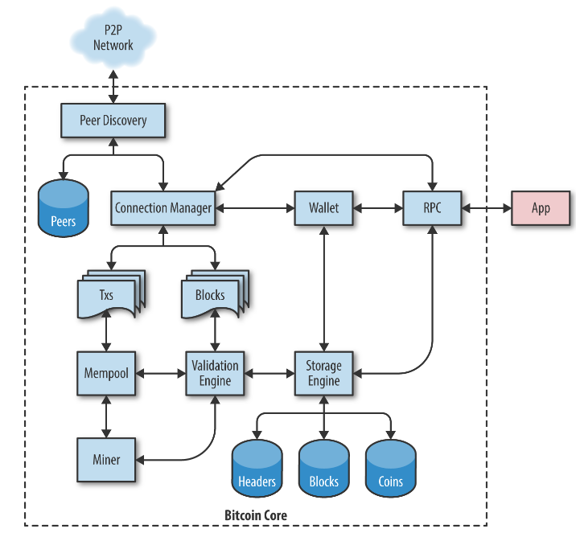
Core (cont.)
Bitcoin is an open source project and the source code is available under an open (MIT) license, free to download and use for any purpose.

Slide 18
Core (cont.)
Ownership of bitcoin is established through digital keys, bitcoin addresses, and digital signatures.
The digital keys aren't actually stored in the network, but are instead created and stored by users in a file, or simple database, called a wallet.
Most bitcoin transactions requires a valid digital signature to be included in the blockchain, which can only be generated with a secret key.
The digital signature used to spend funds is also referred to as a witness, a term used in cryptography.

Slide 19
Wallets
At a high level, a wallet is an application that serves as the primary user interface.
The wallet controls access to a user’s money, managing keys and addresses, tracking the balance, and creating and signing transactions.
Users control the coins on the network by signing transactions with the keys in their wallets. In a sense, a bitcoin wallet is a keychain.

Slide 20
Wallets (cont.)
There are 2 primary types of wallets, distinguished by whether the keys they contain are related to each other or not.
The first type is a nondeterministic wallet, where each key is independently generated from a random number.
The second type of wallet is a deterministic wallet, where all the keys are derived from a single master key, known as the seed.

Slide 21
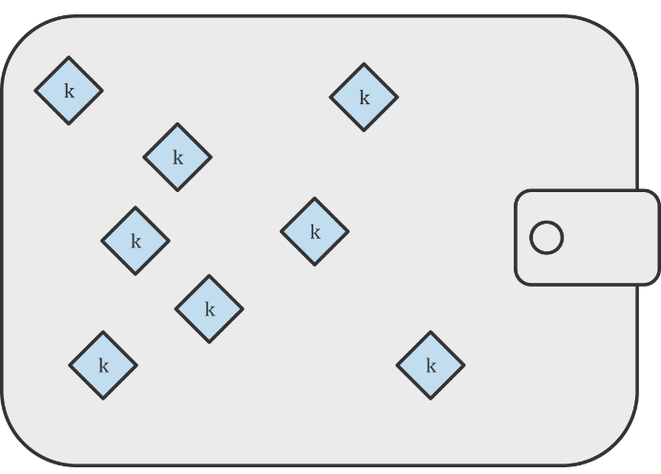
Wallets (cont.)
Nondeterministic (Random) Wallets
In the first bitcoin wallet, wallets were collections of randomly generated private keys.
The disadvantage of random keys is that if you generate many of them you must keep copies of all of them, meaning that the wallet must be backed up frequently.
Each key must be backed up, or the funds it controls are irrevocably lost if the wallet becomes inaccessible.

Slide 22
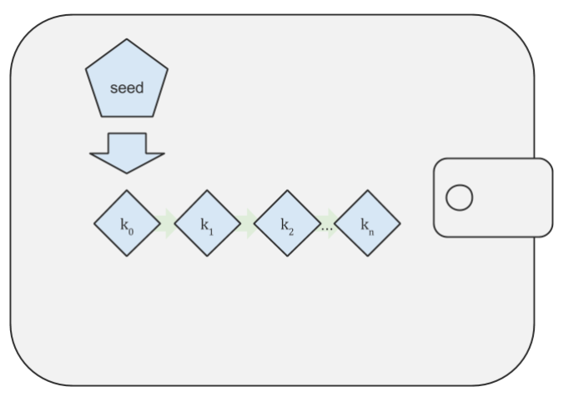
Wallets (cont.)
Deterministic (Seeded) Wallets
Deterministic, or “seeded,” wallets are wallets that contain private keys that are all derived from a common seed, through the use of a one-way hash function.
The seed is a randomly generated number that is combined with other data, such as an index number or “chain code” to derive the private keys.
In a deterministic wallet, the seed is sufficient to recover all the derived keys, and therefore a single backup at creation time is sufficient.

Slide 23
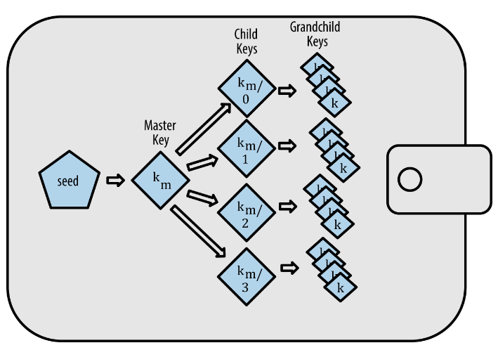
Wallets (cont.)
HD Wallets (BIP-32/BIP-44)
Deterministic wallets were developed to make it easy to derive many keys from a single “seed.”
The most advanced form of deterministic wallets is the HD wallet defined by the BIP-32 standard.
HD wallets contain keys derived in a tree structure, such that a parent key can derive a sequence of children keys, each of which can derive a sequence of grandchildren keys, and so on, to an infinite depth.

Slide 24
Transactions
Transactions are the most important part of the bitcoin system.
Everything else in bitcoin is designed to ensure that transactions can be created, propagated on the network, validated, and finally added to the global ledger of transactions.
Transactions are data structures that encode the transfer of value between participants in the bitcoin system.
Each transaction is a public entry in bitcoin’s blockchain.

Slide 25
Transactions (cont.)
The fundamental building block of a bitcoin transaction is a transaction output.
Transaction outputs are indivisible chunks of bitcoin currency, recorded on the blockchain, and recognized as valid by the entire network.
Bitcoin full nodes track all available and spendable outputs, known as unspent transaction outputs, or UTXO.

Slide 26
Bitcoin Network
Bitcoin is structured as a peer-to-peer network architecture on top of the internet.
The network nodes interconnect in a mesh network with a “flat” topology.
There is no server, no centralized service, and no hierarchy within the network.
Nodes in a P2P network both provide and consume services at the same time with reciprocity acting as the incentive for participation.
P2P networks are inherently resilient, decentralized, and open.

Slide 27
Bitcoin Network (cont.)
Bitcoin’s P2P network architecture is much more than a topology choice.
Bitcoin is a P2P digital cash system by design, and the network architecture is both a reflection and a foundation of that core characteristic.
Decentralization of control is a core design principle that can only be achieved and maintained by a flat, decentralized P2P consensus network.
All nodes include the routing function to participate in the network and might include other functionality.
All nodes validate and propagate transactions and blocks, and discover and maintain connections to peers.

Slide 28
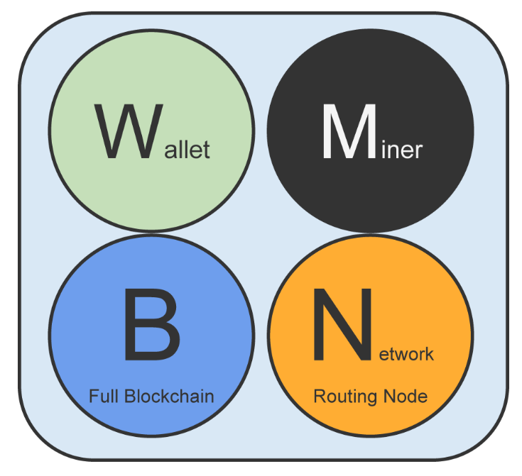
Bitcoin Network (cont.)
Nodes in the bitcoin P2P network are equal, they may take on different roles depending on the functionality they are supporting.
A bitcoin node is a collection of functions: routing, the blockchain database, mining, and wallet services.

Slide 29
Security
Securing bitcoin is challenging because bitcoin is not an abstract reference to value, like a balance in a bank account.
The core principle in bitcoin is decentralization and it has important implications for security.
A bitcoin transaction authorizes only a specific value to a specific recipient and cannot be forged or modified.
A bitcoin payment network does not need to be encrypted or protected from eavesdropping.
Bitcoin’s decentralized security model puts a lot of power in the hands of the users.

Slide 30
Security (cont.)
Traditional security architecture is based upon a concept called the root of trust, which is a trusted core used as the foundation for the security of the overall system or application.
Security architecture is developed around the root of trust as a series of concentric circles, like layers in an onion, extending trust outward from the center.

Slide 31

Bibliography
https://en.wikipedia.org/wiki/Bitcoin
RICHARD OZER - The Insider Guide to Blockchain Technology, Cryptocurrency, and Mining Bitcoin
O’Reilly – Mastering Bitcoin

