Slide 1

Grails
Dima Ionut Daniel

Slide 2
Contents
What is Grails ?
History
Goals
Features
Architecture
Core
GORM
Application Flow
Forms
Plugins
Conclussion
Bibliography

Slide 3

What is Grails ?
Grails is an open source web application framework that uses the Apache Groovy programming language.
It's intended to be a high-productivity framework by following the "coding by convention" paradigm.

Slide 4
History
Grails was previously known as "Groovy on Rails".
In March 2006 that name was dropped in response to a request by David Heinemeier Hansson, founder of the Ruby on Rails framework.
Work began in July 2005, with the 0.1 release on March 29, 2006 and the 1.0 release announced on February 18, 2008.

Slide 5
Goals
Grails was developed to address bellow goals:
provide a web framework for Java platform
re-use technologies such as Hibernate an Spring under a single interface
offer a consistent development framework
provide sample applications that demonstrate the framework
provide a complete development mode, including a web server and automatic reload of resources

Slide 6
Features
The Improved Interactive Mode
Dynamic Domain Class Reloading
HTML5 scaffolded screens
Business Class Citizenship for Testing
Link Generation/Page Renderer APIs
GORM Finders with Groovy Collection find/findAll like syntax
Public methods in controllers as actions which can take arguments
The New Improved Test Reports
DB Console

Slide 7
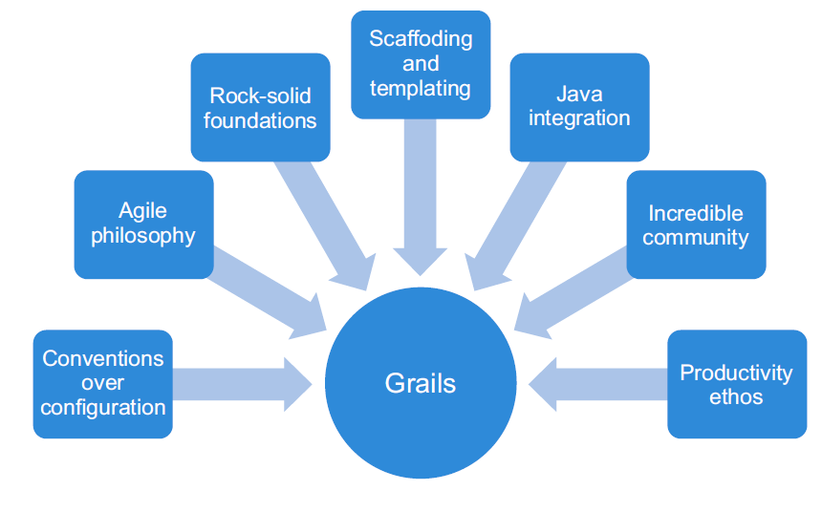
Architecture

Slide 8
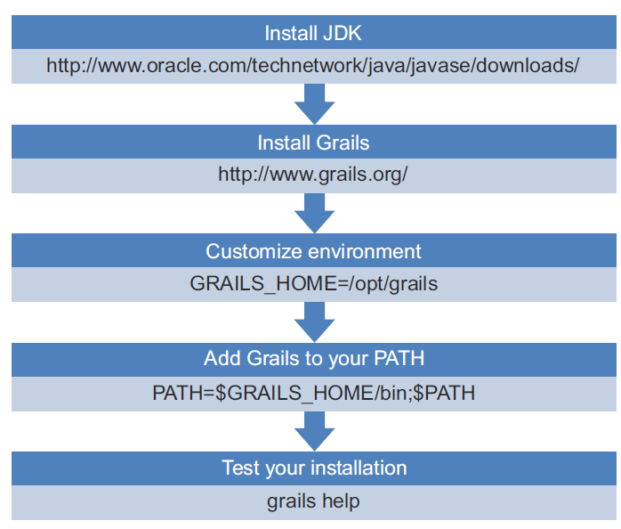
Core
To get Grails up and running we need to install Java and Groovy.

Slide 9
Core (cont.)
To create a Grails application we need to run the following command:
grails create-app <APP_NAME>
After we've created the Grails application we can start it using the command:
grails run-app
We can stop the application by pressing Ctrl+C or running grails stop-app from another command/terminal prompt.

Slide 10
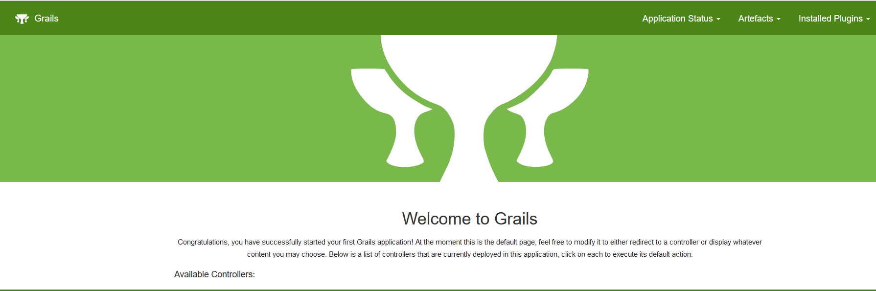
Core (cont.)

Slide 11
Core (cont.)
The default port where the web application will listen is 8080.
We can change it by using -Dserver.port command-line argument.
grails -Dserver.port=17000 run-app

Slide 12
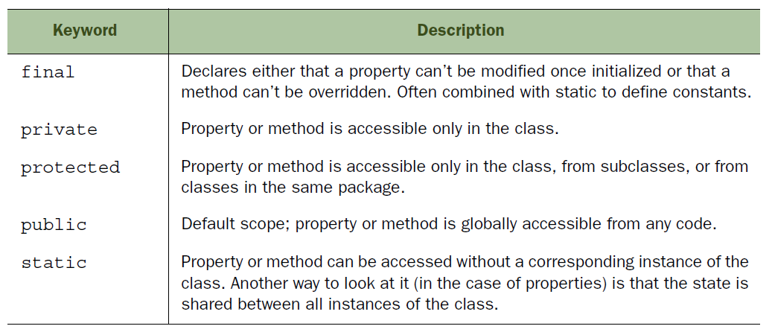
Core (cont.)
Fields have special keywords attached known as classifiers.

Slide 13
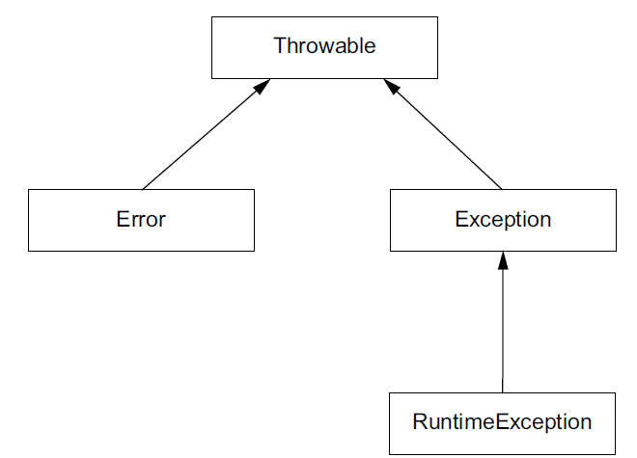
Core (cont.)
The base Groovy exception class hierarchy.

Slide 14
Core (cont.)
Grails handles user interaction via controllers.
Controllers are at the heart of every Grails application.
They take input from web browsers, interacts with business logic and data model, route the user to correct page to display.

Slide 15
Core (cont.)
To create a simple controller we need to run the bellow command:
grails create-controller <CONTROLLER_NAME>
Grails will create a controller, a view and a unit test groovy script for the controller.

Slide 16
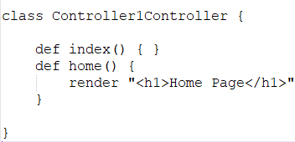
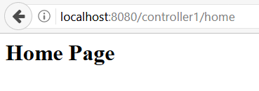
Core (cont.)
Controllers can define methods that are actions.
URLs are mapped as <APP_NAME>/<CONTROLLER_NAME>/<ACTION_NAME>.
Grails provides the render() method to send content directly back to the browser.

Slide 17
Core (cont.)
If we call the controller without the action name by default the index() action will be called.
Embedding HTML inside your code is always a bad idea.
The solution is to move your display logic to views..
Grails applications uses Groovy Server Pages(GSP) which are similar to Java Server Pages(JSP).
The [:] operator in Groovy creates a Map, to pass a series of key/value pairs through to your view.

Slide 18
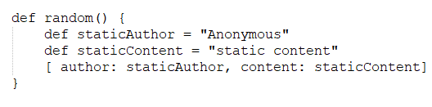
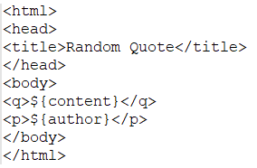
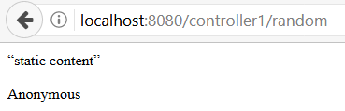
Core (cont.)
Using naming conventions used for the controller, coupled with the action name we place the GSP to
/grails-app/views/<CONTROLLER_NAME>/<ACTION_NAME>.gsp.

Slide 19
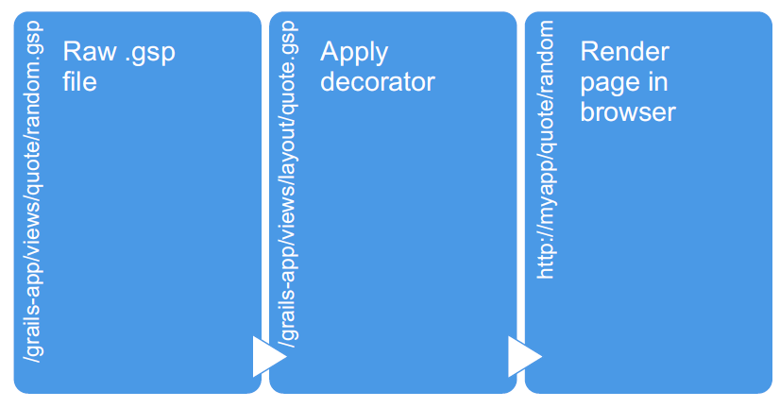
Core (cont.)
GSP expression language uses formats like ${variable}
We can use <g:external>, <g:layoutHead> and <g:layoutBody> tags if we are using layouts.
SiteMesh decorates a raw GSP file with a standard set of titles and sidebars.

Slide 20
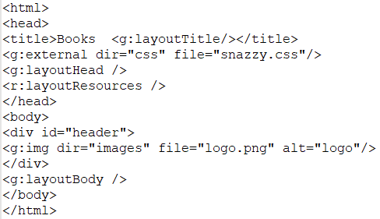
Core (cont.)
When the client’s browser requests the page, Grails replaces those tag calls with real HTML, and the contents of the HTML will depend on what the individual tag generates.
For instance, that <g:external> tag c will generate an HTML <link> element that points to the URL for snazzy.css.

Slide 21
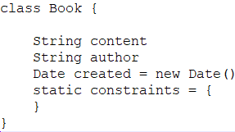
Core (cont.)
Grails uses the term "domain class" to describe objects that can be persisted to DB.
We can create Grails domain class using the following command:
grails create-domain-class <DOMAIN_CLASS>

Slide 22
Core (cont.)
We need to link the data model to the database schema.
Grails does all the hard work behind the scenes.
Grails will create a new table with specific fields when we run grails run-app. The data model will be created on the fly.

Slide 23
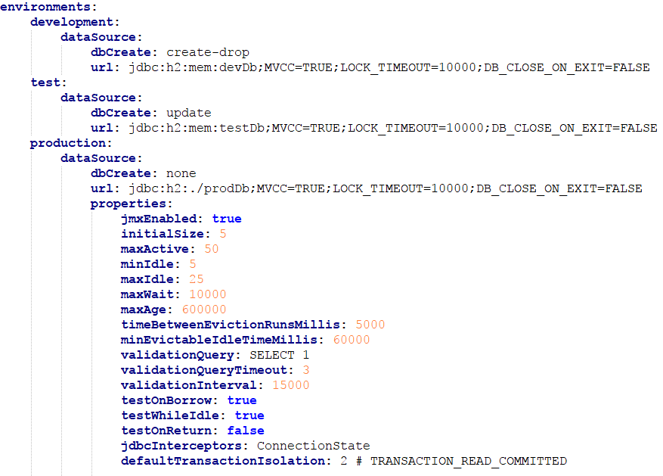
Core (cont.)
Grails ships with an in-memory database out of the box.
In /grails-app/conf we can find the datasource configuration file(application.yml).

Slide 24
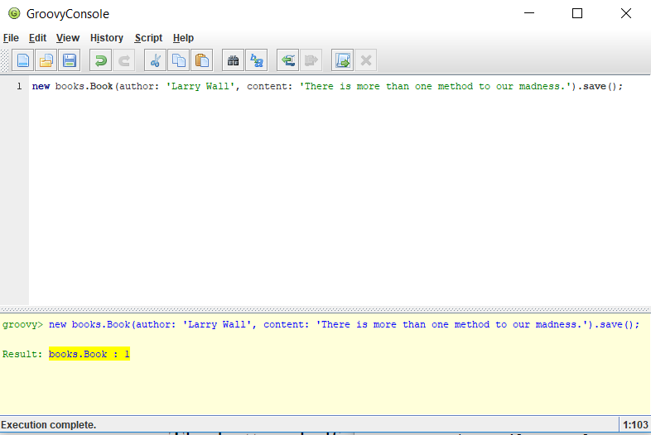
Core (cont.)
he dbCreate strategy tells Grails to drop and recreate the DB on each run, so it's best to change to update.
We can use the grails console command to provisioon data model before the application is ready.

Slide 25
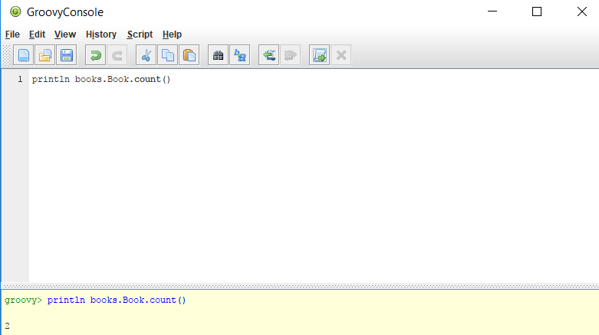
Core (cont.)
Grails automatically endows domains with certain methods.
We can check the size of all domain objects by using the count() method.

Slide 26
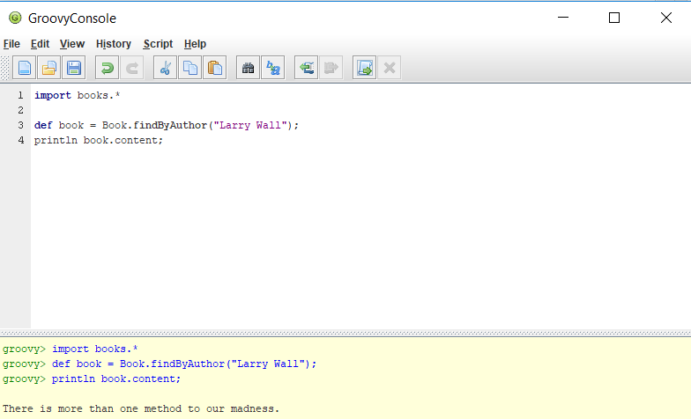
Core (cont.)
Grails introduces special query methods on the domain class called dynamic finders.

Slide 27
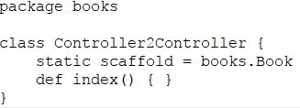
Core (cont.)
Grails offers a shortcut when creating CRUD pages called scaffoloding.
We need to add to controller the statement: static scaffold = <FULL_DOMAIN_CLASS_NAME>

Slide 28

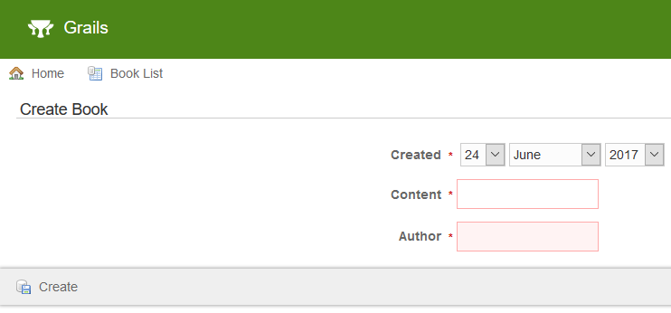
Core (cont.)

Slide 29
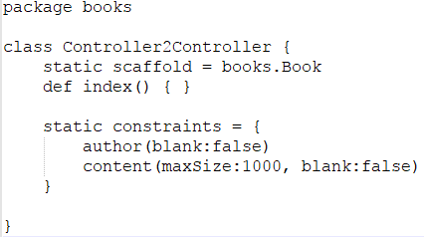
Core (cont.)
We can enforce the domain saving by using the constraints closure.
The constraints tell Grails that neither author nor content can be blank.

Slide 30
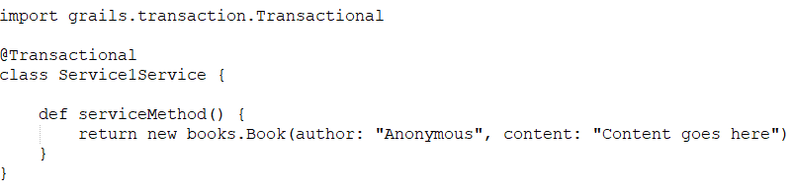
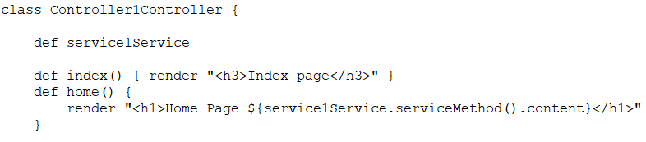
Core (cont.)
We can reuse logic in different controller actions and event across controllers using services.
We can create services in Grails using the command: grails create-service <SERVICE_NAME>
We inject the service into controllers by name convention.

Slide 31
Core (cont.)
@Transactional annotation is new to Grails 2.3.
In earlier versions, services were transactional by default.
Testing is a core part of today’s agile approach to development, and Grails’s support for testing is wired right into the framework.
Grails tests are written in a testing framework called Spock.
Versions of Grails prior to 2.3 created standard JUnit tests rather than Spock ones.

Slide 32
Core (cont.)
The Grails testing framework uses Groovy Mixins at runtime to decorate the test class.
@TestFor tells Grails to automatically inject a service object to the test scope that points to an instance of a real service object.
To run the test we run the command: grails test-app <SPEC_NAME>.
If we omit the test name the command will run all the tests.

Slide 33
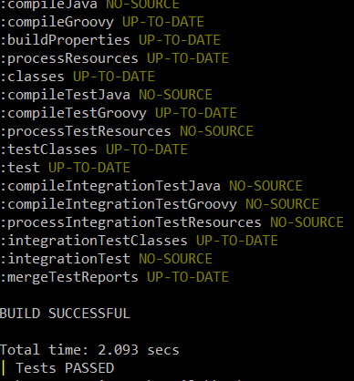
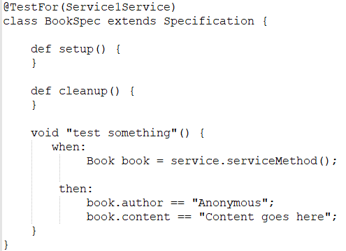
Core (cont.)
We run the command grails test-app books.BookSpec to build the test reports.

Slide 34
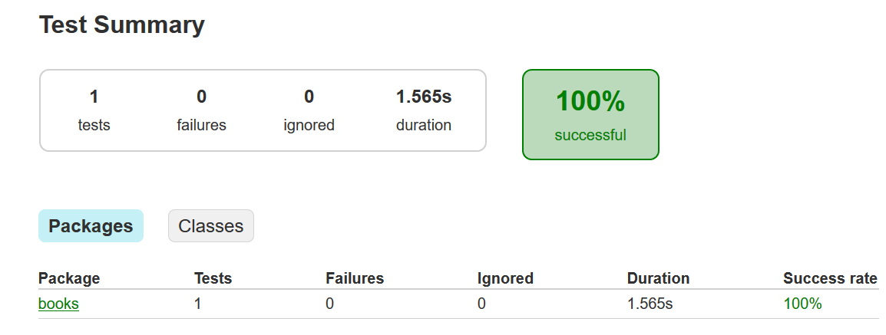
Core (cont.)
The test report shows all tests.

Slide 35
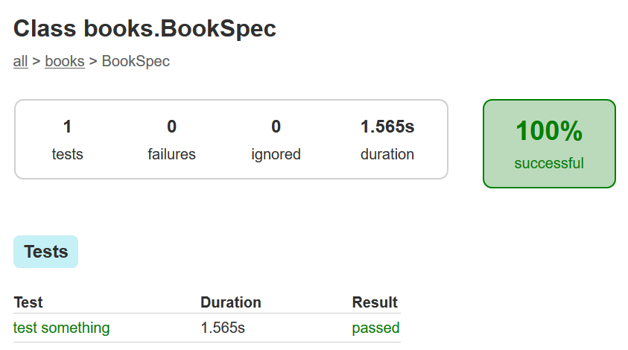
Core (cont.)
We can select a specific test to check the test report

Slide 36
GORM
GORM stands for Grails Object Relational Mapping.
Any time we save, retrieve or relate any of the domain class instances we are using GORM.
GORM removes the need for much of the boilerplate.
Grails uses Groovy's metaprogramming capabilities to synthesize finders for domain class properties at runtime.

Slide 37
GORM (cont.)
We can call methods that begin with findBy, findAllBy or countBy followed by up to 2 properties.
Properties in dynamic finders can be joined by And or Or.
Operators that can be used: LessThan, Between, IsNotNull, Like.

Slide 38
GORM (cont.)
Domain objects can be deleted from DB using delete() method.
We can use the flush:true option if we want the delete operation to be performed immediately.
We can check the existence of any domain instance with the exists() method.

Slide 39
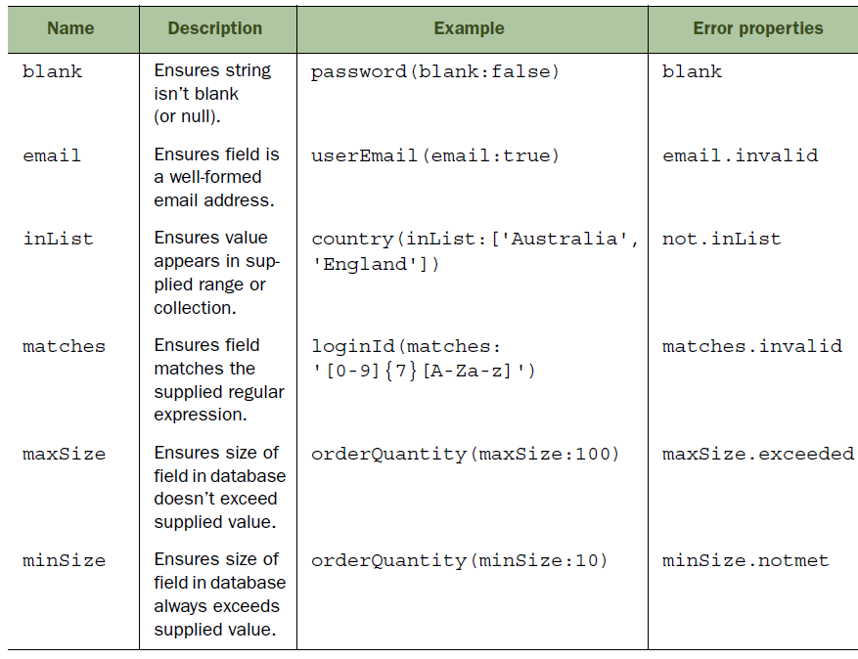
GORM (cont.)
Before saving a domain object we can validate it using validate() method.
Once the user is in a valid state, save() returns the saved object.
Grails comes with validators out of the box.

Slide 40
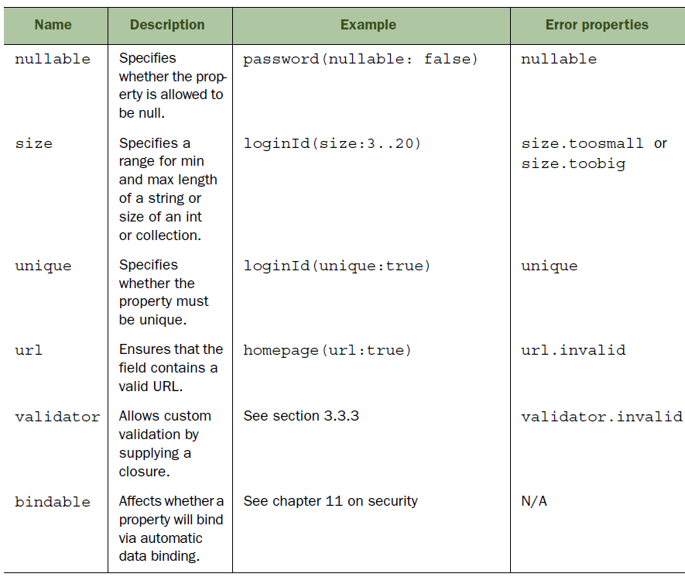
GORM (cont.)

Slide 41
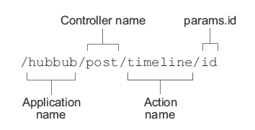
Application Flow
Grails exposes controller actions as URLs using conventions.
Grails translates controller action names into URLs as:

Slide 42
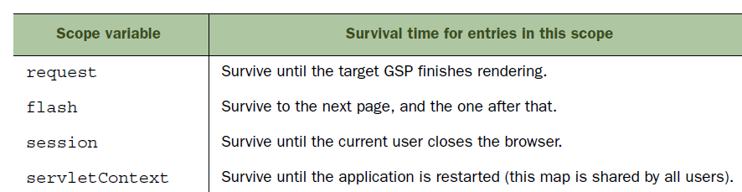
Application Flow (cont.)
Controller actions can return a map that gets passed through to the view.
The passing of the information and the lifetime of the variables that we pass is known as variable scope.
Grails supports different scoped to store information.
When we pass data from controller to a view we implicitly use request scope.

Slide 43
Application Flow (cont.)
In summary we use scopes for:
Request scope: for rendering in the view
Flash scope: for surviving a redirect
Session scope: for long-lived user-specific data
Application scope: for long-lived application-specific data

Slide 44
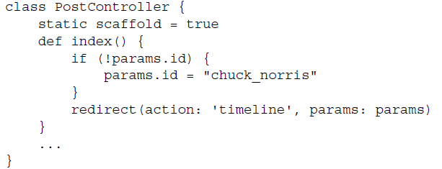
Application Flow (cont.)
Grails supplies a default index action for each controller that we implement.
When the user accesses the controller without specifying an action name the index action is called.

Slide 45
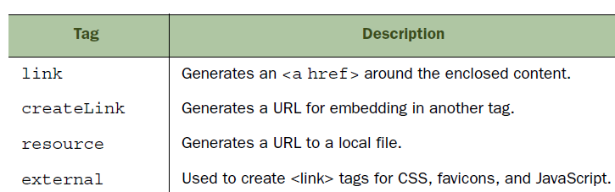
Forms
Grails provides useful GSP tags.
For conditional decision: <g:if />, <g:else />.
For iterating collections or arrays: <g:each />.
To create link we use: <g:link />.

Slide 46
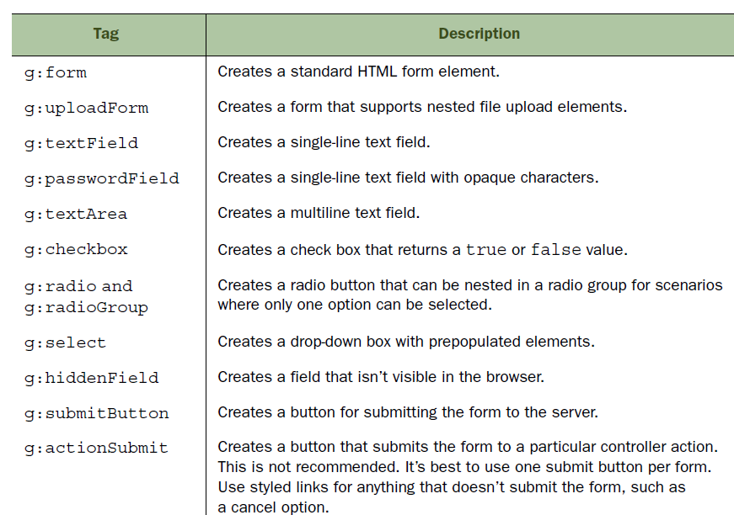
Forms (cont.)

Slide 47
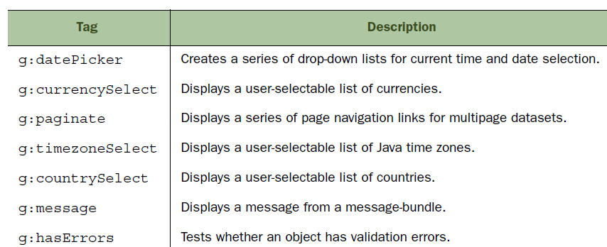
Forms (cont.)
Less common UI related form tags:

Slide 48
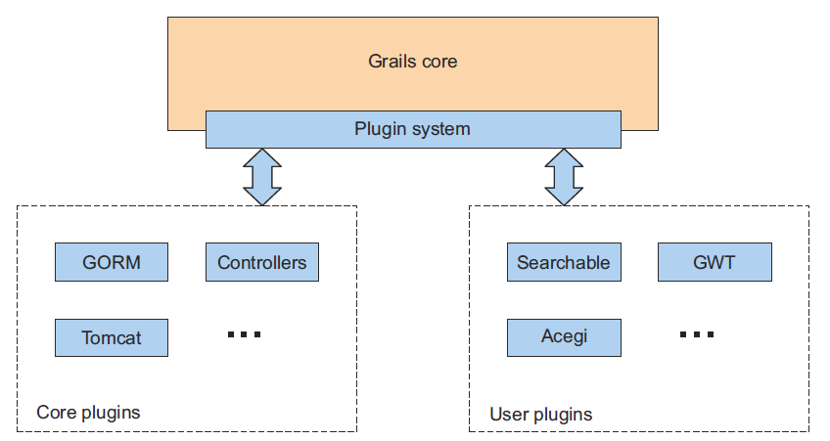
Plugins
Many of the Grails feature are implemented as plugins, including GORM.

Slide 49
Plugins (cont.)
The 2 main sources of plugins are Grails Central Plugin Repository and Grails website.
We can list grails plugins using the command: grails list-plugins.
We can obtain extra information about the plugin using the command: grails plugin-info <PLUGIN_NAME>.
We can install plugins using the command: grails install-plugin <PLUGIN_NAME>.

Slide 50
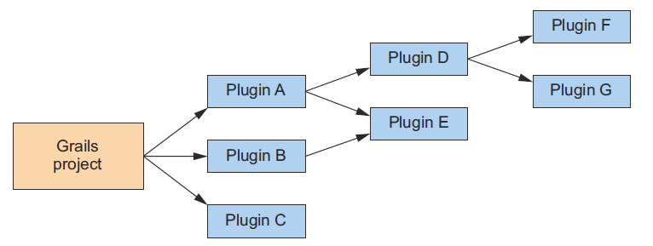
Plugins (cont.)
Some of the plugins can depend from other plugins.

Slide 51
Conclusion
Grails provides rapid devolpment of java applications.

Slide 52

Bibliography
https://en.wikipedia.org/wiki/Grails_(framework)
http://www.tothenew.com/blog/my-top-9-features-from-grails-2-0/
Manning – Grails in Action 2nd edition
Apress – The definitive guide to Grails 2
Grails a quick start guide

Slide 53
Questions ?

