Slide 1

Groovy
Dima Ionut Daniel

Slide 2
Contents
What is Groovy ?
History
Features
Why use Groovy ?
Architecture
Core
Operator Overloading
Data Type
Classes
Gpath
Control Structures
Clojure
Frameworks
GDK
Conclussion
Bibliography

Slide 3

What is Groovy ?
Apache Groovy is an object oriented programming language for Java platform.
It's a dynamic language with features similar to those of Python, Ruby, Perl, and Smalltalk.
It's dynamically compiled to JVM bytecode, and interoperates with other Java code and libraries.

Slide 4
History
James Strachan first talked about the development of Groovy on his blog in August 2003.
After the Java Community Process (JCP) standardization effort began, the version numbering changed and a version called "1.0" was released on January 2, 2007.
In March 2004, Groovy had been submitted to the JCP as JSR 241.
On July 2, 2012, Groovy 2.0 was released, which, among other new features, added static compiling and static type checking.
Groovy graduated from Apache's incubator and became a top-level project in November 2015.

Slide 5
Features
Most valid Java files are also valid Groovy files.
Groovy code can be more compact, because it does not need all the elements that Java needs.
Unlike Java, a Groovy source code file can be executed as an (uncompiled) script if it contains code outside any class definition.

Slide 6
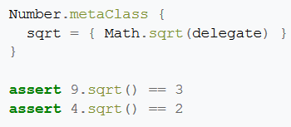
Features (cont.)
GroovyBeans are Groovy's version of JavaBeans and implicitly they have getters and setters.
From Groovy 2, it offers support for prototype extension through ExpandoMetaClass, Extension Modules.
ExpandoMetaClass offers a domain-specific language (DSL) to express the changes in the class easily.

Slide 7
Features (cont.)
Although Groovy is mostly an object-oriented language, it also offers functional programming features.
Closures in Groovy work similar to a 'method pointer', enabling code to be written and run in a later point in time.

Slide 8
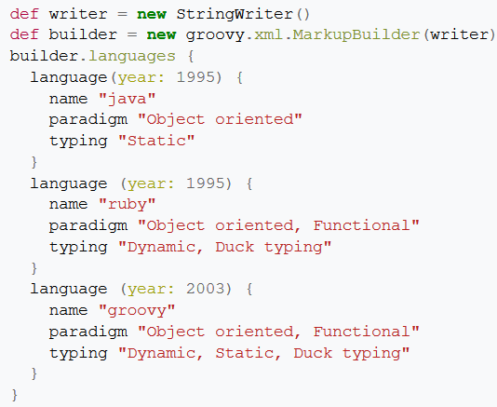
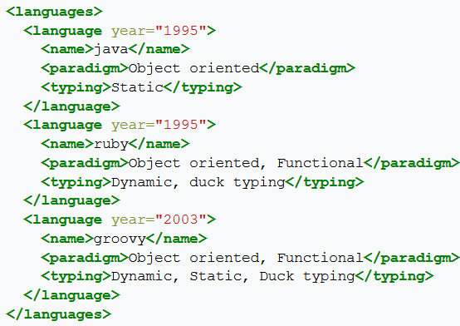
Features (cont.)
On XML and JavaScript Object Notation (JSON) processing Groovy employs the Builder pattern.
The sample xml can be generated via the bellow Groovy code.

Slide 9


Features (cont.)
In Groovy, the string can be interpolated with variables and expressions by using GStrings.
GStrings containing variables and expressions must be declared using double quotes.
A complex expression must be enclosed in curly brackets.

Slide 10
Features (cont.)
Abstract syntax tree transformation
When the Groovy compiler compiles Groovy scripts and classes, at some point in the process, the source code will end up being represented in memory in the form of a Concrete Syntax Tree, then transformed into an Abstract Syntax Tree.

Slide 11
Features (cont.)
Traits are a structural construct of the language which allow: composition of behaviors, runtime implementation of interfaces, behavior overriding, and compatibility with static type checking/compilation.
Traits can be seen as interfaces carrying both default implementations and state.

Slide 12
Why use Groovy ?
Groovy focus on simplicity and ease of use as its leading principle.
The enhancements of Groovy compared to Java can be classified as:
Groovy language features
Groovy specific libraries
Additional methods to existing Java classes by the Groovy Developer Kit, this is commonly known as the Groovy JDK.

Slide 13
Why use Groovy ? (cont.)
Simplification
Groovy does not require semicolons at the end of statements.
The return keyword can be left out, by default Groovy returns the last expression of the method.
Top level parentheses can be left out, the public keyword can be left out, it is the default in Groovy.
It also allows optional typing.

Slide 14
Why use Groovy ? (cont.)
Flexibility
Groovy allows to change classes and methods at runtime.
If a method is called which does not exist on a class, the class can intercept this call and react to it.
This allows for example that Groovy provides a very flexible builder pattern.

Slide 15
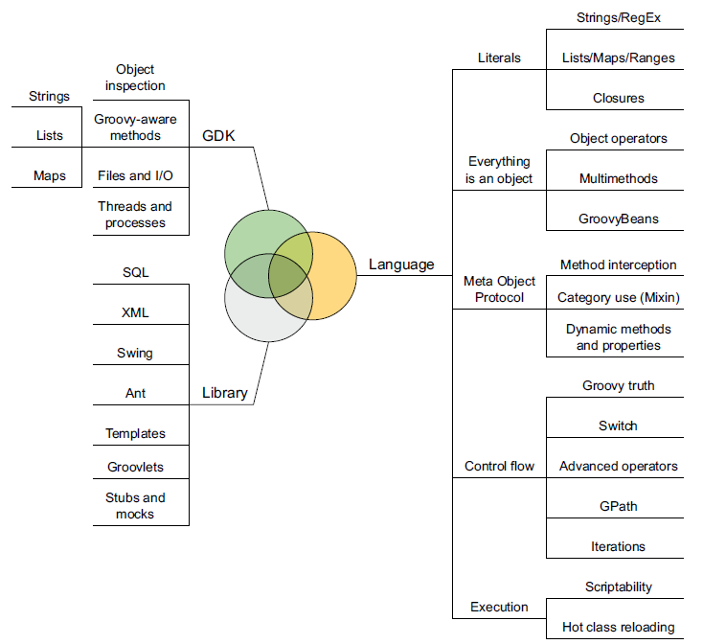
Architecture

Slide 16
Core
A Groovy source files ends with the .groovy extension.
This file can contain a Groovy script or a Groovy class.
Groovy scripts are converted at compile time to a class which extends the groovy.lang.Script class.

Slide 17
Core (cont.)
Groovy automatically imports the following packages and classes which can be used in Groovy without specifying the package name.
groovy.lang.*
groovy.util.*
java.lang.*
java.util.*
java.net.*
java.io.*
java.math.BigInteger
java.math.BigDecimal

Slide 18
Core (cont.)
We can execute a Groovy class or script from:
The Groovy shell: groovysh
The Groovy interpreter: groovy
The Groovy Console : groovyConsole
Complile Groovy code to classfiles and run it via the Java virtual machine

Slide 19
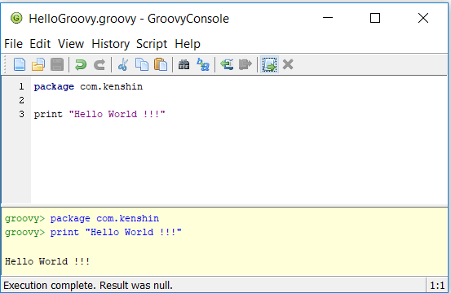
Core (cont.)
The console allows to test Groovy code.

Slide 20
Core (cont.)
Compiling Groovy is straightforward because it comes with a compiler called groovyc.
The groovyc compiler generates at least one class file for each Groovy source file compiled.
The name of the compiled class matches the name of the script being compiled.
Groovy comes with a groovyc Ant task that works pretty much like the javac task.

Slide 21
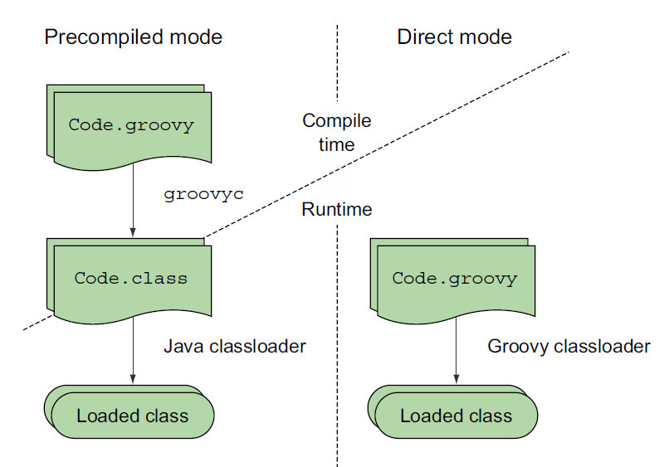
Core (cont.)
Groovy enhances Java at the source-code level but stays compatible at the bytecode level.

Slide 22
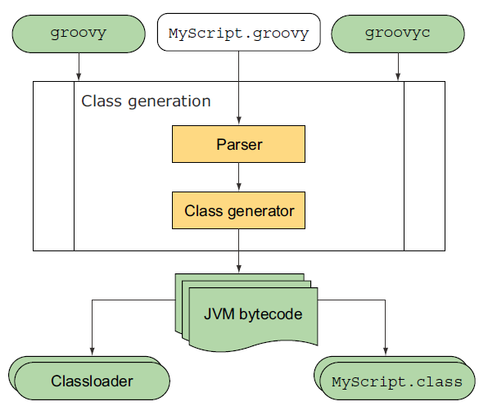
Core (cont.)
Groovy syntax is line-oriented, but the execution of Groovy code is not.
Groovy code is fully parsed, and a class is generated from the information that the parser has built.
The generated class is the binding device between Groovy and Java, and Groovy classes are generated such that their format is identical to Java bytecode.

Slide 23
Core (cont.)
One difference between Java and Groovy is that the == operator will check for equality and not for identity.
Java checks if both variables points to the same object while Groovy checks if both variables are equals.
To check for identify you can use in Groovy the is() method.

Slide 24
Core (cont.)
Groovy supports the syntax of generics but does not enforce it.
We can put any type into a List<Integer> collection.
To enforce type checking in Groovy we can use AST transformations.

Slide 25
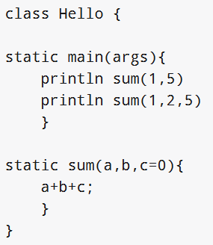
Core (cont.)
Groovy allows to have optional parameter values.
Optional parameter values are indicated by = 0.

Slide 26
Core (cont.)
Single-line comments and multiline comments are exactly like those in Java.
Most Groovy code appears exactly as it would in Java.
In Groovy we can define and use annotations just like in Java.
Immutable types are always helpful for a clean design.
The @Immutable annotation is only one of many that can enhance the code with additional characteristics.

Slide 27
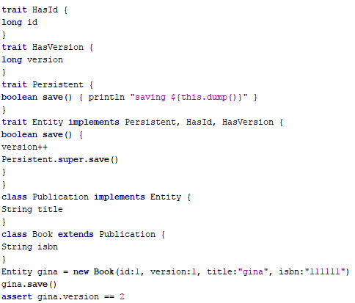
Core (cont.)
Groovy traits support composition of capabilities.
Capabilities that are designed to be shared are implemented in traits.
The classes can implement those traits to indicate that they provide that capability.

Slide 28
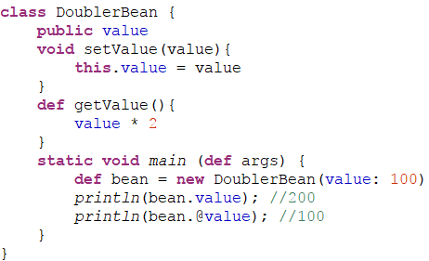
Core (cont.)
We can access directly the fields instead of using accessors using the .@(dot-at) operator.

Slide 29
Operator Overloading (cont.)
Operator overloading
Groovy supports that you can use the standard operations in your own classes.
If we want to use the operation a+b where a and b are from class Z then you have to implement the method plus(Zname) in class Z

Slide 30
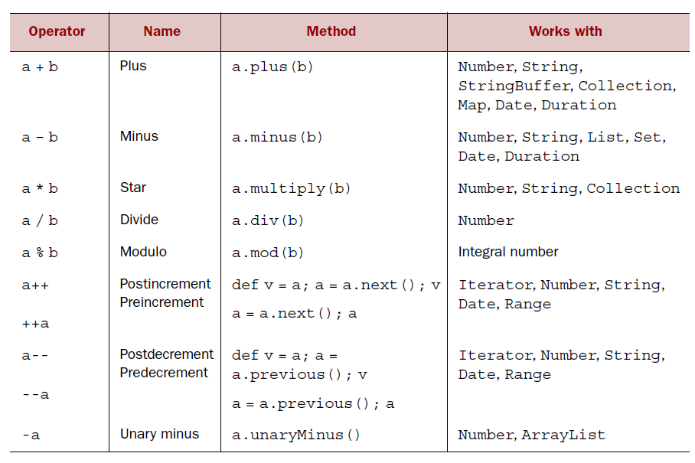
Operator Overloading (cont.)

Slide 31
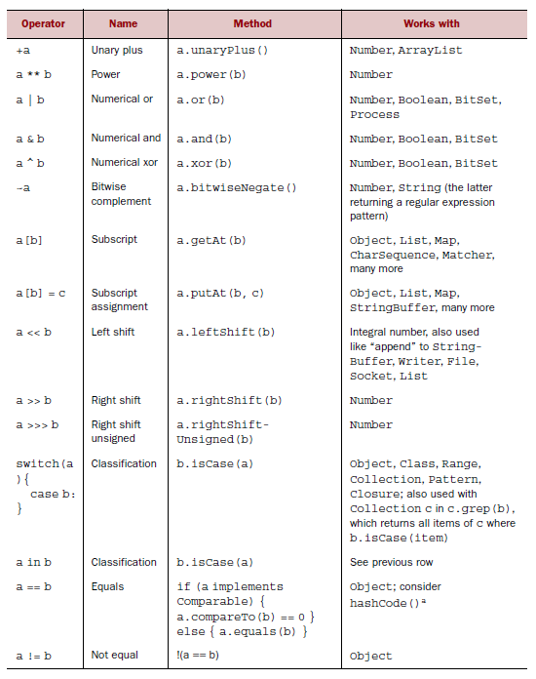
Operator Overloading (cont.)

Slide 32
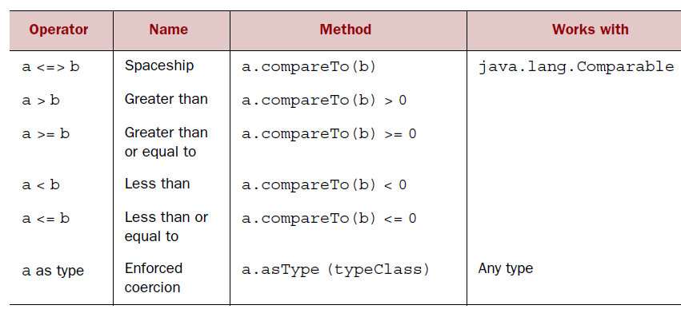
Operator Overloading (cont.)

Slide 33
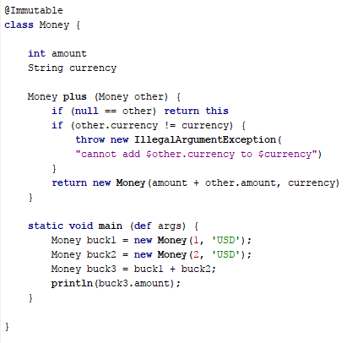
Operator Overloading (cont.)
Operator overloading example bellow:

Slide 34

Operator Overloading (cont.)
We can provide the additional method for different data types.
It overloads the plus method with a second implementation that takes an Integer parameter.
The plus operation on the Money class returns Money objects in both cases.

Slide 35
Data Type
Variables and fields can be typed as in Java or your can use the def keyword to define a variable.
At runtime variables and fields are always typed, Groovy infers the type based on your source code.
It means that at runtime we receive an error if we try to assign a non fitting type to a variable.

Slide 36
Data Type (cont.)
All variables in Groovy are objects (reference variables), Groovy does not use primitive variables.
Groovy allows to use the primitives types as a short form for the variable declaration but the compiler translates this into the object.

Slide 37
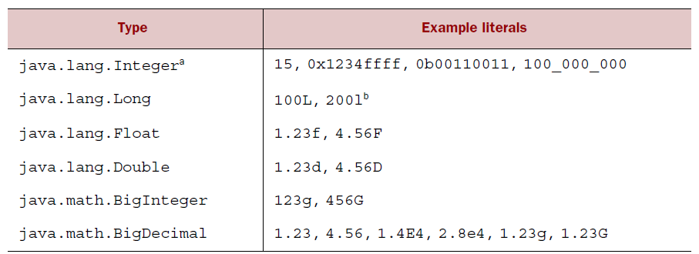
Data Type (cont.)
Numeric literals in Groovy

Slide 38
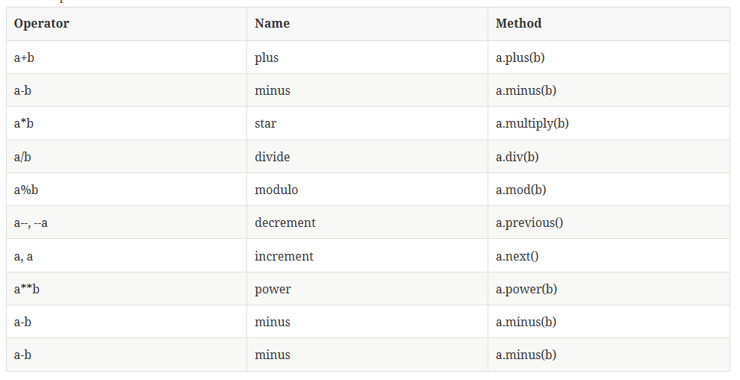
Data Type (cont.)
Numbers are objects in Groovy, as well as variables defined as int, float, double, etc.

Slide 39
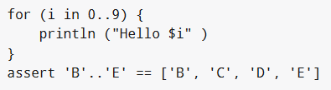
Data Type (cont.)
Groovy supports the Range data type is a Collection.
Ranges consists of 2 values separated by two dots.

Slide 40
Data Type (cont.)
We can define lists via List list = new List[].
We can also use generics.
To access element i in a list you can either use list.get(i) or list[i].

Slide 41
Data Type (cont.)
We can search in a list:
findAll{closure} - returns all list elements for which the closure validates to true
find{closure} - returns the list element for which the closure validates to true
grep(Object filter) - iterates over the collection of items and returns each item that matches the given filter. This method can be used with different kinds of filters like regular expressions, classes, ranges etc.

Slide 42
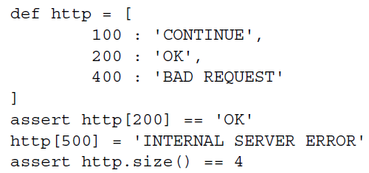
Data Type (cont.)
A map is a storage type that associates a key with a value.
Maps store and retrieve values by key; lists retrieve them by numeric index.

Slide 43
Data Type (cont.)
We can use the following methods:
findAll(closure) - Finds all entries satisfying the condition defined by the closure
find(closure) - Find the first entry satisfying the condition defined by the closure
collect(closure) - Returns a list based on the map with the values returned by the closure
submap('key1', 'key2', ) - returns a map based on the entries of the listed keys

Slide 44
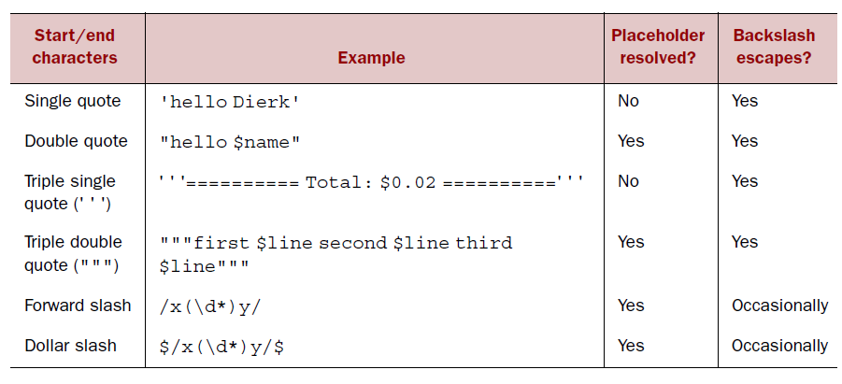
Data Type (cont.)
Groovy strings come in two flavors: plain strings and GStrings.
Plain strings are instances of java.lang.String, and GStrings are instances of groovy.lang.GString.
GStrings allow placeholder expressions to be resolved and evaluated at runtime.
Many scripting languages have a similar feature, usually called string interpolation.

Slide 45
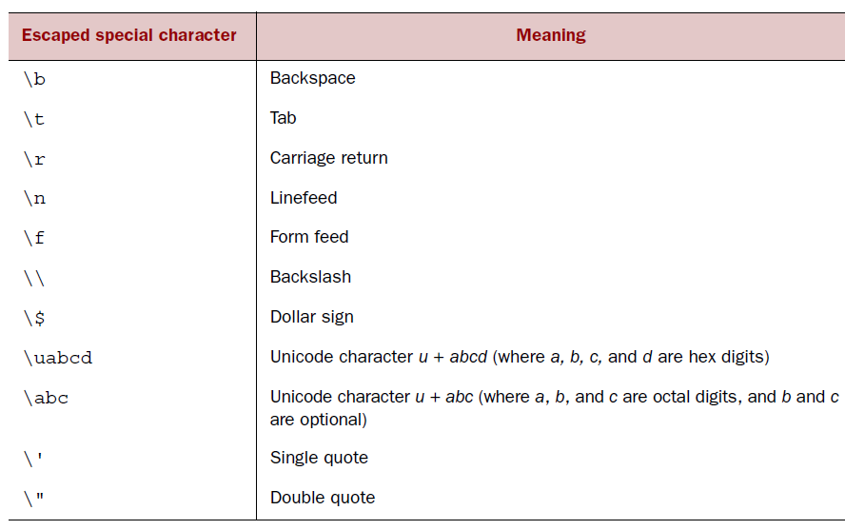
Data Type (cont.)
Escaped characters are shown bellow:

Slide 46
Data Type (cont.)
GStrings are like strings with additional capabilities.
They are literally declared in double quotes.
Placeholders can appear in a full ${expression} syntax or an abbreviated $reference syntax.
Each placeholder inside a GString is evaluated at declaration time and the result is stored in the GString object.

Slide 47
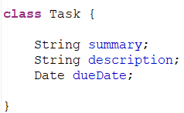
Classes
A Groovy class is defined with the class keyword, similar to Java.
All Groovy classes and methods are by default public.

Slide 48
Classes (cont.)
In Groovy all fields of a class have by default the private access modifier.
Groovy creates automatically getter and setter methods for the fields.
If we annotate the class or a property with the @Bindable annotation, Groovy also adds PropertyChangeSupport to the class or property.
Such a Groovy classes fits to the Java beans specification.

Slide 49
Classes (cont.)
Groovy objects are frequently referred to as Plain Old Groovy Objects (POGO).
Groovy uses the getter or setter method, even if we directly use the name of the field.
If a field should not be changeable define it as final, in this case Groovy will not provide a setter.

Slide 50
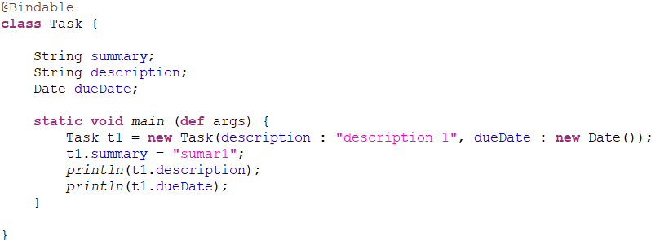
Classes (cont.)
Groovy provides constructors with named parameters.
The constructor is called map based constructor and uses the property:value map syntax.

Slide 51
GPath
GPath is a path expression language integrated into Groovy which allows parts of nested structured data to be identified.
It has similar aims and scope as XPath does for XML.
GPath navigation works also in complex structures like XML or JSON.

Slide 52
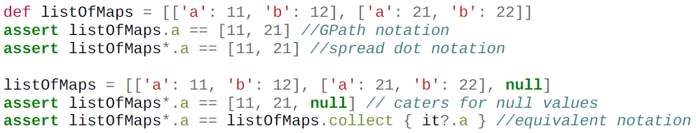
GPath (cont.)
Groovy provides syntactic sugar making it really easy to deal with nested collections.

Slide 53
Control structures
Groovy evaluates a condition defined in a control statement differently from Java.
A pure boolean expression is evaluated the same as in Java.
The number "0" evaluates to false and other numbers evaluate to true.
Empty collections or null evaluate to false.
Every other non-null object evaluates to true.

Slide 54
Control structures (cont.)
The switch statement is very flexible, everything which implements the isCase method can be used as classifier.
Groovy provides an implementation of the isCase() method to Class (using isInstance), Object (using (equals), Collections (using contains) and regular expressions (using matches).

Slide 55

Control structures (cont.)
We can use safe navigation operator to check safety for null via the ?. operator.
This will avoid a NullPointerException if we access properties of an object which is null.

Slide 56
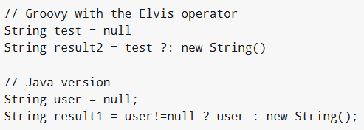
Control structures (cont.)
The ?: (called the Elvis operator) is a short form for the Java ternary operator.
We can use this to set a default if an expression resolves to false or null.

Slide 57
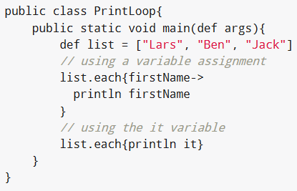
Control structures (cont.)
Groovy supports the standard Java for, the for-each and the while loop.
Groovy doesn't support the do while loop.
While for and while loops are supported the Groovy way of iterating throw a list is using the each() method.
Groovy provides this method on several objects include lists, maps and ranges.

Slide 58
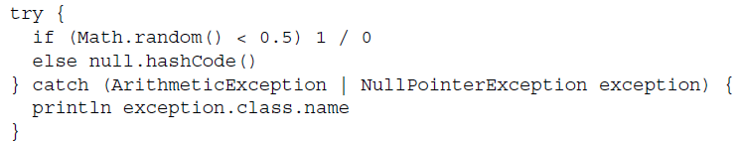
Control structures (cont.)
Exception handling in Groovy is similar to Java and follows the same logic.
We can specify a complete try-catch-finally sequence of blocks, or just try catch, or just try-finally.
Java 7 introduced a multi-catch syntax which Groovy also supports it.

Slide 59
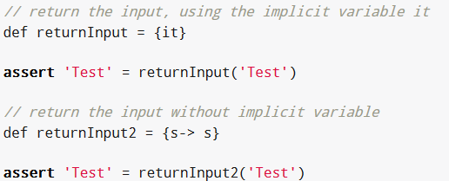
Clojure
Closures are code fragments or code blocks which can be used without being a method or a class.
A closure in Groovy is defined via the following construct: {list of parameters→ closure body}.
The values before the → sign define the parameters of the closure.
For the case that only one parameter is used you can use the implicit defined it variable.

Slide 60
Clojure
A closure is a piece of code wrapped up as an object.
It acts like a method in that it can take parameters and return a value.
Groovy provides a very easy way of creating closure objects.

Slide 61
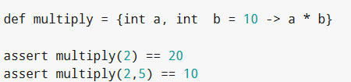
Clojure (cont.)
We can define closures with default values for its parameters.

Slide 62
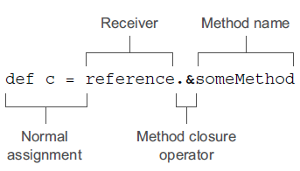
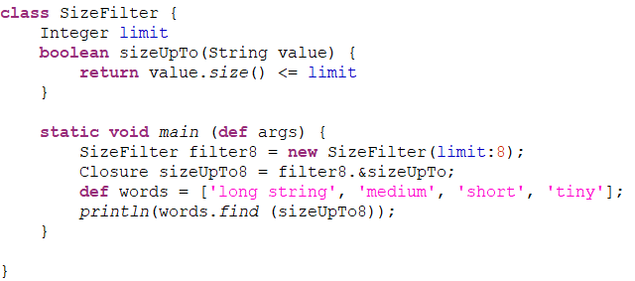
Clojure (cont.)
We can declare a closure by reusing already declared methods.

Slide 63
Frameworks
Web and UI Frameworks
Grails: Web-framework inspired by Ruby-on-Rails; has at least 800 plugins.
Griffon: Swing UI, command-line very similar to grails: create-app cool -archetype=jumpstart
vert.x: A framework for asynchronous application development.
Ratpack: A toolkit for web applications on the JVM and RESTful web-services (microservices).

Slide 64
Frameworks (cont.)
Build Frameworks
Gradle: a Groovy DSL for building projects. Uses build.gradle.
Gant: Like Ant in Groovy. Born in 2006; now in maintenance mode. Was used by Grails & Griffon.

Slide 65
Frameworks (cont.)
Concurrency
GPars: a multi-threading framework for Groovy. It has a fork/join abstraction, actors, STM, and more (it actually comes bundled with Groovy).
RxGroovy: a Groovy adapter to RxJava - a library for composing asynchronous and event-based programs using observable sequences for the JVM.

Slide 66
Frameworks (cont.)
Testing Frameworks/Code Analysis
Easyb: BDD - behavior driven development, human readable.
Spock: DSL testing framework. Around since 2007. Uses strings as method names.
Codenarc: Static code analysis for Groovy. Around since 2009. Has plugins for Grails and Griffon.

Slide 67
Frameworks (cont.)
Cloud Computing Frameworks
Gaelyk: An abstraction over GAE (Google App Engine); has an emerging plugin system.
Caelyf: Born in 2011, Apache 2 licensed framework for CloudFoundry; similar to gaelyk.

Slide 68
Frameworks (cont.)
Others
gvm: The Groovy enVironment Manager (GVM); now SDKMAN (The Software Development Kit Manager), very cool. Allows you to manage multiple versions of several Groovy and non-Groovy applications including Groovy itself.
lazybones: A simple project creation tool that uses packaged project templates. This can be installed using gvm/sdkman.

Slide 69
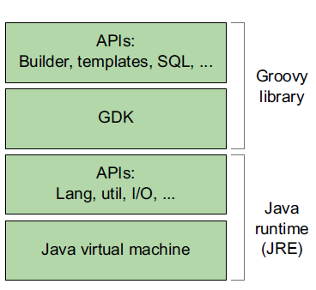
GDK
Groovy extends this foundation by providing an extension to the core Java classes, called the GDK.
The GDK includes some new classes and utility libraries.

Slide 70
GDK (cont.)
Groovy adds two more methods to Object class:
dump: returns a description of the object’s state, namely its fields and their values.
inspect: makes a best effort to return the object as it could appear in Groovy source code, with lists and maps in the format of their literal declaration. If it cannot do better, it falls back to toString.

Slide 71
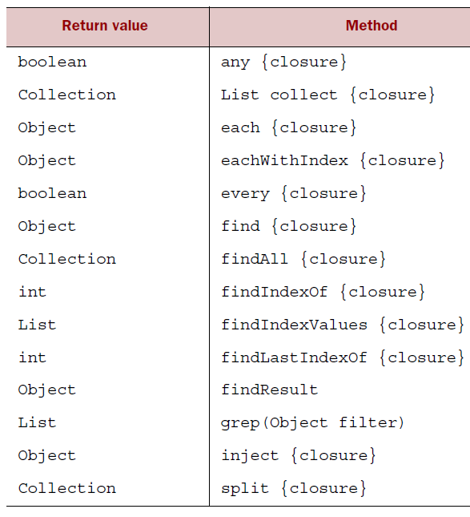
GDK (cont.)
Iterative Object methods.

Slide 72
GDK (cont.)
Many scripts uses files and other sources of data from remote systems.
The JDK addresses this need with its java.io and java.net packages.
GDK provides numerous methods for working with I/O.

Slide 73
GDK (cont.)
Groovy feature for multithreading support is that Closure implements Runnable.
This allows simple thread definitions like:
t = new Thread() { /* Closure body */ }
t.start();
This can even be simplified with two new static methods on the Thread class:
Thread.start { /* Closure body */ }

Slide 74
GDK (cont.)
Groovy can work with templates.
A template is essentially text.
Templates are used for:
Organizing database queries
Helping to connect to web services
Generating code
Transforming XML
Predefining PostScript documents
Standard emails

Slide 75
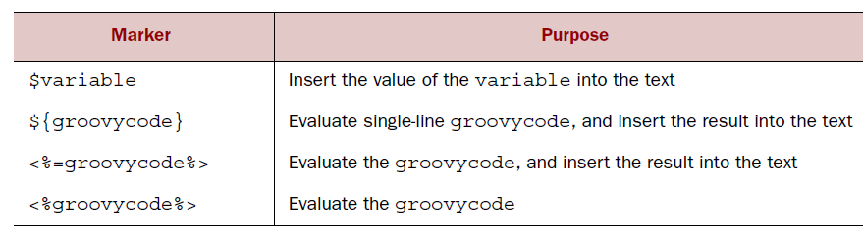
GDK (cont.)
The format of templates is insipired by the JSP syntax, the JSP Expression Language(EL), the Velocity framework and GStrings.

Slide 76
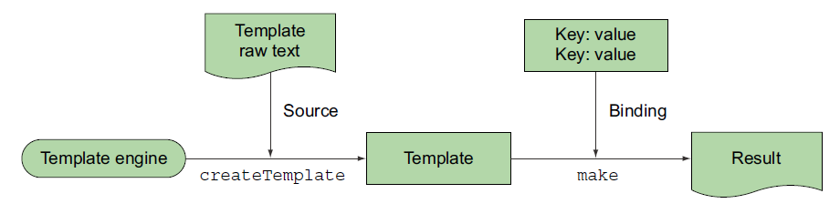
GDK (cont.)
Template object can make a final text by replacing all the placeholders with their respective values.

Slide 77
GDK (cont.)
Groovlets are to Groovy what servlets are to to Java: a basic standardized way of writing web applications.
The pure use of Groovlets is good for small and simple applications, whereas more demanding applications benefit from frameworks such as Grails or Ratpack .

Slide 78
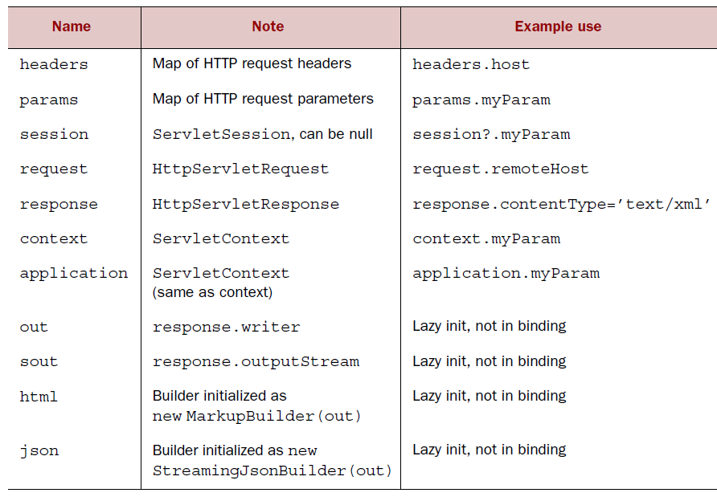
GDK (cont.)

Slide 79
Conclusion
Apache Groovy is a language very easy to learn, especially for the Java developer.
Groovy blends different programming paradigms elegantly: functional programming, dynamic programming, object orientation, or even imperative.

Slide 80

Bibliography
https://en.wikipedia.org/wiki/Groovy_(programming_language)
http://www.vogella.com/tutorials/Groovy/article.html
Manning – Groovy in Action
LeanPub - Learning Groovy

Slide 81
Questions ?

