Slide 1

IPSec
Dima Ionut Daniel

Slide 2
Contents
What is IPSec?
Architecture
ESP
AH
IKE
IPSec Implementations
IPSec Modes
Security Associations
SA Parameters
Policy
Bibliography

Slide 3

What is IPSec ?
IPSec provides a standard, robust and extensible mechanism in which to provide security to IP and upper-layer protocols (eg: UDP/TCP).
IPSec protects IP datagrams by defining a method of specifying the traffic to protect, how that traffic is to protected and whom the traffic is sent.
IPSec can protect packets between hosts, between network security gateways(eg: routers, firewalls), or between hosts and security gateways.
The method of protecting IP datagrams or upper-layer protocols is by one of the IPSec protocols:
Encapsulating Security Payload (ESP)
Authentication Header (AH)

Slide 4
What is IPSec ? (cont.)
AH provides proof-of-data origin on received packets, data integrity and antireplay protection.
ESP provides all that AH provides in addition to optional data confidentiality.
A difference between the 2 is the scope of coverage of authentication.
The security services that IPSec provides requires shard keys to perform authentication and/or confidentiality.
A mechanism to manually add keys for these services is mandatory to implement.

Slide 5
What is IPSec ? (cont.)
Manual key addition scales poorly so a standard method of dynamically authenticating IPSec peers, negotiating security services and generating shared keys is defined which is called IKE(Internet Key Exchange).
The shared keys used with IPSec are using symmetric cipher(for confidentiality) or keyed MAC(for data integrity) or both.
IPSec must be fast and existing public key technologies(like RSA, DSS) are to slow to operate on a packet-by-packet basis.
Presently the public key is limited to initial authentication during key exchange.

Slide 6
Architecture
The architecture document for IPSec defines the base architecture upn which all implementation are built.
It defines the security services provided by IPSec, how packets are constructed/processed.
Transport mode is used to protect upper-layer protocols.
Tunnel mode is used to protect entire IP datagrams.

Slide 7
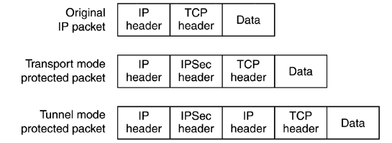
Architecture (cont.)
In transport mode, an IPSec header is inserted between the IP header and the upper-layer protocol header;
In tunnel mode the entire IP packet to be protected is encapsulated in another IP datagram and an IPSec header is inserted between the outer and inner IP headers.
Both IPSec protocols, AH and ESP, can operate in either transport mode or tunnel mode.

Slide 8
Architecture (cont.)
IPSec may be implemented in end systems or on security gateways such as routers and firewalls.
This is done by directly modifying the IP stack to support IPSec natively.
When access to the IP stack of a machine it's not possible, IPSec may be implemented as a "Bump in the Stack" (BITS) or "Bump in the Wire" (BITW).
BITS extracts and inserts packets from the IP stack.
BITW is an external dedicated crypto device that may be independently addressable.

Slide 9
Architecture (cont.)
To properly process IPSec packets it's necessary to have a way to associate security services and a key with the traffic to be protected and the remote peer with whom IPSec
traffic is being exchanged.
This is called a "security association"(SA). An SA contains the state necessary to do IPSec procesing on an IP packet.
An IPSec SA is unidirecitonal.

Slide 10
Architecture (cont.)
SAs are identified by a SPI(Security Parameter Index) which exists in IPSec protocol headers, the IPSec protocol value(AH or ESP) and the destination address to which the SA applies.
SAs exists in pairs, one in each direction and can be created manually or dynamically.
SAs reside in the Security Association Databases(SADB).
When created manually, an SA has no lifetime as it exists until it's deleted manually.
When created dynamically, an SA may have a lifetime associated with it, negotiated between the IPSec peers by the key management protocol.

Slide 11
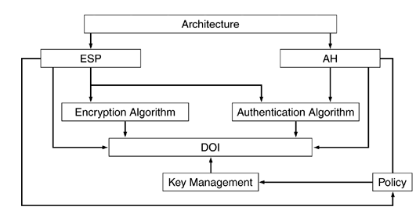
Architecture (cont.)
The IPSec protocols include AH, ESP, IKE, ISAKMP/Oakley, and transforms.

Slide 12
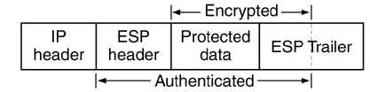
ESP
Encapsulating Security Payload(ESP) provides confidentiality, data integrity and data
source authentication of IP packets and protection against replay attacks.
It inserts an ESP header after an IP header and before the data to be protected.
RFC2406 defines ESP.

Slide 13
ESP (core.)
Each ESP SA will have at most one cipher and one authenticator.
All encryption algorithms used with ESP must operate in cipher block chaining (CBC) mode.
CBC requires that the amount of data to encrypt be a multiple of the block size of the cipher.
Compliant implementations are required to support the Data Encryption Standard (DES).
Ciphers in CBC mode also require an initialization vector (IV) to jump-start the encryption process.

Slide 14
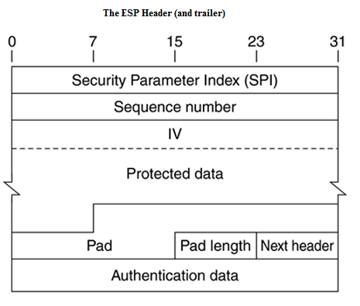
ESP (core.)

Slide 15
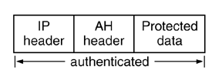
AH
Authentication Header (AH) provides data integrity, data source authentication,
and protection against replay attacks.
It doesn't provide confidentiality.
The AH header is much simpler than ESP.

Slide 16
AH (cont.)
Authentication Header (AH) provides data integrity, data source authentication, and protection against replay attacks.
It doesn't provide confidentiality.
The AH header is much simpler than ESP.

Slide 17
AH (cont.)
The AH header, like the ESP header contains an SPI to help locate the SA with which the packet is processed, a sequence number to provide against replay attacks and an authentication data field to contain the digest from the keyed MAC used to secure the packet.
The mandatory to implement keyed MACs for AH are HMAC-MD5, HMAC-SHA both truncated to 96 bits.
The RFC2403 for HMAC-MD5-96 and RFC2404 for HMAC-SHA-96 are used to define how to use these MACs with ESP and AH.

Slide 18
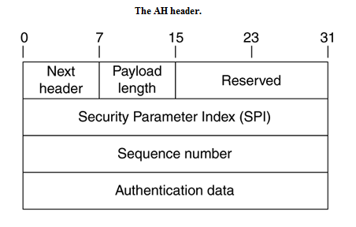
AH (cont.)
AH doesn't provide confidentiality using a symmetric cipher in CBC mode and there is no explicit padding
requirement.
The authentication coverage of AH differs from that of ESP.
AH authenticates the outer IP header of the IPSec packet.

Slide 19
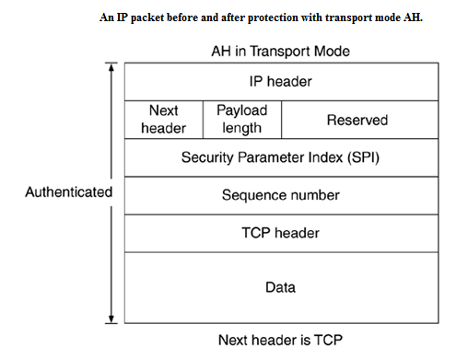
AH (cont.)

Slide 20
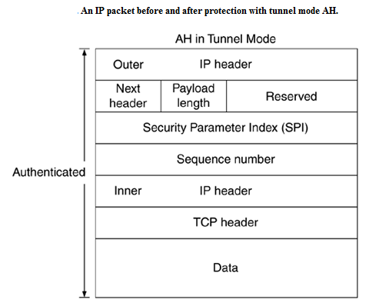
AH (cont.)

Slide 21
IKE
Security associations(SA) are used with IPSec to define the processing done on a specific IP packet.
If there is no SA that instantiates the policy from the SPD it's necessary to create one.
IKE establish the shares security parameters and authenticated keys.
The IKE protocol is a hybrid od the Oakley and SMEKE protocols and operates inside a framework defined by ISAMP(Internet Security Association and Key Management Protocol).

Slide 22
IKE (cont.)
Oakley and SKEME define the steps two peers must take to establish a shared, authenticated key.
IKE uses the ISAKMP language to express these and other exchanges.
The specification of what IKE is being used for is done in a Domain of Interpretation (DOI)
RFC2407 defines how IKE negotiates IPSec SAs.

Slide 23
IKE (cont.)
IKE uses the concept of a SA but the physical construct of an IKE SA is different than an IPSec SA.
The IKE SA defines the way in which the 2 peers communicate.
The IKE protocol is performed by each party that will be performing IPSec.
The IKE peer is also the IPSec peer.

Slide 24
IKE (cont.)
Implementation of a compliant IKE requires:
the base ISAKMP specification (RFC2408)
the Domain of Interpretation for IPSec (RFC2407)
IKE specification itself (RFC2409).

Slide 25
IPSec Implementations
IPSec can be implemented and deployed in the end hosts/gateways/routers or in both.
Host implementation:
provides security end to end
ability to implement all modes of IPSec security
provides security on a per flow basis
ability to maintain user context for authentication in establishing IPSec connects
Host implementation can be:
integrated with the OS
shim between the network and the data link layer of the protocol stack("Bump in the Stack").

Slide 26
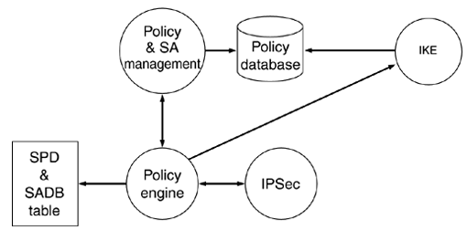
IPSec Implementations (cont.)
IPSec implementation architecture

Slide 27
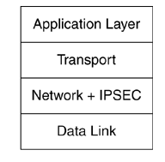
IPSec Implementations (cont.)
OS Integrated
In the host implementation IPSec can be integrated with the OS.
IPSec layer needs the services of the IP layer to construct the IP header.
This model is identical to the implementation of other network layer protocols such as ICMP.

Slide 28
IPSec Implementations (cont.)
Advantages of integrating IPSec with OS:
as IPSec is integrated into the network layer, it can be enable services such as fragmentation, PMTU, user context(sockets).
easy provision of security services.
all IPSec modes are supported.

Slide 29
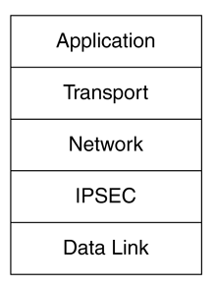
IPSec Implementations (cont.)
The OS integrated solution can limit capabilities to provide advanced solutions.
To overcome this limitation IPSec is implemented as a shim, inserted IPSec between Network and
Data Link: Bump in the Stack (BITS).

Slide 30
IPSec Implementations (cont.)
Duplicating functionality leads to undesired complications as it becomes more difficult to handle issues such as fragmentation, PMTU and routing.
BITS implementation provides capability to provide a complete solution.
Vendors providing integrated solutions such as firewalls may have their own client as the OS vendor and may not have all features requires to provide a complete solution.

Slide 31
IPSec Implementations (cont.)
The router implementation provides the ability to secure a packet over network.
Advantages:
secures packets between 2 networks over a public network.
authenticate and authorize users entering the private network.

Slide 32
IPSec Implementations (cont.)
There are 2 types of router implementation:
Native: IPSec is integrated with router software
Bump in the Wire (BITW): IPSec is implemented in a device that is attached to the physical interface of the router. The device is used to secure the packets.

Slide 33
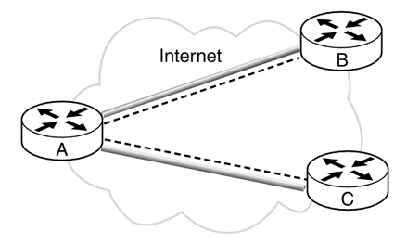
IPSec Implementations (cont.)
Native implementation deployment architecture

Slide 34
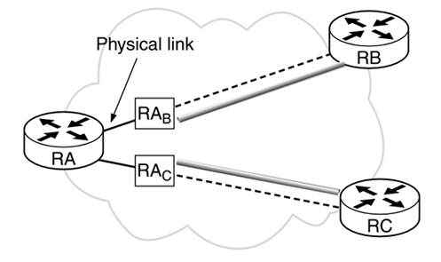
IPSec Implementations (cont.)
BITW deployment architecture

Slide 35
IPSec Modes
There are 4 possible combinations of modes and protocols:
AH in transport mode
AH in tunnel mode
ESP in transport mode
ESP in tunnel mode
The AH and ESP header doesn't change between tunnel or transport mode.

Slide 36
IPSec Modes (cont.)
In transport mode, AH and ESP protect the transport header.
When security isn't enabled, transport layer packets flow into the network layer, IP, which adds the IP header and calls into the data link layer.
When security in transport layer is enabled, the transport layer packets flow into the IPSec component.
The IPSec component is implemented as part of the network layer (when integrated with OS).
The IPSec component adds the AH, ESP, or both headers, and invokes the part of the network layer that adds the network layer header.

Slide 37
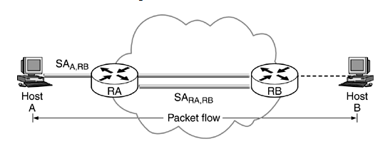
IPSec Modes (cont.)
IPSec in tunnel mode is normally used when the destination of the packet is different from the security termination point.
The tunnel mode is also used in cases when the security is provide by a device that did not originate packets as in the case of VPNs.
It's also used when a router provides security services for packets it is forwarding.

Slide 38

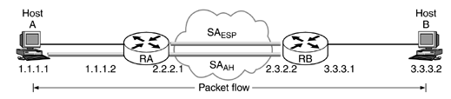
IPSec Modes (cont.)
An IPSec tunnel mode packet has 2 IP headers: inner and outer.
The inner header is constructed by the host and the outer header is added by the device that is providing the security services.
IPSec also supports nested tunnels.

Slide 39
Security Associations
SA form the basis for IPSec.
SA are the contract between 2 communicating entities.
SA determine the IPSec protocols used for securing the packets, transforms, keys and the duration for which the keys are valid.
An IPSec implementation always has a SA database(SADB) that maintains the SAs that the IPSec protocols use to secure the packets.

Slide 40
Security Associations (cont.)
When 2 hosts communicates securely using ESP there will be a SA having SAin and SAout.
There is an SA for each protocol.
Security Policy Database (SPD) works in conjunction with the SADB in processing packets.
The policy defines:
the security communications characteristics between 2 entities.
protocols to use in what modes and transforms.
how IP packets are treated.

Slide 41
Security Associations (cont.)
An SPI is a 32-bit entity that is used to uniquely identify an SA at the receiver.
The source identifies the SA by using the selectors.
To identify the SA on the destination, the SPI that uniquely identifies the SA on the destination is sent with every packet.
The destination uses the value to index into the receiving SADB and fetch the SA.
There is a requirement to maintain a separate SPI domain for each protocol.
IPSec specifies that the <spi, destination address> in the packet should uniquely identify an SA.

Slide 42
Security Associations (cont.)
The receiver allocates the SPI that is stored as part of the SA on the sender.
The sending host uses the selectors to uniquely index into the sending SADB.
The host that allocates the SPI guarantees uniqueness.
The SPI is reused once the SA expires but it is guaranteed that at any point the mapping between <spi, dst>, and SA is one to one.
The SPI is transmitted as part of AH and ESP headers.

Slide 43
Security Associations (cont.)
SA management consists in creation and deletion.
The management of SAs can be either manual or through an Internet standard key management protocol such as IKE.
The SA management requires an interface for the user applications (which includes IKE) to communicate with kernel to manage the SADB.

Slide 44
Security Associations (cont.)
The SA creation is a 2 step process negotiating the parameters of the SA and updating the SADB with the SA.
Manual keying is mandatory to support and it was used extensively during the initial development and testing of IPSec.
The process of allocating the SPI, negotiation of parameters is all manual.

Slide 45
Security Associations (cont.)
Once the SA are created they are alive until are deleted.
The SAs are created using IKE.
IKE negotiates the SA with the destination or intermediate host/router, depending on the policy, and creates the SA.
Once the SA is created and added to the SADB, secure packets start flowing between the two hosts.

Slide 46
Security Associations (cont.)
SA can be deleted because of:
lifetime has expired
keys are compromised
the other end requests the SA to be deleted
The number of bytes encrypted/decrypted or authenticated using this SA has exceeded a certain threshold set by the policy.

Slide 47
Security Associations (cont.)
The SAs can be deleted manually or using IKE.
It's important to refresh the keys.
IPSec doesn't provide the ability to refresh the keys, so we need to delete existing SA and
create a new SA.
Once the SA is deleted, the SPI can be reused.

Slide 48
SA Parameters
The SA stores both protocol specific and generic fields.
Some of the fields are used for outbound processing, some for inbound processing, some for both.
Certain fields are updated when the SA is used to process a packet.

Slide 49
SA Parameters (cont.)
The sequence number is a 32-bit field and is used in outbound processing and it's part of both AH and ESP header.
It's incremented by 1 every time the SA is used to secure a packet.
This field is used to detect replay attacks by the destination.
When the SA is established this field is set to 0.

Slide 50
SA Parameters (cont.)
Sequence Number Overflow is used in outbound processing and is set when the sequence number overflows.
The policy determines if the SA can still be used to process additional packets.
Antireplay Window is used in inbound processing against replay attack.
IPSec overcomes this by detecting packets replayed by rogue hosts.

Slide 51
SA Parameters (cont.)
There is a lifetime associated with each SA beyond which the SA cannot be used.
When the lifetime of the SA expires, it cannot be used anymore.
There are 2 kinds of lifetime: soft and hard.
The soft lifetime is used to warn the kernel that the SA is about to expire
This allows the kernel to negotiate a new SA before the hard lifetime expires.

Slide 52
SA Parameters (cont.)
IPSec protocols can be used either in tunnel or transport mode.
The payload is processed differently depending on the value of the mode.
This field is set to tunnel mode, transport mode, or a wild card.
When this field is set to a wild card, it implies that the SA can be used either for tunnel or transport mode.

Slide 53
SA Parameters (cont.)
The tunnel destination indicates the tunnel destination the destination IP address of the outer header when tunnel mode is used.
When IPSec is used in tunnel mode, it has to maintain the PMTU information so that it can fragment the packets accordingly.

Slide 54
SA Parameters (cont.)
The security policy determines the security services afforded to a packet.
IPSec implementations store the policy in a database called the SPD.
The database is indexed by selectors and contains the information on the security services offered to an IP packet.
The security policy is consulted for both inbound and outbound processing of the IP packets.

Slide 55
SA Parameters (cont.)
Selectors are used to determine security services afforded to a packet.
The selectors are extracted from the network and transport layer headers.

Slide 56
SA Parameters (cont.)
The source address can be a wild card, an address range, a network prefix, or a specific host.
The network prefix and address range is used for security gateways providing security to hosts behind it and to build VPNs.
A specific host is used either on a multihomed host or in the gateways when a hosts security requirements are specific.

Slide 57
SA Parameters (cont.)
The destination address can be a wild card, an address range, a network prefix, or a specific host.
In the case of tunneled IP packets, the destination IP address of the outer header can be different from that of the inner header when the packets are tunneled.

Slide 58
SA Parameters (cont.)
The name field is used to identify a policy tied to a valid user or system name.
These include a DNS name, X.500 Distinguished Name, or other name types defined in the IPSec DOI.
The name field is used as a selector only during the IKE negotiation, not during the packet processing.

Slide 59
SA Parameters (cont.)
The protocol field specifies the transport protocol whenever the transport protocol is accessible.
When ESP is used, the transport protocol is not accessible.
In cases where there is session-oriented keying, the upper layer ports represent the src and dst ports to which the policy is applicable.
The wild card is used when the ports are inaccessible.

Slide 60
Policy
Policy isn't a standard.
IPSec protocol standards define various capabilities of policy.
Policy management defines the following interfaces:
interface between the directory service and the local databases where the policy is stored.
interface between the user interface application and the local policy DB.
interface between IKE and policy database DB.
interface between kernel and the policy DB.

Slide 61

Bibliography
Prentice Hall IPSEC New Security Standard For Internet Intranets And Virtual Private Networks 2nd Edition

