Slide 1

MQTT
Dima Ionut Daniel

Slide 2
Contents
What is MQTT?
Concepts
Core
Security
Brokers
MQTT vs HTTP
Bibliography

Slide 3

What is MQTT ?
MQTT (MQ Telemetry Transport or Message Queue Telemetry Transport) is an ISO standard publish-subscribe-based "lightweight" messaging protocol for use on top of the TCP/IP protocol.
The publish-subscribe messaging pattern requires a message broker.
The broker is responsible for distributing messages to interested clients based on the topic of a message.
Alternative protocols include the Advanced Message Queuing Protocol (AMQP), Streaming Text Oriented Messaging Protocol (STOMP) the IETF Constrained Application Protocol, XMPP and Web Application Messaging Protocol (WAMP).

Slide 4
What is MQTT ? (cont.)
The MQ Telemetry Transport (MQTT) is better suited for this scenario in which many devices have to exchange data between themselves in near real time.
The MQTT protocol is a Machine-to-Machine (M2M) and IoT connectivity protocol.
The most popular versions of MQTT are 3.1 and 3.1.1.
The MQTT 3.1.1 specification has been standardised by the OASIS consortium.

Slide 5
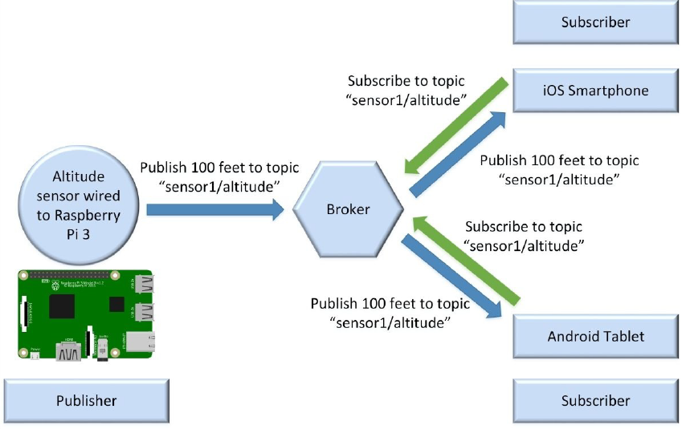
Concepts
The publish-subscribe pattern requires a broker, also known as server.
All the clients establish a connection with the broker.
The client that sends a message through the broker is known as the publisher.
The clients that register to the broker as interested in specific types of messages are known as subscribers.

Slide 6
Concepts (cont.)
A topic is a named logical channel and it is also referred to as a channel or subject.
The data for a message is known as payload. A message includes the topic to which it belongs and the payload.
Publishers and subscribers are decoupled in space because they don't know each other.
Publishers and subscribers don't have to run at the same time.

Slide 7
Core
MQTT defines methods (sometimes referred to as verbs) to indicate the desired action to be performed on the identified resource.
The resource corresponds to a file or the output of an executable residing on the server.

Slide 8
Core (cont.)
Connect:
waits for a connection to be established with the server.
Disconnect:
waits for the MQTT client to finish any work it must do, and for the TCP/IP session to disconnect.
Subscribe:
waits for completion of the Subscribe or UnSubscribe method.
UnSubscribe:
requests the server unsubscribe the client from one or more topics.
Publish:
returns immediately to the application thread after passing the request to the MQTT client.

Slide 9
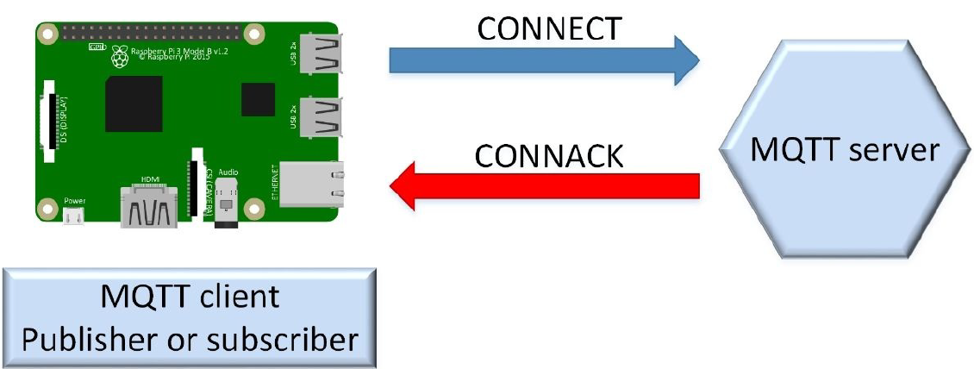
Core (cont.)
The MQTT client sends a CONNECT control packet to the MQTT server with a payload in order to establish a connection.
The MQTT server will check the CONNECT packet, perform authentication and authorization and send a response to the client with a CONNACK control packet.

Slide 10
Core (cont.)
After a successful connection has been established between an MQTT client and an MQTT server, the server will keep the connection open until the client loses the connection or sends a DISCONNECT control packet to the server to close the connection.

Slide 11
Core (cont.)
The CONNECT control packet must include values for the following fields in the payload and bits for a special flags byte.
ClientId:
identifies each MQTT client that connects to an MQTT server.
If a client specifies an empty value as the ClientId, the MQTT server must generate a unique ClientId to identify the client.
CleanSession:
specifies what happens after an MQTT client disconnects from the MQTT server and then reconnects.
if set to 1 or true, the client indicates to the MQTT server that the session will only last as long as the network connection is alive.
After the MQTT client disconnects from the MQTT server, any information related to the session is discarded.
If CleanSession is set to 0 or false, we will work with a persistent session.

Slide 12
Core (cont.)
ProtocolLevel:
indicates the MQTT protocol version that the MQTT client requests the MQTT server to use.
KeepAlive:
a time interval expressed in seconds.
If the value for keep alive is not equal to 0, the MQTT client commits to send control packets to the server within the time specified for KeepAlive.
If the MQTT client doesn't have to send any control packet, it must send a PINGREQ control packet to the MQTT server
Will, WillQoS, WillRetain, WillTopic and WillMessage:
allow the MQTT client to take advantage of the last will and testament feature of MQTT.

Slide 13
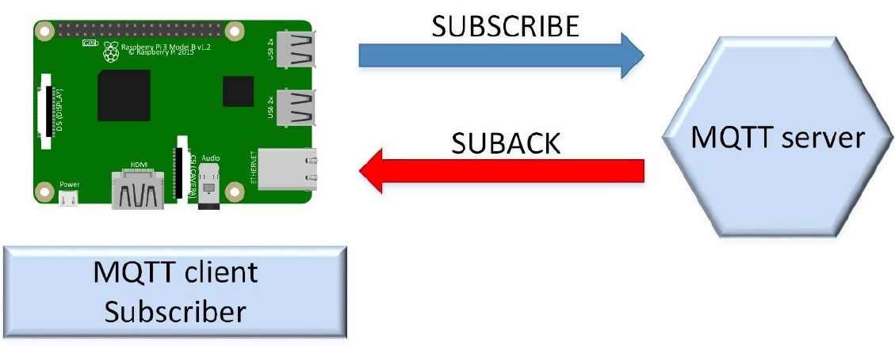
Core (cont.)
The quality of service is known as QoS.
A single SUBSCRIBE packet can request the MQTT server to subscribe a client to many topics.
The SUBSCRIBE packet must include at least one topic filter and QoS pair to comply with the protocol.
The MQTT server will process a valid SUBSCRIBE packet and it will respond with a SUBACK packet that indicates the subscribe acknowledgement and confirms the receipt and processing of the SUBSCRIBE packet.

Slide 14
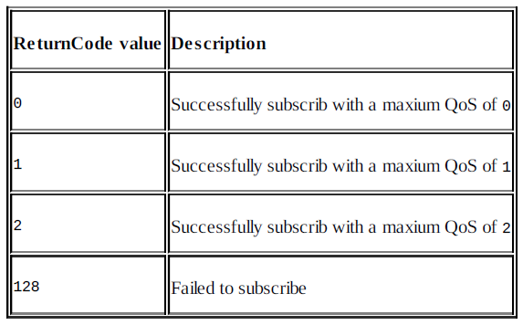
Core (cont.)
The SUBACK packet will include the same packet identifier (PacketId) in the header that was received in the SUBSCRIBE packet.
The number of return codes will match the number of topic filters included in the SUBSCRIBE packet.

Slide 15
Core (cont.)
The MQTT client that has already established a connection sends a PUBLISH packet to the MQTT server
with a header that includes the following fields and flags.
PacketId: if the QoS level is equal to 0, the value for this field will be 0 or it won't be present.
Dup: if the QoS level is equal to 0, the value for this field will be 0.
QoS: specifies the QoS level for the message.
Retain:if the value for this flag is set to 1 or true, the MQTT server will store the message with its specified QoS level.
TopicName: the topic name to which the message must be published.

Slide 16
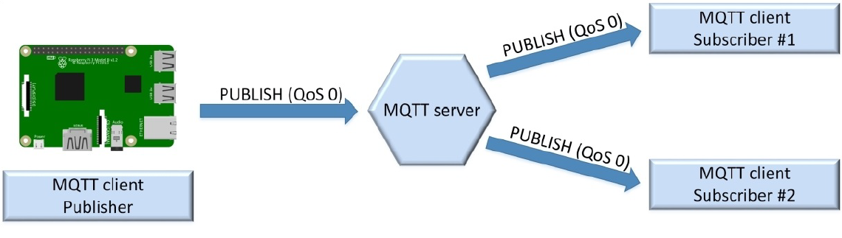
Core (cont.)
The payload contains the actual message that the MQTT client wants the MQTT server to publish.
The MQTT server will read a valid PUBLISH packet and it will respond with a packet only for QoS levels greater than 0.
In case the QoS level is 0, the MQTT won't respond.

Slide 17
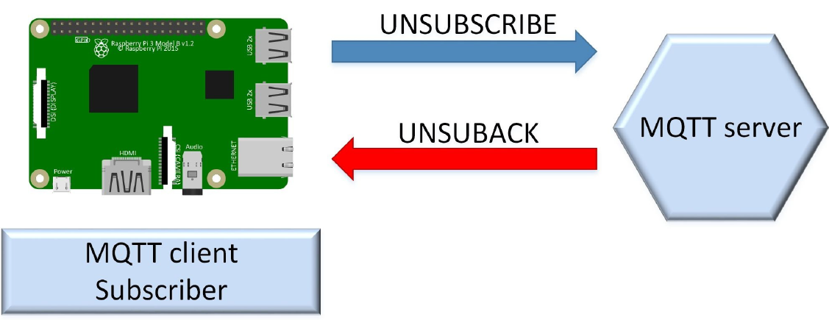
Core (cont.)
The MQTT client sends an UNSUBSCRIBE packet to the MQTT server with a packet identifier (PacketId) in the header and one or more topic filters in the payload.
The QoS level isn’t necesary because the MQTT client just wants to unsubscribe.

Slide 18
Core (cont.)
There is a QoS level for the publish process between the publisher and the MQTT server and another QoS level for the publish process between the MQTT server and the subscriber.
Based on the QoS level, we have differences in the meaning of a successfully delivered message in the MQTT protocol between the involved parties.

Slide 19
Core (cont.)
MQT supports the following three possible QoS levels:
0, At most once delivery:
This QoS level offers the same warranty as the underlying TCP protocol.
The message isn't acknowledged by the receiver or destination.
The key advantage of this QoS level is that it has the lowest possible overhead.
1, At least once delivery:
This QoS level adds a confirmation requirement to the destination that has to receive the message.
It provides a warranty that the message will be delivered at least once to the subscriber.
The sender stores the message until it receives an acknowledgement from the subscriber.
2, Exactly once delivery:
This QoS level provides a warranty that the message is delivered only once to the destination.
QoS level 2 has the highest overhead, compared to the other QoS levels.

Slide 20
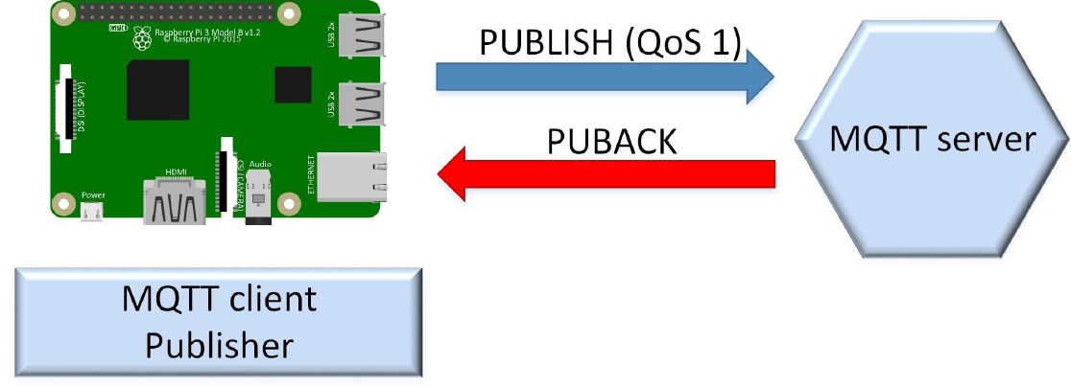
Core (cont.)
The bellow diagram shows the interaction between a publisher and an MQTT server to publish a message with a QoS level of 1.

Slide 21
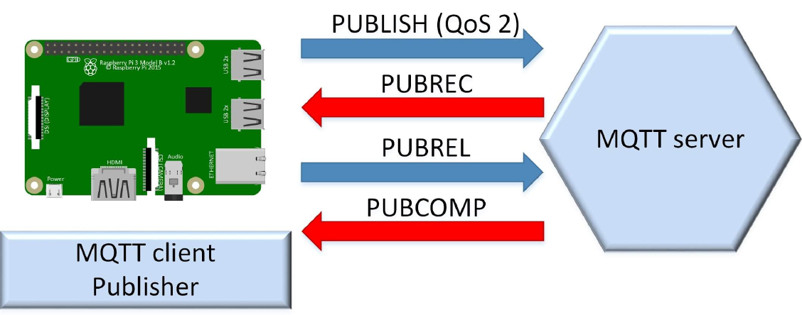
Core (cont.)
The bellow diagram shows the interaction between a publisher and an MQTT server to publish a message with a QoS level of 2.

Slide 22
Security
Many MQTT implementations have security standards like SSL/TLS is used.
Security in MQTT is divided into multiple layers.
Network Level:
using a physically secure network or VPN for communication provides a secure connection.
Transport Level:
TLS/SSL can be used for transport encryption that ensures communication is encrypted and identity is authenticated.
Application Level:
the protocol has Client ID, Username/Password credentials which can bring about device authentication. Another way is to have payload encryption without having an extensive transport encryption.

Slide 23
Brokers
Mosquitto
Erlang MQTT Broker (EMQ)
CloudMQTT
HiveMQ
Mosca

Slide 24
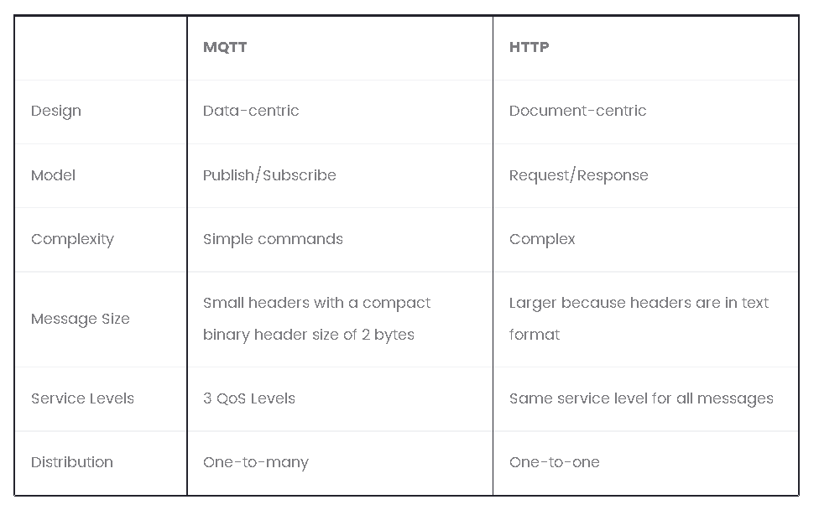
MQTT vs HTTP

Slide 25

Bibliography
https://en.wikipedia.org/wiki/MQTT
http://mqtt.org/
http://blog.catchpoint.com/2017/05/30/protocol-for-internet-of-things/
Packt - MQTT Essentials

