Slide 1

OAuth 2
Dima Ionut Daniel

Slide 2
Contents
What is OAuth2 ?
Architecture
Core
Benefits
Roles
Client Types
Authorization
Endpoints
Payload
Security
OAuth 2 Extensions
Conclussion
Bibliography

Slide 3

What is OAuth 2 ?
OAuth 2 is an authorization framework that enables applications to obtain limited access to user accounts on an HTTP service.
OAuth 2.0 is the next evolution of the OAuth protocol which was originally created in late 2006.
OAuth 2.0 focuses on client developer simplicity while providing specific authorization flows for web applications, desktop applications, mobile phones, and living room devices.

Slide 4
What is OAuth 2 ? (cont.)
OAuth 2 core is defined under RFC 6749, RFC 6750, RFC 6819 and has also extensions defined.
OAuth acts as an intermediary on behalf of the end user, providing the service with an access token that authorizes specific account information to be shared. The process for obtaining the token is called a flow.

Slide 5
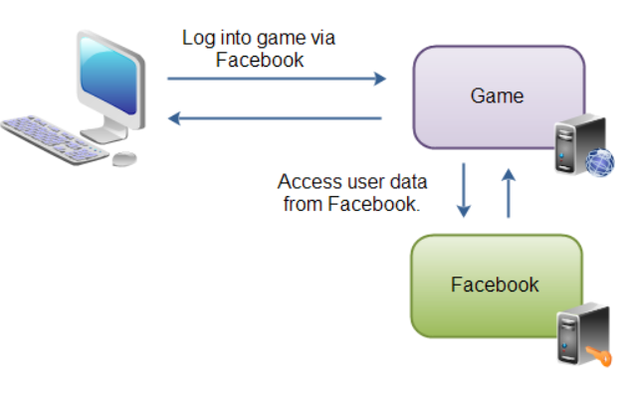
Architecture
A game application can access a users data in the Facebook application.

Slide 6
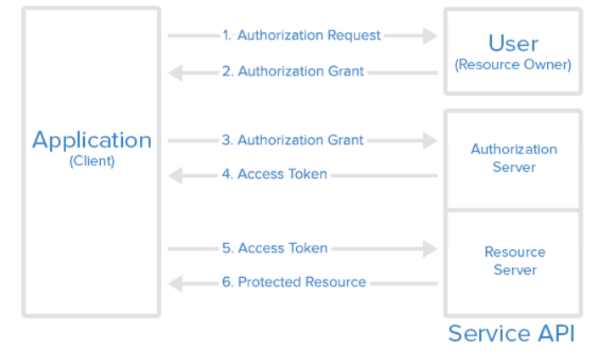
Architecture (cont.)

Slide 7
Architecture (cont.)
The application requests authorization to access service resources from the user
If the user authorized the request, the application receives an authorization grant
The application requests an access token from the authorization server (API) by presenting authentication of its own identity, and the authorization grant
If the application identity is authenticated and the authorization grant is valid, the authorization server (API) issues an access token to the application. Authorization is complete.
The application requests the resource from the resource server (API) and presents the access token for authentication
If the access token is valid, the resource server (API) serves the resource to the application

Slide 8
Core
The OAuth 2.0 specification defines a delegation protocol that is useful for conveying authorization decisions across a network of web-enabled applications and APIs.
OAuth 2.0 is not an authentication protocol.
Authentication in the context of a user accessing an application tells an application who the current user is and whether or not they're present. OAuth tells the application none of that.

Slide 9
Benefits
API security
Internal enterprise applications
Service integration and authorization delegation
Federated identity
Easier service monitoring

Slide 10
Benefits (cont.)
API security
In order to make an API secure for customers we need to use a secure data transfer(Base64, SSL).
Those mechanism are sending either username or password over the wire.
Instead of sending username and password an access token is sent.
The token is obtained by the client application before making the requests, and represents the user on whose behalf the client application is using the API.

Slide 11
Benefits (cont.)
Internal enterprise applications
We could have a chain of enterprise applications where username and password is needed to enter in every separate application.
The user can log in with first credentials and in all the other applications he is simply redirected to the provider where he logged in and confirms that he wants to be authorized.

Slide 12
Benefits (cont.)
Service integration and authorization delegation
Service A depends on service B.
If these two services have OAuth 2.0 integration between them, the user can authorize
the service B to access resources from the sharing service A on his behalf.

Slide 13
Benefits (cont.)
Federated identity
With federated identity, a person's digital identity and detail can be linked between several distinct services.
For example, a user wants to post a comment on some blog post and needs to be identified.
Easier service monitoring
Enterprises can track and monitor more easily which access token is making which request.

Slide 14
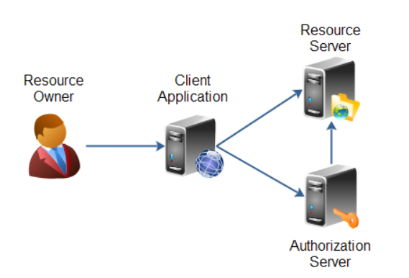
Roles
OAuth 2.0 defines the following roles of users and applications:
Resource Owner
Resource Server
Client Application
Authorization Server

Slide 15
Roles (cont.)
The resource owner(a user on Facebook or Google) is the person or application that owns the data that is to be shared.
The resource server(Facebook or Google) is the server hosting the resources.
The client application(game) is the application requesting access to the resources stored on the resource server.
The authorization server is the server authorizing the client app to access the resources of the resource owner.

Slide 16
Client Types
OAuth 2.0 specification defines 2 types of clients:
Confidential
it' an application that is capable of keeping a client password confidential.
Public
isn't capable of keeping a client password confidential.

Slide 17
Client Types (cont.)
OAuth 2.0 specification mentions a set of client profiles
Web Application
User Agent
Native
These profiles are concrete types of applications, that can be either confidential or public.

Slide 18
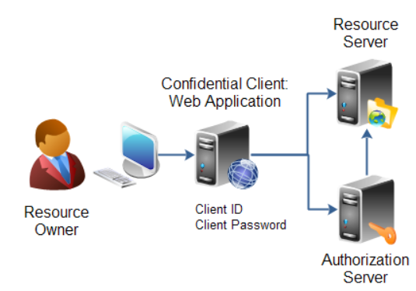
Client Types (cont.)
A web application is an application running on a web server.
It consists of both a browser part and a server part.
If a web application needs access to a resource server, then the client password could be stored on the server.
The password would thus be confidential.

Slide 19
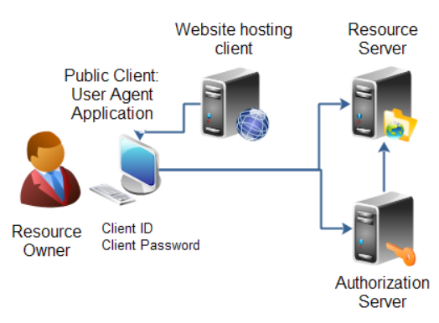
Client Types (cont.)
A user agent application is for instance a JavaScript application running in a browser.
The browser is the user agent.
A user agent application may be stored on a web server, but the application is only running in the user agent once downloaded.

Slide 20
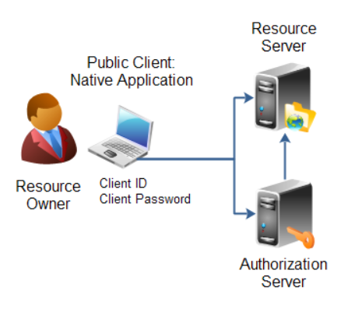
Client Types (cont.)
A native application is for instance a desktop application or a mobile phone application.
Native applications are typically installed on the users computer or device.
The client password will be stored on the users computer or device too.

Slide 21
Authorization
When a client applications wants access to the resources of a resource owner, hosted on a resource server, the client application must first obtain an authorization grant.
Client ID, Client Secret and Redirect URI
Before a client application can request access to resources on a resource server, the client application must first register with the authorization server associated with the resource server.
At registration the client application is assigned a client ID and a client secret (password) by the authorization server.
During the registration the client also registers a redirect URI.
When a resource owner has successfully authorized the client application via the authorization server, the resource owner is redirected back to the client application, to the redirect URI.

Slide 22
Authorization (cont.)
The authorization grant is given to a client application by the resource owner, in cooperation with the authorization server associated with the resource server.
The OAuth 2.0 specification lists 4 types of authorization grants.
Each type has different security characteristics.
Authorization Code
Implicit
Resource Owner Password Credentials
Client Credentials

Slide 23
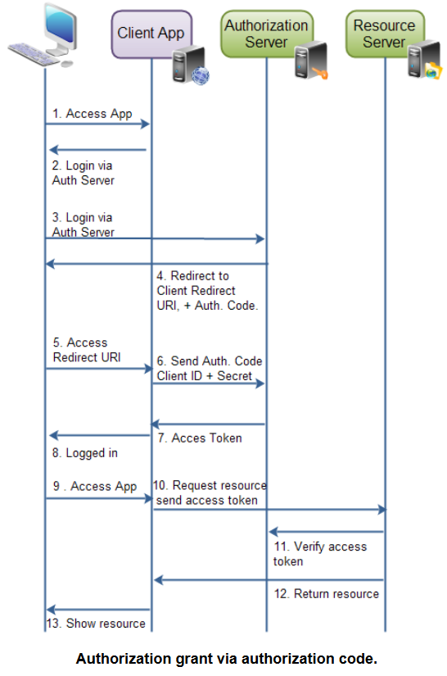
Authorization (cont.)

Slide 24
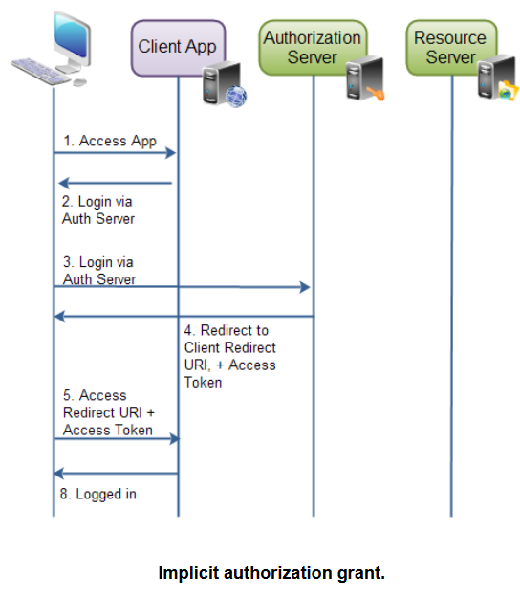
Authorization (cont.)

Slide 25
Authorization (cont.)
The resource owner password credentials authorization grant method works by giving the client application access to the resource owners credentials.
Using the resource owner password credentials requires a lot of trust in the client application.
Client credential authorization is for the situations where the client application needs to access resources or call functions in the resource server, which are not related to a specific resource owner.

Slide 26
Endpoints
OAuth 2.0 defines a set of endpoints.
An endpoint is typically a URI on a web server.
The endpoints defined are:
Authorization Endpoint
Token Endpoint
Redirection Endpoint

Slide 27
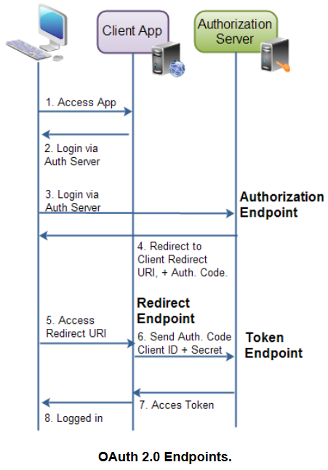
Endpoints (cont.)

Slide 28
Payload
The authorization code grant consists of 2 requests and 2 responses in total:
authorization request
authorization response
token request
token response

Slide 29
Payload (cont.)
The authorization request is sent to the authorization endpoint to obtain an authorization code.
response_type (M): must be set to code
client_id(O): the client identifier as assigned by the authorization server, when the client was registered.
redirect_uri(O): the redirect URI registered by the client.
scope(O): the possible scope of the request.
state(O): any client state that needs to be passed on to the client request URI.

Slide 30
Payload (cont.)
The authorization response contains the authorization code needed to obtain an access token.
code(M): the authorization code.
state(M): if present in request. The same value as sent by the client in the state parameter, if any.

Slide 31
Payload (cont.)
Authorization Error Response
If an error occurs during authorization, two situations can occur.
1)The client is not authenticated or recognized
2)The client is authenticated correctly, but that something else failed. Then the error response is sent to the client, included in the redirect URI.
error(M). Must be one of a set of predefined error codes.
error_description(O): A human-readable UTF-8 encoded text describing the error. Intended for a developer, not an end user.
error_uri (O): A URI pointing to a human-readable web page with information about the error.
state(M): if present in authorization request. The same value as sent in the state parameter in the request.

Slide 32
Payload (cont.)
Token Request
Once an authorization code is obtained, the client can use that code to obtain an access token.
client_id(M). The client application's id.
client_secret(M). The client application's client secret .
grant_type(M). Must be set to authorization_code .
code(M). The authorization code received by the authorization server.
redirect_uri(M) if the request URI was included in the authorization request. Must be identical then.

Slide 33
Payload (cont.)
Token Response
The response to the access token request is a JSON string containing the access token plus some more information:
{ "access_token" : "...",
"token_type" : "...",
"expires_in" : "...",
"refresh_token" : "...",
}

Slide 34
Payload (cont.)
The access_token property is the access token as assigned by the authorization server.
The token_type property is a type of token assigned by the authorization server.
The expires_in property is a number of seconds after which the access token expires, and is no longer valid. Expiration of access tokens is optional.
The refresh_token property contains a refresh token in case the access token can expire. The refresh token is used to obtain a new access token once the one returned in this response is no longer valid.

Slide 35
Security
When an access token is issued to a client application, the scope specified in it defines the access authorization associated for that particular token.
With scope in OAuth2.0 we can:
Reduce the type of access from the client application to the resource server to the level that is really needed
Minimize the damage an attacker can perform if an access token is stolen
Have an overview of the API methods that are accessible by a client with a given token

Slide 36
Security (cont.)
It's recommended that all requests sent from the client during the execution of a grant flow are done over TLS.
OAuth 2.0 relies heavily on TLS.
It maintains confidentiality of the exchanged data over the network by providing encryption and integrity on top of the connection between the client and server.

Slide 37
OAuth 2 Extensions
OAuth 2.0 Device Flow
OAuth 2.0 Token Introspection - RFC 7662, to determine the active state and meta-information of a token
PKCE - Proof Key for Code Exchange, better security for native apps
Native Apps - Recommendations for using OAuth 2.0 with native apps
JSON Web Token - RFC 7519
OAuth Assertions Framework - RFC 7521
SAML2 Bearer Assertion - RFC 7522, for integrating with existing identity systems
JWT Bearer Assertion - RFC 7523, for integrating with existing identity systems

Slide 38
OAuth 2 Extensions
Protocols Built on OAuth 2.0
Open ID Connect
UMA
Green Button
Blue Button (obsolete)

Slide 39
Conclussion
Pros:
Ease
Time
Networking
Privacy
Security
Control
Expenses
Traffic
Cons:
Lack of anonymity
Phishing
Data misuse

Slide 40

Bibliography
https://oauth.net/2/
https://oauth.net/articles/authentication/
http://searchmicroservices.techtarget.com/definition/OAuth
https://en.wikipedia.org/wiki/OAuth
http://tutorials.jenkov.com/oauth2/
http://www.socialtechnologyreview.com/articles/oauth-pros-and-cons-oauth
PacktPub – Oauth 2.0 Identity and Access Management Patterns

Slide 41
Questions ?

