Slide 1

Openshift
Dima Ionut Daniel

Slide 2
Contents
What are Openshift ?
Cloud Computing
IaaS
PaaS
SaaS
Architecture
Concepts
Basic
Bibliography

Slide 3

What are Openshift ?
Openshift is a Red Hat product for container-based software deployment and management.
It supports the distribution of Kubernetes using Docker containers and DevOps tools for accelerated application development.
OpenShift Origin is the upstream community project used in OpenShift Online, OpenShift Dedicated, and OpenShift Container Platform.
All source code for the Origin project is available under the Apache License (Version 2.0) on GitHub.

Slide 4
Cloud Computing
Cloud computing is a model for enabling ubiquitous, convenient, on-demand network access to a shared pool of configurable computing resources that can be rapidly provisioned and released with minimal management effort or service provider interaction.

Slide 5
Cloud Computing (cont.)
Characteristics:
On-demand self-service: a consumer can provision computing capabilities such as server time, network storage without requiring human interaction with each service provider.
Broad network access: capabilities are available over the network and accessed through standard mechanisms.
Resource pooling: Provider's computing resources are pooled to serve multiple consumers using multi-tenant model with different physical and virtual resources dynamically assigned and reassigned according to consumer demand.
Rapid elasticity: capabilities can be elastically provisioned and releases in some cases automatically, to scale rapidly.
Measured service: Cloud systems automatically control and optimize resource use by leveraging a metering capability at some level of abstraction appropriate to the type of service.

Slide 6
Cloud Computing (cont.)
Service Models:
Software as a service (Saas): The capability provided to the consumer is to use the provider's applications running on a cloud infrastructure.
Platform as a Service (Paas): The capability provided to the consumer is to deploy onto the cloud infrastructure consumer-created or acquired applications created using libraries, services, languages, tools supported by the provider.
Infrastructure as a Service (Iaas): The capability provided to the consumer is to provision storage, networks and other fundamental computing resources where the consumer is able to deploy and run software.

Slide 7
Cloud Computing (cont.)
Deployment Models:
Private cloud: the infrastructure is provisioned for exclusive use by a single organization that has multiple consumers.
Community cloud: the infrastructure is provisioned for exclusive use by a specific community of consumers that have shared concerns.
Public cloud: the infrastructure is provisioned for open use by the general public.
Hybrid cloud: the infrastructure is a composition of 2 or more distinct infrastructures.

Slide 8
IaaS
Within an IaaS cloud environment, all the aspects of an infrastructure are virtualized into an abstraction structure.
IaaS offers:
Operating System Deployment (OSD)
Service Daemon Configuration (SDC)
Storage Provisioning (SP)
Network Configuration (NC)
Backups

Slide 9
PaaS
PaaS service model aims to offer flexibility of an IaaS by removing the overhead to maintain the OS, storage, deployment, provisioning and configuration management.
In a PaaS environment, operators can select the components for their application to run, such as the service daemon, programming language, web framework, database, etc.

Slide 10
SaaS
SaaS is the cloud evolution of hosted web applications.
This layer of abstraction removes the largest amount of control from the user or customer.
Common examples of SaaS hosting:
Customer Relations Management (CRM)
Enterprise Resource Planning (ERP)
Management Information Systems (MIS)

Slide 11
Architecture
Openshift is designed to expose underlying Docker-formatted container image and Kubernetes concepts with focus on easy composition of applications by developers.
The Docker service provides the abstraction for packaging and creating Linux-based lightweight container images.
Kubernates provides the cluster management and orchestrates containers on multiple hosts.

Slide 12
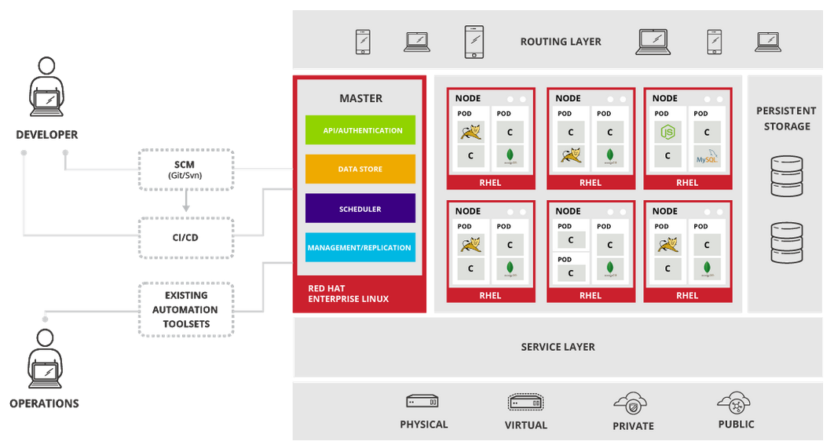
Architecture (cont.)

Slide 13
Concepts
Containers and images are the building blocks for deploying your applications.
Pods and services allow for containers to communicate with each other and proxy connections.
Projects and users provide the space and means for communities to organize and manage their content together.
Builds and image streams allow you to build working images and react to new images.
Deployments add expanded support for the software development and deployment lifecycle.
Routes announce your service to the world.
Templates allow for many objects to be created at once based on customized parameters.

Slide 14
Concepts (cont.)
Containers are basic units of OpenShift Origin applications.
They are lightweight Linux containers running isolating processes.
Containers in OpenShift Origin are based on Docker-formatted container images.
An image is a binary that includes all of the requirements for running a single container, as well as metadata describing its needs and capabilities

Slide 15
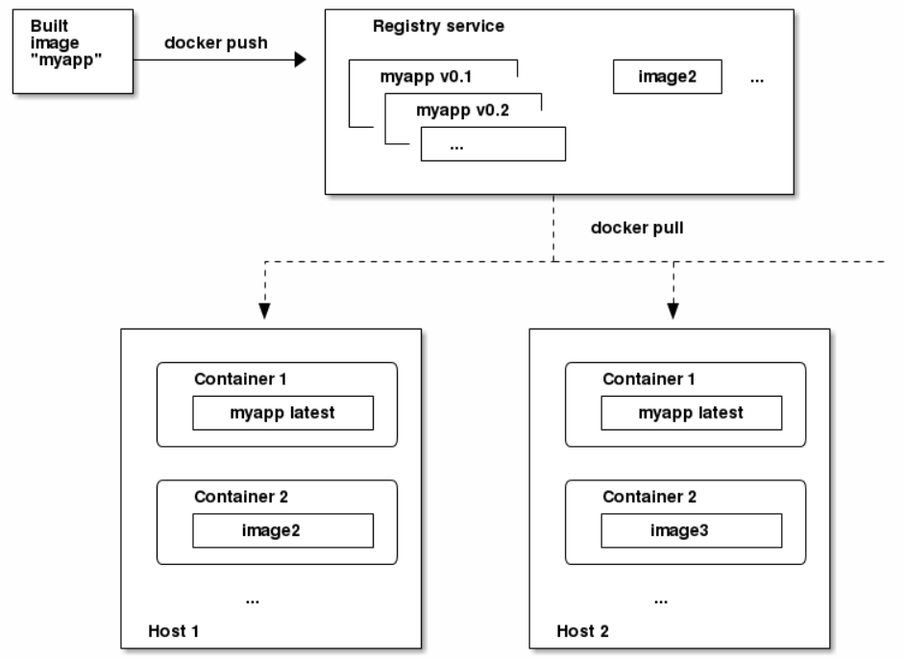
Concepts (cont.)
A container registry is a service for storing and retrieving Docker-formatted container images.
A registry contains a collection of one or more image repositories.
Each image repository contains one or more tagged images.

Slide 16
Concepts (cont.)
Pods are the equivalent of a machine instance (physical or virtual) to a container.
Each pod is allocated its own internal IP address and containers within pods can share their local storage and networking.
Pods, depending on policy and exit code, may be removed after exiting, or may be retained in order to enable access to the logs of their containers.

Slide 17
Concepts (cont.)
Pods can be "tagged" with one or more labels, which can then be used to select and manage groups of pods in a single operation.
The labels are stored in key/value format in the metadata hash.
Environment variables can be specified to pass necessary values to each container.
Each container in the pod is instantiated from its own Docker-formatted container image.
The pod defines storage volumes that are available to its container(s) to use.

Slide 18
Concepts (cont.)
A Kubernetes service serves as an internal load balancer and identifies a set of replicated pods in order to proxy the connections it receives to them.
Backing pods can be added to or removed from a service arbitrarily while the service remains consistently available.
Services are assigned an IP address and port pair that, when accessed, proxy to an appropriate backing pod.

Slide 19
Concepts (cont.)
Interaction with OpenShift Origin is associated with a user.
User object represents an actor which may be granted permissions in the system by adding roles to them or to their groups.
A project is a Kubernetes namespace with additional annotations and is the central vehicle by which access to resources for regular users is managed.
A project allows a community of users to organize and manage their content in isolation from other communities.

Slide 20
Concepts (cont.)
A build is the process of transforming input parameters into a resulting object.
The process is used to transform input parameters or source code into a runnable image.
OpenShift Origin leverages Kubernetes by creating Docker-formatted containers from build images and pushing them to a container registry.

Slide 21
Concepts (cont.)
A replication controller ensures that a specified number of replicas of a pod are running at all times.
If pods exit or are deleted, the replication controller acts to instantiate more up to the defined number.
A replication controller configuration consists of:
The number of replicas desired (which can be adjusted at runtime).
A pod definition to use when creating a replicated pod.
A selector for identifying managed pods.

Slide 22
Concepts (cont.)
A job is similar to a replication controller, in that its purpose is to create pods for specified reasons.
The difference is that replication controllers are designed for pods that will be continuously running, whereas jobs are for one-time pods.

Slide 23
Concepts (cont.)
An OpenShift Origin administrator can deploy routers to nodes in an OpenShift Origin cluster, which enable routes created by developers to be used by external clients.
The routing layer in OpenShift Origin is pluggable, and two available router plug-ins are provided and supported by default.
A router uses the service selector to find the service and the endpoints backing the service.
When both router and service provide load balancing, OpenShift Origin uses the router load balancing.

Slide 24
Concepts (cont.)
A template router is a type of router that provides certain infrastructure information to the underlying router implementation, such as:
A wrapper that watches endpoints and routes.
Endpoint and route data, which is saved into a consumable form.
Passing the internal state to a configurable template and executing the template.
Calling a reload script.

Slide 25
Basic
The easy way to get started developing microservices with Openshift is to use Red Hat Container Development Kit (CDK).
CDK is free, small, self-contained VM that runs on a single machine that contains: Docker, Kubernetes and a web console(OpenShift)
With the CDK installed, we can build, deploy and run microservices as Docker containers and deliver microservices through other application lifecycle management features inside of OpenShift.

Slide 26
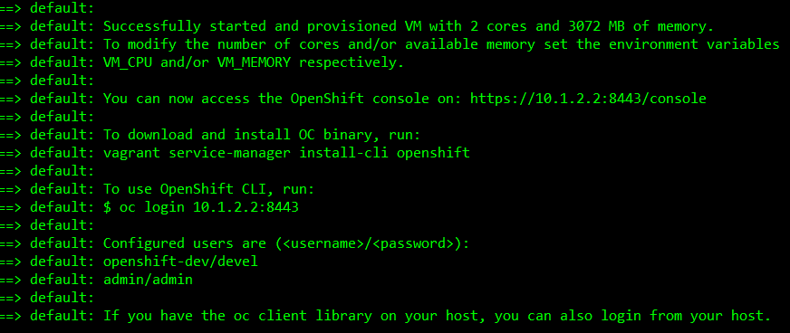
Basic (cont.)
To start up the CDK we navigate ./components/rhel/rhel-ose subdirectory and execute: vagrant up

Slide 27
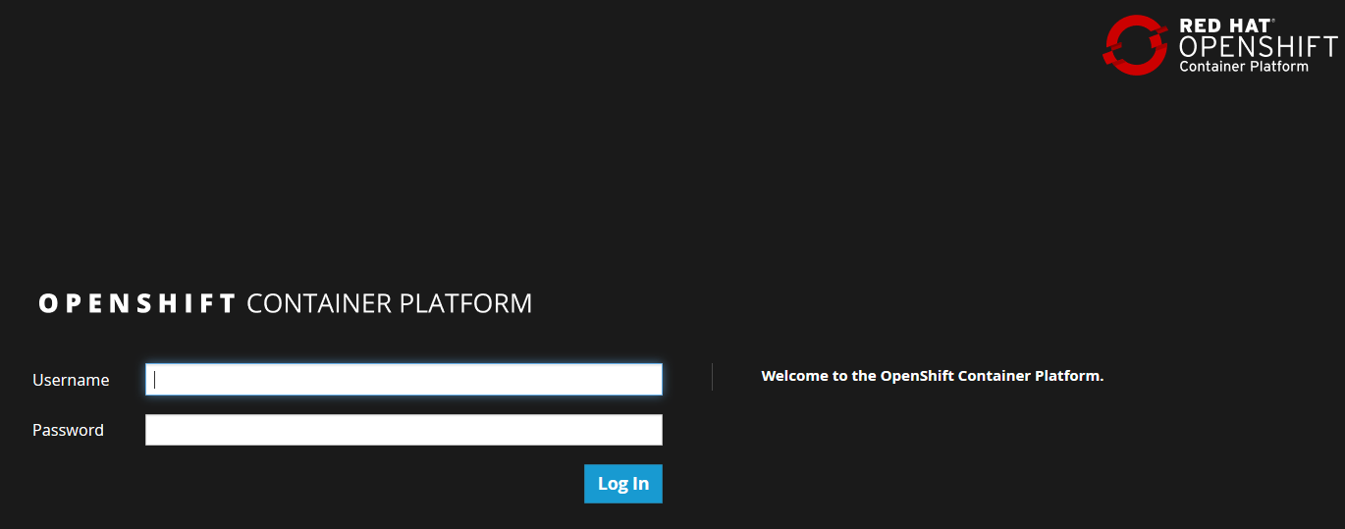
Basic (cont.)
It will boot the VM that exposes a Docker daemon at tcp://10.1.2.2:2376 and the Kubernetes API at https://10.1.2.2:8443.

Slide 28
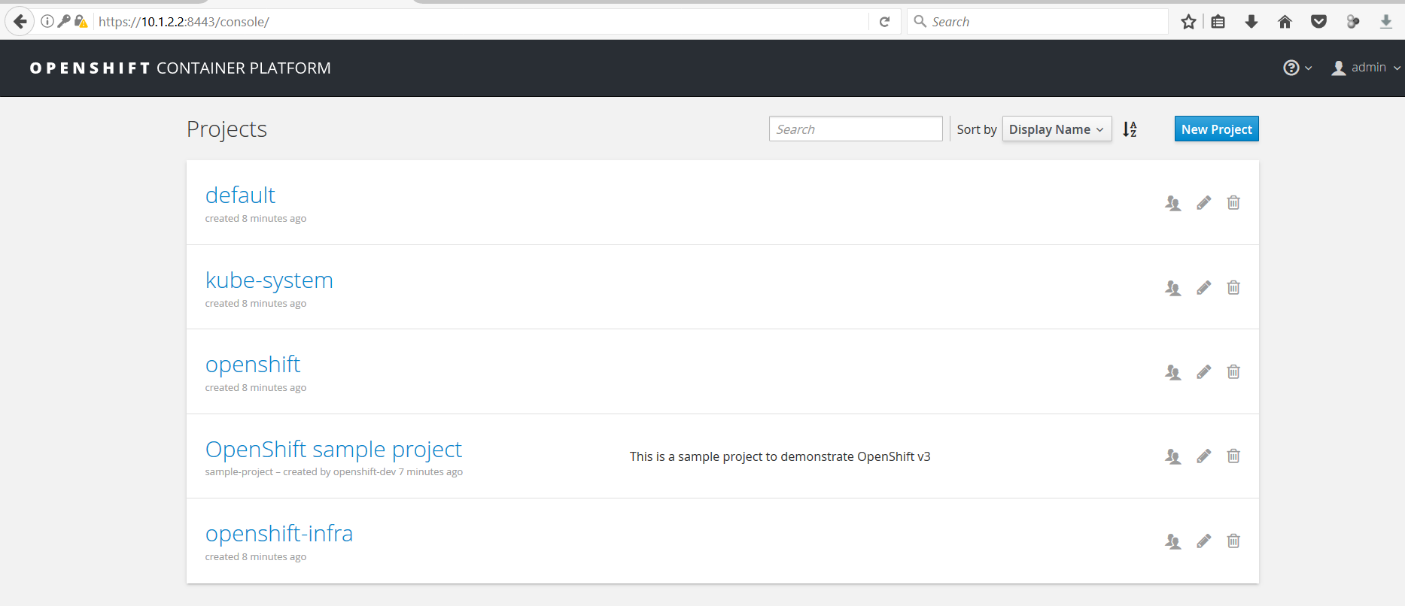
Basic (cont.)

Slide 29
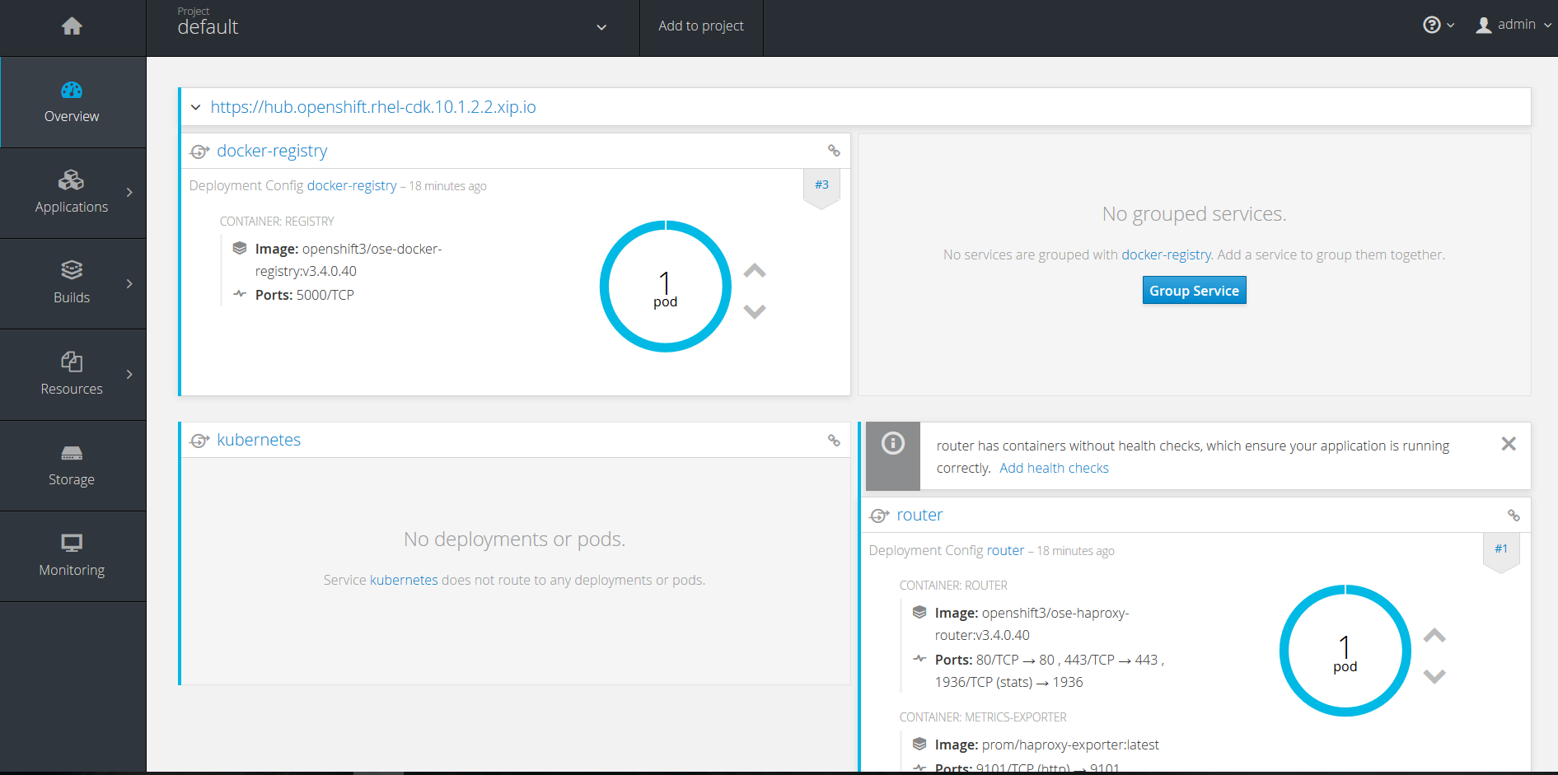
Basic (cont.)

Slide 30

Bibliography
http://nvlpubs.nist.gov/nistpubs/Legacy/SP/nistspecialpublication800-145.pdf
https://docs.openshift.org
https://en.wikipedia.org/wiki/OpenShift
PacktPublising – Implementing OpenShift

