Slide 1

Portlets
Dima Ionut Daniel

Slide 2
Contents
What are Portlets ?
History
Features
Architecture
Concepts
Basics
Core
Life Cycle
Implementations
Bibliography

Slide 3

What are Portlets ?
Portlets are pluggable user interface software components that are managed and displayed in a web or enterprise portal.
Portlets produce fragments of markup (HTML, XHTML, WML) code that are aggregated into a portal.

Slide 4
History
The Java Portlet Specification V1.0 was developed under the Java Community Process as Java Specification Request JSR 168, and released in its final form in October 2003.
The Java Portlet Specification V1.0 introduces the basic portlet programming model with:
two phases of action processing and rendering in order to support the Model-View-Controller pattern.
portlet modes
window states
portlet data model, allowing the portlet to store view information in the render parameters
a packaging format in order to group different portlets and other Java EE artifacts
Portal development as a way to integrate the different web-based applications for supporting deliveries of information and services.

Slide 5
History (cont.)
JSR-286 is the Java Portlet specification v2.0 as developed under the JCP and created in alignment with the updated version 2.0 of WSRP.
It was released in June 2008.
Some of its major features include:
Inter-Portlet Communication through events and public render parameters
Serving dynamically generated resources directly through portlets
Serving AJAX or JSON data directly through portlets
Introduction of portlet filters and listeners

Slide 6
History (cont.)
JSR-362 is the Java Portlet specification v3.0. Currently it is in early draft status.
Support JEE 7 features in Portlets
Resources sharing among portlets
Better client side support
Improved the mobile devices support
Optimize Java Server Faces (JSF) support
Support for WSRP future specification
Web Socket Support
Support Open Social Standards
Improvements in Portlet Event based Communication

Slide 7
Features
Resource serving: provides the ability for a portlet to serve a resource.
Events: enables a portlet to send and receive events and perform state changes or send further events as a result of processing an event.
Public render parameters: allows portlets to share parameters with other portlets.
Invoking a Portlet directly, but through the Portal.
PortletURL generation callback listeners.
Extended Cache
Portlet Filter

Slide 8
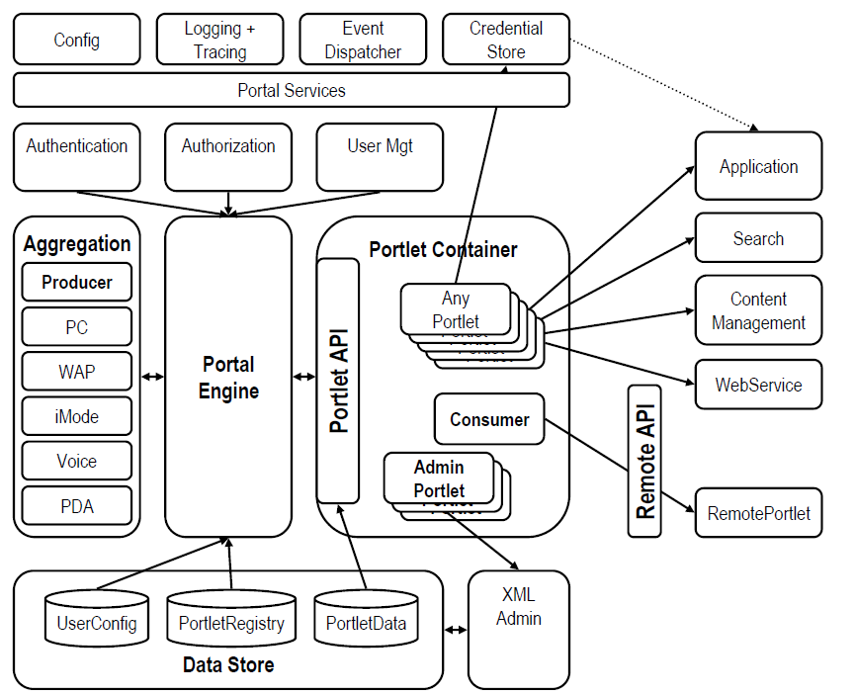
Architecture

Slide 9
Concepts
The PortletRequest interface in the portlet API represents the common functionality in an action request and a render request.
The ActionRequest interface and the RenderRequest interface both extend PortletRequest.
The PortletRequest interface provides methods for accessing information about the user’s request, such as the parameters on the request.

Slide 10
Concepts (cont.)
Request attributes are a way to pass Java objects between portlets, servlets, and JSP pages.
These attributes are name/value pairs, with a String value representing the name and a java.lang.Object as the value.
The request attributes are valid only for the action request and any subsequent render requests.

Slide 11
Concepts (cont.)
The portlet can access properties defined by the portal server or portlet container through the request object.
These properties are up to the portal vendor to determine, and aren't guaranteed to be portable between different portal servers.
Each property consists of a name and one or more values.
The name and the values are all strings.

Slide 12
Concepts (cont.)
Request parameters consist of a name as a String object, and one or more String objects as the value or values of the parameter.
Sources of request parameters are parameters on portlet URLs, parameters on HTML forms, and render request parameters set during the action request processing.
The parameters sent to the portlet for an action request are valid only while that action request is processed.

Slide 13
Concepts (cont.)
The portlet request’s context path is the part of the URL that corresponds to the portlet’s context.
For instance, if the URL is http://localhost/portal/MyPortletApp/MyPortlet, the context path would be /MyPortletApp.
If there is a trailing slash on the end of the path, the trailing slash isn't part of the context path.
The context path is retrieved from the PortletRequest object using the getContextPath() method.

Slide 14
Concepts (cont.)
The file upload portlet uses the Jakarta Commons File Upload Library to process multipart form submissions.
These submissions could include file uploads and regular HTML form parameters.
The form is the only content displayed to users when they first load the portlet.
If the user submits the form back to the server, the portlet processes the inputs in the processAction() method.

Slide 15
Concepts (cont.)
The portlet sends a response object back to the portal after every request.
The response contains the content fragment for the portlet, any requested portlet modes or window states.
The PortletResponse interface contains the common functionality for the portlet’s response to an action request and its response to a render request.

Slide 16
Concepts (cont.)
Portlets will use the PortletContext object to get access to logging, resources, attributes, and initialization parameters, just like servlets in a web application would use a ServletContext object.
The PortletContext object provides information and resources from the portlet application.

Slide 17
Concepts (cont.)
The portlet may retrieve information about the version of the portlet API that the portlet container supports.
This could be useful for supporting future changes.
If a future version of the portlet API provides a new mechanism for accessing user information, the portlet could support this.

Slide 18
Concepts (cont.)
A portlet application can track the user across multiple client requests for a portal page using sessions.
Session tracking for portlets is similar to the session tracking used in the servlet API.
For portlets, the portal is responsible for the mechanics of maintaining a session for the user across HTTP.
The portal’s session tracking could be done with HTTP cookies, URL rewriting, or another mechanism, but the portlet should not rely on or expect any particular method.
A portlet in a portlet application can get access to the session through a PortletSession object.

Slide 19
Concepts (cont.)
These portlet modes are the different functions that a portlet container can ask a portlet to perform.
The portlet container is responsible for telling the portlet which mode it's in.
Each portlet can also change its mode based on the user input, if needed.
The getPortletMode() method on the PortletRequest object returns a PortletMode object.

Slide 20
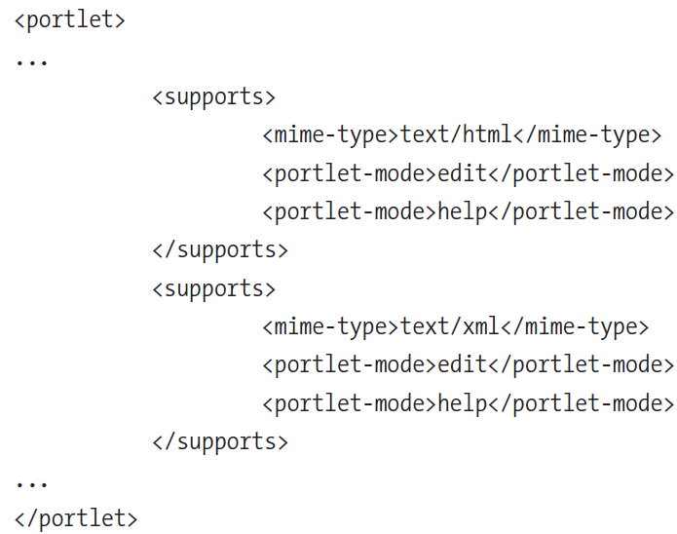
Concepts (cont.)
The portlet.xml portlet deployment descriptor contains <supports> elements for each markup MIME type that a portlet could handle.
Because each portlet has to support the VIEW mode, we don't have to include the VIEW mode in the list of supported modes.

Slide 21
Concepts (cont.)
The portal can display one or more portlets at a time on the portal page.
These portlets can take up amounts of screen space, and the portal container can tell the portlet what type of space it expects to fill.
The portlet can use this information, called a window state, to determine how much information to display.
Each portal may define custom window states for other uses.
Window states: NORMAL, MAXIMIZED, MINIMIZED.

Slide 22
Basics
Portlets are individual classes that process requests from a user and return content for display inside a portal.
Portlet applications are standard J2EE web applications that include portlet classes and the portlet.xml portlet deployment descriptor.
The portlet container is part of a portal, and it instantiates and executes the portlet classes.
Portals aggregate the output of one or more portals into a portal page, which is served to a user.

Slide 23
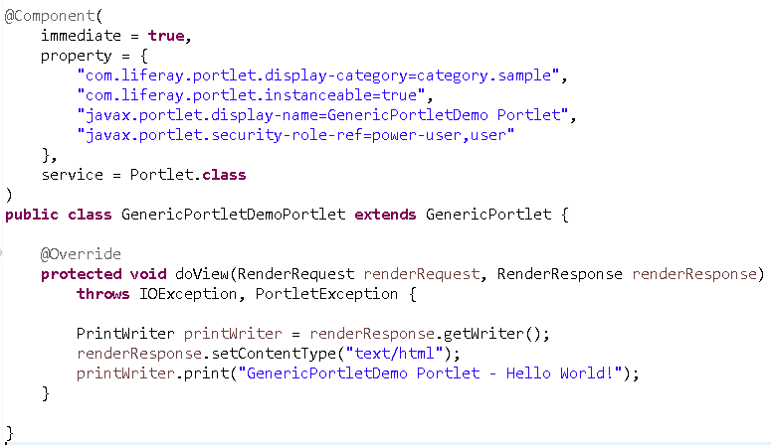
Basics (cont.)
Bellow is an example of a simple generic portlet, using the Portlet API.
Portlet API is defined under JSR 168 for 1.0 version and JSR 286 for 2.0 version.

Slide 24
Basics (cont.)
There are lots of similarities between portlets and servlets.
Both uses request and response objects.
The portlet throws a PortletException instead of a ServletException.

Slide 25
Basics (cont.)
Portlets handle requests differently than servlets.
With servlet there is one request per reponse.
The servlet calls doGet() or doPost() methods to generate a response.
With portals there can be one or more portlets supplying content for each portal page served.

Slide 26
Basics (cont.)
Portlets must handle 2 different types of requests: an action request and a render request.
Action request is asking portlet do to something.
Render request tells the portlet do display contents based on its state.
An action request is handled in two phases.
Render URLs requested from the portal send render requests to all of the portlets.
Portlets have two request-handling methods: processAction() and render().
The GenericPortlet class is an abstract implementation of the Portlet interface.

Slide 27
Basics (cont.)
doView() method is similar to doGet() or doPost() method on a servlet.
Three modes for portlets are defined in the standard: VIEW, EDIT, and HELP.
Only the VIEW portlet mode is required; the EDIT and HELP modes are optional.
VIEW: Used to display the current contents of the portlet and allow interaction. You will use this mode for most of your portlet development.
EDIT: Used to allow the user to edit preferences for the portlet to customize its behavior, provide connection data, or conduct similar tasks.
HELP: Used to provide help to the user on using or customizing the portlet.

Slide 28
Basics (cont.)
When a portlet receives a render request, the render() method from the Portlet interface class is called.
For portlets that subclass the GenericPortlet abstract class, the render() method sets the title for the portlet, and then calls the doDispatch() method on the GenericPortlet class.
The doDispatch() method checks the portlet’s window state to see if it should display any content.
The window state for a portlet could be normal, maximized, or minimized.
If the window state isn’t minimized, the doDispatch() method delegates the request object and the response object to the appropriate method based on the portlet mode (doView(), doEdit(), or doHelp()).

Slide 29
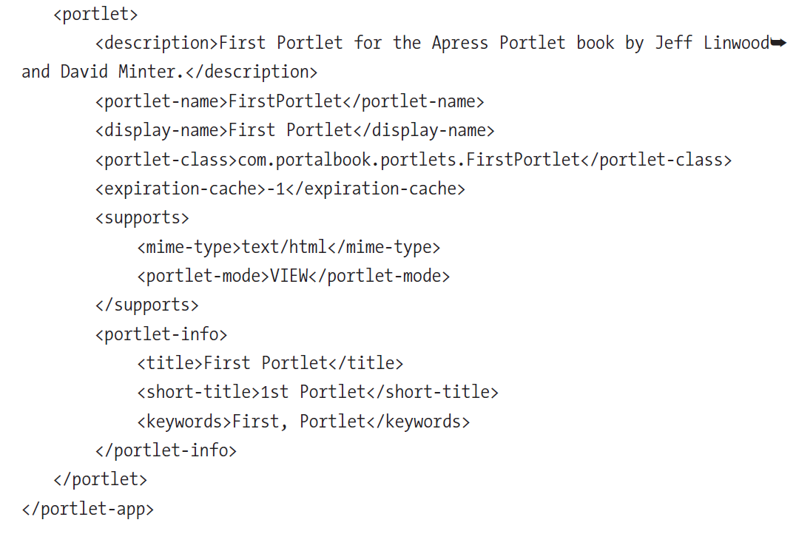
Basics (cont.)
The web.xml deployment descriptor is also used for describing any servlets included in the portlet application.
To describe portlets, we use the portlet.xml deployment descriptor.

Slide 30
Basics (cont.)
The portlet deployment descriptor has to comply with the portlet API xml.
The <portlet-app> element of the deployment descriptor is the root of the XML document.
The <portlet> element represents one of the available portlets in the portlet application.
There can be more than one <portlet> element under a <portlet-app> element.

Slide 31
Core
Portlets are allowed to be displayed in the three standard modes—VIEW, EDIT, and HELP.
They don't have to support any of them except VIEW and don't require any action handling.
The GenericPortlet abstract class provides an initial startup to build a custom portlet.
A portlet derived from GenericPortlet must implement a constructor, a getTitle() method, and a doView() method.
GenericPortlet’s render() method calls the doDispatch() method. This method determines the current mode of the portlet render request, and calls doView(), doEdit(), and doHelp() as appropriate

Slide 32
Core (cont.)
The protlet application can use servlets and JavaServer Pages (JSP) in addition to portlets.
The portlet can use a portlet request dispatcher to include the content from a servlet or JSP page.
The portlet request dispatcher translates the portlet’s render request and render response into servlet requests and responses.
The portlet has access to a portlet request dispatcher through the portlet’s PortletContext object.

Slide 33
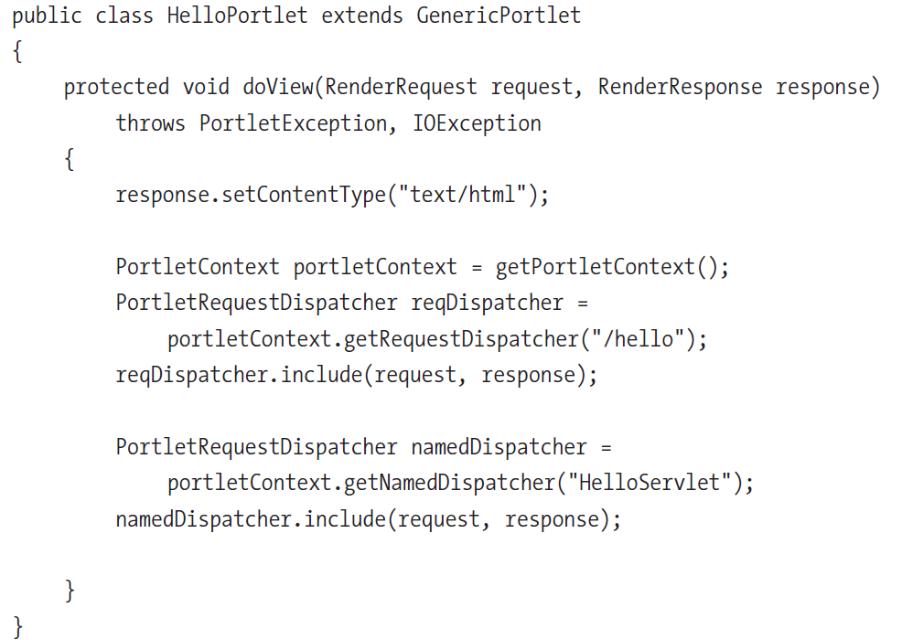
Core (cont.)

Slide 34
Core (cont.)
The portlet API defines several interfaces for working with preferences and settings for the portal, the portlet application, and the current user of the portlet.
Portlets access information about the portal through the PortalContext object.
The configuration settings for the application are available from the PortletConfig class.
The portlet accesses and persists individual settings and preferences transparently with the PortletPreferences object.

Slide 35
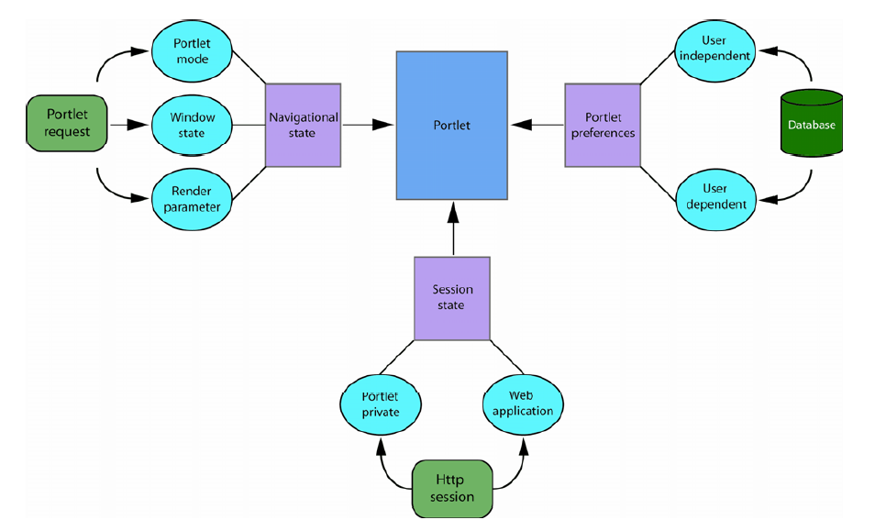
Core (cont.)

Slide 36
Core (cont.)
The portlet data model shows different types of state information that a portlet has access to.
The portlet can access 2 different types of persistent data, the initialization parameters and the portlet preferences.
The portlet uses all this information to display a consistent, personalized user interface.

Slide 37
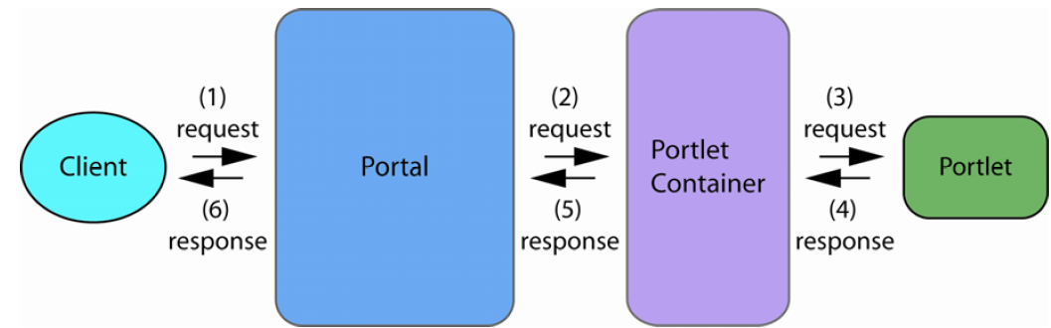
Core (cont.)
Requests travel from the client (browser), through the portal and portlet container to the portlet.

Slide 38
Life Cycle
A simple portlet implements the Portlet interface directly.
The life cycle of a portlet consists in:
1. Creation of the portlet
2. Processing of a number of user requests (or possibly none)
3. Removal and garbage collection of the portlet

Slide 39
Life Cycle (cont.)
The container is required to initialize the portlet once it has been loaded and instantiated.
The container is calling the init() method:
public void init(PortletConfig config) throws PortletException
The destroy() method will not be invoked until all other initialization or processing threads on the instance have completed.

Slide 40
Implementations
Portals that implements the Java Portal Specification are:
Apache Pluto
Liferay
Exo Platform
jPortal
Jetspeed
uPortal
Hippo
Jboss Portal
InfoGlue
IBM WebSphere Portal
Oracle WebLogic Portal

Slide 41

Bibliography
https://en.wikipedia.org/wiki/Portlet
https://en.wikipedia.org/wiki/Java_Portlet_Specification
Apress - Building Portals with the Java Portlet API
Manning – Portlets And Apache Portals

Slide 42
Questions ?

