Slide 1

WebRTC
Dima Ionut Daniel

Slide 2
Contents
What is WebRTC ?
History
Features
JSEP
Core
Model
SIP Servers
IMS
PSTN
SIP Services
Bibliography

Slide 3

What is WebRTC ?
WebRTC ("Web Real-Time Communication") is a collection of communications protocols and application programming interfaces that enable real-time communication over peer-to-peer connections.
This allows web browsers to not only request resources from backend servers, but also real-time information from browsers of other users.

Slide 4
History
In May 2011, Google released an open source project for browser-based real-time communication known as WebRTC.
The W3C draft of WebRTC is a work in progress with advanced implementations in the Chrome and Firefox browsers.
SIP over Websockets is often used partially due to the applicability of SIP.

Slide 5
Features
Platform and device independence
Secure voice and video
Advanced voice and video quality
Reliable session establishment
Multiple media streams
Adaptive to network conditions
Interoperability with VoIP and video
Rapid application development

Slide 6
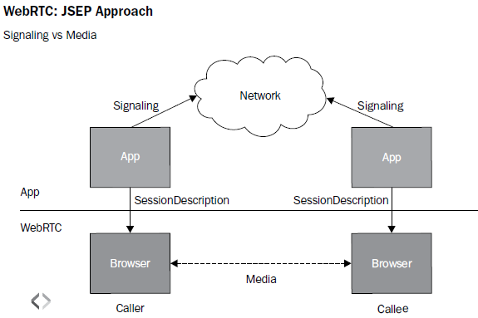
JSEP
The communication model between a client and remote host is based on the JSEP(JavaScript Session Establishment Protocol) architecture, which differentiates the signaling and media transaction into different layers.

Slide 7
JSEP (cont.)
A initiates communication with B.
A being the offerer will have to call the createOffer function to begin a session.
A also mentions details such as codecs through a setLocalDescription function, which sets up its local config.
The remote party, B, reads the offer and stores it using the setRemoteDescription function.
The remote party, B, calls the createAnswer function to generate an appropriate answer, applies it using the setLocalDescription function, and sends the answer back to the initiator over the signaling channel.
When A gets the answer, it also stores it using the setRemoteDescription function, and the initial setup is complete.
This is repeated for multiple offers and answers.

Slide 8
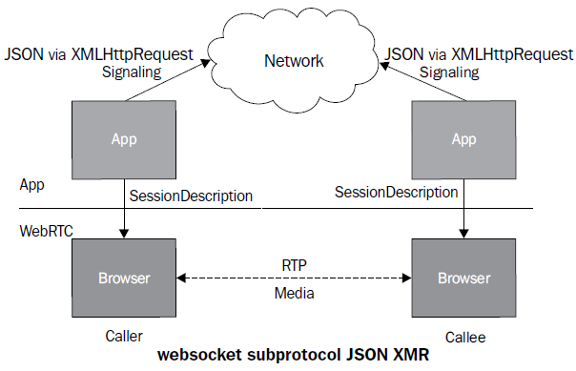
JSEP (cont.)
The signaling mechanism can be any among HTTP/REST, JavaScript Object Notation (JSON) via XMLHttpRequest (XHR), Session Initiation Protocol (SIP) over websockets, XMPP, or any custom or proprietary protocol.
The media (audio/video) is defined through the Session Description Protocol (SDP) and flows from peer to peer.

Slide 9
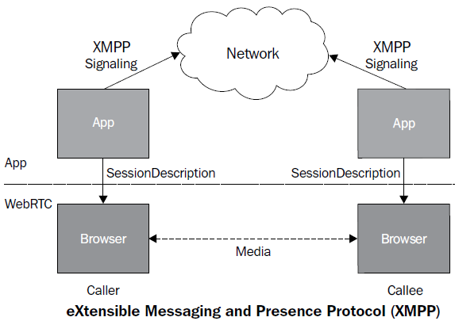
JSEP (cont.)
We can signaling over the WebRTC API using eXtensible Messaging and Presence Protocol (XMPP)

Slide 10
Core
WebRTC is used in various apps like WhatsApp, Facebook Messenger, appear.in and platforms such as TokBox.
WebRTC has also been integrated with WebKitGTK+ and Qt native apps.
Microsoft added MediaCapture and Stream APIs to Edge.
WebRTC implements three APIs:
MediaStream (aka getUserMedia)
RTCPeerConnection
RTCDataChannel

Slide 11
Core (cont.)
WebRTC applications need to do several things:
Get streaming audio, video or other data.
Get network information such as IP addresses and ports, and exchange this with other WebRTC clients (known as peers) to enable connection, even through NATs and firewalls.
Coordinate signaling communication to report errors and initiate or close sessions.
Exchange information about media and client capability, such as resolution and codecs.
Communicate streaming audio, video or data.

Slide 12
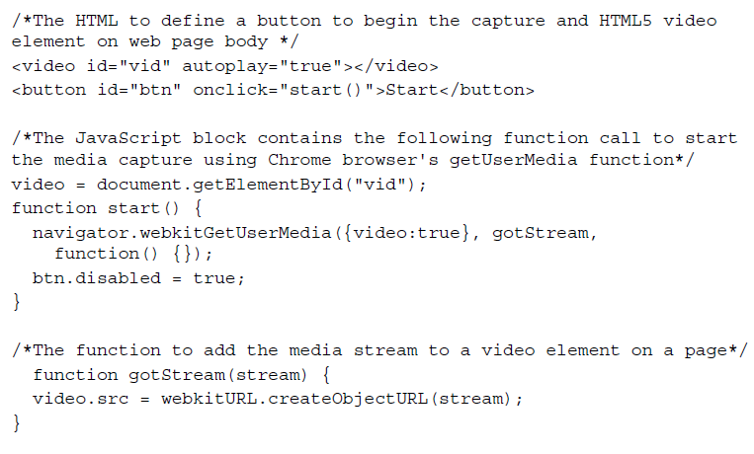
Core (cont.)
RTCPeerConnection
Bellow is an example using Google Chrome browser that displays local video using <video/> element.

Slide 13
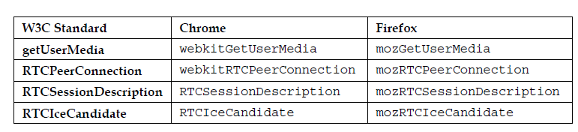
Core (cont.)
To make the peer connection, we need a function to populate the values of the RTCPeerConnection, getUserMedia, attachMediaStream, and reattachMediaStream parameters.
The browser APIs of different browsers have different names.

Slide 14
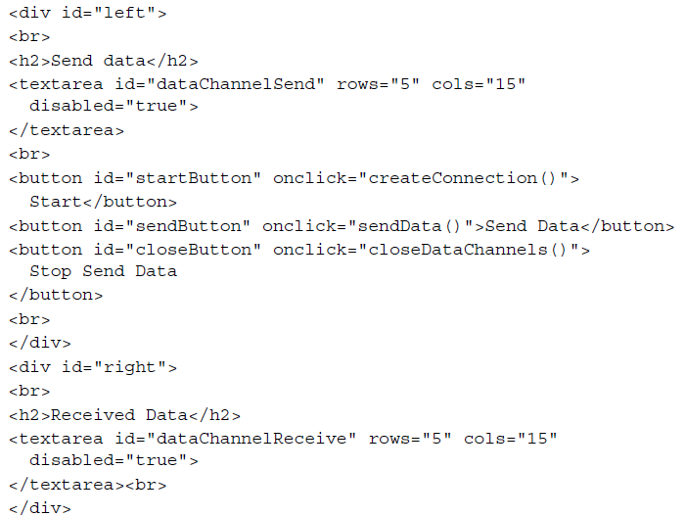
Core (cont.)
RTCDataChannel
The DataChannel function is used to exchange text messages by creating a bidirectional data channel between two peers.

Slide 15
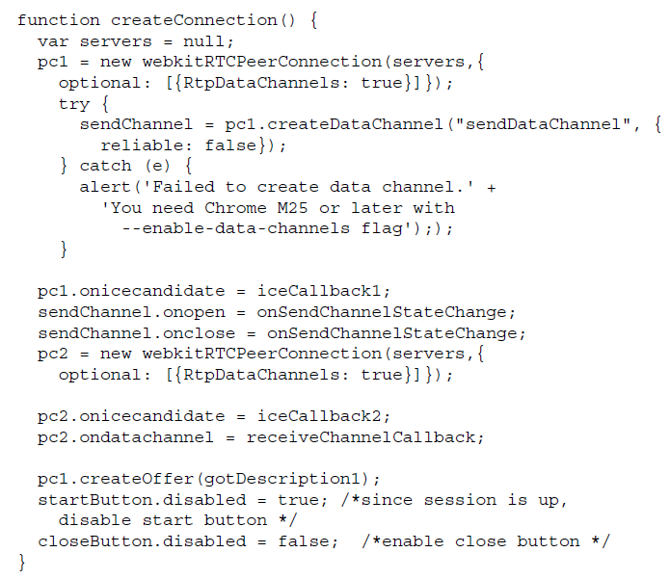
Core (cont.)
The following code snippet is the script to create PeerConnection in Google Chrome

Slide 16
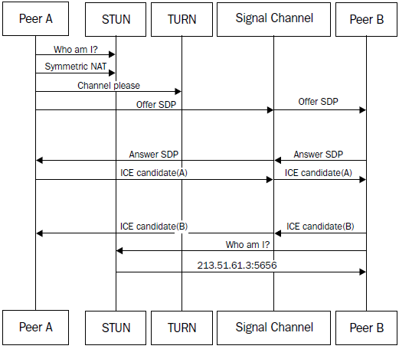
Core (cont.)
Real-time Transport Protocol (RTP) is the way for media to flow between end points. Media could be audio and/or video based.
RTP in WebRTC is by default peer-to-peer as enforced by the Interactive Connectivity Establishment (ICE) protocol candidates, which could be either STUN or TURN.

Slide 17
Core (cont.)
Session Initiation Protocol (SIP) is a signaling protocol that is used to establish an RTP between two endpoints.
The SIP stack defines the Request and Response methods.
These methods are used to gather the information about endpoints that wish to participate in a communication so that the device-specific information such as IP, port, availability, media understanding, and audio-video device compatibility can be sorted out before establishing a flowing media connection.

Slide 18
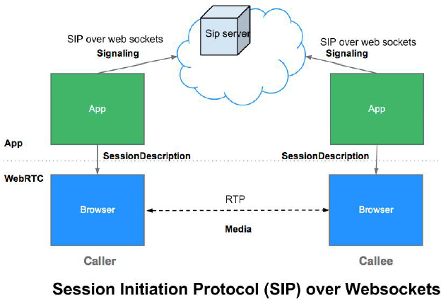
Core (cont.)
SIPWS(SIP over WebSocket) is a bit different than traditional SIP.
SIPWS is used in case of WebRTC with SIP signaling.

Slide 19
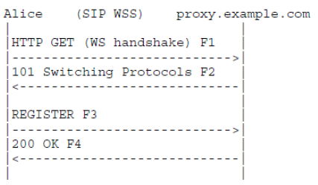
Core (cont.)
Any SIP request is preceded by a one-time WebSocket handshake.

Slide 20
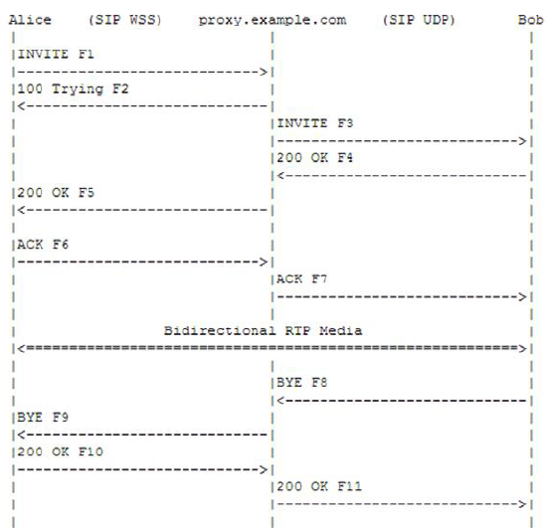
Core (cont.)
The bellow diagram shows the call between Alice and Bob through the SIP proxy server over WebSocket signaling.

Slide 21
Core (cont.)
JavaScript libraries that offer easy-to-integrate support for WebRTC communication using SIP signaling:
SIPJS:
a SIP stack in JavaScript to implement SIP-based audio and video user agents in the browser.
JSSIP:
an SIP over WebSocket transport API for audio/video calls and instant messaging.
sipML5:
an open source JavaScript library with a provision for RTCWeb.
QuoffeSIP:
WebRTC SIP library to establish real-time communication between browsers.

Slide 22
Model
WebRTC client-server model includes the components:
SIP stack, in the form of a JavaScript library, to perform signaling
Cascading Style Sheets (CSS) to style a page
WebRTC media API to render a peer-to-peer connection between the audio-video components of a page
An HTML5-based graphical interface to provide inputs such as registration parameters, self-URI (short for Uniform Resource Identifier), URI of the party to be called, etc.

Slide 23
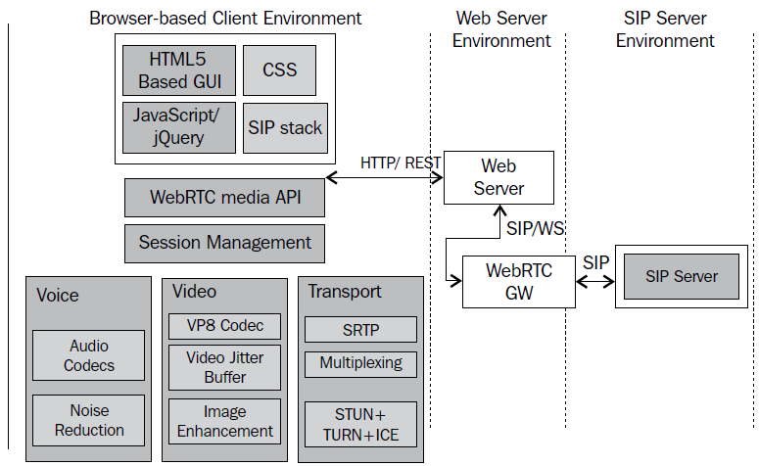
Model (cont.)

Slide 24
Model (cont.)
The components that must be deployed on the network side are:
The WebRTC gateway to connect to the native SIP world
The SIP server to embed the SIP application/proxy logic

Slide 25
Model (cont.)
The web browser is the key component in WebRTC transactions.
A WebRTC-capable browser has the additional ability to access the user's input media devices, such as microphones and camera, and stream them across the network.

Slide 26
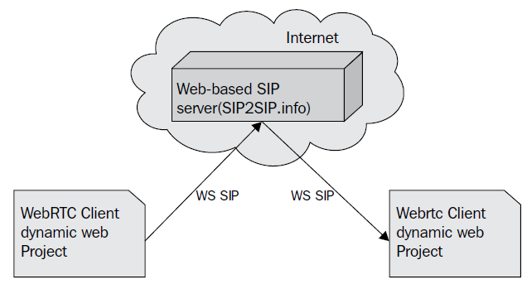
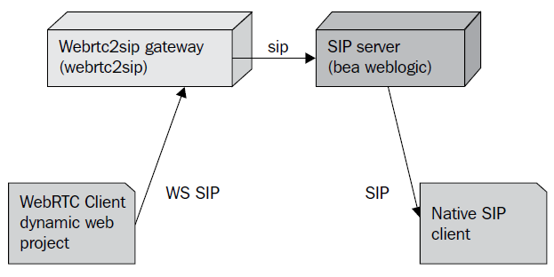
SIP Servers
The WebRTC client with an SIP stack can be registered and can send an invitation or give answers through an SIP server.
The SIP server might or might not have the support for WebSocket.
1)WebRTC-compliant SIP server, and the caller and receiver are both on SIP over WebSocket (SIP WS to SIP WS).
2)simple SIP server that does not respond to SIP over WebSocket, but only to SIP (Sip WS to Sip).

Slide 27
IMS
IP Multimedia Subsystem (IMS) is an architectural framework for IP Multimedia communications and IP telephony based on Convergent applications. It specifies three layers in a telecom network:
Transport or Access layer: This is the bottom-most segment responsible for interacting with end systems such as phones.
IMS layer: This is the middleware responsible for authenticating and routing the traffic and facilitating call control through the Service layer.
Service or Application layer: This is the top-most layer where all of the call control applications and Value Added Services (VAS) are hosted.

Slide 28
IMS (cont.)
IMS standards are defined by Third Generation Partnership Project (3GPP) which adopt and promote Internet Engineering Task Force (IETF) Request for Comments (RFCs).
The WebRTC gateway is the first point of contact for the SIP requests from the WebRTC client to enter into the IMS network.

Slide 29
IMS (cont.)
The WebRTC gateway converts SIP over WebSocket implementation to legacy/plain SIP.
WebRTC clients are meant to interact after the signals are traversed through core IMS nodes.
IMS nodes are:
Call Session Control Function (CSCF)
Home Subscriber Server (HSS)
Telecom Application Server (TAS)

Slide 30
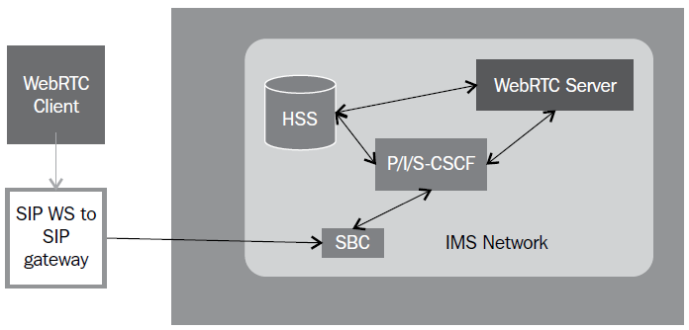
IMS (cont.)
The bellow diagram shows the placement of the SIPWS to SIP gateway in the IMS network.

Slide 31
IMS (cont.)
IMS is an architecture for real-time multimedia (voice, data, video, and messaging) services using a common IP network.
According to the 3GPP specification, IMS entities are classified into six categories:
Session management and route (CSCF, GGSN, and SGSN)
Database (HSS and SLF)
Interworking elements (BGCF, MGCF, IM-MGW, and SGW)
Service (Application Server, MRFC, and MRFP)
Strategy support entities (PDF)
Billing

Slide 32
IMS (cont.)
Interoperability with the SIP infrastructure requires a session border controller to decrypt the WebRTC control and media flows.
A media node is also set up for transcoding between WebRTC codecs and other legacy phones.
When a gateway is involved, the WebRTC voice and video peer connections are between the browser and the border controller.

Slide 33
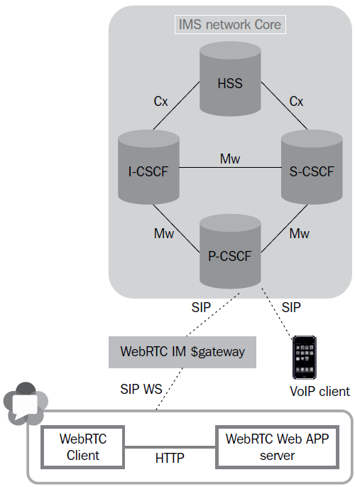
IMS (cont.)
The Open IMS Core is an open source implementation for core elements of the IMS network that includes IMS CSCFs nodes and HSS.

Slide 34
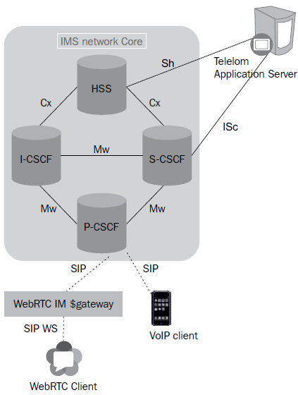
IMS (cont.)
The TAS is where the logic for processing a call resides. It can be used to add applications such as call blocking, call forwarding, and call redirection according to the predefined values.

Slide 35
PSTN
The Voice over Internet Protocol (VoIP) telephony is very usefull for communication such as user discovery; user presence; virtual conferences; file sharing; notifications based on web feeds such as news updates, parental control, and IPTV / Video On Demand.
PSTN = Public Switched Telephone Network.
As WebRTC is not intended to be just a web-only communication tool but to also connect to all other devices capable of communication,

Slide 36
PSTN (cont.)
IMS systems have hooks for PSTN terminals through the PSTN gateway.
The IN setup, which is based on SS7 signaling, not only includes GSM/UMTS access networks, but also includes legacy networks such as the Integrated Service Digital Network (ISDN), the PSTN, and the Public Land Mobile Network (PLMN).

Slide 37
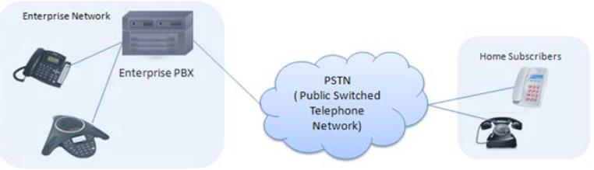
PSTN (cont.)
PSTN is the connection of many wired communication endpoints.
The communication is circuit-switched in nature.
PSTN endpoints were fixed-line analog telephone systems, also referred to as Plain Old Telephone Systems (POTS).
A Private Brach Exchange (PBX) is a telephone-switching system that comprises cables and micro controllers.
The modern IP PBX is also capable of switching between VoIP and the traditional telephone system.

Slide 38
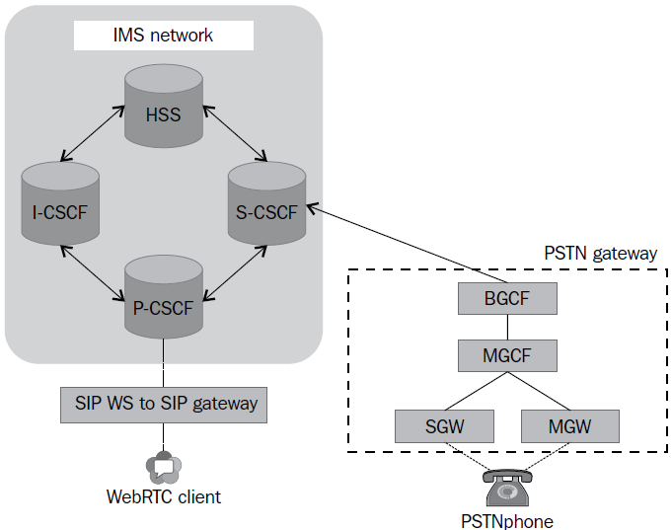
PSTN (cont.)
The bellow diagram shows the WebRTC-to-PSTN connectivity via the PSTN gateway:

Slide 39
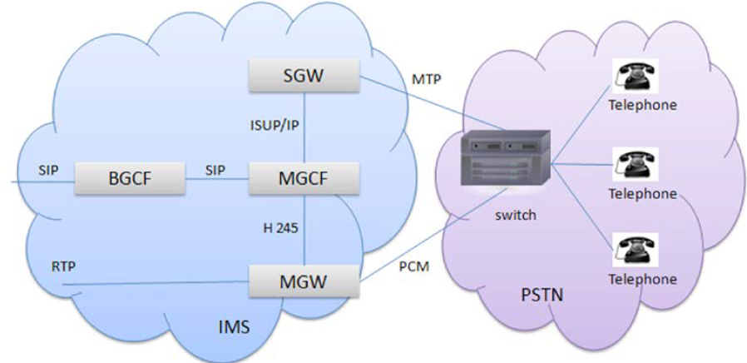
PSTN (cont.)
PSTN gateways are the major game players in this setup.
The gateway consists of three components:
Signaling Gateway (SGW)
Media Gateway (MGW)
Media Gateway Controller (MGC)

Slide 40
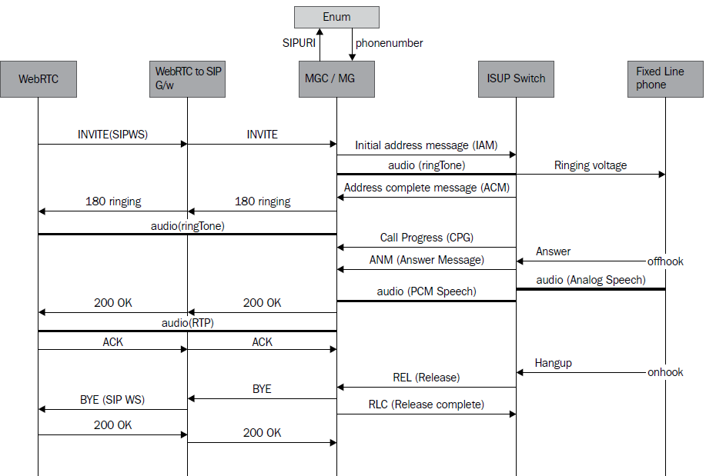
PSTN (cont.)

Slide 41
SIP Services
SIP services are communication features that are intrinsic to SIP requests itself.
These services include the following:
Registration
Audio/video call
Instant message
Presence

Slide 42
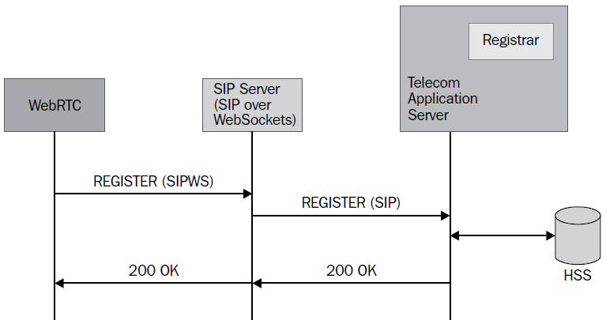
SIP Services (cont.)
A SIP client, such as a SIP phone, SIP soft client, and SIP WebRTC web page, it registers itself with the Registrar.
The Registrar informs the VoIP systems about how you can be reached for an incoming event such as a call, instant message, and Presence update.
A Registrar notes down the physical address of each of the clients through the SIP REGISTER request and confirms their registration with a 200 OK response.
The values obtained are copied to the HSS/Location Server.

Slide 43
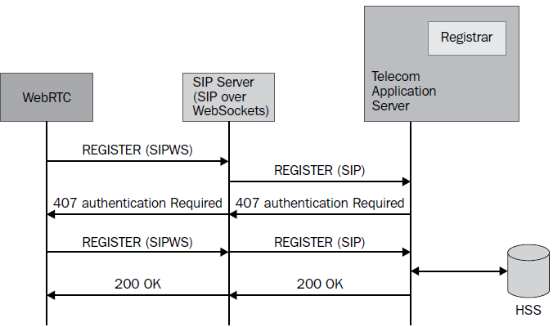
SIP Services (cont.)
With the introduction of secure registration with authentication, the server throws an authentication challenge in the form of a 407 Proxy Authentication Required response.

Slide 44
SIP Services (cont.)
The overall working principle for a SIP call based on requests revolves around the following 4 requests:
The Invite SIP request for session request
The Ack SIP request confirms a request
The Cancel SIP request is to end a pending request
The Bye SIP request is to end a session

Slide 45
SIP Services (cont.)
A 200 OK SIP response to the Invite SIP request is followed by the transmission of the Ack SIP request.
The Ack SIP request is used to transport the Session Description Protocol (SDP) for media negotiation.
This leads to successful call establishment between the caller and receiver parties.
A call request that does not receive a success response of 200 OK is gracefully ended with a Cancel SIP request.
An ongoing call is ended with a Bye SIP request.

Slide 46
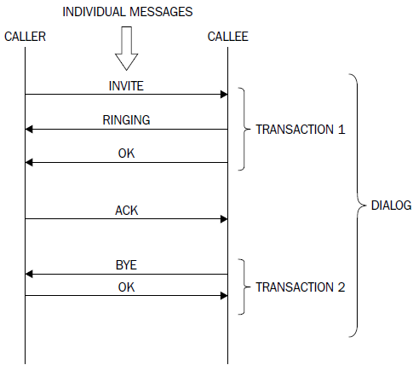
SIP Services (cont.)
The bellow diagram gives a description of the SIP Dialog and SIP Transaction:

Slide 47
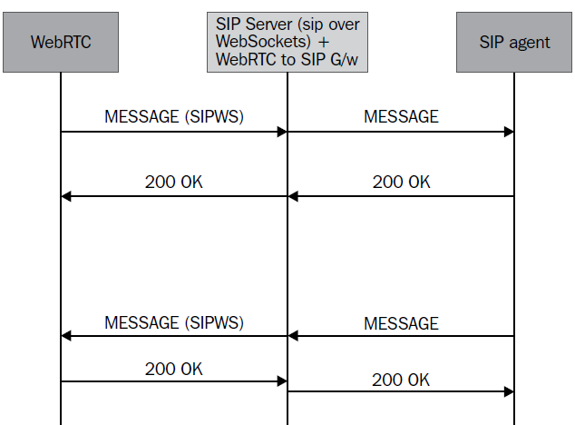
SIP Services (cont.)
The MESSAGE SIP request is the way through which messages are delivered to the SIP Server.
The frontend of the WebRTC client issues a MESSAGE SIP request from the sender to the receiver who carries the message body.

Slide 48
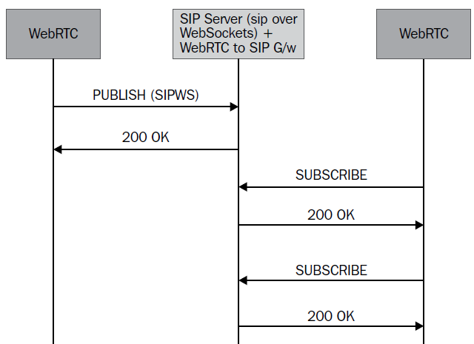
SIP Services (cont.)
The availability of users is determined by a SIP process called Presence.
Depending on their registration validation and reachability, a SIP or WebRTC client might send online or offline status notifications.
The PUBLISH SIP request publishes the status of a user to the SIP Server, which might either be online or offline.
The Server then sends out the NOTIFY SIP request to update the subscribed users about the current status of user X.

Slide 49
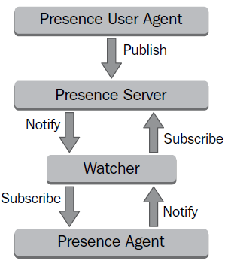
SIP Services (cont.)
The working principle for the Presence service is described bellow.
The Presence Agent publishes its current state to the Presence Server via the Watcher, which continuously monitors the state change for users.

Slide 50
SIP Services (cont.)
The three major SIP requests for the Presence service are given as follows:
Publish for event state update
Subscribe to enable the receipt of notifications
Notify to send updated information

Slide 51

Bibliography
https://en.wikipedia.org/wiki/WebRTC
https://webrtc.org/
https://www.html5rocks.com/en/tutorials/webrtc/basics/
PacktPublishing - WebRTC Integration Guide

Slide 52
Questions ?

