Slide 1

SonarQube
Dima Ionut Daniel

Slide 2
Contents
What is SonarQube?
Architecture
Basics
IDE Integration
Administration
Rule Profiles
Conclussion
Bibliography

Slide 3

What is SonarQube?
SonarQube (formerly Sonar) is an open source platform for continuous inspection of code quality.
It supports 25+ languages: Java, C/C++, Objective-C, C#, PHP, Flex, Groovy, JavaScript, Python, PL/SQL, COBOL, etc.
It offers reports on duplicated code, coding standards, unit tests, code coverage, complex code, potential bugs.

Slide 4
What is SonarQube? (cont.)
Provides fully automated analyses: integrates with Maven, Ant, Gradle and continuous integration tools (Atlassian Bamboo, Jenkins, Hudson, etc.)
Integrates with the Eclipse development environment
Integrates with external tools: JIRA, Mantis, LDAP, Fortify, etc.
Is expandable with the use of plugins.

Slide 5
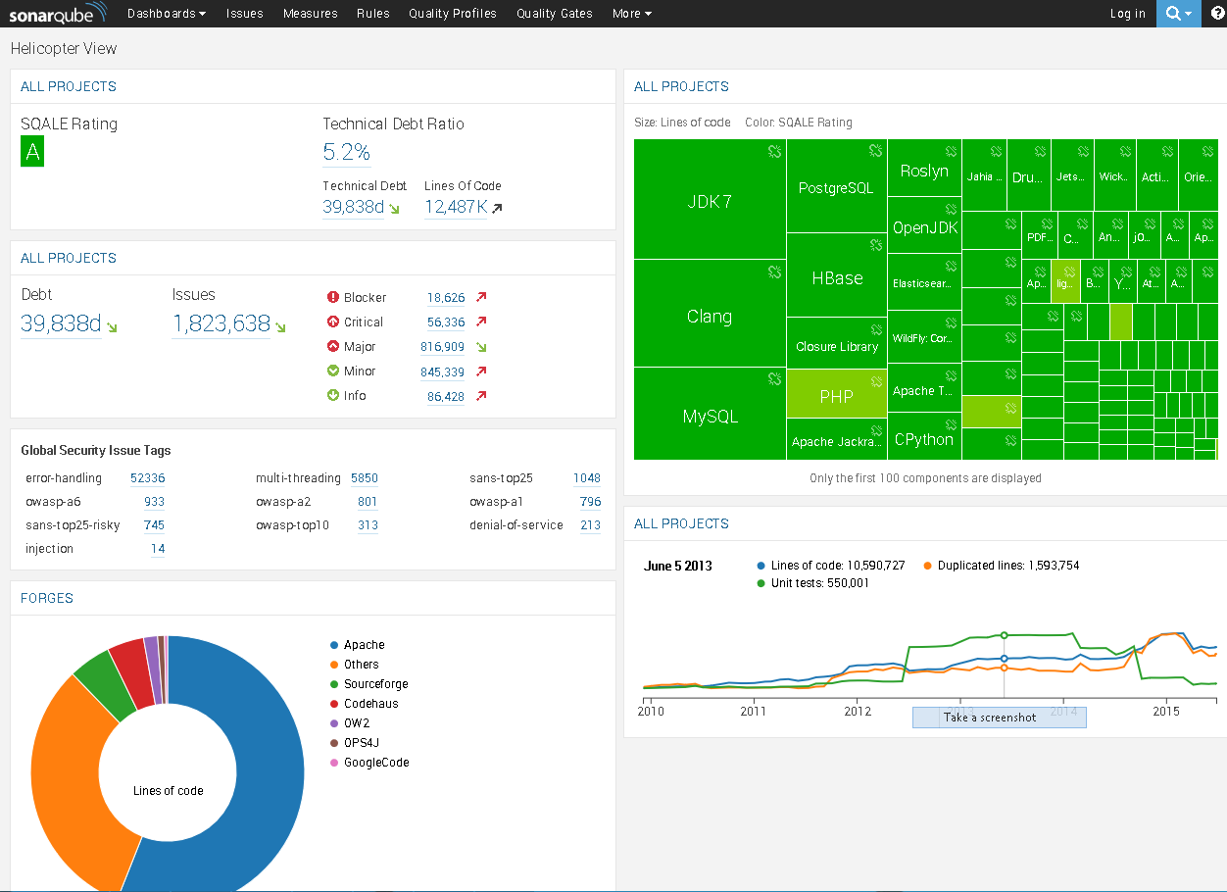
What is SonarQube? (cont.)
SonarQube has a public instance called Nemo: http://nemo.sonarsource.org with analyses of many open source projects.

Slide 6
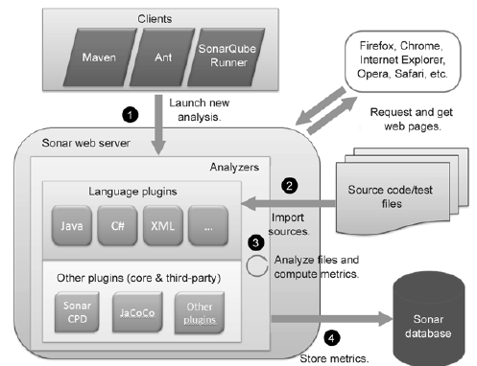
Architecture

Slide 7
Architecture (cont.)
In general you can run a SonarQube analysis with three different tools/client: Maven, Ant, and SonarQube Runner.
Once SonarQube has the source files loaded, it’s time to analyze them with a variety of analyzers that can create or update measures.
These analyzers are either embedded in SonarQube core, included in language plugins, or provided by non-language-specific plugins.

Slide 8
Basics
SonarQube needs to have a database configured and that's it.
Once you’ve set up your database, configured SonarQube, and started it, open a browser and head to port 9000 of your SonarQube host.
The local URL is http://localhost:9000.
The analysis is done by SonarRunner or other tools like Maven Sonar Plugin.
The analysis is accomplished by setting some properties and firing off the sonar-runner executable.

Slide 9
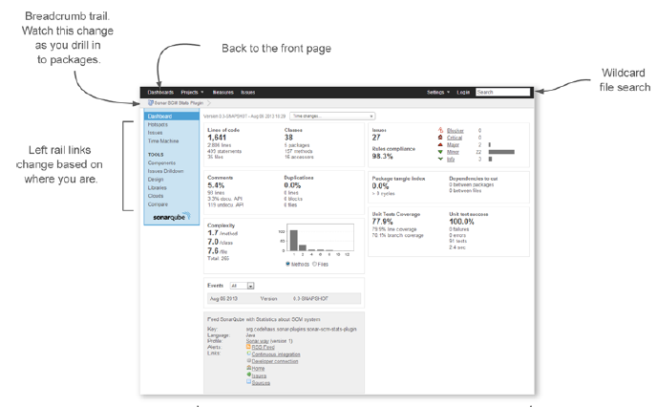
Basics (cont.)
SonarQube’s default dashboard.

Slide 10
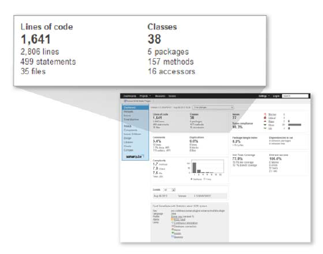
Basics (cont.)
The size metrics widget at upper left falls in the neutral category.
It tells you how many lines of code, methods, classes, and packages it found during the analysis.

Slide 11
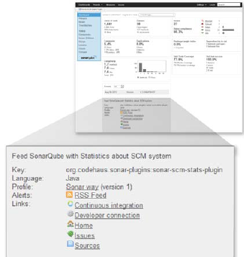
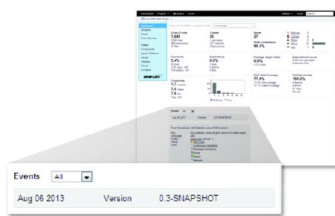
Basics (cont.)
Events are significant, at least in part because they flag an analysis snapshot for long term retention.
Every time an analysis is performed, a snapshot of the project state is taken.
The description widget is a brief curriculum vitae of your project, showing the language and ID you set during analysis.

Slide 12
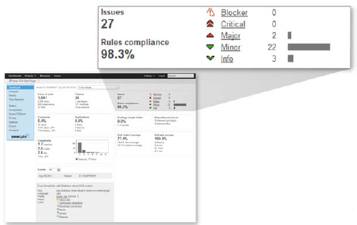
Basics (cont.)
It’s clear that some issues are worse than others.
That’s why SonarQube ranks them at different severities: Blocker, Critical, Major, Minor, and Info.
The rules-compliance percentage you see at lower left in the issues widget gives perspective.
It’s based on the number and severity of issues versus the lines of code in the project.

Slide 13
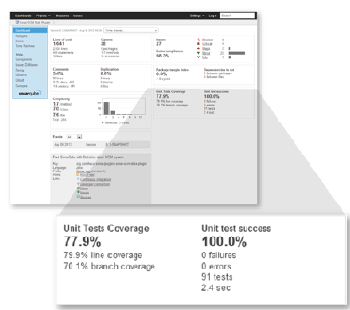
Basics (cont.)
The test coverage widget shows how well that coverage equation balances and whether your tests are passing, failing

Slide 14
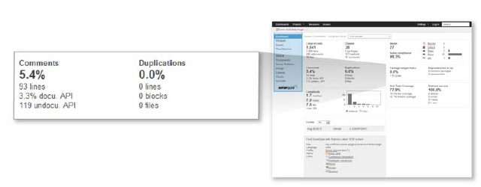
Basics (cont.)
The comments and duplications widget is another two-for-one.
Both are leading quality metrics.
The problem is that although copy-paste, the source of duplications, is often expedient, it’s not efficient in the long term.

Slide 15
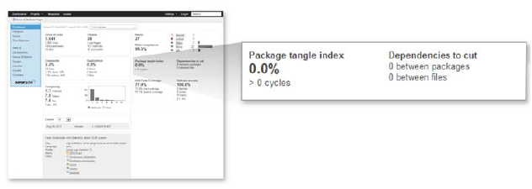
Basics (cont.)
The package design widget shows how clean your design implementation is
It gives a high-level figures showing how much work needs to be done to make the implementation as clean as the original design undoubtedly was.

Slide 16
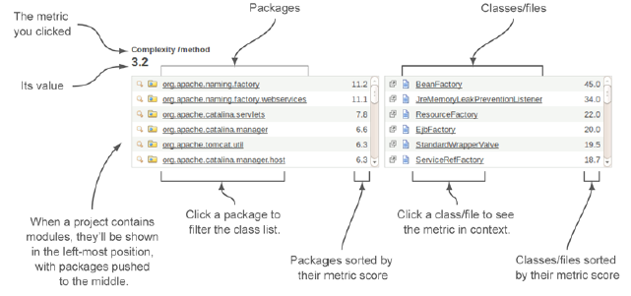
Basics (cont.)
Every metric on the dashboard clicks-through to a metric drilldown, which is designed to help you find the specific files.
Drilldowns in SonarQube start with the chosen metric and its value in the top row.
It's followed by a row of hierarchical widgets: modules, then directories/packages, then classes/files.
Each widget’s contents are sorted by its metric value.

Slide 17
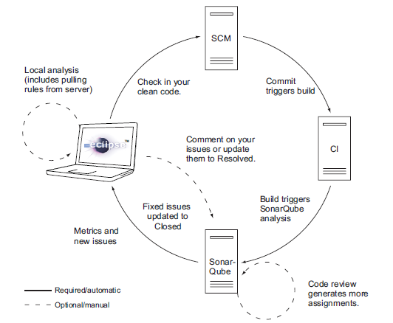
IDE Integration
If we're working in Eclipse, SonarQube integration is easier and richly featured.

Slide 18
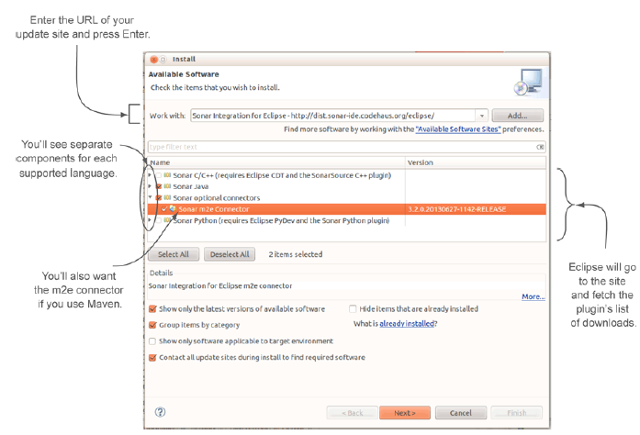
IDE Integration (cont.)
Eclipse makes plugin installation in general fairly painless.

Slide 19
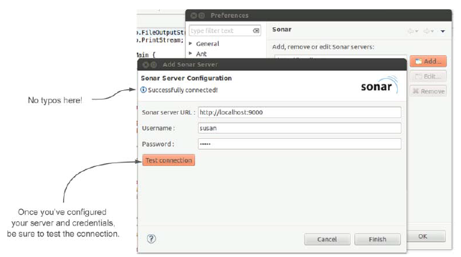
IDE Integration (cont.)
We need to configure the address for the SonarQube and credentials if needed.

Slide 20
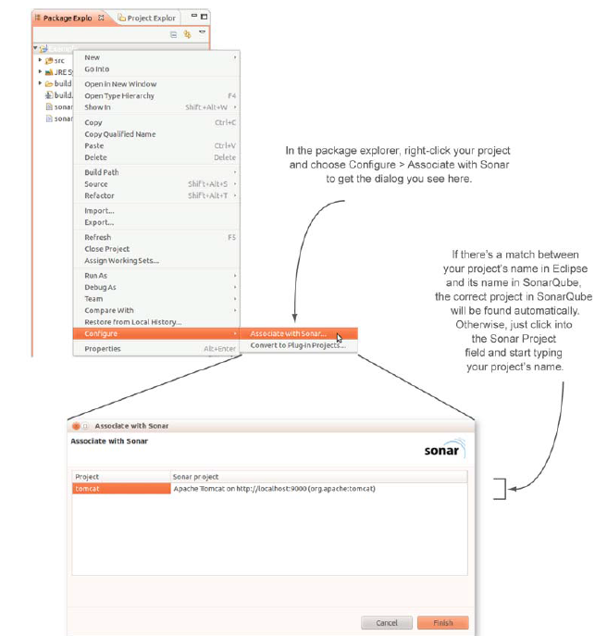
IDE Integration (cont.)

Slide 21
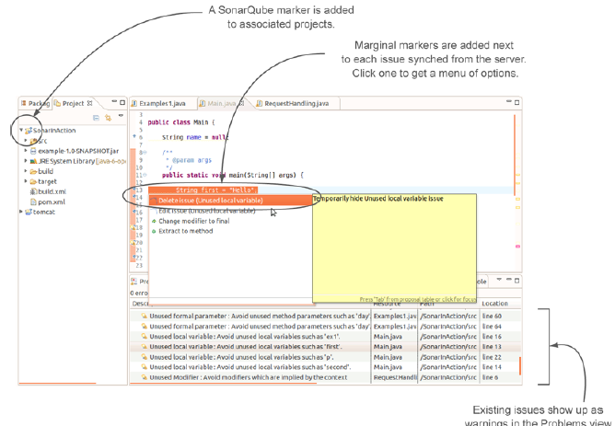
IDE Integration (cont.)
Existing issues also show up as warnings in the Problems view.

Slide 22
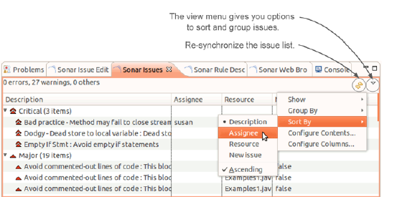
IDE Integration (cont.)
Use the Synchronize button to re-synchronize SonarQube issues

Slide 23
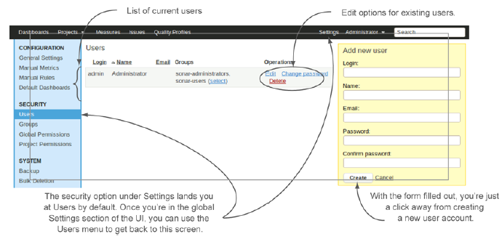
Administration
The foundations of security in any application are users and their permissions.
SonarQube can handle both authentication and authorization.
The Users interface gives a list of current users, links to manage each one, and the form to create new users.

Slide 24
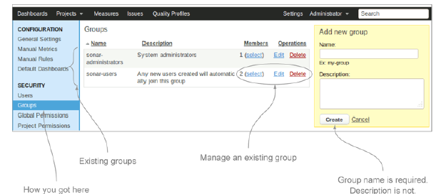
Administration (cont.)
SonarQube gives you the ability to grant permissions to either users or groups.

Slide 25
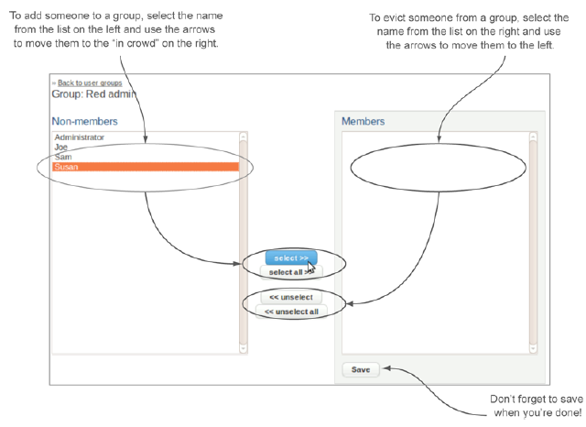
Administration (cont.)
The group membership interface presents two lists: the in crowd on the right and everyone else on the left.
Use the arrows between the two lists to move people from one side to the other

Slide 26
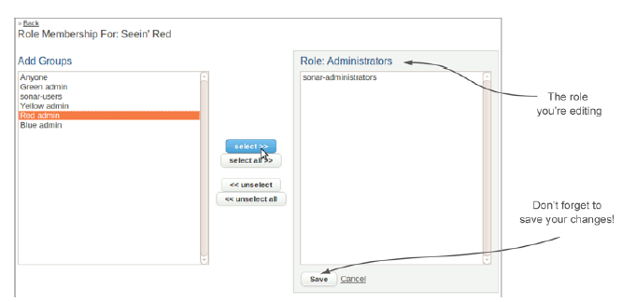
Administration (cont.)
To add a group to a project role, highlight it on the left, use the Select button to move it to the right, and save your changes.

Slide 27
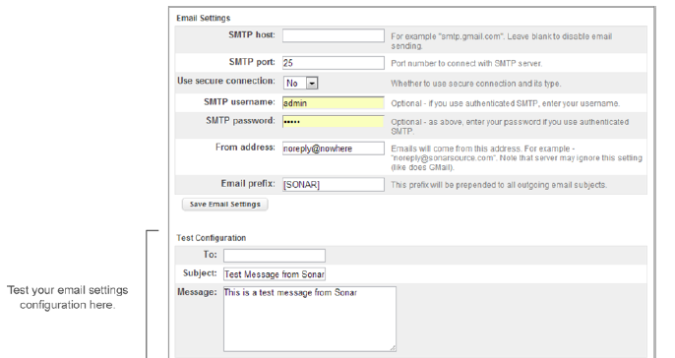
Administration (cont.)
We can activate email notifications.

Slide 28
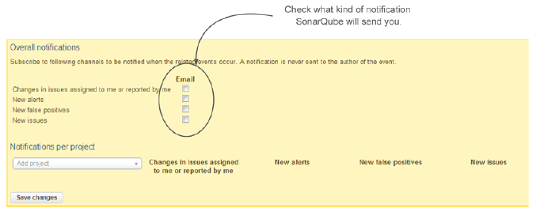
Administration (cont.)
Check the boxes to subscribe to the event types and start receiving emails for all projects.
If you enable the first notification, SonarQube will send you a message when a change occurs.

Slide 29
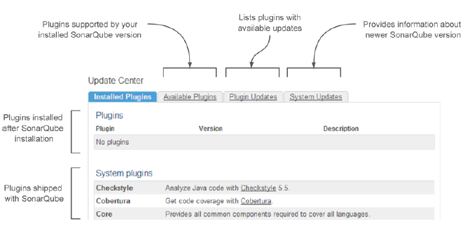
Administration (cont.)
SonarQube’s update center allows the installation of custom plugins.

Slide 30
Rule Profiles
A lot of things happen during an analysis.
The code is examined for duplications, complexity, measured against a set of rules: a rule profile.
Those default rule sets make great starting points, but they’re not perfect for every situation.

Slide 31
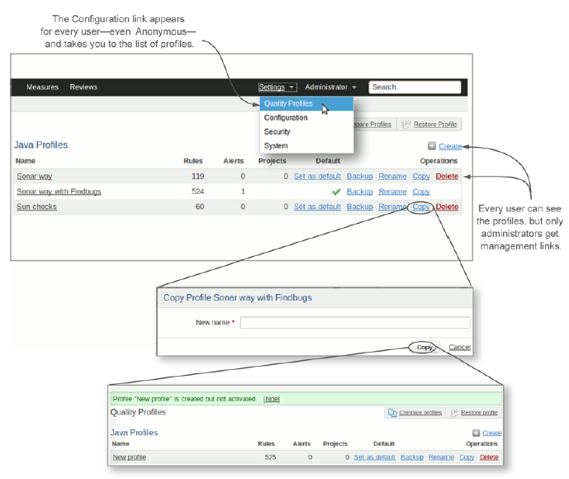
Rule Profiles (cont.)

Slide 32
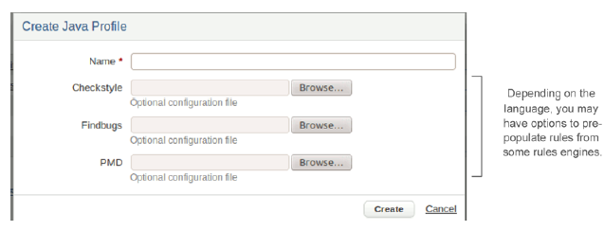
Rule Profiles (cont.)
Clicking the Configuration link at the top of the page takes you to a list of rule profiles.
Logged-in administrators can easily copy any profile with the click of a mouse.

Slide 33
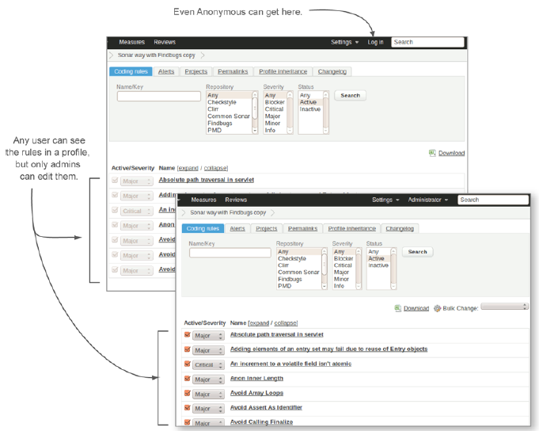
Rule Profiles (cont.)

Slide 34
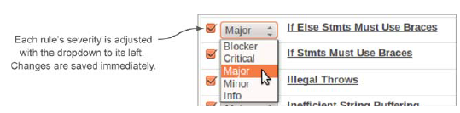
Rule Profiles (cont.)
Use the drop-down menu to the left of any rule to adjust its severity in that profile.
Note that no other profile is affected by this change.

Slide 35

Bibliography
https://en.wikipedia.org/wiki/SonarQube
Manning – SonarQube in Action

Slide 36
Questions ?

