Slide 1

Activiti
Dima Ionut Daniel

Slide 2
Contents
What is Activiti?
Activiti Basics
Activiti Explorer
Activiti Modeler
Activiti Designer
BPMN 2.0
Activiti Process Engine
Activiti Tool Stack
Error handling
Deployment and Configuration
BPM Alternatives
Bibliography

Slide 3

What is Activiti?
Activiti is a light-weight workflow and Business Process Management (BPM) Platform
Its core is a super-fast and uses BPMN 2 process engine for Java
It's open-source and distributed under the Apache license.
Activiti runs in any Java application, on a server, on a cluster or in the cloud.
It integrates perfectly with Spring, it is extremely lightweight and based on simple concepts.

Slide 4
Activiti Basics
Activiti is a BPMN 2.0 process-engine framework that implements the BPMN 2.0 specification.
The Activiti Engine is a state machine.
In the Activiti Engine, most BPMN 2.0 elements are implemented as a state.

Slide 5
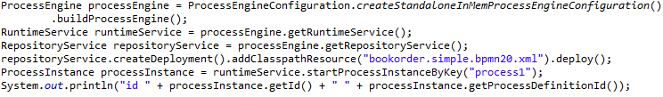
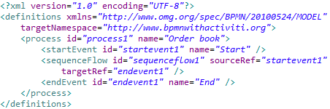
Activiti Basics (cont.)
The process engine can be created with the ProcessEngineConfiguration which can be used to start the Activiti engine and the H2 database.
Activiti can run on database platforms other than H2, such as Oracle, Mysql, PostgreSQL, etc.
To deploy a process from Java we need to access the RepositoryService from the ProcessEngine instance.
The RepositoryService instance is used to add from classpath the XML file and deploy the it to process engine.
The process engine will validate the process file and create a new process definition in the H2 database.
The startProcessInstanceByKey() method is used to start the newly deployed process definition

Slide 6
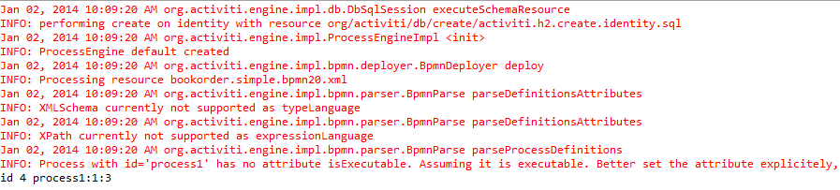
Activiti Basics (cont.)
A process instance is stored to the H2 database, and a process instance ID that can be used as a reference to this specific process instance is created.
This message means that the process instance ID is 4 and the process definition that was used to create the instance was the "process1" definition with version 1 and the process definition database ID is 3.

Slide 7
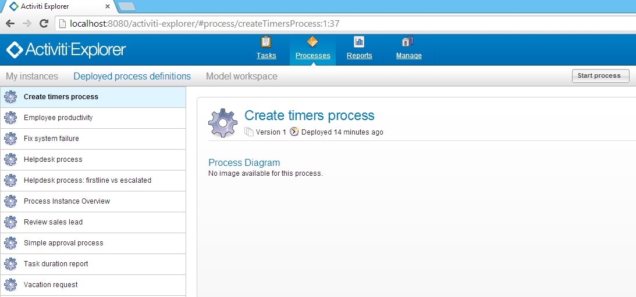
Activiti Explorer
Activiti Explorer is a vaadin web application.
Explorer uses an in-memory database, but it is easy to switch to a different database.

Slide 8

Activiti Explorer (cont.)
Tasks: user tasks from running processes.
Process: shows the deployed process definitions, and allows to start new process instances.
Reporting: generate reports and view previously saved results.
Manage: Allows to administrate the Activiti engine; manage users and groups, execute and see stuck jobs, see the database and deploy new process definitions

Slide 9
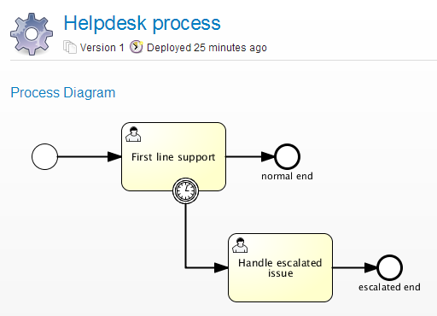
Activiti Explorer (cont.)
The Explorer includes functionality to dynamically generate an overview of a process definition using the Raphael Javascript framework.
This process image can only be generated when the process definition XML contains BPMN DI information.

Slide 10
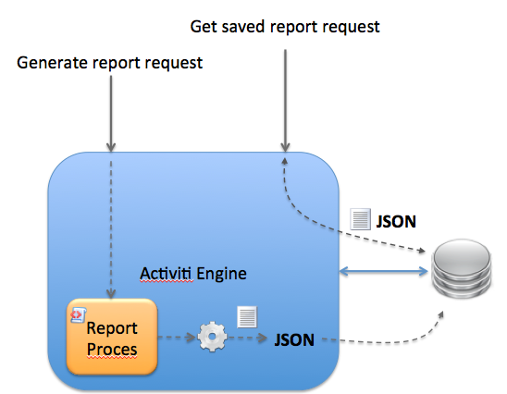
Activiti Explorer (cont.)
Activiti Explorer has the capability to easily add new reports to the system.
Generate reports: shows a list of all reports known to the system.
Saved reports: shows a list of all reports that were previously saved. These are personal saved reports only and it is not possible to see the saved reports of someone else.

Slide 11
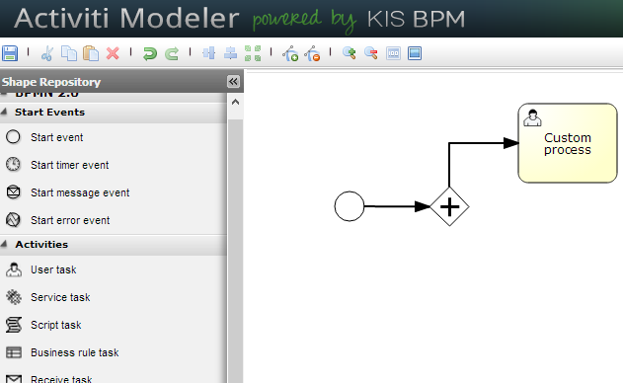
Activiti Modeler
The Activiti Modeler is an add-on component to the core Activiti framework and is a web application.
The Activiti Modeler sources are available from the Signavio Core Components Google repository.
The Activiti Engine doesn’t support all of these BPMN elements.

Slide 12
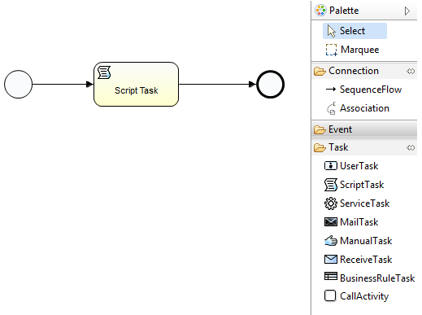
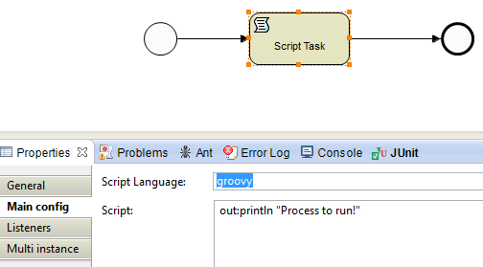

Activiti Designer
The Activiti Designer can be used to add technical details to an imported process model.
It can also be used to model new processes from scratch.

Slide 13
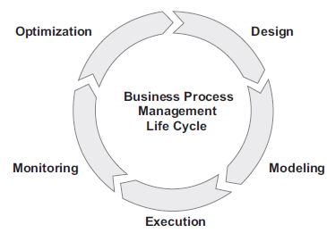
BPMN 2.0
Business Process Model and Notation (BPMN) is a graphical representation for specifying business processes in a business process model. It is also known as Business Process Modeling Notation.
Design: define the business process
Modeling: the business process is fully specified and validated.
Execution: the modeled business process is implemented in a business process application
Monitoring: the processes are monitored for business goals that are defined by key performance indicators (KPIs).
Optimization: the implemented business processes will need to be optimized.
When the optimization phase is done, the business process goes into the design phase again and the cycle is completed.

Slide 14
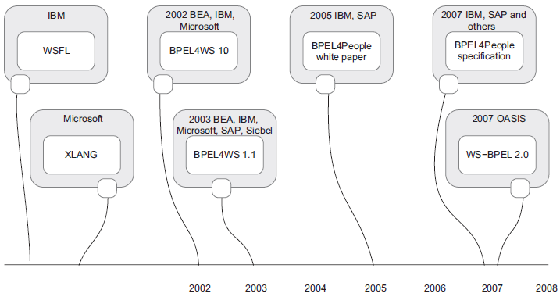
BPMN 2.0 (cont.)
BPMN 1.0 had been standardized and was widely used by information and business analysts from 2004
WS-BPEL was the first BPM language that was used by developers to run processes on a process engine.

Slide 15
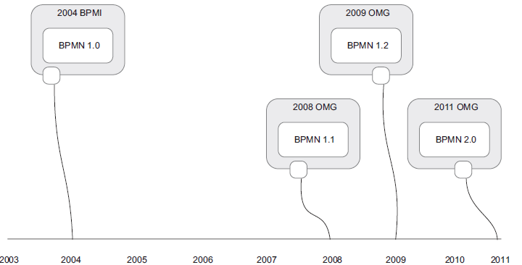
BPMN 2.0 (cont.)
BPMN 1.x is widely used as a modeling notation for business processes.
The BPMN 2.0 specification is found at the Object Management Group (OMG) website (www.omg.org/spec/BPMN).

Slide 16
BPMN 2.0 (cont.)
BPMN models consist of simple diagrams constructed from a limited set of graphical elements.
BPMN's basic element categories:
Flow objects: Events, activities, gateways
Connecting objects: Sequence flow, message flow, association
Swim lanes: Pool, lane
Artifacts: Data object, group, annotation

Slide 17


BPMN 2.0 (cont.)
Event is represented with a circle and denotes something that happens.
Start event is the process trigger.
Intermediate event represents something that happens between the start and end events.
End event represents the result of a process
Activity describes the kind of work which must be done.
Task is a single unit of work that is not or cannot be broken down to a further level of business process detail.
Sub-process has its own self-contained start and end events.
Transaction is a form of sub-process in which all contained activities must be treated as a whole.
Call Activity is a point in the process where a global process or a global Task is reused.

Slide 18
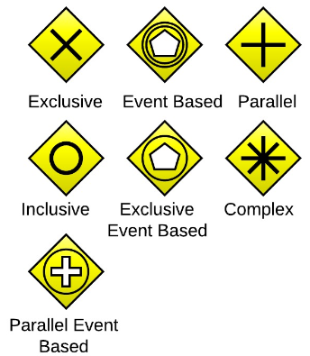
BPMN 2.0 (cont.)
Event is represented with a circle and denotes something that happens.
Gateway determines forking and merging of paths, depending on the conditions expressed.
Exclusive is used to create alternative flows in a process.
Event Based determinates the path of a process is based on an evaluated event
Parallel is used for creating parallel paths without evaluating any conditions.
Inclusive is used to create alternative flows where all paths are evaluated.
Exclusive Event Based is evaluated to determine which of mutually exclusive paths will be taken.
Complex is used to model complex synchronization behavior
Parallel Event Based. two parallel process are started based on an event but there is no evaluation of the event

Slide 19
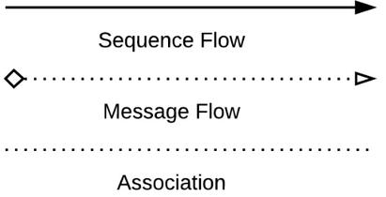
BPMN 2.0 (cont.)
Connections. Flow objects are connected to each other using Connecting objects.
Sequence Flow shows in which order the activities are performed
Message Flow tells us what messages flow across organizational boundaries.
Association is used to associate an Artifact or text to a Flow Object, and can indicate some directionality

Slide 20
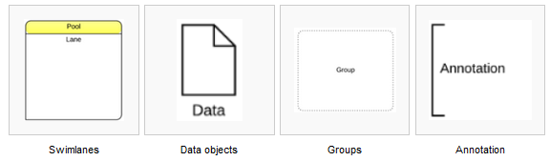
BPMN 2.0 (cont.)
Swim lanes are a visual mechanism of organising and categorising activities.
Pool represents major participants in a process; a pool contains one or more lanes.
Lane is used to organise and categorise activities within a pool.
Artifacts allow developers to bring some more information into the model/diagram; the model/diagram becomes more readable.
Data objects show the reader which data is required or produced in an activity
Group is used to group different activities but does not affect the flow in the diagram.
Annotation is used to give the reader of the model/diagram an understandable impression.

Slide 21
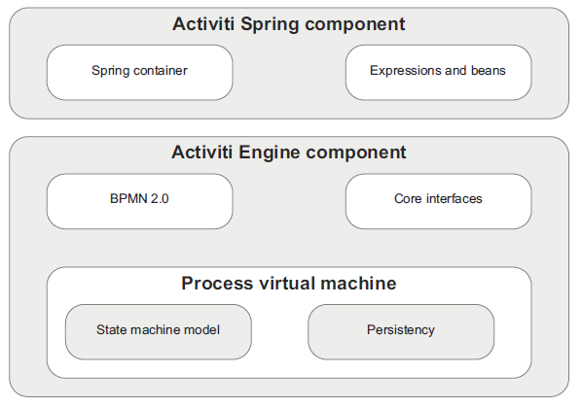
Activiti Process Engine
Activiti engine consists of several layers.
The engine component includes a process virtual machine abstraction, which translates the BPMN 2.0 engine logic into a state machine model,
An optional layer is the Spring container integration for the Activiti engine.

Slide 22
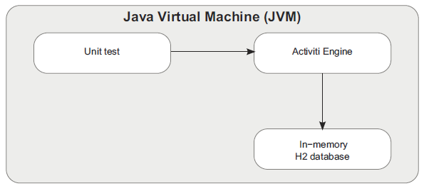
Activiti Process Engine (cont.)
Activiti uses the standard Java java.util.logging API, also known as JDK 1.4 logging and Spring uses Apache commons logging.
A good way to test a BPMN 2.0 process is to run the Activiti Engine inside the Java Virtual Machine (JVM) with an in-memory database.

Slide 23
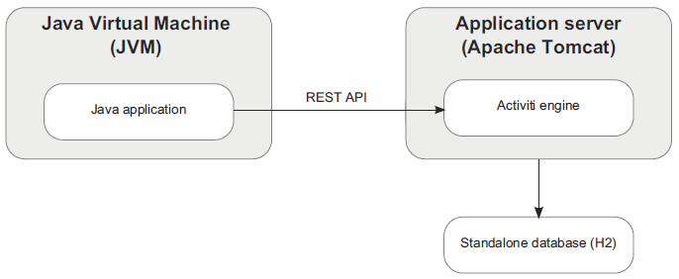
Activiti Process Engine (cont.)
We can use REST API to interact with Activiti Engine.

Slide 24
Activiti Process Engine (cont.)
The Activiti Engine API is divided into 7 core interfaces, each targeted at interacting with different functionality of the process engine.
FormService: in order to work with user task forms.
HistoryService: retrieve information about completed process instances.
IdentityService: interface on the authentication component.
ManagementService: can be used to query Activiti tables and execute jobs.
RepositoryService: provides functionality to deploy,query,deploy and retrieve process definitions.
RuntimeService: provides interface to start/query instances.
TaskService: services related to tasks.

Slide 25
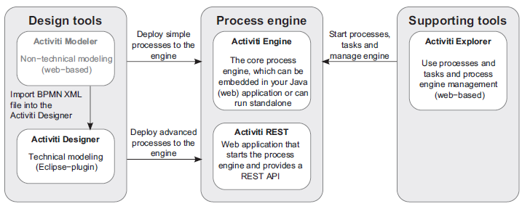
Activiti Tool Stack
The core component of the Activiti framework is the process engine.
The process engine provides the core capabilities to execute Business Process Model and Notation (BPMN) 2.0 processes.
The BPMN specification and lots of examples can be found at www.bpmn.org.
We can use Activiti Modeler(Eclipse-based plugin) to create the BPM.

Slide 26
Activiti Tool Stack (cont.)
Activiti supporting tools:
Activiti Engine: performs the process engine functions, such as executing BPMN 2.0 business processes and creating workflow tasks.
Activiti Modeler: web-based modeling environment for creating BPMN 2.0-compliant business process diagrams.
Activiti Designer: Eclipse plugin that can be used to design BPMN 2.0-compliant business processes
Activiti Explorer: web application that can be used for a wide range of functions in conjunction with the Activiti Engine.
Activiti REST: web application that provides a REST interface on top of the Activiti Engine.

Slide 27
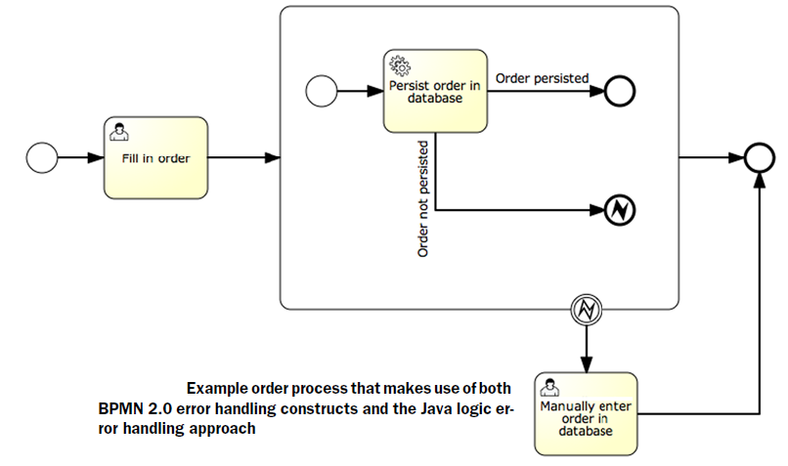
Error Handling
The Activiti Engine provides this flexibility by supporting both the standard BPMN error handling constructs as well as error handling via Java exceptions.
Choosing the Java logic approach means that the error handling is implemented inside a service task and, therefore, is not part of the process model.

Slide 28
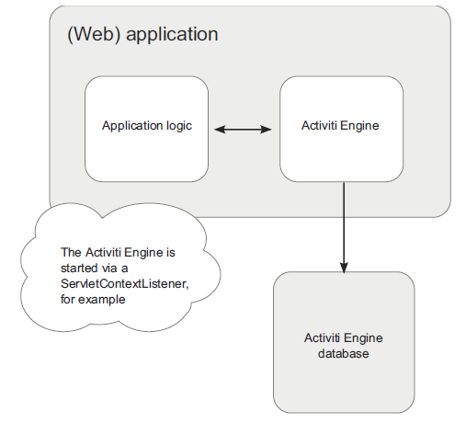
Deployment and Configuration
There are two common ways to set up your application environment with an Activiti Engine:
Embedded - Embed the Activiti Engine instance in your application and use the Activiti Java API to communicate with the Activiti Engine.
Standalone - Set up a standalone Activiti Engine instance and have multiple applications access the Activiti Engine via the REST API.

Slide 29
BPM Alternatives
Other open source process engine like Activiti:
JBoss BPM
open source process engine that first supported the custom jPDL process language
because version 5.0 supports BPMN 2.0, the jBPM project has merged with the JBoss Drools project
BonitaSoft
open source process engine that provides support for the BPMN 2.0 process language
provides a large set of supported elements and the integrated development environment

Slide 30

Bibliography
http://www.activiti.org/
Manning Activiti in Action
http://en.wikipedia.org/wiki/Business_Process_Model_and_Notation

Slide 31
Questions ?

