Slide 1

Wiremock
Dima Ionut Daniel

Slide 2
Contents
What is Wiremock ?
Features
Core
Configuration
Stubbing
Veryfing
Request Matching
Extending Wiremock
Conclusions
Bibliography

Slide 3

What is Wiremock?
Mock your APIs for fast, robust and comprehensive testing WireMock is a simulator for HTTP-based APIs.
It supports testing of edge cases and failure modes that the real API won't reliably produce.
It's fast and it can reduce the build time from hours down to minutes.

Slide 4
What is Wiremock? (cont.)
WireMock is distributed in 2 flavors:
standard JAR containing only WireMock
standalone fat JAR containing WireMock and all its dependencies

Slide 5
Features
Flexible deployment: run WireMock from within your Java application, JUnit test, Servlet container or as a standalone process.
Powerful Request Matching: match request URLs, methods, headers cookies and bodies using a wide variety of strategies. It support for JSON and XML.
Record and Playback: get up and running quickly by capturing traffic to and from an existing API.

Slide 6

Core
We need to import WireMock fluent API:
WireMock ships with some JUnit rules to manage the server’s lifecycle and setup/tear-down tasks.
To start and stop WireMock per-test case, add the following to your test class.

Slide 7
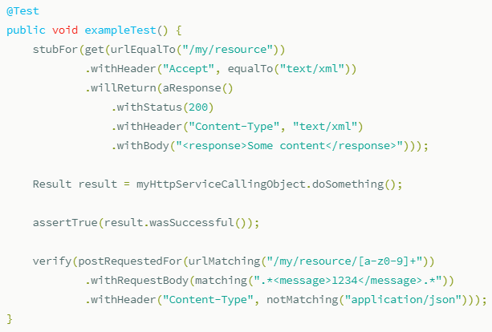
Core (.cont)

Slide 8
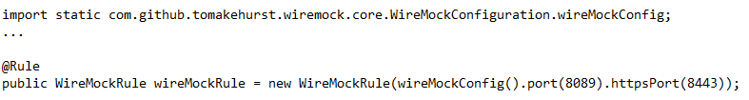
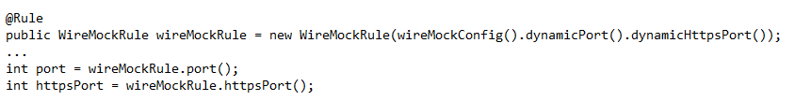
Core (.cont)
We can control WireMock server using the WireMockConfiguration.
We can start the WireMock using dynamic ports.

Slide 9
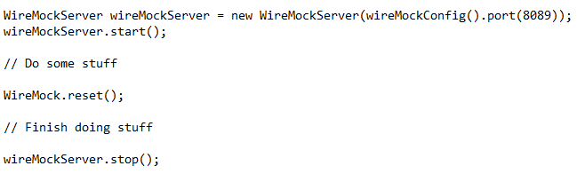
Core (.cont)
If we aren't using JUnit or neither WireMock rules we can manage the lifecycle programatically.

Slide 10
Core (.cont)
The WireMock server can be run standalone and configured via the Java API, JSON/HTTP or JSON files.
The WireMock server will start on port 8080.
WireMock can be packaged up as a WAR and deployed into a servlet container.

Slide 11
Core (.cont)
The JUnit rule provides a convenint way to include WireMock in test cases.
It handles the lifecycle, starting/stoping the server before each test method.
@Rule
public WireMockRule wireMockRule = new WireMockRule();

Slide 12
Core (.cont)
From JUnit 4.11 and above prohibits @Rule on static members.
@ClassRule
public static WireMockClassRule wireMockRule = new WireMockClassRule(8089);
@Rule
public WireMockClassRule instanceRule = wireMockRule;

Slide 13
Core (.cont)
WireMockServer and WireMockRule take a configuration builder as the parameter to the constructor.
import static com.github.tomakehurst.wiremock.core.WireMockConfiguration.options;
WireMockServer wm = new WireMockServer(options().port(2345));
@Rule
WireMockRule wm = new WireMockRule(options().port(2345));

Slide 14
Configuration
Network ports and bindings
.port(8000) // Statically set the HTTP port number. Defaults to 8080.
.httpsPort(8001) // Statically set the HTTPS port number. Defaults to 8443.
.dynamicPort() // Randomly assign the HTTP port on startup
.dynamicHttpsPort() // Randomly asssign the HTTPS port on startup
.bindAddress("192.168.1.111") // Bind the WireMock server to this IP address locally. Defaults to the loopback adaptor.

Slide 15
Configuration (.cont)
Jetty configuration
.containerThreads(5) // Set the number of request handling threads in Jetty. Defaults to 10.
.jettyAcceptors(4) // Set the number of connection acceptor threads in Jetty. Defaults to 2.
.jettyAcceptQueueSize(100) // Set the Jetty accept queue size. Defaults to Jetty's default of unbounded.
// Set the size of Jetty's header buffer (to avoid exceptions when very large request headers are sent). Defaults to 8192.
.jettyHeaderBufferSize(16834)
// Enable asynchronous request processing in Jetty. Recommended when using WireMock for performance testing with delays, as it allows much more efficient use of container threads and therefore higher throughput. Defaults to false.
.asynchronousResponseEnabled(true)
// Set the number of asynchronous response threads. Effective only with asynchronousResponseEnabled=true. Defaults to 10.
.asynchronousResponseThreads(10)

Slide 16
Configuration (.cont)
WireMock can accept HTTP connections from clients that cna have certificates as authentication.
.keystorePath("/path/to/https-certs-keystore.jks") // Set the keystore containing the HTTPS certificate
.keystorePassword("verysecret!") // Set the password to the keystore
.keystoreType("BKS") // Set the keystore type
// Require a client calling WireMock to present a client certificate
.needClientAuth(true)
// Path to the trust store containing the client certificate required in by the previous parameter
.trustStorePath("/path/to/trust-store.jks")
.trustStorePassword("trustme") // The password to the trust store

Slide 17
Configuration (.cont)
Proxy settings
// Make WireMock behave as a forward proxy e.g. via browser proxy settings
.enableBrowserProxying(true)
// Send the Host header in the original request onwards to the system being proxied to
.preserveHostHeader(false)
// Override the Host header sent when reverse proxying to another system (this and the previous parameter are mutually exclusive)
.proxyHostHeader("my.otherdomain.com")
// When reverse proxying, also route via the specified forward proxy (useful inside corporate firewalls)
.proxyVia("my.corporate.proxy", 8080)

Slide 18
Configuration (.cont)
WireMock will try to find file under src/test/resources as a filesystem root if it's not configured.
// Set the root of the filesystem WireMock will look under for files and mappings
.usingFilesUnderDirectory("/path/to/files-and-mappings-root")
// Set a path within the classpath as the filesystem root
.usingFilesUnderClasspath("root/path/under/classpath")

Slide 19
Configuration (.cont)
WireMock can start as a standalone process from command line.
Command line options options:
--port: sets the HTTP port number
--https-port: enables HTTPS on specific port
--bind-address: IP address used for WireMock server.
--verbose: turn on verbose logging to stdout
--root-dir: sets root directory, under which mappings and __files reside.
--print-all-network-traffic: prints incoming/outgoing network traffic to console

Slide 20
Configuration (.cont)
WireMock server can be configured via JSON over HTTP.
We can create a stub mapping by posting to WireMock HTTP API:
$ curl -X POST \
--data '{ "request": { "url": "/get/this", "method": "GET" }, "response": { "status": 200, "body": "Here it is!\n" }}' \
http://localhost:8080/__admin/mappings/new
$ curl http://localhost:8080/get/this
Here it is!

Slide 21
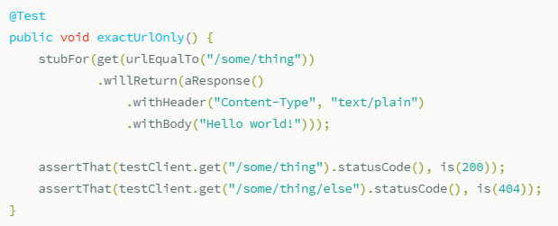
Stubbing
A core feature of WirMock is the ability to return HTTP responses for request matching criteria.

Slide 22
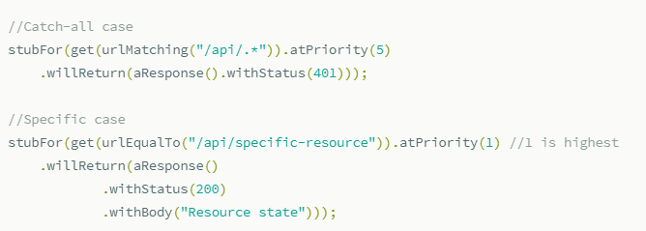
Stubbing (.cont)
We can define a stubb for any URL that doesn't math any specific cases.

Slide 23
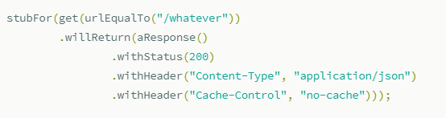
Stubbing (.cont)
We can send response headers as well.

Slide 24
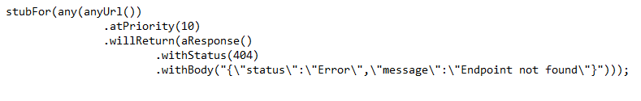
Stubbing (.cont)
When a request cannot be mapped to a resource, WireMock returns an HTML response with a 404 status code.
It's possible to customize the response by catching all URL with low priority.

Slide 25
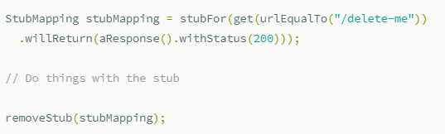
Stubbing (.cont)
Stub mappings can be deleted via Java API:

Slide 26
Stubbing (.cont)
All stub mappings can be fetched in Java by calling WireMock.listAllStubMappings().
To fetch mappings via HTTP API we send a GET request to http://<host>:<port>/__admin/mappings.
Limit and offset parameters can be specified with http://localhost:8080/__admin/mappings?limit=10&offset=50.

Slide 27
Veryfing
WireMock server records all requests it receives until it's reseted.
This makes possible to verify that a request maching a specific pattern war received.
Veryfying and querying requests relies on the request journal, which is an in-memory log of received requests. This can be disabled for load testing.
// Do not record received requests. Typically needed during load testing to avoid JVM heap exhaustion.
.disableRequestJournal()
// Limit the size of the request log (for the same reason as above).
.maxRequestJournalEntries(Optional.of(100))

Slide 28
Veryfing (.cont)
To verify that a request is matching a criteria we can use:
verify(postRequestedFor(urlEqualTo("/verify/this")).withHeader("Content-Type", equalTo("text/xml")));
To check for a pricese number of requests matching the criteria we use this form:
verify(3, postRequestedFor(urlEqualTo("/three/times")));

Slide 29
Request Matching
WireMock supports matching of requests to stubs using following attributes:
URL
HTTP Method
Query parameters
Headers
Basic authentication
Cookies
Request body
Multipart/form-data

Slide 30
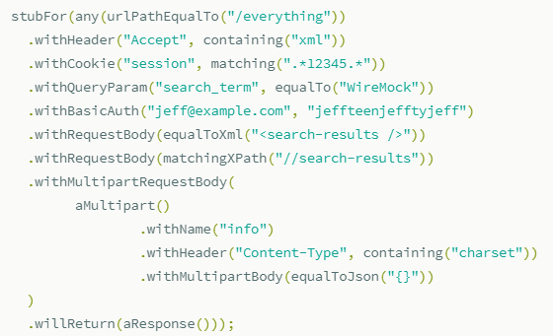
Request Matching (.cont)

Slide 31
Request Matching (.cont)
URL matching
URLSs can be matched either by equality or by regular expression.
We can choose to match just the path part of the URL or the path and query together.
urlEqualTo("/your/url?and=query")
urlMatching("/your/([a-z]*)\\?and=query")
urlPathEqualTo("/your/url")
urlPathMatching("/your/([a-z]*)")

Slide 32
Request Matching (.cont)
Matching other attributes
All request attributes other than the URL match can be matched.
.withHeader("Content-Type", equalTo("application/json"))
.withHeader("Content-Type", equalToIgnoreCase("application/json"))
.withCookie("my_profile", containing("johnsmith@example.com"))
.withQueryParam("search_term", matches("^(.*)wiremock([A-Za-z]+)$"))
.withQueryParam("search_term", notMatching("^(.*)wiremock([A-Za-z]+)$"))
.withRequestBody(equalToJson("{ \"total_results\": 4 }"))

Slide 33
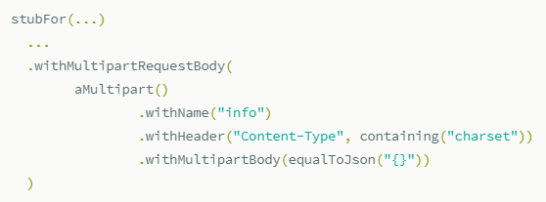
Request Matching (.cont)
Multipart/form-data
A multipart pattern can be defined as matching ANY request mutiparts or ALL.
The default matching type is ANY.

Slide 34
Request Matching (.cont)
Basic Authentication
HTTP basic authenticaiton could be supported via a correctly encoded Authorization header.
stubFor(get(urlEqualTo("/basic-auth")).withBasicAuth("user", "pass")

Slide 35
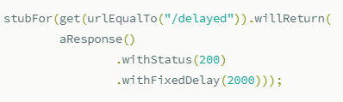
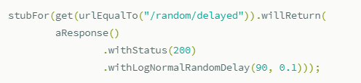
Request Matching (.cont)
Simulating Faults
WireMock is able to generate a few types of problems.

Slide 36
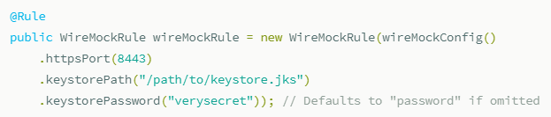
Request Matching (.cont)
HTTPS
WireMock can optionally accept requests over HTTPS.

Slide 37
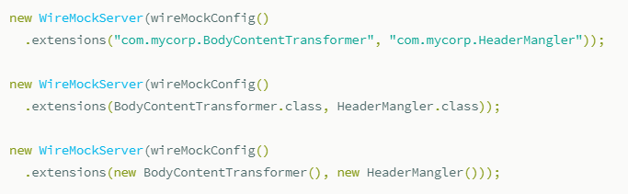
Extending Wiremock
Extending WireMock
We can register extensions programmatically via its class name, class or an instance

Slide 38
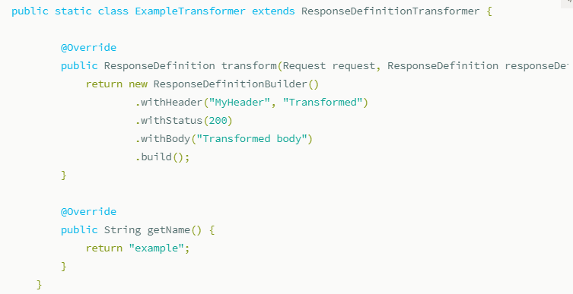
Extending Wiremock (cont.)
To transform ResponseDefinition, extend the ResponseDefinitionTransformer.

Slide 39
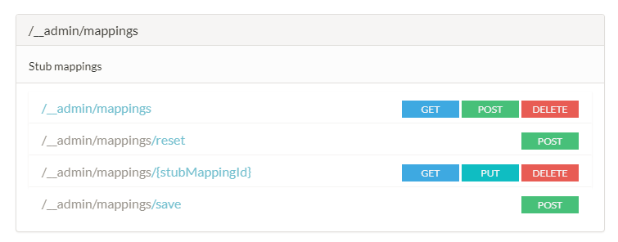
Extending Wiremock (cont.)
Admin API Reference
The WireMock admin API is described in RAML and Swagger.
The spec files in these formats plus a Swagger UI can be accessed from a running WireMock instance under the /__admin/docs.

Slide 40
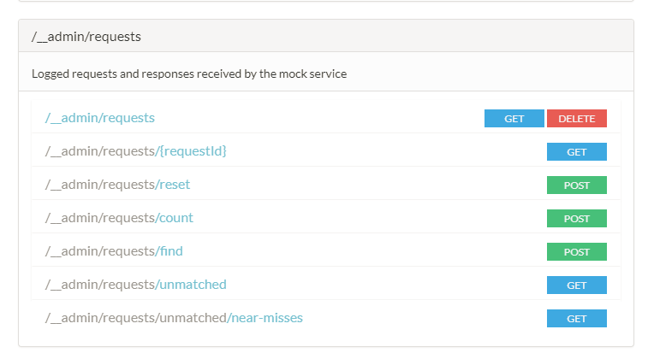
Extending Wiremock (cont.)

Slide 41
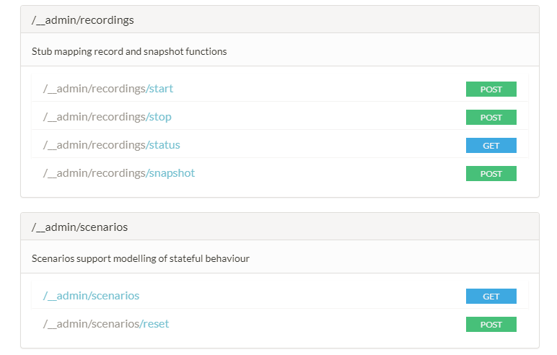
Extending Wiremock (cont.)

Slide 42
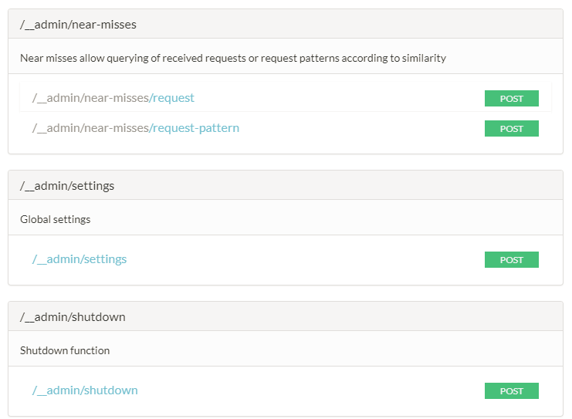
Extending Wiremock (cont.)

Slide 43
Conclusions
Allows for Production-like test cases and error scenarios
Mirror end user app/service real behavior
Fixes are directly and smoothly deployed to Production without unexpected bugs
Real Production data can be replicated to test with real cases
Easy to keep Production environment updated

Slide 44

Bibliography
http://wiremock.org/

