Slide 1

Rundeck
Dima Ionut Daniel

Slide 2
Contents
What is Rundeck ?
History
Architecture
Features
Jenkins and Rundeck
Concepts
Core
Conclusions
Bibliography

Slide 3

What is Rundeck?
Rundeck is open source software that helps you automate routine operational procedures in data center or cloud environments.
Rundeck allows you to run tasks on any number of nodes from a web-based or command-line interface.
Rundeck also includes other features that make it easy to scale up your automation efforts including: access control, workflow building, scheduling, logging, and integration with external sources for node and option data.

Slide 4
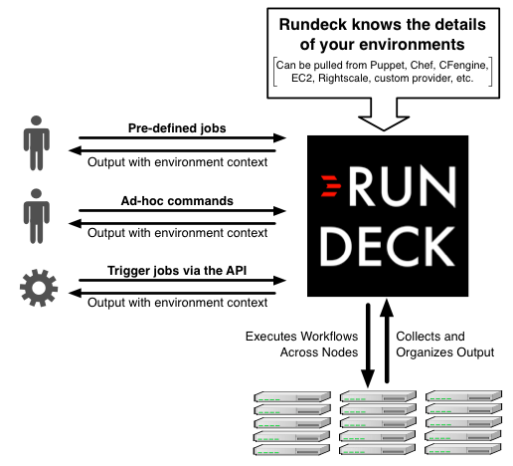
Architecture

Slide 5
Features
Web API
Distributed command execution
Pluggable execution system (SSH by default)
Multi-step workflows
Job execution with on demand or scheduled runs
Graphical web console for command and job execution
Role-based access control policy with support for LDAP/ActiveDirectory
History and auditing logs
Open integration to external host inventory tools
Command line interface tools

Slide 6
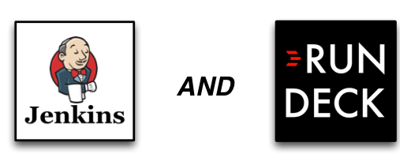
Jenkins and Rundeck
Jenkins and Rundeck are complementary tools that serve 2 necessary purposes.
Jenkins is a development tool, designed for automating software builds.
Rundeck is an operations tool, designed for executing operations tasks.

Slide 7
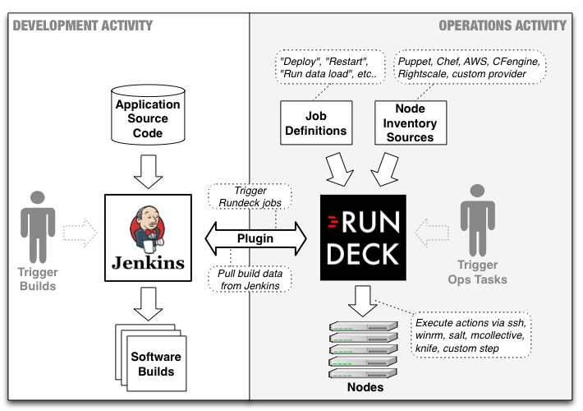
Jenkins and Rundeck (cont.)

Slide 8
Concepts
Role-based Access Control Policies:
grants users and user groups certain privileges to perform actions against rundeck resources like projects, jobs, nodes, commands and API.
Projects:
place to separate management activity.
All activities occur within the context of a project.
Multiple projects can be maintained on the same Rundeck server.
Jobs:
encapsulate a sequence of steps, job options and nodes where the steps execute.
Nodes:
resource that is either a physical or virtual instance of a network accessible host.
A resource model is a representation of Nodes in a project.

Slide 9
Concepts (cont.)
Commands:
a single executable string executed on a Node.
Rundeck invokes commands on nodes via a node executor which evaluates the command string and executes it.
Executions:
representation of the activity of a running or completed command or job. The data about the execution is used in rundeck to monitor the progress of a job or command and later for reporting about what happened.
Plugins:
Plugins exist to execute commands on nodes, perform steps in a job, send a notification about job status, gather information about the hosts in your network, copy a file to a remote server, store and stream logs, or talk to a user directory.

Slide 10
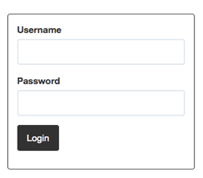
Core
Rundeck requires every user to login.
The default installation defines an "admin" user with access to perform all actions.

Slide 11
Core (cont.)
The Rundeck page header contains global navigation control to move between tabbed pages: Jobs, Nodes, Commands and Activity.
A new installation will not contain any projects.
Press the "New Project" button to create a project.
Fill the project creation form with a desired name.

Slide 12
Core (cont.)
Jobs provide a means to encapsulate a process.
A Job is a configuration representing input options, the steps in the process, a filter expression that matches the nodes where those steps will execute, and execution control parameters that specify if steps are run in parallel and what to do if an error occurs in one of the steps.
Job access is governed by an access control policy you define declaring how users are given privileges to read, create, edit, run and kill Jobs.
As many jobs will accumulate over time, it is useful to organize Jobs into groups

Slide 13
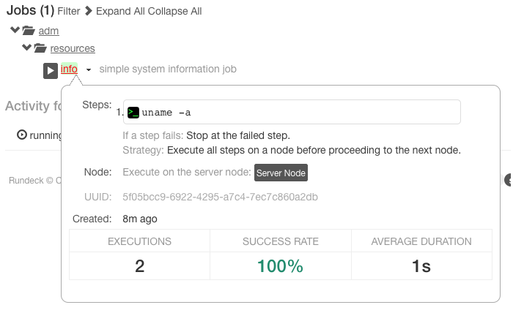
Core (cont.)
A Job's detail can be previewed by hovering the mouse pointer over the Job's name link.
Click outside the popup to close it.

Slide 14
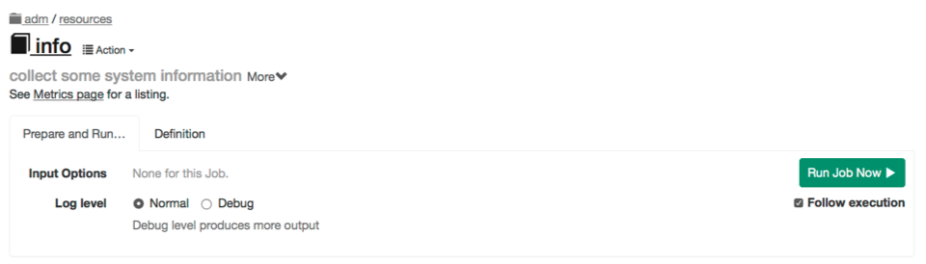
Core (cont.)
Pressing the link for the Job name will navigate to a separate page where you can run the job or view the job definition.

Slide 15
Core (cont.)
The information in the Job detail view includes:
Steps the job will execute
Options presented to the user at the time of job run
Node filter expression with a button to show the matched nodes
Job UUID
Creation date
Statistics about the job executions

Slide 16
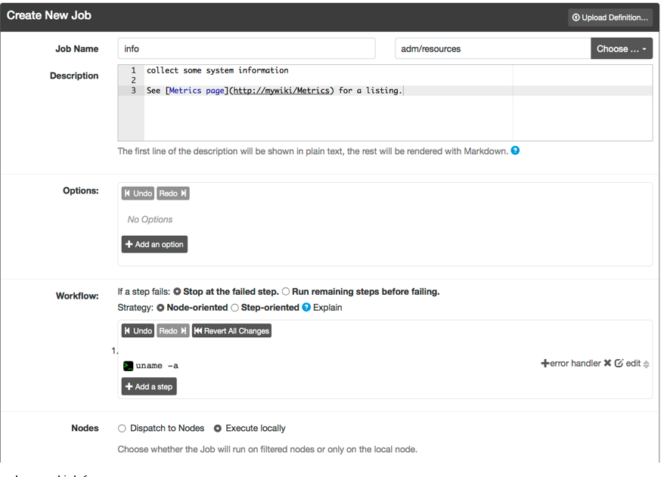
Core (cont.)

Slide 17
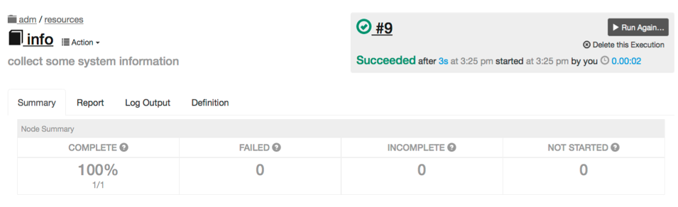
Core (cont.)
Press the "Run Job Now" button to begin execution.
The job will be queued and executed.

Slide 18
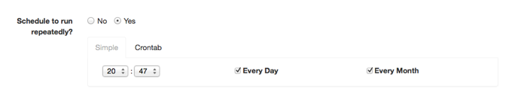
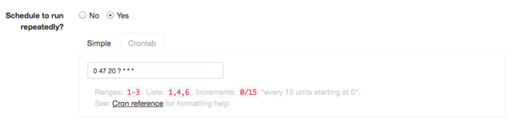
Core (cont.)
Jobs can be configured to run on a periodic basis.
If we want to create a Scheduled Job, select Yes under "Schedule to run repeatedly?"
The schedule can be defined in a simple graphical chooser or Unix crontab format.

Slide 19
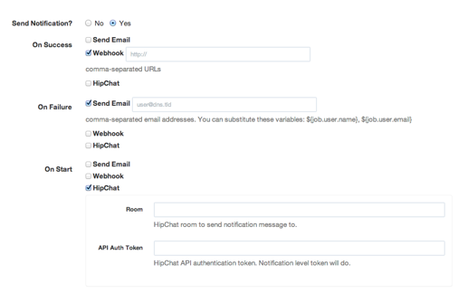
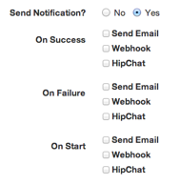
Core (cont.)
Job notifications are messages triggered by a job event.
We can configure notifications to occur when a Job Execution starts or finishes, with either success or failure.

Slide 20
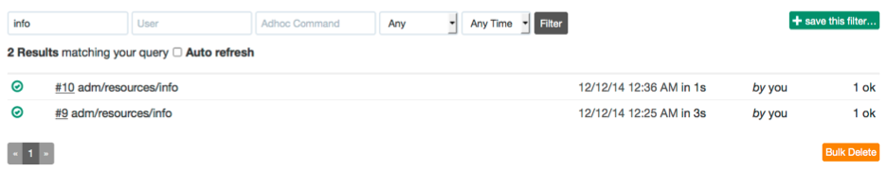
Core (cont.)
In the Job page, you can see the outcome of previous executions of Jobs by looking at the Activity section.
We can click on any past execution in the list to see the full execution for that job run.
We can also navigate to the Acitity page from the top navigation bar and use the search filter to find executions by typing in the job name.

Slide 21
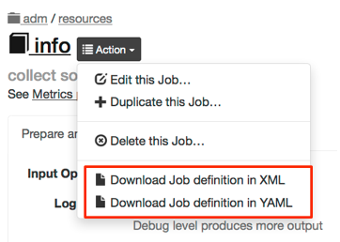
Core (cont.)
Job definitions created inside the Rundeck graphical console can be exported to XML or YAML file formats and be used for later import.

Slide 22
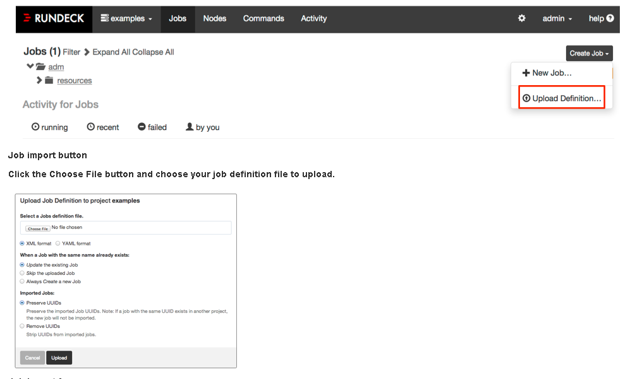
Core (cont.)
If we have a job definition file (See above) and want to upload it via the GUI web interface, you can do so.
Click on the "Create Job" menu button in the Job list.
Click the item that says "Upload Definition...":

Slide 23
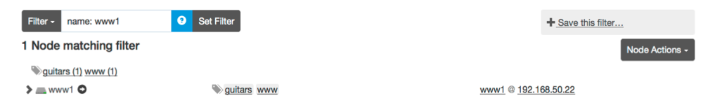
Core (cont.)
A Node is a resource that is either a physical or virtual instance of a network accessible host.
Nodes have a few basic attributes but a Node's attributes can be extended to include arbitrary named key/value pairs.
Attributes typically describe the properties of a node or reflect the state of the node.

Slide 24
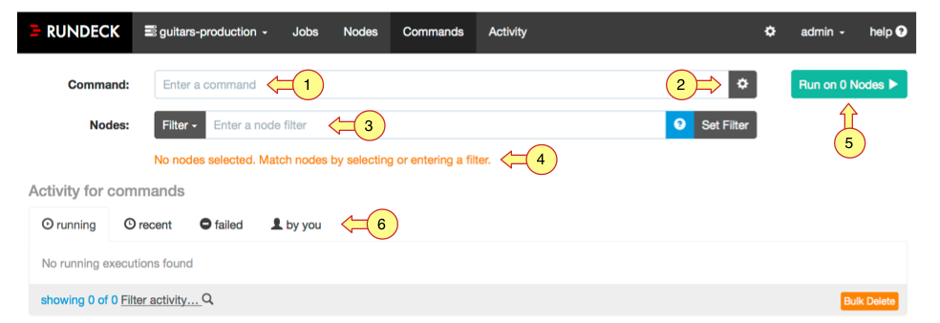
Core (cont.)
A command is a single executable string executed on a Node.
Rundeck invokes commands on nodes via a node executor which evaluates the command string and executes it.
Node executors evaluate the command string in a data context containing information about the Node resource.

Slide 25
Core (cont.)
An execution is a representation of the activity of a running or completed command or job.
The data about the execution is used in rundeck to monitor the progress of a job or command and later for reporting about what happened.
Each execution contains any output generated by commands or job steps, a record of the nodes where they occurred and the start/end time and status for each step.

Slide 26
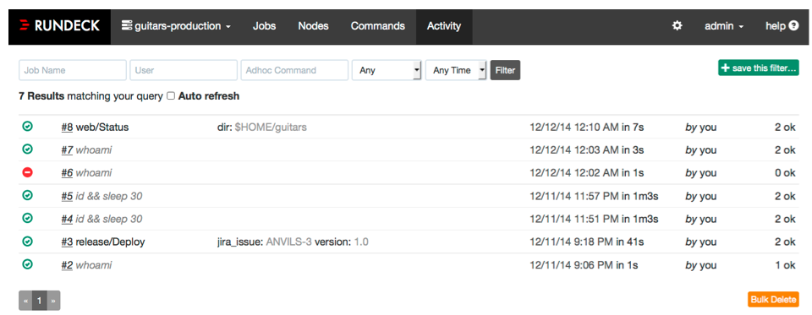
Core (cont.)
Execution history for commands and Jobs is stored by the Rundeck server.
Execution history can be filtered and viewed inside the "Activity" page.

Slide 27

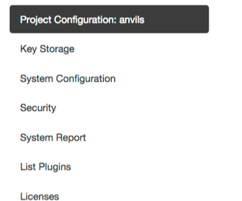
Core (cont.)
The Rundeck GUI has a Configuration Page which contains lets you view and manage some configuration settings.

Slide 28
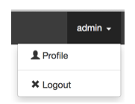
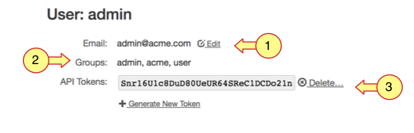
Core (cont.)
The User menu contains items to view your Profile and log out.

Slide 29
Conclusions
Easy to Use
REST API
Plugin API
Extensible
Documented

Slide 30

Bibliography
http://rundeck.org/

