Slide 1

Chroma
Dima Ionut Daniel

Slide 2
Contents
What is Chroma?
History
Features
Goals
Use Cases
Arhitecture
Concepts
Core
Vector stores comparision
Conclusion
Bibliography

Slide 3

What is Chroma?
Chroma Vector Database (Chroma DB) is a modern, high-performance, open-source vector database designed specifically for AI and machine learning applications. It is built to store and manage vector embeddings—numerical representations of data such as text, images, and other complex media types used by AI models.

Slide 4
History
Its headquarters are in San Francisco. In April 2023, it raised 18 million US dollars as seed funding.
ChromaDB has been used in academic studies on artificial intelligence, particularly as part of the tech stack for retrieval-augmented generation.

Slide 5
Features
Efficient Similarity Search: Quickly finds nearest neighbors in high-dimensional vector space.
Scalable Architecture: Can horizontally scale across multiple nodes for large datasets.
Open Source: Encourages community contributions and customization.
In-memory and Persistent Storage: Offers fast read/write with options for durability.
Simple API: Facilitates easy embedding management and searching.

Slide 6
Goals
Provide a modern, open-source embedded vector database designed specifically for AI and machine learning workloads, focusing on efficient storage, management, and retrieval of vector embeddings derived from data like text, images, and audio.
Optimize fast and scalable similarity search to enable applications to find nearest neighbors or semantically similar items quickly, supporting use cases like recommender systems, semantic search, image retrieval, and chatbot memory.
Offer seamless integration with popular machine learning frameworks such as TensorFlow, PyTorch, and Hugging Face, making it easier to incorporate embeddings generated by models into AI application workflows.

Slide 7
Goals (cont.)
Support horizontal scalability and large-scale data handling to accommodate enterprise needs, ensuring that the system remains performant as the volume of embeddings grows.
Provide a simple, developer-friendly API for managing embeddings, metadata, documents, and full-text search within one database, enabling flexible, hybrid retrieval strategies.
Enable real-time ingestion and up-to-date vector storage so that AI applications can adapt rapidly to new data, critical for recommendations, adaptive learning, or live query responses.
Maintain an open-source, community-driven ethos under the Apache 2.0 license to promote transparency, extensibility, and broad adoption in AI and data science communities.

Slide 8
Use Cases
Semantic search in documents
Personalized recommendation engines
Image and multimedia retrieval
AI chatbot conversation context management

Slide 9
Arhitecture
Chroma is designed with a modular architecture that prioritizes performance and ease of use.
It scales seamlessly from local development to large-scale production, while exposing a consistent API across all deployment modes.
Local: as an embedded library - great for prototyping and experimentation.
Single Node: as a single-node server - great for small to medium scale workloads of < 10M records in a handful of collections.
Distributed: as a scalable distributed system - great for large scale production workloads, supporting millions of collections.

Slide 10
Arhitecture (cont.)
Regardless of deployment mode, Chroma is composed of five core components.
The Gateway: the entry point for all client traffic.
Exposes a consistent API across all modes.
Handles authentication, rate-limiting, quota management, and request validation.
Routes requests to downstream services.
The Log: Chroma’s write-ahead log.
All writes are recorded here before acknowledgment to clients.
Ensures atomicity across multi-record writes.
Provides durability and replay in distributed deployments.
The Query Executor: responsible for all read operations.
Vector similarity, full-text and metadata search.
Maintains a combination of in-memory and on-disk indexes, and coordinates with the Log to serve consistent results.

Slide 11
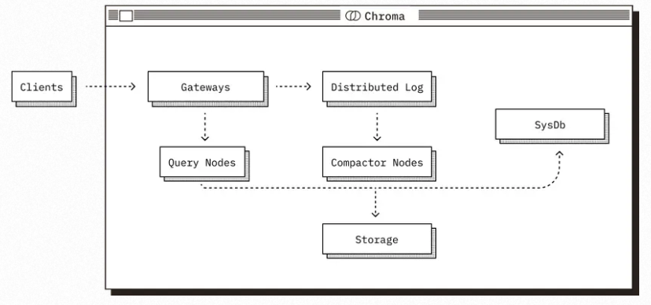
Arhitecture (cont.)
The Compactor: service that periodically builds and maintains indexes.
Reads from the Log and builds updated vector / full-text / metadata indexes.
Writes materialized index data to shared storage.
Updates the System Database with metadata about new index versions.
The System Database: Chroma’s internal catalog.
Tracks tenants, collections, and their metadata.
In distributed mode, also manages cluster state (e.g., query/compactor node membership).
Backed by a SQL database.

Slide 12
Arhitecture (cont.)
These components operate differently depending on the deployment mode, particularly in how they use storage and the runtime they operate in.
In Local and Single Node mode, all components share a process and use the local filesystem for durability.
In Distributed mode, components are deployed as independent services.
The log and built indexes are stored in cloud object storage.
The system catalog is backed by a SQL database.
All services use local SSDs as caches to reduce object storage latency and cost.

Slide 13
Concepts
Vector Embeddings
Numerical representations of data used to capture semantic meaning.
These embeddings allow the database to perform similarity searches to find data points close to one another in vector space.
Similarity Search
The process of finding vectors in the database closest to a query vector based on distance metrics such as cosine similarity or Euclidean distance.
This allows for semantic and context-aware retrieval, not just keyword matching.
Indexing Techniques
Specialized algorithms like Hierarchical Navigable Small World (HNSW), Locality-Sensitive Hashing (LSH), and Product Quantization (PQ) organize vectors to enable fast approximate nearest neighbor searches at scale.
These methods balance speed, accuracy, and memory consumption.

Slide 14
Concepts (cont.)
Metadata Filtering
In addition to vector similarity, vector databases can store and filter associated metadata, enabling more flexible, multi-criteria searches and retrievals.
In-memory Storage and Persistence
Chroma uses in-memory storage for fast access but can extend to persistent storage to retain data across restarts.
Advanced Query Capabilities:
The database supports fast and accurate retrieval of vectors based on similarity metrics such as cosine similarity or Euclidean distance, essential for AI use cases like semantic search, recommendation systems, and natural language processing.

Slide 15
Core
A vector database
encodes information as vectors in a multi-dimensional space to perform high-efficient queries based on similarity.
is a specialized type of database designed to store, manage, and index high-dimensional vectors (essentially fixed-length lists of numbers that represent features of data items like words, images, videos, documents, or audio).
Unlike traditional databases that query exact matches, vector databases enable similarity searches using approximate nearest neighbor (ANN) algorithms to find data points closest to a query vector based on similarity metrics.

Slide 16
Core (cont.)
Key Features
Store vectors representing complex data objects in high-dimensional space.
Use ANN algorithms (e.g., PQ, LSH, HNSW) for fast, approximate similarity search.
Index vectors to optimize query speed and accuracy trade-offs.
Enable semantic search and similarity-based retrieval, not exact match.
Support metadata storage, data versioning, and integration with other systems.
Used in AI areas like semantic search, recommendation engines, multi-modal search, and domain-specific LLM augmentation.

Slide 17
Core (cont.)
Vector DB advantages
Data Representation as Vectors: vector is vectorized which brings lots of benefits for searching.
Similarity Search: finding data points closest to a given query vector.
Efficiency in High-Dimensional Searches: use of specialized indexing structures that are highly optimized.
Handling Unstructured Data: vector database are made to deal with unstructured data.
Schema-less Design: don’t require schema, allowing more flexibility in handling various data types and structures.

Slide 18
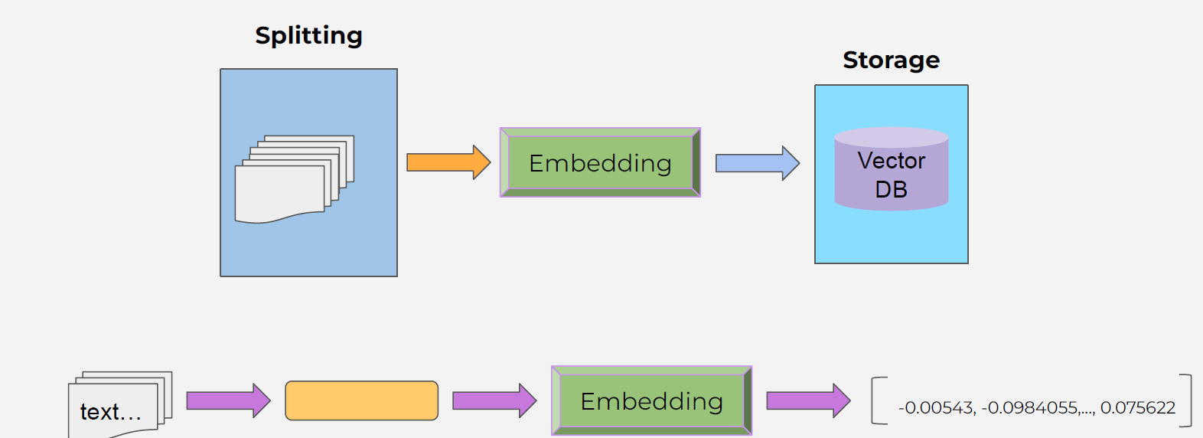
Core (cont.)
Embedding vector keeps the content and the meaning of the text.
Text with similar content and meaning will have similar vectors.

Slide 19
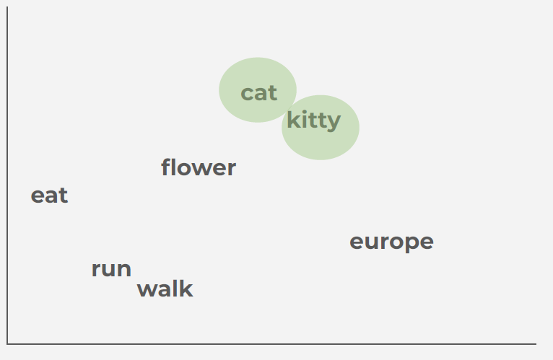
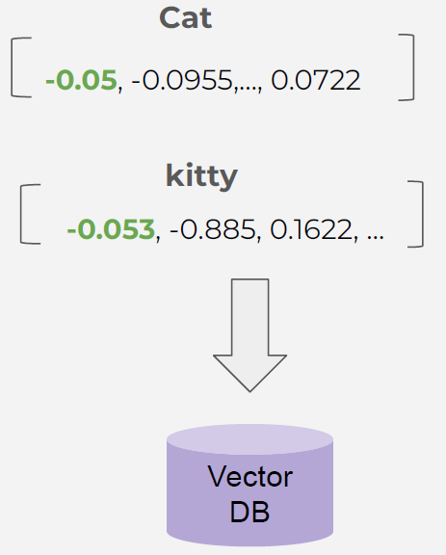
Core (cont.)
Text with similar content and meaning will have similar vectors.

Slide 20
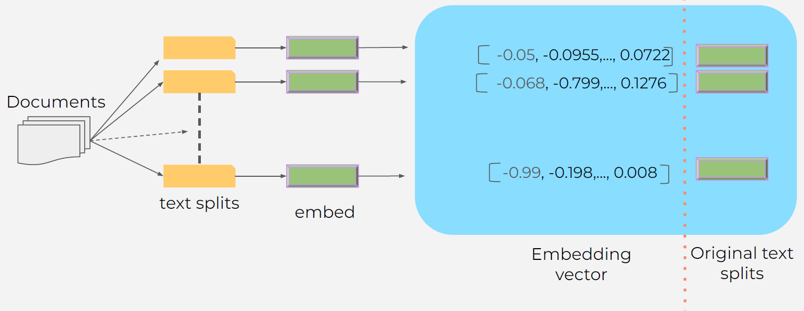
Core (cont.)
Embedding creation and storage

Slide 21
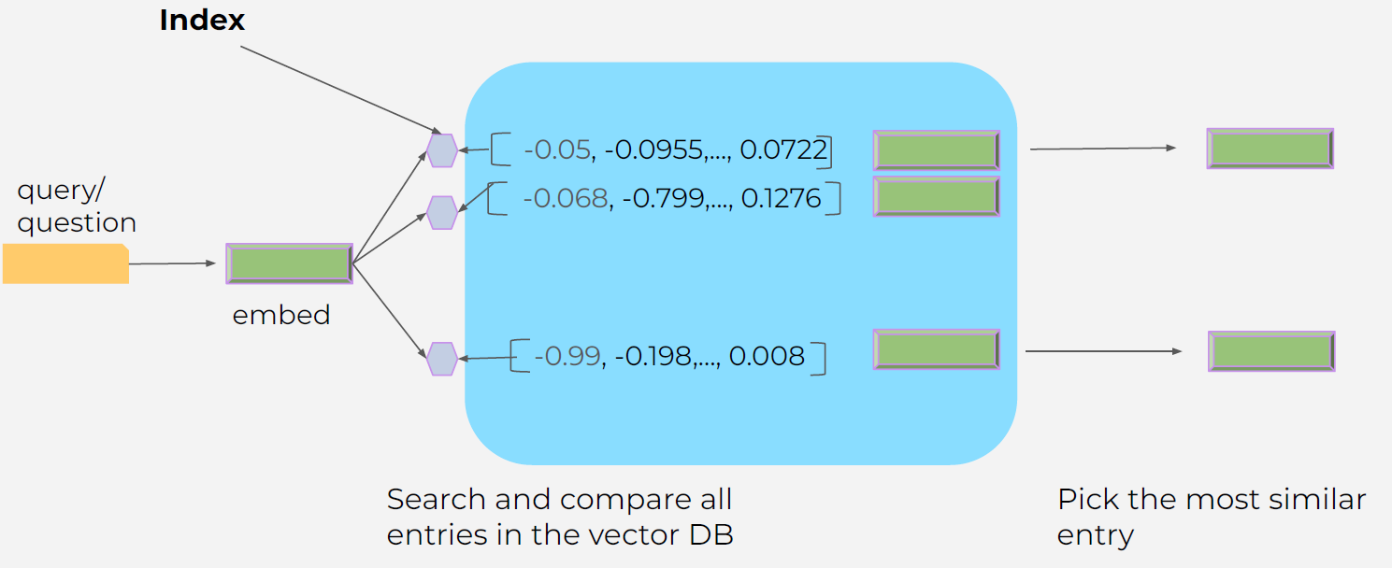
Core (cont.)
Vector Database (Vector store) - querying the vector database

Slide 22
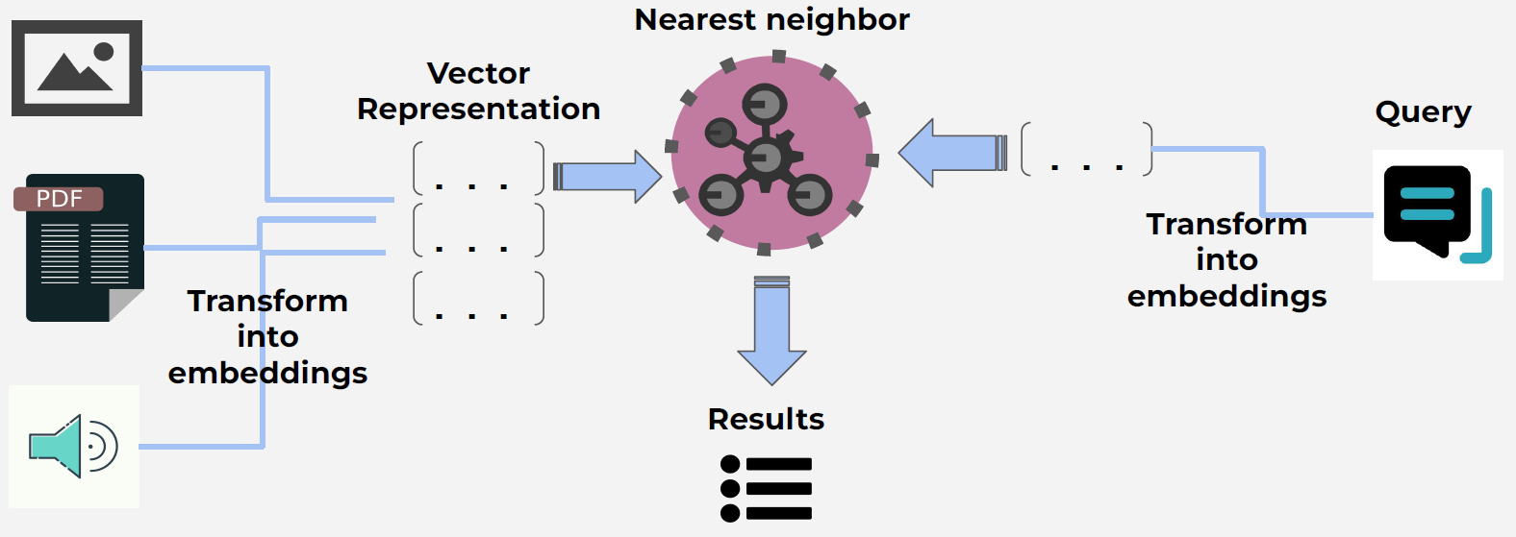
Core (cont.)
Vector databases - store and query process

Slide 23
Core (cont.)
Vector: A vector is a generic mathematical object, an array of numbers used to represent features or attributes of data. For example, a vector for an image might include pixel intensity values or color histograms. Vectors can be handcrafted (feature vectors) or learned.
Embedding: An embedding is a learned, dense, lower-dimensional vector specifically created by AI models (e.g., neural networks) that maps complex data like text, images, or audio into a continuous vector space where semantically or contextually similar items are close together. Embeddings encode latent patterns beyond simple features.
Embeddings are specialized semantic vectors essential to modern AI’s ability to understand and process meaning, while vectors are the broader mathematical entities that represent data points numerically.
Embeddings are vectors, but not all vectors are embeddings.

Slide 24
Core (cont.)
Creation: Feature vectors are often crafted manually using domain knowledge, while embeddings are automatically learned during model training to capture meaningful relationships in the data.
Purpose: Embeddings serve to translate unstructured or complex data into a numerical form that preserves semantic similarity, enabling AI tasks like similarity search, clustering, or classification. Vectors more generally represent any numerical data point, regardless of semantic content.
Example: In NLP, word embeddings map words like "king" and "queen" to vectors close in space due to related meanings, while generic vectors might just represent frequency counts or other explicit features without capturing context.

Slide 25
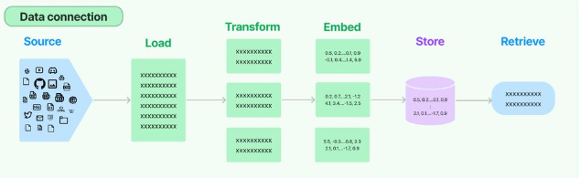
Core (cont.)
Most complex and knowledge-intensive LLM applications require runtime data retrieval for Retrieval Augmented Generation (RAG).
A core component of the typical RAG stack is a vector store, which is used to power document retrieval.
Using a vector store requires setting up an indexing pipeline to load data from sources (a website, a file, etc.), transform the data into documents, embed those documents, and insert the embeddings and documents into the vector store.

Slide 26
Core (cont.)
We can start ChromaDB using docker using the command:
docker run -it --name chroma-1.0.21 \
-p 8000:8000 \
-v ./chroma-data:/chroma/chroma \
chromadb/chroma:1.0.21.dev64
ChromaDB exposes a RESTful API primarily through FastAPI when running in client-server mode.
We can view the full interactive OpenAPI documentation (Swagger UI) by navigating to http://localhost:8000/docs while the container is running.

Slide 27
Core (cont.)
Endpoint | Method | Description
/api/v2/heartbeat | GET | Returns a nanosecond heartbeat to check server liveness.
/api/v2/version | GET | Returns the current server version.
/api/v2/collections | GET | Lists all existing collections in the database.
/api/v2/collections | POST | Creates a new collection with a specified name and metadata.
/api/v2/collections/{id} | GET | Retrieves details for a specific collection by its ID.
/api/v2/collections/{id} | DELETE | Deletes a collection and all associated data.
/api/v2/collections/{id}/add | POST | Adds documents, embeddings, and metadata to a collection.

Slide 28
Core (cont.)
Endpoint | Method | Description
/api/v2/collections/{id}/get | POST | Retrieves specific documents from a collection by ID or filter.
/api/v2/collections/{id}/query | POST | Performs a similarity search (ANN) against the collection.
/api/v2/collections/{id}/update | POST | Updates existing documents or metadata within a collection.
/api/v2/collections/{id}/upsert | POST | Updates documents if they exist, or adds them if they do not.
/api/v2/collections/{id}/delete | POST | Deletes specific documents from a collection based on IDs or filters.
/api/v2/collections/{id}/count | GET | Returns the total number of items in a collection.
/api/v2/reset | POST | Resets the entire database (requires ALLOW_RESET=True env var).

Slide 29

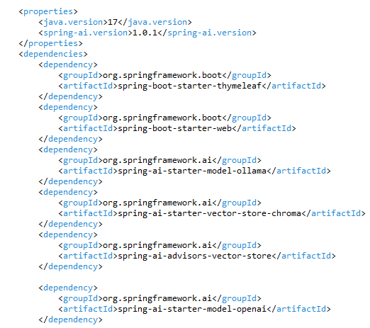
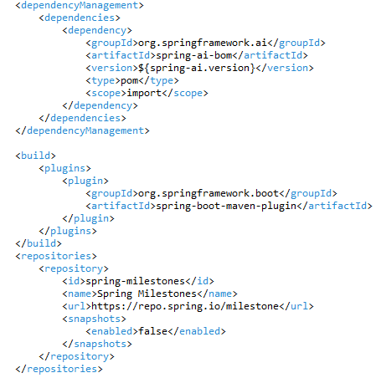
Core (cont.)
We can create a Spring AI application, where we define in application.properties the following setup

Slide 30
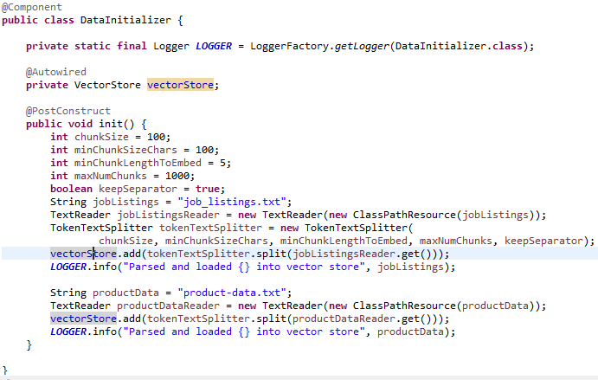
Core (cont.)
We use the VectorStore interface to interact with the vector store.

Slide 31
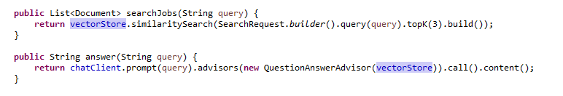
Core (cont.)
After we store embeddings in the ChromaDb vector store we need later to perform the searches.

Slide 32
Vector store comparision
Feature | Pinecone | Milvus | Chroma | Weaviate | Qdrant | pgvector | Vald | CockroachDB
Open-Source | No | Yes | Yes | Yes | Yes | Yes | No | Yes
Primary Use Case | Managed vector search | High performance AI search | LLM apps & development | Vector similarity search | Rapid large-scale search | PostgreSQL extension | Cloud native vector management | Multi-model resilient database
Scalability | High, cloud-native | Very high distributed | Moderate | High, cloud-scale | Very high, cloud native | Depends on PostgreSQL | Horizontal scaling | Horizontal scaling
Search Speed | Low latency | Ultra-fast | Fast | Fast | Fast | Approximate NN | Optimized | Depends on setup
Data Privacy | Managed service | Self-hosted | Self-hosted | Self-hosted & managed | Self-hosted | Self-hosted | Managed & self-hosted | Self-hosted & managed
Integration | ML frameworks, APIs | Multiple SDK | LangChain APIs | Multiple APIs, GraphQL | Rest, SDKs | SQL, Python | REST APIs | SQL, distributed transactions
Key Strengths | Managed, scalable, easy | Open source, versatile | Open source, flexible | Semantic search, extensibility | Open source, flexible | Embedding support | Resilience, multi-tenancy | Resilience for multi-model

Slide 33
Conclusion
Pros:
High-performance similarity search
Scalability
Ease of use
Real-time data ingestion
Open-source
Integration with popular ML frameworks
Cons:
Limited to vector data
Memory intensive
Less optimized for extremely large scale
Still evolving ecosystem
Limited advanced security

Slide 34

Bibliography
https://en.wikipedia.org/wiki/Chroma_(vector_database)
https://docs.trychroma.com
Udemy - Unlock the Potential of Your Data with Pinecone, Chroma, and Beyond for AI-based Applications. Master Vector Databases
https://blog.langchain.com/syncing-data-sources-to-vector-stores/

