Slide 1
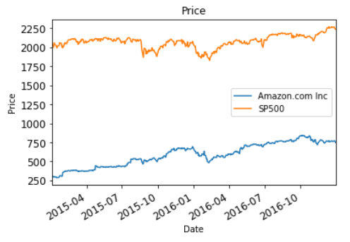
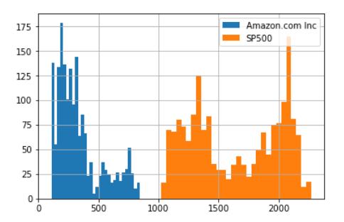
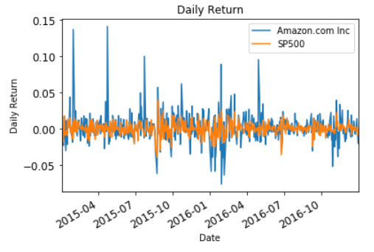
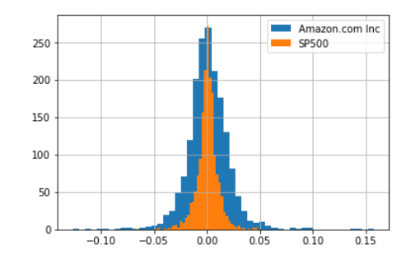

Slide 2
S&P500 trailing return
NASDAQ trailing return
Model
KNN
SVR
Decision Tree
Random Forest
DAX trailing return
NIK trailing return
S&P500 future return
(10day cumulative)
S&P500 trade volume
GOLD future price/return
Oil future price/return

Slide 3
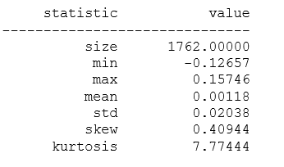
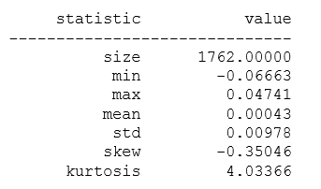
Amazon
S&P 500

Slide 4
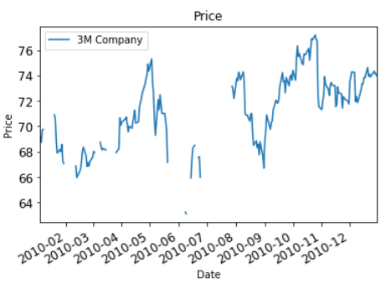
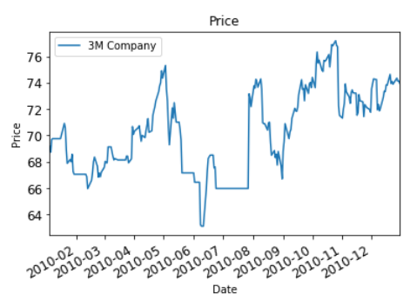

Slide 5
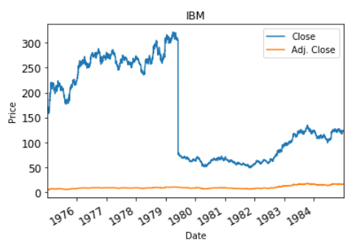
Event: Stock Split(6:1)
While ‘Close’ shows immediate drop,
‘Adj. Close’ compensates for price anomaly from stock splits.

Slide 6
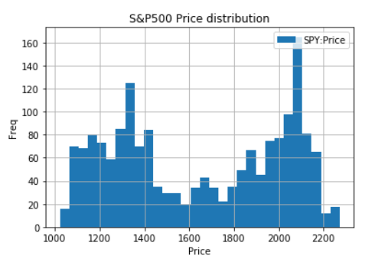
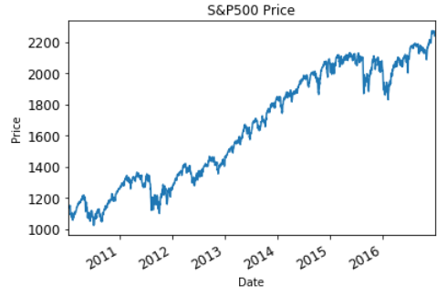
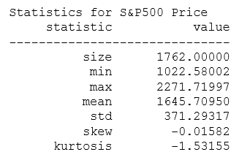
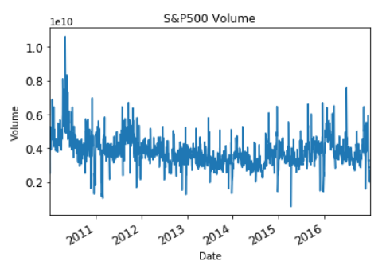
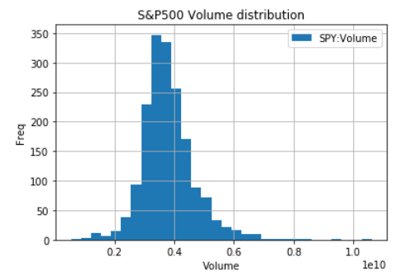
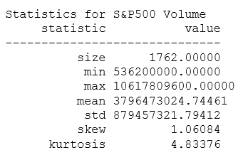

Slide 7
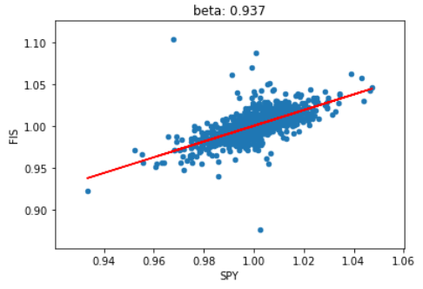
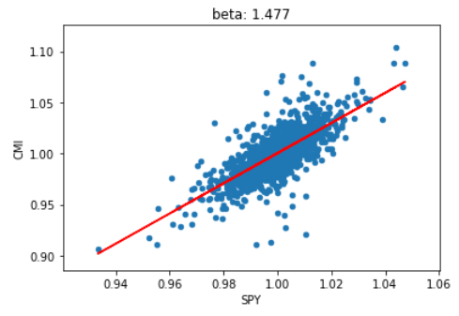
High beta stocks shows higher gradient of fitted line.
Low beta stocks shows lower gradient of fitted line.
If market rise by 1%:
CMI is expected to rise by 1.477%
FIS is expected to rise by 0.937%
→ We can profit more than market by selecting CMI
If market falls by -1%:
CMI is expected to fall by -1.477%
FIS is expected to fall by -0.937%
→ We can loss less than market by selecting FIS
→ Hence, to outperform market select high beta stocks in bull market, and low beta stocks in bear market

Slide 8
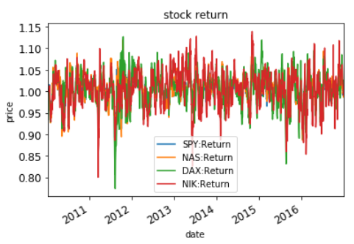
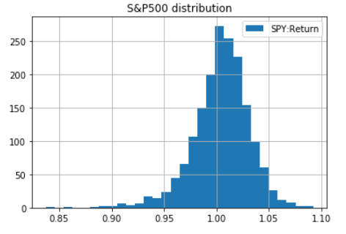
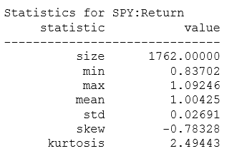

Slide 9
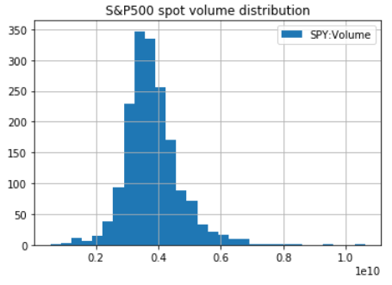
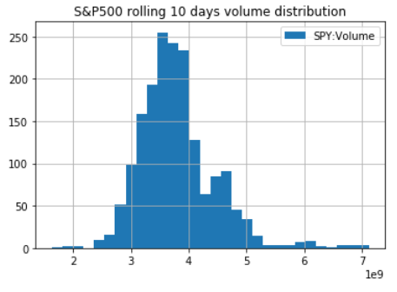
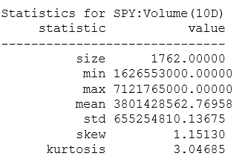

Slide 10
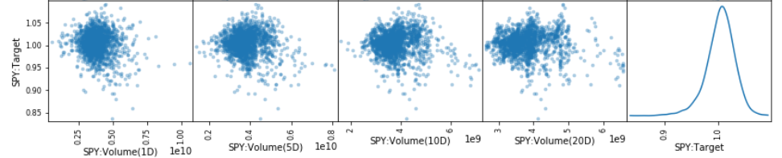
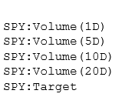
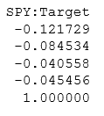

Slide 11
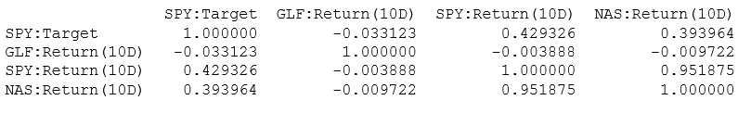
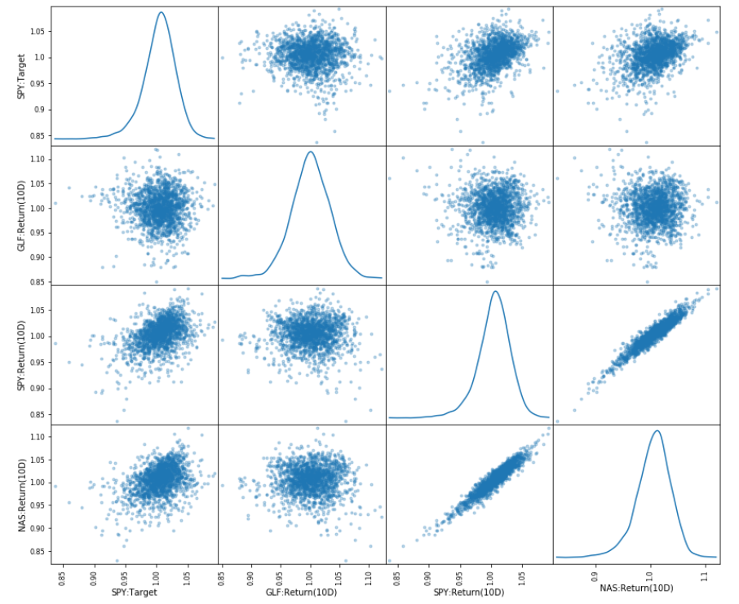

Slide 12
Model | R2 score | max_depth | n_estimator | n_neighbor | weights | Kernel | C | epsilon
Random Forest | 0.512 | 3 | 20 | - | - | - | - | -
KNN | 0.274 | - | - | 27 | ‘distance’ | - | - | -
Decision Tree | 0.492 | 3 | - | - | - | - | - | -
SVR | 0.484 | - | - | - | - | ‘rbf’ | 10.0 | 0.001

Slide 13
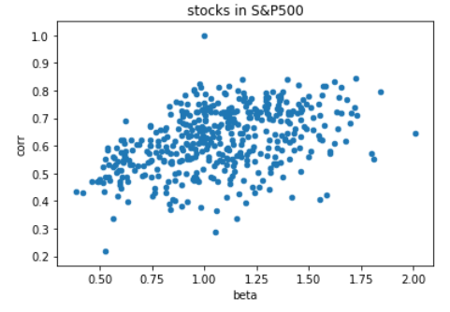
When selecting stocks for portfolio,
try to select ones that has high correlation.

Slide 14
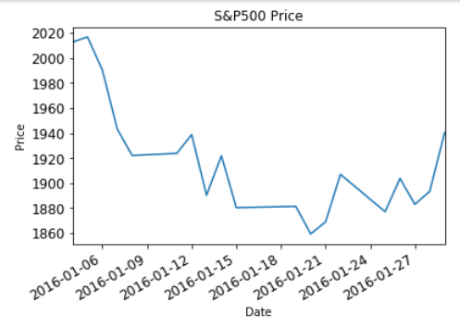
2016-01-12
Model for predicting 10day cumulative return from 2016-01-07
(X: input feature)
(y: target)
10day cumulative return from 2016-01-12
2016-01-12
2016-01-12
10day cumulative return from 2016-01-07
(This is what we will predict)
2016-01-11
2016-01-07
2016-01-17
1-day
2016-01-07
5-day
2016-01-02
10-day
2015-12-22
20-day

Slide 15
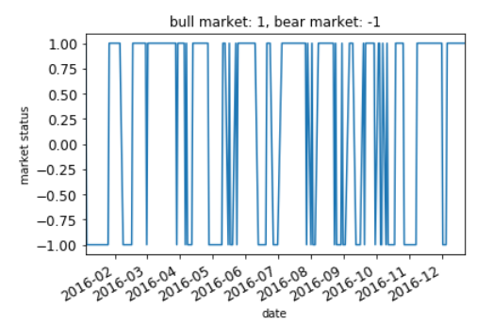
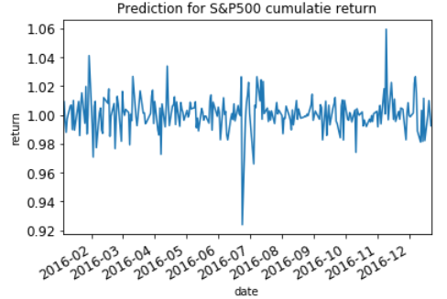

Slide 16
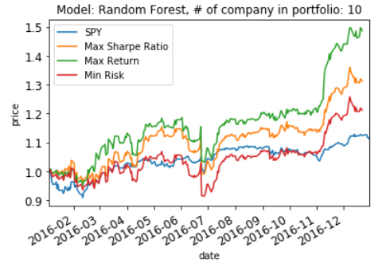
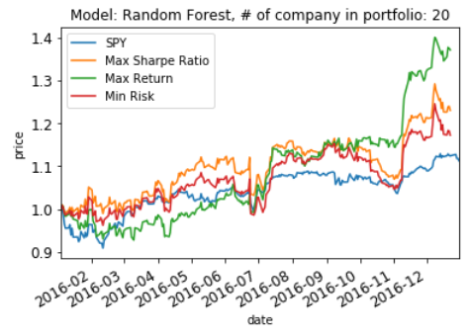
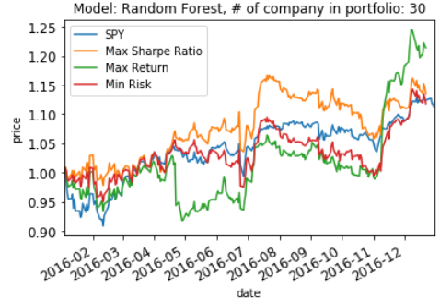
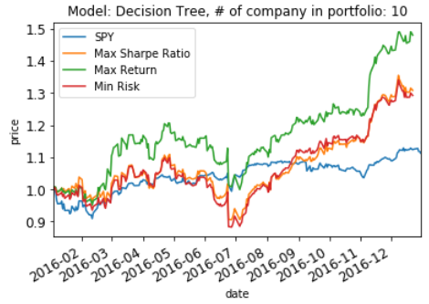
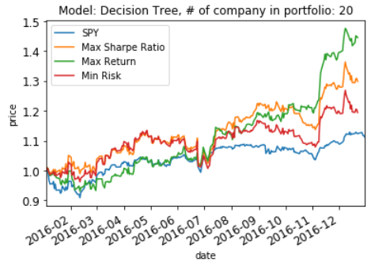
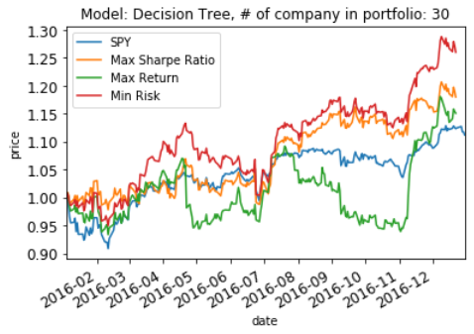

Slide 17
