Slide 1


PWE STUDIO · CUSTOMER ROADSHOW / 客户路演版
Give the time back to the work.
把时间还给创作。
Studio management for art, music, dance and small education businesses.
面向美术、音乐、舞蹈与小型教育机构的一体化运营系统。
v10.9 / CURRENT
LIVE PRODUCTION / 已上线
AUSTRALIA / 澳大利亚
The system carries the operational weight. Your studio keeps the stage.
系统托住运营，工作室继续站在台前。
PWE Studio · Powered by Paradise Production · 天域文创
01 / 11
Notes:
Open with the operating promise: the system carries routine weight while each studio keeps its own name, work and teaching style in front.
This deck is aligned to the v9.8.8 production release.
[Sources]
- README.md: v9.8.8 product scope and production status.
- docs/HANDOFF_LATEST.md: v9.8.8 release and public acceptance evidence.
- docs/design/Brand_Identity.md: Feather Star, product naming and colour system.
- Local visual asset: backend/frontend/assets/showcase-botanical-home.webp.

Slide 2

PWE STUDIO · CUSTOMER ROADSHOW / 客户路演版
Your craft deserves more than admin.
你的才华，不该耗在行政里。
The work that steals a studio owner’s attention is rarely the teaching itself.
真正消耗工作室主理人的，往往不是教学，而是教学之外的碎片。
01
Enquiries in chat
follow-up gets fuzzy / 线索难跟进
询价散在聊天记录里
02
Schedules in spreadsheets
changes are hard to share / 改动难同步
排课散在表格里
03
Credits by hand
reconciliation waits until night / 晚上还要对账
课时与出勤靠手工
Your attention is the scarce resource.
真正稀缺的，是你的注意力。
PWE Studio · Powered by Paradise Production · 天域文创
02 / 11
Notes:
Name the operational friction before showing features: enquiries, schedules and credits are necessary, but none is the reason a studio exists.
[Sources]
- README.md: studio-owner outcome and product positioning.
- docs/guides/Studio_Owner_Guide.md: current daily operating scope.
- Local visual asset: backend/frontend/assets/showcase-coast-home.webp.

Slide 3
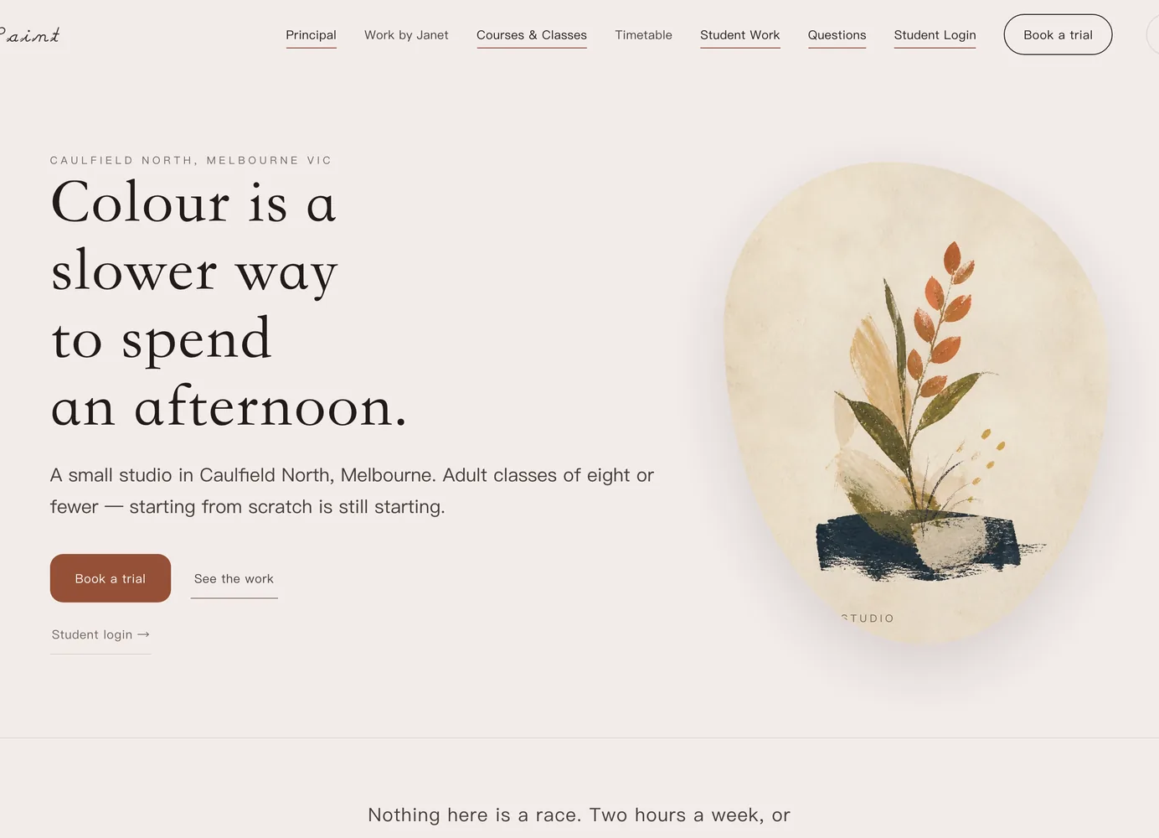
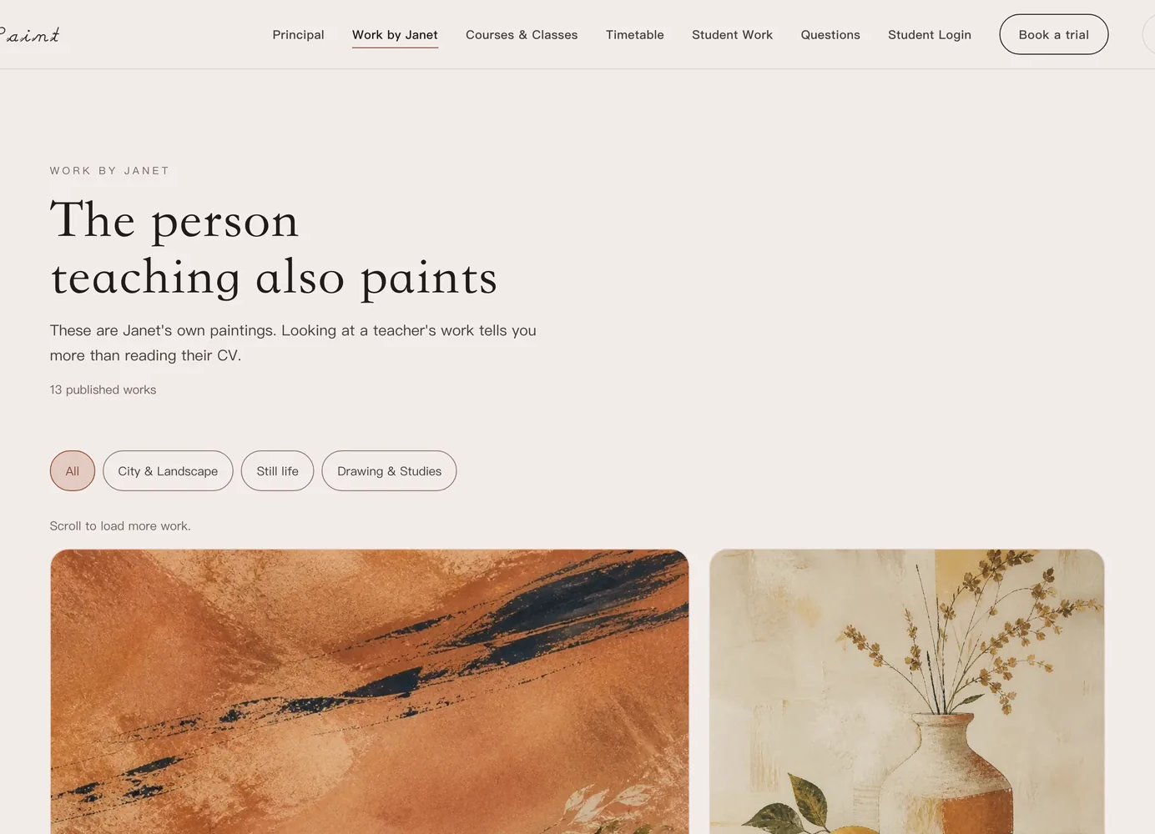
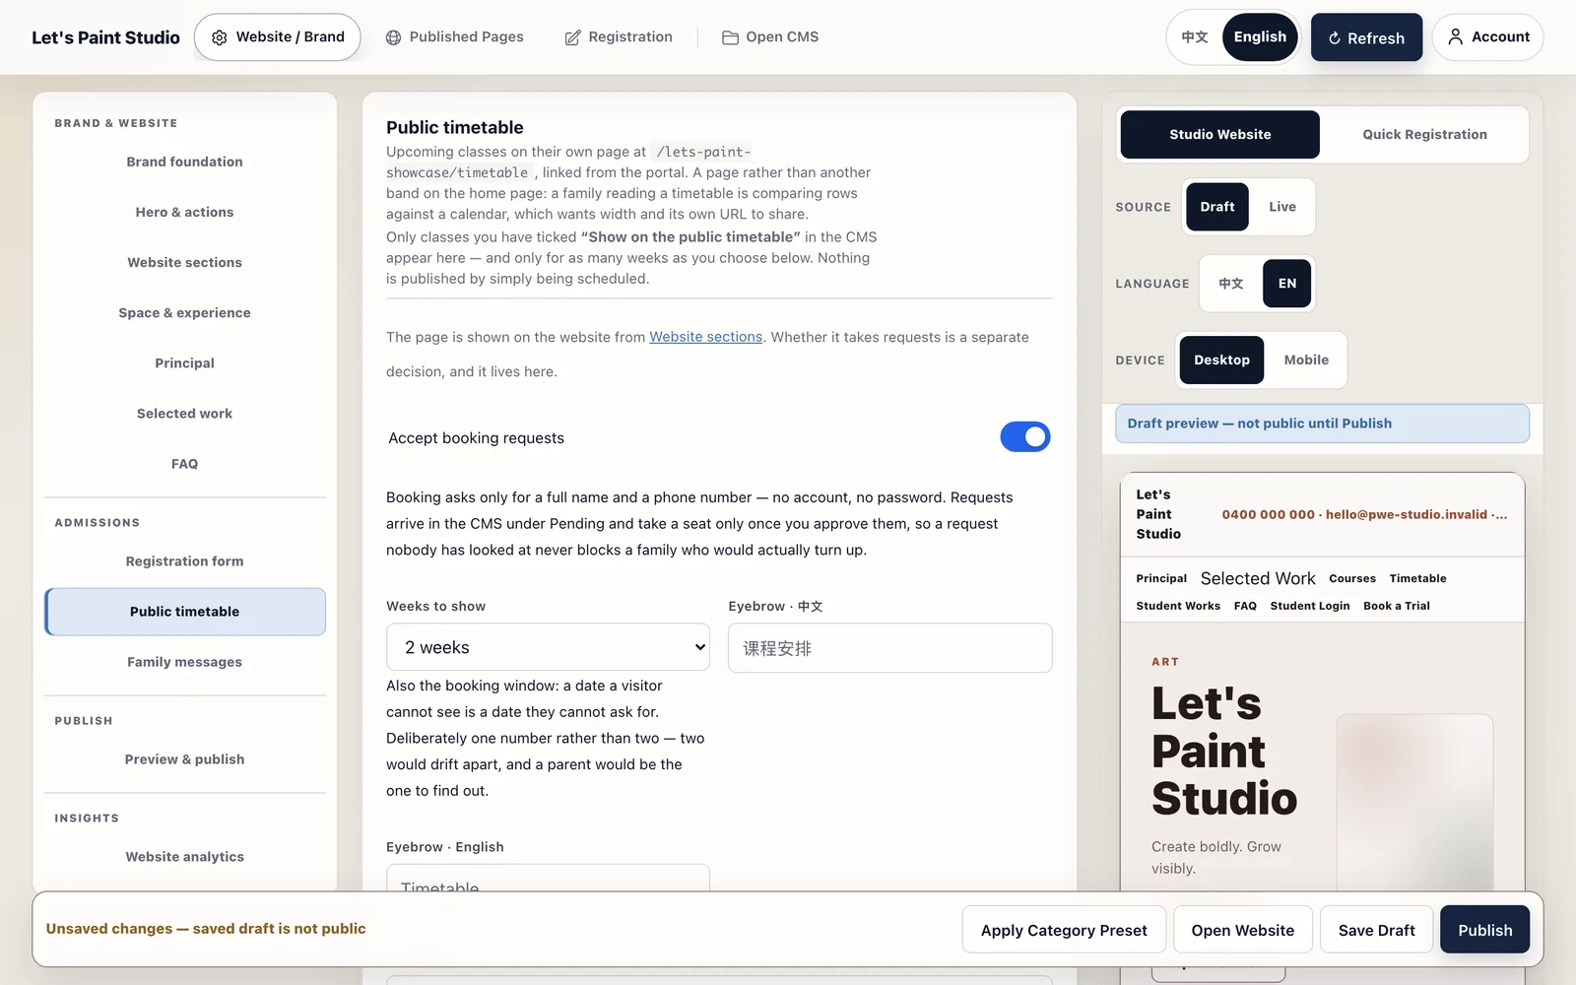
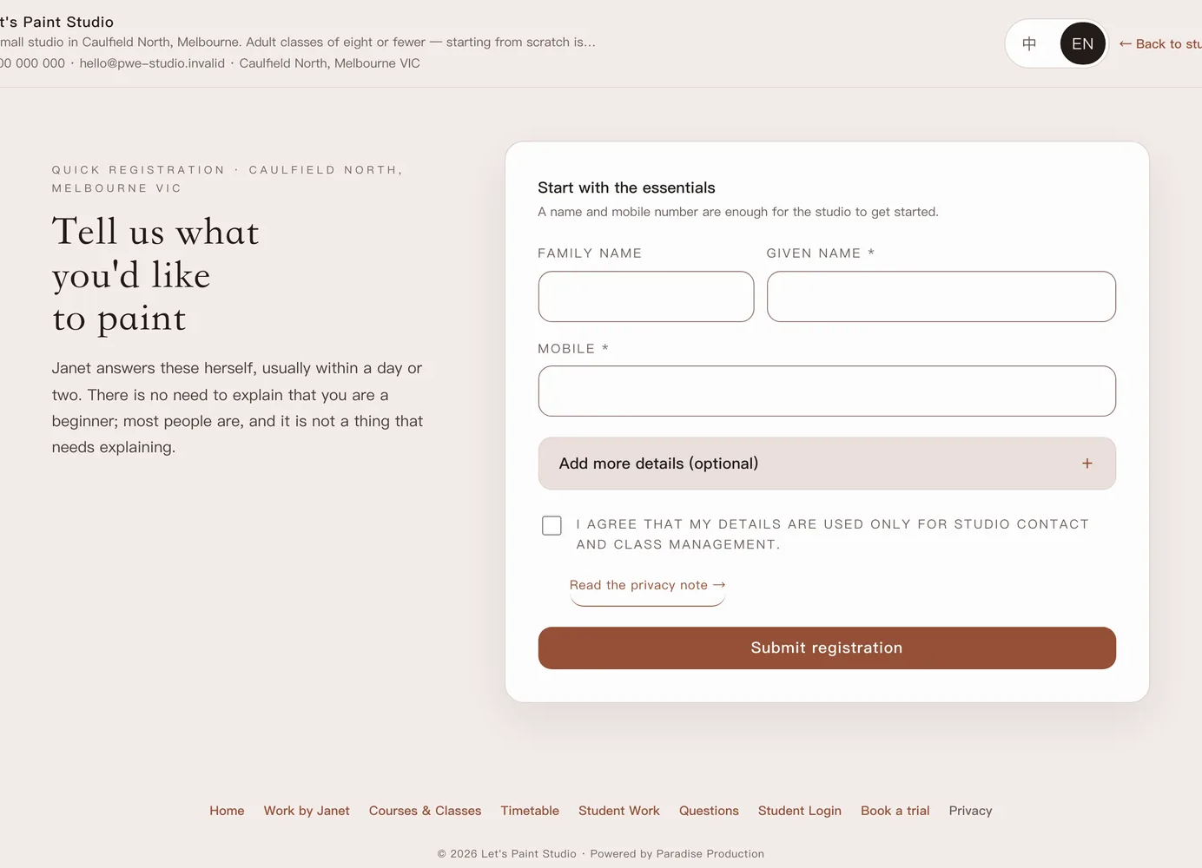
PWE STUDIO · CUSTOMER ROADSHOW / 客户路演版
One studio brand. Four public surfaces.
一个工作室品牌，四个公开入口。
Portal, Showcase, Timetable and Register share one public-surface contract.
官网、作品、课表与报名共用一套公开表面规则。
Portal / 门户
Showcase / 作品归档
Timetable / 公开课表
Register / 快速报名
Public studio site / 工作室官网
Archive + filters / 归档 + 分类
1–4 week view / 1–4 周课表
Lead-ready entry / 可跟进报名
The four entries share one readiness contract.
四个公开入口共用同一套就绪规则。
PWE Studio · Powered by Paradise Production · 天域文创
03 / 11
Notes:
Explain the v9.8.8 public-surface contract: Portal, standalone Showcase, Timetable and Register are separate entries with shared readiness rules.
[Sources]
- docs/Product_Surface_Model.md: canonical surface responsibilities and routes.
- README.md: portal, showcase, timetable and register behavior in the current release.
- docs/guides/Studio_Owner_Guide.md: showcase limits and public entry behavior.
- Local visual assets: backend/frontend/assets/manual/02-portal.en.webp, 02-showcase-portal.en.webp, 04-timetable.en.webp and 02-register.en.webp.

Slide 4
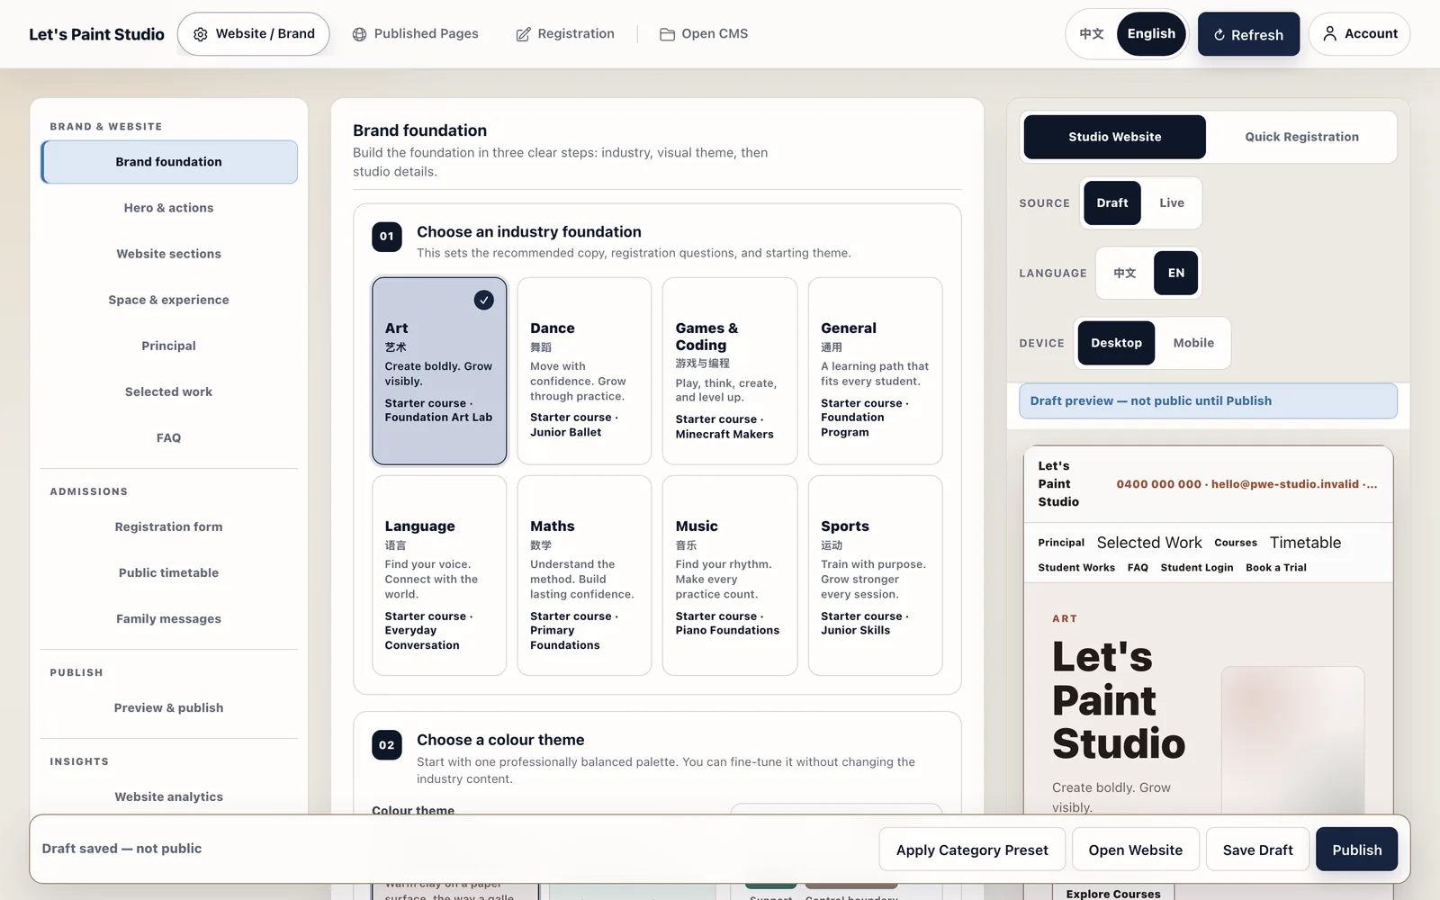
PWE STUDIO · CUSTOMER ROADSHOW / 客户路演版
Your brand stays in front.
你的品牌始终在台前。
DRAFT → PUBLISH → VERIFY
Build the public experience in your own voice.
用自己的语言，搭建对外的工作室体验。
• Logo, colours and bilingual copy / Logo、配色与双语文案
• Registration fields and FAQs / 报名字段与常见问题
• Live preview before publishing / 发布前实时预览
• Tenant identity leads every customer surface / 每个客户表面都以你的身份为主
• Your web address is yours to keep / 你的公开网址，换了也不会丢
PWE Studio appears as the platform brand. Your studio appears as the experience.
PWE Studio · Powered by Paradise Production · 天域文创
04 / 11
Notes:
Show Studio Admin as the owner control point: configure the brand, publish the public experience and verify the public result.
[Sources]
- docs/Product_Surface_Model.md: Studio Admin owns brand and publication.
- docs/HANDOFF_LATEST.md: v9.8.8 truthful public-surface verification.
- Local visual asset: backend/frontend/assets/manual/01-brand-workbench.en.webp.

Slide 5
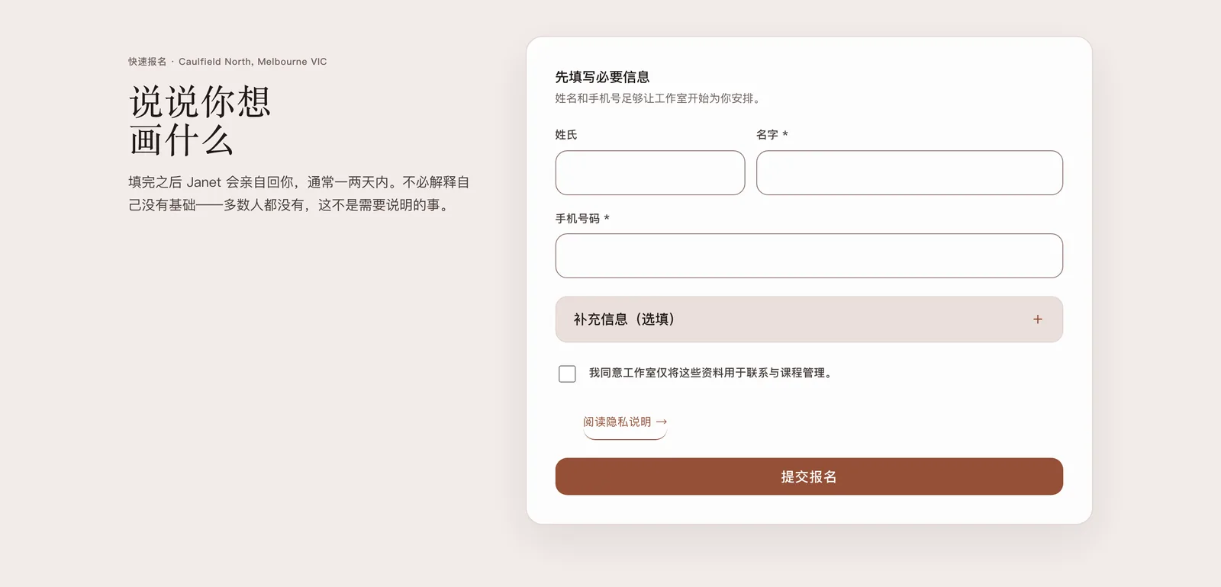
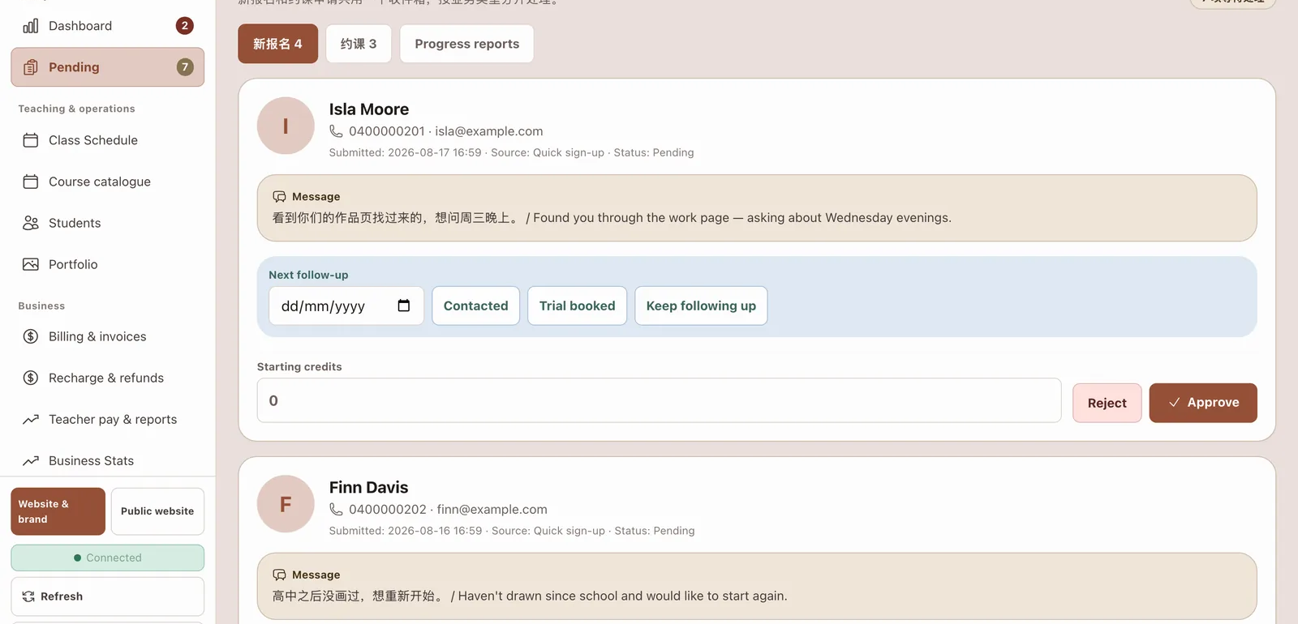
PWE STUDIO · CUSTOMER ROADSHOW / 客户路演版
From first click to a reviewed lead.
从第一次点击，到一条可跟进的报名线索。
01
Discover
02
Register
03
Review
04
Convert
发现
报名
跟进
建档
A focused public entry.
一个聚焦的对外入口。
A team-ready follow-up queue.
一条可执行的跟进队列。
PWE Studio · Powered by Paradise Production · 天域文创
05 / 11
Notes:
Walk left to right: a family discovers the studio, submits a focused registration, the team sees the pending record with its source and next action, then approves it into the studio workflow.
[Sources]
- docs/Product_Surface_Model.md: registration conversion flow.
- docs/customer/FAQ.md: registration, messaging and public-surface boundaries.
- Local visual assets: backend/frontend/assets/manual/02-register.en.webp and 02-pending.en.webp.

Slide 6
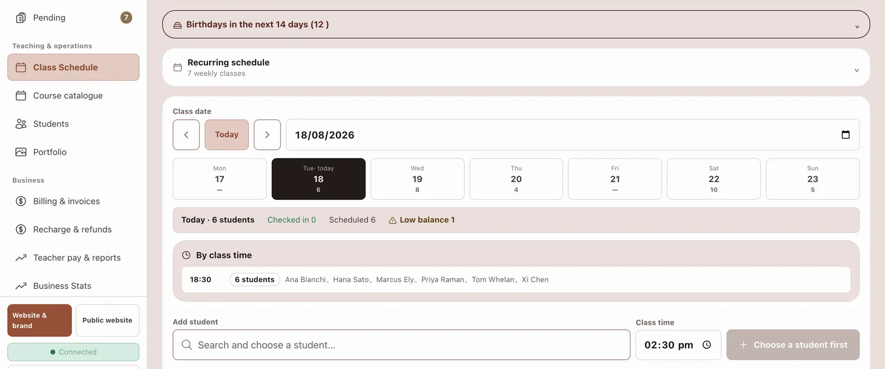
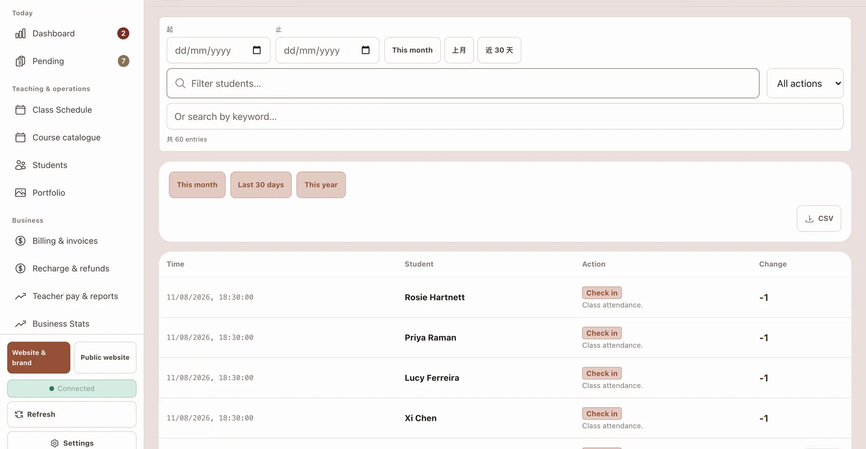
PWE STUDIO · CUSTOMER ROADSHOW / 客户路演版
A public timetable, a calmer daily loop.
公开课表，让日常运营更清晰。
CLASS SCHEDULE / 课程安排
Publish · book · check in · export
发布 · 约课 · 签到 · 导出
PWE Studio · Powered by Paradise Production · 天域文创
06 / 11
Notes:
Frame the timetable as a public window into the studio: the owner chooses the horizon and fields, families can request a place, and staff keep approval and capacity control in the CMS.
[Sources]
- docs/design/Public_Timetable.md: public timetable, booking-window and field rules.
- docs/guides/Studio_Owner_Guide.md: timetable and booking behavior.
- Local visual assets: backend/frontend/assets/manual/04-timetable.en.webp, 03-roster.en.webp and 04-log.en.webp.

Slide 7
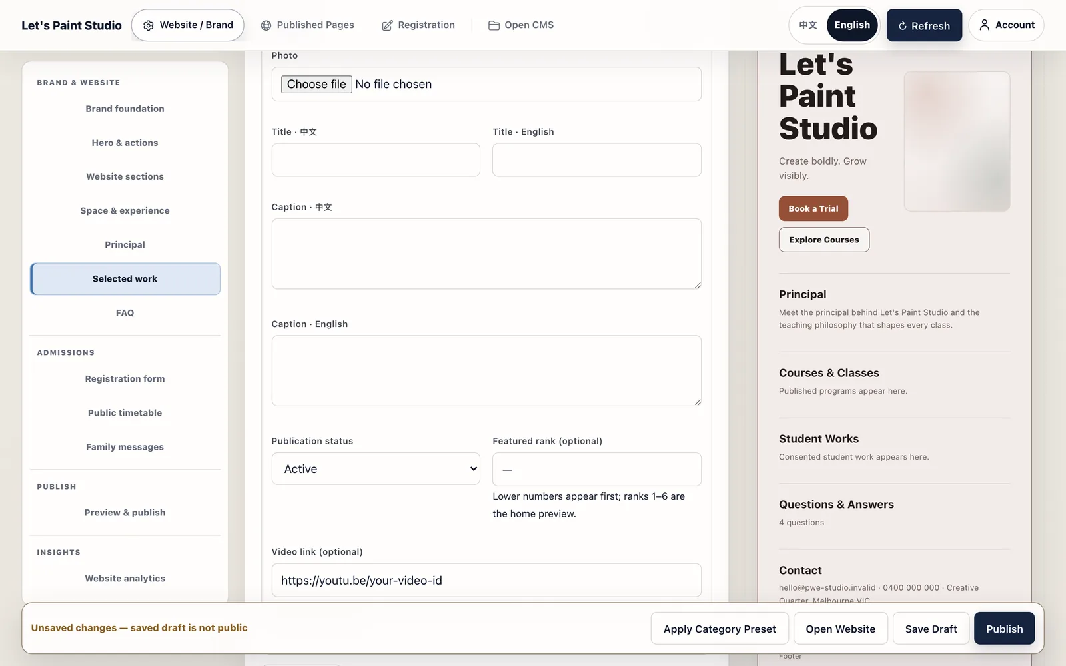
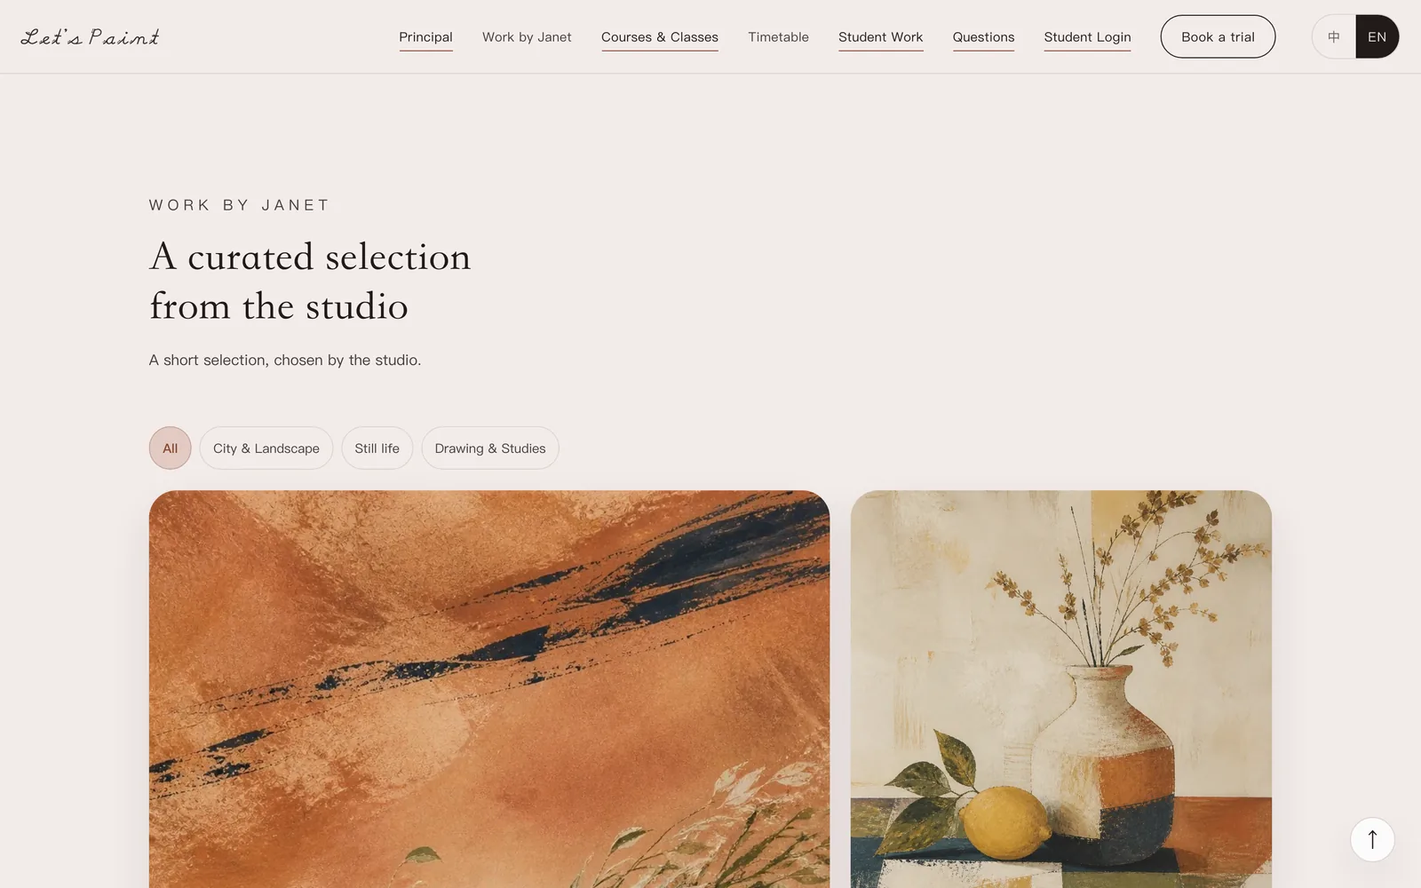
PWE STUDIO · CUSTOMER ROADSHOW / 客户路演版
Families see the work, not the backstage.
家长看到作品，后台留在幕后。
Home previews 6 works; the archive loads 12 per page. Student records stay private.
首页预览最多 6 件；独立归档每页 12 件，学员档案默认私密。
Curate selected work / 整理作品
Publish to showcase / 发布到作品归档
PWE Studio · Powered by Paradise Production · 天域文创
07 / 11
Notes:
Move to the family-facing showcase: owners curate the studio-owned work archive, while student records remain private by default.
Call out the current scale plainly: home preview up to 6 works; standalone archive 12 per page; plan active-work allowances are 15 / 60 / 150.
[Sources]
- README.md: v9.8.7 showcase ranking, archive, category and pagination behavior carried into v9.8.8.
- docs/guides/Studio_Owner_Guide.md: work archive, plan allowances and privacy boundary.
- docs/customer/Security_Privacy_Compliance.md: student media consent and private-by-default behavior.
- Local visual assets: backend/frontend/assets/manual/01-showcase-workbench.en.webp and 02-showcase-portal.en.webp.

Slide 8
PWE STUDIO · CUSTOMER ROADSHOW / 客户路演版
Reconciliation moves into daylight.
对账搬进白天，深夜不再加班。
Invoices, credits, statements and a per-student timeline grow out of daily operations.
发票、课时、月结单与学员时间线，都从日常运营里自然生成。
01
Invoices & credit notes
settle & refund, audited / 结算退款全程留痕
发票与贷记单
02
Statements & timeline
every dollar tells its story / 每笔钱都有来龙去脉
月结单与学员时间线
03
Xero connection
connect now · push staged / 可连接·推送分阶段
Xero 已可连接
Every number traces to a class, a payment, a person.
每个数字，都能追溯到一节课、一笔钱、一个人。
PWE Studio · Powered by Paradise Production · 天域文创
08 / 11

Slide 9
PWE STUDIO · CUSTOMER ROADSHOW / 客户路演版
Publishing should tell the truth.
发布状态，也应该如实。
A successful write is not the same as a ready public page.
写入成功，不等于每个公开页面已就绪。
Publish intent / 发布意图
1
Owner intent drives the write, not an empty link.
以 Owner 意图写入，不制造空链接。
Shared surface contract / 公开表面契约
2
Portal, showcase, timetable and register share one rule.
官网、作品、课表与报名共用一套规则。
Truthful retry / 如实重试
3
Still settling? The panel says so; retry stays available.
仍在确认？后台如实说明，并保留重试。
CURRENT PLATFORM · v10.9
pwestudio.online · production
PWE Studio · Powered by Paradise Production · 天域文创
09 / 11
Notes:
Use this slide to explain the v9.8.8 publication truth: a successful write can precede public projection; the owner sees the real state, a reason and a retry path.
[Sources]
- README.md: v9.8.8 publicSurfaceContract and truthful verification scope.
- docs/HANDOFF_LATEST.md: structured bilingual pending-verification state and retry path.
- Local visual asset: backend/frontend/assets/manual/01-brand-workbench.en.webp.

Slide 10
PWE STUDIO · CUSTOMER ROADSHOW / 客户路演版
Start focused. Grow with the studio.
先从清晰的范围开始，再随工作室成长。
A transparent starting point. A scoped path to launch.
清晰的订阅起点，配合按范围交付的上线路径。
RECOMMENDED / 推荐
Starter
Studio
Growth
起步
工作室
成长
$49
$99
$189
AUD / month
AUD / month
AUD / month
50 students · 1 seat · 15 works · 2 GB
250 students · 5 seats · 60 works · 10 GB
500 students · 20 seats · 150 works · 50 GB
50 名学员 · 1 席位 · 15 件作品 · 2 GB
250 名学员 · 5 席位 · 60 件作品 · 10 GB
500 名学员 · 20 席位 · 150 件作品 · 50 GB
One-time setup AUD 299–999 covers implementation, migration and training. Final price, GST and terms are confirmed in the signed order form.
一次性 Setup 服务费 AUD 299–999（配置、迁移与培训）；最终价格、GST、期限与条款以签署的订单为准。
Available as multi-tenant SaaS or customer-owned Edition / 可选多租户 SaaS 或客户自有 Edition
PWE Studio · Powered by Paradise Production · 天域文创
10 / 11
Notes:
Present the plan anchors as a starting point, then qualify scope: implementation, migration and training are quoted separately, and final price, GST and terms belong in the signed order form.
The compact card line surfaces the current public-work allowances: Starter 15, Studio 60 and Growth 150. Team-user allowances remain 1 / 5 / 20.
[Sources]
- backend/db/schema_v1.sql: current plan catalogue values.
- docs/customer/Pricing_and_Package_Boundaries.md: pricing, limits and commercial boundaries.
- docs/guides/Studio_Owner_Guide.md: current showcase allowances.

Slide 11

NEXT STEP / 下一步
A 30-minute walkthrough, using your studio’s name.
用你的工作室名字，走一遍 30 分钟演示。
Brand · surfaces · operations · launch
四步确认品牌、公开入口与上线节奏。
01
02
03
04
Brand
Public surfaces
Operations
Launch path
品牌
公开入口
运营
上线路径
pwestudio.online
让系统退到幕后，把作品放回台前。
PWE Studio · Powered by Paradise Production · 天域文创
11 / 11
Notes:
Close with a concrete next step: configure the studio identity, preview the public surfaces, walk through daily operations and agree the onboarding path.
[Sources]
- docs/customer/Onboarding_Checklist.md: brand setup, migration, training and acceptance phases.
- docs/customer/Welcome_Pack.md: customer addresses and first steps.
- README.md: pwestudio.online production entry point.
- Local visual asset: backend/frontend/assets/showcase-coast-home.webp.

