Slide 1
About Scientific Writing (target MSc thesis)
Kent-Andre Mardal

Slide 2
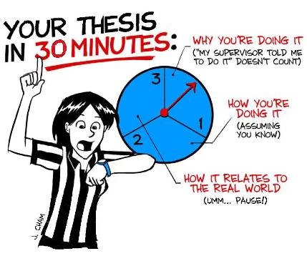
Overview of this lecture
Scientific writing is different from other types of writing – it is all about precise and balanced content
Today we will discuss how scientific writing is typically evaluated (master thesis evaluation)
Then, try to come up with an algorithm for writing a first draft

Slide 3
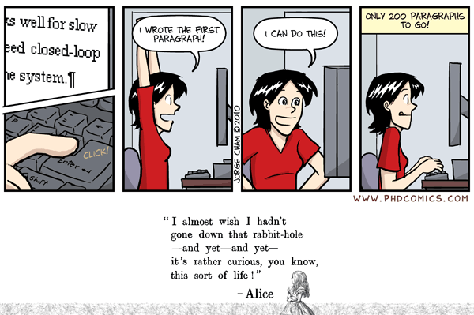
Sensor guidance on censorship of master assignments
The sensor assesses for each point the extent to which the candidate has achieved these goals:
1. Professional anchoring 2. Theoretical insight
3. Target description 4. Skill Level
5. The work 6. Analysis and discussion
7. Critical reflection 8. Own contribution / goal achievement
9. Structure 10. Language
11. Form
https://www.uio.no/for-ansatte/arbeidsstotte/sta/enheter/mn/eksamen/sensorveiledninger/

Slide 4
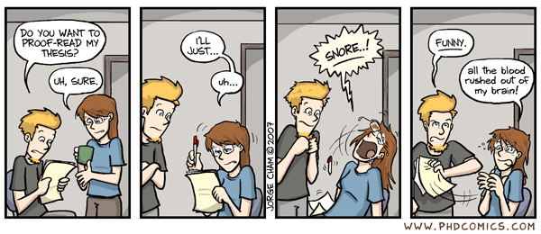
Language
From the guide: “Can the candidate present problem and results with the necessary professional precision? Is it highly readable with high quality in the language used?”
(Usually not a problem mostly because fellow students help with cleaning up the language)

Slide 5
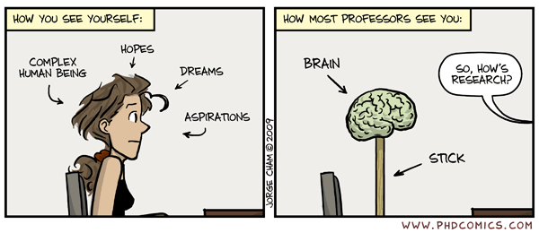
Skill level
Do candidates apply relevant methods and use them in their own work in an appropriate and integrated manner?
(Usually not a problem because the supervisor has a pretty good idea of appropriate methods)

Slide 6
Effort
Does the work show creativity and / or contribute to innovation / innovation? Does the work give an impression of being particularly extensive? How is the quality and importance of new knowledge / new results generated in the work assessed?
(usually the effort is substantial – don´t put too much weight on the innovative and creative parts)

Slide 7
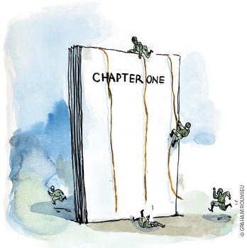
Professional anchoring
Is the theoretical and academic foundation well described so that the work is included in the field of international research?
(quite often a problem: to little
time spent on reading to get
an overview)

Slide 8
Analysis and discussion
Is analysis, interpretation / synthesis and discussion professionally founded and justified and clearly linked to the issue? Is the discussion at a high academic level? Can the candidate apply his / her knowledge and skills in new areas and place the results in a larger context?
(quite often a problem: requires an overview)

Slide 9
Critical reflection
Does the candidate give a reasonable assessment of the importance of the results? Is the candidate critical of different sources of information? Are uncertainties, such as method errors, measurement errors, and others considered and discussed? Are relevant academic, occupational and research ethical issues analyzed?
(quite often a problem: again how can one assess the importance and limitations of the work without an overview of the field)

Slide 10
Preliminary conclusion
A lot of the criteria concern “your overview of the field”:
anchoring
analysis and discussion
critical reflection
It is not sufficient to just read the few papers your supervisor hands out in the beginning

Slide 11
Matt Might´s illustrated guide

Slide 12
The problem, broad terms
What others have done
What you will do and how
Introduction
The bulk of the thesis
Preliminaries, notation
Methodology
Results
Summary of what you have done
Limitations, weakness
What others have done
And significance
Discussion/Conclusion

Slide 13
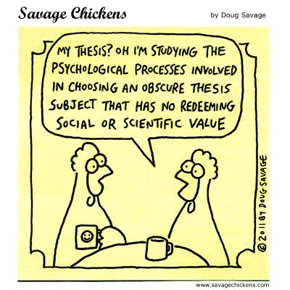
Examples of introductions
-Big Picture / Why
-What others have done
-What you will do
-How you will do it

Slide 14
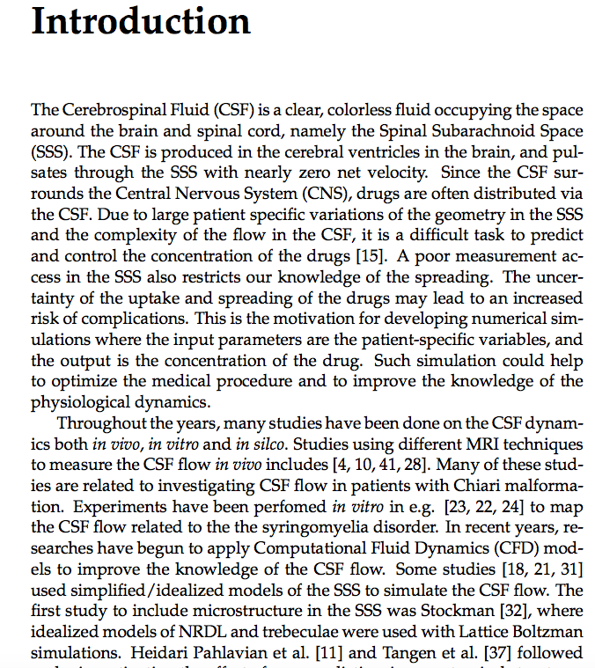
Per Thomas Haga, Numerical simulations of advection-dominated scalar
mixing with applications to spinal CSF flow and drug transport, 2015

Slide 15
Big picture, overview
What others have done
Per Thomas Haga, Numerical simulations of advection-dominated scalar
mixing with applications to spinal CSF flow and drug transport, 2015

Slide 16
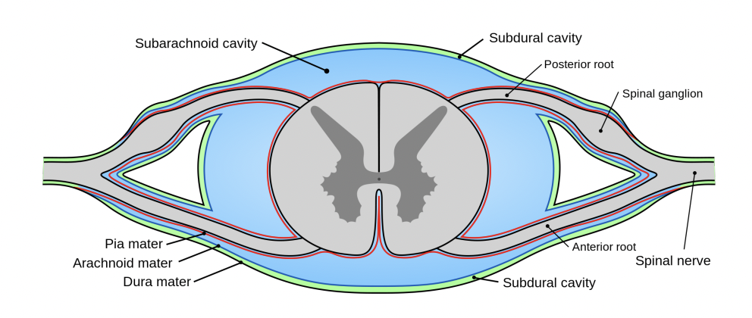
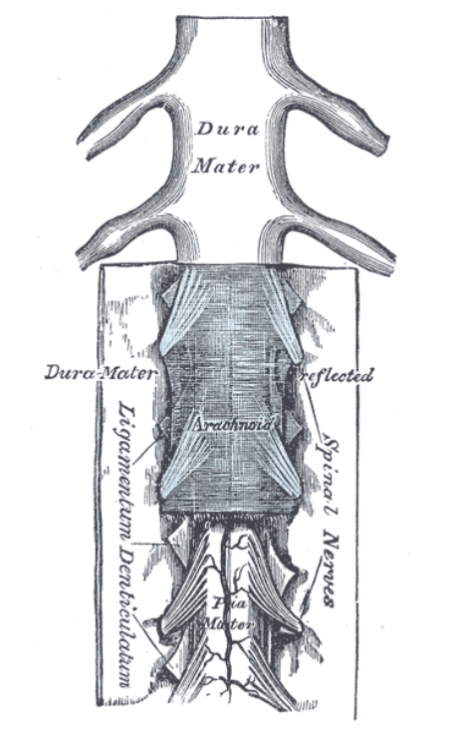
Big picture, overview
Associated
Images:
What others have done
Per Thomas Haga, Numerical simulations of advection-dominated scalar
mixing with applications to spinal CSF flow and drug transport, 2015

Slide 17
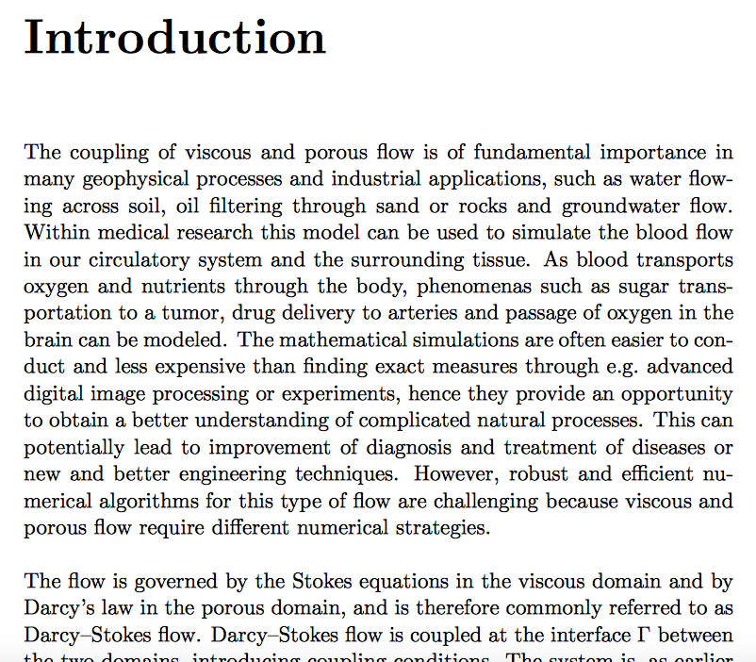
Ada Johanne Ellingsrud, Preconditioning unified mixed
discretizations of coupled Darcy–Stokes flow, 2015

Slide 18
Big picture, overview
Big picture, overview, math point of view
Ada Johanne Ellingsrud, Preconditioning unified mixed
discretizations of coupled Darcy–Stokes flow, 2015

Slide 19
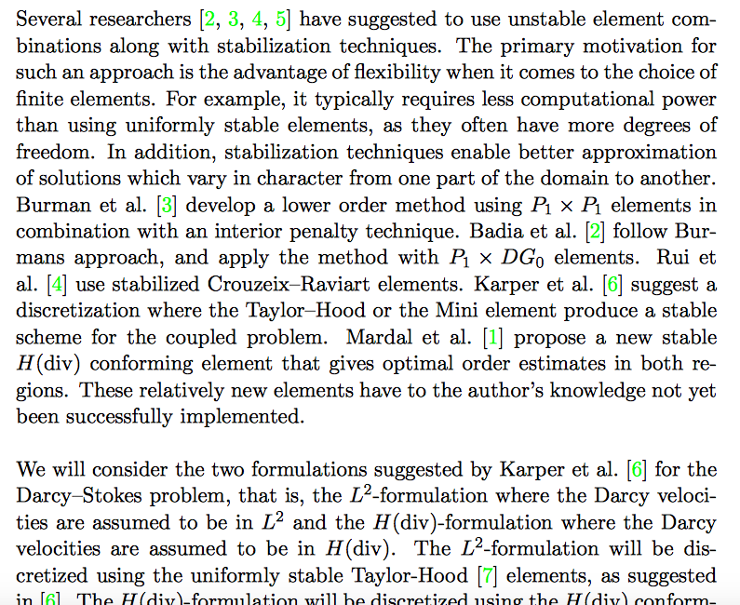
What others have done
What will be done and how
Ada Johanne Ellingsrud, Preconditioning unified mixed
discretizations of coupled Darcy–Stokes flow, 2015

Slide 20
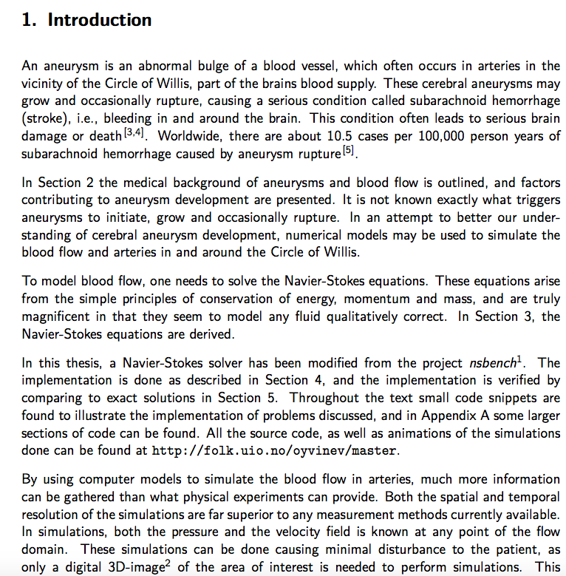
Øyvind Evju, Sensitivity analysis of simulated blood flow in cerebral aneurysms, 2011

Slide 21
Big picture, overview
Background with other works is here elsewhere (chap 2)
What will be done and how
Øyvind Evju, Sensitivity analysis of simulated blood flow in cerebral aneurysms, 2011

Slide 22
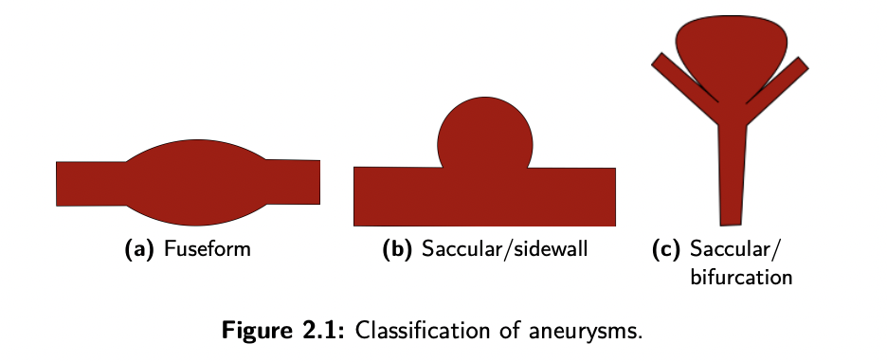
Big picture, overview
Background with other works is here elsewhere (chap 2)
What will be done and how
Øyvind Evju, Sensitivity analysis of simulated blood flow in cerebral aneurysms, 2011

Slide 23
Examples of some discussions/conclusions
-Summary of what has been done
-limitations, weakness
-how it relates to what others have
done
-significance

Slide 24
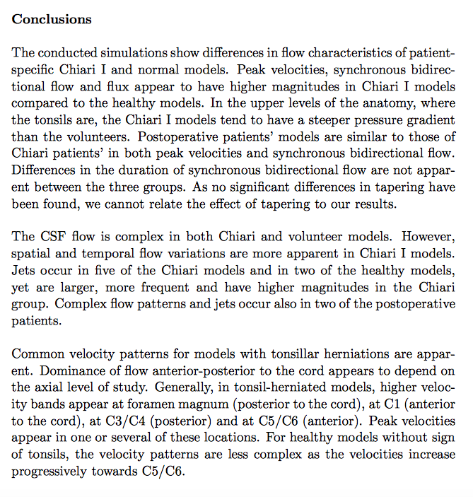
Gabriela Rutkowska, Computational Fluid Dynamics in Patient-Specific
Models of Normal and Chiari I Geometries, 2011

Slide 25
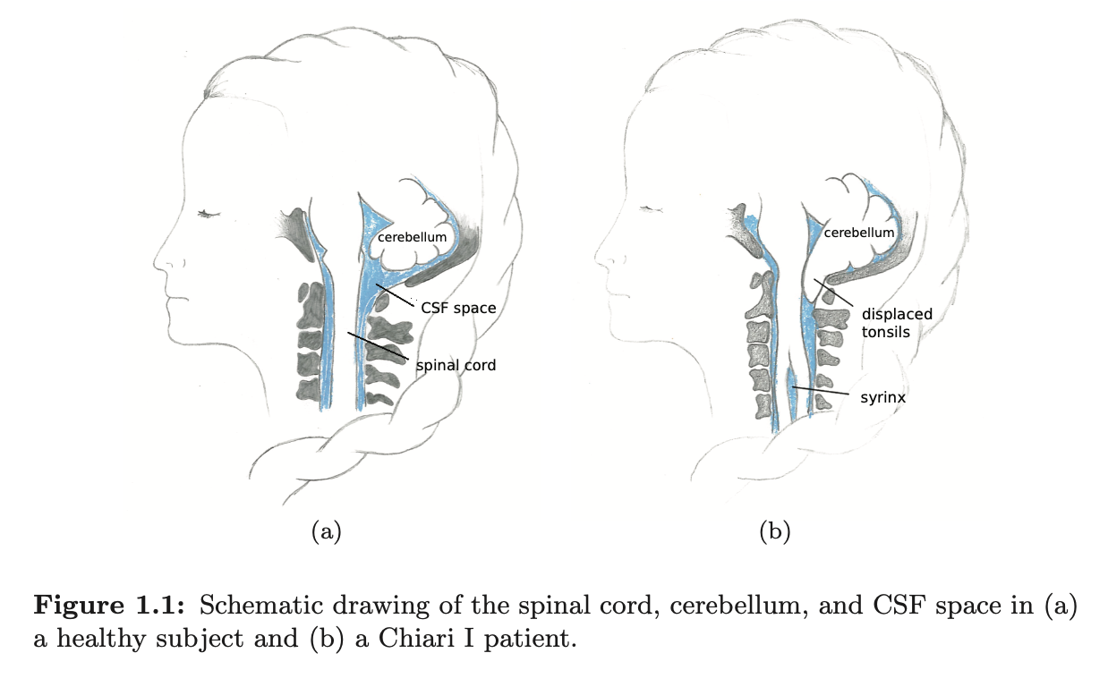
Gabriela Rutkowska, Computational Fluid Dynamics in Patient-Specific
Models of Normal and Chiari I Geometries, 2011

Slide 26
Summary of findings
Gabriela Rutkowska, Computational Fluid Dynamics in Patient-Specific
Models of Normal and Chiari I Geometries, 2011

Slide 27
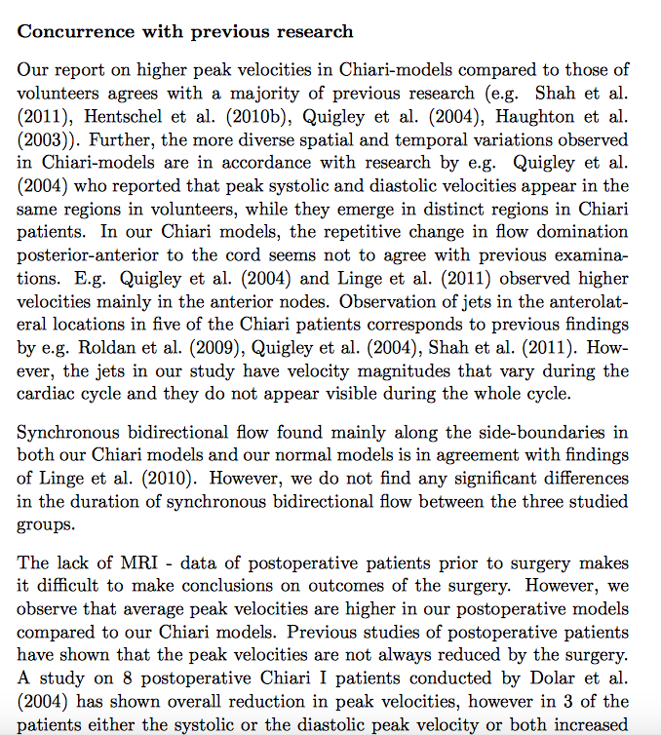
Gabriela Rutkowska, Computational Fluid Dynamics in Patient-Specific
Models of Normal and Chiari I Geometries, 2011

Slide 28
How the work is related to what others have done
Gabriela Rutkowska, Computational Fluid Dynamics in Patient-Specific
Models of Normal and Chiari I Geometries, 2011

Slide 29
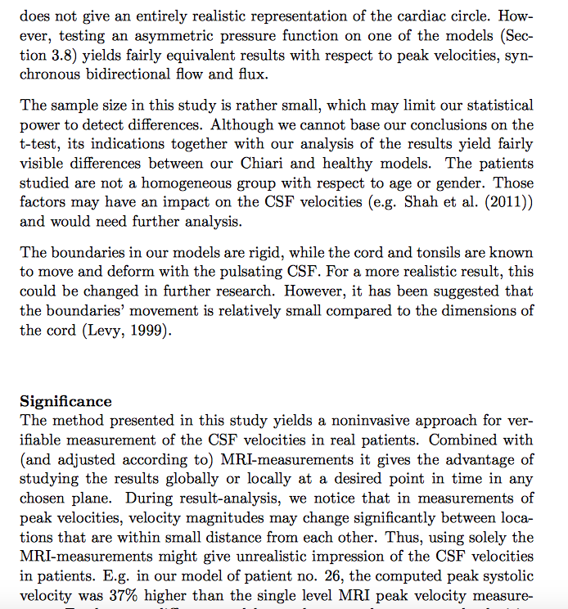
Gabriela Rutkowska, Computational Fluid Dynamics in Patient-Specific
Models of Normal and Chiari I Geometries, 2011

Slide 30
Limitations, weakness
Why is this study important, quantification
Gabriela Rutkowska, Computational Fluid Dynamics in Patient-Specific
Models of Normal and Chiari I Geometries, 2011

Slide 31
The problem, broad terms
What others have done
What you will do and how
Goal description
Professional anchoring
The bulk of the thesis
Preliminaries, notation
Methodology
Results
Skill level, theoretical insight, effort
Analysis, discussion, crtical reflection
Summary of what you have done
Limitations, weakness
What others have done
And significance
Goal achievement

Slide 32
Pitfalls
Start to broad: “In 16xx Newton changed the world by inventing calculus.”
Statements that are probably true but without references: “Multilevel algorithms are among the most efficient.“
Assume that the reader knows what you are describing so that you do not need to introduce terms or concepts.
Do not spend to much time on fancy language – the language should be straightforward and to the point

Slide 33
Tip
Search for recent works – they provide recent overviews of the fields (although tailored to their story)
It is not sufficient to read textbooks – they are structured differently and there is no need for novelty in a textbook
Avoid adjectives such as better, faster, etc. Quantify instead.
Try to be precise and complete in your writing – draft early with this in mind to get an overview of what you will need to include

Slide 34
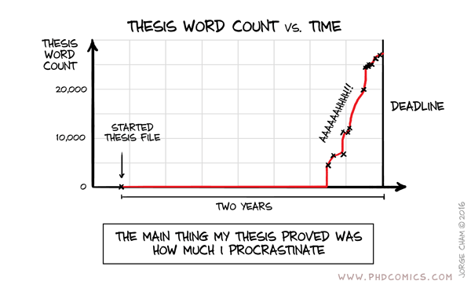
Ways of structuring the writing

Slide 35

A good way of structuring the writing: focus on one paragraph at the time

