Slide 1
NYCU 2024 Spring DL Lab6
Generative Models
TA 楊賀弼
Aug 13, 2024
Notes:
1

Slide 2
Outline
  Rule
  Lab description
  Model design guide
  Scoring criteria
Notes:
2

Slide 3
Rule
Report submission deadline: Aug 23, 2024, 11:59 p.m.
No need to demo this lab
Zip all files in one file
  Report (.pdf)
  Source code
Name it "DL_LAB6_YourStudentID_YourName.zip”
  Example: “DL_LAB6_313553051_楊賀弼.zip”
-5% to your score if you do not follow the format
Upload the model weight

Slide 4
Lab description

Slide 5
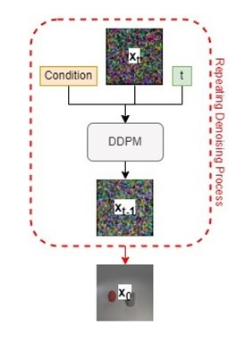
Lab objective
You need to implement a DDPM to generate synthetic images according to multi-label conditions

Slide 6
Requirements
Design and train your models
  Implement a conditional DDPM
  You can use any architecture you like
Synthesis image and evaluate the results
  Show the synthetic images in grids (for test.json, new_test.json)
  Show the denoising process in a grid for sampling from your DDPM
(with the label set ["red sphere", "cyan cylinder", "cyan cube"])
  Evaluate your model with the classification accuracies from the provided evaluator (for test.json, new_test.json)

Slide 7
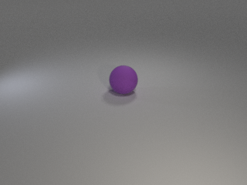
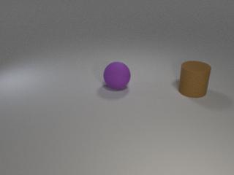
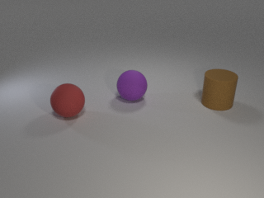
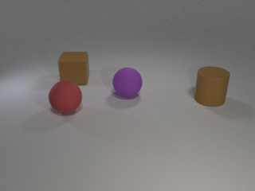
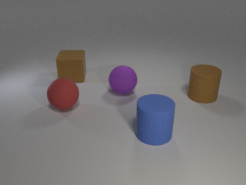
Dataset
Provided files
  readme.txt, train.json, test.json, new_test.json, object.json, iclevr.zip
object.json
  Dictionary of objects
  24 classes
Example of labels:
  [“cyan cylinder”, “red cube”], [“green sphere”], …
  The same object will not appear twice in an image

Slide 8
Pretrained evaluator
Provided files: evaluator.py, checkpoint.pth
  DO NOT modify any of them
Use eval(images, labels) to compute accuracy of your synthetic images
  Labels should be one-hot vector. E.g. [[1,1,0,0,…],[0,1,0,0,…],…]
  Images should be all generated images. E.g. (batch size, 3, 64, 64)
  Images should be normalized with transforms.Normalize((0.5, 0.5, 0.5), (0.5, 0.5, 0.5))
You can involve this evaluator in training or sampling for better result
  E.g. classifier guidance for DDPM
  Inherit the class if you need extra functionalities
  Again, DO NOT modify the weight and class script

Slide 9
Implement a conditional DDPM

Slide 10
Design of DDPM
Denoising diffusion model
Latent diffusion model
  encoder/decoder design
Condition embedding
  label embedding
  Time embedding
Noise schedule
  linear
  cosine
  other

Slide 11
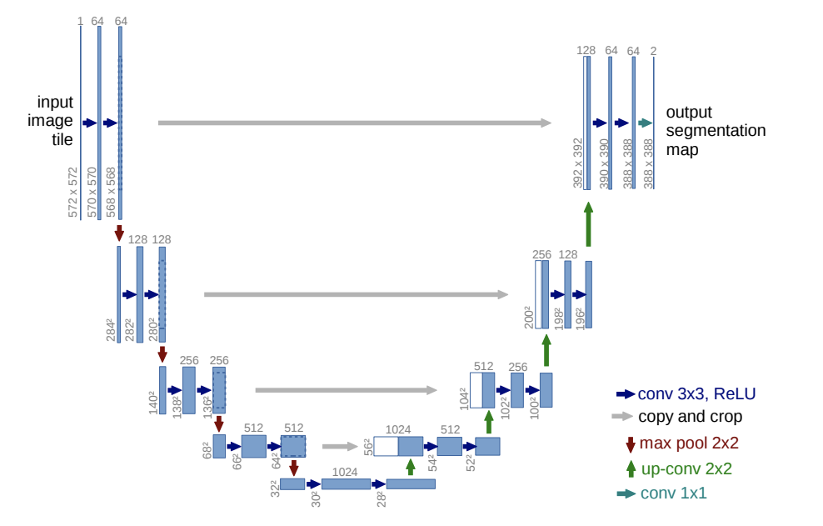
Design of UNet
Number of blocks
Number of layers, channels in each blocks
Down/upsampling blocks design
  Architecture for the blocks. e.g. Resnet block
  Self/cross attention
  Where to add condition
  other

Slide 12
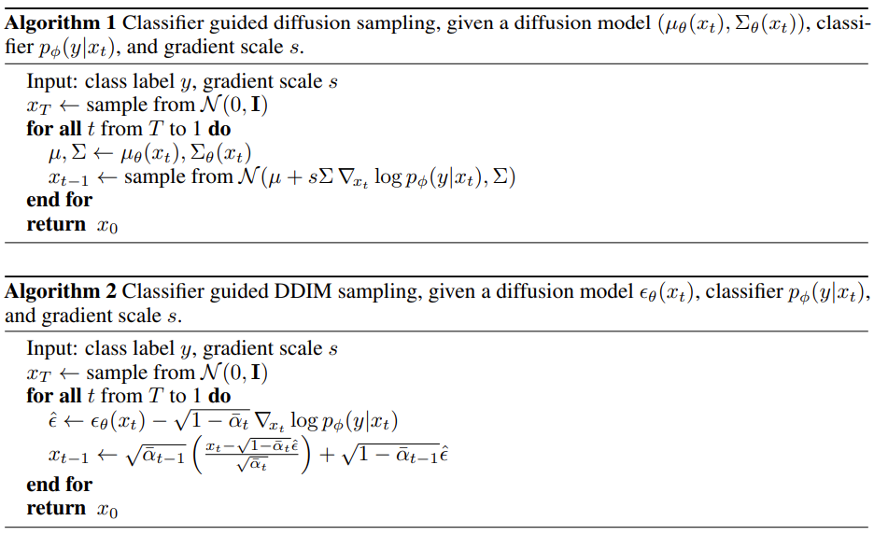
Choice of sampling method
DDPM, DDIM, etc.
With classifier guidance (Diffusion models beat gans on image synthesis)
You can include the pretrained evaluator (classifier) here
You can include the pretrained evaluator (classifier) here

Slide 13
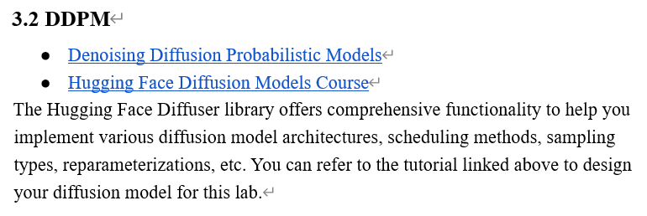
Simple suggestions (in the other PDF)

Slide 14
Scoring criteria

Slide 15
Scoring criteria
Report (60%)
  Introduction (5%)
  Implementation details (25%)
    Describe how you implement your model, including your choice of DDPM, noise schedule
(There is no demo in this lab, so please write in detail.)
  Results and discussion (30%)
    Show your synthetic image grids (16%: 8% * 2 testing data) and a denoising process image (4%)
    Discussion of your extra implementations or experiments (10%)

Slide 16
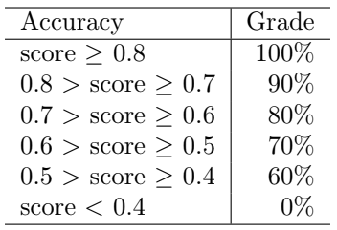
Scoring criteria
Result (40%) (based on results shown in your report)
  Classification accuracy on test.json and new_test.json.
  Show your accuracy screenshots
  The command for inference process(save the synthetic images)
(Please make sure TA can understand how to run your inference code)
  20% * 2 testing data

Slide 17
Model Weight Upload
Weight upload link： Link
Notice：Please name your model weight as “DL_lab6_YourStudentID_Name.pth”
e.g.”DL_lab6_ 313553051_楊賀弼.pth”
The deadline for uploading model weight is the same as the lab.

Slide 18
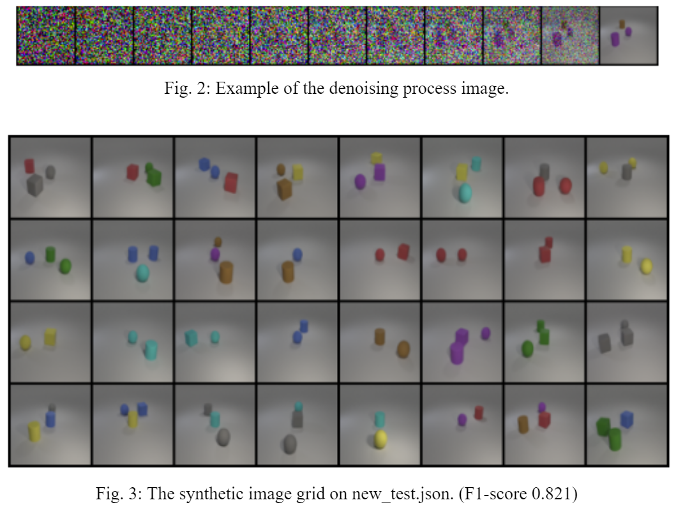
Output
examples

