Slide 1
Zero-Shot Noise2Noise: Efficient Image Denoising without any Data
CVPR 2023
Youssef Mansour and Reinhard Heckel,
School of Computation, Information and Technology, Technical University of Munich
Munich Center for Machine Learning
Dept. of Electrical and Computer Engineering, Rice University
Group 20

Slide 2
Outline
Introduction
Related Work
Method
Experiments
Conclusion

Slide 3
Introduction
Problem to solve
  Current SOTA denoising techniques rely on large data sets of clean-noisy image pairs which is difficult to collect and time-consuming
  Network trained on dataset suffers from a performance drop if the test images come from a different distribution of images

Slide 4
Introduction
Problem to solve
  Current SOTA denoising techniques rely on large data sets of clean-noisy image pairs which is difficult to collect and time-consuming
  Network trained on dataset suffers from a performance drop if the test images come from a different distribution of images
Dataset-free method (Zero-shot)

Slide 5
Introduction
Problem to solve
  Current SOTA denoising techniques rely on large data sets of clean-noisy image pairs which is difficult to collect and time-consuming
  Network trained on dataset suffers from a performance drop if the test images come from a different distribution of images
  Suitable only for specific noise distributions that do not generalise to different noise distributions or levels
  Need previous knowledge of the noise level, which require a lot of compute (time, memory, GPU) to denoise an image

Slide 6
Introduction
Key attributes
  Compute
  Generalisation

Slide 7
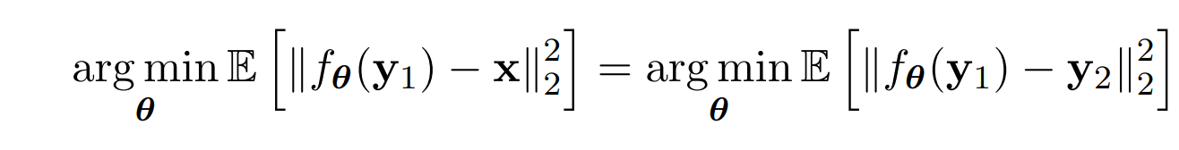
Related Work
Background
  Noise2Noise: Learning Image Restoration without Clean Data
    assuming zero mean noise, training a network in a supervised manner to map a noisy image to another noisy image is equivalent to mapping it to a clean image
  Neighbor2Neighbor: Self-Supervised Denoising from Single Noisy Images

Slide 8
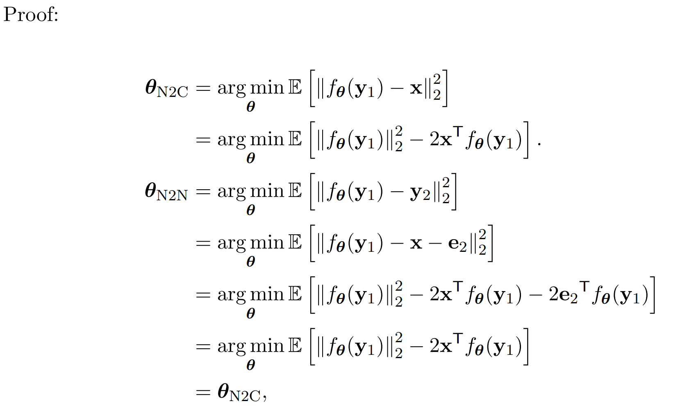
Related Work
Background
  Noise2Noise: Learning Image Restoration without Clean Data
    assuming zero mean noise, training a network in a supervised manner to map a noisy image to another noisy image is equivalent to mapping it to a clean image
  Neighbor2Neighbor: Self-Supervised Denoising from Single Noisy Images

Slide 9
Related Work
Background
  Noise2Noise: Learning Image Restoration without Clean Data
    assuming zero mean noise, training a network in a supervised manner to map a noisy image to another noisy image is equivalent to mapping it to a clean image
  Neighbor2Neighbor: Self-Supervised Denoising from Single Noisy Images
    extends N2N and allows training only on a set of single noisy images, by sub-sampling a noisy image to create a pair of noisy images

Slide 10
Method
Innovation
  Zero-Shot Noise2Noise (ZS-N2N) is a novel method for image denoising that does not require any training data.
  It utilizes a lightweight two-layer neural network with approximately 20k parameters, significantly reducing computational cost and allowing efficient execution on CPU.
  The method generalizes well result on noise distributions,which making it effective in scenarios with limited computational resources.

Slide 11


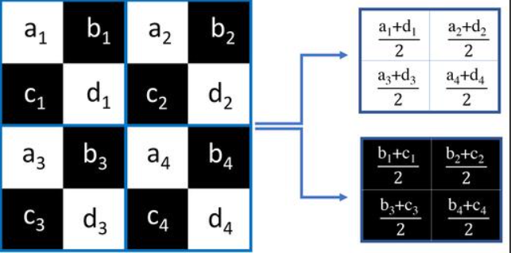
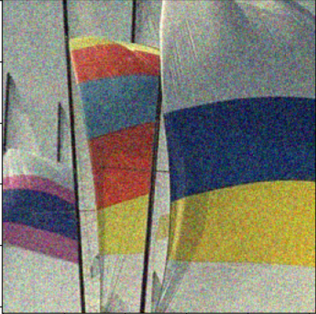
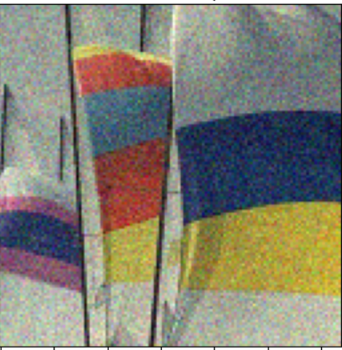
Method
Step 1: DownSampling
  with 2 fixed kernel,which the convolution has stride 2, and it is apply to each image channels independently.
  These downsampled images simulate two noisy observations of the same scene with similar underlying signals but independent noise.
D1(y)
y
D2(y)
Notes:
Look at the top right of this slide.
The two kernel’s meaning is calculate the mean of diagonal and antidiagonal.

Slide 12
Method
Step 2: Lightweight Neural Network Setup
  The network consists of two convolutional layers with a kernel size of 3×3 followed by a final layer of 1×1convolutions.
  The total number of parameters in the network is approximately 20k, making it lightweight and computationally efficient.
  The network does not include any normalization or pooling layers, which further reduces computational complexity.

Slide 13
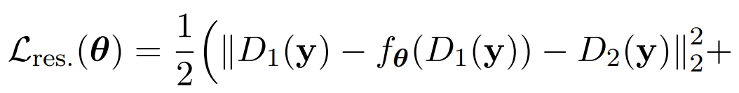
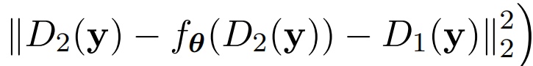
Method
Step 3: Training the Neural Network with Residual Learning
  The network is trained using a residual learning approach, where the network is optimized to fit the noise rather than the image itself.
  Residual Loss:To fit the noise rather than the image itself
  Consistency Loss: ensure the image consistency
Notes:
In the later slide i will talk deeper in this to function
The folloowing two loss are the component of loss function:
1.Residual loss:To fit the noise rather than the image itself,this is the function of residual loss.I will explain this function in more detail later.
3.Consistency loss: make sure you denoise a image y and do downsampling is the same as you do downsampling first and then you do the denoise process.
The order of your step will not influence your final result

Slide 14

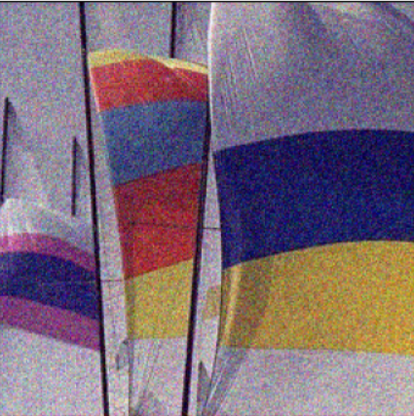
-
D1(y)
model
f(D1(y))
D1(y)
f(D1(y))
-
y
D2(y)
f(D2(y))
f(D2(y))
D2(y)
-
R1
D2(y)
+
-
R2
D1(y)
Notes:
We hope the result after D1(y)minusf(D1(y)) as close as the other one of images downsampler, In this case R1 should as close as D2(y)
likewise D2(y) minus f(D2(y)) is the same
To ensure the symmetric property, the loss function adds the two parts together and takes the mean of their sum.

Slide 15
model
D1(f(y))
f(D1(y))
y
f(y)
D2(f(y))
f(D2(y))
minimize the mse between the two grpah
Notes:
pass a noisy image y pass it through the model and you can get the noise distribution of the y which called f(y) and you do downsampler to get D1(f(y)) and D2(f(y))
and calculate the loss of the f(D1(y)) and f(D2(y)) which i methoned in previous slide.
This is in order to calculate the consistency loss. The main goal of the consistency loss is
to ensure that performing the downsampler first or the denoise first makes no difference to the result.

Slide 16
Method
Step 4 :Applying the Trained Network
-
-
-
y
f(y)
Denoise image
Notes:
first,you put a noisy image y. pass it to neural network to get the f(y) and do y minus f(y) to get the denoise image

Slide 17
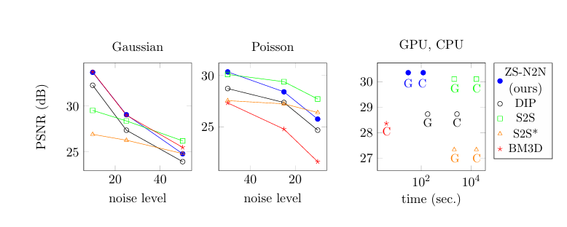
Experiments
Different kind of noise
Notes:
This is the main experiments of this paper. This show the performance between different kind of zero shot method , including DIP S2S BM3D under different kind of noise enviornment
1.As the noise level increase, we can see that the blue curve decrease more soomth.We also can see this result in poisson distribution noise,espacilly in lower noise level
2.The computation efficiency of ZS N2N is more efficient than the other method, because it use the 20K parameters network as the model

Slide 18
Conclusion
Algorithm Innovation: We proposed a novel zero-shot image denoising algorithm that does not require any training examples.
Simple Network Architecture: The method utilizes a simple 2-layer network.
High Computational Efficiency: The algorithm can perform denoising in a relatively short period of time, even without the use of a GPU.
Wide Application Range: The method performs well on both simulated noise and real-world noise from cameras.
Balanced Performance: It achieves a good trade-off between generalization, denoising quality, and computational resources.
Notes:
This method has the following advantage

Slide 19
Thank You for Your Attention

Slide 20
Conclusion

Slide 21
Experiments
Prepare backup slides if necessary

Slide 22
Visualization (Optional)

Slide 23
Ablation Study (Optional)

Slide 24
Experiments

Slide 25
Method
The proposed method (novelty) in the paper
The main component in the presentation
Please ensure the explanation is clear and concise

