Slide 1
Core Data and TableView
By Kent Huang

Slide 2
Core Data
Object-oriented database
Mapping between database and objects
Access data in database using the vars in the objects

Slide 3
Development

Slide 4
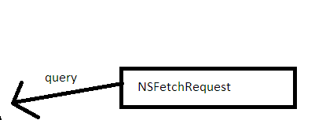
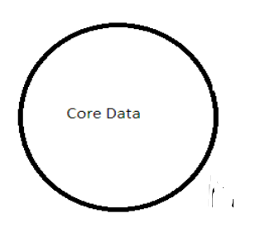
How to query

Slide 5
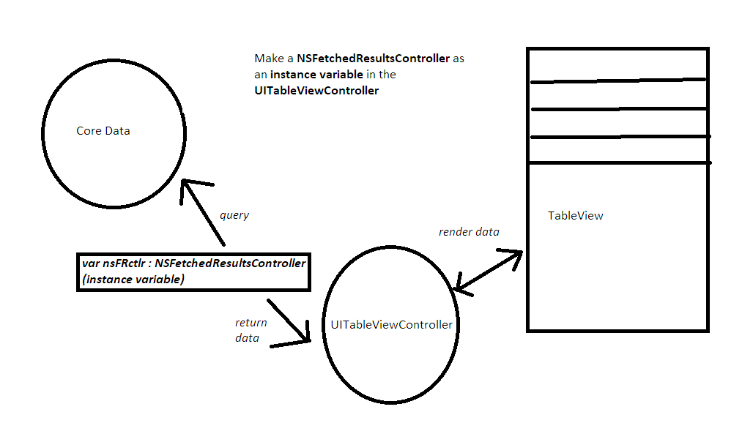

Slide 6
Code

Slide 7
UITableViewController to implements NSFetchedResultsControllerDelegate

Slide 8
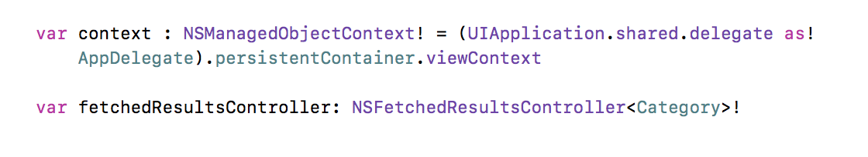
2. Set up the NSFetchedResultsController in the UITableViewController

Slide 9
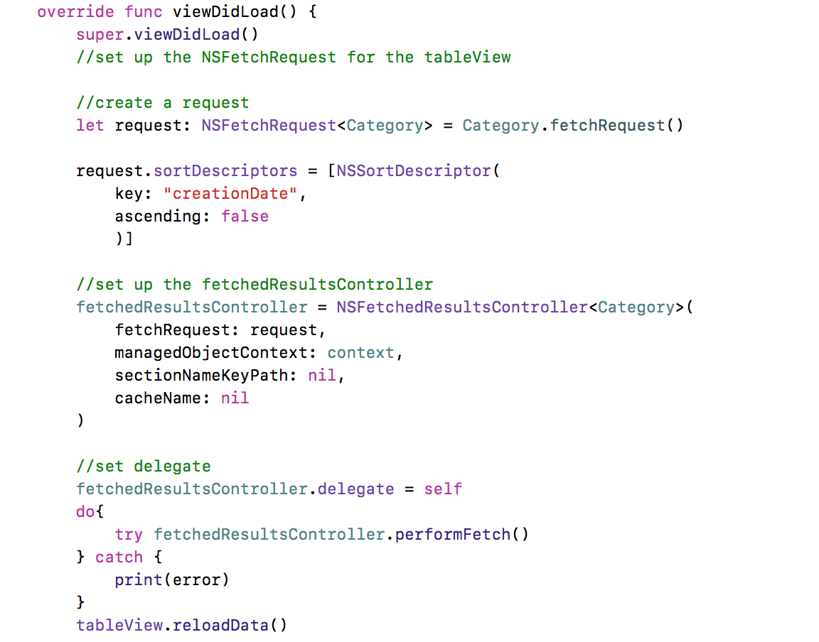
3. Set up in viewDidLoad

Slide 10
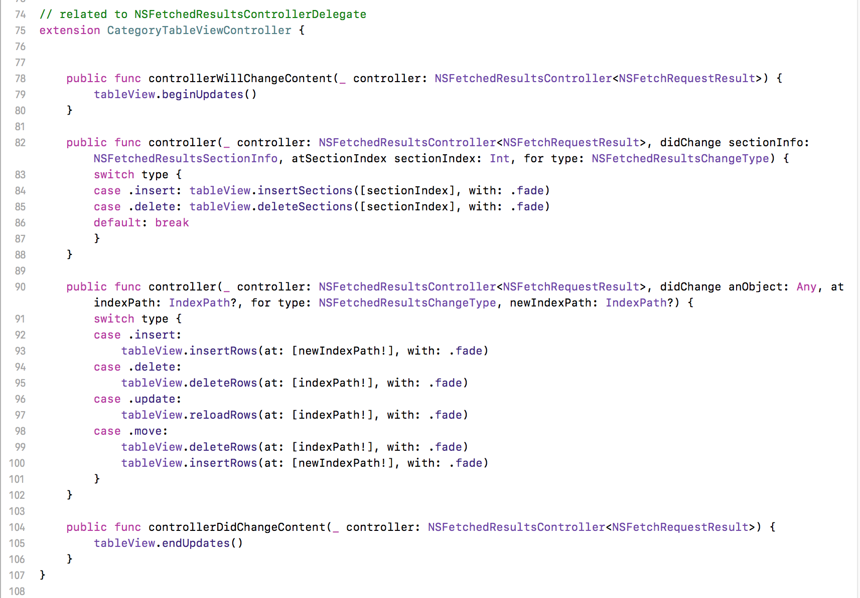
4. Set up NSFetchedResultsControllerDelegate methods (typical usage)

Slide 11
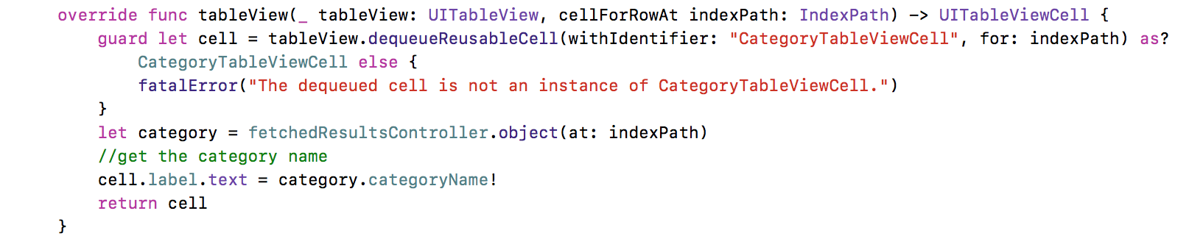
5.Get the data and show them on the table cells

Slide 12
Source code
https://github.com/kent426/CoreDataTableView-iOS

