Slide 1
Core Data and TableView
By Kent Huang

Slide 2
Core Data
Object-oriented database
Mapping between database and objects
Access data in database using the properties in the objects

Slide 3
Development

Slide 4
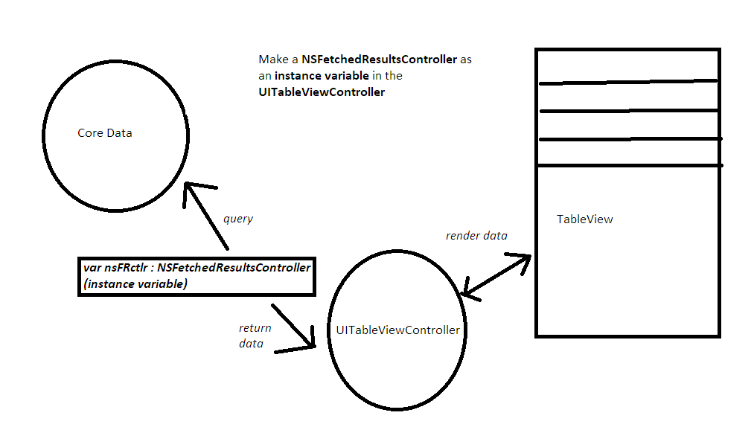

Slide 5
Code

Slide 6
UITableViewController to implements NSFetchedResultsControllerDelegate

Slide 7
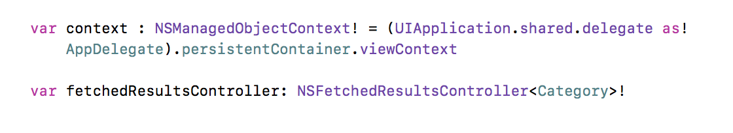
2. Set up the NSFetchedResultsController in the UITableViewController

Slide 8
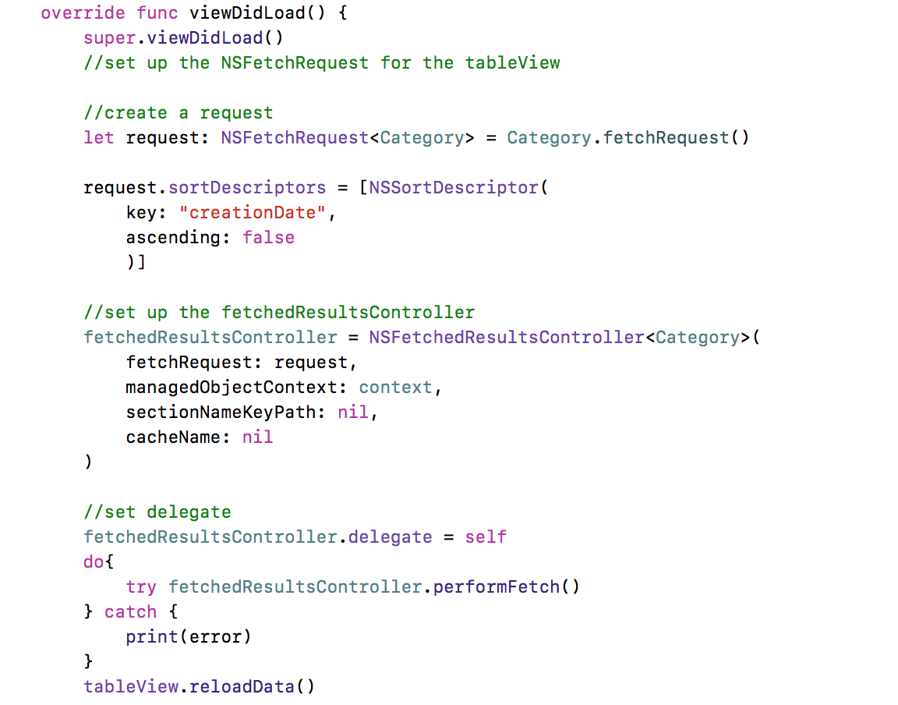
3. Set up in viewDidLoad

Slide 9
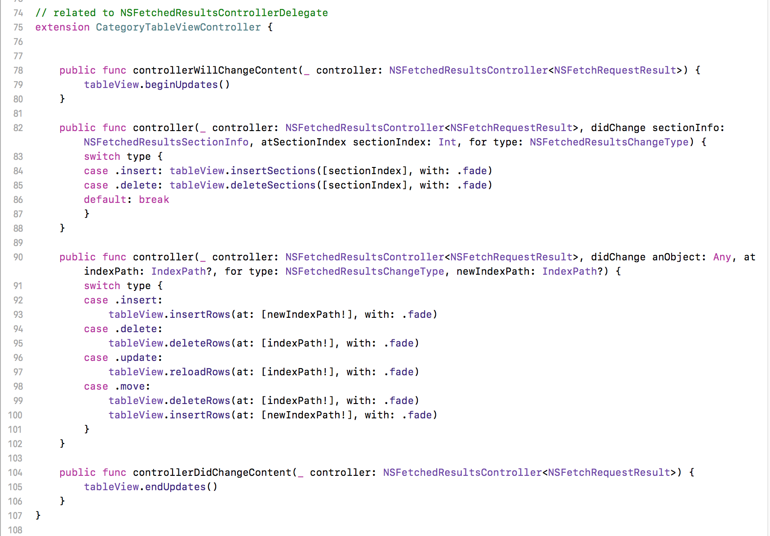
4. Set up NSFetchedResultsControllerDelegate methods (typical usage)

Slide 10
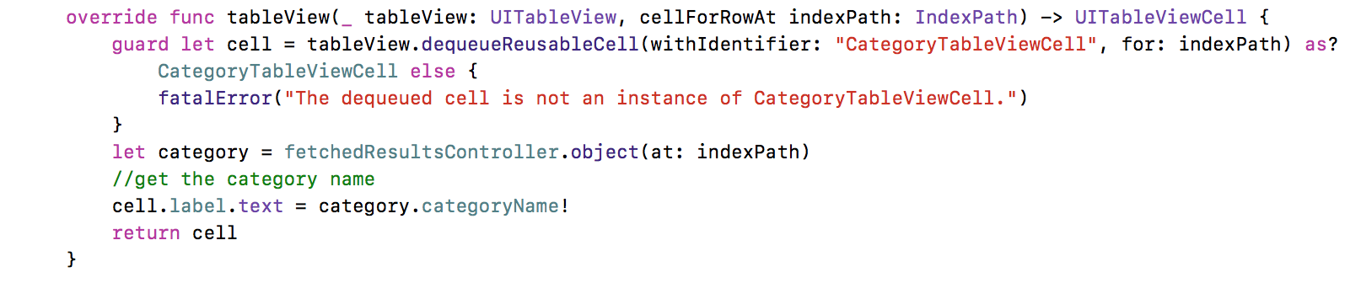
5.Get the data and show them on the table cells

