Slide 1
The Man Who Would Be King
Group 4

Slide 2
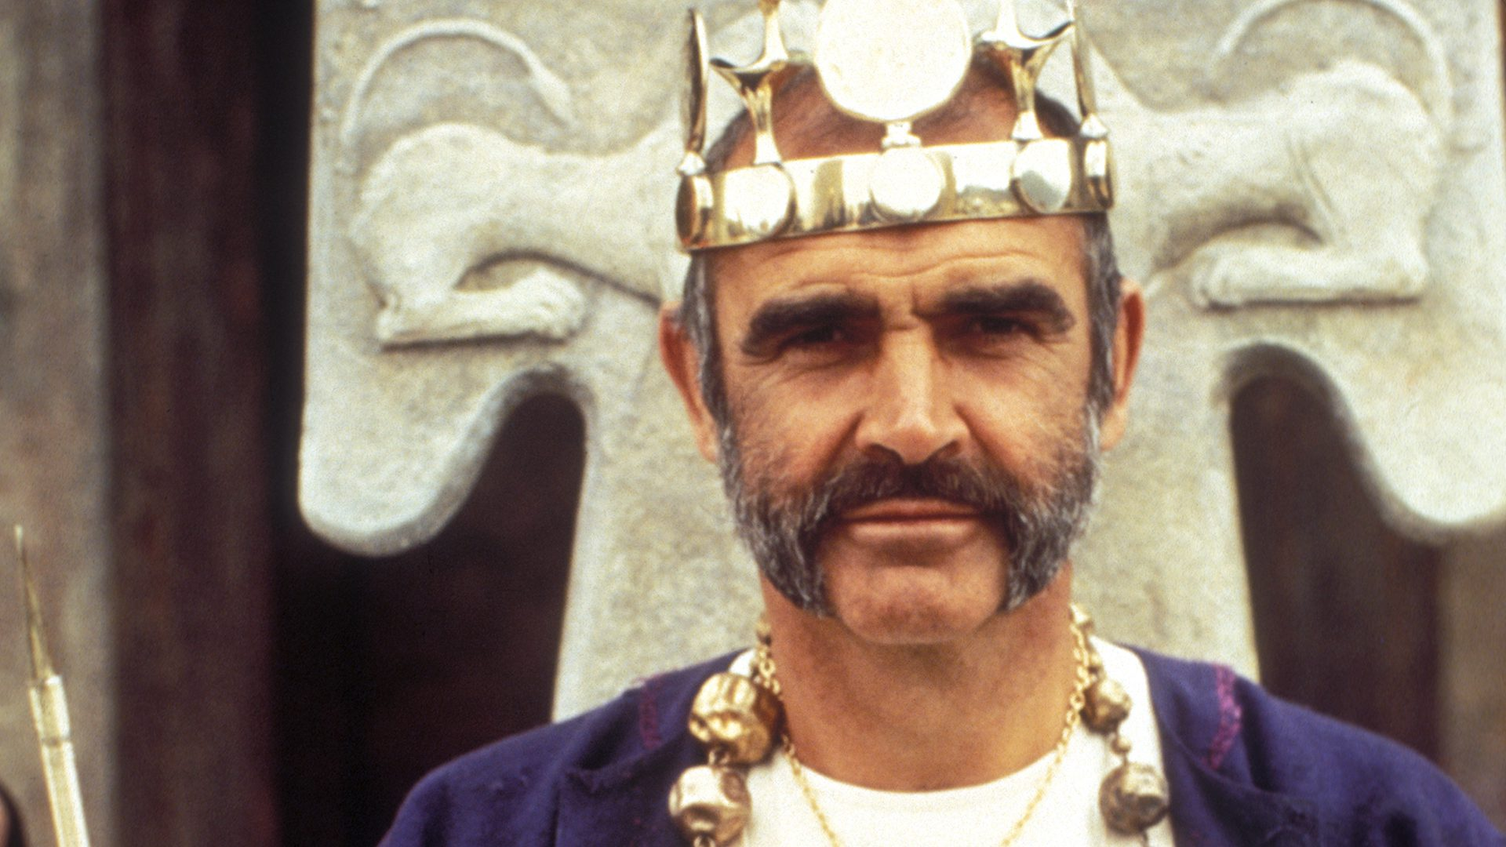
About
Characters
Daniel Dravot

Slide 3
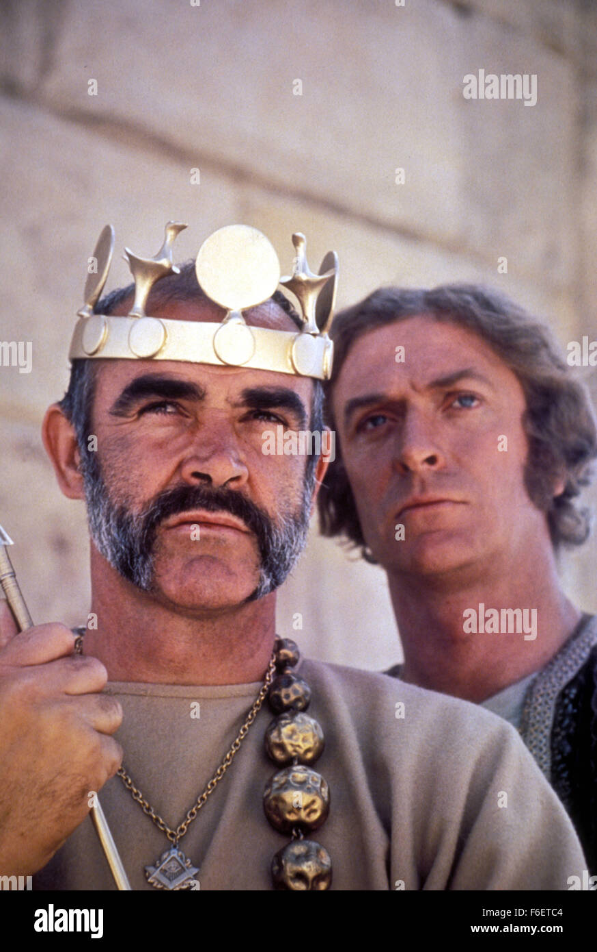
About
Characters
Peachey Taliaferro Carnahan

Slide 4
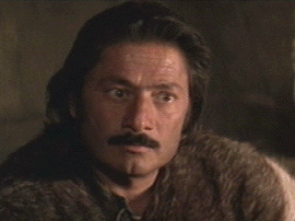
About
Characters
Billy Fish

Slide 5
Theme
The Danger of Arrogance
The story is about a man, Daniel Dravot, whose arrogance drove him to first build an empire and then to destroy it. The same self-importance that caused him to decide that he could become a local ruler in Kafiristan led him to grossly overextend himself. He allowed and encouraged the local men to believe that he and his friend Peachey were not men but gods possessing immense secrets.

Slide 6
Theme
The Obligation of Friendship
Early in the story, Dan and Peachey sign a contract that obligate them to do three things: to become kings in Kafiristan, to avoid alcohol, women, and other things that may distract them from that goal until the goal is achieved, and for each to render aid if the other is in trouble.

Slide 7
Theme
Racial Superiority
In The Man Who Would Be King, the two main characters, who are English, believe that they have the right and in fact the duty to go to Kafiristan and set themselves up as kings. To this, they trust to two things: first, their presumed cultural and ethnic superiority, and second, lots of guns and ammunition. Their behavior once they arrive is deceptive, brutal, insensitive, and ultimately self destructive.

Slide 8
Summary
This movie is about two ambitious ex-soldiers stationed in India who set out to become the rulers of an entire country. After finishing their tour of duty in India, Daniel Dravot and Peachy Carnehan have decided that India is "too small for the likes of them", so they decide to bribe a local ruler and extort money from him, in order to buy twenty Martini rifles, which they will use to take over villages in Kafristan. They face many challenges and perils along the way, including difficult terrain, hostile natives, freezing temperatures, and an avalanche high in the mountains. They eventually come to a small village, Urheb, where they meet Ootah and Billy Fish, an Indian who speaks English. He then becomes their translator.

Slide 9
Summary
They then train the natives of this village to use the rifles, and soon conquer village after village. During a battle, Daniel is struck by an arrow that seemingly sticks out of his chest. The ignorant natives believe that he must be a God for not having died, and fall down and begin worshipping him. Daniel and Peachy decide that it would be easier for a "God " to take over the country, so they pretend that Daniel is a god, the son of Alexander the Great who has returned after two thousand two hundred years to again rule Kafristan. The entire country celebrated the return of their new ruler, the Son of Segunda (Alexander).

Slide 10
Summary
As a token of their admiration, the holiest of holy men gives Daniel all of the gold and riches left by Alexander in 328 B.C. It is enough to make them the richest men in the world. All goes well until Daniel's ego and greed gets the best of him. He asks Peachy to bow when he walks in front of him. He later tells Peachy that he has decided to stay, and now believes that he is the son of Alexander ("in spirit, anyways"), and that to fulfill his destiny, he will marry Roxanne, like his "father" Alexander did before him.

Slide 11
Summary
The Kafiri's believe that a mortal cannot marry a God, but Daniel goes ahead anyway. Peachy was set to leave with his share of the treasure, but Daniel convinced him to stay "for old time's sake" for the wedding. At the ceremony, Roxanne, believing that she would soon die, bites Daniel, drawing blood. The entire crowd realizes that since Danny is bleeding, that he is a man, not a God, and that he has been deceiving them the entire time. Peachy grabs Daniel and they run off with their twenty soldiers, shooting at the crowd of monks who set out to kill them. They are eventually captured, and Daniel is forced to walk out on a rope bridge.

Slide 12
Summary
The monks cut the ropes, and Daniel bravely falls to his death. Peachy is later crucified. When they come to see him the next day, he is still alive, and they say that it is a miracle that he lived, and they cut him down. He eventually climbs down into the valley and retrieves Danny's head, still wearing the crown. He brings it back to Rudyard Kipling, a writer for the Northern Star, as proof that Daniel accomplished his goal, and became the King of Kafristan

Slide 13
True as gospel. Kings we were, with crowns upon our heads—me and Dravot—poor Dan—oh, poor, poor Dan, that would never take advice, not though I begged of him!
―Peachey Carnehan

