Slide 1
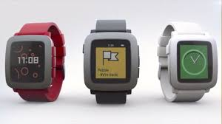
Programming The Pebble
Time To Code

Slide 2
Kent Archie
I am a software developer at DRW Trading.
Over the years I have programmed on everything from Fortran using punched cards on a Univac 1100 to web applications using node.js and Mongodb.
I have taught at several local colleges including a brief stint at IIT.
I am lately having fun playing with my Pebble watch and Ringo toy robot.

Slide 3
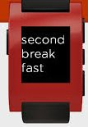
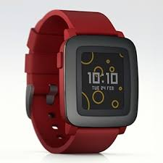
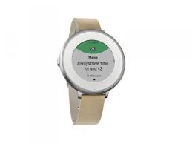
Pebble History
The first Pebble was the product of a hugely successful Kickstarter,
raising over $10,000,000
The Pebble Time and Pebble Steel
were pre-sold on Kickstarter.
Most recently, they produced
the Pebble Round

Slide 4
Pebble Time Features
screen type, size, resolution
1.25 inches, 144x168 pixels, 182 ppi, 64 color e-paper, backlight
Interaction type
4 buttons, TimeLine interface
Phone OS’s supported
Android, IOS
Watch processor, memory, radios, sensors
100Mhz Cortex M4, 16Mb memory, Bluetooth 4 6 axis accelerometer, ambient light sensor, compass, gyrometer, magnetometer,pedometer, microphone
Battery Life
150 mAh, up to 7 days, I see 5-6 days
Watch peripherals
Watch strap connects to watch, more battery, sensors, open specs

Slide 5
Development Environments
Development tools run natively on Linux and Mac
Run on Windows using VM running Linux
Command Line Development Tools
Web based IDE

Slide 6
Command Line Development Tools
Installing the Pebble tools installs the toolchain to build ARM applications
After build, it copies the executable and other files to the phone using the local network.
The phone app transfers the watch executable to the watch using Bluetooth
The Pebble phone app implements the configuration code, if any

Slide 7
Code Locations
Developer written code ends up in 3 places
The ARM executable ends up on the watch
This is built from C code and the Pebble library
Code that provides an interface between the Pebble phone app and the watch
This is dev written Javascript code and the Pebble javascript library on the phone app
The configuration page, if any, is on a developer provided web site
This is normal web page code

Slide 8
Debugging/Testing
The watch code and the Pebble phone app Javascript code write to the same logging stream
APP_LOG(DebugLevel, "ICEWatch: key=:%d: bool value=%s",key,value ? "true" : "false");
console.log("phoneSide: init called!");
The configuration page code doesn’t go into the logging stream. This can be tested using a normal web browser
The Pebble build tool can compile apps to be run in a Pebble watch emulator running on the development machine

Slide 9
Web Based IDE (CloudPebble)
text

