Slide 1
Cross Platform Coding
Write once or so and run several places

Slide 2
Me
Kent Archie
kentarchie@gmail.com
Code and slides on GitHub
https://github.com/kentarchie/cross-platform-coding-talk.git
References at the end

Slide 3
Definitions
Cross platform for us means multiple OSes
Not just different versions of a given OS
Not about how applications built for Windows XP can run on Windows 10 or even using C# on Linux
Desktop here means Windows, MacOS or *nix(GNU/Linux, UNIX, Solaris etc)
Mobile means IOS or Android

Slide 4
History
Every machine had different instruction set, thus different assembly language
The Burroughs B5000 supported user defined instructions
https://www.smecc.org/The%20Architecture%20%20of%20the%20Burroughs%20B-5000.htm
High level languages (FORTRAN, COBOL,C etc) allowed code to be ported
Code still had to be recompiled on each new machine
UCSD Pascal compiled to a virtual instruction set, so compiled code could be moved as long as the p-code interpreter had been ported
https://en.wikipedia.org/wiki/UCSD_Pascal
Notes:
Do VMs qualify as cross plats cross platform
Do you know of any other historical cross platform tools or systems?

Slide 5
History
More recently, Java was developed to be cross platform
“Write Once, Run Everywhere” was the slogan
(Also the slogan of XOJO cross platform dev environment)
Expected to run on all desktop OSes and in the web browser
Java compiled to JVM, runs on desktop, “same” code could run as applets in browser
Never quite worked as desired, applets didn’t catch on
Java still used heavily in web backends, multiple languages compile to the JVM

Slide 6
This Talk
In this talk we will be discussing:
Electron for desktop apps
Flutter/Dart for mobile
Both are free (mostly open source)
Development can be done on (at least) Windows and Linux (Haven’t tried MacOS)

Slide 7
Electron
Originally developed by Github (now owned by Microsoft)
Used by many current applications (Visual Studio Code, Slack, WhatsApp)
Combines Chromium (open source version of Chrome browser) and Node JS
Code written in JavaScript, but like NodeJS, you can develop C++ modules)
Docs, downloads etc here https://electronjs.org/
History https://electronjs.org/docs/tutorial/about
Notes:
Developed to create Atom editor ( which sort of became Visual Studio Code)

Slide 8
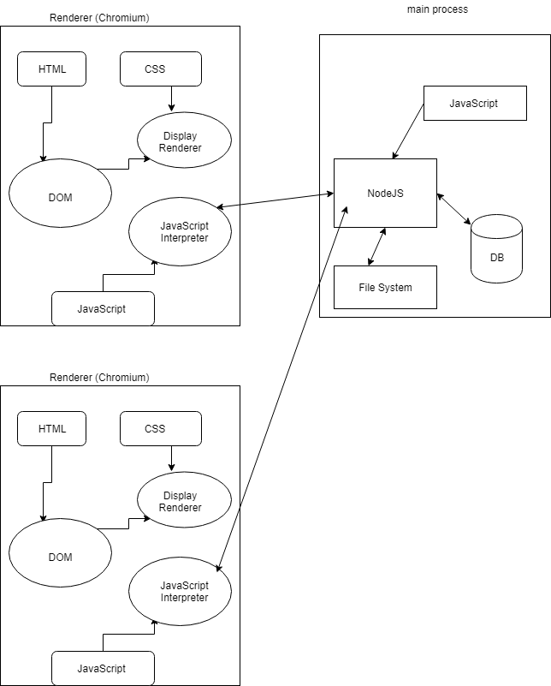
Electron App Structure
Notes:
Always a main process that runs NodeJS, acts like the server part of a web application
1 renderer process for each web page in the app
This mostly runs the usual Javascript parts of a web app but also has access to Node packages

Slide 9
Electron App Notes
This is very similar to a normal NodeJS app
You create web pages using the usual techniques (CSS,HTML)
The Render process connects to the NodeJS process on the same machine
The Render process javascript is run using NodeJS so you have access to all the Node libraries
The resulting Electron app has pretty much a full Chrome browser and a NodeJS server in it

Slide 10
Electron Notes
When completed, you use the Electron build tools to create a separate executable for whichever of Windows, MacOS and Linux that you want.
Your web code is the same in all 3, but the Chromium and NodeJS parts are specific to the OS you are targeting
Package dependency is a concern as is the shear size of the resulting applications
Notes:
The howdy applications uses 19 MB of nodejs modules, 178 modules.
All the rest is about 120Kb
Any of these could have security flaws.
Github does some checks on commit
https://www.theregister.co.uk/2016/03/23/npm_left_pad_chaos/

Slide 11
Electron Application Structure
HowdyUniforum/
├── clientApp
│ ├── css
│ │ └── HowdyUniforum.css
│ ├── index.html
│ └── js
│ ├── HowdyUniforum.js
│ └── thisButton.js
├── mainJS
│ └── serverMain.js
|____node_modules
├── package.json
└── tabs.vim
Notes:
clientApp is the web page (renderer)
mainJS is the server code (main process)

Slide 12
package.json
Defines the project
{
"name": "howdyuniforum",
"version": "1.0.0",
"description": "Simple Uniforum Example",
"main": "mainJS/serverMain.js",
"scripts": {
"test": "echo \"Error: no test specified\" && exit 1"
,"start" : "electron mainJS/serverMain.js"
},
"keywords": [
"example"
],
"author": "Kent Archie",
"license": "MIT"
}

Slide 13
Electron Application Main Process Code, part 1
'use strict';
global.__base = __dirname + '/';
const {app, BrowserWindow} = require('electron');
const APP_URL = 'file://' + __dirname + '/../clientApp/index.html';
let MainWindow = null;
app.on('ready', () => {
createMainWindow();
});
Notes:
__dirname built in that contains the paht to the application
App ready event occurs when the runtime system is ready to show a web page,
Equivalent to the document ready event

Slide 14
Electron Application Main Process Code, part 2
//quit the app once closed
app.on('window-all-closed', () => {
if (process.platform !== 'darwin')
app.quit();
});
app.on('activate', () => {
if (MainWindow == null)
createMainWindow();
});

Slide 15
Electron Application Main Process Code, part 3
function createMainWindow()
{
MainWindow = new BrowserWindow({
'width': 800
,'height': 600
,backgroundColor: "#D6D8DC"
,show: false
});
MainWindow.loadURL(APP_URL);
MainWindow.webContents.openDevTools(); // show chrome console
MainWindow.on('closed', () => { MainWindow = null; });
MainWindow.once('ready-to-show', () => { MainWindow.show(); });
} // createMainWindow
Notes:
You can have multiple BrowserWindows an example would be a help or About page
The ‘closed’ line is to prevent memory leaks should there be multiple window openings
The ‘ready-to-show’ event happens after the page is loaded into the browser window

Slide 16
Electron Renderer HTML
<html>
<head>
<title>Simple Uniforum Electron App</title>
<link rel='stylesheet' type='text/css' href='css/HowdyUniforum.css' />
</head>
<body>
<h1>Simple Uniforum Electron App</h1>
<h2>Built With Versions:</h2>
<ul>
<li>Node: <span id='nodeVersion'></span></li>
<li>Chrome: <span id='chromeVersion'></span></li>
<li>Electron:<span id='electronVersion'></span></li>
</ul>
<button type='button' id='thisButton'>Don't Press This</button>
</body>
<script type='text/javascript' src='js/HowdyUniforum.js'></script>
<script type='text/javascript' src='js/thisButton.js'></script>
</html>
Notes:
Pretty much what you would have in a web application

Slide 17
Electron Renderer Code
document.addEventListener("DOMContentLoaded", function()
{
document.getElementById('nodeVersion').innerHTML = process.versions.node;
document.getElementById('chromeVersion').innerHTML = process.versions.chrome;
document.getElementById('electronVersion').innerHTML = process.versions.electron;
document.getElementById('thisButton').addEventListener("click",thisButton,false);
});
Notes:
The process object is provided via NodeJS, not Javascript by itself
Talk about the separation of activities between the renderer and the main
Like the main talks to the file system not the renderer
Mention the remote() function

Slide 18
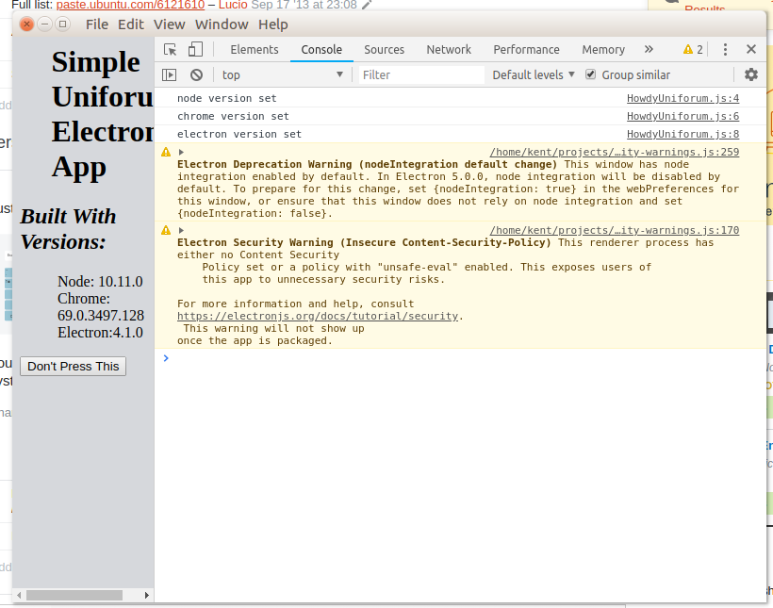
Howdy app with debug
Notes:
Note the menu bar at thetop

Slide 19
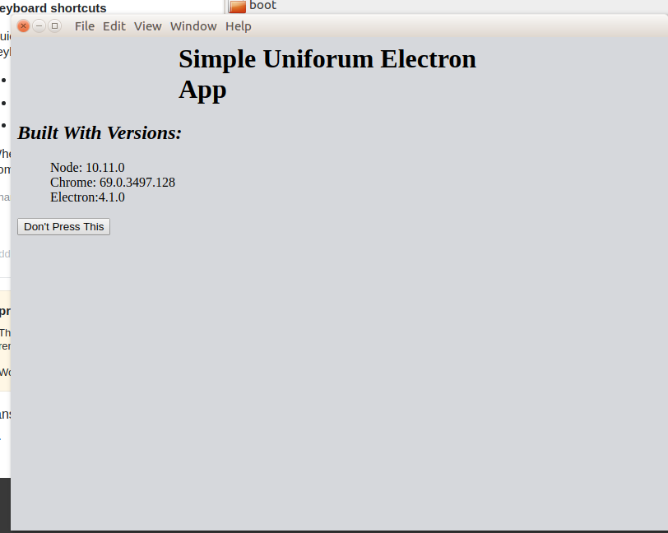
Howdy app without debug
Notes:
Where did the menu bar go?

Slide 20
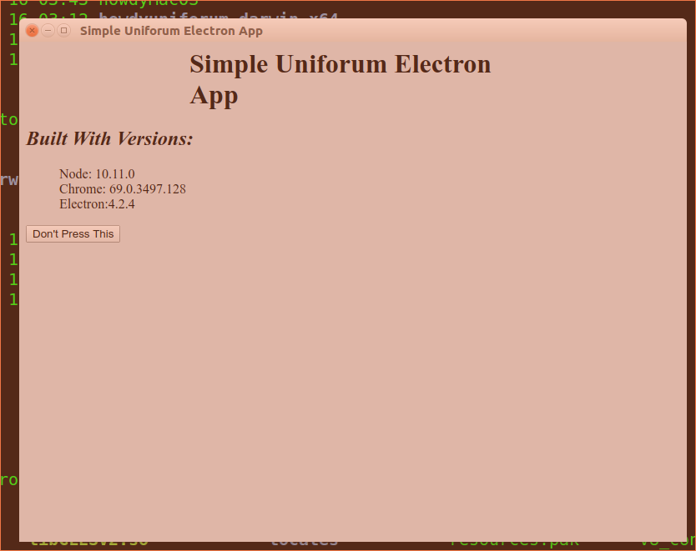
Electron App Linux Build Test

Slide 21
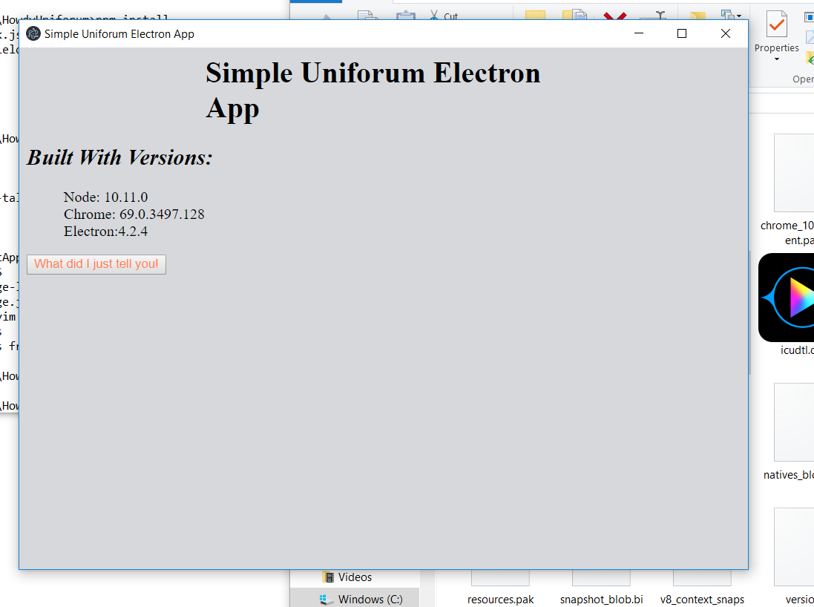
Electron App Windows Build Test

Slide 22
Electron App Mac Build Test
Failed completely, I’m blaming Daryl
Many symbolic links in the build results which might not have been copied correctly from Linux to Mac

Slide 23
Electron Desktop App Comments
The directory for the Windows run is about 120 MB, 73 files.
The .exe file won’t run outside the directory
Start seemed kind of slow as well
Convenient for the developer, maybe not so much for the customer
The default menu bar shown on the dev version is missing on the production one
But it did work on two OSes using the same source without building on two machines

Slide 24
Electron Desktop App Comments
Probably need to build production under the OS you are building for
If you use some libraries (like sqlite) you have to build it natively
The build tools can produce native OS installers so that might have worked better on the Mac version

Slide 25
Bigger Electron Application
Show some of the photo manager code

Slide 26
Mobile Cross Platform
There are several mobile Cross Platform system
https://www.outsystems.com/blog/free-cross-platform-mobile-app-development-tools-compared.html
https://www.netsolutions.com/insights/cross-platform-app-frameworks-in-2019/
Of the popular ones, Microsoft owns two, Adobe, Facebook and Google each own one
Some are encapsulated web pages like Electron, others are built using C# and Mono.

Slide 27
Mobile Cross Platform
I chose Flutter/Dart because it is freely available and a very recent addition to the set of systems
Google also supports another build system using a new language called Motion in addition to Java. This is not Cross platform

Slide 28
Flutter/Dart
A completely different approach
Flutter is the UI framework and the app is built using the Dart language
Developed by Google
Best built with Android Studio, but works well with other IDEs
No HTML, CSS or Javascript
One code base to build iOS and Android apps that look native
Notes:
I’m going to switch to VS Coide after watching a couple of videos

Slide 29
Architecture
Everything is a widget and a widget is
a structural element (like a button or menu)
a stylistic element (like a font or color scheme)
an aspect of layout (like padding)
The UI is built of nested widgets, reminds me of Java UI
Each widget implements a build method used to specify its appearance and action
Every time a build method is called it returns a new set of widgets, the foundation system modifies the display to rreflect the changes so your code doesn’t have to

Slide 30
Widget State
Widgets that contain data, like user input or results of an action are children of StateFulWidget. If not, they are StatelessWidget
When a StateFulWidgets value changes, it calls setState() which calls the build method and a new widget is created
The widgets state is kept separate from the widget so the system can recreate the widget without losing the state

Slide 31
Basic Default Flutter App
When a new project is created (I am using Android Studio) it has some simple functions
The resulting project contains 78 files in 41 directories and uses 180 kB
After the first build, there are 285 files in 236 directories using 261MB

Slide 32
References
I found this guys videos to be handy for understanding some Flutter development techniques
https://www.youtube.com/watch?v=Un7eG5hHNPg

