Slide 1
Why Node JS?
A brief Summary

Slide 2
Me
Kent Archie
kentarchie@gmail.com
Code and slides on GitHub
https://github.com/kentarchie/nodeJS-UniforumTalk
References at the end

Slide 3
Node JS history
Started in 2009 as a command line interpreter for Google V8 JavaScript
Microsoft adds support in 2011
Npm package manager added in 2011
NodeJS Foundation begun in 2015
Many IDEs developed for Node and Node support added to Visual Studio and others
Used by PayPal, Netflix, Uber, New York Times and many others

Slide 4
Node Basics
Node executes Javascript
It can be a web server by running code that implements a web server
It can be used for local applications as well
Written in C++, Node can be linked to existing libraries
You can now run COBOL and Fortran code in Node
Applications don’t block, even the IO
Supports a Read-Eval-Print loop

Slide 5
Windows Installation
Get installers from nodejs.org
Run them
Notes here
https://docs.npmjs.com/getting-started/installing-node
http://blog.teamtreehouse.com/install-node-js-npm-windows

Slide 6
OS X Installation
Get installers from nodejs.org
Run them
I haven’t tried any of this
Notes here
http://blog.teamtreehouse.com/install-node-js-npm-mac
http://sourabhbajaj.com/mac-setup/Node.js/README.html
http://shapeshed.com/setting-up-nodejs-and-npm-on-mac-osx/

Slide 7
Linux Installation
Simplest process is to use the software install on your distribution. For example:
sudo apt-get install nodejs
But these can be out of date
So notes here on updating the installation
http://www.hostingadvice.com/how-to/install-nodejs-ubuntu-14-04/

Slide 8
Javascript without a browser
Node runs any Javascript, just like your browser
No DOM, no graphics
Access to local file system
Packages to access databases and other external libraries

Slide 9
REPL Example
$ node
> var a=6;
> function bob(foo) {
... console.log("bob: result="+foo+3)
... }
> bob(3);
bob: result=33
>

Slide 10
File Search
You can write applications in Node that work solely on the local machine
This example opens a file, reads it line by line and searches each line for a specified string. It then prints lines that match
It uses 3 libraries to access files, parse file paths and process command line parameters.
There are lots of better ways to do this, with and without Node, it’s just an example

Slide 11
File Search code, part 1
var fs = require('fs'); // we need the file system library
var path = require('path'); // library to process file paths
var commandLineArgs = require('command-line-args'); // command line processing
// define allowed command line args
var cli = commandLineArgs([
{ name: 'fileName', alias: 'f', type: String }
,{ name: 'searchString', alias:'s',type: String}
])
// nothing to do if we don't have a file to search and something to search for
// node searchFile filename searchString
var commandName = path.basename(process.argv[1]);
if(process.argv.length < 4) {
console.log('missing args: node '+commandName+' datafile searchString');
process.exit();
}
var options = cli.parse(); // parse command line

Slide 12
File Search code, part 2
var fileName = options.fileName;
var searchString = options.searchString;
console.log(commandName + ': fileName=' + fileName + 'searchString='+searchString);
fs.readFile(fileName, 'utf8', function (err,data) {
if (err) {
return console.log(argv[1] + ':' + err);
}
var dataLines = data.split('\n');
for(var i = 0; i< dataLines.length; ++i) {
dataLines[i] = dataLines[i].trim(); // remove leading/trailing whitespace
if(dataLines[i].indexOf(searchString) != -1)
console.log(dataLines[i]);
}
console.log("fs.readFile anonymous function completed");
});
console.log("fs.readFile completed");

Slide 13
C Version
This is the C version of the main loop
if ( (file = fopen(fileName, "r")) == NULL ) {
fprintf(stderr, "-f %s failed\n", fileName);
return 1;
}
while ( fgets ( line, sizeof line, file ) != NULL ) {
if(strstr(line, searchString) != NULL)
printf("%s\n", line);
} // while

Slide 14
C and Node Comparison
The C version reads and process the lines one by one, reading a line from the file and checking it.
The Node version gets the entire file contents, splits it into lines and checks them one by one.
In the C version, the main code pauses while the data is read. In the Node version, the fs.readFile() call completes without waiting for the datafile to be read. When the data is available, the function passed to fs.readFile is called.
searchFile: fileName=testdata.csv searchString=stone
fs.readFile completed
Yellowstone1999,,yes,yes,,,yes
Yellowstone2005,yes,yes,yes,,,yes
fs.readFile anonymous function completed

Slide 15
General Web App Structure

Slide 16
NodeJS Web App Structure

Slide 17
WebServer and Node Comparison
The WebServer and the backend code are in different processes (mod_perl, etc are exceptions). Each call to the backend spawns another process.
They are generally not written in the same language.
In Node, there is a single process doing all the work. Each backend call is handled without making a new process.
The webserver code and the backend code are in the same language and the same process.

Slide 18
Howdy Web App
var http = require('http'); // need a web server library
function sendHowdy(req, res)
{
res.writeHead(200, {'Content-Type': 'text/plain'});
res.end('Howdy do, Uniforum\n');
} // sendHowdy
http.createServer(sendHowdy).listen(8124, "127.0.0.1");
console.log('Server running at http://127.0.0.1:8124/');
Notes:
// howdy/index.js
var http = require('http'); // need a web server library
// usually this is an anonymous function passed to the createServer call
// below, but I seperated it out to show the parts better
// the req parameter contains information about the sender
// the res parameter is used to send a response back to the browser
function sendHowdy(req, res)
{
res.writeHead(200, {'Content-Type': 'text/plain'});
res.end('Howdy do, Uniforum\n');
} // sendHowdy
// start listening for web traffic
// provide a callback function to be run when a browser connects to
// the web server we are creating.
// the listen function tells the webserver what port and IP address to listen on
http.createServer(sendHowdy).listen(8124, "127.0.0.1");
// write to standard out to tell us it is ready
console.log('Server running at http://127.0.0.1:8124/');

Slide 19
Run it
$ node index.js
Server running at http://127.0.0.1:8124/

Slide 20
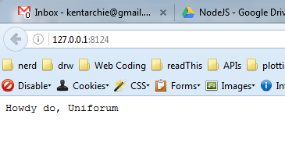
Results

Slide 21
Generate Page
var http = require('http');
http.createServer(function (req, res) {
res.writeHead(200, {'Content-Type': 'text/html'});
res.write('<html>');
res.write('<body>');
res.write('<h1>Page written by node</h1>');
res.write('<h4>request headers</h4>');
res.write('<pre>');
res.write(JSON.stringify(req.headers,null,'\n'));
res.write('</pre>');
res.write('<hr />');
res.write('</body>');
res.write('</html>');
res.end();
}).listen(8124, "127.0.0.1");
console.log('makePage server running at http://127.0.0.1:8124/');

Slide 22
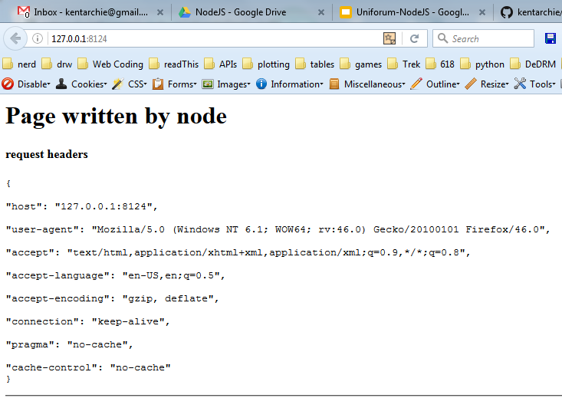

Slide 23
Page From File
var http = require('http');
var fs = require('fs'); // file system
http.createServer(function (req, res) {
res.writeHead(200, {'Content-Type': 'text/html'});
fs.readFile('index.html', 'utf8',
function (err,data) {
if (err) {
return console.log(err);
}
res.write(data);
res.end();
});
}).listen(8124, "127.0.0.1");
console.log('makePage server running at http://127.0.0.1:8124/');

Slide 24
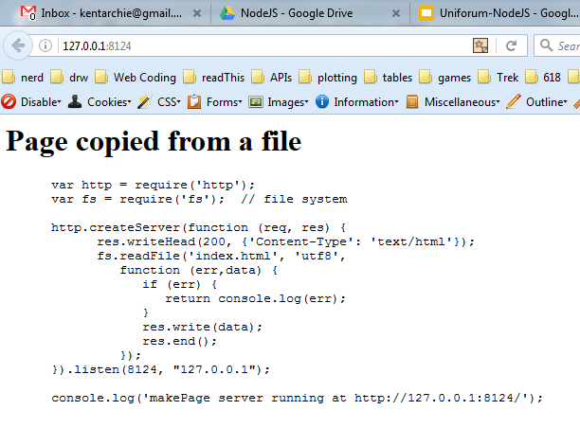

Slide 25
Simple Routing
var http = require('http'), // library to act as web server
url = require('url'); // library to manipulate incoming url
http.createServer(function (req, res) {
setTimeout(function () {
res.writeHead(200, {'Content-Type': 'text/plain'});
var url_parts = url.parse(req.url);
console.log(url_parts.pathname);

Slide 26
Simple Routing 2
switch(url_parts.pathname){
case '/':
res.write("display root");
break;
case '/one':
res.write("route one");
break;
case '/two':
res.write("route two");
break;
default:
res.write("oh dear, 404");
}
res.end();
}, 2000);
}).listen(8000);

Slide 27
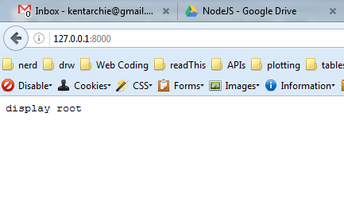

Slide 28
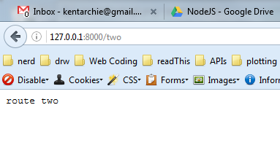

Slide 29
Simple Routing log
$ node index.js
/
/favicon.ico
/favicon.ico
/two

Slide 30
Web Application
A typical application has 3 parts
A Node based webserver
Node controlled backend code
Front end web page

Slide 31
Include libraries
Npm manages a large set of Node libraries
Similar to CPAN in Perl, pip in python and gem in Ruby
A bit like apt-get in Ubuntu as well
Running it in a project updated the package.json file
npm install --save express will download and install the Express library but also update the package.json file
npm --update will update all dependencies in package.json

Slide 32
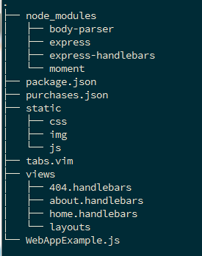
Web App Layout

Slide 33
package.json
{
"name": "web-app-example",
"version": "1.0.0",
"description": "Uniforum NodeJS Web App Example",
"main": "WebAppExample",
"repository": "https://github.com/kentarchie/nodeJS-UniforumTalk.git",
"scripts": {
"test": "echo \"Error: no test specified\" && exit 1"
},
"author": "Kent Archie",
"license": "ISC",
"dependencies": {
"body-parser": "^1.15.1",
"express": "^4.13.4",
"express-handlebars": "^3.0.0",
"moment": "^2.13.0"
}
}

Slide 34
Live Code
Show the structure and use of a small web app
Run using node WebAppExample.js
Talk about web page views and layouts
Demonstrate template code
Show difference between node code and web age code

Slide 35
References
Ok overview and history
https://en.wikipedia.org/wiki/Node.js
Web Development with Node and Express Todd Brown O’Reilly Press
Node JS Chicago Meetup
Npm notes
https://docs.npmjs.com/getting-started/using-a-package.json
Incomplete but interesting
https://blog.risingstack.com/node-hero-tutorial-getting-started-with-node-js/

