Slide 1


Slide 2
Project Statement
Model global temperature as a function of multiple global ecosystem variables using advanced multivariate time-series modeling.
Examine correlations with policy and political events.

Slide 3
Impacts on global temperature:
CO2 levels
Cloud cover
Vegetation / Tree cover
Surface and ocean temperature
Wind
Rain
Ice consistency
Snow pack
Humidity
Atmospheric pressure
Volcanic activity
Solar activity

Slide 4
High Data Correlation
Many variables are a function of current temperature
Vice-versa

Slide 5
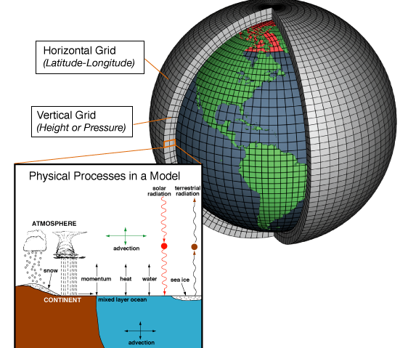
State of the Art
Complex modeling of global physical systems - NOAA
https://www.climate.gov/maps-data/climate-data-primer/predicting-climate/climate-models

Slide 6
Objectives
Predict monthly global temperature using Transformer-based time series modeling
Observe/predict impacts of major policy and political events
Observe effect of Uncertainty data - understand measurement reliability

Slide 7
Global Objective
Local data rolled up
Long term mean = mean, soften anomalies

Slide 8
Datasets
Berkeley Global Temperature Aggregated data extracted from:
Global Historical Climatology Network (GHCN2), Peterson and Vose, 1997); the Atmospheric Environment Service/Environment Canada; the State Hydrometeorological Institute, St. Petersburg, Russia; Greenland—from the GC-Net (Steffen et al., 1996); the Automatic Weather Station Project (courtesy of Charles R. Stearns at the University of Wisconsin-Madison); the Global Synoptic Climatology Network (Dataset 9290c, courtesy of National Climatic Data Center); and the Global Surface Summary of Day (GSOD) (NCDC)
1750 - 2015, daily average temperature
8.6M rows across 3448 cities in 159 countries
AverageTemperature(Celsius), City, Country, Lat/Lon(DD)
Also available by: Country, State, MajorCity, global
.
https://www.kaggle.com/datasets/berkeleyearth/climate-change-earth-surface-temperature-data
https://berkeleyearth.org/data/

Slide 9
Datasets
Berkeley Global Temperature
Global rollup based on daily distributed observations
1750 - 2015, monthly global average in degrees Celsius
3192 rows
LandAverageTemperature, LandMaxTemperature, LandMinTemperature
LandAndOceanAverageTemperature
Monthly averages of station air temperature were interpolated to a 0.5 degree by 0.5 degree latitude/longitude grid, where the grid nodes are centered on the 0.25 degree.

Slide 10
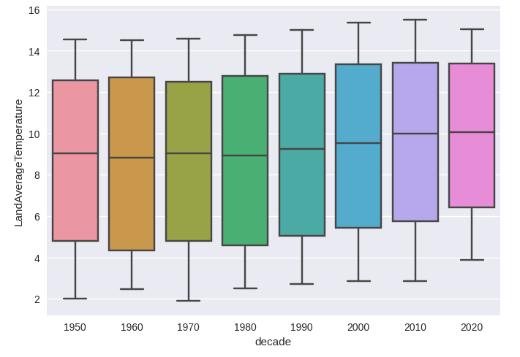
Datasets

Slide 11
Datasets
Atmospheric parameters for rainfall predictions National Center for Atmospheric Research, NOAA
1948 - 2018, daily
temp - degrees Kelvin, LTM
lat/lon - decimal degrees
LTM values for air press, u/v wind,
humidity, soil moisture, many more
Data provided by the NOAA Physical Sciences Laboratory, Boulder, Colorado, USA, from their website at https://psl.noaa.gov/ https://www.kaggle.com/datasets/shiratorizawa/ncarcsv

Slide 12
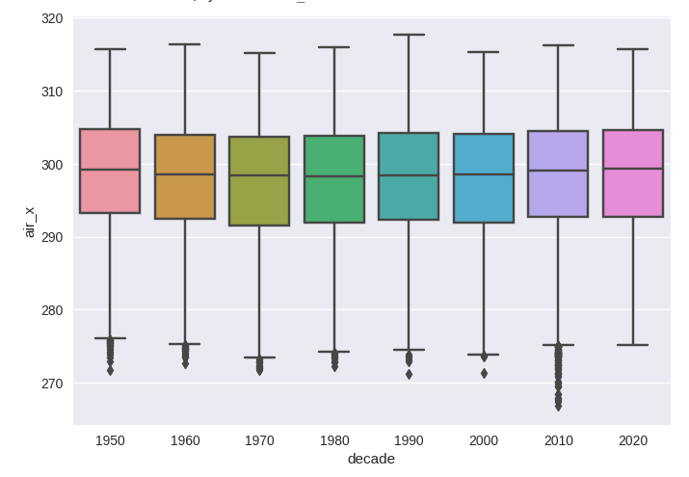
Datasets

Slide 13
Datasets
Carbon Dioxide Levels in Atmosphere
The Keeling Curve, Mauna Loa Observatory
Collected and published by the University of California's Scripps Institution of Oceanography
1958 – 2017, monthly
CarbonDioxide(ppm), SeasonallyAdjustedCO2(ppm)
https://www.kaggle.com/datasets/ucsandiego/carbon-dioxide https://keelingcurve.ucsd.edu/

Slide 14
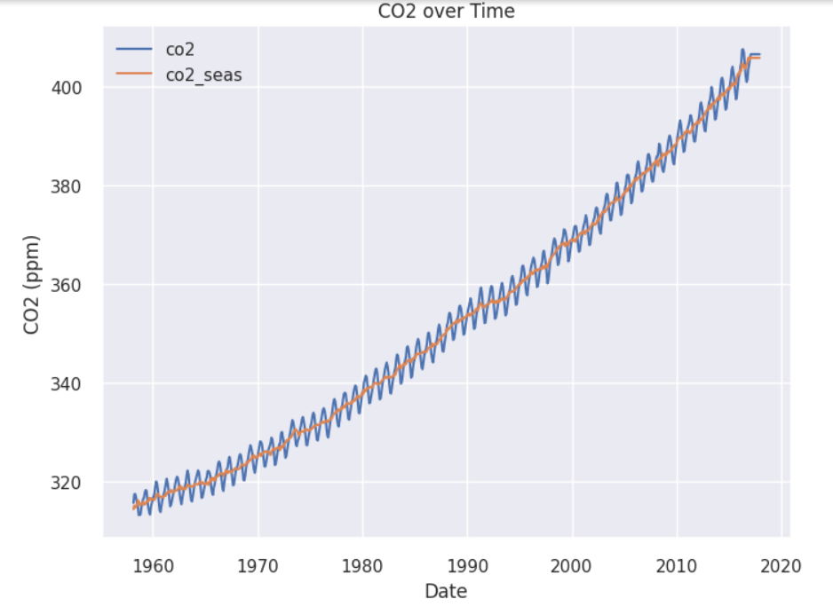
Datasets

Slide 15
Datasets
Volcano Eruptions
The Smithsonian Institution.
1883 - present
start date, end date, VEI intensity rating (0-6)
https://www.kaggle.com/datasets/jessemostipak/volcano-eruptions

Slide 16
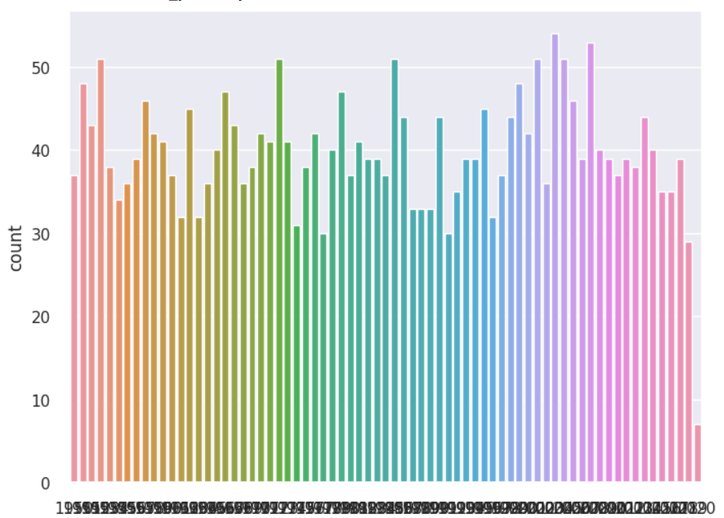
Datasets

Slide 17
Datasets
Daily Sea Ice Extent Data
National Snow and Ice Data Center (NSIDC)
1978 - 2015, daily
extent - 10^6 sq km
missing - 10^6 sq km
https://www.kaggle.com/datasets/nsidcorg/daily-sea-ice-extent-data

Slide 18
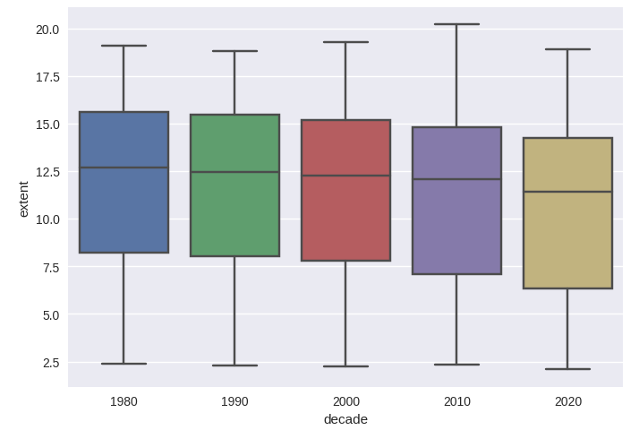
Datasets

Slide 19
Datasets
World Forest Cover Trends
Food and Agricultural Organisation of the United Nations
1990,2000,2010,2020
by country, across 215 countries
TotalArea - hectares
CoverArea - hectares
PctCover - percentage of forest cover
https://www.kaggle.com/datasets/parasharmanas/world-forest-cover-trends

Slide 20
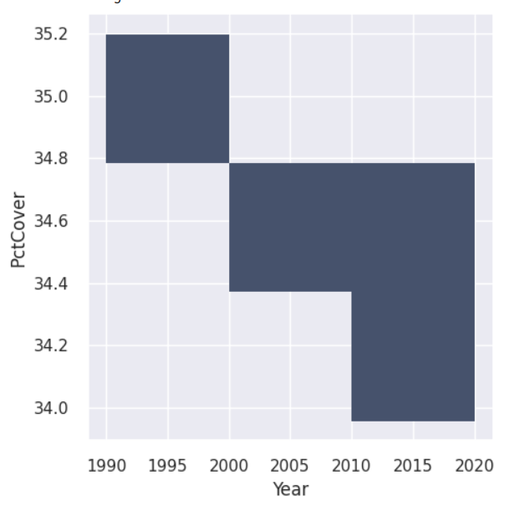
Datasets

Slide 21
Datasets
Average Sun Spot Number
Space Weather Services (Australian Government Bureau of Meterology)
1700 – 2014, annual
count of sunspots in the year
https://www.kaggle.com/datasets/sarahvch/yearly-mean-sunspot-numbers

Slide 22
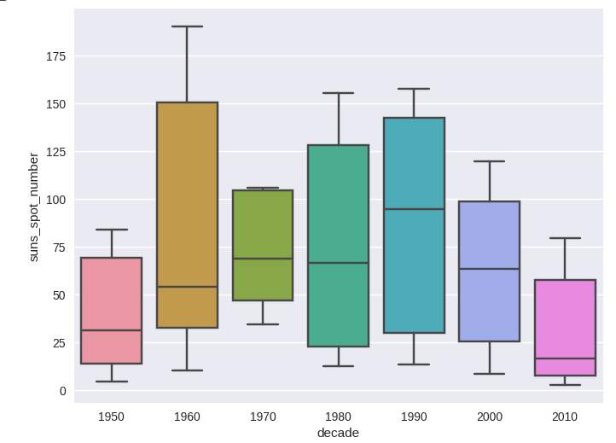
Datasets

Slide 23
Approach
Model monthly global mean temperature
Observe effects of political/economic and policy impacts; predict future effects
Observe effects of available Uncertainty data on predictions

Slide 24
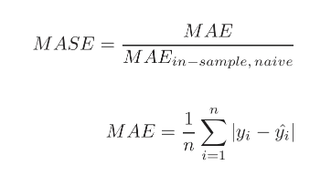
Measure Error
MASE - Mean Absolute Scaled Error used in forecasting (time-series)

Slide 25
Stretch Goals
Observe/predict regional differences
Predict localized hotspots
Decompositional analysis

Slide 26
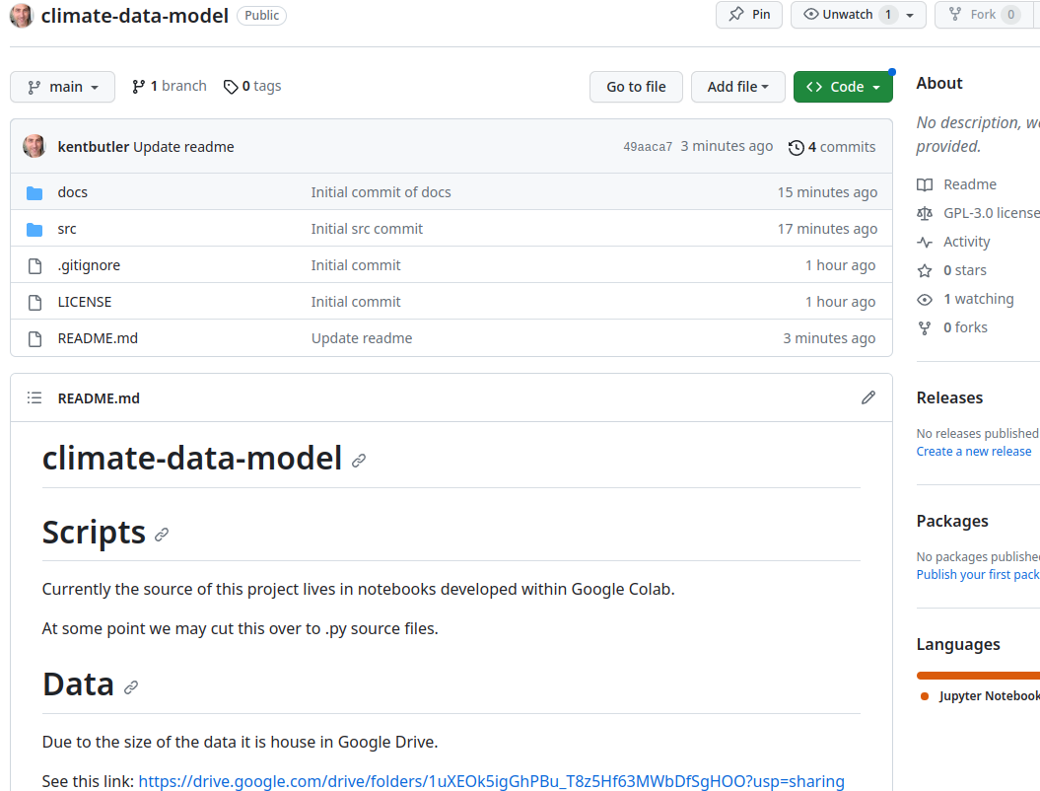
Find us on GitHub
https://github.com/kentbutler/climate-data-model

