Slide 1
Overlays
Kentaro Matsuoka
7/18/2018

Slide 2
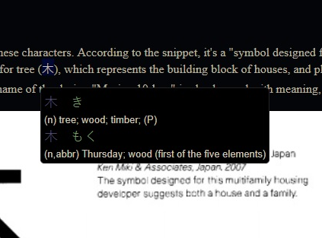
Rikai-kun/-chan/-sama
Translates Japanese into English by hovering over words (also gives kanji reading); adds an inline frame over current frame
Firefox original (-chan)
Ports for Chrome (-kun), Explorer (-sama)
Developed by Todd David Rudick; Chrome port created by Erek Speed
Both programmers from U.S. with graphic/game design experience in Japan
Personally, it has helped my Japanese improve greatly
The efficiency is unmatched due to its inline nature (no need to keep opening a separate online dictionary)

Slide 3
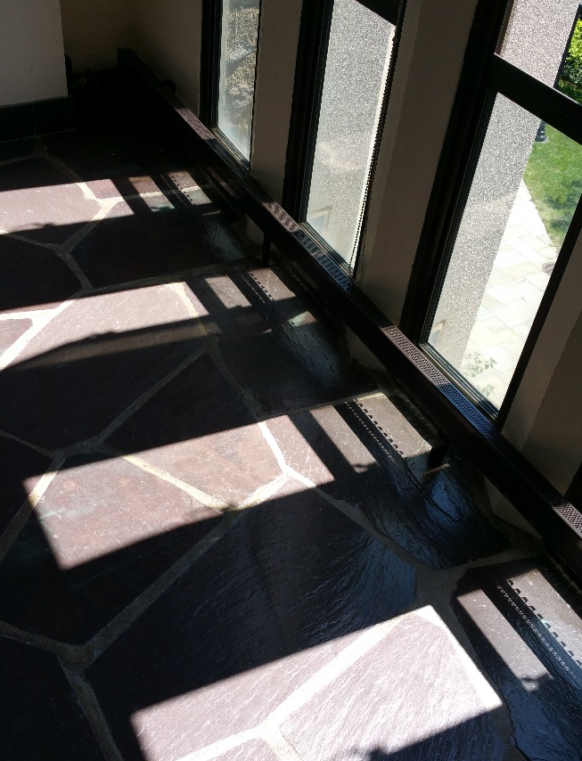
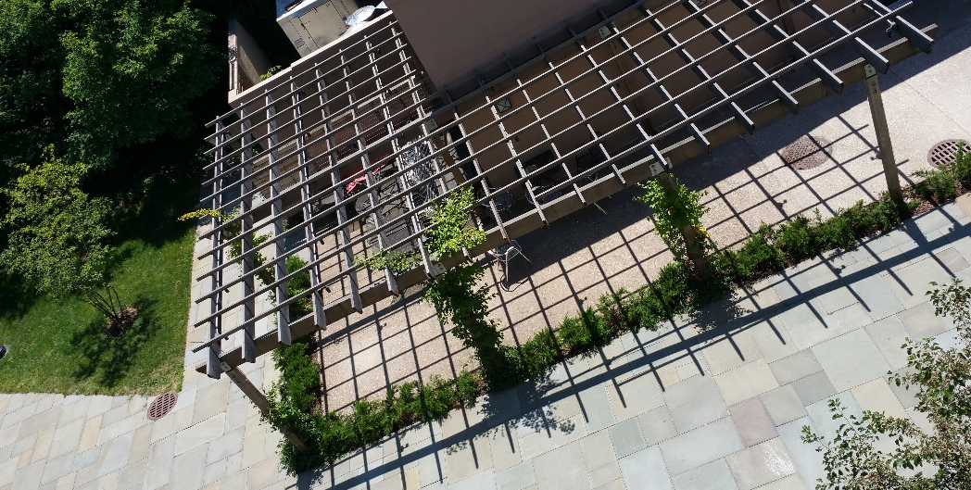
Light and Shadow
This “natural” overlay can be found anywhere
Source of light can be natural/artificial
The Sun vs light bulb
Objects “creating” the shadows can be natural/artificial
Free-growing plants vs angled web-awning
The edges/contrast can be stark or blurry
Depending on the proportions, either light or shadow can be seen as the overlay (similar to the eternal question behind the stripes of zebras: Is it black on white, or white on black?)
Suggests the common theme seen throughout art & literature between “light and darkness”

Slide 4
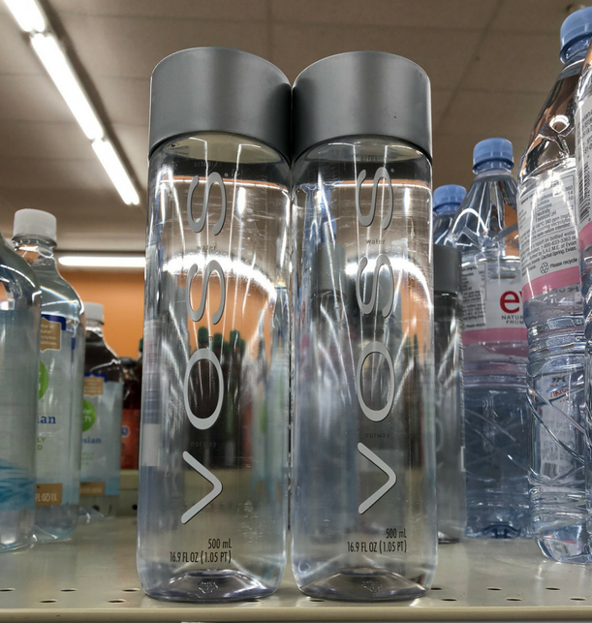
Water (bottles)
Focus on transparent water/beverage bottles (as opposed to colored drinks like iced tea or Coke)
Refracts the image through the water
May distort image significantly, effectively hiding image behind water
Voss + store background, Fiji water & laptop keyboard
Provides a warped look, designed by nature
Artificial equivalent may be prescription glasses
Similar, but different, overlay can be observed in water splashes
Room splash, post-rain

Slide 5
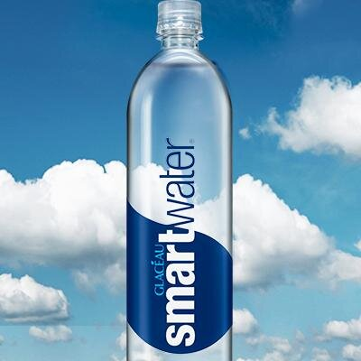
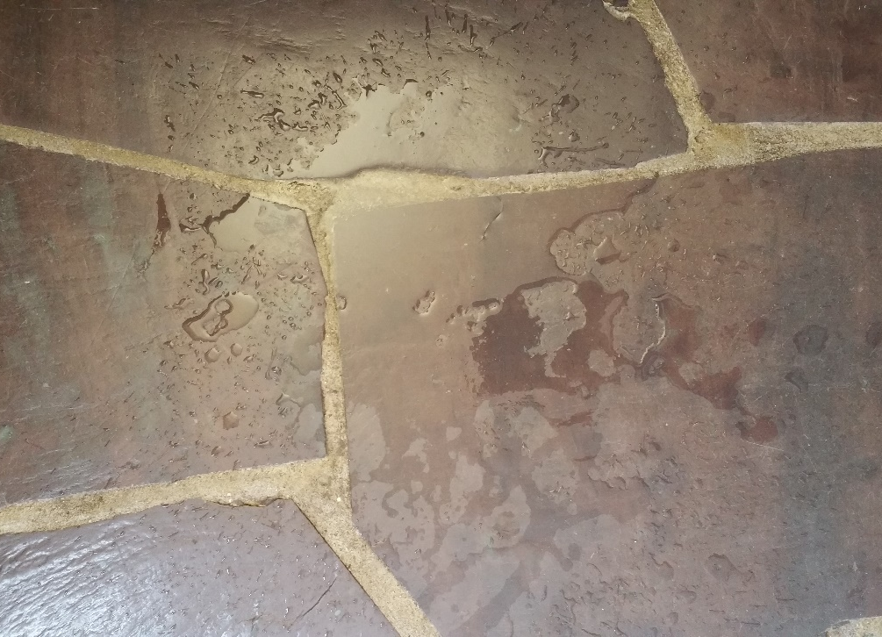
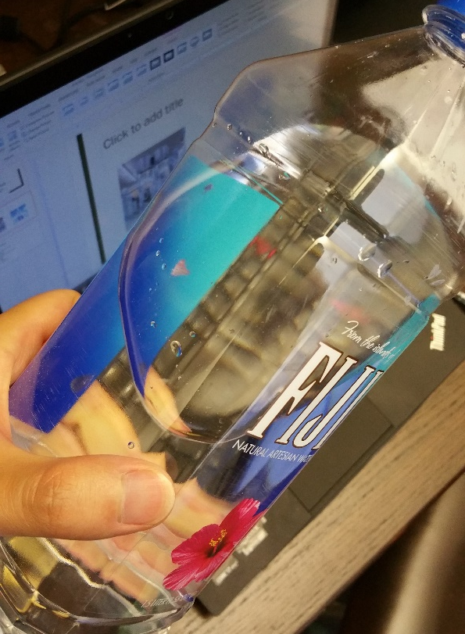
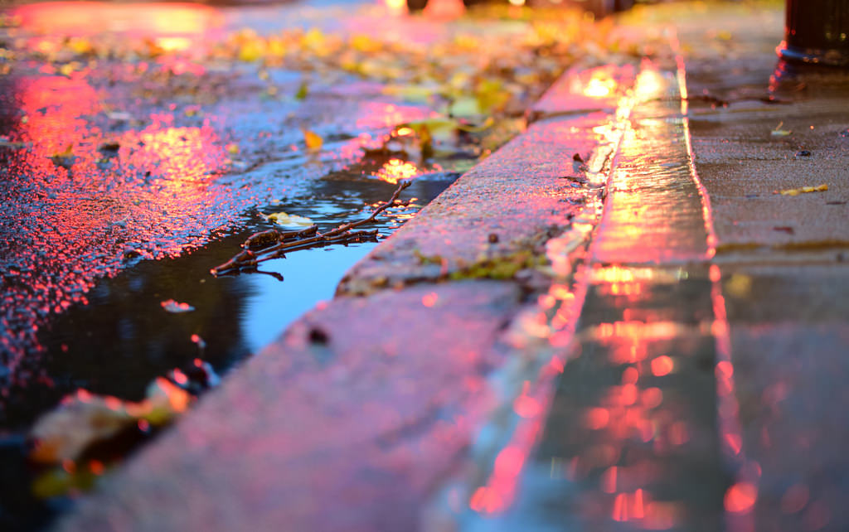

Slide 6
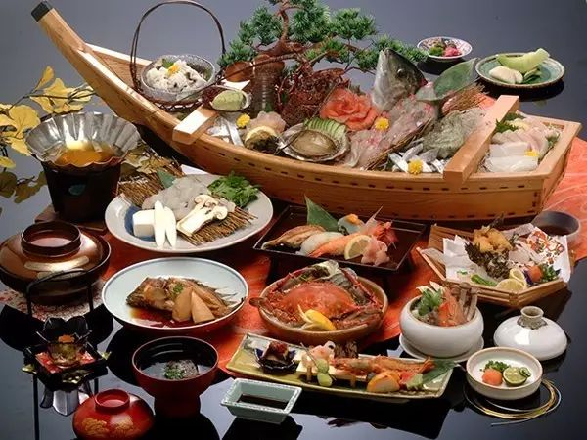
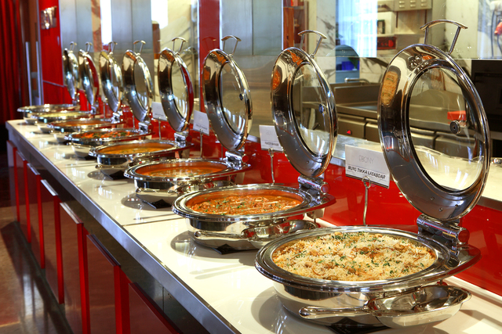
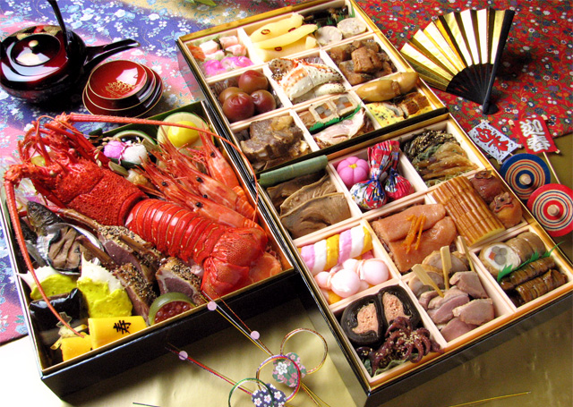
Other Ideas
Dark Reader (Chrome Extension)
Maps (online maps, paper maps)
Glasses (frames, foggy glasses, etc)
Food: Menus, plating, the food itself?

