Slide 1

jQuery
Bits-Please

Slide 2
LEARNING OBJECTIVES
Be familiar with basic definitions
Be familiar with how to install and run jQuery
Learn to maneuver the DOM
Learn to modify the DOM
Learn jQuery event handling
Learn jQuery styling
Be familiar with jQuery methods relating to AJAX

Slide 3
WHAT IS JQUERY
JQuery is a JavaScript library developed by John Resig in 2006. It is the most widely deployed JavaScript library in the world.

Slide 4
WHY JQUERY
It is free
Its size is small. It is less than 1 MB.
It offers many great features that simply the client-side developing.
It is cross-platform. It eliminates the cross-browser inconsistency that may happens to JavaScript.
Extensibility: You can easily add new method and reuse it as a plugin.

Slide 5
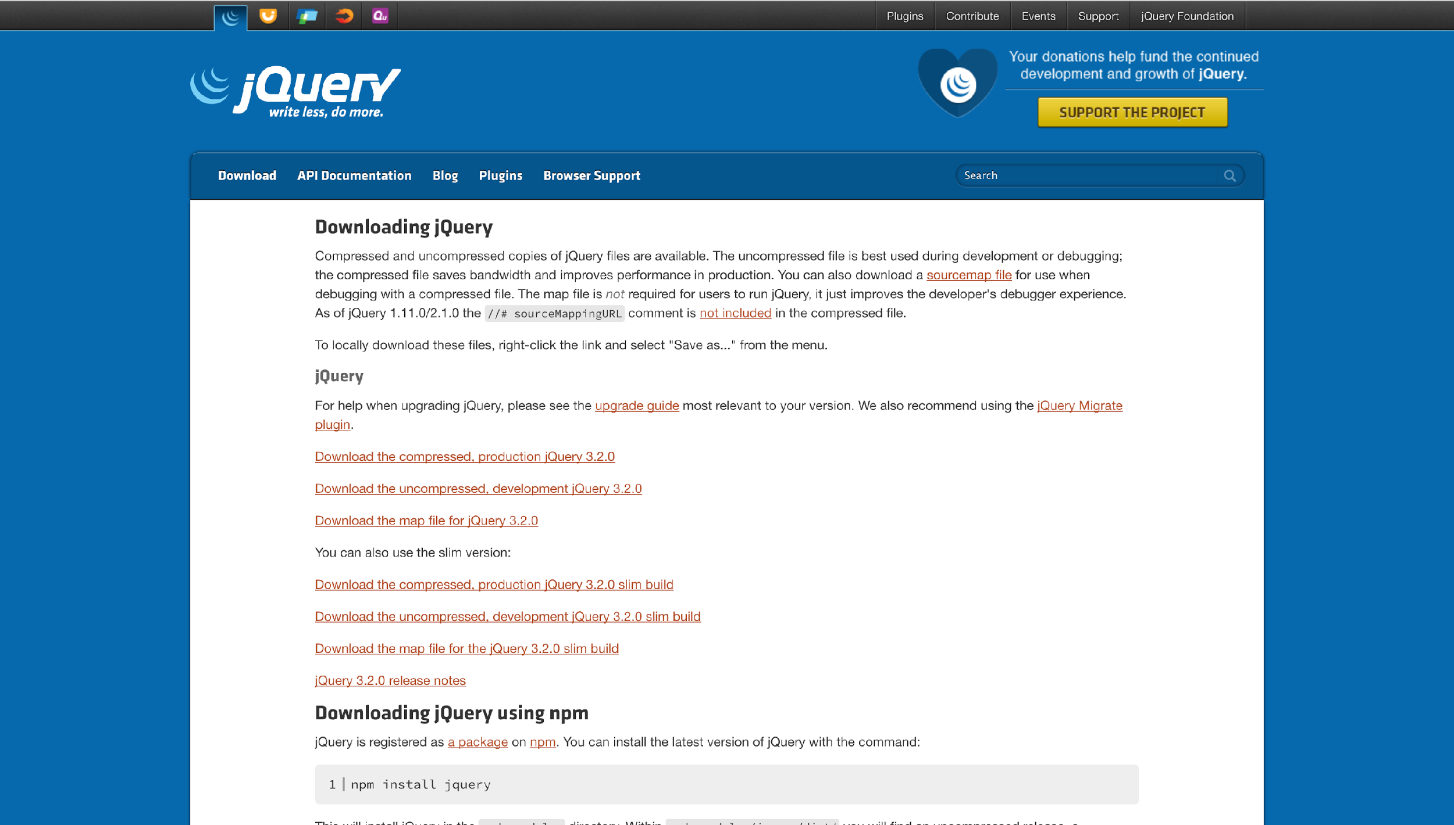
GETTING STARTED
Download from jQuery.com/download
CDN (Content Delivery Network) [Preferred]

Slide 6
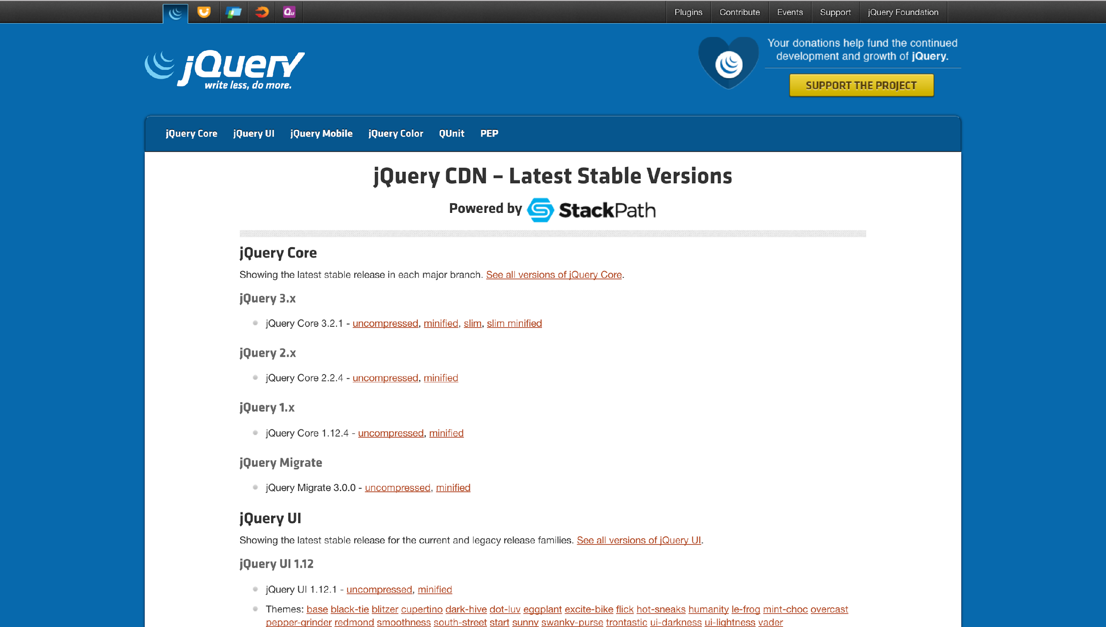
GETTING STARTED
Download from jQuery.com/download
CDN (Content Delivery Network) [Preferred]

Slide 7
MANEUVERING THE DOM

Slide 8
WHERE TO INCLUDE SCRIPT TAG?
End of
Wrap in document.ready
Both work!

Slide 9
MANEUVERING THE DOM
$()
CSS selector: .class, #id, :pseudo-classes, and tag (not ::pseudo-elements)
Pure JS code:
document.getElementsBy(“ul”);
document.getElementsByClassName(“highlight”);
document.getElementById(“footer”);
jQuery code:
$(“ul”);
$(“.highlight”);
$(“#footer”);
"" vs ''?
jQuery Core Style Guide

Slide 10
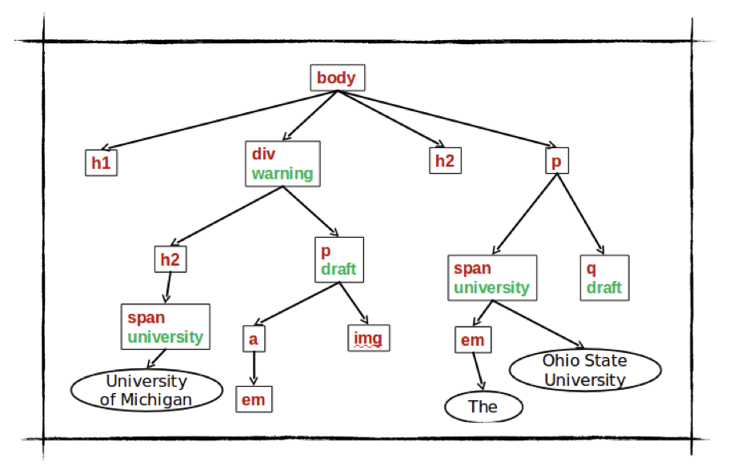
TREE EXAMPLE

Slide 11
YOUR TURN
$(“”); //=>the span node under the div in class university
$(“”); //=> A collection of all nodes in class university
$(“”); //=> ALL H2 nodes under BODY
$(“”); //=> the H2 that is a direct child of BODY
$(“”); //=> the IMG node which is the second child of
the P tag in the class draft
$(“”); //=> Collection of the H2 node and the P node under the div

Slide 12
TREE EXAMPLE CODE REWRITTEN
$(“div”).find(“.university”);
$(“.university”); // This wouldn’t change because there is only one tag
$(“body”).find(“h2”); // Recall that this gets all children
$(“body”).children(“h2”); // This will get only DIRECT children
$(“p.draft”).nth-child(2);
$(“div”).find(“h2, p”);

Slide 13
JQUERY SELECTOR METHODS
find()
children()
nth-child(n)
most pseudo-classes are also implemented as methods
jQuery methods or CSS selectors?
Used to be that jQuery methods were most optimal; however, more browsers implement document.querySelectorAll()
Results in a negligible performance upgrade
Method chaining can be more readable for long selectors

Slide 14
WALKING THE DOM
next([])
prev([])

Slide 15
TRAVERSING THE DOM
.parent([])
.closest(<selector>)

Slide 16
TREE EXAMPLE AGAIN

Slide 17
YOUR TURN
$(“img”).; //=> P node that is in the draft class from IMG
$(“img”).; //=> DIV node, in warning class from IMG
$(“img”).; //=> A node that is the previous sibling of the IMG
node
$(“div”).; //=> Same DIV node that we started with

Slide 18
YOUR TURN - ANSWERS
$(“img”).parent(); //=> P node that is in the draft class from IMG
$(“img”).closest(“div”); //=> DIV node, in warning class from IMG
$(“img”).prev(); //=> A node that is the previous sibling of the IMG
node
$(“div”).next().prev(); //=> Same DIV node that we started with

Slide 19
MODIFYING THE DOM

Slide 20
ONE METHOD, TWO FUNCTIONALITIES
JQuery provides methods that can set or return the content of the selected element.
These methods are:
text()
html()
val()
attr()

Slide 21
SET()
In order to get the text content with set(), you need to call the method without any parameter.
If you want to set the content, you need to put the new content as the parameter.
<p id="test">This is some <b>example</b> on JQuery method.</p>
alert($("#test").text());
<p id="test">This is a example.</p>
$("#test").text("Hello World! ");

Slide 22
HTML()
html() shares a similar syntax with text(). The only difference is html() will set or return html content instead of text content. Here are the examples:
<p id="test">This is a example.</p>
alert($("#test").html();
$("#test2").html("<b>Hello world!</b>");

Slide 23
VAL()
val() will set or return the value of input field of the selected elements.
It also has a similar syntax with text().
It will return “Example” and change it to “Hello”.
<p>Name: <input type="text" id="test" value=”Example"></p>
alert($("#test").val());
$("#test").val(”Hello");

Slide 24
ATTR()
attr() will set or return the value of attribute.
It will return http://www.youtube.com and set the value to http://www.google.com.
<p><a href="https://www.youtube.com" id="yt">Youtube</a></p>
alert($("#yt").attr());
$("#yt").attr("href", "https://www.google.com");

Slide 25
ADD NEW CONTENT
JQuery provides these four methods to add the content in different locations.
append() - Inserts content at the end of the selected elements
prepend() - Inserts content at the beginning of the selected elements
after() - Inserts content after the selected elements
before() - Inserts content before the selected elements

Slide 26
APPEND() AND PREPEND()
Here is a example illustrate the difference between append() and prepend()
<p>This is a example.</p>
<ol>
<li>example 1</li>
<li>example 2</li>
<li>example 3</li>
</ol>
$("p").append(" <b>Append</b>");
$("ol").prepend("<li>Prepend</li>");

Slide 27
APPEND() AND PREPEND()
Here is the result.
<p>This is a example. <b>Append</b></p>
<ol>
<li>Prepend</li>
<li>example 1</li>
<li>example 2</li>
<li>example 3</li>
</ol>

Slide 28
AFTER() AND BEFORE()
after() and before() is very similar with append() and prepend(). However, after() and before() add content outside the selected element while append() and prepend() add content inside the element.
<p>This is a example.</p>
$("p").after("<b>Before</b>");
$("p").before("<i>After</i>");
<b>Before</b><p>This is a example.</p><i>After</i>

Slide 29
REMOVE CONTENT
Here are two JQuery methods to remove content:
remove() - Removes the selected element and its child elements
empty() - Removes the child elements from the selected element

Slide 30
REMOVE() AS FILTER
You can add any selector syntax as parameter to remove() so that remove() will only remove those that are selected by the selector.
$("p").remove(".test");

Slide 31
MODIFYING CSS
JQuery provides css() to set and return the specified CSS property of selected elements. The following syntax is used to return CSS property: css("property name");
<p style="background-color:#ff0000">This is a example.</p>
$("p").css("background-color");

Slide 32
CSS()
To set the CSS property of selected elements, use the following syntax: css("property name","value");
It will set the background color of all <p>to yellow.
<p style="background-color:#ff0000">This is a example.</p>
$("p").css("background-color", "yellow");

Slide 33
EVENTS IN THE DOM

Slide 34
SYNTAX FOR EVENT METHODS
Introduce the comparison between the pure JavaScript and jQuery creating an event listener for “click”.
document.getElementByclick("p").addEventListener("click", function, false);
$("p").click(function() { // do something })
$("p").on("click", function() { // do something });

Slide 35
COMMON JQUERY EVENT METHODS
create the event listener for "click" (example)
click() vs dblclick()
create the event listener for "mouse" (example)
mouseenter() vs mouseleave()
mousedown() vs mouseup()
hover()
create the event listener for "focus" (example)
focus() vs blur()

Slide 36
EVENT PROPAGATION
•preventDefault() method
•preventDefault() stops the default action
•stopPropagation() method
•stopPropagation() stops the event bubbling

Slide 37
EVENT DELEGATION
•Why we need Event Delegation
attach the event handlers for specified elements from parent element
Delegated method
$("div").on("click", function(){...});
$(document).on("click", "div", function(){...});

Slide 38
TRIGGERING AN EVENT
trigger() method vs triggerHandler() method
triggerHandler() can not trigger the default behavior of the event

Slide 39
STYLING IN THE DOM

Slide 40
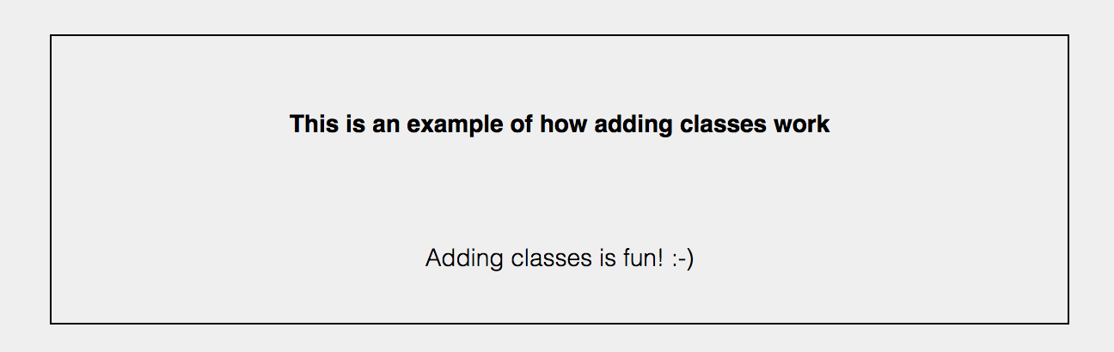
LET’S GET CLASSY
addClass()
$(selector).addClass(classname,function(index,currentclass))

Slide 41
LET’S GET CLASSY
addClass()
$(selector).addClass(classname,function(index,currentclass))

Slide 42
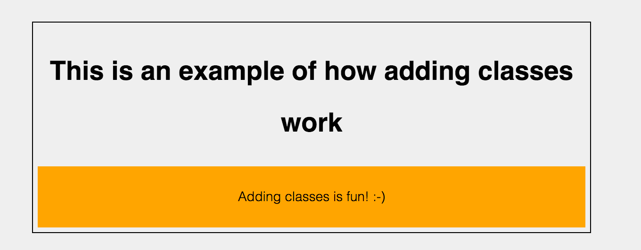
LET’S GET CLASSY
addClass()
$(selector).addClass(classname,function(index,currentclass))

Slide 43
ADDING CLASS EXAMPLE

Slide 44
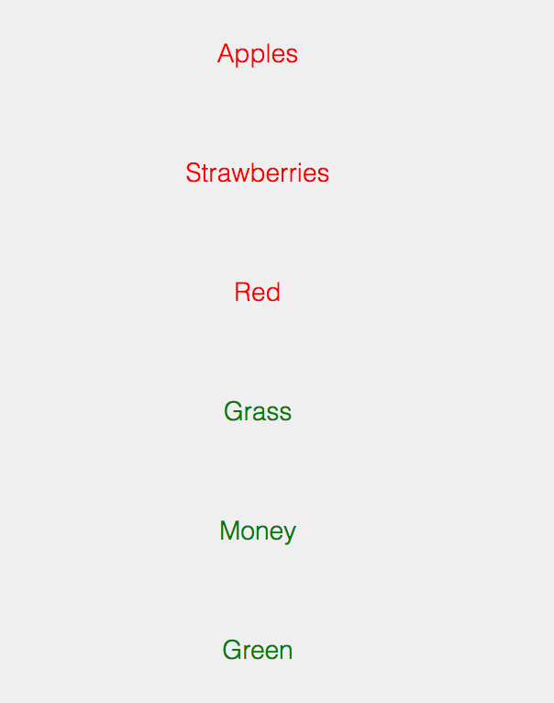
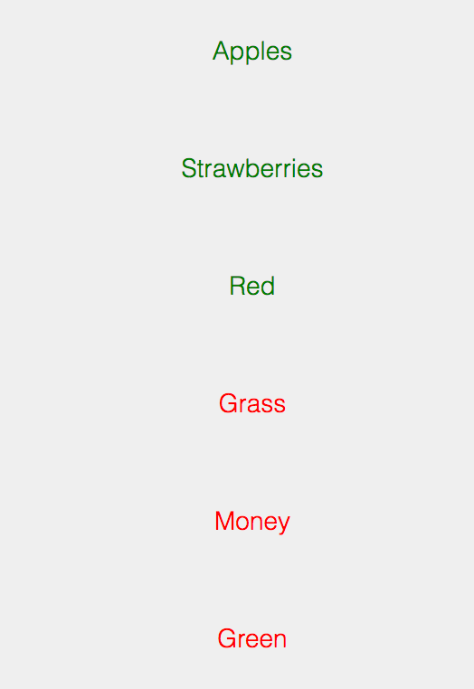
TOGGLE
$(".toggle").toggleClass("red green");

Slide 45
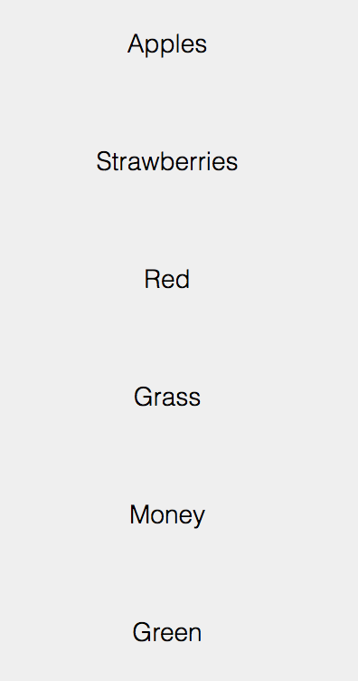
REMOVING A CLASS
$(".toggle").removeClass("red");
$(".toggle").removeClass("green");

Slide 46

HIDE & SHOW
Notes:
https://jsfiddle.net/3jsreyz5/1/#&togetherjs=LCjg34HhHQ

Slide 47
FADING
fadeOut():
will gradually make an element disappear.
fadeIn()
will gradually bring the element back in.
fadeToggle():
will "fade" in/out the elements

Slide 48
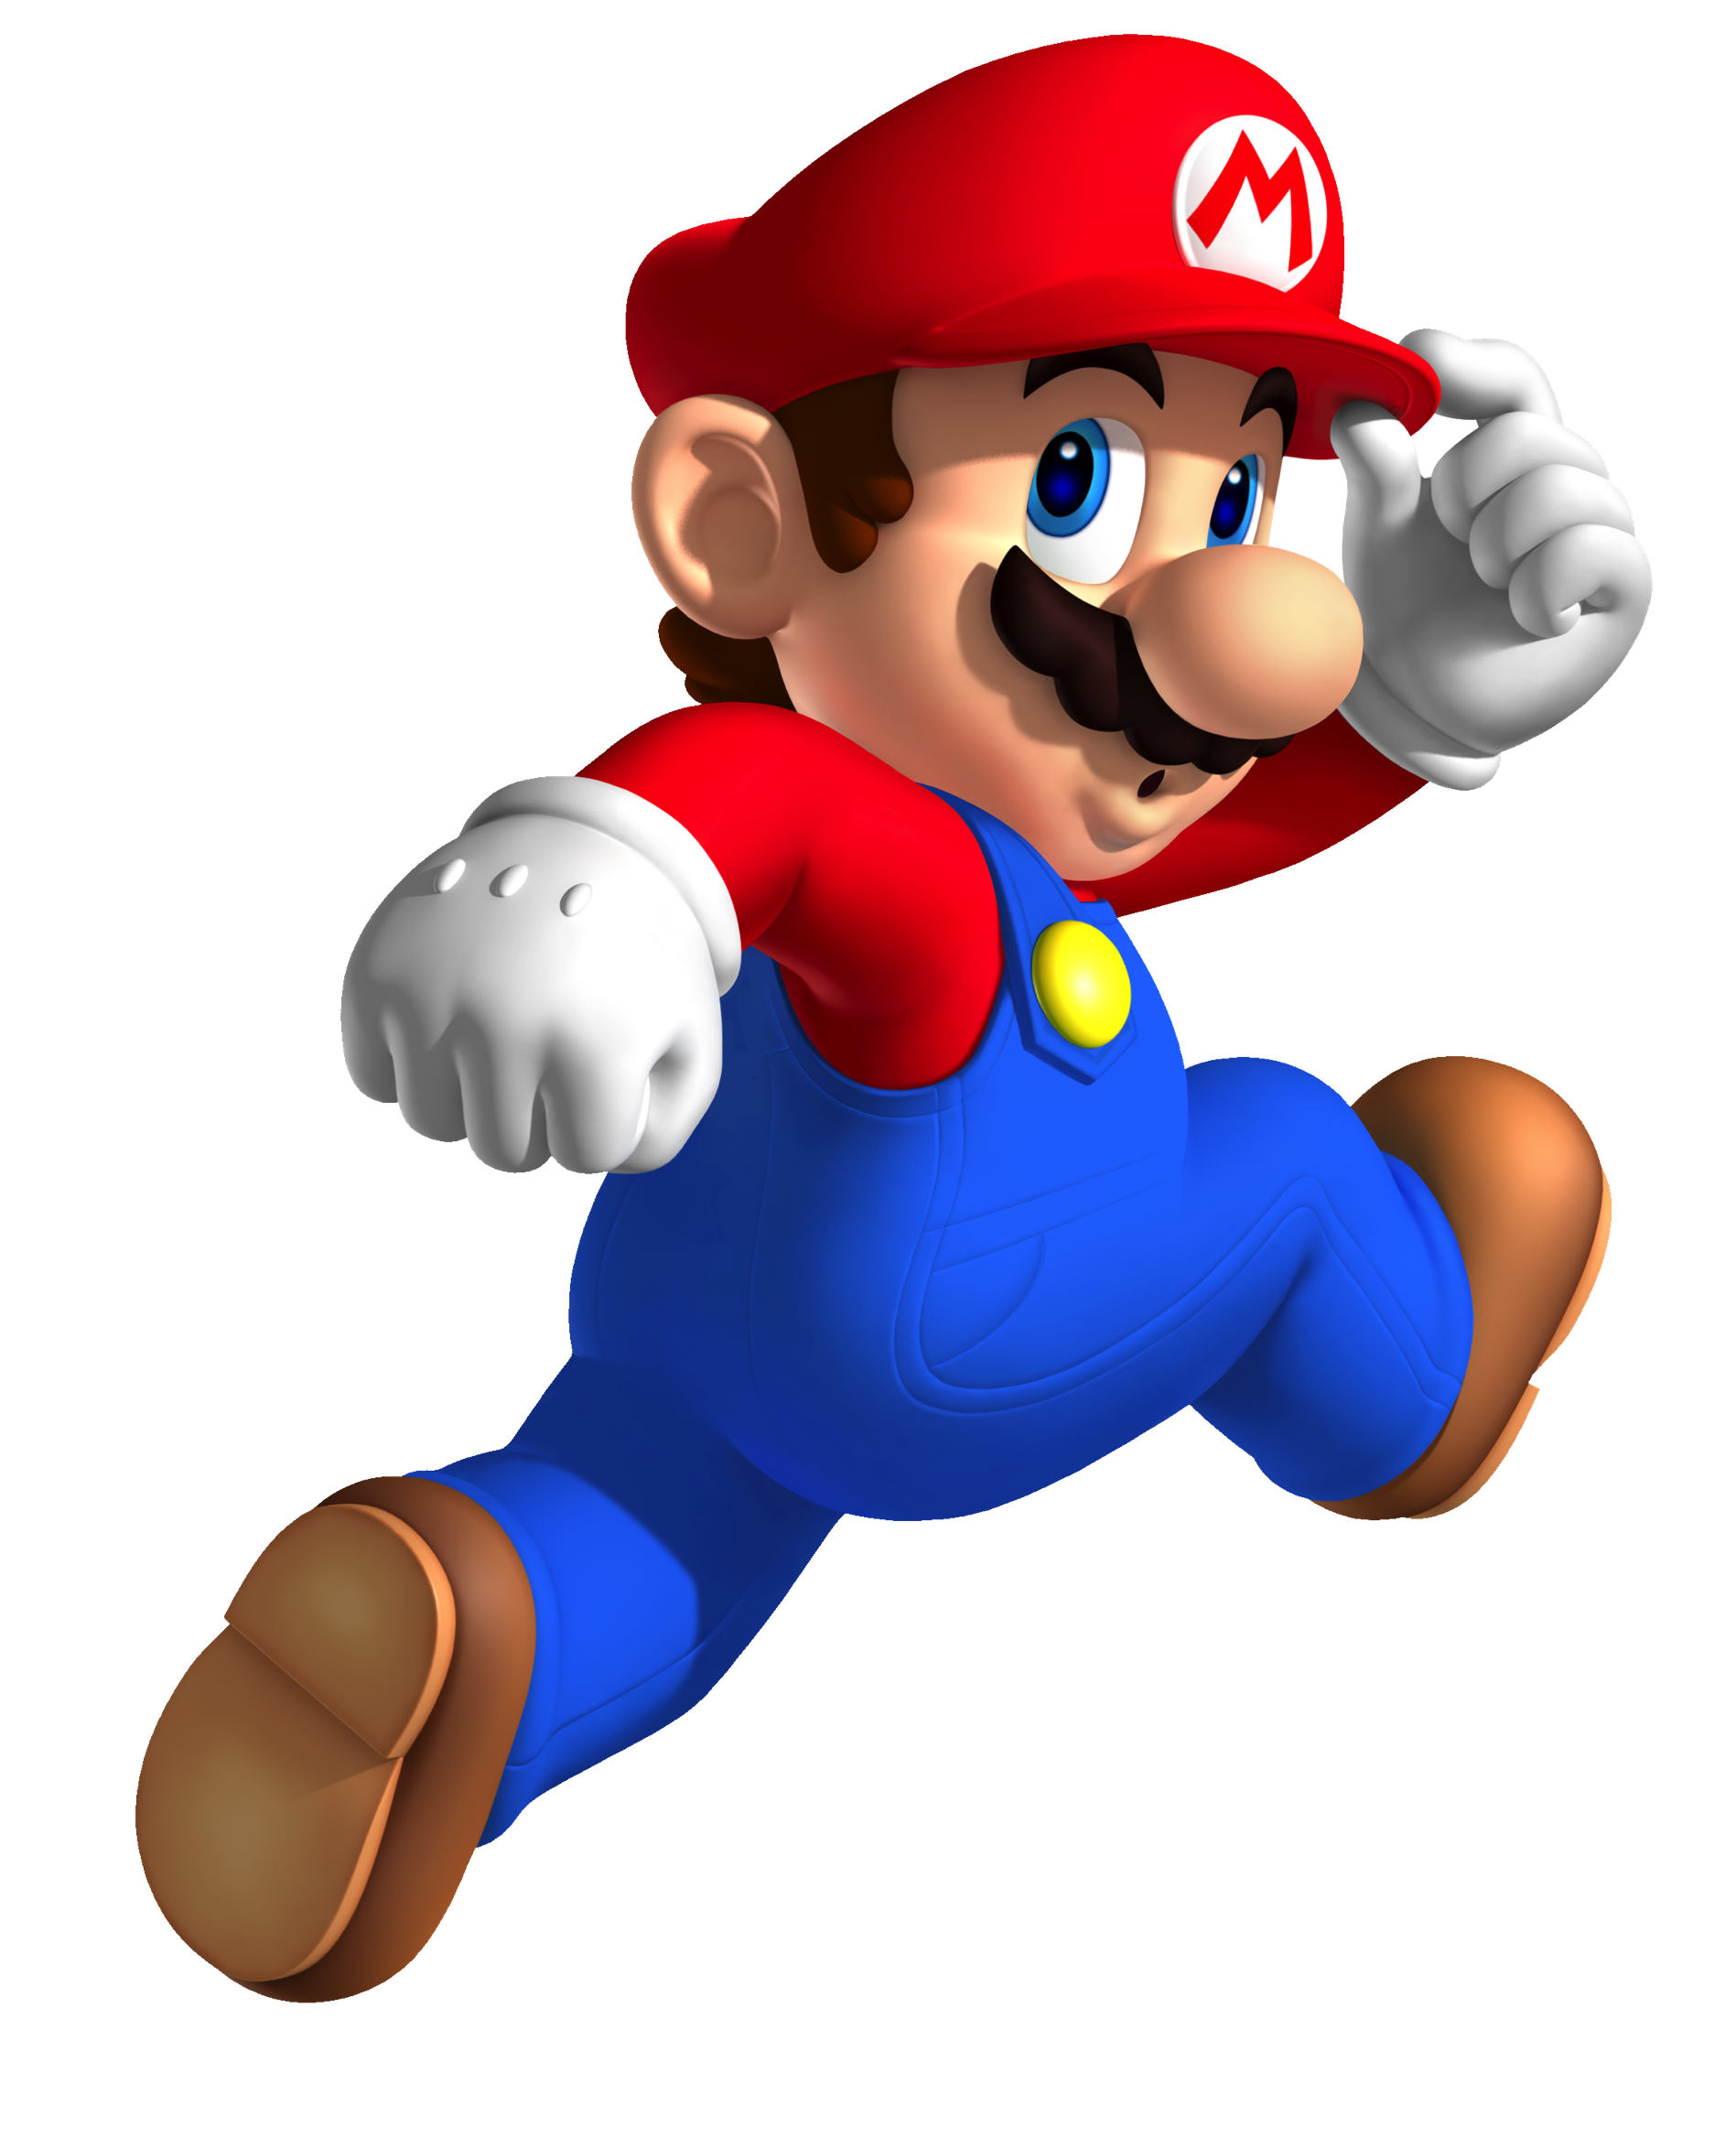
Fading Example
Notes:
https://jsfiddle.net/#&togetherjs=IfrMIQ9QTu

Slide 49

THINK OUTSIDE THE BOX
animate()
Default speed: 400ms
Not all CSS styling effects can be applied
CSS properties that return a numeric property
$(selector).animate({params},speed, callback);
Notes:
https://jsfiddle.net/#&togetherjs=ayt6wAKc2f

Slide 50
DELAY
delay()
Most commonly used for chaining events
$(selector).delay(speed,queueName)

Slide 51
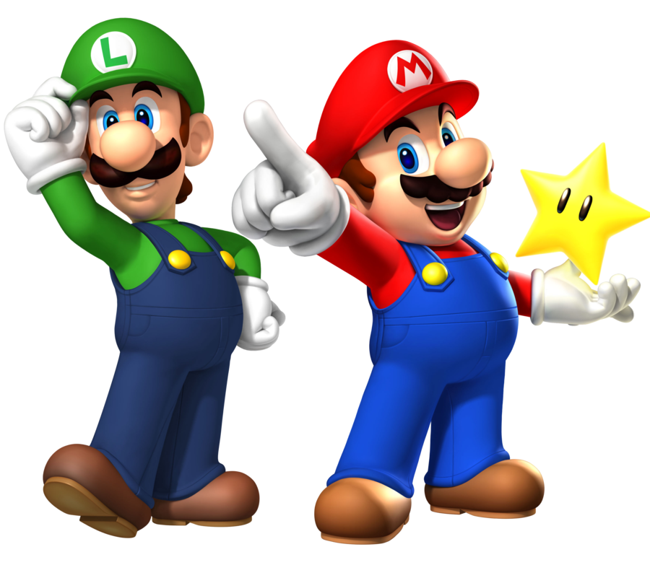
FINISH & STOP
Difference
Finish: show end state
Stop: pause and show current state
Notes:
https://jsfiddle.net/ape02twh/2/#&togetherjs=tSlkshppr3

Slide 52
AJAX

Slide 53
AJAX
Asynchronous JavaScript and XML
Use of XmlHttpRequest objects to interact with web server dynamically via Javascript
Faster data exchange method with server
Single line of Code

Slide 54
IMPLEMENTATION
2 Methods
.ajax() method
Convenience functions: *.get() *.post()

Slide 55
THE HEART OF IT ALL
ajax() method
Takes a parameter of a configuration object
Allows for many more configuration options
Options include: url, data, type, dataType, done, fail, always

Slide 56
EXAMPLE
$.ajax({ url: "post.php", //URL for the request message
data: {id: 100}, //Data to be sent in request
type: "GET",//Whether this is a POST or GET request
dataType: “json", //Type of data expected to be returned
})
//Code to run if request succeeds
.done(function(json) { // callback function })

Slide 57
FOR YOUR CONVENIENCE
.get()
$.get(URL,callback);
sends HTTP GET request to server
.post()
$.post(URL,data,callback);
requests data from server using HTTP POST request

Slide 58
GET AND POST EXAMPLES
$.get( "all_this_data.html",
function(data,status){ //Callback function definition })
$.post("all_this_data.html", {
name: "Fred"
greeting: "Hello World!" },
function(data,status){ //Callback function definition })

Slide 59
PICK YOUR POISON
How to determine what method to use?
Convenience Functions:
Sending simple requests
Default settings are OK
.ajax()
Perform error handling
Single point of Control
Extensive configuration of requests

Slide 60
QUESTIONS || COMMENTS

Slide 61
YOUR TURN - ANSWERS
$(“div .university”); //=>the span node under the div in class university
$(“.university”); //=> A collection of all nodes in class university
$(“body h2”); //=> ALL H2 nodes under BODY
$(“body > h2”); //=> the H2 that is a direct child of BODY
$(“p.draft:nth-child(2)”); //=> the IMG node which is the second child of
the P tag in the class draft
$(“div h2,p”); //=> Collection of the H2 node and the P node under the div

