Slide 1

jQuery
Bits-Please

Slide 2
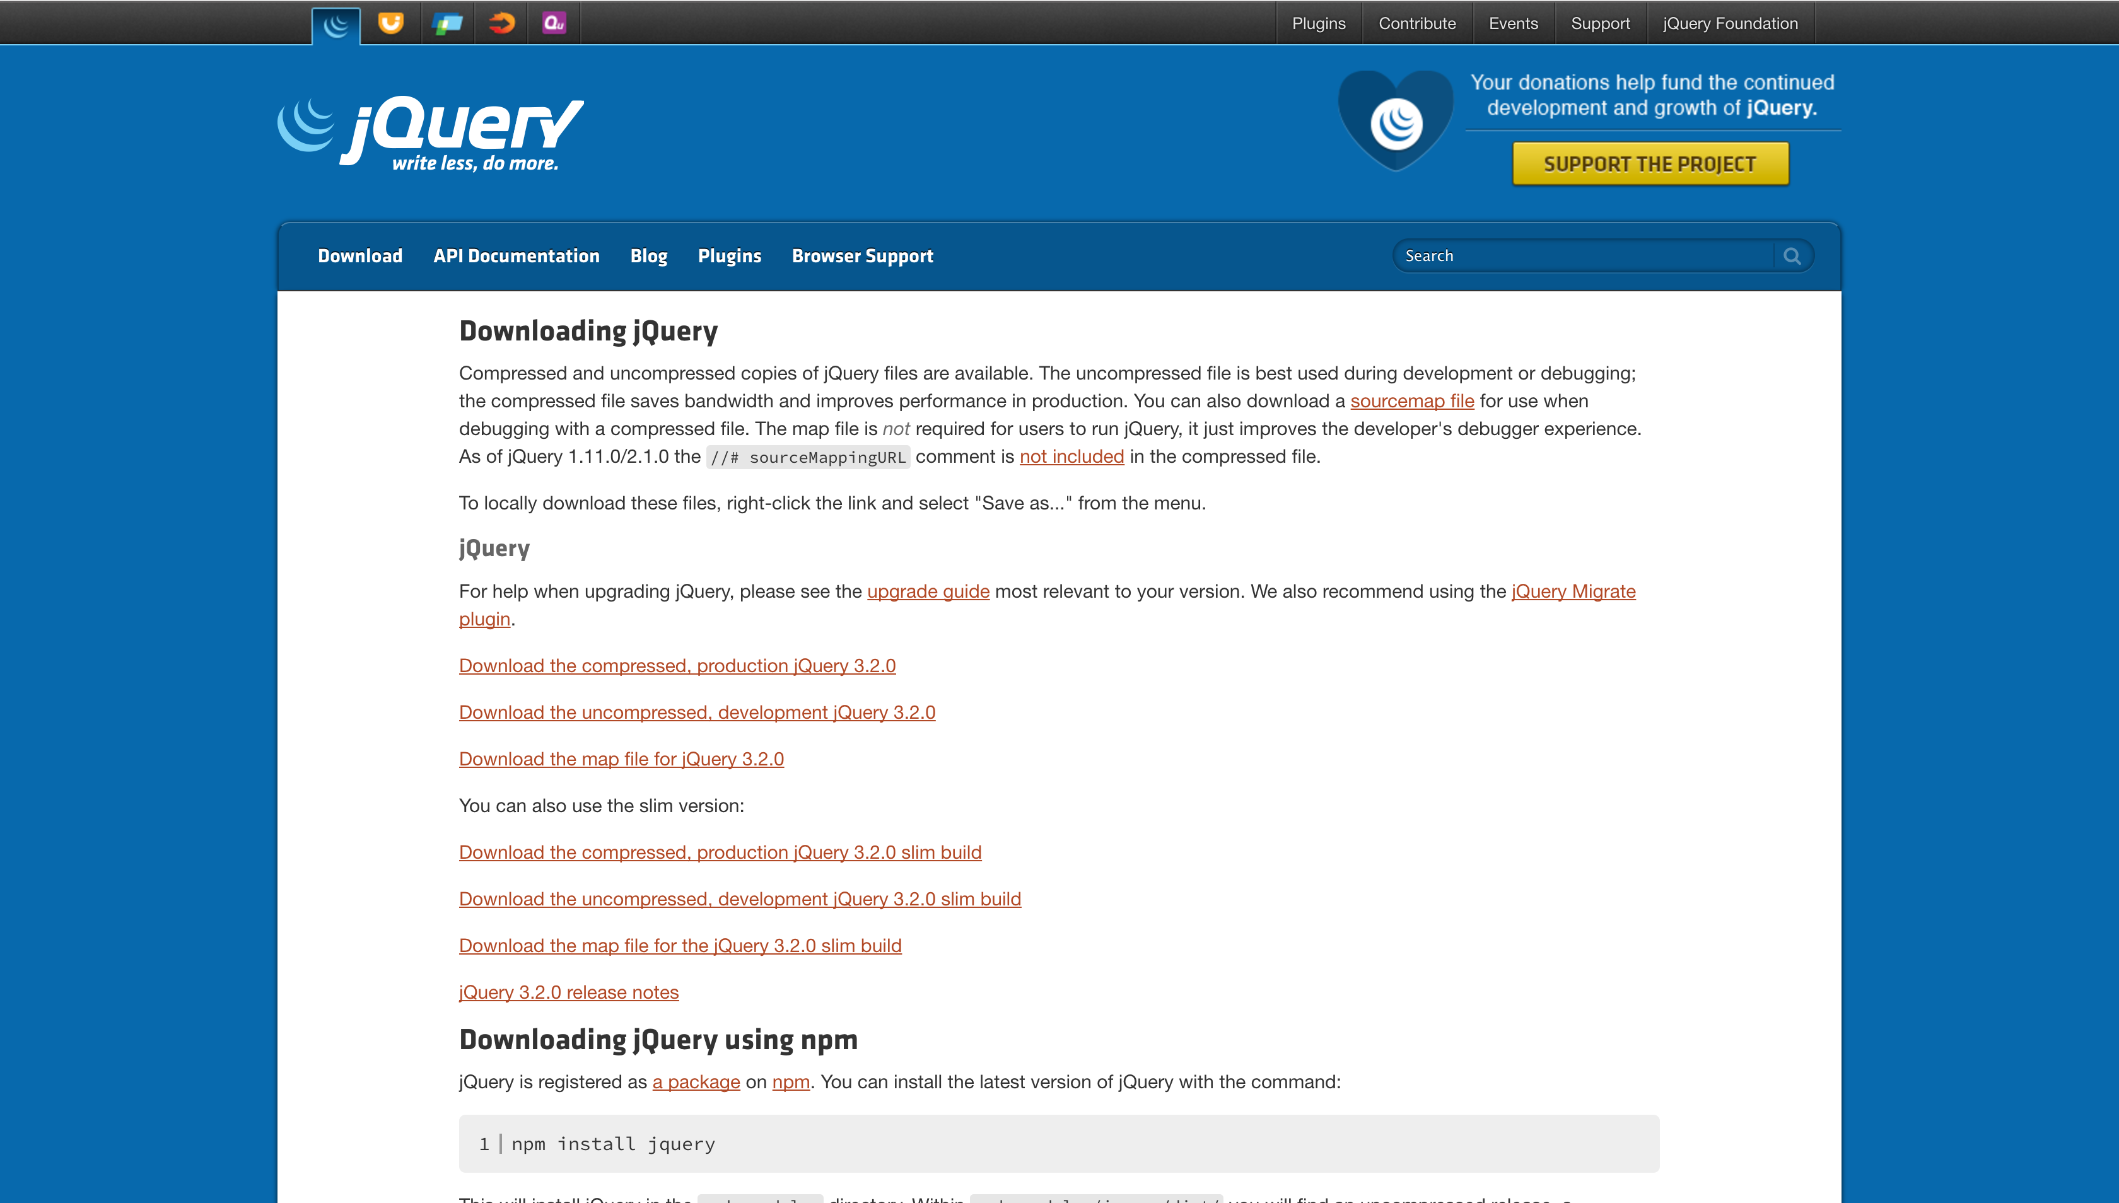
Getting started
Download from jQuery.com/download
CDN (Content Delivery Network) [Preferred]

Slide 3
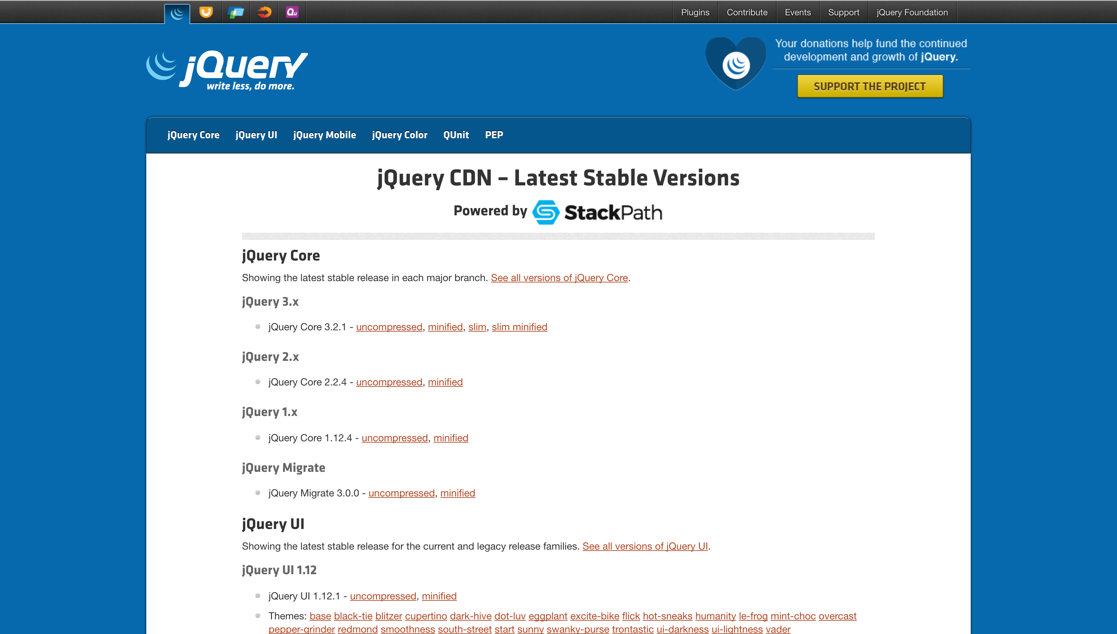
Getting started
Download from jQuery.com/download
CDN (Content Delivery Network) [Preferred]

Slide 4
Maneuvering the DOM

Slide 5
Where to include script tag?
End of
Wrap in document.ready
Both work!

Slide 6
Maneuvering the DOM
$()
CSS selector: .class, #id, :pseudo-classes, and tag (not ::pseudo-elements)
Pure JS code:
document.getElementsBy(“ul”);
document.getElementsByClassName(“highlight”);
document.getElementById(“footer”);
jQuery code:
$(“ul”);
$(“.highlight”);
$(“#footer”);
"" vs ''?
jQuery Core Style Guide

Slide 7
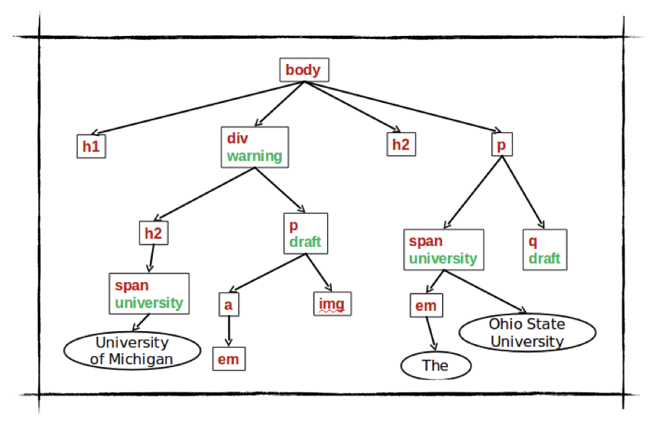
Tree Example

Slide 8
Tree Example (count.)
$(“div .university”); //=>the span node under the div in class university
$(“.university”); //=> A collection of all nodes in class university
$(“body h2”); //=> ALL H2 nodes under BODY
$(“body > h2”); //=> the H2 that is a direct child of BODY
$(“p.draft:nth-child(2)”); //=> the IMG node which is the second child of
the P tag in the class draft
$(“div h2,p”); //=> Collection of the H2 node and the P node under the div

Slide 9
Tree Example Code rewritten
$(“div”).find(“.university”);
$(“.university”); // This wouldn’t change because there is only one tag
$(“body”).find(“h2”); // Recall that this gets all children
$(“body”).children(“h2”); // This will get only DIRECT children
$(“p.draft”).nth-child(2);
$(“div”).find(“h2, p”);

Slide 10
jQuery selector methods
find()
children()
nth-child(n)
most pseudo-classes are also implemented as methods
jQuery methods or CSS selectors?
Used to be that jQuery methods were most optimal; however, more browsers implement document.querySelectorAll()
Results in a negligible performance upgrade
Method chaining can be more readable for long selectors

Slide 11
Walking the dom
next([])
prev([])

Slide 12
traversing the dom
.parent([])
.closest(<selector)

Slide 13
Tree Example AGAIN

Slide 14
Tree Example - Walking/Traversing the DOM
$(“img”).parent(); //=> P node that is in the draft class
$(“img”).closest(“div”); //=> DIV node that is in the warning class
$(“img”).prev(); //=> A node that is the previous sibling of the IMG
node
$(“div”).next().prev(); //=> Same DIV node that we started with

Slide 15
Modifying the DOM

Slide 17
Events in the DOM

Slide 18
Syntax For Event Methods
Introduce the comparison between the pure JavaScript and jQuery creating an event listener for “click”.
document.getElementByclick("p").addEventListener("click", function, false);
$("p").click(function() { // do something })
$("p").on("click", function() { // do something });

Slide 19
Common jQuery Event Methods
create the event listener for "click" (example)
click() vs dblclick()
create the event listener for "mouse" (example)
mouseenter() vs mouseleave()
mousedown() vs mouseup()
hover()
create the event listener for "focus" (example)
focus() vs blur()

Slide 20
Event Propagation
What is Event Propagation
preventDefault() method vs stopPropagation() method (example)

Slide 21
Event Delegation
The behavior of Event Delegation (Syntax)
Why we need Event Delegation
Delegated method
$("div").on("click", function(){...});
$(document).on("click", "div", function(){...});

Slide 22
Triggering an Event
trigger() method vs triggerHandler() method

Slide 23
Styling in the DOM

Slide 24
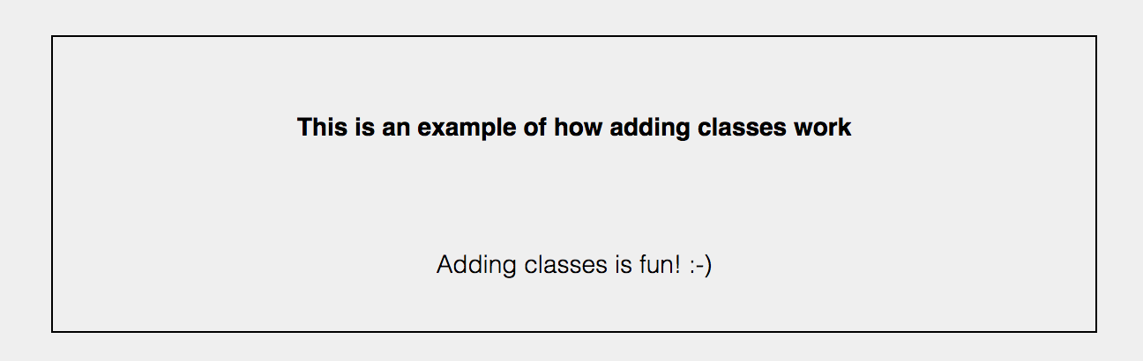
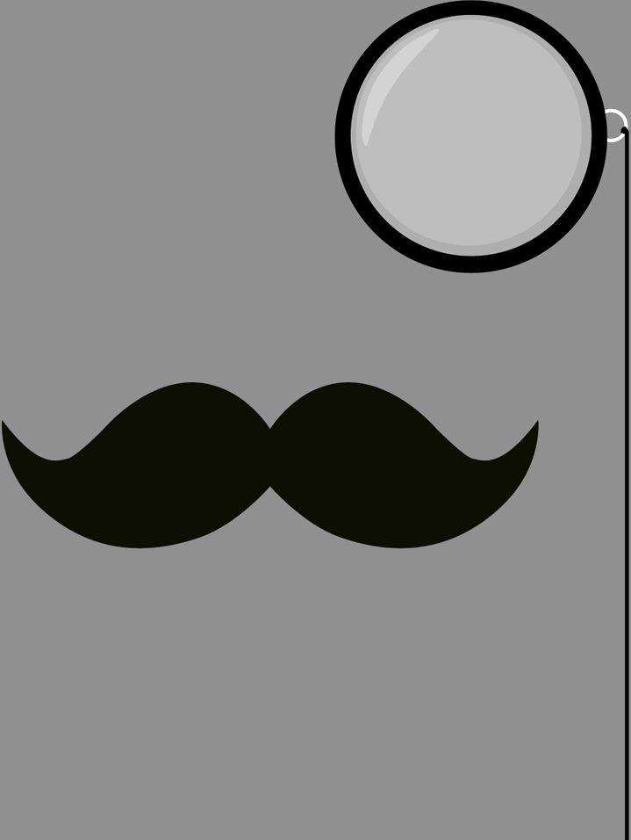
Let’s get classy
addClass()
$(selector).addClass(classname,function(index,currentclass))

Slide 25
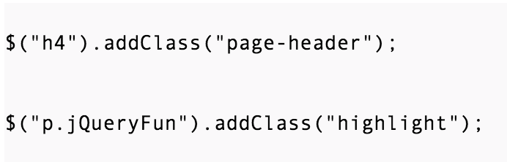
Let’s get classy
addClass()
$(selector).addClass(classname,function(index,currentclass))

Slide 26
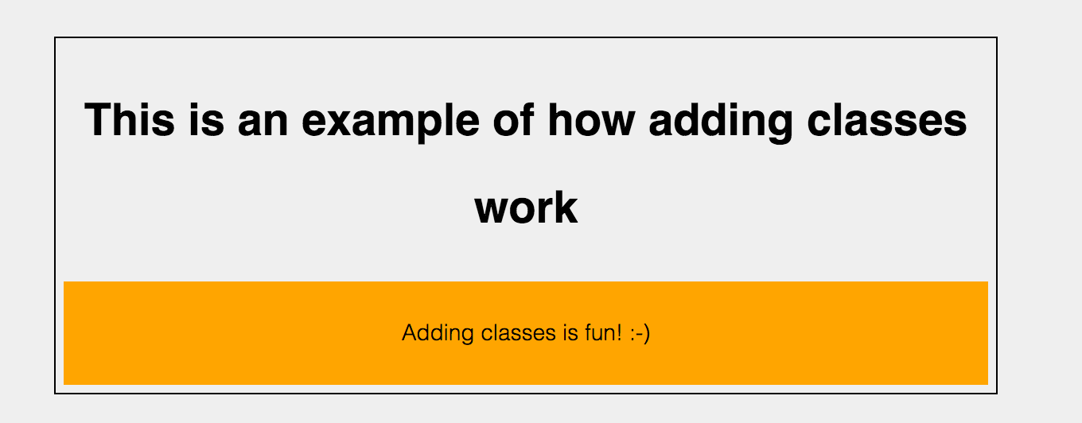
Let’s get classy
addClass()
$(selector).addClass(classname,function(index,currentclass))

Slide 27
adding class example

Slide 28
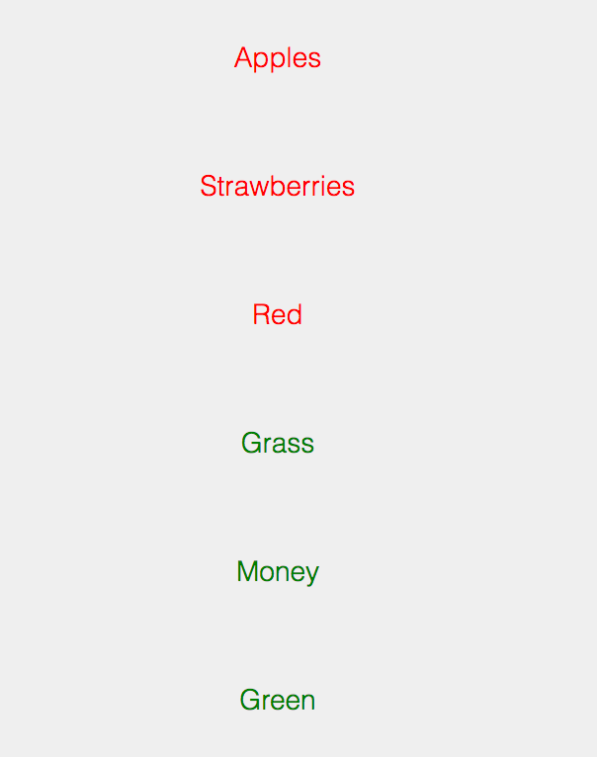
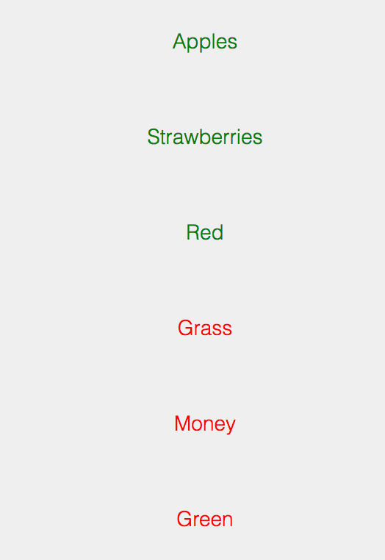
toggle
$(".toggle").toggleClass("red green");

Slide 29
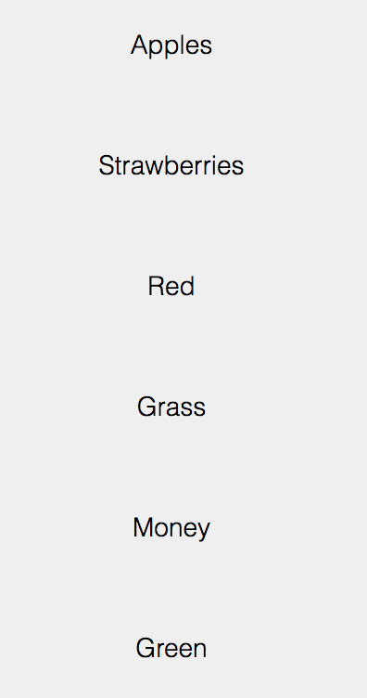
Removing a class
$(".toggle").removeClass("red");
$(".toggle").removeClass("green");

Slide 30
Hide & show
$(".hide").click(function(){
$("img.hideAndSeek").hide();
});
$(".show").click(function(){
$("img.hideAndSeek").show();
});

Slide 31
Fading
fadeOut():
will gradually make an element disappear.
fadeIn()
will gradually bring the element back in.
fadeToggle():
will "fade" in/out the elements

Slide 32

Think outside the box
animate()
Default speed: 400ms
Not all CSS styling effects can be applied
CSS properties that return a numeric property
$(selector).animate({params},speed, callback);

Slide 33
Delay
delay()
Most commonly used for chaining events
$(selector).delay(speed,queueName)

Slide 34
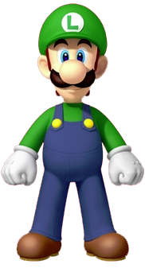
Finish & stop
Difference
Finish: show end state
Stop: pause and show current state

Slide 35
Ajax

Slide 36
ajax
Asynchronous JavaScript and XML
Use of XmlHttpRequest objects to interact with web server dynamically via Javascript
Faster data exchange method with server
Single line of Code

Slide 37
implementation
2 Methods
.ajax() method
Convenience functions: *.get() *.post()

Slide 38

The heart of it all
ajax() method
Takes a parameter of a configuration object
Allows for many more configuration options
Options include: url, data, type, dataType, done, fail, always

Slide 39
example
$.ajax({ url: "post.php", //URL for the request message
data: {id: 100}, //Data to be sent in request
type: "GET",//Whether this is a POST or GET request
dataType: “json", //Type of data expected to be returned
})
//Code to run if request succeeds
.done(function(json) { // callback function })

Slide 40
For your convenience
.get()
$.get(URL,callback);
sends HTTP GET request to server
.post()
$.post(URL,data,callback);
requests data from server using HTTP POST request

Slide 41
Get and Post examples
$.get( "all_this_data.html",
function(data,status){ //Callback function definition })
$.post("all_this_data.html", {
name: "Fred"
greeting: "Hello World!" },
function(data,status){ //Callback function definition })

Slide 42
Pick Your Poison
How to determine what method to use?
Convenience Functions:
Sending simple requests
Default settings are OK
.ajax()
Perform error handling
Single point of Control
Extensive configuration of requests

Slide 43
questions || comments

