Slide 1
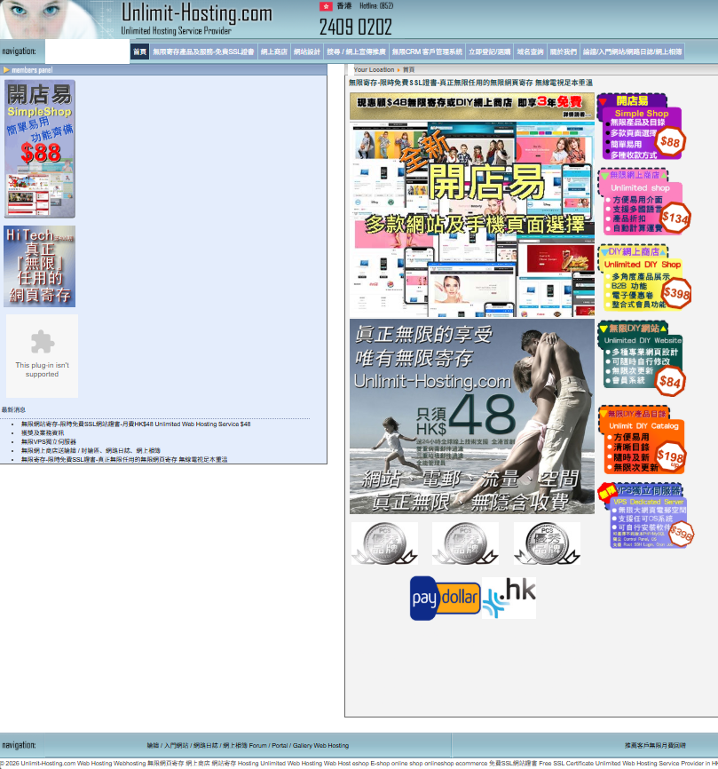



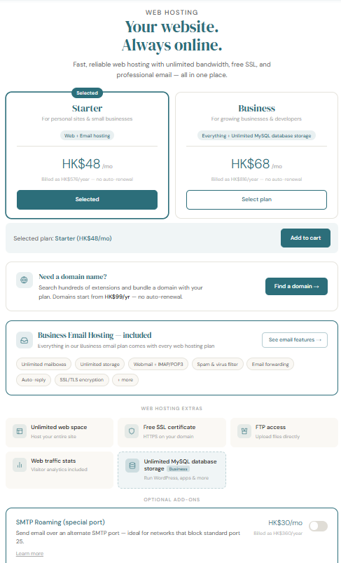


Full stack web development – revamp of a 2-decade old web hosting services provider website https://www.unlimit-hosting.com/
Bilingual set up
Redesign of company logo, website layout, landing page
Plans and feature tables were cluttered and outdated
AI Chatbot and domain name generator via Groq RESTful API using meta llama 3.1 70b versatile LLM
Home page ran on retired plugins and had a lot of clutter and negative space
Redesign of tiered service plans with bundle and add-ons logic
Implement modern domain availability search function using DomScan RESTful API that searches through RDAP, WHOIS, DNS, HTTP/S, SSL/TLS protocols
Removal of obsolete services
Domain availability ran on outdated manual WHOIS database scraper
BEFORE
AFTER

Slide 2

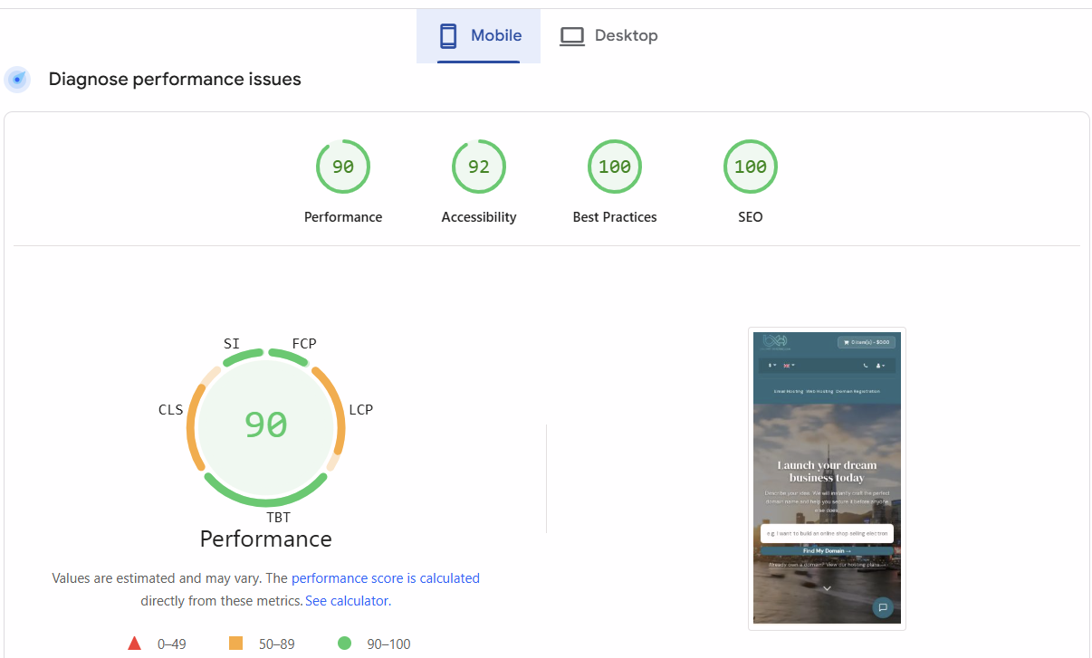


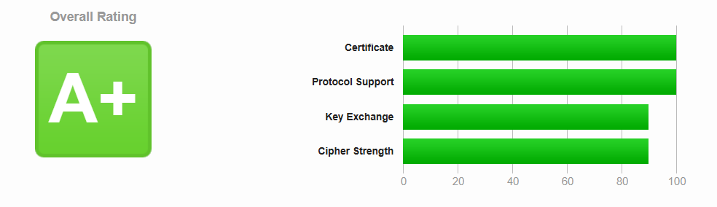
Full stack web development – revamp of a 2-decade old web hosting services provider website https://www.unlimit-hosting.com/
Performance Optimization
Update PHP v7 to 8
Security implementations
Cloudflare Turnstile Captcha
Cloudflare DNS Proxy
Honeypots in forms
Block generic bots
ROT13 encryption of customer support email
API rate limiting to prevent abuse
Website audit: Green across all categories on mobile and desktop on Google Lighthouse
Updated TLS version and ciphers, implemented HSTS, bumping Qualys SSL Labs rating from B to A+

Slide 3
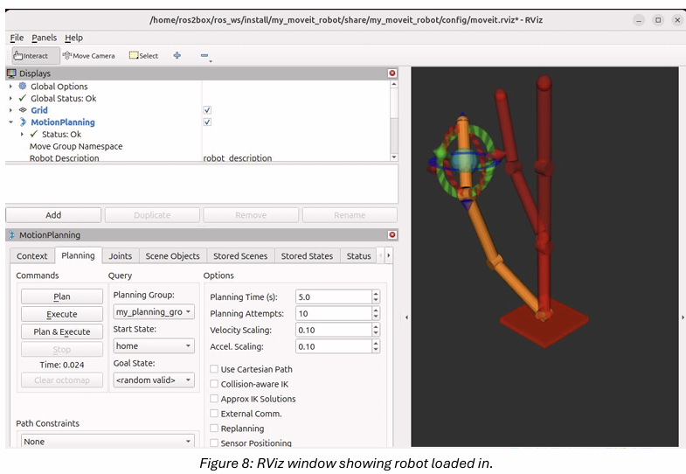
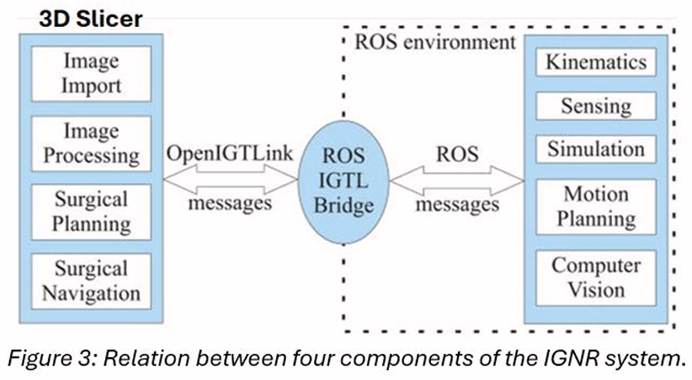
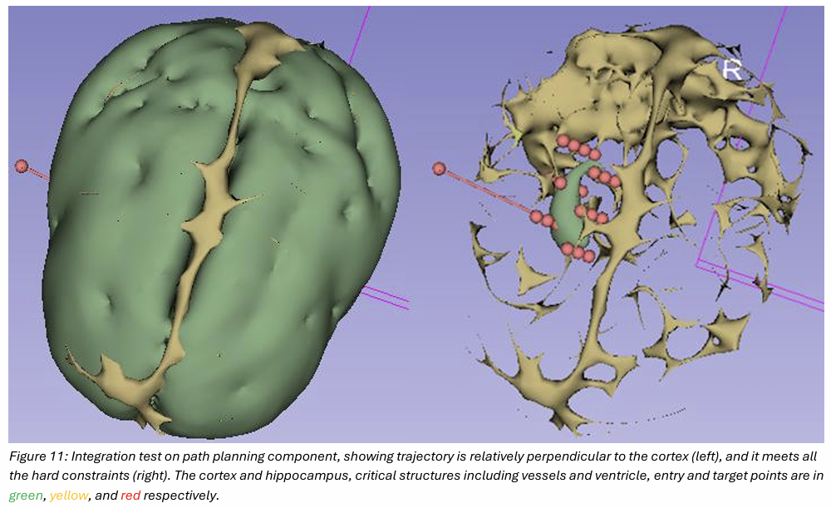
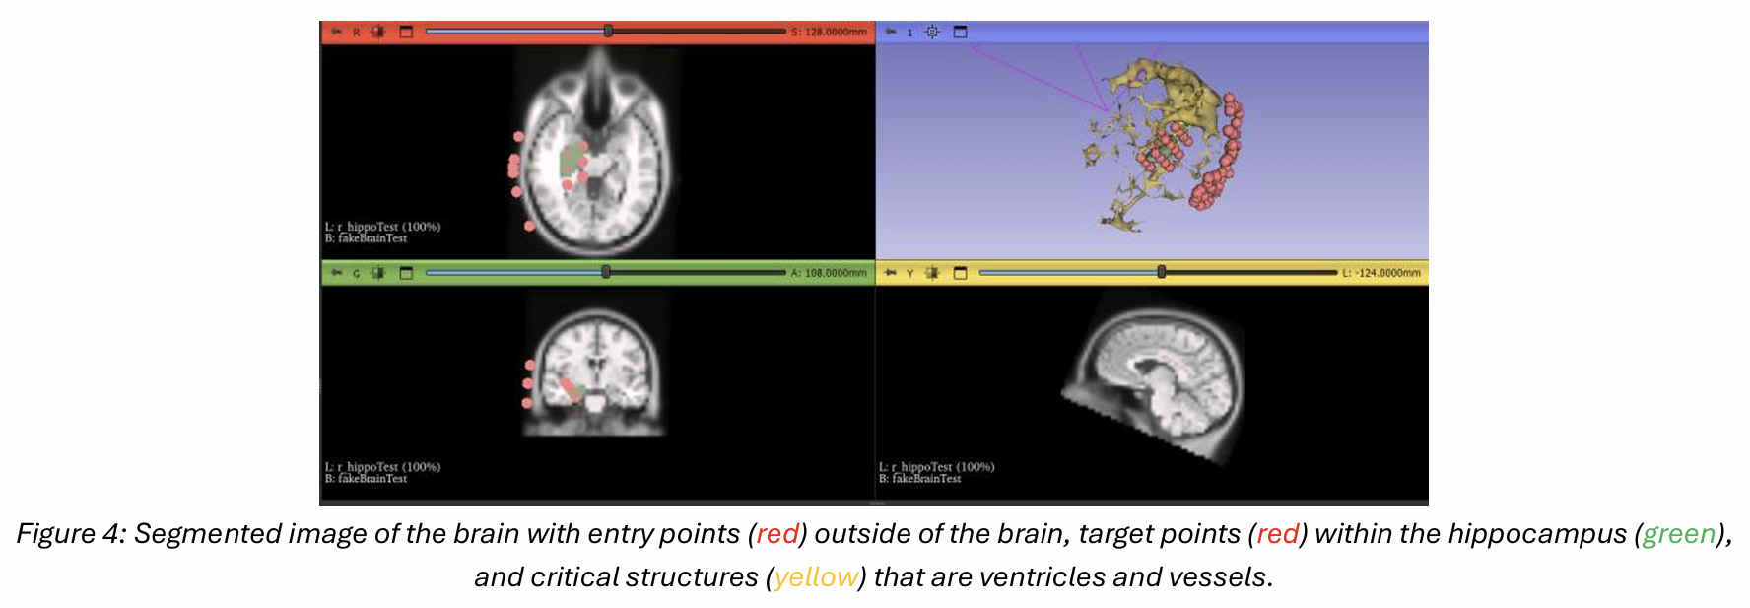
Image-guided Navigation Simulation for Surgical Robotics
The objective of the project is to develop an end-to-end pipeline, creating a simulation that insert an electrode located at the end effector of a robotic arm, through a straight trajectory in the brain to target the hippocampus for recording temporal lobe epilepsy. This is all done while adhering to some constraints to ensure the safety of the patient.
Some hard constraints are that the electrode must target the hippocampus, cannot penetrate ventricles to prevent cerebrospinal fluid leakage, cannot hit blood vessels to prevent hemorrhage, and it must be somewhat perpendicular to the cortex with at least a 55 degrees angle to prevent deflection. A soft constraint is to maximize the minimum distance of the electrode from ventricles & vessels to reduce risk.
The methodology to develop the simulated IGNR system is divided into four components, path planning in 3D Slicer, OpenIGTLink for data transfer from 3D Slicer to ROS2, ROS2
Results: Best trajectory calculated, visualized and validated against constraints..

Slide 4
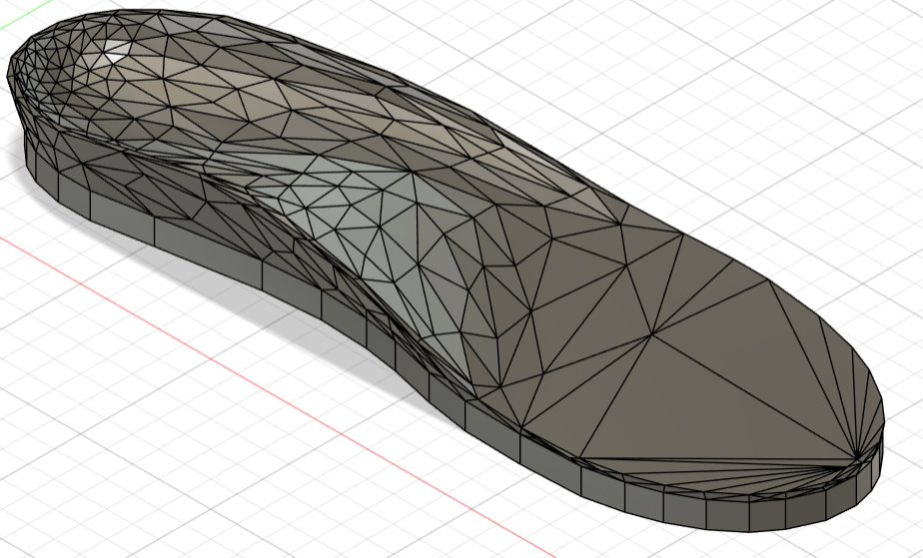
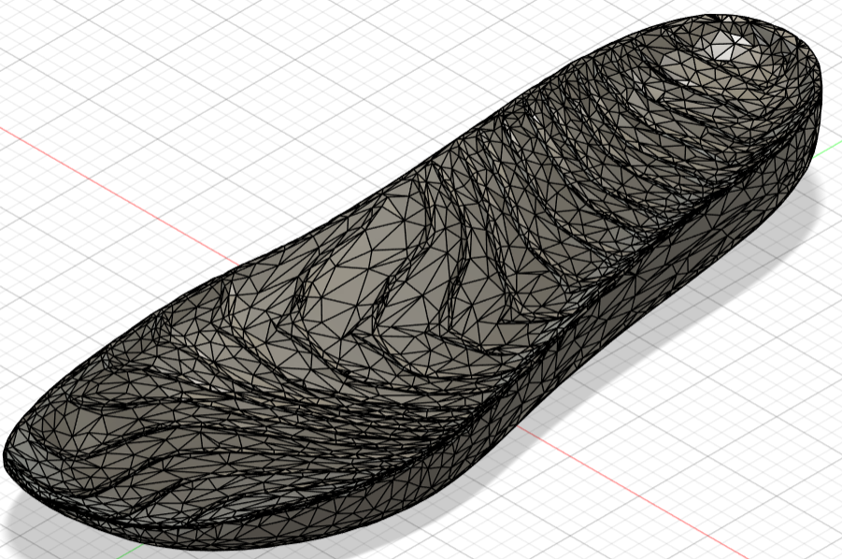
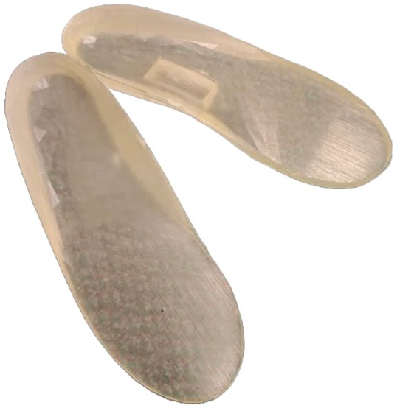
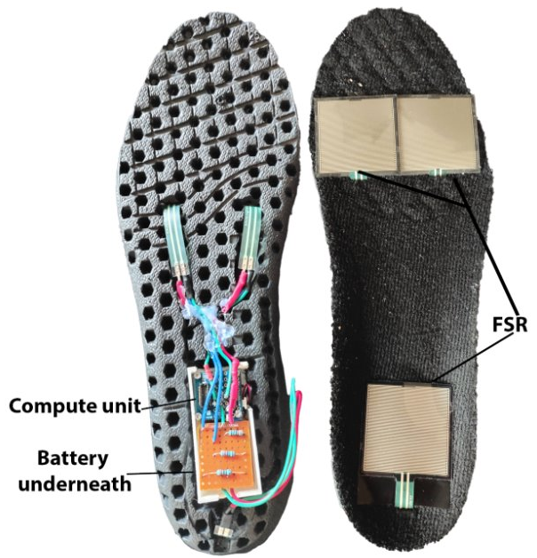
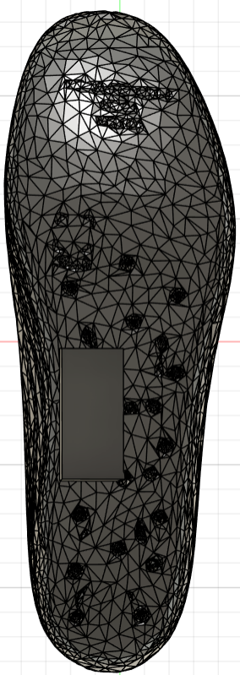
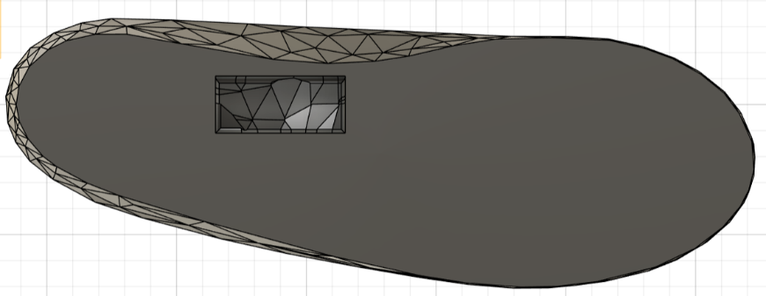
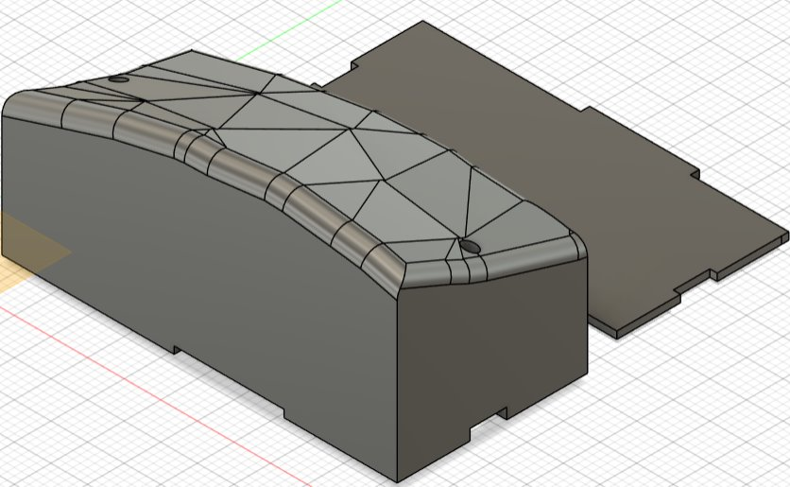
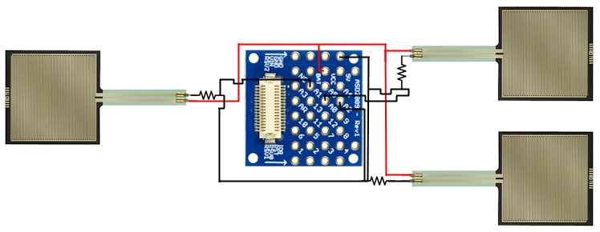
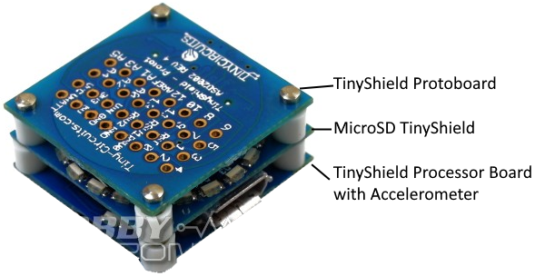
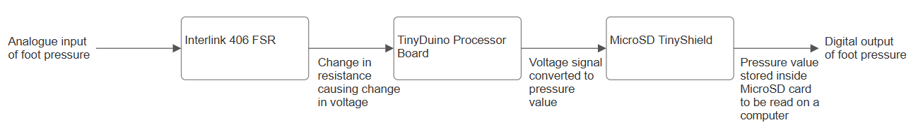
Low-cost smart insole for monitoring and classifying physical activity kentonleung/Low-cost-Smart-Insole: This repository will contain files to run the insole.
Early iterations and 3D printed TPU prototype, too stiff.
Final iteration with manual cut outs to an existing insole
as it is proven to already be somewhat comfortable
Wiring diagram
Compute unit
Block diagram

Slide 5
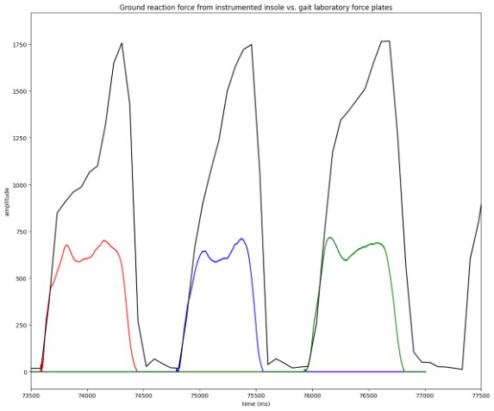
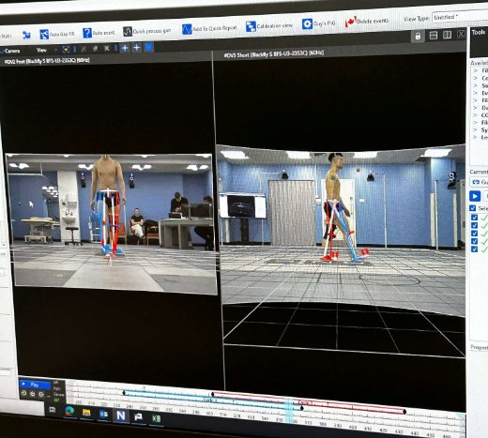
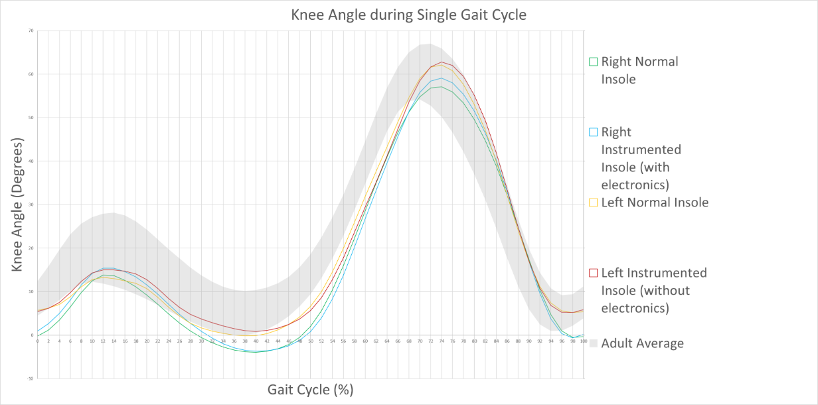
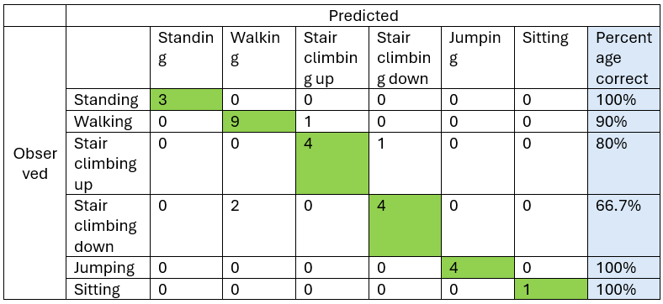
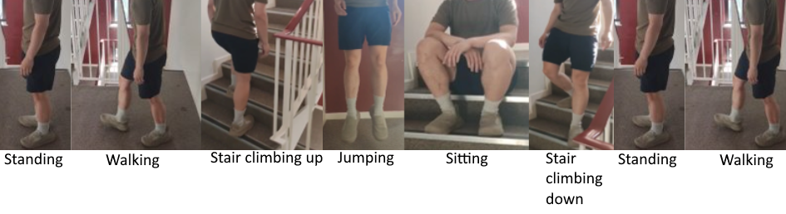
Sensor accuracy and gait alteration was measured in the gait laboratory at Guy’s Hospital.
Sensor Accuracy
Compared to force plates, the system accurately detected gait events but overestimated ground contact time by 7.98% and underestimated peak forces, while maintaining consistent step-to-step trends.
Gait alteration
The prototype caused minimal gait alteration (<2% knee angle deviation) and was comfortable for short-term use, though minor integration issues were observed.
Test for manual classification performance by comparing to video. Manual classification was done by applying thresholds of peak values and standard deviation to data.
Activity classification
Performance was limited, with 66.7% accuracy for stair descent.

Slide 6
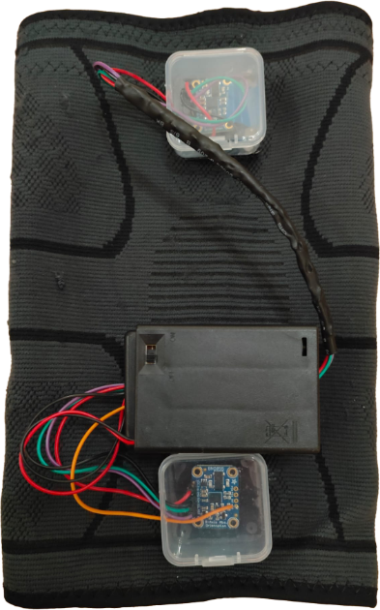
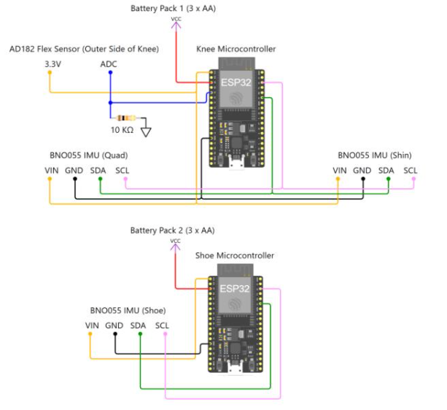
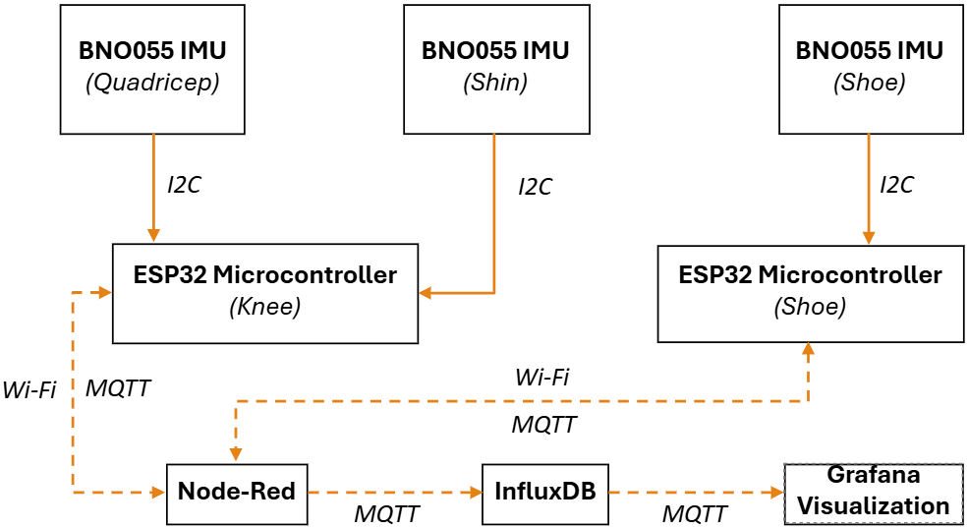
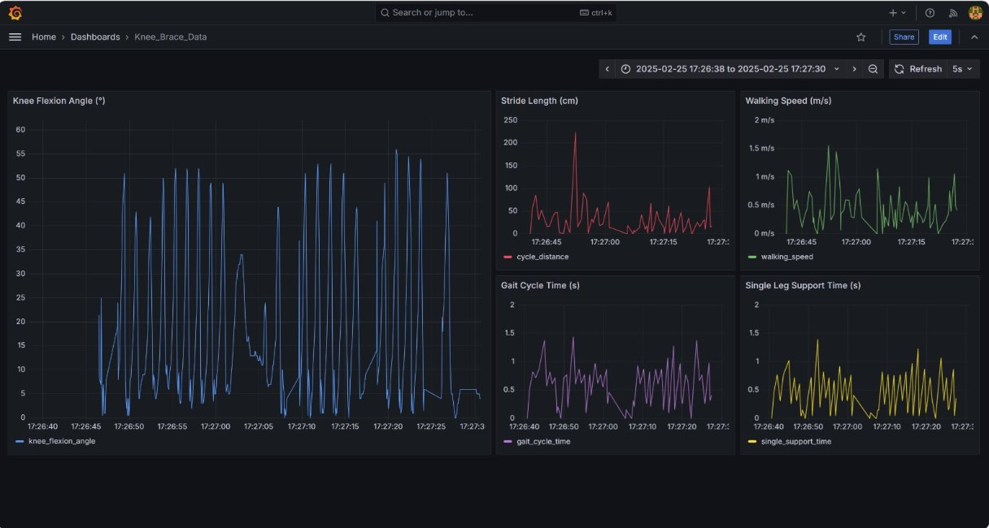
Smart Knee Sleeve – Group Project (responsible for electronics, firmware and testing) kentonleung/Knee-Sleeve: This repository will contain files to run the knee sleeve.
Wiring diagram
Design and built smart knee sleeve from scratch using IMUs.
Accompanied by shoe unit to obtain information of relation between knee and foot.
Based on ESP32 microcontrollers with BNO055 inertial measurement units
Flex sensor option was explored but not implemented due to time constraints. Although it should be more accurate for measuring knee angle,
Block diagram
Grafana Visualization
Knee angle, stride length, walking speed, gait cycle time, single leg support time is calculated and logged wirelessly, then visualized on Grafana

Slide 7
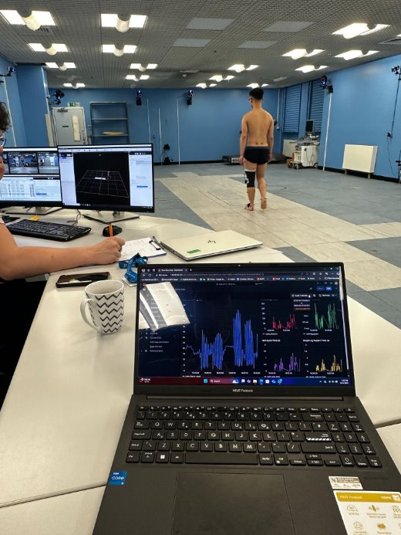
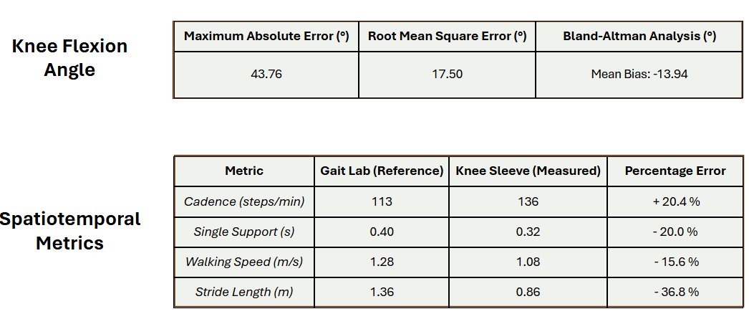
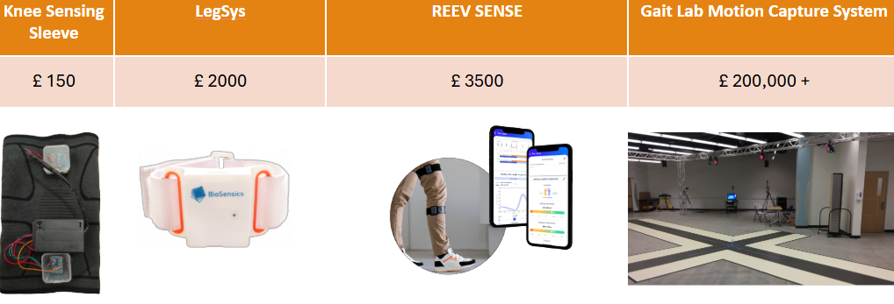
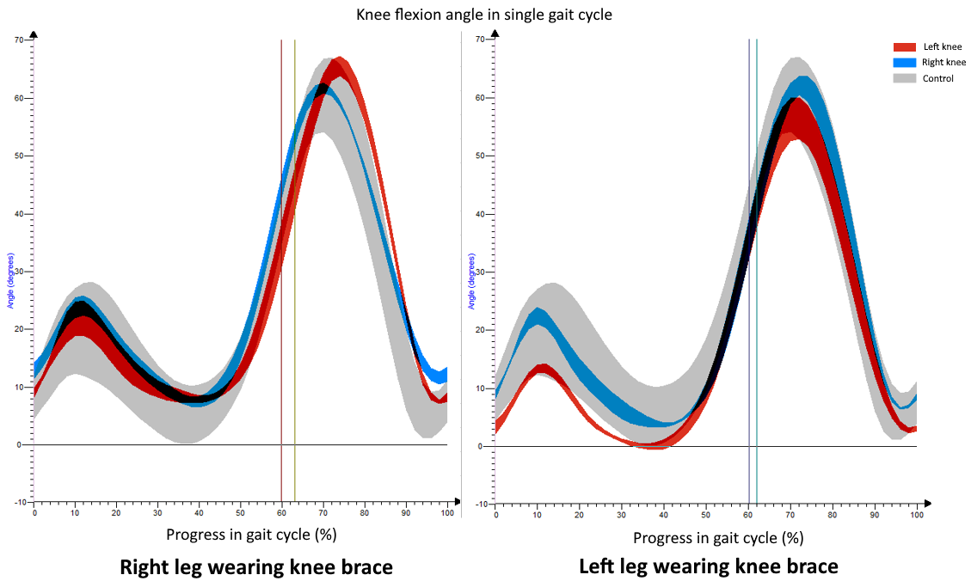
Knee sleeve data is compared to gait lab data as ground truth to assess accuracy
A test on biomechanical affects of wearing the device was also tested by comparing gait with and without sleeve.
Data indicated some considerable error; device is not ready for medical use. However, it may be acceptable as a resource to infer general knee health.
Inexpensive compared to alternatives on the market.
Knee sleeve stunts knee angle by 6 degrees as it restricts knee and foot movement due to bulk and weight.

Slide 8
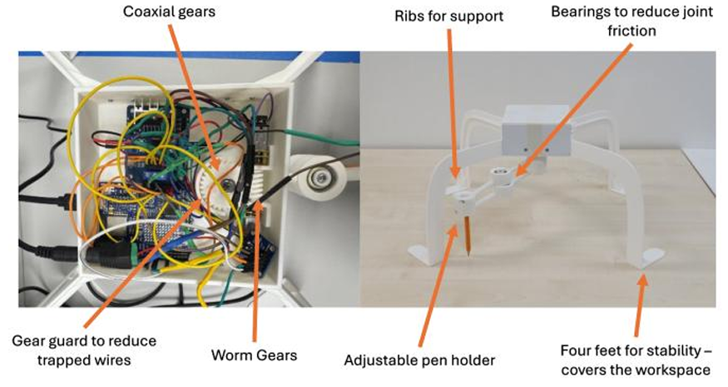
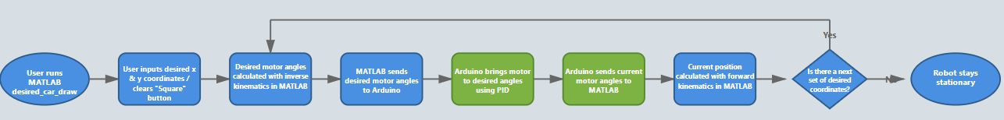
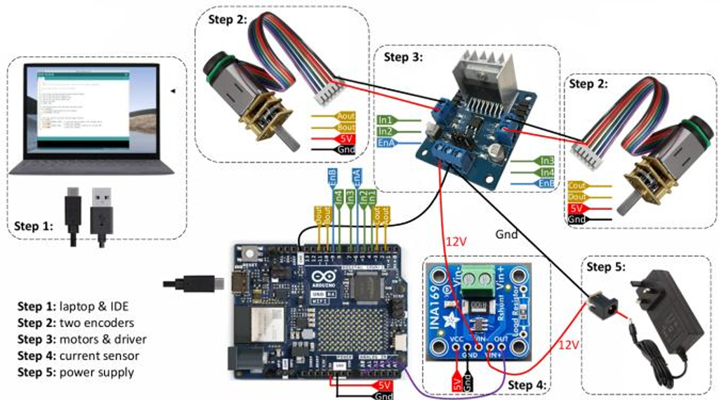
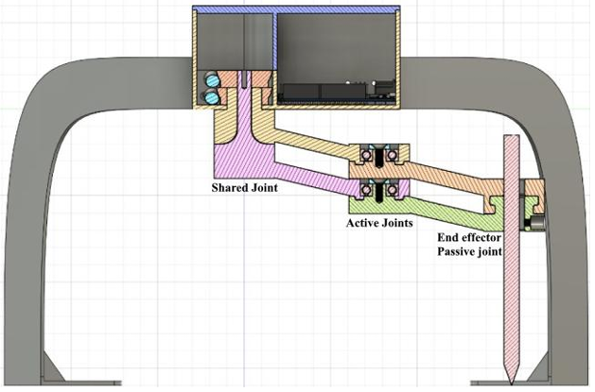
Parallel Drawing Robot – Group Project (responsible for electronics, firmware and user interface) Lucas-G-Xu/Applied-Medical-Robotics-Group-8
MATLAB – Arduino communication flow chart
User controls robot via MATLAB UI, MATLAB runs kinematics calculations based on inputs, sends required motor angles to device, and the firmware gets the motors to the required angles.
Wiring Diagram
Cross sectional view
Device based off 2 motors w/ encoders, current sensor, motor controller, and an Arduino board.

Slide 9
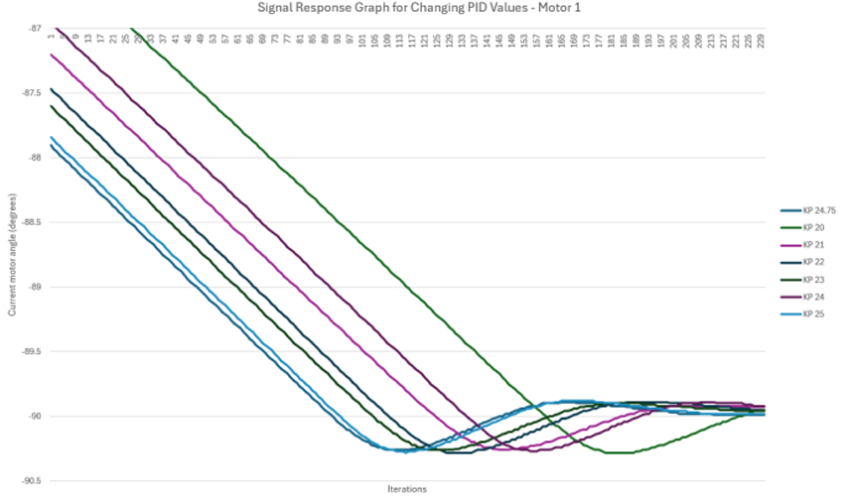
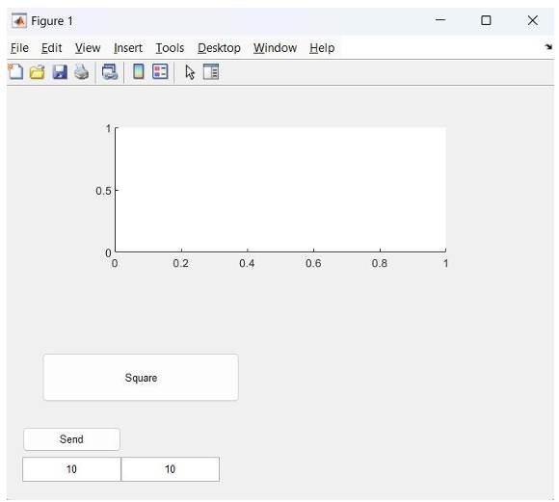
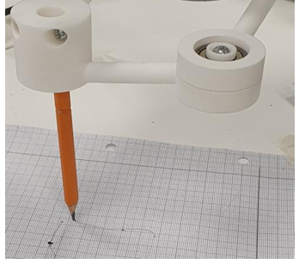
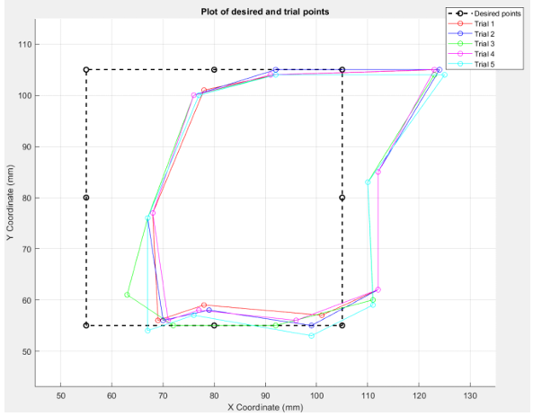
MATLAB UI
User inputs desired coordinates that they want the end effector to move to, or presses “Square” for it to draw a square.
Experimental approach in testing for optimal PID values, by trial and error
Demonstration
Accuracy
Collision detection implementation was attempted by setting maximum current threshold. Noise makes it ineffective. Low pass filter is a solution.

Slide 10
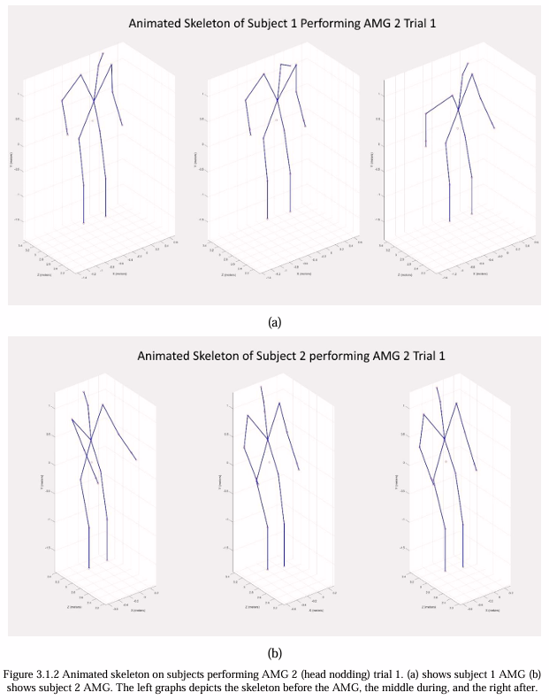
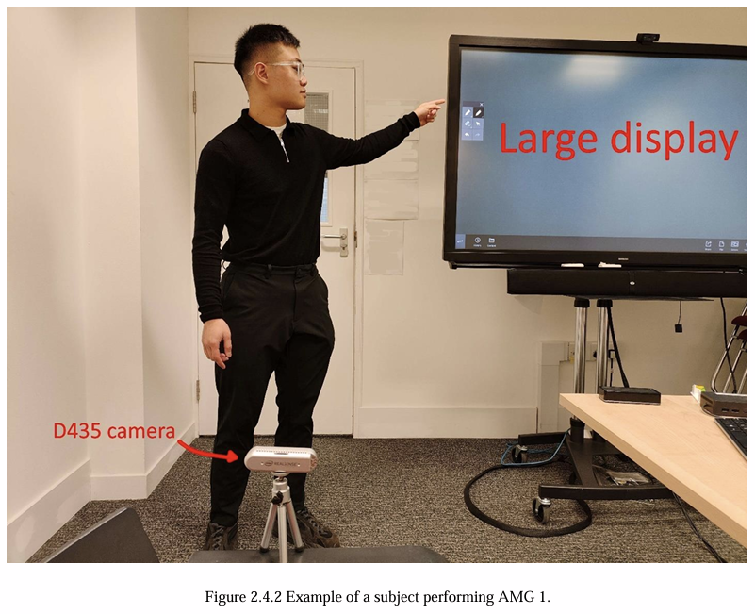
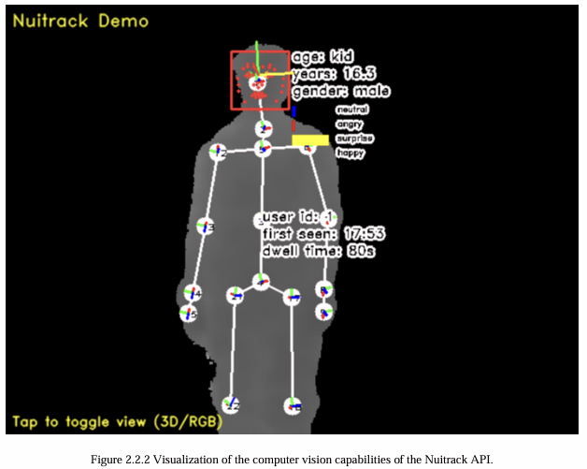
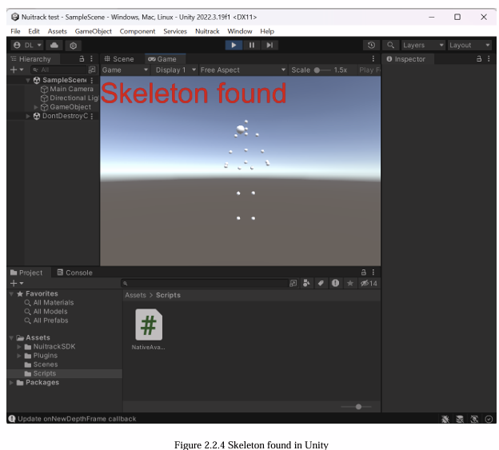
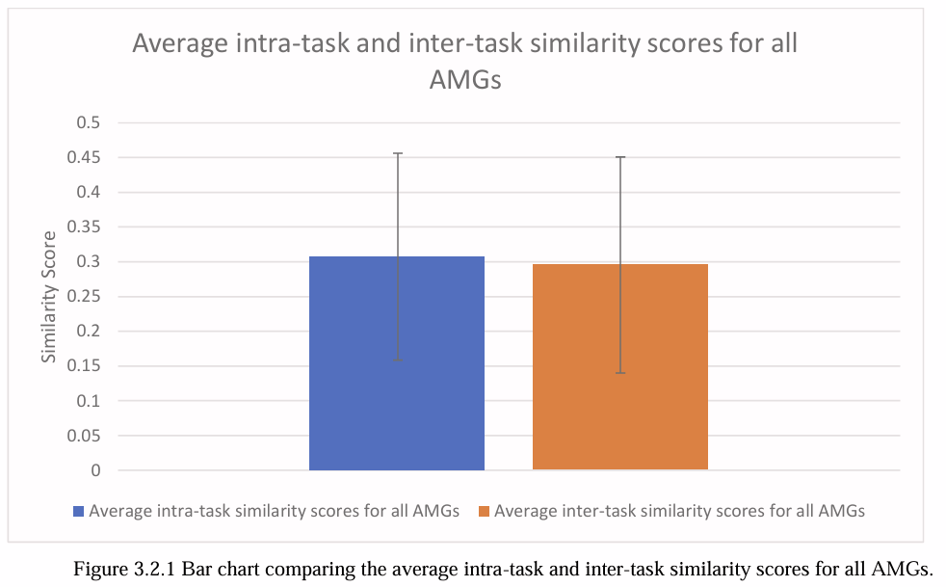
Quantifying and comparing motion
The project aims to develop a system to quantify and compare motion between two subjects, using computer vision, machine learning pose tracking, and a rule-based algorithm for post processing (generating a similarity score between two subjecs’ motion)
A depth camera is used to capture two subjects performing the same motion, the data capture system is built on Unity with NuitrackSDK, and data post processed with MATLAB
The system was successful in differentiating similar and dissimilar motions by giving a high and low similarity score respectively.

Slide 11
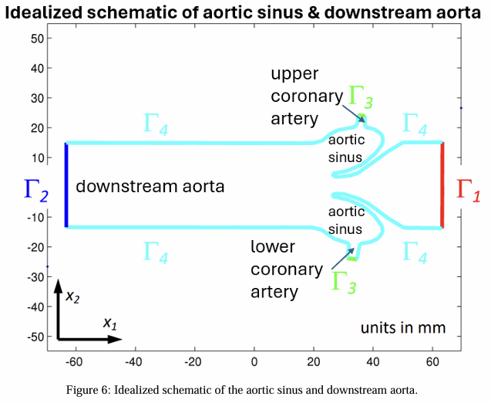
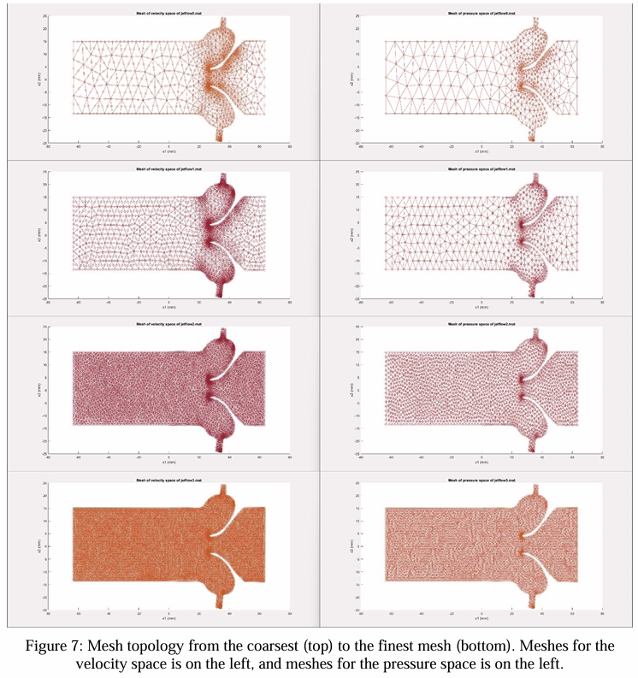
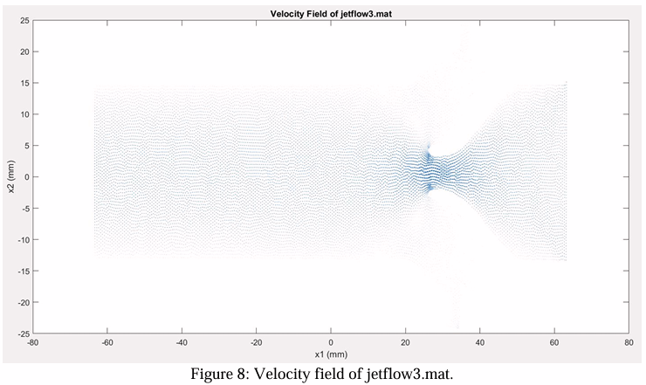
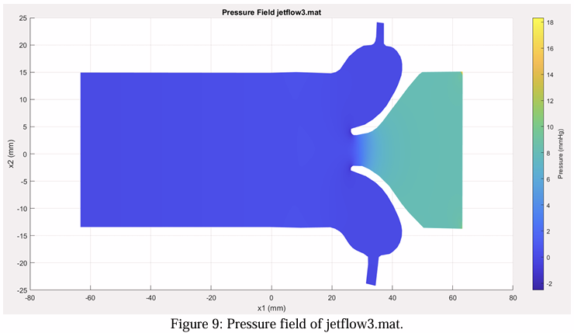
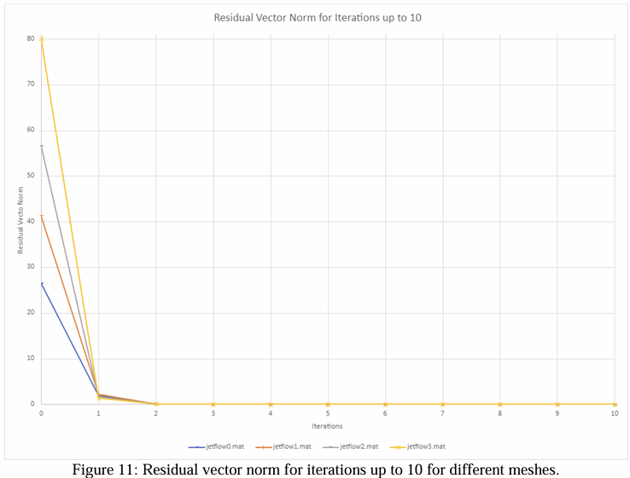

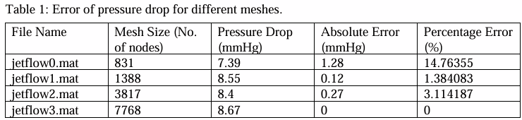
Applied Finite Elements Project – Modelling Blood Velocity & Pressure In The Heart
Visual representation of mesh fidelity
Calculated discretised weak form
2D velocity and pressure modelled with fine mesh
Convergence tests showing:
finer mesh = higher convergence
Beyond 5th iteration = diminishing returns
Pressure drop and error calculated with different mesh fidelity, assuming finest mesh as ground truth

