Slide 2

Recent experience
Logistic Regression
Government sponsored enterprise for the secondary mortgage market:
Profile borrower capacity (e.g. debt-to-income ratios) across history of mortgage holders
Increase the velocity of notifications when loan events occur, such as for a contract being settled, a foreclosure process started, etc.
Large bank holding company:
Back test Value-At-Risk (VaR) models for commercial real estate (REITs).
Major food & beverage retailer:
Combine real time sales transactions with loyalty and rewards reference data to form a 360 degree view of a customer.
K-nearest neighbors
Change Data Capture
Data Lake
Model Testing
Large volume data sets
Kafka Streams

Slide 3
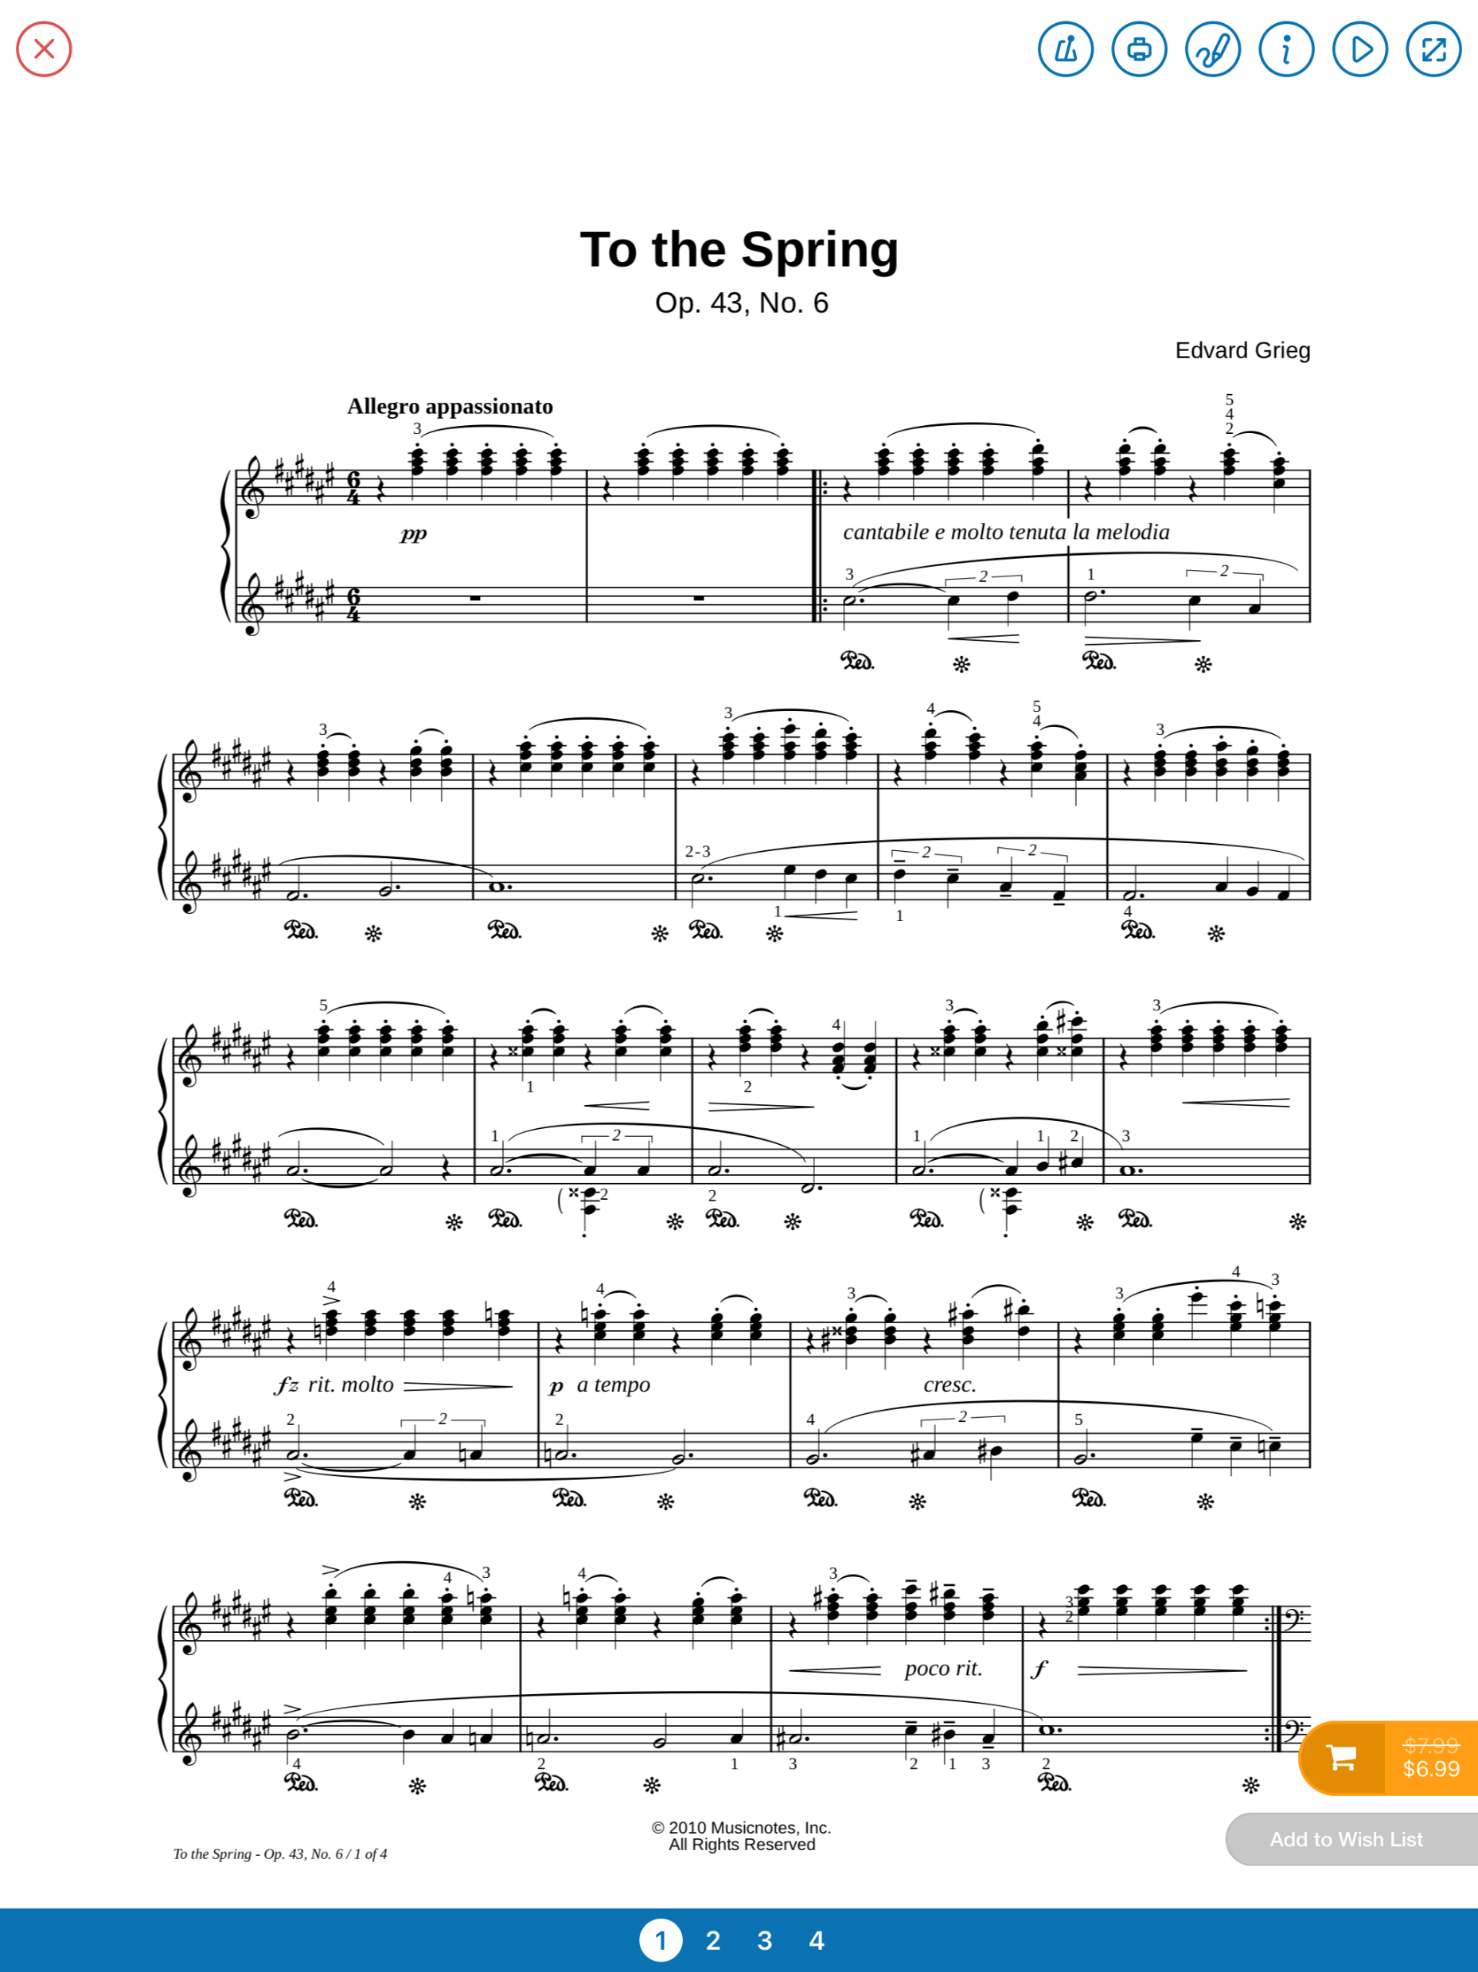
Need a platform to foster R&D and Collaborative Performance

Slide 4
Need a Shared Data Experience
Distance learning for higher education will continue to increase
Music and the Performing Arts are impacted by this more so than most studies
The MIDI market for instruments of all types (not just keyboards) continues to rapidly increase
MIDI software is proliferating but it is decentralized and boutique-driven with no clear industry
leader
Offerings such as Google’s Magenta target AI for music generation but do not address the growing
need for collaborative, data driven sharing by artists

Slide 5
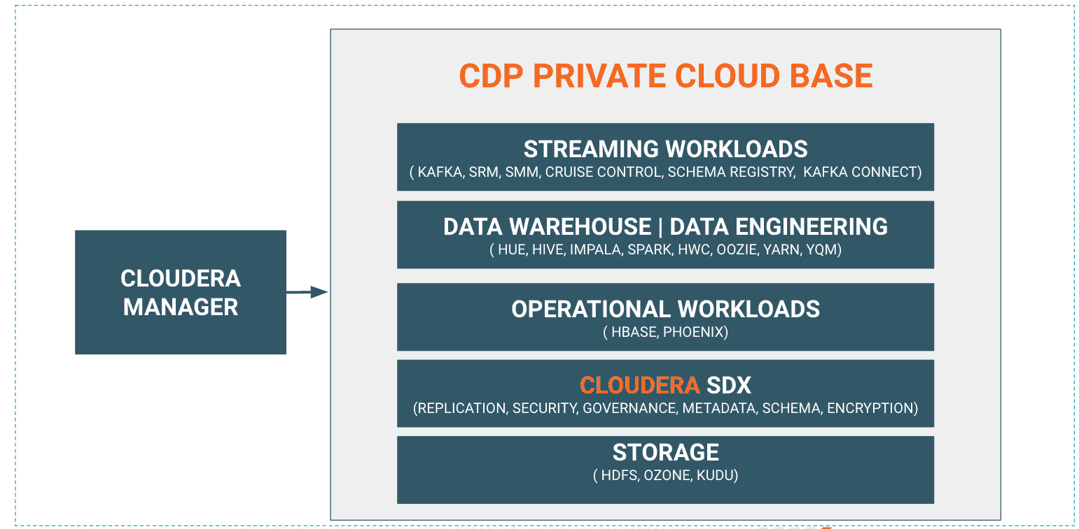
Cloudera Data Platform

Slide 6
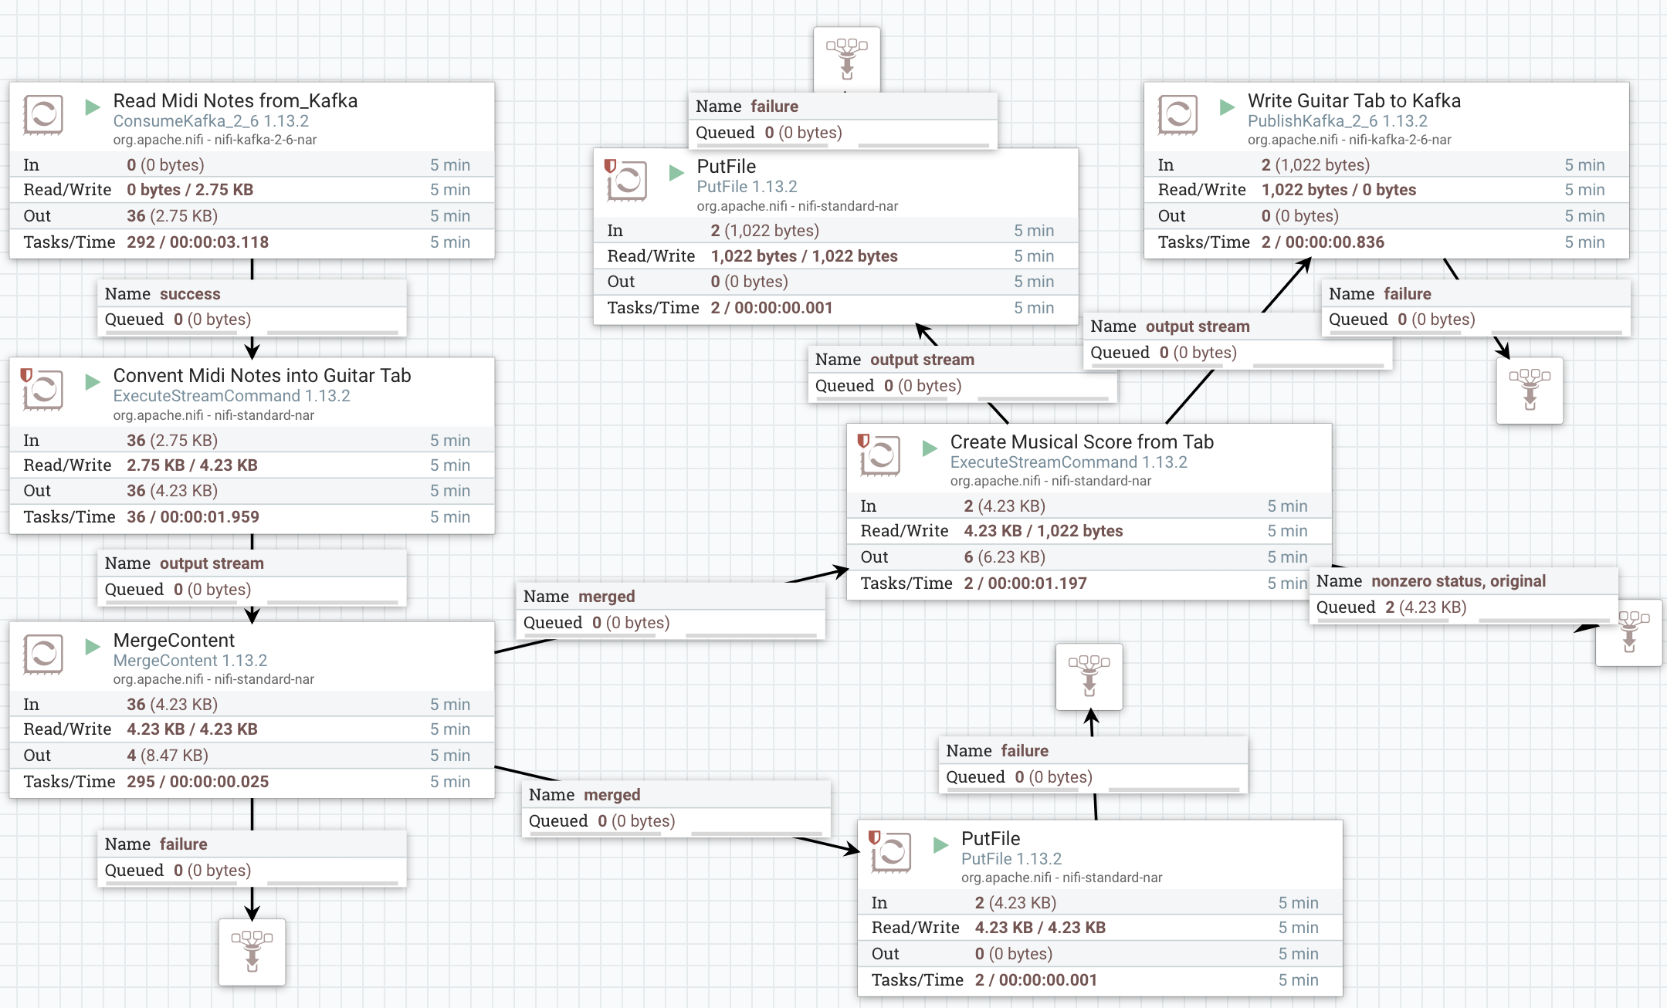
PoC: ETL with NiFi

Slide 7
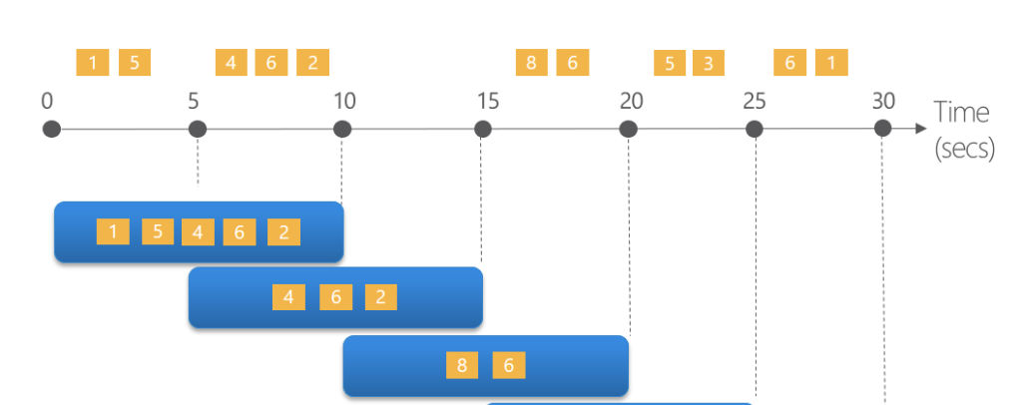
PoC: Structured Streaming to tally values via Windows

Slide 8
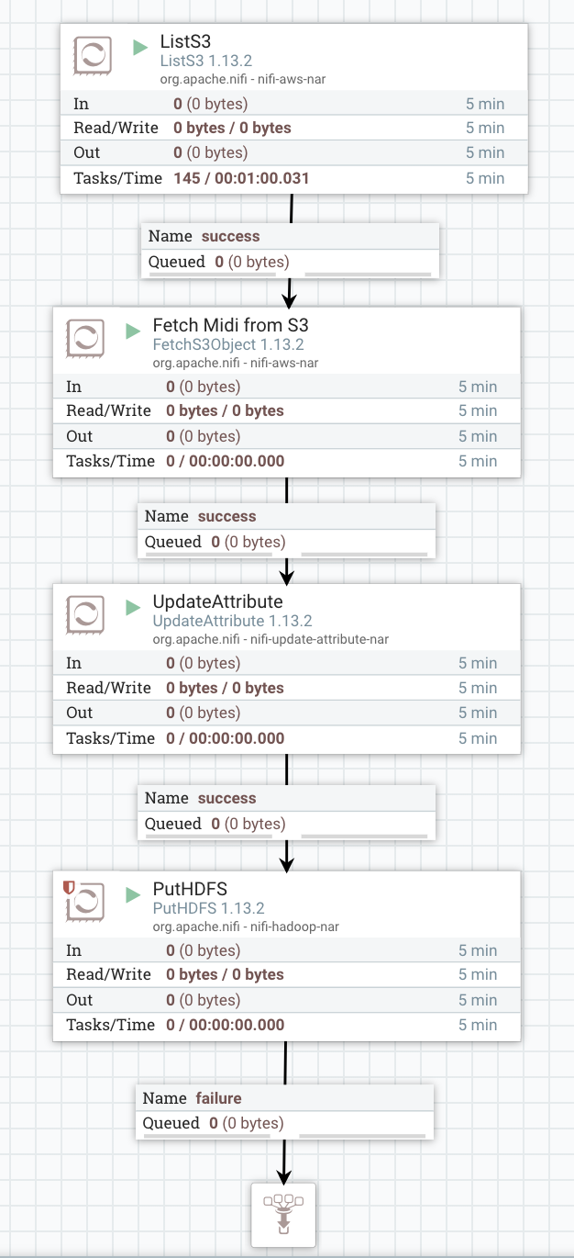
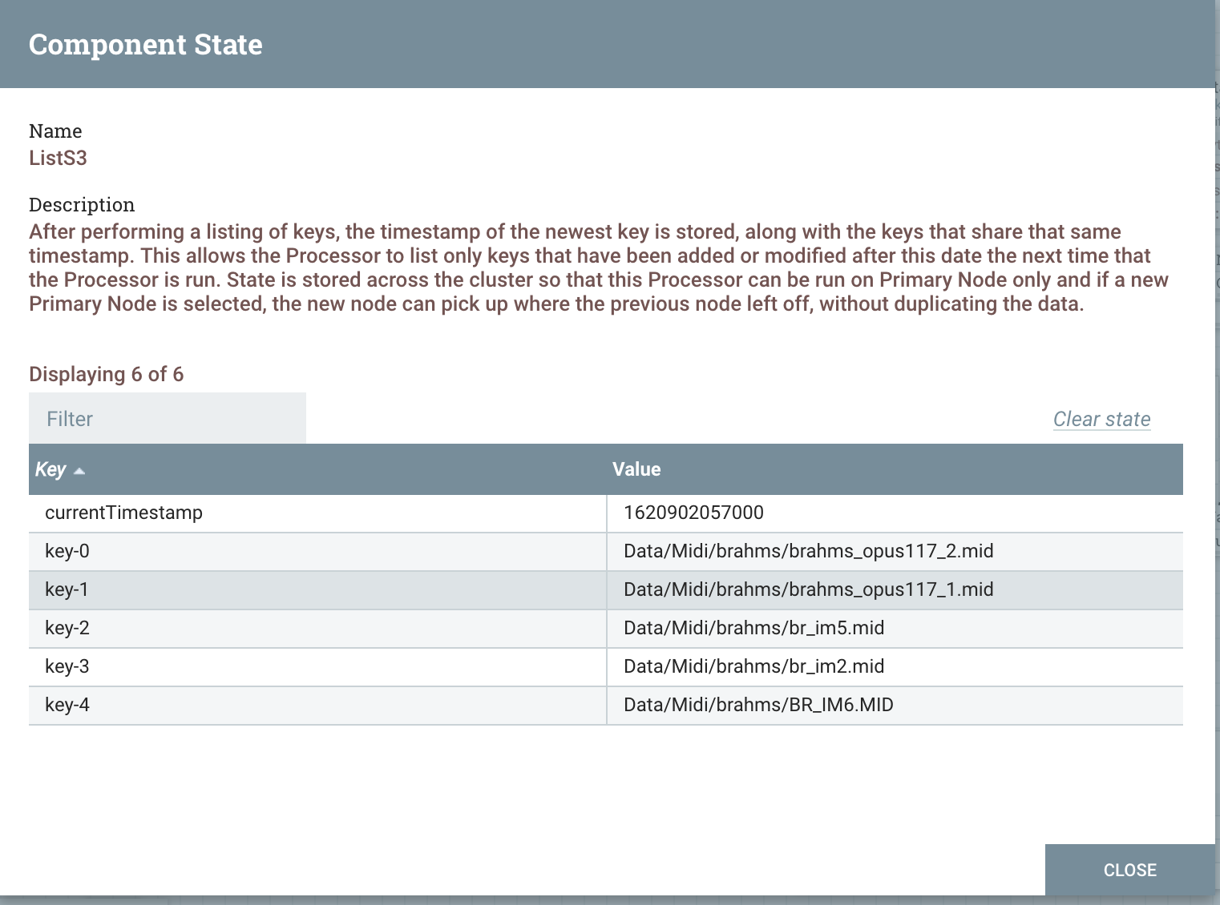
PoC: Upload Data into HDFS

Slide 9
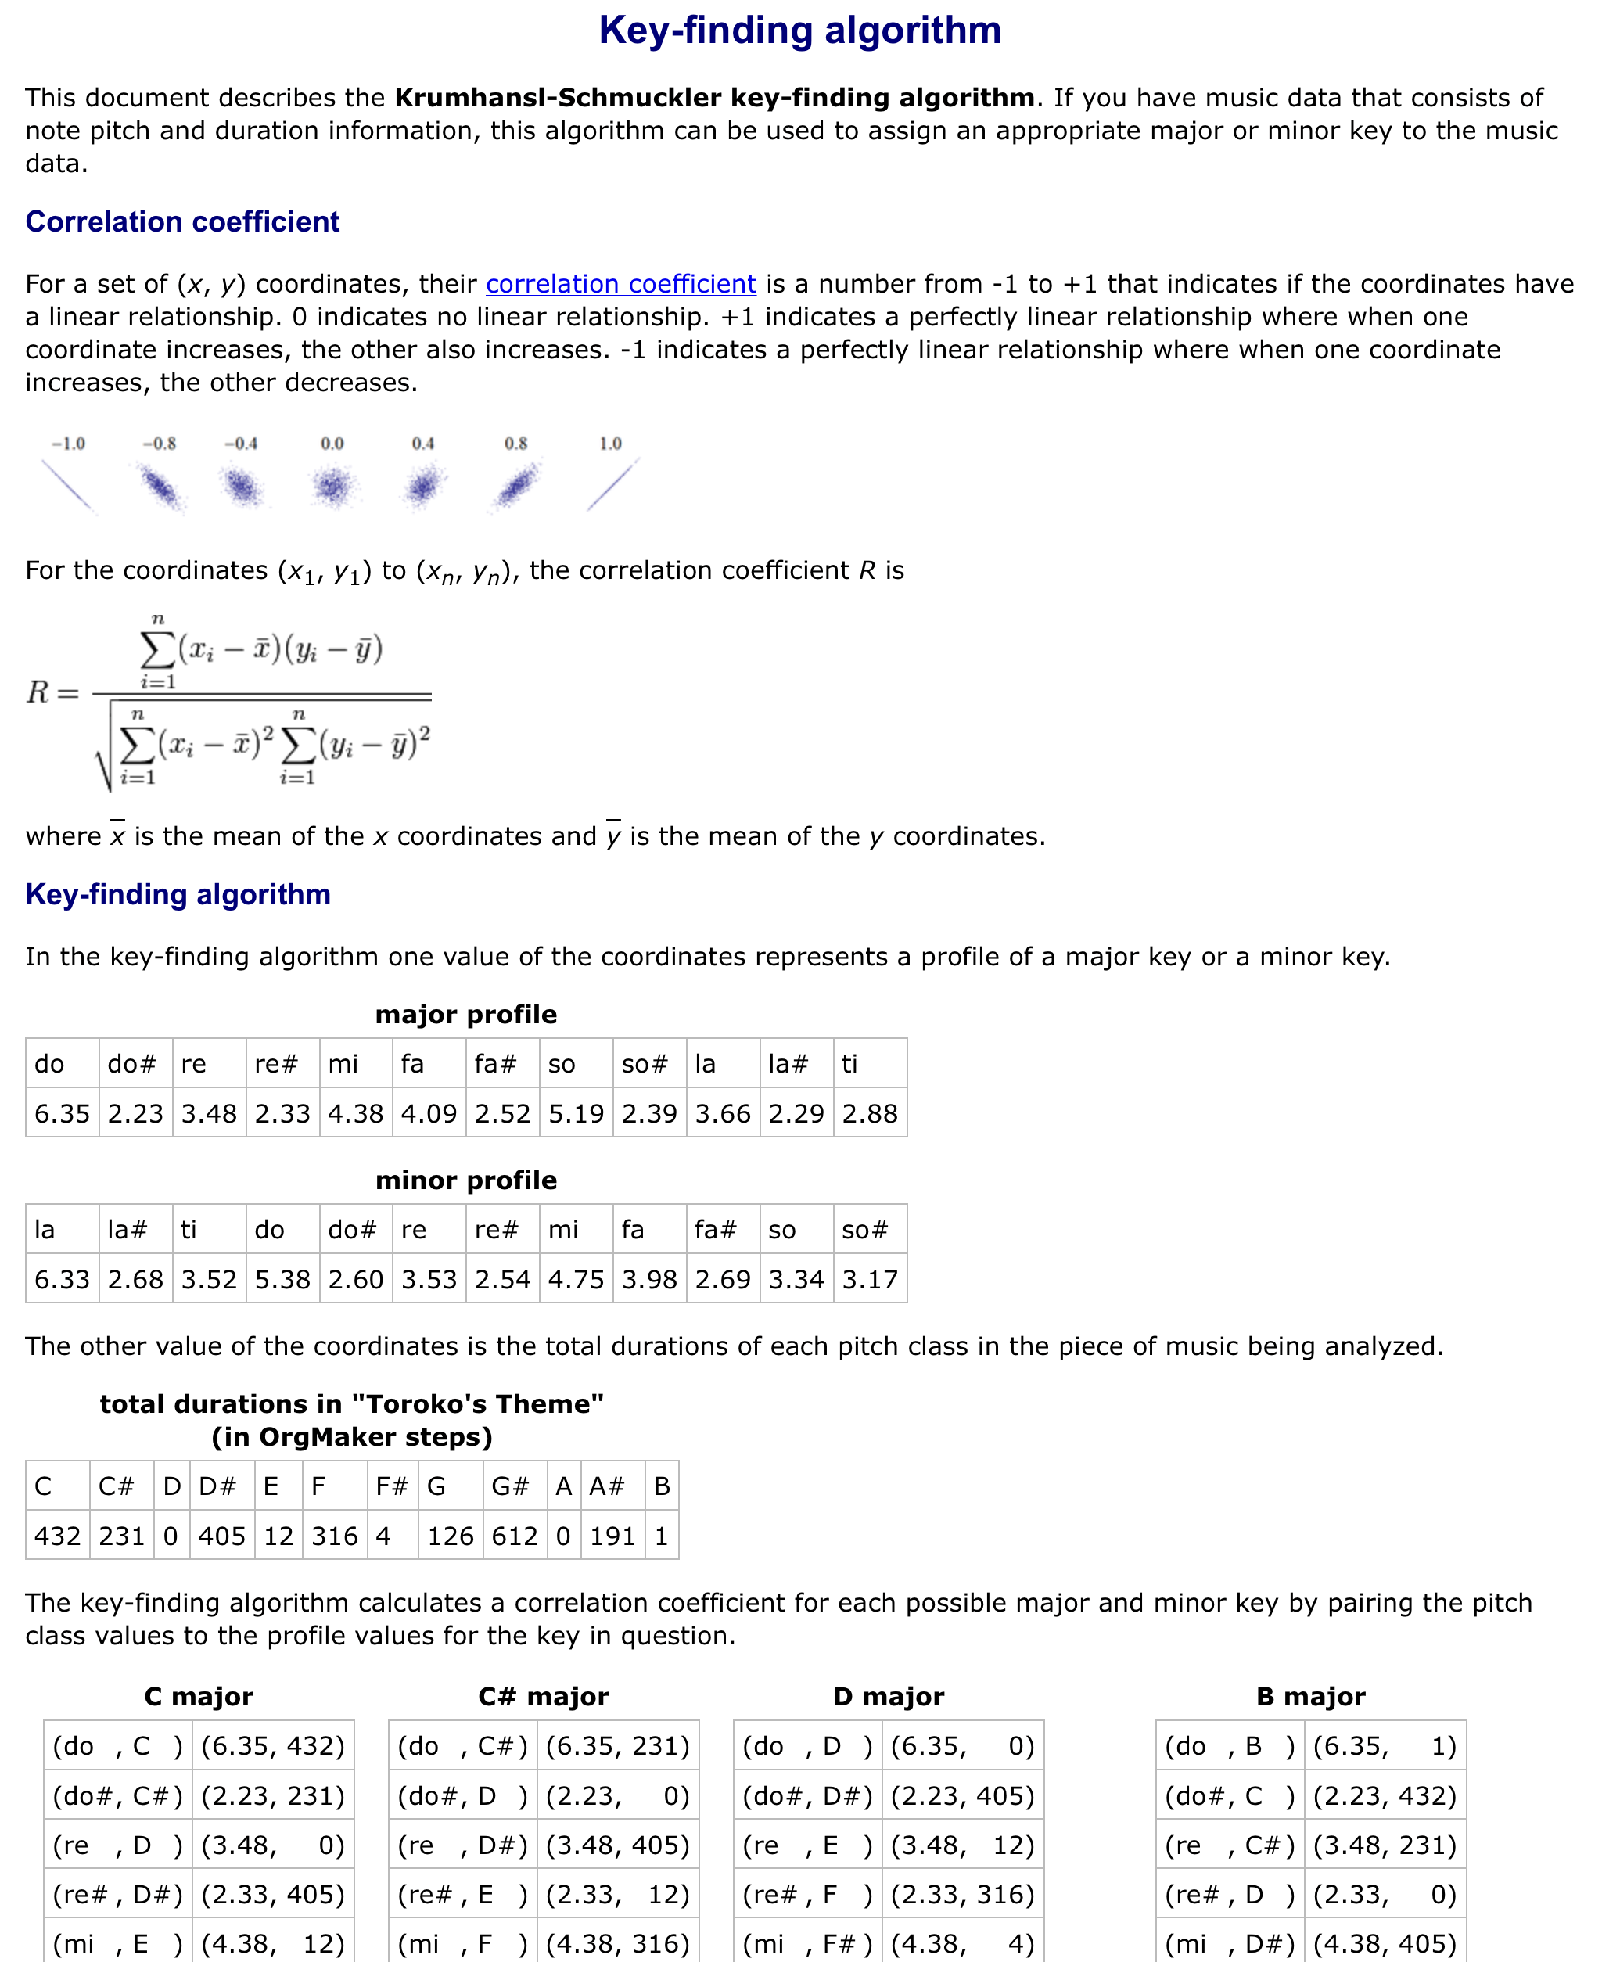
PoC: A bit of Data Science

Slide 10
Why Cloudera - Strategic Value
Integrated offering that accelerates time-to-market in a Cloud agnostic
fashion w/o sacrificing observability and data governance
Enables both Data Lakes and Data Science initiatives with multi-tenancy
and data sharing

Slide 11

Why Cloudera - Technical Value
Apache NiFi
Directed graphs and visual workflows that accelerate data pipeline construction
Ease of use – immediate error display, pending queue inspection, exception routing
Healthy ecosystem of pre-built processors
Provenance information along each hop for lineage tracking and data governance
Streaming
Self-contained platform for streaming – observability via SMM and integration with Spark and Flink
Avoids a loose collection of provisioning tools for Kafka such as is the case Conduktor and lenses.io
Support for python (via PySpark) for advanced Streams use cases (differentiator from Confluent)
Creativity Development Speed

