Slide 1
THE BUSINESS CASE
FOR SAFETY
Adding Value and Competitive Advantage
A Joint Initiative of OSHA, Abbott, and
The Center for Business and Public Policy
at Georgetown University
March 2005
Notes:
Project started as an outgrowth of our work together on Illinois Healthcare Initiative.
Needed a way to explain to Business Community – Business Owners -- Answer Questions
Why should I care about safety?
What does Safety Excellence look like?
Why is it important to me?
How does it add value and provide me with competitive advantage.
Real Business Cases (short case studies)
Tool to use a variety of ways
Presentation to Managers / Business Leaders, Chamber of Commerce, etc.
Case study for internal use/workshop for larger companies
Business School – interject into material
MBA students
Executive Education
Phase II
We hope to continue to add more cases to build our portfolio in different industries on difference subjects.
An suggestions --- let me know ----

Slide 2
WHY BE CONCERNED WITH SAFETY?
  Safety is good business
    Right thing to do…
      Employee morale / protection of most valuable resource
      Control costs (direct and indirect)
    Safety and health excellence correlates with business excellence (quality, efficiency, profitability)
Notes:
Our fundamental premise is Safety is Good Business – for 2 basic reasons –
Right thing to do
Add value / provides competitive advantage

Slide 3
EXCELLENCE IN SAFETY & HEALTH
Adds Business Value and Competitive Advantage …
Ability to compete
Enhanced Reputation
Access to Global Markets
Safety and Health
Cost and Risk Reduction
Employee morale
Improved quality
Improved efficiency
Improved productivity
Notes:
Thus, Safety and Health Add Business Value.
Figure shows many ways that Safety and Health can contribute to an organization’s Strategy.

Slide 4
INTEGRATED INTO THE BUSINESS…
Business Value
Linking steps
Safety and Health Principles
Corporate Image
Ability to Compete
Access to Global Markets
Employee Morale
Efficiency and
  Productivity
Product and
  Service Quality
Cost and Risk Reduction
Senior management commitment and involvement
Employee active participation
Shared goals and accountability
Defined roles and responsibilities
Common language
Effective communication
Right resources
Balanced performance measures
Knowledge sharing and information transfer
Safety is a core value of the company’s culture
A systems approach is taken toward safety
Safety is integrated throughout the company
Employees participate at all levels
Notes:
We know that for Safety (or any other function – Quality, etc.) to add value and provide competitive advantage it must be integrated into the business –
Into the way we do our business on a daily basis and into it’s long term view (Long Range Plan)

Slide 5
BARRIERS TO INTEGRATION
Too often:
Management has a reactive rather than proactive focus
Lack of understanding (vocabulary)
Risks & hazards are poorly communicated
Safety is considered a cost … not an investment
Cost/benefit analysis is rarely applied to justify the safety case
Retrofitting is never as cost-effective as designing it right initially
Notes:
These are common barrier we encounter in trying to integrate a culture of safety into a business –

Slide 6
VALUE CHAIN IMPACTS
Business Process
Procurement
Design
Manufacturing
Service
End of Life
Leverage supplier relationships
Safe and ergonomic processes
High quality and productivity
Customer good-will
Future assets
Notes:
Contributions to the business by integrating safety can occur throughout the value chain –

Slide 7
SAFETY IN THE VALUE CHAIN
Safety and Health issues must be managed throughout the product life-cycle.
The return on investment for Safety & Health decisions is greatest when the decisions are made early in the life-cycle.
Notes:
The value chain is a series (chain) of activities that includes all activities in the product life-cycle. When attempting to make improvements, each activities is investigated to determine what can be done to increase the value perceived by a customer. Activities may include inbound logistics, warehouse and storage, production, finished product storage, outbound logistics, marketing and sales, and customer service.

Slide 8
SAFETY EXCELLENCE MODEL requires…
Management
Commitment
Employee Involvement
Systems
Safety and Health
Site Leadership
Notes:
Excellence in Safety adds value and provides competitive advantage –
What does Excellence in Safety look like?
High quality safety programs have four key aspects common to them all –
Management Commitment
EE Involvement
Safety & Health site leadership
Strong Systems (Policies, Processes, Programs, Procedures)

Slide 9
MANAGEMENT COMMITMENT MEANS…
Valuing and caring for human resources
Demonstrating a visible commitment with continuous involvement
Setting high expectations and accountability for safety
Motivating proper behaviors through leadership
  “Walk the Talk”
Providing resources to affect change
Encouraging employee involvement
Notes:
Describing what we mean by Management Commitment
(All about “Leadership”)

Slide 10
EMPLOYEE INVOLVEMENT MEANS…
Shared ownership of and commitment to the program
Active support of the program
Accountability for one’s personal safety and that of his/her co-workers
Notes:
EE involvement and “Shared Ownership” of the program is fundamental to it’s success –
Without EE’s direct and continued involvement in the safety effort – the Best Processes, Programs, and Procedures are worthless –

Slide 11
WAYS TO INVOLVE EMPLOYEES…
Regular communication with employees on the subject of safety, risk, and hazards
Provide access to information
Provide ways to participate in the program
  e.g., worksite self inspections, safety and health annual evaluation process, incident investigation
Provide ways to report hazards, injuries and make recommendations to control hazards
Notes:
Many ways to involve EE’s in the safety effort.

Slide 12
SAFETY AND HEALTH SITE LEADERSHIP
Key Criteria
Multiple Roles
  Leader, Facilitator, Internal Consultant, and Change Agent
  Partner with Management
Placement and Organizational Structure
Authority and Responsibility to act when needed
Knowledge, Skills and Abilities
  Technical expertise
  People skills
Notes:
An area that is often overlooked
Site level safety leadership can be the “tipping point” for the program’s success.
Achieving “Excellence” or failure / mediocrity
Being
Credible with both management and EE’s
Competent (technically) and a motivated leader for the effort. Many times means the difference between success and failure.

Slide 13
SYSTEMS
Processes, Programs and Procedures
PLANNING
MANAGEMENT
SYSTEMS
INFORMATION
TRANSFER
CONSULTING
ASSURANCE
REGULATORY
ISSUE
MANAGEMENT
H&S POLICY
DEVELOPMENT
(DIRECT)
TRAINING
AND
DELIVERY
DIRECT
SERVICE
INTERNAL
AUDITS
STRATEGIC
PLANNING
EXTERNAL
AUDITS
INPUT INTO OTHER
POLICIES & STANDARDS
(INDIRECT)
NETWORK
COMMUNICATIONS
TOOL/PROCEDURE
DEVELOPMENT
-Incident investiaton
-Corrective Action
IDENTIFICATION
OF
BEST PRACTICES
CORPORATE
REPORTING
-METRICS
-BENCHMARKING
ISSUE
MANAGEMENT
HUMAN
RESOURCES
DEVELOPMENT
Abbott Environmental, Health & Safety
Notes:
A model we use at Abbott to describe what we mean by System –
These are “Core Job Responsibilities” for Safety Leadership whether at a plant, division, or corporate level.

Slide 14
SYSTEMS
Performance Metrics
Leading metrics
Trailing metrics
Attitudes
(set up conditions, behavior)
Incident or Near Miss
Program Elements
Physical conditions
Behavior (action)
- Perception surveys
Training
Accountability
Communications
Planning & Evaluation
Roles & Procedures
Incident Investigations
-Inspections
-Audits
-Risk assessments
-Prevention & control
-Observations
-Feedback loops
OSHA Recordables
Lost Workdays
Restricted Workdays
ORC Worldwide Metrics Taskforce
Notes:
To effectively manage anything –
You first must be able to measure it -- Safety is no different –
Historically – we have used after the fact “trailing indictors” (measuring “failures”)
Ideal situation is to develop a balanced scorecard of leading and trailing indicators – the Key is to correlate leading with trailing to measure the effectiveness of your efforts. Maximum value from metrics.

Slide 15
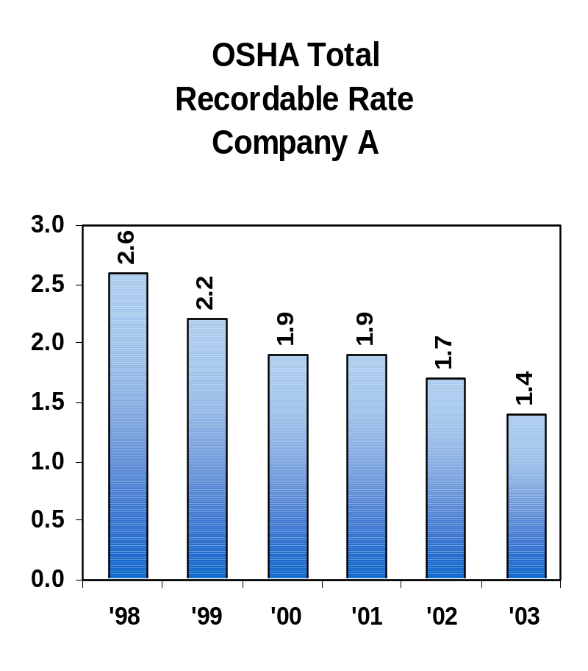
METRICS - TRAILING INDICATORS
Domestic Safety Performance
Injury / Illness 1998 – 2003
OSHA Total
Recordable Case Incident Rate
2003 Peer Company Data
3.50
3.00
2.7
2.8
2.4
2.5
2.50
1.7
1.8
1.8
1.8
1.9
2.00
1.50
1.2
1.4
1.4
1.4
0.9
0.95
1.1
1.00
0.50
0.00
B
C
D
E
F
A
G
H
I
J
K
L
M
N
O
P
Company A = 2003 Performance
Notes:
Example data for ,management
Start by conveying a clear message – GOOD or BAD
Trend (+) or (-)
How your performance compares with your peers –
Same industry
General industry (everyone)
“Best in Class” organizations

Slide 16


WHAT DO ACCIDENTS COST YOU?
Unseen costs can sink the ship!
Direct -
Insured Costs
“Just the tip of the iceberg”
Indirect - Uninsured, hidden Costs - Out of pocket
Examples:
1. Time lost from work by injured employee.
2. Lost time by fellow employees.
3. Loss of efficiency due to break-up of crew.
4. Lost time by supervisor.
5. Training costs for new/replacement workers.
6. Damage to tools and equipment.
7. Time damaged equipment is out of service.
8. Loss of production for remainder of the day.
9. Damage from accident: fire, water, chemical, explosives, etc.
10. Failure to fill orders/meet deadlines.
11. Overhead costs while work was disrupted.
12. Other miscellaneous costs (Over 100 other items of cost may appear one or more times with every accident)
13. Others? ________________________________
Unknown Costs -
1. Human Tragedy
2. Morale
3. Reputation
Notes:
Important to consider both Direct and Indirect Costs
You tend to forget about indirect costs because they are difficult to measure – but they can run between 2 to 6 times your direct costs

Slide 17

SALES TO COVER COSTS*
Accident Costs
1% Profit
2% Profit
3% Profit
$ 1,000
$ 100,000
$ 50,000
$ 33,000
$ 5,000
500,000
250,000
167,000
$ 10,000
1,000,000
500,000
333,000
$ 25,000
2,500,000
1,250,000
833,000
$100,000
It is necessary to sell an additional $250,000 in products or services to pay the cost of $5,000 annual losses
10,000,000
5,000,000
3,333,000
*Source: OSHA’s Safety Pays Web Site, 2004
Notes:
From the OSHA Safety Pays website.
Another way to view the negative impact of even one accident on the business –
If your profit averages 2% and Direct/Indirect costs total $5,000 then you need an additional ¼ million dollars in sales to break even --

Slide 18
IMPLEMENTING SAFETY EXCELLENCE
Assume all incidents are preventable
Assume all exposures/risks can be controlled
Hold management responsible and accountable for preventing injuries
Involve employees
Make working safely a condition of employment
Train employees to work safely
Promote off-the-job safety
Audit safety
Adapted from “Managing Safety: Techniques that Work for the Safety Pro”, DuPont
Notes:
Companies that have demonstrated excellence in safety performance generally have done these things.

Slide 19
SAFETY’S ROLE IN BUSINESS FUNCTIONS
FINANCE / ACCOUNTING
STRATEGY
OPERATIONS
SAFETY
and HEALTH
MARKETING / RISK COMMUNICATION
MANAGEMENT / ORGANIZATIONAL BEHAVIOR
The Center for Business and Public Policy at Georgetown University
Notes:
Safety too often is considered only an operations issue.
Safety & Health need to be framed in the entire business context.
Senior management understand business strategy and finance. Justifications for safety need to consider both the strategic and financial impacts.
Safety problems in the work place generally arise from not considering the organizational culture (e.g., productivity pressures) or from correctly marketing/communicating risks to employees.

Slide 20
SAFETY’S ROLE
Strategy
Providing a safe workplace is key to meeting business objectives
  Protecting reputation
  Attracting and retaining high potential employees
Notes:
These key concepts relate forming Safety’s Value from a business (school) context.

Slide 21
SAFETY’S ROLE
Financial
Financial cost/benefit analysis cases for safety must include the “true costs”
  Direct costs, and
  Indirect “Hidden” costs
    costs from high turnover rates, and
    costs avoided
Notes:
Important that we use financial tolls (Return on Investment (ROI) and Net Present Value (NPV), etc.) and language commonly used by industry / business to describe / communicate value.

Slide 22
SAFETY’S ROLE
Operations
Safety must be considered at every step in the value chain
  Designing safety into a process is cheaper than retrofitting for safety later.
To be able to effectively manage a program and improve safety… measurements must include:
  Both Leading and Trailing Indicators
  Leading indicators should correlate with trailing ones.

Slide 23
SAFETY’S ROLE
Management / Organizational Behavior
Leadership and employee empowerment are keys to creating a proactive safety culture.
  Senior management commitment is critical to improving safety
  Promote program results both internally and externally

Slide 24
SAFETY’S ROLE
Marketing & Communications
People are inherently biased when it comes to evaluating risks.
Safety managers must be able to effectively communicate the risks to:
    Engage senior management
    Affect employee behavior

Slide 25
REMEMBER…
You will achieve the level of
Safety Excellence…
that YOU demonstrate you want to achieve...

Slide 26
Final Thoughts…
“ Establishing a safety and health culture that leads to superior performance is not only the right thing to do or the socially responsible thing to do…
It is also the right economic approach.
Reducing workplace injuries and illnesses conserves critical resources and improves the use of those resources. It saves money, avoids unnecessary costs and ultimately maximizes returns on business investments.”
John Henshaw, Assistant Secretary of Labor, OSHA

Slide 27
CASE STUDIES
Notes:
These case studies have been designed to be used as either
Part of a PowerPoint presentation (tailored to a particular group) e.g. Construction Safety, Nursing Home.
Taught in a presentation / workshop format
Business School case study

Slide 28
CASE STUDIES
Review the impact of safety programs on the “bottom line” in several industries:
  Construction
  Foundry
  Healthcare (Nursing Homes)
  Auto Parts Manufacturing
  Insurance
  Pharmaceutical
Notes:
We are going to discuss how safety affected the bottom line – negatively and positively during the construction of 3 stadiums. We are also going to discuss how improvements to the safety programs reduced cost of workers compensation at 2 nursing homes. Finally, we will discuss how an OSHA intervention improved safety at an auto parts manufacturer.

Slide 29
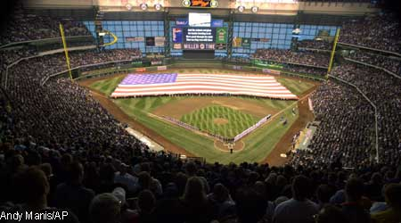
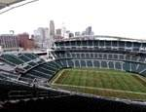
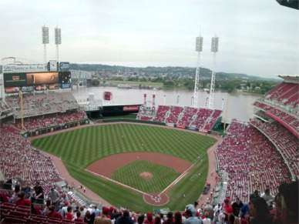
STADIUM CONSTRUCTION CASE STUDIES
A number of stadiums were built in the past few years in Region 5.
Notes:
SPEAKER: Explain what’s going on with stadium construction and why it is so hazardous.
Over the past 5 years several stadiums have been built in Region 5. Miller Park baseball stadium was built in Milwaukee, Paul Brown football stadium in Cincinnati; and Great American baseball park in Cincinnati.
These are huge construction projects – and can have hundreds of construction workers on site at any one time. Needless to say, these jobs are hazardous, and if adequate safety measures are not taken – serious events can occur.
A review of these projects will explain how one site suffered a catastrophic event and how safety projects at the other sites resulted not only in preventing employee deaths, but financial benefit to the owners.

Slide 30
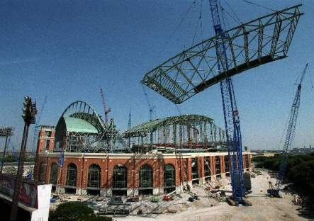
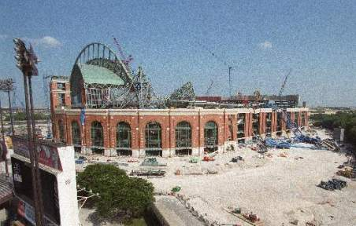
MILLER PARK STADIUM
3 workers killed
July 1999 crane collapse caused the deaths of 3 construction workers.
Hours before collapse of “Big Blue”
After collapse of “Big Blue”
Notes:
Discuss what happened at the site.
In July 1999 three workers were killed in a crane collapse during the construction of Miller Park baseball stadium in Milwaukee.
PRESS RELEASE:
OSHA is issuing willful and serious citations against three firms, Mitsubishi Heavy Industries America, Inc., Lampson International Ltd., and Danny's Construction Company, Inc., with proposed penalties of $240,500, $131,300, and $168,000 respectively.
OSHA's investigation focused on general requirements relating to safe operation of cranes and personnel platforms as well as conditions which may have contributed to the crane collapse. The citations relate to several alleged OSHA violations at the time of the crane collapse as well as unrelated conditions which existed earlier in the day.
Mitsubishi Heavy Industries, under contract with the project's general contractor HCH, was responsible for installing the retractable roof for the Miller Park baseball stadium and subcontracted with Danny's Construction as the ironworker subcontractor to erect the roof, and Lampson as the subcontractor providing crane services on the project. The collapse occurred while the crane known as "Big Blue" was lifting a section of the stadium roof, "4R block 3," weighing over 450 tons.
OSHA issued willful citations to Mitsubishi alleging that the crane's rated load was exceeded when 4R block 3 was first lifted off the ground during the morning of the lift; that workers were not kept clear of the suspended 450 ton load during the morning of the lift and that workers were hoisted in personnel platforms when weather conditions were dangerous.

Slide 31
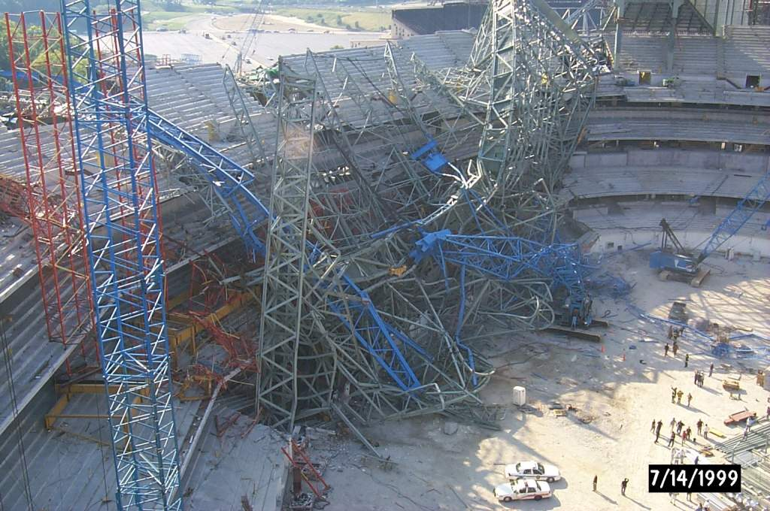
The destruction was extensive

Slide 32
The Sad Results
Delayed the opening for One Year
$100 Million in repairs
Three construction workers killed, several others injured
On Dec. 1, 2000, a Milwaukee County jury awarded $94 million in punitive damages and $5.25 million in compensatory damages to the families of three ironworkers killed in the accident. Although the families have been paid $27 million for their loss, the issue of the large punitive damage award is under appeal and in the news every few weeks.

Slide 33
This did not start this way
Prior to April of 1999 the Miller Park project was at 27% of premium dollars for injuries at the site.
As the need to accelerate the production to make the opening day deadline, a dispute over site arose and the then safety director left.
In the next few months there were serious falls, dropped loads and the death of three workers.

Slide 34

MILLER PARK STADIUM
RESULTS
Original budget
$ 322M
Final Cost: $ 850M+?
  $413.9M (construction)
  $100M (repairs)
  $27-99M (jury awards)
  $330.8M (interest on bonds)
Litigation is ongoing with over a Hundred Million Dollars in claims still unresolved.
Notes:
The original budget for Miller Park was $322M –
Due to the crane collapse – the final cost, which is still unknown, was $413.9M for construction, $100M for repairs from the collapse (insured). In addition – the insured will have between $27M and $99M for jury awards to beneficiaries. Also, the interest on the bonds turned out to be more than the original construction cost.

Slide 35
Other Stadium Construction Deaths
Milwaukee (WI) County Stadium – 1953
  3 workers killed
Rosemont (IL) Horizon Arena – 1979
  5 workers killed
Seattle (WA) Kingdome – 1994
  2 workers killed
Olympic Stadium – Atlanta (GA) - 1995
  1 worker killed
Notes:
Milwaukee County Stadium – 1953
3 workers killed (2 fell 90 feet when container failed while being hoisted by crane) (1 struck-by beam that fell on him)
Rosemont (IL) Horizon Arena – 1979
5 workers killed and 16 injured when a roof collapsed spanning 288 feet
Seattle (WA) Kingdome – 1994
2 workers killed (fell from 225 feet from basket while sandblasting the ceiling – basket struck the ceiling and an extension failed)
Olympic Stadium – Atlanta (GA)
(a man was welding a bank of lights in a light tower – fell 50 feet)

Slide 36
Other Stadium Construction Deaths
Bank One Ballpark – Phoenix (AZ) - 1996
  1 worker killed
Philip’s Arena – Atlanta (GA) - 1998
  2 workers killed
University of Florida – Gainesville (FL) – 2002
  1 worker killed
Ford Field – Detroit (MI) - 2002
  1 worker killed
Notes:
Bank One Ballpark – Phoenix - 1996
1 worker killed (electrocuted when a crane struck a 7,200 volt line)
Philip’s Arena – Atlanta - 1998
2 workers killed (a 19-ton concrete beam fell as it was being hoisted into place in the upper deck)
University of Florida - Gainesville – 2002
1 worker killed (struck by a piece of steel causing him to fall 60 feet)
Ford Field – Detroit Lions - 2002
1 worker killed (painter fell from a hydraulic lift)

Slide 37
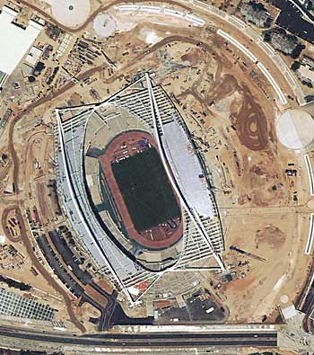
It is not just in the USA
19 workers died building the Olympic Facilities in Athens for the 2004 Summer Games.

Slide 38
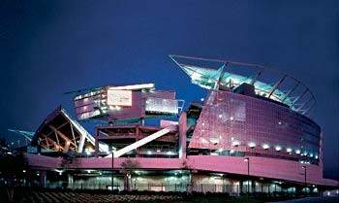
PAUL BROWN STADIUM
No Fatalities
OSHA Partnership
  Labor/Management Partnership
Construction took 2-1/2 years and cost $453 million.
Notes:
EXPLAIN CONSTRUCTION OF PAUL BROWN STADIUM – HOME OF THE BENGALS – AND THE MASTER PROJECT. FOCUS ON THE SAFETY PROGRAMS.
Paul Brown is a football stadium in Cincinnati (Bengals). It was constructed in 2.5 years for $453M.
OSHA MASTER Project: Labor/management form a team to perform continuous monitoring and oversite of safety performance.
Instituted 6 foot fall rule, etc.
Stadium Facts:
Dimensions: The stadium covers approximately 22 acres and is 157 feet high.
Seating Capacity: The stadium has 65,535 seats on three levels, including 7,600 club seats and 114 private suites.
Playing Surface: Natural turf, heated to extend growing season and prevent frozen field.

Slide 39
PAUL BROWN STADIUM
RESULTS
Significant decrease in expected injuries:
  0.95 lost time rate v. 4.0 for construction*
Significant program savings
  $4.6 million less in workers comp and liability cost than would be expected.
No fatalities!
  Only one fall injury
*A job-lost time rate of 0.95 is determined first by dividing the number of job-lost time incidents by the number of employee man-hours and then by converting it to an annual rate for 100 full-time employees. The recordable rate of 5.48 is determined in a similar way but considers the total number of OSHA recordable incidents.
Notes:
DESCRIBE THE OUTCOMES OF THE PARTNERSHIP

Slide 40
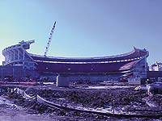
GREAT AMERICAN BALLPARK
No Fatalities
OSHA Partnership
Estimated savings from Owner Control Insurance Program was over $3 million (1999-2003).
Notes:
7/7/00: Great American Insurance purchases the naming rights for the Reds' new ballpark. The Reds' new home will be called Great American Ball Park.
8/1/00: Demolition begins with the destruction of the walkway connecting Cinergy Field, the Firstar Center and the East parking lot.
8/1/00: Construction begins on Great American Ball Park.
Photo shows 6/01: portion of what will be the left field seating area takes its shape in poured concrete
Stadium FACTS:
Seating capacity: 42,059

Slide 41
GREAT AMERICAN BALLPARK
RESULTS
After 1.2 million construction hours, a job-lost time rate of 0.8
Estimated savings from Owner Control Insurance Program (July 1999-May 2003) was $3.125 million (project is on-going until July 2005)

Slide 42
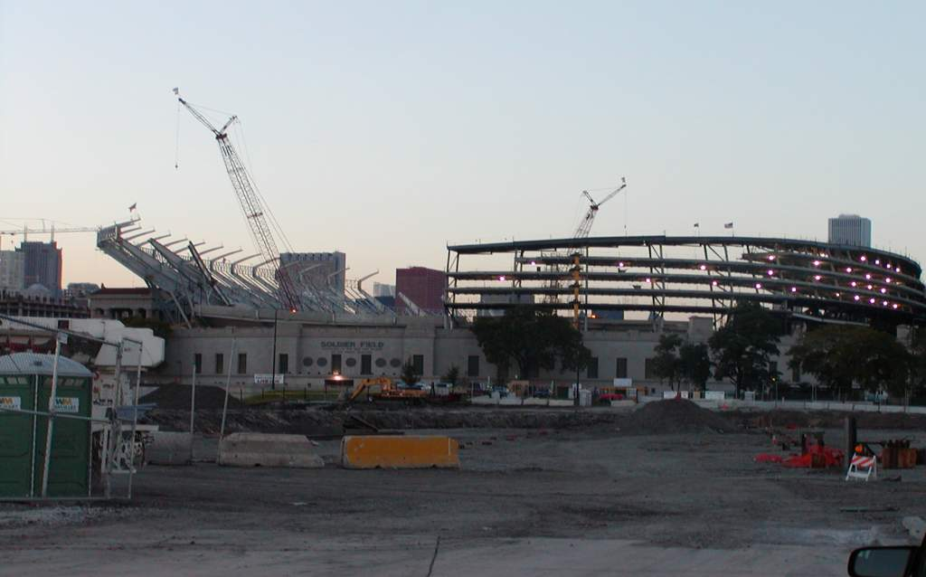
Soldier Field

Slide 43
Results
The Days away from work cases were at 1.7 per 100 person years, the national average was 3.4.
This partnership has demonstrated the cooperative effort that can exist between labor unions, construction management, state consultation, insurance carriers/brokers and OSHA.

Slide 44
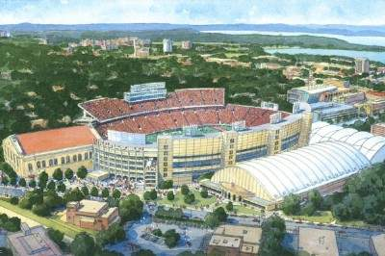
Camp Randal Renovation
University of Wisconsin Madison

Slide 45
The results at Camp Randall
The first year analysis of the OSHA partnership showed a very low rate of injury with a 0.0 lost time incident rate, well below the national average of 3.8 per 100 employees.
The total case incidence rate of 4.5 per 100 employees below the national average of 7.1 per 100 employees.
The insurance carrier indicates that the costs are well below half of those expected for the industry.

Slide 46
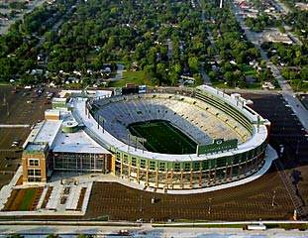
Lambeau Field
No Fatalities
Expansion of the existing Stadium, completed on time with construction and football coexisting for two seasons.

Slide 47
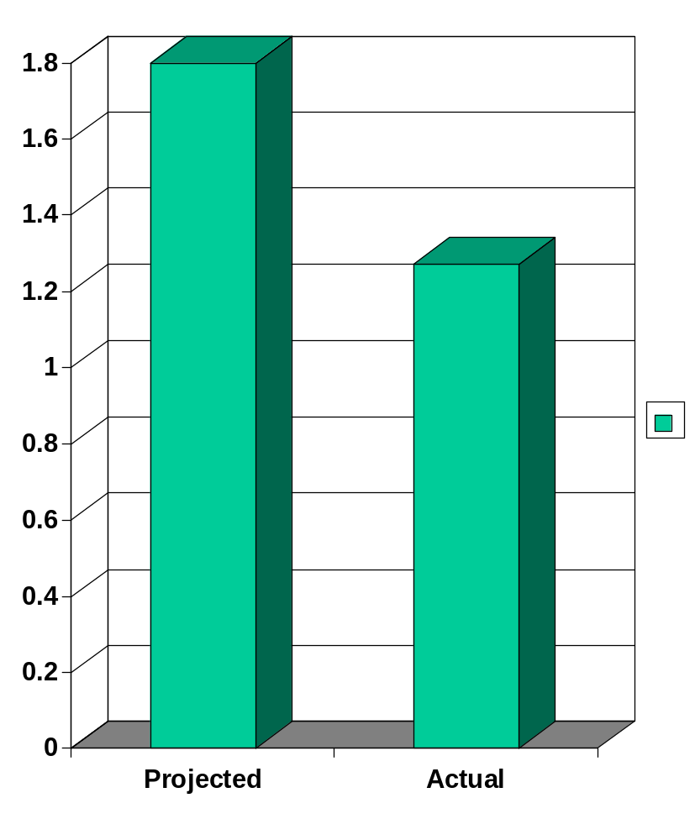
Costs of Lambeau Stadium Injuries
Projected $1.8 Million
Actual incurred costs including reserves
$1.27 Million
A savings of over a half a million dollars

Slide 48
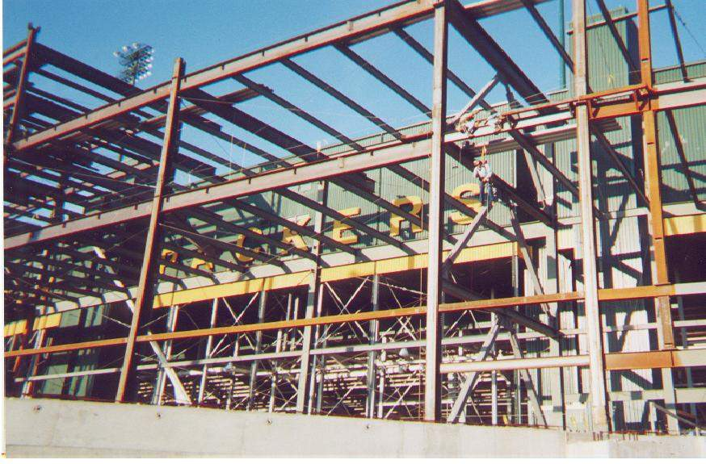
This fall could have been a fatality

Slide 49
WISCONSIN ALUMINUM FOUNDRY
Workers Compensation Loss Summary
200
500,000
166
388,970
400,000
150
300,000
NUMBER OF CLAIMS
94
100
88
COST OF CLAIMS
200,000
50
110,012
91,059
23
100,000
13,814
0
0
2000
2001
2002
2003
(4 months)
# CLAIMS
$ CLAIMS
Notes:
This company recognized the problem in 2000. They began implementing controls and redesigning operations. They have steadily increased safety and health performance reducing injuries and cutting comp costs. They are a part of a Foundry Partnership in Wisconsin and agreed to share their experience with OSHA and other foundries in the area.

Slide 50
WISCONSIN ALUMINUM FOUNDRY
Musculoskeletal (MSD) Disorder Cost Analysis
1-1-99 thru 10-1-03
Body Part | Number | Avg. Cost | Cost Range
Back | 128 | $2,285 | $81 - $48,851
Arm/Wrist | 39 | $4,941 | $79 - $38,638
Shoulder | 29 | $5,017 | $59 - $52,532
Notes:
Estimated cost of injuries 99 to 10/03 - $596,000
Total cost of controls in example in excess of $1 Million. As you will see the controls and systems implemented greatly reduced injuries and illnesses, improved quality and increased productivity. The company claims they recovered costs on all improvements within one year.

Slide 51
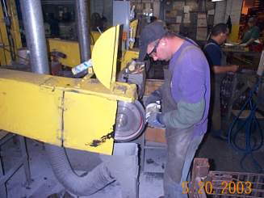
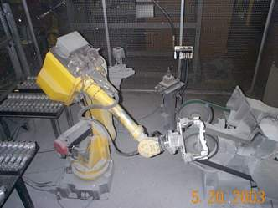
BEFORE
AFTER
PROBLEM: Employees in the Finishing Department were sanding 500-1000 castings with many hand movements. The employee must support the weight of the casting (2-10#) while rotating the casting.
SOLUTION: One robotic sander installed.
COST: $176,000
COST RECOVERY TIME: 6-12 months
BENEFITS: Eliminated strain from repetition and force, increased productivity.

Slide 52
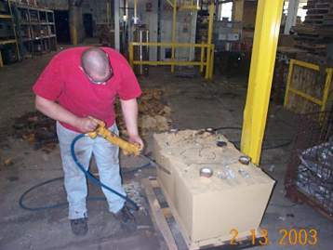
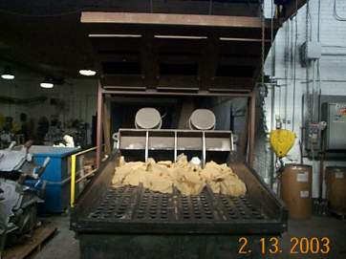
BEFORE
AFTER
PROBLEM: Employees were required to use a jack hammer to remove and break up air set core from castings. Stressors included vibration & bending over for 4-8 hrs/day.
SOLUTION: A core lump crusher has been purchased to eliminate the use of the jack hammer.
COST: $51,000
COST RECOVERY TIME: 8-12 months
BENEFITS: Eliminated strain from repetition, vibration and poor posture, and increased productivity and recovery rate.

Slide 53
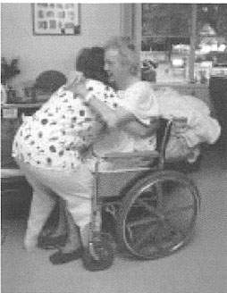
NURSING HOME CASE STUDIES
Historically, nursing homes have high injury rates.
Serious
injuries are caused
by lifting residents.
Notes:
BRIEFLY DESCRIBE HOW NURSING HOMES HAVE HIGH RATES OF INJURIES – PRIMARILY DUE FROM RESIDENT HANDLING.

Slide 54
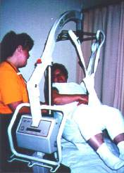
WYANDOT COUNTY, OHIO NURSING HOME
History
  Lift equipment installed 1997
  No-lift policy instituted October 2000
Notes:
Initial lift equipment was in place January 1997.
A no-lift policy went into effect October 2000.
This nursing home is written up in Appendix A of the Guidelines for Nursing Homes, OSHA pub #3182, 2003

Slide 55
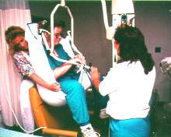
WYANDOT COUNTY NURSING HOME
RESULTS
Outcome
  No back injuries since 1997
  Decreased workers compensation
  Less turnover
A total investment of $155,000 resulted in no back injuries during the past 5 years.
Notes:
While most nursing homes can not invest this much money, nor do they necessarily need to as we will see in the next example, the point of this example is the company saw a return on their investment within two years. They have eliminated most injuries, decreased workers comp costs, decreased turnover and improved patient care.

Slide 56
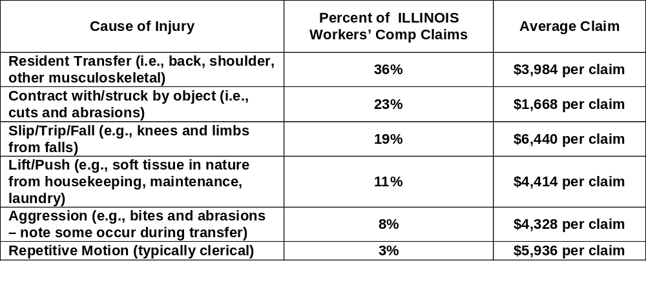
ILLINOIS NURSING HOME INJURY EXPERIENCE
Hazardous Work: Average nursing home injury and illness rate was 14.2 per 100 full time employees*
*Injury data for the first six months of 2003 provided by Life Services Network Association, a provider of Workers’ Compensation insurance for the non-profit long-term care members of its network
Notes:
As of 2003 here are the average costs of comp claims for nursing homes provided by an insurance carrier that works primarily with nursing homes.

Slide 57
COUNTRYSIDE (ILLINOIS)CARE
NURSING HOME
Addressed resident handling injuries
  $24,000 for lifting devices
  Enforcement of rules
Outcomes
  2002: 76 claims: $115K paid out in comp
  2003: 4 claims: $ 4K paid out in comp
Notes:
COUNTRYSIDE IS A NURSING HOME IN AURORA. THEY ARE JCAHO CERTIFIED.
Countryside nursing home wanted to address resident handling injuries that were not only costing them money, but affect resident care.
They nursing facility purchased $24,000 in lifting devices. They also started focusing on behaviors – how were the CNAs doing their job. Importantly, the nursing home enforced the use of lifting devices. For example, if you did not use a lift, you were given 3 days off. This was policed by lifting committee members.
This home implemented their program in a little over 6 months. Even with a more modest approach they saw similar reductions to Wyandot County Nursing Home in Workers Compensation costs, turnover and claims. Patient care improved. The Illinois Department of Public Health gave them a report with no violations for the nursing home. Their safety and health program is addressing all aspects of the home.
Countryside has just been accepted as a SHARP participant.

Slide 58
AUTO PRODUCTS MANUFACTURING (APM) CORPORATION
1988-1994: company growing rapidly
350-400 of the 425 employees were temp workers
OSHA referral from local hospital - treating 2-6 injuries from plant daily
Notes:
APM was a fast growing company with a good market for their product.
In order to cut costs the company eliminated the union at the plant. They replaced the workers with temporary labor employees from Temp Agencies. They also cut down on middle management and continued to add processes and equipment to the already crowded plant.
As a result of high turnover, lack of training and oversight the quality of the product suffered and injury rates skyrocketed. Some Temp Agencies refused to provide any more workers. The company was forced to bus workers in some from 2 hours away to get full coverage in the plant.

Slide 59
APM: OSHA RECORDABLES FOR 1993
 | APM |  | Just-In-Time Labor |  | Combined
 | LWDI* | Incident | LWDI | Incident | LWDI | Incident
Recordable | 7 | 57 | 62 | 88 | 67 | 160
Rate | 1.8 | 14.8 | 16.1 | 22.8 | 17.4 | 41.5
Private Industry, 1992: 3.9 LWDI Incident Rate, 8.9 OSHA Recordable Cases
All Manufacturing, 1992: 5.4 LWDI Incident Rate, 12.5 OSHA Recordable Cases
*LWDI rates have since been replaced by Days Away, Restricted, Transferred (DART). This change was made to improve the information collected about the incidence of occupational injuries and illnesses.
Notes:
When data were collected, the measure was LWDI. This standard has since been replaced with Days Away, Restricted, Transferred (DART) Rate to improve the information collected about the incidence of occupational injuries and illnesses

Slide 60
APM
RESULTS
OSHA inspection conducted in 1995
  Company fined $1.2M
  Willful violations
Under new management in 1997
  Incident rate: 9.8 versus 41.5 (1993)
  12-month period with no loss time injuries
Notes:
As a result of the referral from the Doctor; OSHA conducted an inspection. The company agreed to implement a safety and health program. Customers also intervened over the quality of the product and found a buyer for the company. Significant changes have been implemented at at the plant.

Slide 61
BLUE CROSS BLUE SHIELD Rhode Island
OFFICE ERGONOMICS
According to OSHA’s statistics, MSDs (carpal tunnel syndrome, tendonitis, and back injuries) are frequent and expensive
  34% of all lost workday incidents
  $1 of every $3 of workers comp
Improved ergonomics program
  Increased evaluations
  Worked with every department internally
  Worked with furniture vendors and WC carrier
Notes:
Ergonomic injuries can occur anywhere. Here is an example of an office environment where MSDs were a problem. This is one of the examples from the OSHA Web site. This company is keenly aware of the cost of injuries. They reviewed their data and took steps to address problem areas. They implemented an ergonomics program.

Slide 62
BLUE CROSS BLUE SHIELD RI
RESULTS
Year | Ergo Evaluations | MSD WC Cases w/ Lost Days | Lost Work Days
1999 | 270 | 8 | 345
2000 | 480 (+77%) | 6 (-25%) | 104 (-72.5%)
2001 | 584 (+21.7%) | 4 (-33%) | 91 (-12.%)
2002 | 498 (-14.7%) | 1 (-75%) | 89 (-2.2%)
Notes:
As you can see they were very successful in reducing the number of cases. As part of their program they did evaluations of work stations and addressed any issues they found. By addressing the work stations and their setup they were able to quickly make significant improvements.

Slide 63
ABBOTT
FLEET SAFETY
Sales force exposure is high risk and low profile
  Non-traditional focus area for safety
  22,000 sales representatives worldwide
    4,500 sales representatives in Pharmaceutical Products Division (Largest Domestic Division)
Program targeted new hires, mid-level managers, and high-risk drivers
  One-day training provided (morning in class, afternoon behind-the-wheel)

Slide 64
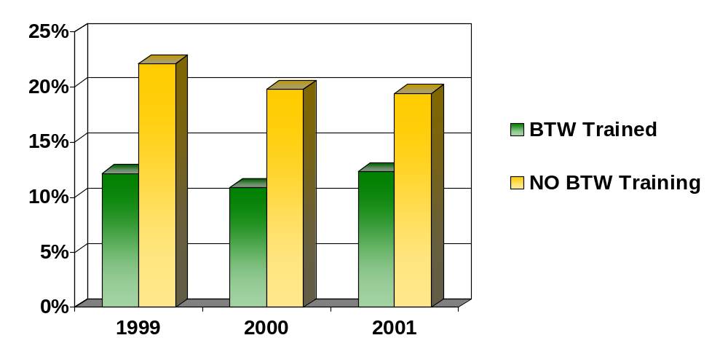
ABBOTT
FLEET SAFETY RESULTS
Trained vs. Untrained
BTW – Behind-the-Wheel
Notes:
Prior to 1999 no “Behind the Wheel” training was
being provided.

Slide 65
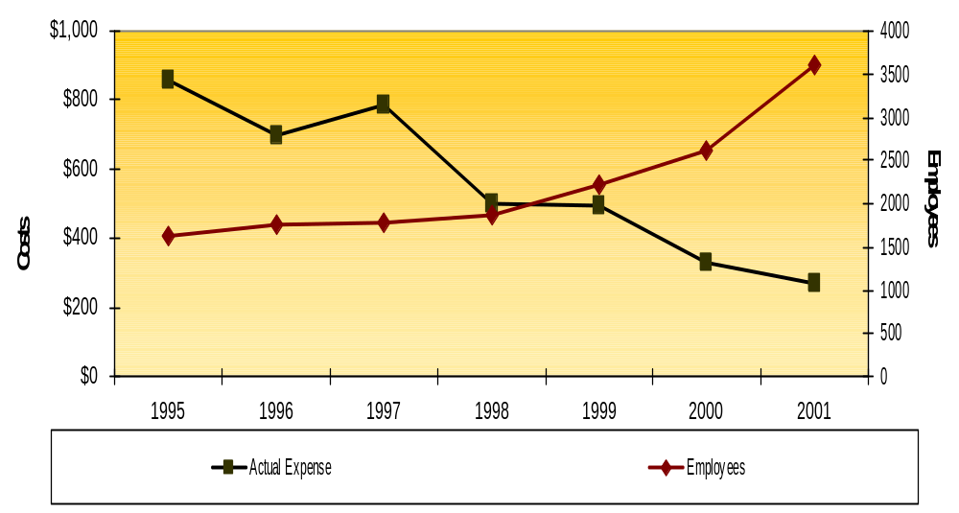
ABBOTT
FLEET SAFETY RESULTS
3rd Party Liability & Workers Compensation Expense
Cost Per Employee - 1995-2001

Slide 66
ABBOTT
ERGONOMIC IMPROVEMENTS IN MANUFACTURING
New product line (A pump) similar to old product (X pump)
Cheapest alternative is to design new line similar to old line
Capital costs for A-pump line: $100,000
Additional investments in Ergonomic material handling controls: $20,000
  Portable lifting tables, product handling turntables, single shelf product carts, conveyor systems, foot rests, ergonomic chairs, automated presses, tool fixturing, and grip enhancements

Slide 67
ABBOTT RESULTS
X pump line manually intensive
  2000: 4 WC incidents $122.0 K (total)
  2001: 1 WC incident $22.0 K
  2002: 1 WC incident $0.8 K
  2003: 1 WC incident $2.5 K
Ergonomics were incorporated in at the design phase of the project

Slide 68
ABBOTT
INDUSTRIAL HYGIENE IN PROCESS DESIGN
Previously outsourced process step for active pharmaceutical ingredient (API) to Third Party Manufacturer (TPM)
Production unit lacked appropriate process containment equipment
Industrial hygiene analysis financially justified purchase of potent API process equipment
  TPM: ~$450 K annually
  In-house:~$100 K in capital
  ~$150 K annual savings
Industrial Hygiene program was key in our ability to take advantage of this strategic opportunity

Slide 69
This slide intentionally
left blank.

Slide 70
SAFETY IS NOT AN EXPENSE --
IT IS AN INVESTMENT

