Slide 1
Why the Future of Lending Isn't About Money, It's About Trust
Every financial system is built on one invisible asset.
The core lending journey, end to end
Register → Login → KYC → Deposit → Borrow → Repay
Trust
PrimeLendRow · Product Walkthrough
PrimeLendRow

Slide 2
PrimeLendRow
THE MVP JOURNEY
Six steps, one connected flow
01
02
03
04
05
06
Register
Login
KYC
Deposit
Borrow
Repay
Email + OTP
Email or username
ID · liveness · wallet
Fund the pool
Apply for a loan
Pay via PayPal
Everything before Deposit is single-user setup; Deposit, Borrow, and Repay are where real pesos move through the pool.

Slide 3
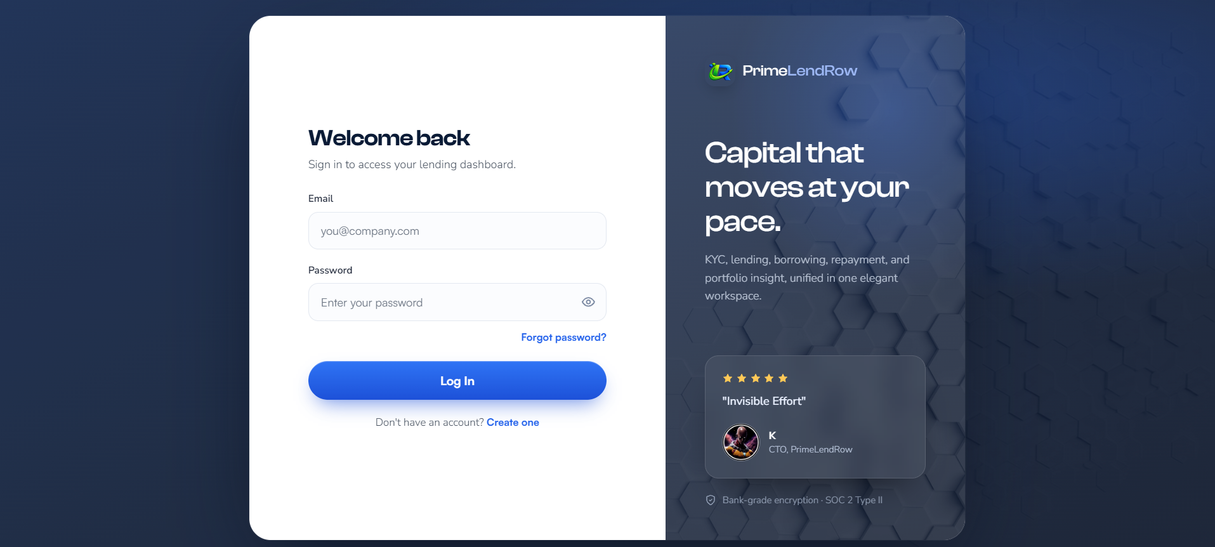
PrimeLendRow
STEP 1–2 / 6
STEP 1–2 · ACCOUNT
Register & Login
• Create an account with an email, username, and password.
• An OTP sent by email must be verified before the account exists.
• Starting state: Role Pending · Credit Score 50 · Wallet Not Connected · KYC Not Submitted.
• Once logged in, a Pending user can view pool stats and manage settings — lending, borrowing, and guarantor actions stay locked until KYC clears.

Slide 4
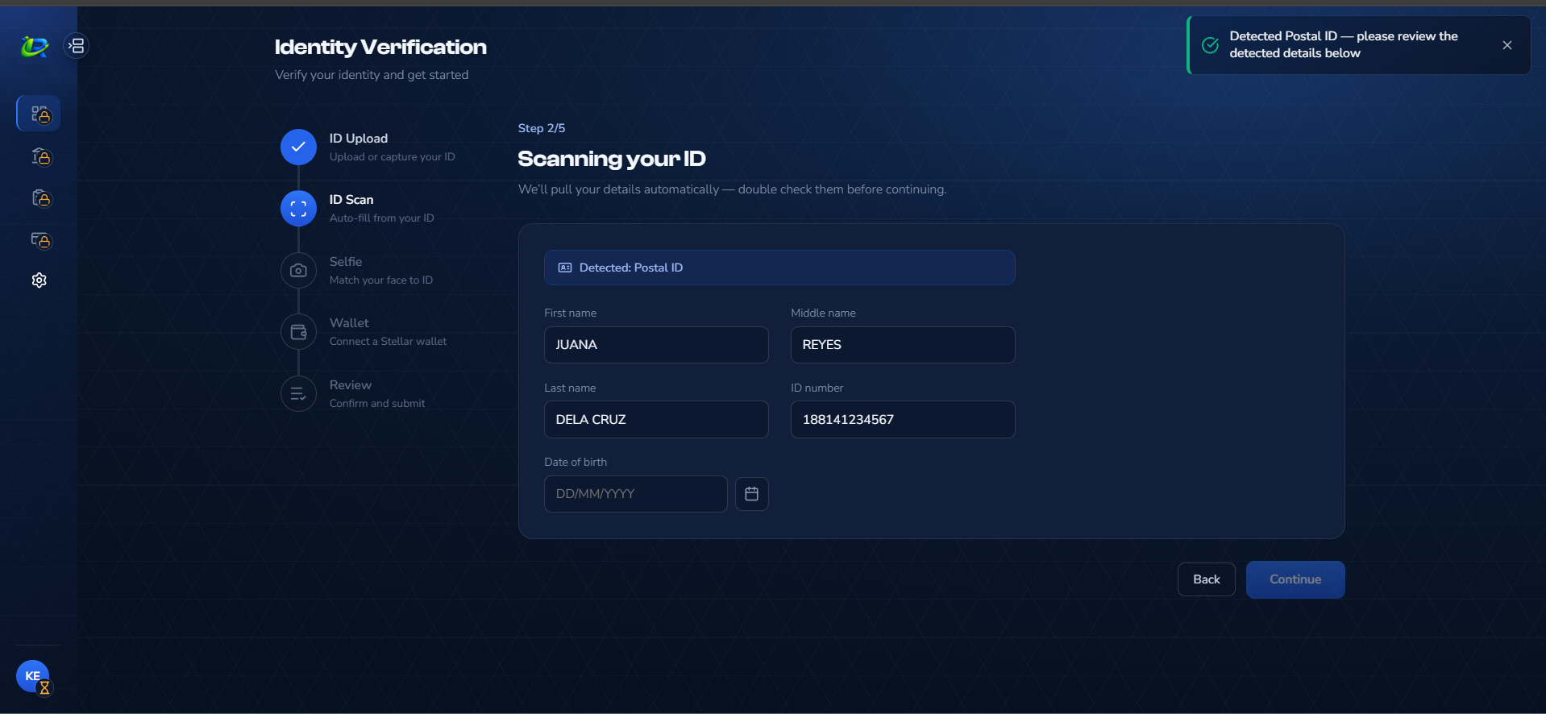
PrimeLendRow
STEP 3 / 6
STEP 3 · IDENTITY
KYC Verification
• A 5-step wizard: ID upload → OCR scan → liveness + face match → connect wallet → review & submit.
• Supports PhilSys ID, Driver's License, Passport, and Postal ID; OCR auto-fills name, DOB, and ID number for review.
• A live blink challenge plus face-match against the ID portrait confirms it's really the applicant.
• The Stellar wallet connected here becomes the account's KYC-verified wallet.
• Admin approval flips the role: Under Review → Approved → Role = User.

Slide 5
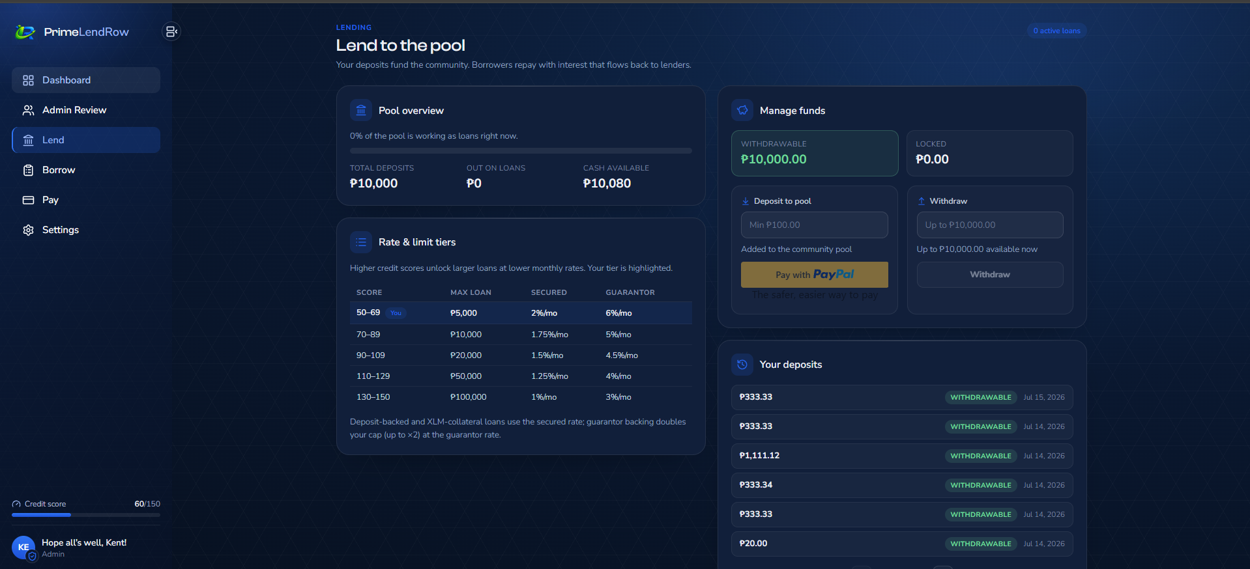
PrimeLendRow
STEP 4 / 6
STEP 4 · LENDING
Deposit to the Pool
• Deposits are never refused — funds join the shared community pool and become Withdrawable.
• Rate & limit tiers scale with credit score, from ₱5,000 at 6%/mo (score 50–69) up to ₱100,000 at 3%/mo (130–150).
• Deposit-backed and XLM-collateral loans use the secured rate; guarantor backing can double a member's cap.
• Deposits fund the community — borrower interest flows back to lenders; PayPal is the deposit rail.

Slide 6
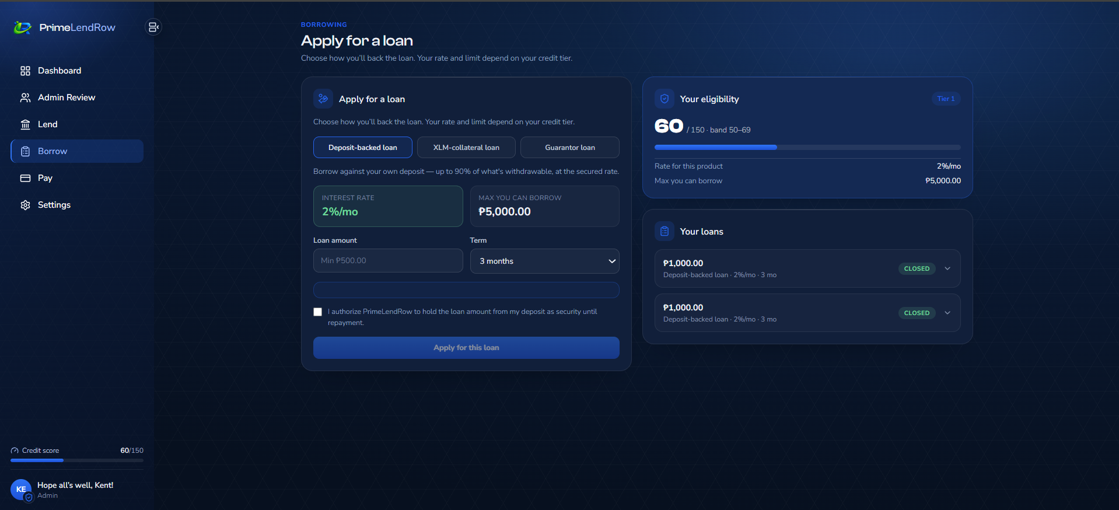
PrimeLendRow
STEP 5 / 6
STEP 5 · BORROWING
Apply for a Loan
• Three products: Deposit-backed loan, XLM-collateral loan, and Guarantor loan.
• Eligibility, rate, and max loan size come straight from the member's credit-score tier.
• Borrower sets the amount and term and authorizes the deposit hold that secures it.
• Past and active loans are tracked on the same screen, with status through to Closed.

Slide 7
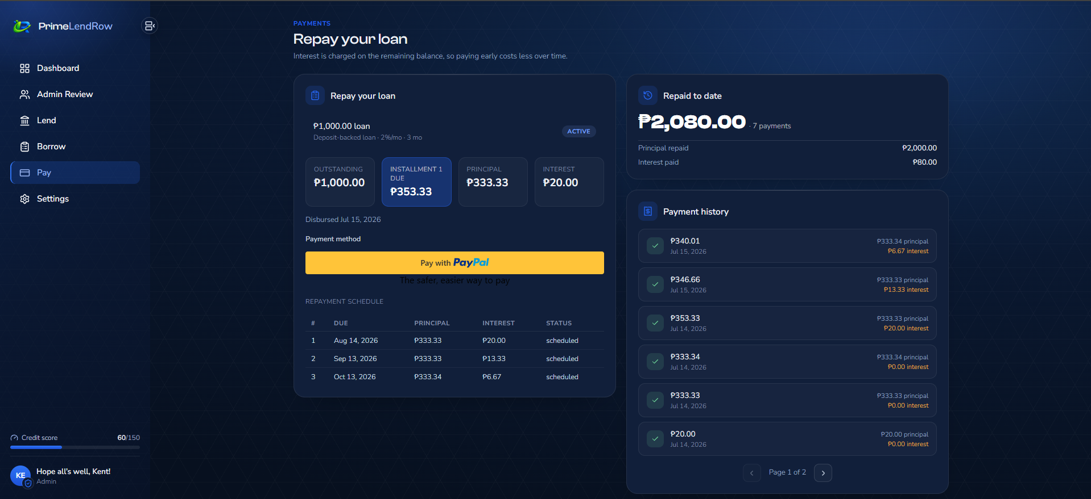
PrimeLendRow
STEP 6 / 6
STEP 6 · REPAYMENT
Repay the Loan
• A diminishing-balance schedule is generated per loan — interest shrinks as principal is repaid.
• Repayment is submitted through PayPal against the current installment.
• Every payment updates the outstanding balance immediately, split into principal and interest.
• Full payment history and repaid-to-date totals stay visible for the life of the loan.

Slide 8
PrimeLendRow
PrimeLendRow
One flow, fully connected.
Register → Login → KYC → Deposit → Borrow → Repay — every step above ships in the MVP.
• Guarantor participation, default handling, and Stellar blockchain anchoring build on this same spine next.
• Full detail: README.md (workflow) and ARCHITECTURE.md (system design), in the project root.

