Slide 1
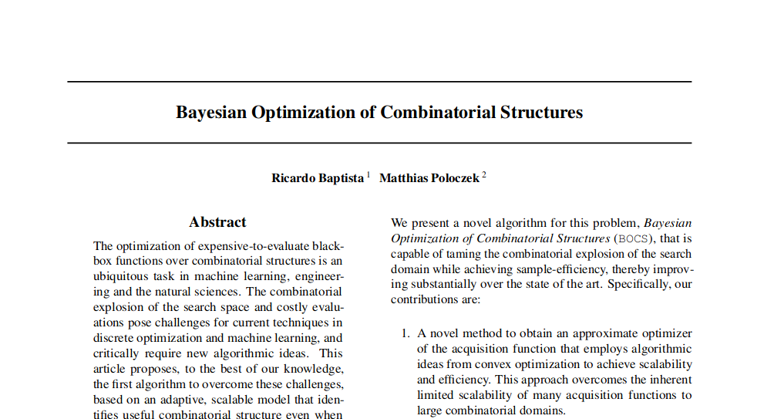

Slide 2
Optomising an expensive black-box function f over a discrete structured domain.
Formally:
Find global optimizer
Motivation

Slide 3

Combinatorial Domains are often considered to be MAB – Multi-Armed Bandits
A single armed Bandit
John
Paul
Ringo
Juergen
Where :

Slide 4
Combinatorial Domains are often considered to be MAB – Multi-Armed Bandits
4
200
100
3
3
50
2
2
True
1
True
25
1
False
0
0
False
5
Horizon length
nbResamples
nbMutatedPoints
UseShiftBuffer
FlipOne
Where :
Is a combinatorial domain

Slide 5
We suppose that observing x provides conditionally independent, normally distributed observations with mean and finite variance
Generative Model
The powerset of the domain (every possible combination of all sizes)
Note: restrict model to second order ‘interactions’
The individual contribution of individual parameters
The individual contribution of a combination of individual parameters
Evaluates to one when combination i is present in x, 0 otherwise

Slide 6
We suppose that observing x provides conditionally independent, normally distributed observations with mean and finite variance
Generative Model
The individual contribution of individual parameters
The individual contribution of a combination of individual parameters
Evaluates to one when combination i is present in x, 0 otherwise

Slide 7
Sparse Bayesian Linear Regression
i = 1,…,N
Observation pairs :
p : exhaustative list of predictors
Matrix of predictors :
Data Model:

Slide 8
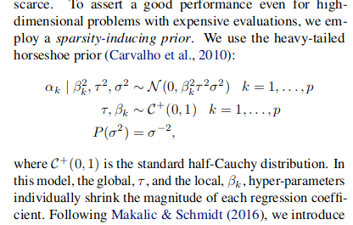
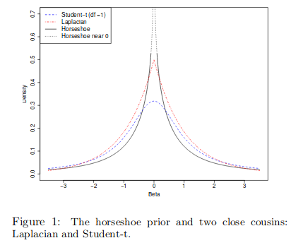
Sparse Bayesian Linear Regression
These act as shrinkage parameters, allowing signals through
and squashing noise

Slide 9
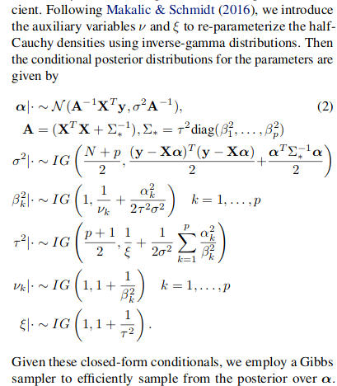
Sparse Bayesian Linear Regression
Parameterization in preperation for Gibbs Sampling

Slide 10
Sparse Bayesian Linear Regression
Gibbs Sampling
MCMC method for finding the and that best fits the data.
Used in multivariate distributions when direct sampling is difficult.
MLE possible, but worse
As it is does not explore enough, becomes greedy and performs worse

Slide 11
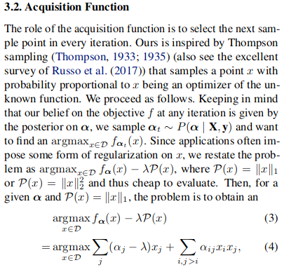
Acquisition function
Regularisation is used to stop
Overfitting and learning the noise as well as the signal.
Thompson Sampling – Take lots of samples alpha from the distribution, then evaluate the function from the mean of the observations

Slide 12
Simmulated Annealing
Pick random start point
The algorithm picks a valid solution uniformly at random and then :
performs a random walk over the neighbourhood of its current point.( A neighbourhood includes all points that are at most one hamming distance away.)
If new point is better than old point, go to new point.
If new point is worse that old point, accept new points with probability:
For each run of the algorithm T starts high to encourage exploration and then cools down to converge to a local maxima.

Slide 13
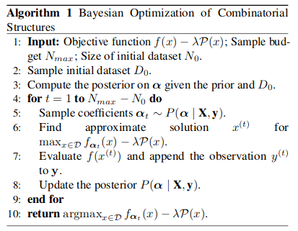
Algorithm
N_0 is an initial sample from the objective function.

Slide 14
Time complexity
The time complexity of the gibbs sampling is dominated by the cost of the multivariate gaussian. And is bounded by
Simmulated annealing is fairly efficient and the overall time complexity of the algorithm is bounded by

