Slide 1
ARC TESTNET · CIRCLE APP KIT · AGENTIC ECONOMY
A
ONCHAIN AGENT
A
AgentTreasury Lite
Policy-gated USDC settlement for autonomous agents
ID 851421
Arc Testnet
WORKING MVP
Real App Kit Send · ERC-8004 identity · Public test evidence
Checkpoint 2 · July 2026
ENCODE CHECKPOINT 2 · ARC TESTNET
01

Slide 2
WHY THIS MATTERS
Agents need spending power — with boundaries
UNCONTROLLED WALLET
A transaction request alone is not a treasury policy.
AGENTTREASURY LITE
Decision logic comes before the wallet signature.
Without explicit controls, an agent cannot prove why a payment was allowed, whether reserves were protected, or who authorized execution.
→
✓ Allowlisted recipient
✓ Maximum payment
✓ Minimum reserve
✓ Invoice ID required
MetaMask remains the final human authorization boundary.
Result: explainable approval, manual authorization, and public settlement evidence.
ENCODE CHECKPOINT 2 · ARC TESTNET
02

Slide 3
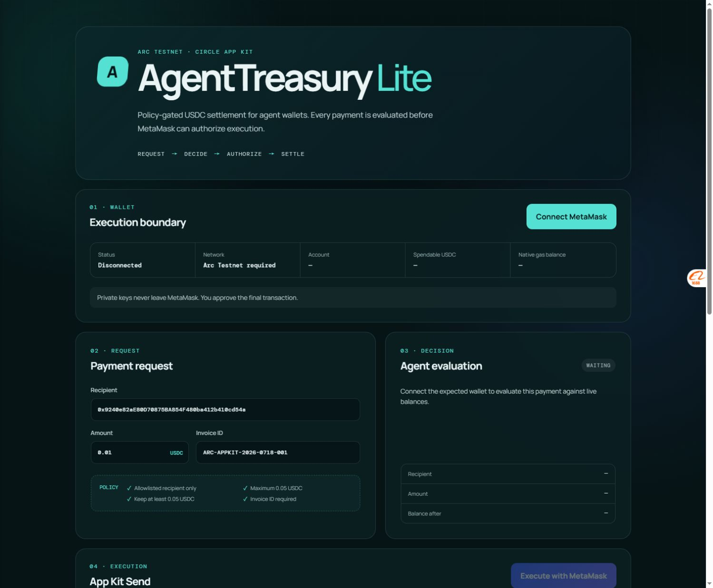
WORKING PRODUCT
The MVP turns a payment request into verifiable settlement
01
02
03
04
REQUEST
DECIDE
AUTHORIZE
SETTLE
Recipient, amount, invoice
Policy returns approve / reject
Human reviews in MetaMask
App Kit Send → ArcScan
LIVE POLICY
Default request: 0.01 USDC
The browser checks the expected Arc network, wallet, spendable balance, allowlist, payment cap, reserve floor, and invoice reference before enabling execution.
Private keys never leave MetaMask.
ENCODE CHECKPOINT 2 · ARC TESTNET
03

Slide 4
ARC + CIRCLE INTEGRATION
One decision layer, several verified settlement primitives
FOUNDATION
BROWSER MVP
Arc Testnet
USDC-denominated gas
Sub-second settlement
DECISION LAYER
Circle App Kit Send
MetaMask authorization
ArcScan receipt
→
AgentTreasury Lite
→
Policy engine + human authorization boundary
SEPARATE VERIFIED ARC EXPERIMENTS
These prove additional settlement paths; they are not presented as one combined browser transaction.
Official Memo
Multicall3From
ERC-8004 Identity
Structured payment references
Sender-preserving batch USDC
Official registry · Agent ID 851421
ENCODE CHECKPOINT 2 · ARC TESTNET
04

Slide 5
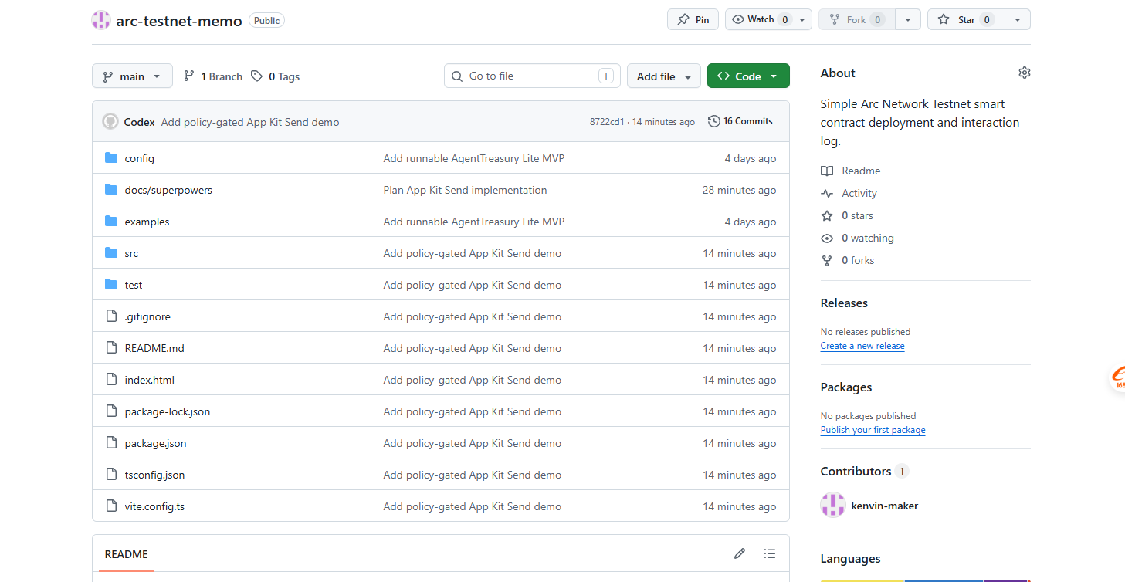
VERIFIED PROGRESS
Public evidence proves the MVP is working
0.01
851421
27/27
USDC
Real Circle App Kit Send
confirmed on Arc Testnet
ERC-8004 Agent ID
owned by the project wallet
Automated tests passing
plus a successful production build
CHAIN EVIDENCE
App Kit Send
0x6a46…1d572
ERC-8004
0xe8b2…e490
Identity Registry
0x8004…BD9e
Receipts, ownership, and tokenURI are documented in the public README.
ENCODE CHECKPOINT 2 · ARC TESTNET
05

Slide 6
CHECKPOINT 2
The core works; next is reviewer-ready packaging
COMPLETED
NEXT
01 Policy-gated browser MVP
01 Tighten the reviewer demo
02 Real App Kit Send evidence
02 Add a compact activity log
03 ERC-8004 onchain identity
03 Package the final submission
04 Public tests and build
No extra transactions without a product or programme requirement.
REVIEW THE WORKING EVIDENCE
github.com/kenvin-maker/arc-testnet-memo
youtube.com/watch?v=3jFuRj20a8g
AGENTTREASURY LITE · BUILDING ON ARC
06

