Slide 1
ENCODE • ARC • AGENTIC ECONOMY
A
ONCHAIN AGENT
A
AgentTreasury Lite
A policy and evidence layer for autonomous USDC payments on Arc
ID 851421
Arc Testnet
PUBLIC BUILD • TESTNET ONLY
Live demo • Public code • Verified Arc testnet evidence
Final submission • August 2026
AGENTTREASURY LITE • BUILDING ON ARC
01
Notes:
[Sources]
Repository README: https://github.com/kenvin-maker/arc-testnet-memo
Live demo: https://agent-treasury-lite.vercel.app
ERC-8004 registration receipt: https://testnet.arcscan.app/tx/0xe8b29a7fe6150281e0917caea39c9cfc6d943d5904580a3cd74332209e93e490

Slide 2
WHY THIS MATTERS
Autonomous payments need an accountable control layer
THE RISK
An agent request alone is not a treasury decision.
AGENTTREASURY LITE
Decide before the wallet asks for a signature.
Without policy checks, a payment cannot show why it was allowed, what reserve was protected, or who approved execution.
→
✓ Recipient allowlist
✓ Spend cap
✓ Reserve floor
✓ Invoice reference
A human wallet confirmation remains the execution boundary.
Result: explainable decisions, explicit authorization, and auditable settlement evidence.
AGENTTREASURY LITE • BUILDING ON ARC
02
Notes:
[Sources]
Product behavior: https://github.com/kenvin-maker/arc-testnet-memo

Slide 3
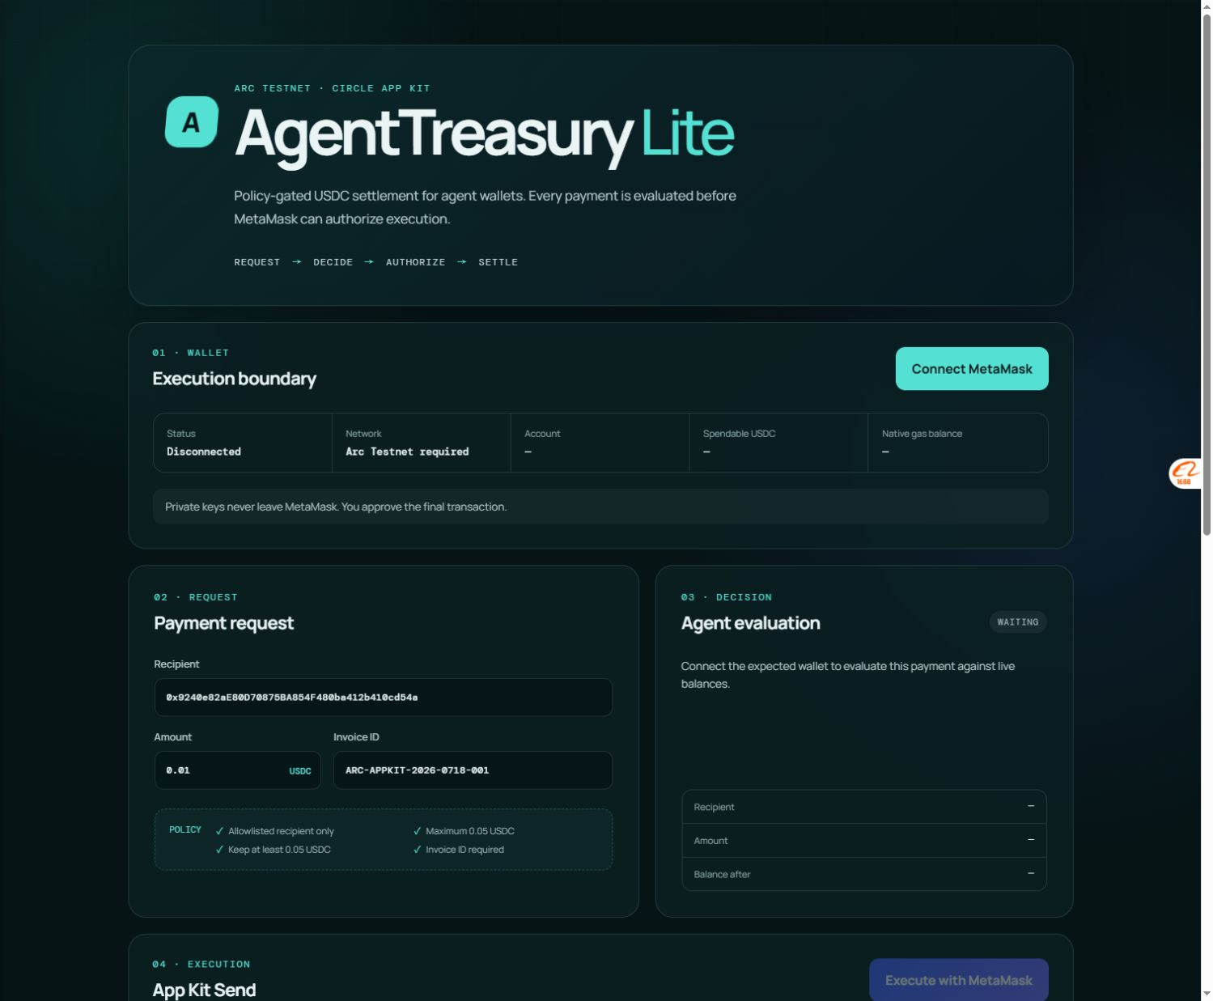
WORKING PRODUCT
The demo turns requests into reviewable evidence
01
02
03
04
REQUEST
DECIDE
AUTHORIZE
RECORD
Recipient, amount, invoice
Policy approves or rejects
Human reviews in wallet
ArcScan receipt + audit log
LIVE DEMO
A small payment, a clear decision trail.
The browser checks the Arc network, connected wallet, spendable balance, recipient allowlist, payment cap, reserve floor, and invoice reference before a wallet can execute.
Private keys never leave MetaMask.
AGENTTREASURY LITE • BUILDING ON ARC
03
Notes:
[Sources]
Live demo: https://agent-treasury-lite.vercel.app
Implementation: https://github.com/kenvin-maker/arc-testnet-memo

Slide 4
VERIFIED ARC TESTNET EVIDENCE
One policy layer, multiple independently verified primitives
FOUNDATION
VERIFIED OUTPUT
Arc Testnet
USDC-denominated gas
Sub-second settlement
DECISION + EVIDENCE
USDC App Kit Send
Structured memo
Public ArcScan receipt
→
AgentTreasury Lite
→
Policy checks + human authorization boundary
ADDITIONAL VERIFIED EXPERIMENTS
These are separate testnet proofs; they are not presented as one combined browser transaction.
ArcMemo
Multicall3From
ERC-8004 identity
Structured payment references
Sender-preserving batch USDC
Official registry • Agent ID 851421
AGENTTREASURY LITE • BUILDING ON ARC
04
Notes:
[Sources]
Repository evidence index: https://github.com/kenvin-maker/arc-testnet-memo
App Kit Send receipt: https://testnet.arcscan.app/tx/0x6a46e44a1346772966d1690c6e03a4baf35ff699a7003a58d99c3fe9cd41d572
ERC-8004 receipt: https://testnet.arcscan.app/tx/0xe8b29a7fe6150281e0917caea39c9cfc6d943d5904580a3cd74332209e93e490

Slide 5
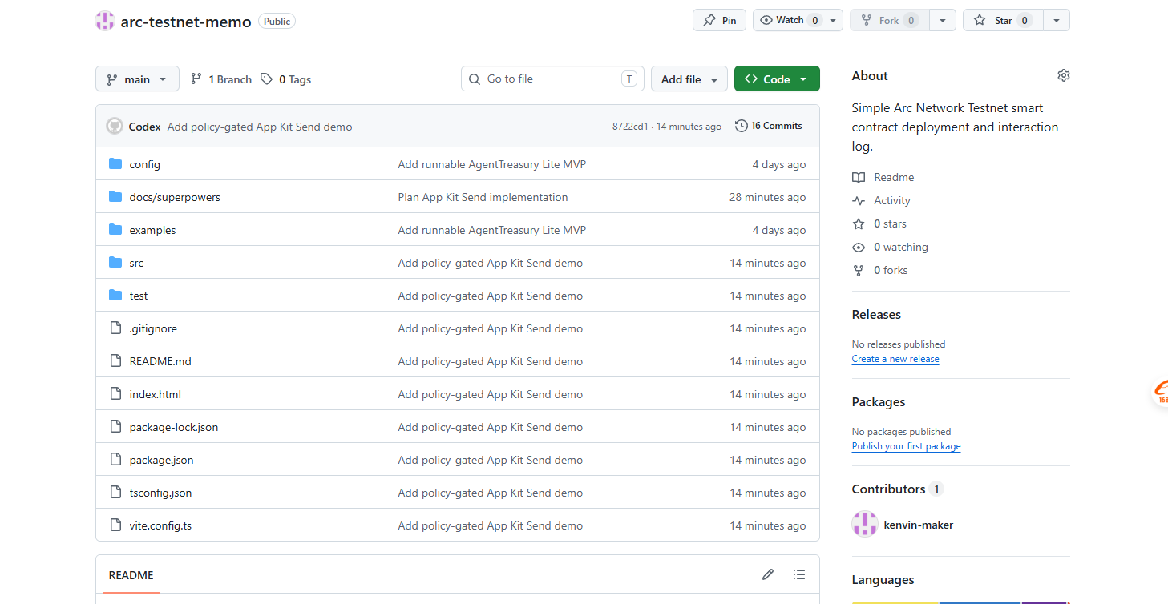
PUBLIC REVIEWER ACCESS
The project is live, inspectable, and still moving
LIVE
851421
30/30
DEMO
Public Vercel deployment
for reviewer access
ERC-8004 Agent ID
owned by the project wallet
Automated tests passing
for the current build
OPEN EVIDENCE
Live demo
agent-treasury-lite.vercel.app
Code
github.com/kenvin-maker/arc-testnet-memo
Video
youtube.com/watch?v=3jFuRj20a8g
A reviewer can inspect the build, testnet evidence, and next integration work in public.
AGENTTREASURY LITE • BUILDING ON ARC
05
Notes:
[Sources]
Live demo: https://agent-treasury-lite.vercel.app
Repository: https://github.com/kenvin-maker/arc-testnet-memo
Video demo: https://www.youtube.com/watch?v=3jFuRj20a8g

Slide 6
NEXT INTEGRATION
Gateway / Nanopayments is a safe, evidence-first next step
TODAY
The prototype already controls and records payment decisions.
PLANNED ADAPTER
Preview authorization before settlement is introduced.
It has verified Arc testnet evidence, but it does not claim live Circle Gateway, x402, Nanopayments, or EIP-3009 settlement.
→
✓ Mock HTTP 402
✓ Policy review
✓ Deterministic reference
✓ No wallet signing
Gateway / Nanopayments remains explicitly labelled planned until official testnet evidence exists.
The roadmap keeps the integration honest: evaluate → authorize → settle → reconcile.
AGENTTREASURY LITE • BUILDING ON ARC
06
Notes:
[Sources]
Roadmap document: https://github.com/kenvin-maker/arc-testnet-memo/blob/main/docs/gateway-nanopayments-plan.md
Mock implementation: https://github.com/kenvin-maker/arc-testnet-memo

Slide 7
CONTINUATION PLAN
Real usage comes next — with the same evidence discipline
BUILT
NEXT
01 Policy-gated payment demo
01 Add reviewer-friendly activity log
02 Arc testnet settlement evidence
02 Validate an official payment adapter
03 ERC-8004 onchain identity
03 Keep shipping public, testable increments
04 Public source, demo, and tests
The project will prioritize genuine user value, explicit approval, and verifiable receipts over transaction volume.
REVIEW THE BUILD
agent-treasury-lite.vercel.app
github.com/kenvin-maker/arc-testnet-memo
AGENTTREASURY LITE • BUILDING ON ARC
07
Notes:
[Sources]
Live demo: https://agent-treasury-lite.vercel.app
Repository: https://github.com/kenvin-maker/arc-testnet-memo

