Slide 1

Developing an SMS Filter for spam SMS
TEAM – 03
Amar - 05
Sidhant Jain - 46
Kenwin Das - 51

Slide 2
Text Pre-Processing
Raw Text
Encoding(Target Variable)
Text Cleaning
Stopwords
Lemmetization
Clean Text

Slide 3
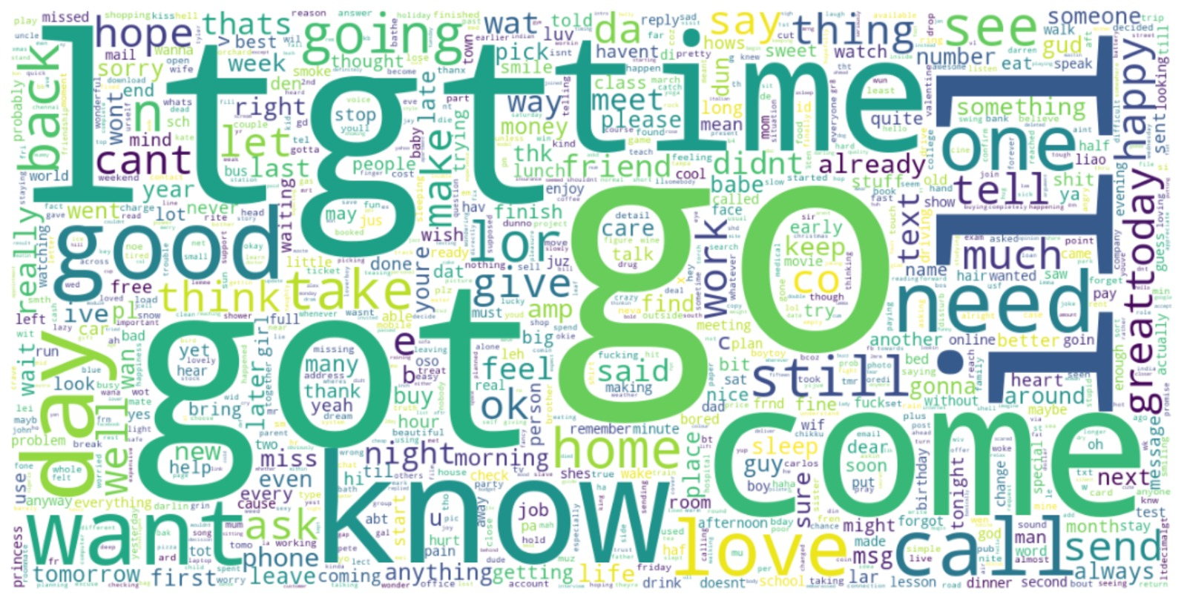
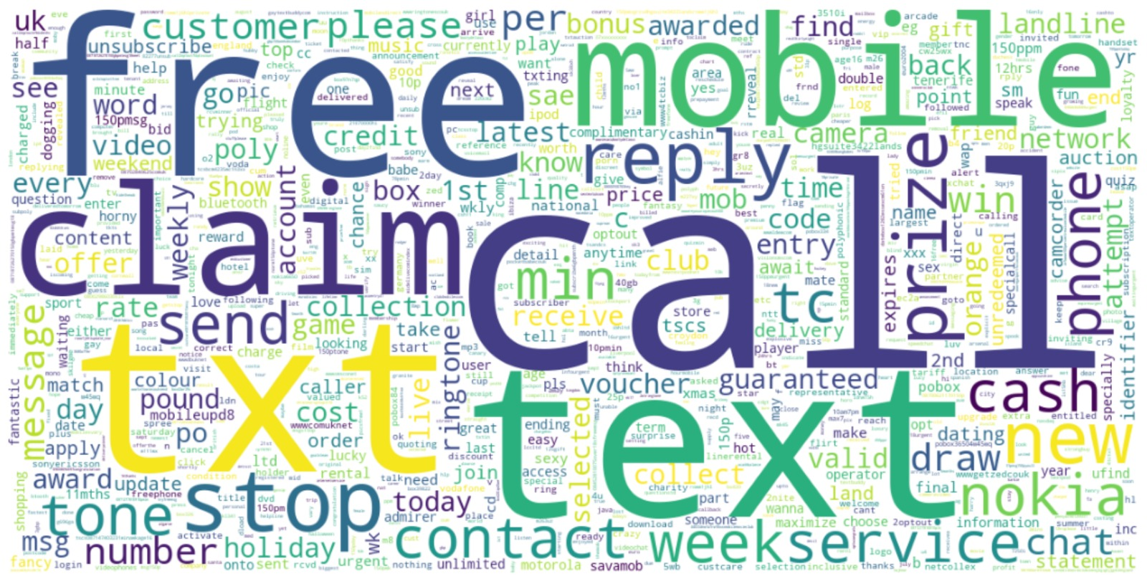
Data Exploration
Ham
In spam message frequency of words like free ,claim, call, prize , award etc is high which are usually used in spam SMS.
In ham message frequency of words like call, u, go, home, come, need, love etc are high which are used in day to day conversations
Spam

Slide 4
Pipelines for TF
Initialization
Initialization Object CountVectorizer
Transforming
Transforming data using CountVectorizer
Dataframe
Converting Document-Term Matrix to a Dataframe

Slide 5
Pipelines for TF-IDF
Initialization
Initialization Object TfidfVectorizer
Transforming
Transforming data using TfidfVectorizer
Dataframe
Converting TF-IDF vectors to a Dataframe

Slide 6
Pipelines for Doc2Vec
Initialization
Initialization of Google model
Embeddings
We used Google model to get embeddings for each word
Transformation
We Converted those document embeddings to dataframe
Data Frame
We converted those embeddings into document vectors by averaging

Slide 7
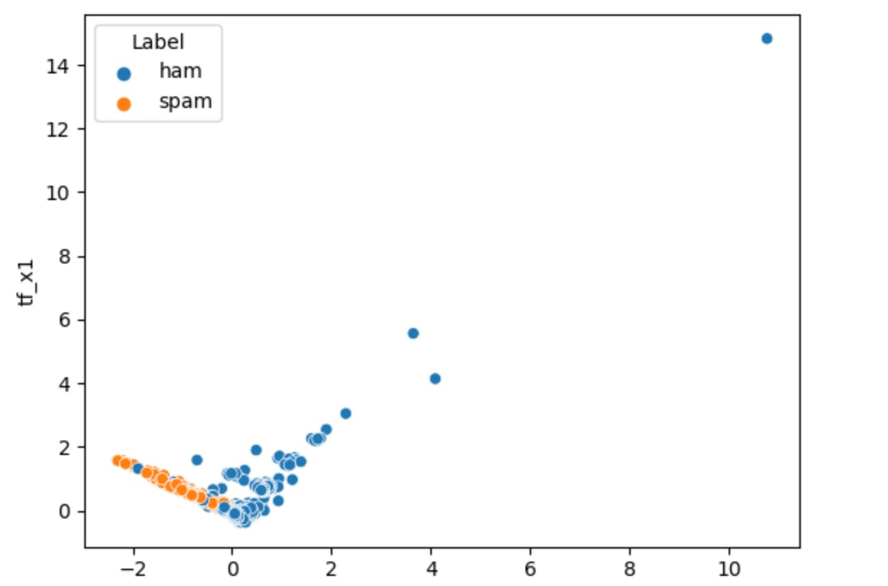
Dimension Reduction & Visualization for TF
Used PCA (Principal Component Analysis) on TF Vectors.
Choose the first 2 components which showed maximum variance to plot the graph.

Slide 8
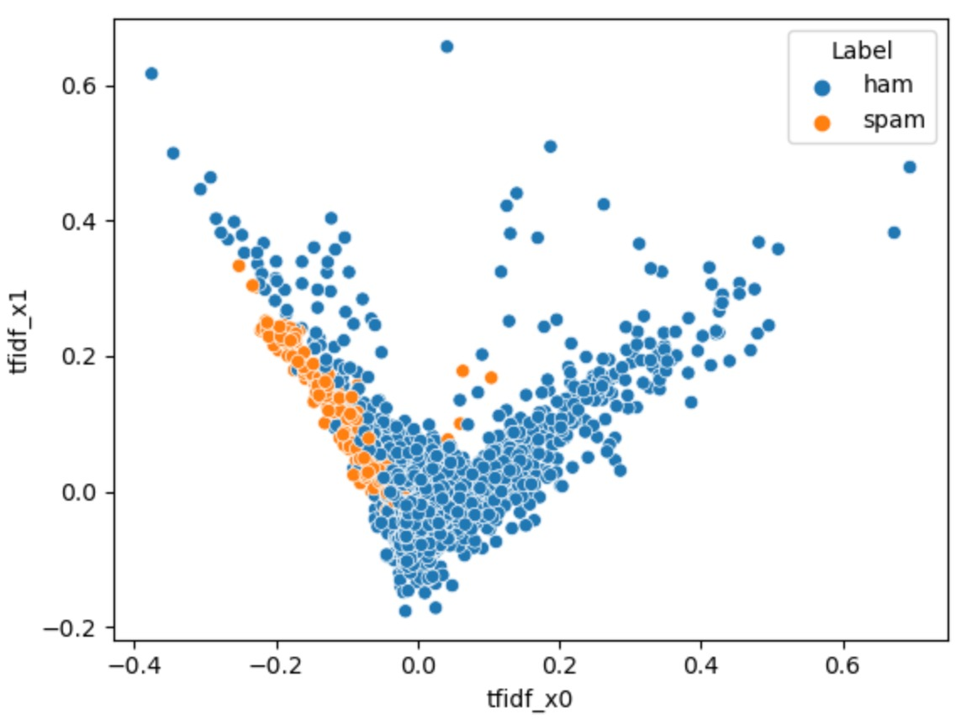
Dimension Reduction & Visualization for TF-IDF
Used PCA (Principal Component Analysis) on TF-IDF Vectors.
Choose the first 2 components which showed maximum variance to plot the graph.

Slide 9
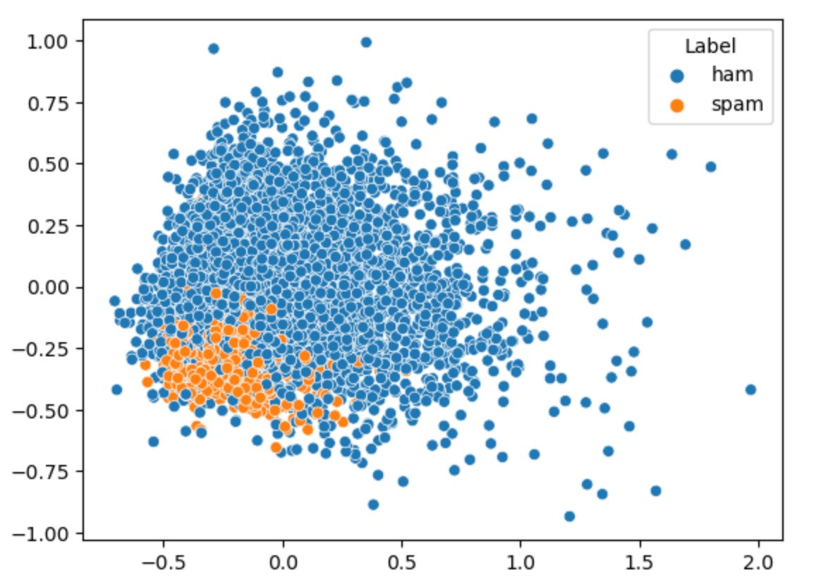
Dimension Reduction & Visualization for Word2Vec
Used PCA (Principal Component Analysis) on Word2Vec Vectors.
Choose the first 2 components which showed maximum variance to plot the graph.

Slide 10
Classification Module

Slide 11
1.Logistic Regression TF-IDF
Aim – Classifying Spam and ham messages
Experiment – Used tuned Logistic Regression on TF-IDF
Observations –
Metrics | Results
Accuracy | 0.976
Recall | 0.829
Precision | 0.981
F1-score | 0.898
Conclusion – This is the best model which we get on the test as well as training data.

Slide 12
2.Logistic Regression TF
Aim – Classifying Spam and ham messages
Experiment – Used tuned Logistic Regression on TF
Observations –
Metrics | Results
Accuracy | 0.968
Recall | 0.770
Precision | 0.980
F1-score | 0.862

Slide 13
3.Ada Boost Classifier Doc2Vec
Aim – Classifying Spam and ham messages
Experiment – Used tuned Ada Boost Classifier on Doc2Vec
Observations –
Metrics | Results
Accuracy | 0.966
Recall | 0.79
Precision | 0.91
F1-score | 0.85

Slide 14
4.Ada Boost Classifier TF-IDF
Aim – Classifying Spam and ham messages
Experiment – Used tuned Ada Boost Classifier on TF-IDF
Observations –
Metrics | Results
Accuracy | 0.964
Recall | 0.766
Precision | 0.942
F1-score | 0.845

Slide 15
5. Support Vector Classifier TF-IDF
Aim – Classifying Spam and ham messages
Experiment – Used tuned Support Vector Classifier on TF-IDF
Observations –
Metrics | Results
Accuracy | 0.962
Recall | 0.823
Precision | 0.868
F1-score | 0.845

Slide 16
6.Ada Boost Classifier TF
Aim – Classifying Spam and ham messages
Experiment – Used tuned Ada Boost Classifier on TF
Observations –
Metrics | Results
Accuracy | 0.962
Recall | 0.744
Precision | 0.954
F1-score | 0.836

Slide 17
7.Bagging Classifier TF
Aim – Classifying Spam and ham messages
Experiment – Used tuned Bagging Classifier on TF
Observations –
Metrics | Results
Accuracy | 0.959
Recall | 0.739
Precision | 0.929
F1-score | 0.823

Slide 18
8.Support Vector Classifier TF
Aim – Classifying Spam and ham messages
Experiment – Used tuned Support Vector Classifier on TF
Observations –
Metrics | Results
Accuracy | 0.959
Recall | 0.688
Precision | 0.992
F1-score | 0.813

Slide 19
9.Bagging Classifier TF-IDF
Aim – Classifying Spam and ham messages
Experiment – Used tuned Bagging Classifier on TF-IDF
Observations –
Metrics | Results
Accuracy | 0.952
Recall | 0.709
Precision | 0.889
F1-score | 0.789

Slide 20
10.Bagging Classifier Doc2Vec
Aim – Classifying Spam and ham messages
Experiment – Used tuned Bagging Classifier Doc2Vec
Observations –
Metrics | Results
Accuracy | 0.947
Recall | 0.595
Precision | 0.939
F1-score | 0.729

Slide 21
Conclusion
Overall , Logistic regression was one of the best models.
Term Frequency(TF) and TF-IDF were better embedding technique then Doc2Vec.
Doc2Vec perform poorly it can be because of that model was trained in 2013 on Google News.
Many of the words were not present in Google pre trained model so we have to drop those rows.
In Future we can use other pre trained models like Elmo, Glove etc.
We could also use Deep Learning sequential Models like LSTM(Long Short Term Memory), GRU(Gated Recurrent Networks) etc.

