Slide 1

PREDICTING TERM DEPOSIT SUBSCRIPTION IN A PORTUGUESE BANK:INSIGHTS FROM PHONE-BASED MARKETING CAMPAIGNS
Submitted by
Kenwin Dass C
Ecolabs Hackathon

Slide 2
Problem Statement: The task is to predict whether a client of a Portuguese bank will subscribe to a term deposit based on phone-based marketing campaigns. The dataset includes demographic information, previous marketing interactions, and behavioral attributes. The goal is to build a model that can accurately classify clients as subscribers or non-subscribers.
Overview of the Dataset:
The Dataset Consists of 33,908 observations and 17 Variables
Nine Numerical Variables and Eight Categorical Variables.
Categorical Variables - job, marital, education, default, housing, loan, contact, month, poutcome
Numerical Variables – age, balance, campaign, day, duration, pdays, previous
Target Variable – ‘y’ which consists of two categories ‘yes’ and ‘no’. where the no category has 88.3% of the data and the yes category has 11.7% of the data, which implies that our target is class imbalanced.

Slide 3
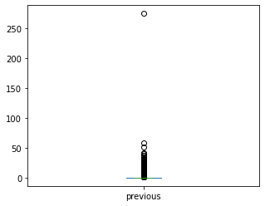
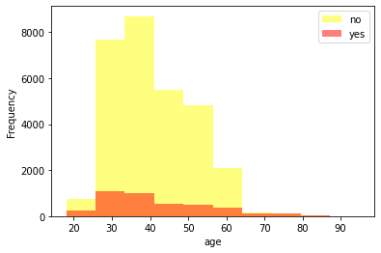
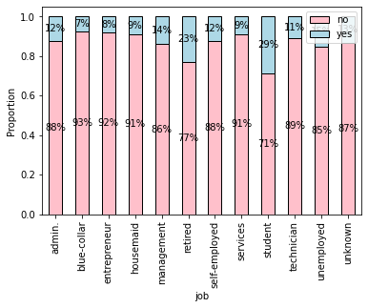
Interesting Results From EDA
Null Values: There are no Null Values in the Dataset
‘Previous’ : In the Previous Variable there is an Outlier value of 275 which is present in the 32,107th row.
The Distribution is Right Skewed for the duration, campaign, pdays, and previous.
The age group between 25 and 40 has the highest subscription rate for term deposits. "Young adults" or "early middle-aged people" are more interested in term deposits.
The longer the phone call, the higher the subscription rate for term deposits.
Students and retirees have the highest subscription rate for term deposits. Students might make that useful for education purposes and, term deposits may offer a stable and predictable source of income, which can be important for retirees who may be living off their savings.
Using the Heatmap, I discovered that previous and pdays had a higher correlation than other numerical variables.

Slide 4
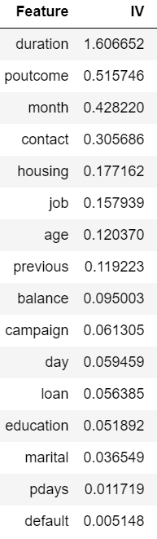
Variable selection strategies used:
For logistic regression, I used Information Value as a variable selection strategy. By calculating, I discovered that the default variable has an Information Value of less than 0.02 and is therefore unsuitable for prediction, while the pdays variable has an Information Value of 0.0117 and is therefore a poor predictor. So I removed the variables pdays and default from the Information value. I fitted the logistic regression model with the remaining 14 predictors after removing those variables. When compared to the baseline model, the logistic regression with selected features produced better results, but not better than the results of other models such as the decision tree and lightgbm. So I kept working with lightgbm and a decision tree with all variables using smote.

Slide 5
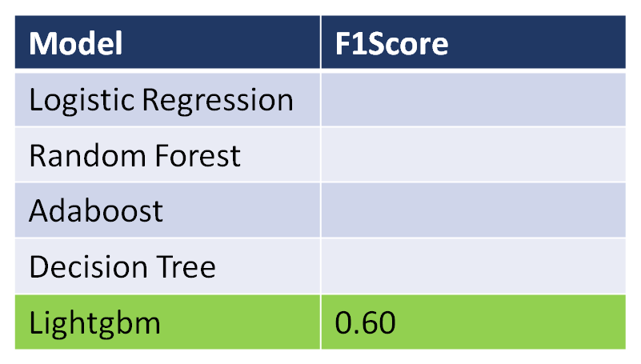

Validation method used for model validation:
K-fold cross-validation was used as a validation technique for the lightgmb model. I obtained an average F-1 score of 0.54 from k-fold cross-validation, while my lightgbm model received an F-1 score of 0.60.
Performance metrics of the final model:
I have Calculated the F-1 score for various models.
Among all the models LightGBM model using
grid search and SMOTE has a better F1 score of 0.60,
indicating that it performs well on my data. This was
achieved by optimizing the hyperparameters using
grid search and balancing the class distribution with
SMOTE.

Slide 6

suggested actions and recommendations:
We should target "Young adults" or "early middle-aged people" in the next campaign because they are more interested in term deposits. The longer the phone call, the higher the term deposit subscription rate. As a result, the next campaign will require a longer duration of interaction. Term deposit subscriptions are highest among students and retirees. Students may find it useful for educational purposes, and term deposits may provide a stable and predictable source of income, which is important for retirees who rely on their savings. As a result, more interaction with students and retirees via phone calls is required beginning with the next campaign.

