Slide 1
KDB+ training
Sigrid Rouam & Aaron Tan
FinTech & Data team
14-15 June 2017

Slide 2

Introductions

Slide 3
Agenda
DAY 1
Getting Started
File I/O
Atoms and Lists
Dictionaries, Tables and Functions
DAY 2
5. Select and qSQL
6. Keywords, Joins, Adverbs
7. Integration with R

Slide 4
1 .Getting Started
1.1 KDB Overview
1.2 ATLAS
1.3 Installing q and qstudio

Slide 5
kdb+
Reference website: http://code.kx.com
High performance database, managing real time and historical data within a single platform
Features:
Column orientated
Embedded query language - q
In-memory and on-disk data access
Optimized and configurable partitioning of on-disk data
64-bit architecture with built-in multi-threaded support
Direct analysis on data
High speed time series analysis
Discrete and continuous joins

Slide 6
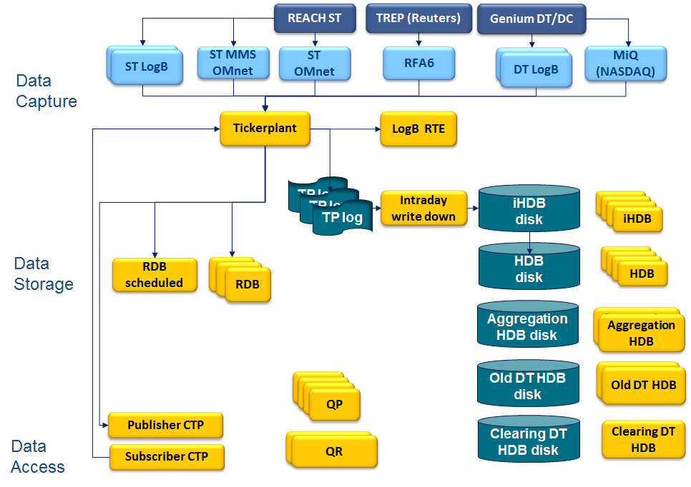
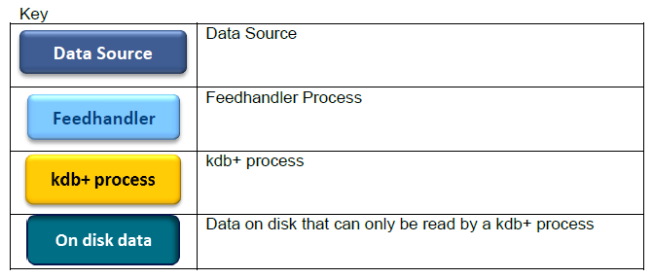
SGX Data Architecture
3 main databases:
Realtime database (RDB)
Intra-day Historic database (iHDB)
Historic database (HDB)
Query Router:
Directs data queries to the relevant database
Query Router Clients:
Directs data queries to the Query Router

Slide 7
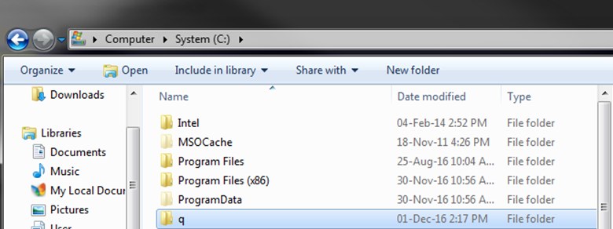
kdb+ Windows Installation (1/3)
Download kdb+/q (win32)(The current version we are using is 3.5) from
https://kx.com/download/
Unzip and place folder at your root directory C:/

Slide 8
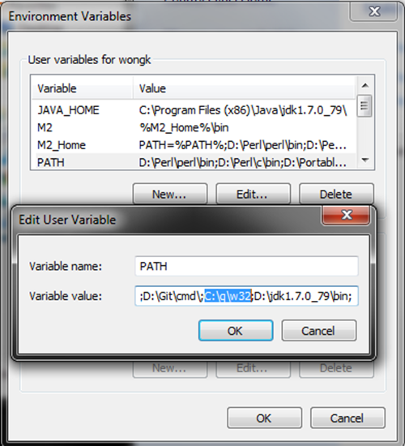
kdb+ Windows Installation (2/3)
3. Set environment variable "path" to include "C:\q\w32".
Go to Control Panel\User Accounts\User Accounts
Select "Change environment variables“
Add "C:\q\w32\" to "PATH" variable. If it does not exist, create it. Remember that all entries are delimited by a semi-colon.
Press "Ok" for everything after

Slide 9
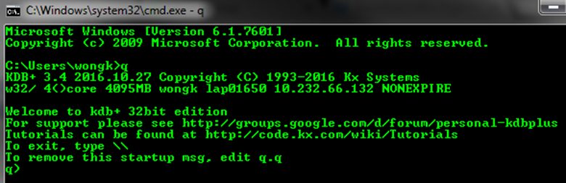
kdb+ Windows Installation (3/3)
4. Test to see if it works!
Run command prompt. Ctrl+R > cmd > Enter > q > Enter

Slide 10
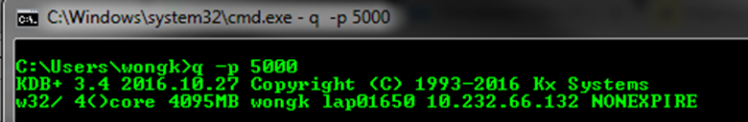
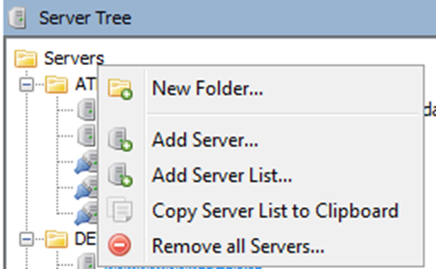
qStudio Windows Installation (1/2)
Download qStudio from
http://www.timestored.com/qstudio/
Copy it to a directory of your choice, I recommend either in C/D root or within your q folder
Open qStudio and let's get you connected:
Start a q process on port 5000 by typing the following in command prompt. "q -p 5000“
Open qStudio and a new server

Slide 11
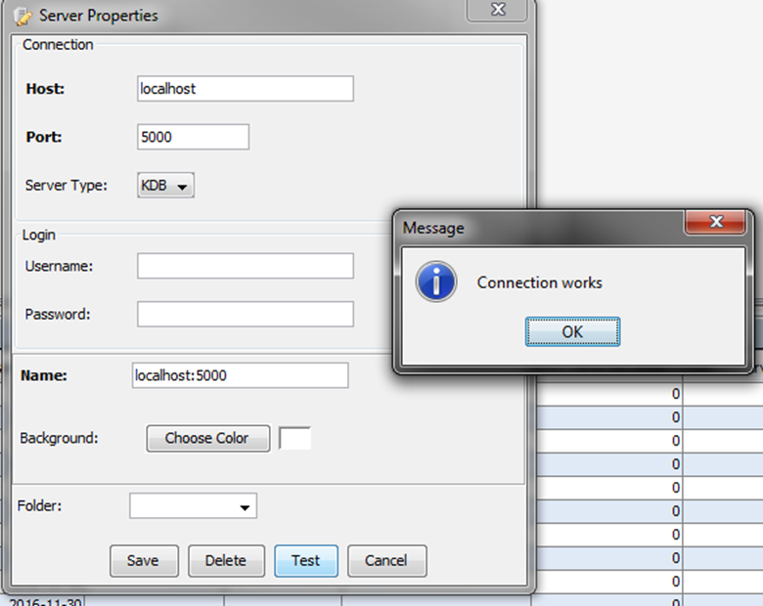
qStudio Windows Installation (2/2)
Host is "localhost" and port is "5000". Name it "localhost:5000".
Press "Test" and then save it.
You can send commands from qStudio to localhost:5000 as long as that process is active

Slide 12
2. File I/O
2.1 Read/Write q file
2.2 Read/Write csv file
2.3 Get data from ATLAS

Slide 13
Working with files
KDB+ distinguishes 3 types of files:
kdb+ data files,
text files
all others (binary files)
Files are identified by the file handles:
q) `:C/kdbtestdata
Notes:
file handle: internal reference to a file, temporary reference number that an OS assigns to a file requested by a user to be opened. The system calls, accesses and interacts with the file through that reference number throughout the session until the user terminates the file or the system session.

Slide 14
KDB Data files
KDB+ data can be written to kdb+ data files with set
The file can be read using the get function
q) filename: hsym (`$\\\\mydrive\\staff$\\rouams\\Documents\\SGX\\Trainings\\KDB\\FIles_For_Training\test.q)
q) filename set 1 2 3 -5 26
q) filename: hsym (`$\\\\mydrive\\staff$\\rouams\\Documents\\SGX\\Trainings\\KDB\\FIles_For_Training\test.q)
q) data:get filename
Notes:
hsym: converts a symbol into a file name

Slide 15
Read/Write csv
Write a csv file:
Read csv file
q) filename: hsym (`$\\\\mydrive\\staff$\\rouams\\Documents\\SGX\\Trainings\\KDB\\FIles_For_Training\test.csv);
q) filename 0:csv 0:data;
q) save `:data.csv
q) refdata0: read0 hsym `$("\\\\mydrive\\staff$\\rouams\\Documents\\SGX\\ Trainings\\KDB\\FIles_For_Training\test.csv");
q) (“*****”;enlist “,”) 0:`:myfile.csv
Notes:
0: prepares text

Slide 16
Query ATLAS
We can query ATLAS via the server
This is reserved for Super-Users!!

Slide 17
3. Atoms and Lists
3.1 Basic Operations: Arithmetic and Variables
3.2 Atoms
3.3 Lists
3.4 List Operations
3.5 Recap

Slide 18
Arithmetic and Variables (1/4)
Basic arithmetic: + - * %
Right of left execution
Use brackets as precedence
Comments can be made after a '/' :
q)2+3
5
q)10-5
5
q)7*6
42
q)10%2
5f /the "f" denotes that the number is a float
q)5*2+3
25
q)(5*2)+3
13
q)a:1 /this is a comment
q)a
1

Slide 19
Arithmetic and Variables (2/4)
Assign variables using `:' instead of `=‘
`=' is used for comparison
q)a:2
q)b:3
q)c:4
q)d:a*b*c
q)d
24
q)a:2
q)b:3
q)3=2
0b /indicating that the statement a equals b is false
q)5.0=5
1b

Slide 20

EXERCISE
Start a new q session
Define the following variables:
a = 5
b = a–3
c = 3b+1
Calculate and store the answer as the variable y.
SOLUTION
q)a:5
q)b:a-3
q)c:1+3*b
q)y: ((a*a) – 3*c) % b

Slide 21
Arithmetic and Variables (3/4)
Comparison can be:
For example:
>= /Greater than or equal to
> /Greater than
<= /Less than or equal to
< /Less than
= /Equal
<> /Not equal / check if 2 number are equal regardless of type
~ /Match / check if 2 variables are of the same type
q)4>1
1b
q)10<>4
1b
q)8>=8
1b
q)6<=3
0b

Slide 22
Arithmetic and Variables (4/4)
Assignments can be combined in a single operation:
Multi-assignment can be performed on one line:
Use \v to check variable names:
q)x:10
q)x:x+1
q)x
11
q)x+:1
12
q)x*:3
q)x
q)c:1+b:3*a:2
q)a
2
q)b
6
q)c
7
q)\v
`a`b`c`d`x
Notes:
x+:
x*:

Slide 23
EXERCISE
Start a new q session
Define the following variables:
a = 5
b = a–3
c = 3b+1
Repeat question 2 in one single assignment statement.
Check the following:
Is a greater than b?
Is c positive?
SOLUTION
q)c:1+3*b:-3+a:5
q)a>b
q)c>=0

Slide 24
Atoms (1/6)
An atom is a singular entity.
It has a specific data type - this could be integer, float, character, symbol, etc.

Slide 25
Atoms (2/6)
Type | Size | CharType | NumType | Notation | Null Value
boolean | 1 | b | 1 | 1b | 0b
byte | 1 | x | 4 | 0x26 | 0x00
short | 2 | h | 5 | 42h | 0Nh
int | 4 | i | 6 | 42 | 0N
long | 8 | j | 7 | 42j | 0Nj
real | 4 | e | 8 | 4.2e | 0Ne
float | 8 | f | 9 | 4.2 | 0n
char | 1 | c | 10 | "z" | " "
symbol | * | s | 11 | `zaphod | `
timestamp | 8 | p | 12 | 2015.01.01T00:00:00.000000000 | 0Np
month | 4 | m | 13 | 2006.07m | 0Nm
date | 4 | d | 14 | 2006.07.21 | 0Nd
datetime | 4 | z | 15 | 2006.07.21T09:13:39 | 0Nz
timespan | 8 | n | 16 | 12:00:00.000000000 | 0Nn
minute | 4 | u | 17 | 23:59 | 0Nu
second | 4 | v | 18 | 23:59:59 | 0Nv
time | 4 | t | 19 | 09:01:02:042 | 0Nt
enumeration |  |  | 20+ | `sym$`kx
table |  |  | 98 | ([] c1:`a`b`c; c2:10 20 30)
dictionary |  |  | 99 | `a`b`v!10 20 30
function |  |  | 100 | {x}
nil item |  |  | 101 | ::

Slide 26
Atoms (3/6)
To force the type, we specify the type as a single letter after the atom:
Some types need to be specified:
q)a:1 /- no type forced
q)a:1i /- force to be an integer
q)b:1f /- force to be a float
q)c:0b /- booleans defined 0b or 1b
q)d:"m" /- define a character
q)e:`symbol /-define a symbol

Slide 27
Atoms (4/6)
If we query the type of an atom, it returns a negative number:
The negative sign indicates an atom.
The number tells us the type.
The default integer is no longer type int (i), which was 32-bit, it is now long (j) 64-bit.
q)100i
100i
q)type 100i
-6h
Notes:
h – always there when you choose ‘type’

Slide 28
EXERCISE
Find the type values of the following objects:
123
123f
2014.09m
`me
"you"
Which of the following objects have the same type?
4.29999871
7j
4.2f
0b
9.8
What are the types of the other objects?

Slide 29
EXERCISE
Find the type values of the following objects:
123
123f
2014.09m
`me
"you"
Which of the following objects have the same type?
4.29999871
7j
4.2f
0b
9.8
What are the types of the other objects?
SOLUTION
123 j - long
123f f - float
2014.09m m - month
`me s - symbol
"you“ c - character
4.29999871 f - float
7j j - long
4.2f f - float
0b b - boolean
9.8 f – float

Slide 30
Atoms (5/6)
We have temporal types in q, and can perform temporal arithmetic. For example
There are some variables stored in the workspace:
.z.D holds current date
.z.T holds current time
.z.P holds current timestamp
Datetime and timestamp have different precisions (resp. 6 and 9)
q)time:09:00:00.000000000
q)time+00:00:30
0D09:00:30.000000000
q)date:2014.04.29
q)date+10
2014.05.19
q)timestamp:2014.04.29D09:30:00
q)timestamp+time
2014.04.29D18:30:00.000000000
q)date+time
2014.04.29D09:00:00.000000000

Slide 31
EXERCISE
Get today’s date and store it as the variable d.
Calculate the number of days since last Christmas.
Find out on which day of the week was the 10th of January 2011 was (hint: try using mod with a date)
SOLUTION
q) d: .z.D
q) d - 2016.12.25
q) 2011.01.10 mod 7 // 0 is saturday, so 10th jan was a monday
q) .z.D mod 7
Notes:
2000.01.01

Slide 32
Atoms (6/6)
Changing types of items - casting ($):
new type $ object to change
To cast to a string, we use the keyword string
q)`int$1h /- name representation
1i
q)6h$1h /- number representation
1i
q)"i"$1h /- character representation
1i /- change from type short to type int
q)`int$3.3f
3i /- rounds up from type float to type int
q) "I" $ "4" /- from a string
q)string text
"text"
q)
q)string 1234
"1234"

Slide 33
EXERCISE
Define the following items, and then cast as appropriate to the stated type:
d1:“16/04/2017" to a date
d2:`2016.12.10 to a date
n1:3.14 to an integer
n2:"2" to an integer
a1:"abcde" to a symbol
SOLUTION
q) \z 0 //mmddyyyy
q) \z 1 //ddmmyyyy
q) d1: "D"$"16/04/2017"
q) "D"$"16-04-2017"
q) "D"$"16 April 2017"
q) "D"$"16 Apr 2017"
q) d2: "D"$string `2016.12.10
q) n1: "i"$3.14
q) n2: "I"$"2"
q) a1: `$"abcde"

Slide 34
Lists (1/4)
A collection of atoms
Data type associated with positive number
Basic arithmetical operations and logical operations work item by item on lists
Other mathematical functions such as min, max, avg ... act on all elements of the list
q) ls: til 5
0 1 2 3 4
q) ls * 5
0 5 10 15 20
q)ls > 3
00001b
q) type ls
7h
q) avg ls
2f
q) max ls
4

Slide 35
Lists (2/4)
Simple list - contains atoms with same data type:
Empty list - contains nothing:
q)l1: (100i;200i;300i;400i)
q)l1
100 200 300 400i
q)type l1
6h
q)type each l1
-6 -6 -6 -6h
q)()
q)type ()
0h
q)type `int$() /empty list with specific type
6h

Slide 36
Lists (3/4)
Mixed list - contains atoms with different data types:
Comparison of a simple list and a mixed list:
q)l2: (100i;200h;300j;400e)
q)l2
100i
200h
300
400e
q)type l2
0h
q)type each l2
-6 -5 -7h -8h
q)l1 ~ l2
0b /match (~)considers the different data types
q)l1 = l2
1111b /the = operator does not consider data types

Slide 37
Lists (4/4)
Index assignment:
Matrix - list with depth 2:
q)l[2]:10
q)l
1 2 10 4 5 6
q)l[0]:1.1 /the assigned value must match the type of list
‘type
q)a:(`a;2;3.15)
q)a[0]:"a" /unless the list is a mixed list
q)a
"a"
2
3.15
q)a[0 1]:`a`b /index assign using list
q)a
`a
`b
3.15
q)mm:(1 2 3;4 5 6;7 8 9)
q)mm
1 2 3
4 5 6
7 8 9

Slide 38
EXERCISE
Copy the following list into your q process.
t:`b`i`i`n`o`b`k`h`l`m`m`c`e`f`m`m`e`o`c`o
Find the first place/index the symbol `o occurs
Find all of the indices where the symbol `o occurs
How many elements of t are later in the alphabet than the letter j? What are those elements? Hint: Use the comparison operators (=,>,<,...) just like you would with numbers!
Type out the following
mylist:("hello";"world";1 2 3 4 5;101b)
Use first to get the first element of each element
Use indexing to get the first element of each element
SOLUTION
q) t:`b`i`i`n`o`b`k`h`l`m`m`c`e`f`m`m`e`o`c`o
q) t?`o
q) where t=`o
q) t>`j
q) sum t>`j
q) t where t>`j
q) mylist:("hello";"world";1 2 3 4 5;101b)
q) first each mylist
q) mylist[0 1 2 3;0]
q) mylist[;0]
Notes:
change the list to numbers

Slide 39
List Operations (1/9)
Join (,)
Drop (_)
q)1,2 /atom to atom
1 2
q)`a,`b`c`d /atom to list
`a`b`c`d
q)1 2 3,4 5 6 /list to list
1 2 3 4 5 6
q)1 2, `a`b /joining two lists of different types
1
2
`a
`b
q)2_1 2 3 4 5 /drop first 2
3 4 5
q)-2_1 2 3 4 5 /drop last 2
1 2 3
q)1 2 3 4 5 _ 2 /drop item with index 2
1 2 4 5

Slide 40
List Operations (2/9)
Cut
Take (#)
q)4 cut 1 2 3 4 5 6 /cut at index 4
1 2 3 4
5 6
q)2#1 2 3 4 5 /take first 2
1 2
q)-2#1 2 3 4 5 /take last 2
4 5
q)10#1 2 3 4 5 /repeat take
1 2 3 4 5 1 2 3 4 5
q)2 3#1 2 3 4 5 /2x3 matrix
1 2 3
4 5 1

Slide 41
List Operations (3/9)
Sublist
Find (?)
q)2 sublist 1 2 3 4 5 /take first 2
1 2
q)-2 sublist 1 2 3 4 5 /take last 2
4 5
q)10 sublist 1 2 3 4 5 /take only what
s available
1 2 3 4 5
q)2 3 sublist 1 2 3 4 5 /takes 3 items starting from position 2
3 4 5
q)1 2 3 4 5?3 /find the position of 3
2
q)1 2 3 4 5?7 /not found
5 /return the maximum index+1
q)1 2 2 3 4?2 /only return the first occurrence
1

Slide 42
List Operations (4/9)
Count
q)count 1 2 3 4 /count number of elements in list
4
q)count enlist 1 2 3 4 /counts the first dimension of the enlisted
1 /structure
q)count (1 2 3;4 5 6) /2 lists in a nested list
2
q)count each (1 2 3;4 5 6) /count each list in a nested list
3 3
q)count () /works on an empty list
0
q)count 5 /works on an atom
1

Slide 43
List Operations (5/9)
First, Last
q)first 42 /operates on atoms and lists
42
q)ls
3 7 8 2 1 4 2 8 0 5
q)first ls
3
q)last ls
5
q)ls2:enlist(10)
q)ls2
,10
q)first ls2 /acts as a dual to `enlist
10
q)nls:(1 2; 4; 5 6 7; 8 9; 0 10 11 12 13)
q)first each nlst /can be used on each row of a nested list
1 4 5 8 0

Slide 44
List Operations (6/9)
distinct - returns the distinct items within a group of entities
except - excludes the speficied item from a list or dictionary
inter - returns the elements common to both arguments
q)syms:`a`b`c`a`a`d`c
q)distinct syms
`a`b`c`d
q)l1:45 60 20
q)l2:45 20 90 80
q)l1 except l2
,60
q)l2 except l1
90 80
q)list1:1 2 3 4
q)list2:2 3 6 7
q)list1 inter list2
2 3

Slide 45
List Operations (7/9)
union - returns a list of the distinct elements of its combined arguments
flip - takes a simple list, column, dictionary, or table and transposes it
q)list1:3 4 5 6
q)list2:6 7 8
q)list1 union list2
3 4 5 6 7 8
q)list2 union list1
6 7 8 3 4 5
q)matrix:(1 2;3 4)
q)flip matrix
1 3
2 4

Slide 46
List Operations (8/9)
in - returns a boolean result on whether a specified item is in a list
reverse - reverses the order of items in a list, dictionary, or table
q)fruit:`apple`banana`apple`pear
q)`apple in fruit
1b
q)`orange in fruit
0b
q)nums:3 4 5 2 2
q)reverse nums
2 2 5 4 3

Slide 47
List Operations (9/9)
string - this can be applied to any data type and the result will be a list of characters forming a string
where - uses one list to find elements in another
q)string `banana
"banana"
q)string 1 2 3
,"1"
,"2"
,"3"
q)raze string 1 2 3
"123"
q)l1:2 4 6 2
q)l2:8 8 4 3
q)l2 where l1<6
8 8 3
q)l2 where l1=6
,4

Slide 48
EXERCISE
1. Create a list, list 1, with 20 random values between 3 until 30.
Find the maximum, minimum and average value of list1
Find the number at index 10 in list1
Find the 20th number in list1.
Are any of the following numbers in the list?
3 5 7 11 13 17
Multiply each element of list1 by 3.
Add to each element of list1 its index in the list, i.e. add 0 to the element at index 0, add 1 to the element at index 1 and so on.
Find all the even numbers in the list; how many are there?
Take the first 10 items of list1 and cast them to dates; why do you get these dates?
SOLUTION
q) list1: 20?3 + til 30
q) max list1
q) min list1
q) avg list1
q) list1[20]
q) 3 5 7 11 13 17 in list1
q) list1 * 3
q) list1 + til count list1
q) list1 mod 2 // use mod 2 to find even elements
q) count where not list1 mod 2
q) `date$10#list1 // dates are stored as integer (days) from 2000.01.01

Slide 49
EXERCISE
2. How many elements are in the each of the following?
("H"; "e";"l"; "l"; "o")
(`Hello)
("Hello")
3. Define the strings s1:”Hello” and s2:”World”.
Join them together to form a new string s:”Hello World”.
Find the index of the letter “W” in s.
Find the index of the last “I” in s.
From the string s, remove “Hello” from the start and add “of Warcraft” on the end. Try to do this in one single operation
SOLUTION
q) count ("H"; "e";"l"; "l"; "o")
q) count(`Hello)
q) count("Hello")
q) s1:"Hello"
q) s2:"World“
q) s:s1," ",s2
q)s?"W"
q)last ss[s;"l"]
q)ssr[s;"Hello ";""], " of Warcraft"

Slide 50
EXERCISE
The following data regards the network duration for different trading account and different gateways. One duration correspond to one connection.
trading_acc | gateway | total_duration
VT560 | pdtcel01 | 55 59 62 41
FD009 | pdtcel02 | 65 62 62
P1009 | pdtcel02 | 52 55 56 98
TG389 | pdtcel03 | 96 56
F1012 | pdtcel04 | 72 75 63
T7009 | pdtcel04 | 66
GT660 | pdtcel01 | 100 98 99 65
MS888 | pdtcel02 | 50 51 50
OT092 | pdtcel02 | 55 56 43 75 54 56
P2560 | pdtcel04 | 50 50

Slide 51
EXERCISE
Create three lists, one for each column of data in the table. The lists trading_acc and gateway should be of type symbol (abbreviate as you wish!), with levels a list of nested lists, of type int.
Create another list, which is the number of connections for each trading account
Calculate the average duration for each trading account
Create a boolean list indicating where the average duration is more than 80
For which trading account is the average duration more than 80?
Find the maximum duration for trading account GT660
SOLUTION
q) trading_acc: `VT560`FD009`P1009`TG389`F1012`T7009`GT660`MS888`OT092`P2560;
q) gateway: `pdtcel01`pdtcel02`pdtcel02`pdtcel03`pdtcel04`pdtcel04`pdtcel01`pdtcel02`pdtcel02`pdtcel04;
q) total_duration: (55 59 62 41i; 65 62 62i; 52 55 56 98i; 96 56i; 72 75 63i; 66i; 100 98 99 65i; 50 51 50i; 55 56 43 75 54 56i; 50 50i);
q) count each total_duration
q) avg each total_duration
q) (avg each total_duration) > 80
q) where (avg each total_duration) > 80
q) trading_acc where (avg each total_duration) > 80
q) max raze total_duration where trading_acc=`GT660

Slide 52
SUMMARY: Atoms and Lists
 | ATOMS | LISTS
What | Single element | A collection of Atoms
Count | 1 | any
Type | negative number | positive number
Examples | 1b 42h 42j 4.2f “a” `sgx 2017.01.01 10:05:01 | 1 2 3 `a`b`c (2;3 5f;"hello") (1 2 3;23 34;0 0 8)

Slide 53
4. Dictionaries, Tables and Functions
4.1 Dictionaries
4.2 Tables
4.3 Insert & Upsert
4.4 Conditional statements
4.5 Functions

Slide 54
Dictionaries (1/8)
A dictionary is a mapping between a list of keys and a list of values
A foundation of a table (table is a list of dictionaries)
We can create a dictionary like this:
Retrieve the key and value like this:
q) /- dictname: `list`of`keys ! values
q) dict: `a`b`c ! 10 11 12
q) dict
a| 10
b| 11
c| 12
q) key dict
`a`b`c
q) value dict
10 11 12

Slide 55
Dictionaries (2/8)
Dictionary lookup
Joining dictionaries:
q)dy:(`a`b`c)!(1 2 3;`a`b`c;7 8 9)
q)dy
a| 1 2 3
b| a b c
c| 7 8 9
q)
q)dy[`a]
1 2 3
q)dy1:(`a`b`c)!(7 8 9;`d`e`f;101b)
q)
q)dy1,:`c`d!8 7 /join in place
q)
q)dy1
a| 7 8 9
b| `d`e`f
c| 8 /existing key is amended
d| 7 /new key is added

Slide 56
Dictionaries (3/8)
Lookup assignment:
Type
q)dy2:(`a`b`c)!(1 2 3;4 5 6;7 8 9)
q)dy2[`c]:9 3 6 /amend existing key
q)dy2
a| 1 2 3
b| 4 5 6
c| 9 3 6
q)dy2[`d]:8 8 8 /add new key
a| 1 2 3
b| 4 5 6
c| 9 3 6
d| 8 8 8
q)type dy2
99h

Slide 57
EXERCISE
Create the following dictionary, d1, which gives the number of hours past GMT for several cities:
London : 0 Paris : 1 Athens : 2 Toronto : -5 Sydney : 9 Tokyo : 8 Chicago : -6
2. Extract the number of hours past GMT for Tokyo and Athens.
SOLUTION
q) d1:`London`Paris`Athens`Toronto`Sydney`Tokyo`Chicago!0 1 2 -5 9 8 -6
q) d1[`Tokyo`Athens]

Slide 58
Dictionaries (4/8)
We can use the operators find (?), drop (_), and take (#) with dictionaries:
q)dict:`a`b`c!10 11 12
q)
q)dict?10 / find values
`a
q)dict?10 12 / find multiple values
`a`c
q)
q)`a _ dict / drop keys
b| 11
c| 12
q)`a`b _ dict / drop multiple keys
c| 12
q)dict _ `a
b| 11
c| 12
q)
q)`b`c`g#dict / take
b| 11
c| 12
g|

Slide 59
Dictionaries (5/8)
Arithmetic operators act on the range lists of dictionaries for each element they have in common. Other domain elements are present but remain unchanged.
q)d1:`alpha`bravo`charlie`delta`echo`foxtrot!10 15 3 21 6 30
q)d2: `alpha`charlie`bravo`foxtrot!10 8 6 30
q)
q)d2*2
alpha | 20
Charlie | 16
bravo | 12
Foxtrot | 60
q)
q)d1+d2 /result shows all the distinct domains,
alpha | 20 /and only adds those present in both
bravo | 21
Charlie | 11
delta | 21
echo | 6
Foxtrot | 60

Slide 60
Dictionaries (6/8)
Logical operators will also match on dictionary ranges according to keys:
We can also use other mathematical operations:
q)d1=d2
alpha | 1
bravo | 0
Charlie | 0
delta | 0
echo | 0
Foxtrot | 1
q)dy2:(abc)!(1 2 3;4 5 6;7 8 9)
q)avg dy2 /average on whole dictionary by index
4 5 6f
q)avg each dy2 /average on each value of dictionary
a| 2
b| 5
c| 8

Slide 61
EXERCISE
Create the following dictionary, d1, which gives the number of hours past GMT for several cities:
London : 0 Paris : 1 Athens : 2 Toronto : -5 Sydney : 9 Tokyo : 8 Chicago : -6
2. Extract the number of hours past GMT for Tokyo and Athens.
3. If it is 12:30 in Paris, calculate the time in Chicago.
4. It is now British summer time, change the London value from 0 to 1.
5. Include the data for Rome (GMT+1) in the dictionary d1.
SOLUTION
q) d1:`London`Paris`Athens`Toronto`Sydney`Tokyo`Chicago!0 1 2 -5 9 8 -6
q) d1[`Tokyo`Athens]
q) 12:30 + 01:00*(d1`Chicago) - d1`Paris
q) d1[`London]:1
q) d1[`Rome]:1

Slide 62
Dictionaries (7/8)
Relationship between a dictionary and a table
q)show dy2:(`a`b`c)!(1 2 3;4 5 6;7 8 9)
a| 1 2 3
b| 4 5 6
c| 7 8 9
q)show tab:flip dy2
a b c
-----
1 4 7
2 5 8
3 6 9
q)type tab: flip dy2
98h /unkeyed table
q)dy2~flip tab2 /table can be flipped back to dictionary
1b

Slide 63
Dictionaries (8/8)
The value in a dictionary must be a list in order to flip to a table
q)dy4:(`a`b`c)!(1 2 3)
q)dy4
a| 1
b| 2
c| 3
q)type each dy4
a| -7 /values are atoms
b| -7
c| -7
q)tab:flip dy4
rank
q)tab:enlist dy4 /put the dictionary elements into a list
q)tab /as table is a list of dictionaries
a b c
-----
1 2 3
q)flip enlist each dy4 /convert each atom to singleton list
a b c
-----
1 2 3
q)tab~flip enlist each dy4
1b

Slide 64
EXERCISE
Suppose we have a dictionary, d3, which lists the price recorded for a variety of indices during May.
d3:`NK`TW`CN`CH!(19800 19750 19785;374.24 374.30 370.80; 10502 10501 10500 ;7191.73 7192 7194)
What was the average price for each index?
Convert all the price to decimal price (multiply by 100).
Suppose we create a new dictionary,
d4:(enlist `price)!enlist d3;
Use d4 to find the maximum price for NK.
Add another row to d4, entitled “volume", with the following statistics: NK, 10 50 25 32; TW 12 20; CN 20 10; CH 50 75.
SOLUTION
q) avg each d3
q) d3*100
q) max d4[`price][`NK]
q) d4[`volume]: (`NK`TW`CN`CH)!(10 50;25 32;12 20;50 75)
q) d4, (enlist `volume)!enlist(`NK`TW`CN`CH)!(10 50;25 32;12 20;50 75)

Slide 65
Tables (1/5)
A collection of named columns or a list of dictionaries
Simple table
Keyed table
Empty table
q)([]a:1 2 3;b:`a`b`c;c:7 8 9)
a b c
-----
1 a 7
2 b 8
3 c 9
q)([a:1 2 3]b:`a`b`c;c:7 8 9)
a| b c /dictionary of tables
-| ---
1| a 7
2| b 8
3| c 9
q)([]a:`int$();b:();c:())
a b c
-----

Slide 66
Tables (2/5)
Use ‘meta’ to retrieve table’s attributes
Empty table meta type
Simple table with attributes
‘c’ gives the column names
‘t’ gives the column types
‘f’ gives the foreign keys
‘a’ gives the attributes
q)meta ([]a:();b:();c:())
c| t f a
-| -----
a|
b|
c| /empty meta table as there is no information held
q)meta ([]a:`s#1 2 3;b:`g#`a`b`c;c:`u#"abc")
c| t f a
-| -----
a| j s
b| s g
c| c u

Slide 67
Tables (3/5)
Extract rows and columns:
q)t:([]a:1 2 3;b:4 5 6;c:7 8 9)
q)
q)t[2] /take all columns from third row
a| 3
b| 6
c| 9
q)t[`a] /take column a from all rows
1 2 3
q)t[`a`b]
1 4
2 5
3 6

Slide 68
Tables (4/5)
Operations on tables
With keyed tables then we can use arithmetic (as shown previously for dictionaries) and the operations will match on the keys.
The result contains all key present, and the ranges remain unchanged if not common to both
q)kt1:([ks: `a`b`c] v1: 1 2 3; v2: 10 11 12)
q)kt2:([ks:`b`c`e] v1: 20 30 40; v2: 9 8 7)
q)
q)kt1+kt2
ks| v1 v2
--| ----------
a | 1 10
b | 22 20
c | 33 20
e | 40 7

Slide 69
Tables (5/5)
With unkeyed tables, we can only use arithmetic if the table consist s of numeric fields and row counts match.
q)t1:([]a: 1 2 3; b: 11 12 13f)
q)t2:([]a:4 5 6; b: 10 11 12)
q)t3:([]a:20 21 22 23; b:100 101 102 103)
q)t1+t2
a b
-------
5 21
7 23
9 25
q)t1+t3
‘length

Slide 70
EXERCISE
1. Create an empty trade table, with 4 columns:
sym (symbol type)
side (char)
size (int)
price (float)
2. Create another empty table, lasttrade, which is a copy of trade. Key this by sym.
3. Is there a difference in the metadata between trade and lasttrade? What about the type?
SOLUTION
q) trade:([] sym:`$();side:`char$();size:`int$();price:`float$())
q) lasttrade:([sym:`$()] side:`char$();size:`int$();price:`float$())
q) (meta trade) ~ (meta lasttrade)
q) (meta trade) = (meta lasttrade)
q) type trade
q) type lasttrade

Slide 71
EXERCISE
Suppose the keyed table tab1 is given by the following:
tab1: ([sym:`A`B`C];side:string each(`BSS); size:(90 77 150i);price:(10.8 19.5 11.2f))
a) Extract a dictionary of information corresponding to the sym “B".
b) Add the following two rows of information to tab1:
(sym = `D; side= B; size = 80; price = 11.2)
(sym = `E; side = S; size = 100; price = 32.1)
c) Remove the keyed column from tab1 and rename this new table tab2.
d) Find the first index where a sell entry appears in tab2.
SOLUTION
q) tab1[`B]
q) tab1,:(sym:`D; side:"B"; size:80i; price:11.2f)
q) tab1,:(sym:`E; side:"S"; size:100i; price:32.1f)
q) tab2: 0!tab1
q) value tab1
q) tab2[`side]?"S"

Slide 72
SUMMARY: Dictionaries and Tables
 | Dictionary | Table
What | key/value pair | flipped dictionary
Empty set | ()!() | ( [] a:`$() )
Extract elements | dict[`a] | table[0;]
Type | 98 | 99
Examples | `a`b`c!1 2 3 `a`b`c!"hey" | tab:flip `items`sales`prices!(`nut`bolt`cam`cog;6 8 0 3;10 20 15 20) tab2:([]items:`nut`bolt`cam`cog;sales:6 8 0 3;prices:10 20 15 20)

Slide 73
Insert (1/2)
Insert appends a new record with the specified field values
q) t:([] name:`Dent`Beeblebrox`Prefect; iq:42 98 126)
name iq
--------------
Dent 42
Beeblebrox 98
Prefect 126
q)`t insert (`name`iq)!(`Slartibartfast; 134)
name iq
------------------
Dent 42
Beeblebrox 98
Prefect 126
Slartibartfast 134
q)`t insert (`Marvin; 150)
name iq
------------------
Dent 42
Beeblebrox 98
Prefect 126
Slartibartfast 134
Marvin 150

Slide 74
Insert (2/2)
Inserting into Keyed Tables:
q) kt:([eid:1001 1002] name:`Dent`Beeblebrox; iq:98 42)
eid | name iq
----| -------------
1001| Dent 98
1002| Beeblebrox 42
q) `kt insert (1005; `Marvin; 200)
eid | name iq
----| --------------
1001| Dent 98
1002| Beeblebrox 42
1005| Marvin 200
q) `kt insert (1004;`Slartibartfast;158)
eid | name iq
----| ------------------
1001| Dent 98
1002| Beeblebrox 42
1005| Marvin 200
1004| Slartibartfast 158
q) `kt insert (1004; `Marvin; 200)
'insert

Slide 75
Upsert (1/1)
The upsert template is like insert, except for keyed tables.
We have seen that insert has undesirable semantics on keyed tables – i.e., it rejects “duplicate” keys. Upsert updates the data:
q) t:([] name:`Dent`Beeblebrox`Prefect; iq:42 98 126)
q)`t upsert (`name`iq)!(`Slartibartfast; 134)
`t
q)`t upsert (`Marvin; 150)
_
q)`t upsert ([] name:`Slartibartfast`Marvin; iq:134 200)
_
q)t:3#t
q)upsert[`t; (`Slartibartfast; 134)]
q)`kt upsert (1001; `Beeblebrox; 42)
_
q)`kt upsert (1001; `Beeblebrox; 43)
_
q)kt
eid | name iq
----| -------------
1001| Beeblebrox 43

Slide 76
EXERCISE
Make an unkeyed table with 3 columns: sym (as symbols), price (integers) and the last with string describing the series e.g. “NK".
Key the your table on the sym columnn.
Add a row to your (keyed) table with a new sym.
Replace the entry for the first sym with a price of 100 and the series “NKJ17".
SOLUTION:
q) w:([]sym:`a`b`c`d;price:22 23 21 20;series:("NK";"CN";"CH";"TW"))
q) w: 1!w
q) `w insert (`d;24;"FE")
q) `w upsert (`d;1000;"NKJ17")

Slide 77
If Statement
The general template of the if statement is
If[cond; expr1; expr2; … ; exprN]
If the condition is true then all expressions are evaluated.
The condition can be a numerical value – zero evaluates to false, nonzero evaluates to true.
if does not return a value.
q)a:b:0
q)if[a>0; b:10] /- false condition
q)b
0 /- assignment not executed
q)if[a=0;b:10] /- true condition
q)b
10 /- assignment executed

Slide 78
If-else Statement
The general template of if-else is
$[cond1; expr1; cond2; expr2; … ; falseexpr]
If cond1 is true, expr1 is executed, else-if cond2 is true, expr2 is executed.
Once a true condition is met, no other conditions are evaluated.
If all conditions are false then falseexpr is executed.
A value is retuened in an if-else statement.
\vspace{2mm}
q)a:1
q)$[a<0; b:10; a>0; b:20; b:30] /- a>0
q)b
20 /- second assignment executed
q)a:1
q)$[a<0; 10; a>0; 20; 30] /- a>0
20 /- second assignment executed

Slide 79
Vector conditional
The general form of the vector conditional is
?[vector condition; true expr; false expr]
The true expr and false expr must either be vectors of the same length as the vector condition or atoms.
Where the vector condition returns true, the true expr is returned, where it returns false, the false expr is returned.
q)p:4 2 6 8 3 7 4 9 6
q)p>5 /- vector condition
001101011b /- returns a boolean vector
q)?[p>5; p; -1]
-1 -1 6 8 -1 7 -1 9 6
q)/- where boolean vector is true
q)/- the corresponding element of p is returned
q)/- where boolean vector is false, -1 is returned

Slide 80
EXERCISE
Using a conditional statement, replace B and S by 1 and 2 in the following list
L1: "B","B","B","S","S","S","S","B","S","S","B"
Recode the following list:
L2: 0 1 1 1 0 5 6 4 2 2 1 3 5
with 0 as "No stop condition"; 1 as "Bid price larger or equals stop price"; 2 as "Bid price less or equals stop price"; 3 as "Ask price larger or equals stop price"; 4 as "Ask price less or equals stop price"; 5 as "Last traded larger or equals stop price"; 6 as "Last traded less or equals stop price"
SOLUTION
q) ?[L1="B";1;2]
q) ?[L2=0; `$"No stop condition"; [L2=1;`$"Bid price larger or equals stop price"; [L2=2 ;`$"Bid price less or equals stop price"; [L2=3;`$"Ask price larger or equals stop price"; [L2=4;`$"Ask price less or equals stop price"; [L2=5;`$"Last traded larger or equals stop price";`$"Last traded less or equals stop price"]]]]]]

Slide 81
User Defined Functions (1/5)
Function definition:
: assigns the function definition to variable f
The text within { } gives the function definition
The text within [ ] specifies the function arguments (separated by ;)
If no [] is present, q will try to infer arguments x, y, z from the definition (ie: {x+1})
: within the function body sets the return value and interrupts the function
If the last statement doesn’t have a ; to suppress output; it becomes the return a value
If there’s no explicit or implicit return, :: is returned
Takes max 8 parameters
q)f:{ [arg1] arg1+2}

Slide 82
User Defined Functions (2/5)
Niladic function – no arguments
Monadic function execution: - one argument
Dyadic function execution: - two arguments
q)f:{1+1}
q)f[]
2
q)f:{x+1}
q)f[2]
q)f 2
q)f @ 2
q)f:{x+y}
q)f[1;2]
q)f.1 2

Slide 83
User Defined Functions (3/5)
User defined functions are not `special‘
Triadic function – three arguments
Multivalent function - more than three arguments
q)f:+
q)+[1;2]
q)f[1;2]
q)1+2
q)1 f 2
type
\- this syntax only works for dyadic functions in the
\- .q namespace
q)f:{x+y+z}
q)f[6;7;8]
21
q)f:{[a;b;c;d;e;f] a+b+c+d+e+f}
q)f[1;2;3;4;5;6]
21

Slide 84
User Defined Functions (4/5)
Variable overload - maximum 8 arguments
We can get around this using a single list or dictionary argument:
Alternatively, we can use some required arguments and an optional list/dict argument:
q)f:{[a;b;c;d;e;f;g;h;i;j] a+b+c+d+e+f+g+h+i+j}
‘params
/- error as variables exceed limit
q)f:{[d] (+/)d}
q)f 1 2 3 4 5 6 7 8 9 10
q)f:{[a;b;d] a+b+$[count d;(+/)d;0]}
q)f[1;2;()]
3
q)f[1;2;3]
6

Slide 85
User Defined Functions (5/5)
Type of a function
q)type {[x;y;z] d:x+y+z+12;.k.k:1;10}
100h

Slide 86
EXERCISE
Write a monadic function, f, which calculates the square of a number (using an
explicitly denied parameter).
Execute f, with argument a=5, and assign the result to new variable b.
Write a dyadic function, g, which calculates the square of the first argument,
divided by the square of the second argument (using implicit parameters).
Execute g, with arguments a and b. Store the result of this function in a variable
called c.
SOLUTION
q) f:{[a] a*a}
q) a:5
q) b:f[a]
q) g:{(x*x)%y*y}
q) c:g[a;b]

Slide 87
DAY 1 SUMMARY
What did we learn today? (round table)

