Slide 1
KDB+ Training 2019 Day 2
APAC Data & Analytics
19-20 February 2019

Slide 2
Recap on Day 1
File I/O
Arithmetic
divide is ‘%’ and comment is ‘/’
left of right execution
Atoms
type defined by a letter or a number
Lists
1 type or mixed type, nested lists, operations => summary table
Dictionaries
defined using ()!()
dictionary to table: keys must be symbols, values must be lists of same length
Tables
defined from a dictionary using flip, or with ([key:()] a:();b:())
upsert/insert

Slide 3
Agenda
DAY 1
Getting Started
File I/O
Atoms and Lists
Dictionaries, Tables and Functions
DAY 2
5. Q-sql, Joins
Adverbs
Debugging
Intro to kdb tick architecture
Application sharing

Slide 4
5. Selects and QSQL
5.1 Select
5.2 Exec
5.3 Where
5.4 By
5.5 Update
5.6 Delete

Slide 5
Select (1/3)
Select Query assist us in data extraction
General Template:
select [columns] [by columns] from table [where conditions]
q)sales:([] fruit:10?`apple`banana`orange; grocer:10?`dave`mark`jane;price:10?10; quantity:10?100)
q)select from sales
fruit grocer price quantity
-----------------------------
orange mark 6 12
apple jane 6 10
apple mark 1 1
orange jane 8 90
apple mark 5 73
banana dave 4 90
apple dave 9 43
apple mark 2 90
apple jane 7 84
orange mark 0 63

Slide 6
Select (2/3)
Select specific columns
\
Applying Arithmetic
q)select quantity, fruit from sales
quantity fruit
----------------
34 apple
77 banana
61 apple
70 apple
36 orange
12 orange
97 banana
92 apple
99 orange
45 banana
q)select sum quantity*price , grocer by fruit from sales
fruit | quantity grocer
------| -----------------------------
apple | 444 `jane`mark
banana| 1322 `jane`jane`jane`mark
orange| 1365 `mark`mark`dave`mark

Slide 7
Select (3/3)
Column Rename
q)select profit: sum quantity*price by fruit, grocer from sales
fruit grocer| profit
-------------| ------
apple jane | 236
apple mark | 208
banana jane | 1292
banana mark | 30
orange dave | 510
orange mark | 855

Slide 8
Exec (1/1)
Execute data extraction from table in a list or dictionary format
q)exec fruit from sales // Returns a list
`banana`orange`apple`orange`orange`banana`orange`banana`banana`apple
q)exec fruit, price from sales // Returns a dictionary
fruit| banana orange apple orange orange banana orange banana banana apple
price| 7 8 4 4 6 9 9 2 5 4
q)exec fruit!price from sales // Creates Dictionary where key is fruit and value is price
banana| 7
orange| 8
apple | 4
orange| 4
orange| 6
banana| 9
orange| 9
banana| 2
banana| 5
apple | 4
q)exec fruit!price by grocer from sales
dave| (,`orange)!,6
jane| `banana`apple`banana`banana!7 4 9 2
mark| `orange`orange`orange`banana`apple!8 4 9 5 4

Slide 9
Where (1/1)
Importance of ordering filters (time to process)
Where condition is processed from left to right
q)n: 10000000
::
q)tab:([]price:n?100f; size:n?1000)
::
q)\t select from tab where price>50, size>900 // \t shows time taken to run
260
q)\t select from tab where size>900, price>50
136

Slide 10
By (1/1)
Group data by a column
If no algorithm is applied on the data when doing a grouping
q)select max price,sum size by sym, src from trades where date within (2014.04.21,2015.05.02)
sym src| price size
--------| -----------
AAPL L | 26.06 1032
AAPL N | 29.22 6161
AAPL O | 30.03 12792
CSCO L | 46.19 12357
CSCO N | 44.65 11411
..
q)select price, size by sym, src from trades where date within (2014.04.21,2015.05.02)
sym src| price size ..
--------| -------------------------------------------------------------------..
AAPL L | 26.06 25.65 777 255i ..
AAPL N | 26.74 24.33 29.22 26.23 25.05 25.07 110 4247 175 ..
AAPL O | 23.93 30.03 23.79 24.32 3481 2469 245..
CSCO L | 36.17 40.01 46.19 43.58 43.35 43.33 3548 1947 270..
CSCO N | 36.69 39.37 44.65 1125 3511 677..
..

Slide 11
EXERCISE
Consider the following table: BD6_20170517.q
Load the table into KDB.
Get the Highest, Lowest, Opening and Closing price (price) from the trades table by sym where the timestamp is between 9am and 9.30am.
Get the maximum price and the total size of trades for TA account ‘S009’
SOLUTION:
q) filename: hsym `$("c:/q/training/BD6_20170517.q")
q) data: get filename
q) select high:max price,low:min price,open:first price,close:last price by sym from data where timestamp within (2017.05.17T09:00:00 2017.05.17T09:30:00)
q) select maxprice: max price, volume:sum quantity from data where TA like "S009"

Slide 12
Update (1/3)
Allows us to modify the results displayed when querying the table by adding a new column or change the value of an existing column
q)update salevalue:price*quantity from sales // add new column to results
fruit grocer price quantity salevalue
--------------------------------------
banana jane 7 53 371
orange mark 8 66 528
apple jane 4 59 236
orange mark 4 30 120
orange dave 6 85 510
banana jane 9 89 801
orange mark 9 23 207
banana jane 2 60 120
banana mark 5 6 30
apple mark 4 52 208

Slide 13
Update (2/3)
Adjust column result’s value based on a condition
q)update price:11 from sales where fruit=`banana /adjust existing column result's value
fruit grocer price quantity
----------------------------
banana jane 11 53
orange mark 8 66
apple jane 4 59
orange mark 4 30
orange dave 6 85
banana jane 11 89
orange mark 9 23
banana jane 11 60
banana mark 11 6
apple mark 4 52

Slide 14
Update (3/3)
To permanently modify the table, we have to declare the table as a symbol
q)update price:11 from `sales where fruit=`banana
`sales
q)select from sales
fruit grocer price quantity
----------------------------
banana jane 11 53
orange mark 8 66
apple jane 4 59
orange mark 4 30
orange dave 6 85
banana jane 11 89
orange mark 9 23
banana jane 11 60
banana mark 11 6
apple mark 4 52

Slide 15
Delete (1/4)
Similar rules apply to Delete as to “Update”
q)delete grocer from sales // remove the column from result
fruit price quantity
---------------------
banana 11 53
orange 8 66
apple 4 59
orange 4 30
orange 6 85
banana 11 89
orange 9 23
banana 11 60
banana 11 6
apple 4 52

Slide 16
Delete (2/4)
Delete where
q)delete from sales where grocer=`jane // remove rows where grocer is jane
fruit grocer price quantity
----------------------------
orange mark 8 66
orange mark 4 30
orange dave 6 85
orange mark 9 23
banana mark 11 6
apple mark 4 52

Slide 17
Delete (3/4)
Apply Delete to table
q)delete price from `sales //permanently affecting a table by declaring the table as a symbol
`sales
q)select from sales
fruit grocer quantity
----------------------
banana jane 53
orange mark 66
apple jane 59
orange mark 30
orange dave 85
banana jane 89
orange mark 23
banana jane 60
banana mark 6
apple mark 52

Slide 18
Delete (4/4)
To remove a table from the workspace
Checking if table still exist
q)delete sales from `.
`.
q)tables[]
`symbol$()

Slide 19
EXERCISE
Consider the following table: BD6_20170517.q
Load the table into KDB.
Delete data before 9.05am
Change the trading account “S009” to “S010” (column: TA)
SOLUTION:
q) filename: hsym `$("c:/q/training/BD6_20170517.q")
q) data: get filename
q) delete from data where timestamp<2017.05.17T09:05:00
q) delete from `data where timestamp<2017.05.17T09:05:00
q) update TA:`S010 from data where TA like "S009"

Slide 20
EXERCISE
The trades table: upload file BD6_20170517.csv
Count the total number of trades
Count the number of trades by sym
Select trades where the instrument group is 60
Select trades between 9 and 9.15am
Select the total and average trade volume for sym=83_160_50_0_229_14522_0.
Find the open, low, high and close over five minute intervals for the same sym.
SOLUTION:
q) count data
q) select count i by sym from data
q) select from data where instgroup=60
q) select from data where timestamp within (2017.05.17T09:00:00 2017.05.17T09:30:00)
q) select total:sum quantity, average:avg quantity from data where sym=`83_160_50_0_229_14522_0
q) select high:max price,low:min price,open:first price,close:last price by 5 xbar timestamp.minute from data where sym=`83_160_50_0_229_14522_0

Slide 21
SUMMARY SELECT
What is the order of the select elements?
How do you change a row?
How do you remove a row?
How do you do in place update/delete?
select [columns] [by columns] from table [where conditions]
update [columns] from table [where conditions]
delete [columns] from table [where conditions]
update [columns] from `table [where conditions]
delete [columns] from `table [where conditions]

Slide 22
6. Keywords, Joins, Adverbs and Attributes
6.1 Keywords
6.2 Joins
6.3 Adverbs
6.4 Attributes

Slide 23
Keywords
Table Modification
cols - lists the columns of a table.
xcol - rename columns.
xcols - reorder columns.
xasc - sort ascending by column.
xdesc - sort descending by column.
xkey - key a table by a column.
key/keys - get the key columns of a table.
Statistical keywords can be used to analyse list of numerical values.
Basics - first, last, min, max, sum, avg
Cumulative - mins, maxs, sums, avgs
Moving - mmin, mmax, msum, mavg

Slide 24
Keywords
cols - lists the columns of a table
xcol - rename columns
xcols - reorder columns
q)t:([] v1:10 20 30; v2:1.1 2.2 3.3)
q)cols t
`v1`v2
q)`volume`price xcol t
volume price
------------
10 1.1
20 2.2
30 3.3
q)`v2`v1 xcols t
v2 v1
------
1.1 10
2.2 20
3.3 30

Slide 25
Keywords
xasc - sort ascending by column
xdesc - sort descending by column
q)t:([] v1:10 20 30; v2:1.1 2.2 3.3)
q)`v1 xasc t
v1 v2
------
10 1.1
20 2.2
30 3.3
q)`v1 xasc `t
q)t:([] v1:10 20 30; v2:1.1 2.2 3.3)
q)`v1 xdesc t
v1 v2
------
30 3.3
20 2.2
10 1.1
q)`v1 xdesc `t

Slide 26
Keywords
xkey - key a table by a column
key/keys - get the key columns of a table
q)t:([] v1:10 20 30; v2:1.1 2.2 3.3)
q) `v1 xkey t
v1| v2
--| ---
10| 1.1
20| 2.2
30| 3.3
q) `v1 xkey `t
q) key `v1 xkey t
v1
--
10
20
30
q) keys `v1 xkey t
,`v1

Slide 27
Keywords
Basics - first, last, min, max, sum, avg
q)select fst:first v1,lst:last v1,mn:min v1,mx:max v1,sm:sum v1,av:avg v1 from t
fst lst mn mx sm av
--------------------------
10 20 10 30 100 16.66667

Slide 28
Keywords
Cumulative - mins, maxs, sums, avgs
q)t
v1 v2
------
10 1.1
20 2.2
30 3.3
10 4.4
10 5.5
20 6.6
q)select mn:mins v1,mx:maxs v1,sm:sums v1,av:avgs v1 from t
mn mx sm av
------------------
10 10 10 10
10 20 30 15
10 30 60 20
10 30 70 17.5
10 30 80 16
10 30 100 16.66667

Slide 29
Keywords
Moving - mmin, mmax, msum, mavg
q)t
v1 v2
------
10 1.1
20 2.2
30 3.3
10 4.4
10 5.5
20 6.6
q)select mn:3 mmin v1,mx:3 mmax v1,sm:3 msum v1,av:3 mavg v1 from t
mn mx sm av
-----------------
10 10 10 10
10 20 30 15
10 30 60 20
10 30 60 20
10 30 50 16.66667
10 20 40 13.33333

Slide 30
EXERCISE
Load BD6_20170517.q
List the columns within the trades table
Rename the column quantity with volume
Sort the prices within the trades table in ascending/descending order
Meta on the sorted table -> what do you notice
Make the sym column the primary key for the trades table
SOLUTION:
q) filename: hsym `$("c:/q/training/BD6_20170517.q")
q) data: get filename
q) cols data
q) update price,volume:quantity from data
q) `price xasc data
q) `price xdesc data
q) meta `price xdesc data
q) `sym xkey data

Slide 31
Joins
Joins combine data together from different tables.
Some joins are keyed, i.e. the join is matched on columns in a keyed table.
Some joins are asof, i.e. the time column in the first table dictates intervals for the time column in the second table.
Columns will be filled with nulls if necessary.

Slide 32

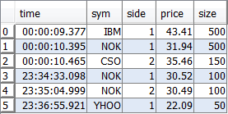

Vertical Joins
table1 , table2
The vertical join ‘,’ is used as for joining simple lists, and table2 is concatenated to table1.
Both tables must have exactly the same schema (column names and column types) or the join will fail.

Slide 33
Vertical Joins
Load table BD6_20170517.q
Build 2 tables T1 and T2 with the top 3 and bottom 3 rows from table
Join T1 and T2 (vertically)
SOLUTION:
q)T1:3#trades
q)T2:-3#trades
q)T1,T2

Slide 34



Horizontal Joins
table1 , ' table2
The horizontal join joins tables with the same number of rows; i.e. adds an extra set of columns.

Slide 35
Horizontal Joins
Load table BD6_20170517.q
Build 2 tables T1 and T2. T1 contains timestamp and sym from the trades tables. T2 contains the price and volume (quantity) from the trades table
Join T1 and T2 (horizontally)
SOLUTION:
q) table1: select timestamp,sym from data
q) table2: select price,volume:quantity from data
q) table1,'table2

Slide 36
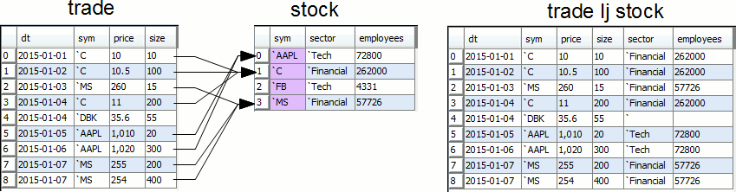
Left Joins
table lj keyedtable
A left join is a horizontal join, based on the value of a subset of columns.
The right argument must be keyed, and where the keys are matched to the columns in the left argument the join is completed. The left argument can be keyed or unkeyed.
If a key from keyedtable isn't present in table, that data will not be joined.
If there is no key present in keyedtable which is in table, then the join results in null values.

Slide 37
Left Joins
Load table BD6_20170517.q
Build a first table T1 with timestamp, sym, price, quantity for sym 83_153_50_0_202_14540_0 and 83_153_50_0_202_14577_0
Build a second table with 2 columns: sym and series. For 83_153_50_0_202_14540_0, the series should be NKM17. For 83_153_50_0_202_14577_0, the series should be NKN17.
Left Join the 2 tables
SOLUTION:
q) trade1: select timestamp, sym ,price,volume:quantity from data where sym in (`83_153_50_0_202_14540_0,`83_153_50_0_202_14577_0)
q) seriesinfo: ([] sym:`83_153_50_0_202_14540_0`83_153_50_0_202_14577_0; series:`NKM17`NKN17)
q) trade1 lj `sym xkey seriesinfo

Slide 38
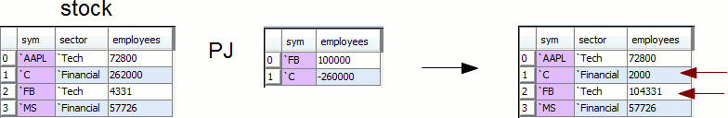
Plus Joins
table pj keyedtable
A plus join (pj) is a variation on the left join;
Where the key column names match, numeric values are added.
Other columns of the left argument remain unchanged.

Slide 39
Plus Joins
Load table BD6_20170517.q
Create table trade1 with the volume by sym where timestamp between 9 and 9.30am
Create table trade2 with the volume by sym where timestamp between 9.30 and 10am
Plus join trade1 and 2
SOLUTION:
q)trade1: select volume:sum quantity by sym from data where timestamp within (2017.05.17T09:00:00 2017.05.17T09:30:00)
q)trade2: select volume:sum quantity by sym from data where timestamp within (2017.05.17T09:30:00 2017.05.17T10:00:00)
q)trade1 pj trade2

Slide 40
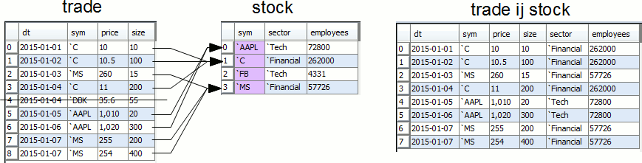
Inner Joins
table ij keyedtable
An inner join joins two tables on the keys of keyedtable.
Where a match occurs, the column is either added on, or updated if it already exists - the result will be a table with one row for each row of the first table which matches the keys of the second.
Non-matches are not returned in the result - i.e. there will be no nulls in the resulting table.
Equi join (ej) is a variation on ij, where the column names can be specified.

Slide 41
Inner Joins
Load table BD6_20170517.q
Build a table with 2 columns: sym and series. For 83_153_50_0_202_14540_0, the series should be NKM17. For 83_153_50_0_202_14577_0, the series should be NKN17.
Inner Join the trade and series tables
Compare to Left join earlier
SOLUTION:
q) seriesinfo: ([] sym:`83_153_50_0_202_14540_0`83_153_50_0_202_14577_0; series:`NKM17`NKN17)
q) data ij `sym xkey seriesinfo
q) t1:select timestamp, sym ,price:price,volume:quantity from data where sym in (`83_153_50_0_202_14540_0,`83_153_50_0_202_14577_0)
q) count data ij `sym xkey seriesinfo
17396
q) count t1 ij `sym xkey seriesinfo
17396

Slide 42
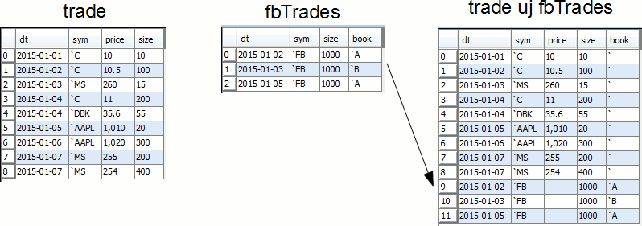
Union Joins
table1 uj table2
Keyedtable1 uj keyedtable2
A union join allows tables with different columns to be joined, and is an extension of the simple vertical join (‘,’).
Both tables must be either keyed or unkeyed.

Slide 43
Union Joins
When both tables are unkeyed:
The resulting table is simply the superset of rows and columns of the two tables;
The length of the new table is equal to the length of table1 plus the length of table2;
If the columns are shared, they are concatenated;
If the columns are not shared, they will be filled with nulls.
When both tables are keyed:
Update existing records in keyedtable1 with matches from keyedtable2;
Where no match is found, the row is appended.
For example, if we want to join two tables which are time bucketed, we can use a uj

Slide 44
Union Joins
Load table BD6_20170517.q
Create a1 using the top 10 rows of data with columns timestamp, price, sym
Create a2 using the bottom 10 rows of data with columns timestamp, price, sym, volume (quantity)
Union join a1 and a2
Try with keyed tables
SOLUTION:
q) a1: 10#select timestamp, sym ,price from data
q) a2: -10#select timestamp, sym ,price, volume:quantity from data
q) a1 uj a2
q) (`sym xkey a1) uj (`sym xkey a2)

Slide 45


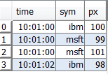
Asof Joins
aj[`col1`col2; table1; table2]
An asof join is not a straight match on a column value. Instead, the values in the chosen column in table1 give an interval within which to match from table2.
The last value within the interval is taken from table2.
A common usage is for time series data, when the time values will not match up exactly - instead, an asof join will select the row from table2 with the time not more than the corresponding time in table1. It joins the last value from table2 to table1.
table1
table2
Notes:
aj[`sym`time;t1;t2]

Slide 46
Asof Joins
The first argument `col1`col2 is a list of columns to join on, commonly `sym`time.
The last column in the list is the asof match. The remaining column(s) are the exact match columns.
For correct and optimum performance, it is recommended that:
there should be at most one exact match column
the exact match column should have a `p or `g attribute set
the data must be sorted by the asof column within the match column (so in the `sym`time example, the data doesn't have to be globally sorted by time, but does have to be sorted within each sym)
q)aj[`sym`time;trades;quotes]
time sym side price size bid ask bsize asize
-------------------------------------------------------------------------------
00:00:09.377 IBM buy 43.51 5000 43.49 43.51 8000 9000
00:00:10.395 NOK buy 31.78 5000 31.77 31.78 6000 9000
00:00:10.465 CSCO sell 35.43 1500 35.43 35.47 3000 7000
00:00:11.424 CSCO sell 35.43 1000 35.43 35.47 3000 7000
...
Notes:
the last column should be the time column

Slide 47
Asof Joins
Create a “trade” table with 3 columns – timestamp, sym, qty
Create a “quote” table with 3 columns – timestamp, sym, px
Both tables should have 100,000 rows
For each row in the trade table, find the prevailing price at the point in time
You’ll find that the aj will take some time to run. Apply a grouped attribute on the sym column of the quote table.
Re-run the aj and note the performance.
SOLUTION:
q) n:10000
q) trade:([]timestamp:asc n?00:00:00.000;sym:n?`msft`ibm`ge`c`goog`aapl`nflx`bac;qty:n?500)
q) quote:([]timestamp:asc n?00:00:00.000;sym:n?`msft`ibm`ge`c`goog`aapl`nflx`bac;px:n?1000f)
q) \ts aj[`sym`timestamp;trade;quote]
q) update `g#sym from `quote
q) \ts aj[`sym`timestamp;trade;quote]
47

Slide 48
Adverbs
Combine 2 verbs and use it as a new function
Each
Eachboth (')
If a function can accept lists, its better to not use each:
q)til each 4 5 6
0 1 2 3
0 1 2 3 4
0 1 2 3 4 5
q)(1 2 3), ’(1 2 3) /join each right and left
1 1
2 2
3 3
q)f:{x+y}
q)f’[1 2;3 4]
4 6
q)f[1 2;3 4]
4 6

Slide 49
Adverbs
Eachleft (\:)
Eachright (/:)
q)(1 2 3)+\:(4 5 6 7) /add right to each left
5 6 7 8
6 7 8 9
7 8 9 10
q)(1 2 3)-/:(4 5 6 7) /minus left to each right
-3 -2 -1
-4 -3 -2
-5 -4 -3
-6 -5 -4

Slide 50
EXERCISE
Create a list of 5 random numbers ranging from 0 to 10 (Call it a)
Perform the til function on each of the numbers in the list
Subtract 1, 2, and 3 from a using the eachright function
SOLUTION:
q) a:5?10
q) til each a
q) a-/:(1 2 3)

Slide 51
JOINS SUMMARY
Join | Description
Vertical Join | Joins tables with the same columns together Assumes columns sequence and type between tables are the same
Horizontal Join | Joins tables with the same number of rows together. Join assumes that the rows correspond to each other
Left Join | Joins tables together with the use of a primary key Rows without joining keys will be left blank Rows with multiple joining keys will return an error
Plus Join | Similar to the Left Join, plus join includes an additon feature to sum the same columns Only applicable to numeric fields
Inner Join | Joins tables together with the use of primary key Rows that do not have matching primary keys would be excluded from resulting table
Union Join | Joins tables with the same columns together Similar columns will be mapped against each other
Asof Join | Joins tables along columns that are usually time columns. In the join, the last value (most recent time) is taken.

Slide 52
7. kdb+ Tick Architecture
7.1 Introduction

Slide 53
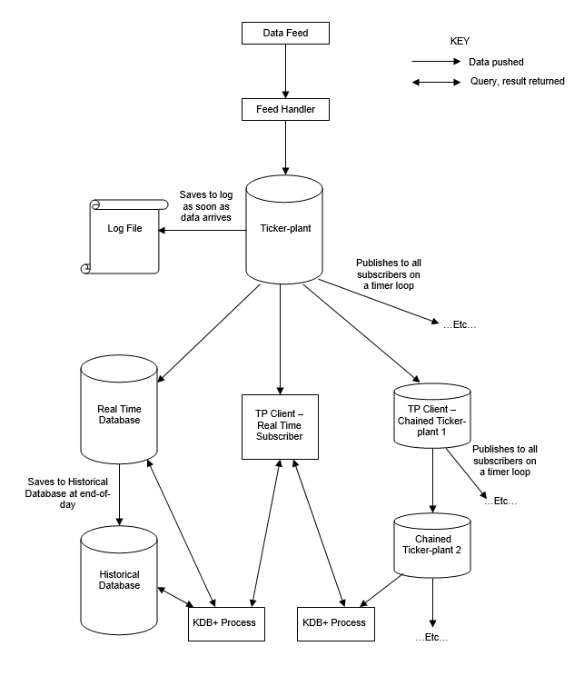
kdb+ tick Architecture
The Ticker-plant, Real-Time Database and Historical Database are operational on a 24/7 basis.
The data from the data feed is parsed by the feed handler.
The feed handler publishes the parsed data to the ticker-plant.
Immediately upon receiving the parsed data, the ticker-plant publishes the new data to the log file and updates its own internal tables.
On a timer loop, the ticker-plant publishes all the data held in its tables to the real-time database and publishes to each subscriber the data they have requested. The ticker-plant then purges its tables. So the ticker-plant captures intra-day data but does not store it.

Slide 54
kdb+ tick Architecture
The real-time database holds the intra-day data and accepts queries.
In general, clients which need immediate updates of data (for example custom analytics) will subscribe directly to the ticker-plant (becoming a real-time subscriber). Clients which don’t require immediate updates, but need a view the intra-day data will query the real-time database.
A real-time subscriber can also be a chained ticker-plant. In this case it receives updates from a ticker-plant (which could itself be a chained ticker-plant) and publishes to its subscribers. This will reduce latency through the system.
At the end of the day the log file is deleted and a new one created, and the real-time database saves all it’s data to the historical database and purges its tables.

Slide 55
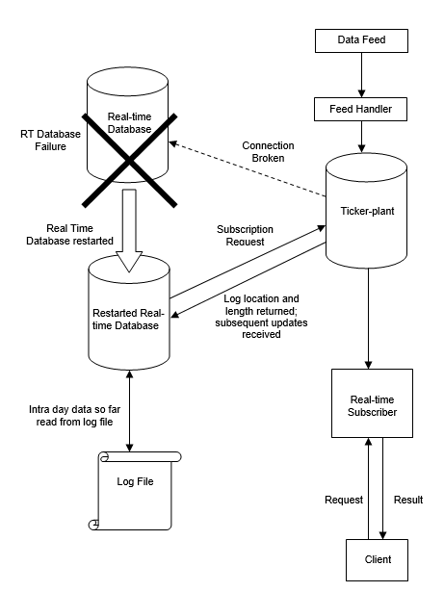
kdb+ tick rdb recovery
When the RDB goes down, it should be restarted (either manually, or using system tools). However, it will have lost all the intra-day data so far.
To regain this, it sends a subscription request to the ticker-plant which returns a message containing the location of the log file, and the number of lines to read. The RDB replays the number of lines specified from the log file, storing the results. In this way it regains an up-to-date set of data.
The restarted RDB receives all subsequent updates from the ticker-plant. If updates arrive whilst the RDB is reading from the log file they are buffered in the TCP/IP buffer.
Replaying the log can potentially take several minutes towards the end of the day.

