Slide 1
KDB+ Training 2019 Software Setup Guide
APAC Data & Analytics
19-20 February 2019

Slide 2
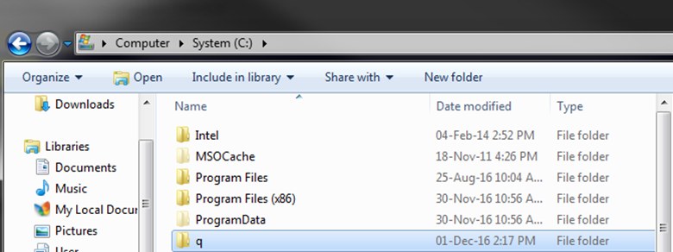
kdb+ Windows Installation (1/3)
Download kdb+/q (win32) from
https://kx.com/download/
Unzip and place folder at your root directory C:/

Slide 3
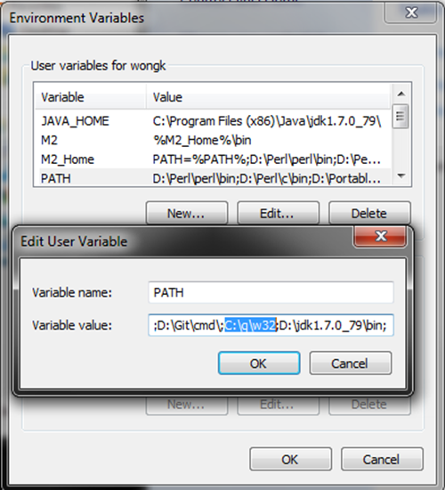
kdb+ Windows Installation (2/3)
3. Set environment variable "path" to include "C:\q\w32".
Go to Control Panel\User Accounts\User Accounts
Select "Change environment variables“
Add "C:\q\w32\" to "PATH" variable. If it does not exist, create it. Remember that all entries are delimited by a semi-colon.
Press "Ok" for everything after

Slide 4
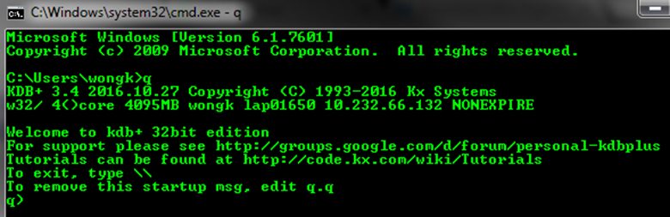
kdb+ Windows Installation (3/3)
4. Test to see if it works!
Run command prompt. Ctrl+R > cmd > Enter > q > Enter

Slide 5
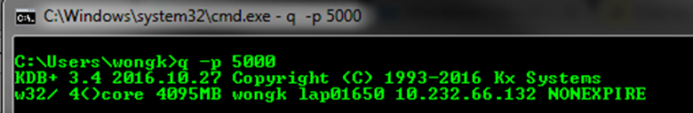
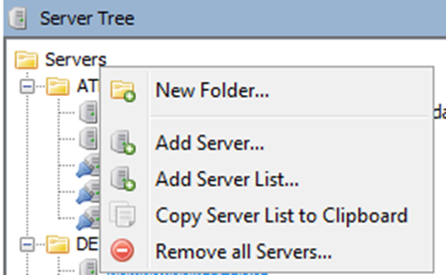
qStudio Windows Installation (1/2)
Download qStudio from
http://www.timestored.com/qstudio/
Copy it to a directory of your choice, I recommend either in C/D root or within your q folder
Open qStudio and let's get you connected:
Start a q process on port 5000 by typing the following in command prompt. "q -p 5000“
Open qStudio and a new server

Slide 6
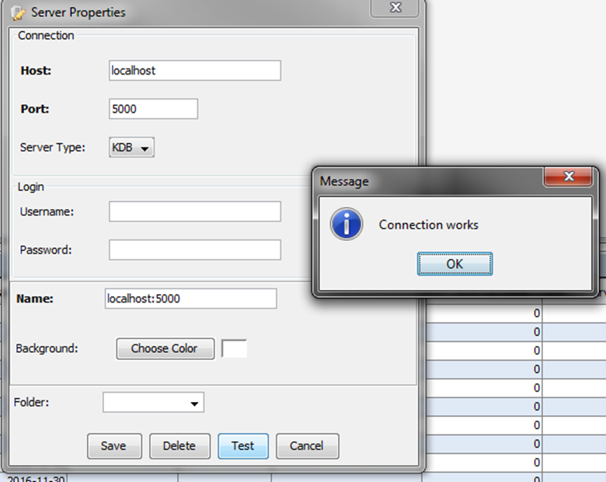
qStudio Windows Installation (2/2)
Host is "localhost" and port is "5000". Name it "localhost:5000".
Press "Test" and then save it.
You can send commands from qStudio to localhost:5000 as long as that process is active

