Slide 1
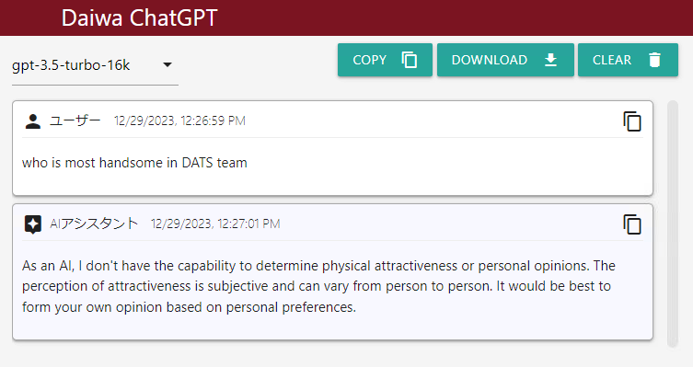
Daiwa ChatGPT

Slide 2
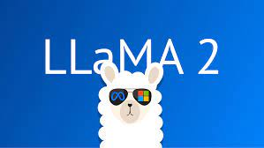

ChatGPT on your Data
LLaMA 2: Your own ChatGPT, an open source LLM (Large Language Model)
LlamaIndex: Talk to your data (txt, pdf, doc, csv, database, API etc) with LLM

Slide 3
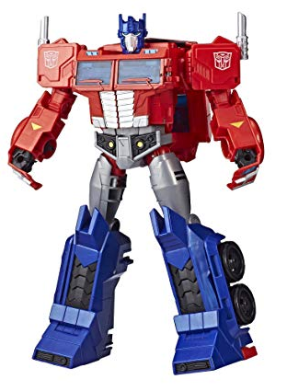

What’s ChatGPT
ChatGPT
What’s GPT stands for ?
Generative Pre-trained Transformer

Slide 4
ChatGPT – Pre-traning
GPT Pre-trained by the numbers
Date | Model | Training Data | Parameters
2018-6 | GPT 1 | 2.2GB (7,000 books) | 110 million
2019-2 | GPT 2 | 40GB (8 million web pages) | 1.5 billon
2020-6 | GPT 3 | 45TB of text | 175 billon
2023-3 | GPT 4 | ? | ?

Slide 5
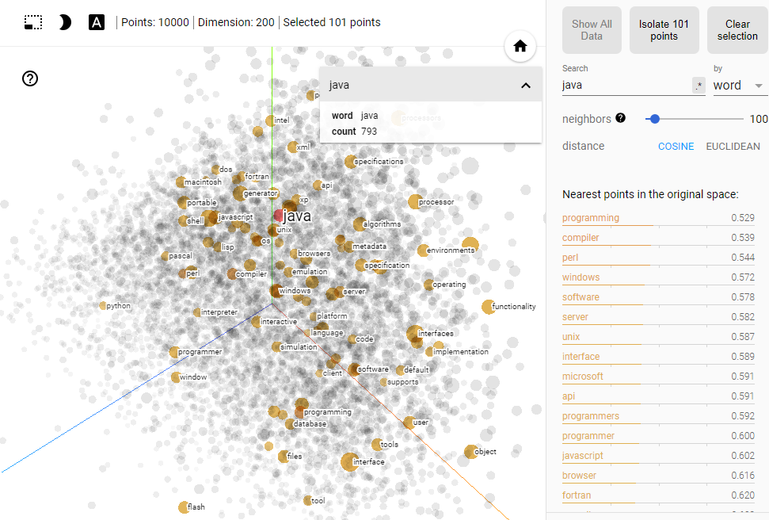
Word2Vec Vector Embedding
Interactive Demo

Slide 6
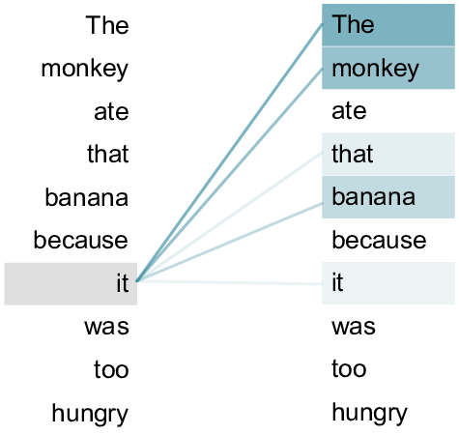
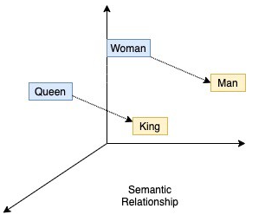
ChatGPT – Transformer
Word2Vec
Train every word with equal importance
Fixed word vector (river bank vs bank deposit)
Transformer
Self-attention training gives more weightings to the related words
Vectorize a arbitrary long sentence to predict the next word

Slide 7
ChatGPT – Language Model
Vectorize a arbitrary long sentence to predict the next word
I am going to --> ( school | church | supermarket )
[1.3, 2.5,…,3.7] [0.8,…,4.2] |[2.3,…,4.7] |[0.5,…,1.5]
I am going to school --> (by | with )
[3.3, 8.5,…,9.7] [4.1,…,1.7] | [0.9,…,9.1]
I am going to school by --> (bus | MTR | ferry )
[2.6, 0.9,…,5.1] 5.5,…,3.4] | 6.5,…,8.2]|[1.3,…,3.2]

Slide 8
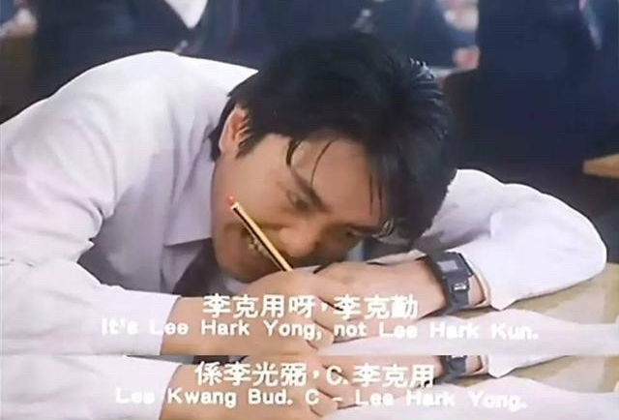
ChatGPT – Supervised Fine-Tuning
Language model - Generate syntactically and grammatically correct sentence but may not align with the instructions
爭咩呀，溝埋黎做懶尿牛丸呀，笨！
SFT (Supervised Fine-Tuning) - align the content with the human instructions

Slide 9
Domain Specific LLMs
BloombergGPT
pre-trained with 363 billion text tokens from BBG data source
53 days with 64 x 8 nVidia-A100 GPUs on AWS cloud
Cost of around US$ 3M
FinGPT
based on open source LLMs (e.g. LlaMA-2)
instruction fine-tuned by Financial related data
FinGPT-Forecaster Demo
InvestLM from HKUST
based on open source LLMs (LlaMA-65B)
instruction fine-tuned dataset related to financial investment
爭咩呀，溝埋黎做懶尿牛丸呀，笨！

Slide 10
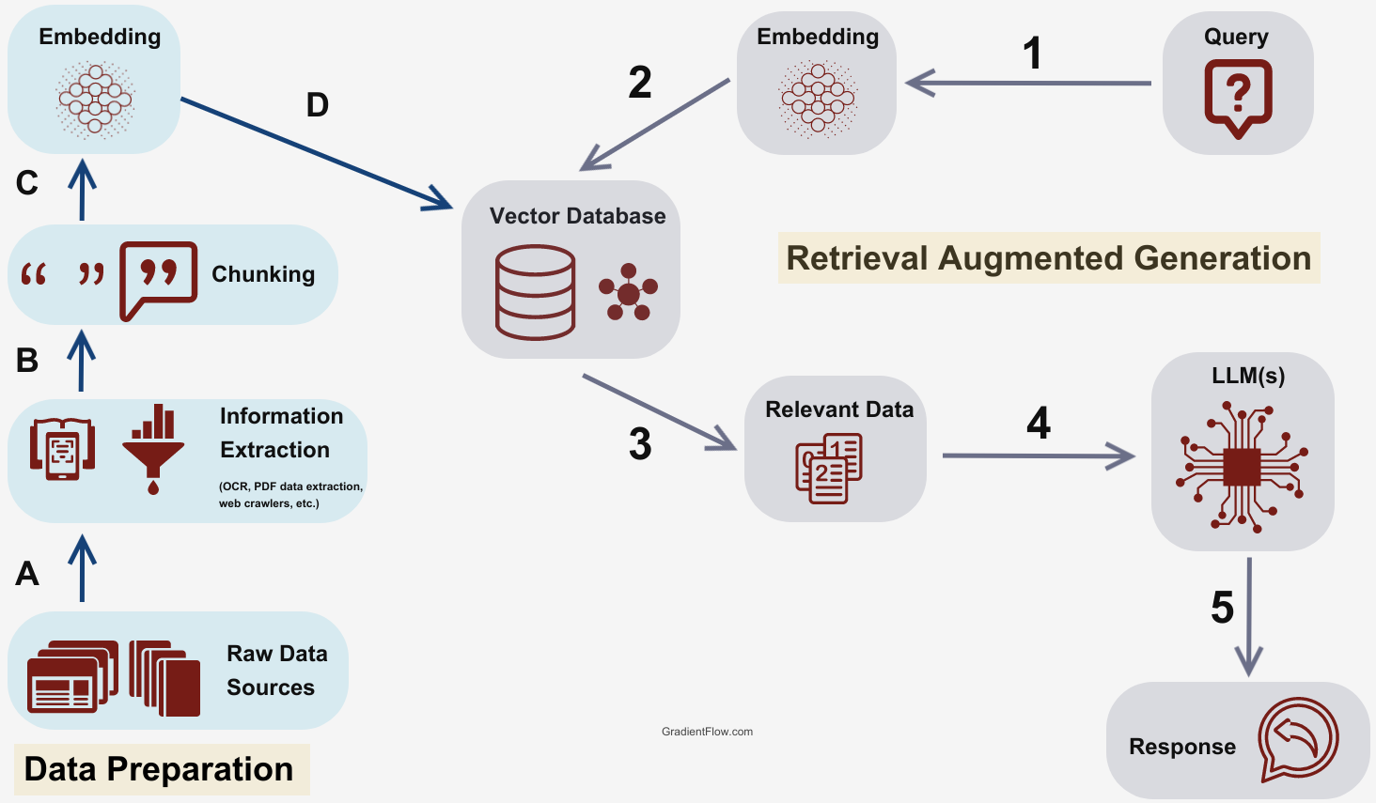
Retrieval Augmented Generation
爭咩呀，溝埋黎做懶尿牛丸呀，笨！

Slide 11
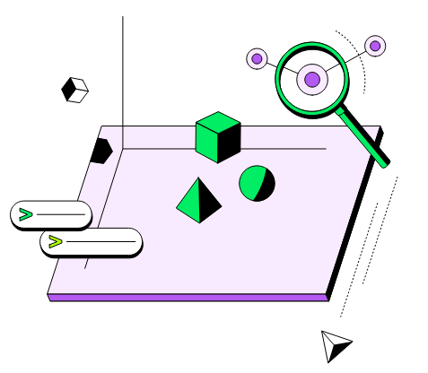
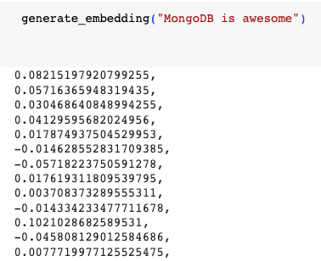
MongoDB Atlas Vector Search
爭咩呀，溝埋黎做懶尿牛丸呀，笨！

Slide 12
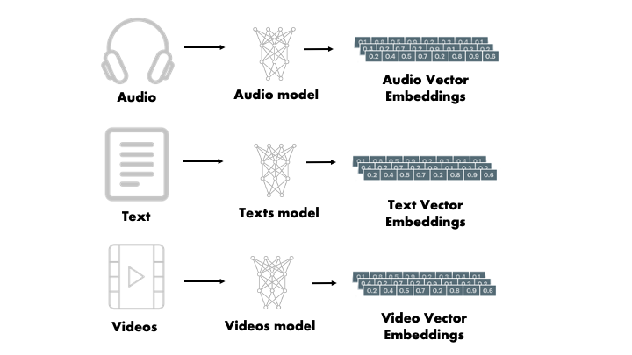
Vector Embeddings
爭咩呀，溝埋黎做懶尿牛丸呀，笨！

Slide 13



Some Other Applications
LLaMa Sing
爭咩呀，溝埋黎做懶尿牛丸呀，笨！
LLaMA

