Slide 1
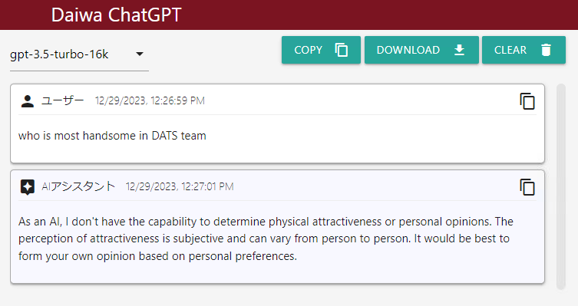
Daiwa ChatGPT

Slide 2
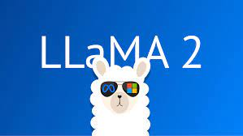

ChatGPT on your Data
LLaMA 2: Your own ChatGPT, an open source LLM (Large Language Model)
LlamaIndex: Talk to your data (txt, pdf, doc, csv, database, API etc) with LLM

Slide 3
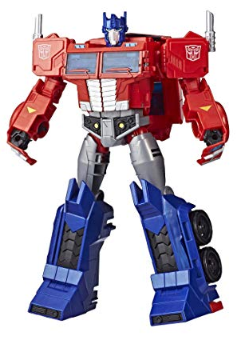

What’s ChatGPT
ChatGPT
What’s GPT stands for ?
Generative Pre-trained Transformer

Slide 4
ChatGPT – Pre-traning
GPT Pre-trained by the numbers
Date | Model | Training Data | Parameters
2018-6 | GPT 1 | 2.2GB (7,000 books) | 110 million
2019-2 | GPT 2 | 40GB (8 million web pages) | 1.5 billon
2020-6 | GPT 3 | 45TB of text | 175 billon
2023-3 | GPT 4 | ? | ?

Slide 5
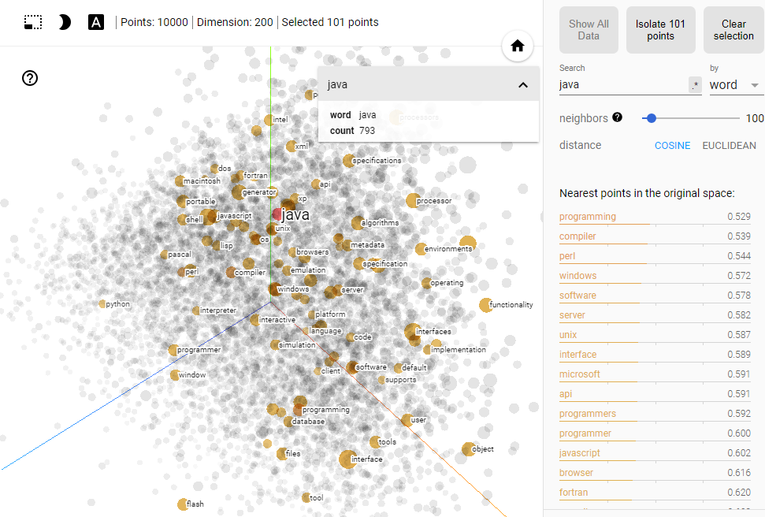
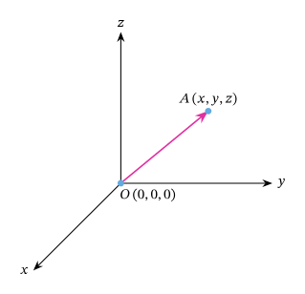
Word2Vec Vector Embedding
3D vector: [1, 2, 3], [1, 4, 6], [3, 4, 7] … Calculate vector distance

Slide 6


Word2Vec to Transformers
Word2Vec
Vectorize one word to predict next word (vector)
Transformers
Vectorize words, sentences, paragraphs to predict next word (vector)

Slide 7
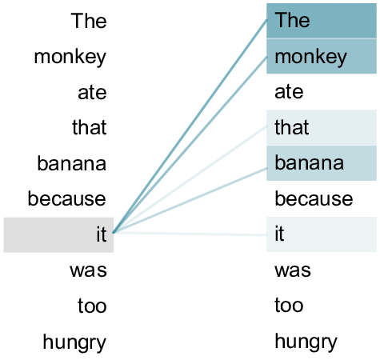
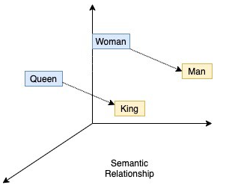
ChatGPT – Transformer
Word2Vec
Train every word with equal importance
Fixed word vector (river bank vs bank deposit)
Transformer
Positional encoding provides a relative position for each token or word in a sequence
Self-attention training gives more weightings to the related words

Slide 8
ChatGPT – Language Model
Vectorize words, sentences, paragraphs to predict next word (vector)
I am going to --> ( school | church | supermarket )
[1.3, 2.5,…,3.7] [0.8,…,4.2] |[2.3,…,4.7] |[0.5,…,1.5]
I am going to school --> (by | with )
[3.3, 8.5,…,9.7] [4.1,…,1.7] | [0.9,…,9.1]
I am going to school by --> (bus | MTR | ferry )
[2.6, 0.9,…,5.1] 5.5,…,3.4] | 6.5,…,8.2]|[1.3,…,3.2]

Slide 9

ChatGPT – Supervised Fine-Tuning
Language model - Generate syntactically and grammatically correct sentence but may not align with the instructions
爭咩呀，溝埋黎做懶尿牛丸呀，笨！
SFT (Supervised Fine-Tuning) - align the content with the human instructions

Slide 10

ChatGPT – Prompt Engineering
I, Robot (2004)
Prompt Engineering: crafting and refining prompts (questions) to generate desired responses from language models

Slide 11
Domain Specific LLMs
BloombergGPT
pre-trained with 363 billion text tokens from BBG data source
53 days with 64 x 8 nVidia-A100 GPUs on AWS cloud
Cost of around US$ 3M
FinGPT
based on open source LLMs (e.g. LLaMA-2)
instruction fine-tuned by Financial related data
FinGPT-Forecaster Demo
InvestLM from HKUST
based on open source LLMs (LLaMA-65B)
instruction fine-tuned dataset related to financial investment
爭咩呀，溝埋黎做懶尿牛丸呀，笨！

Slide 12
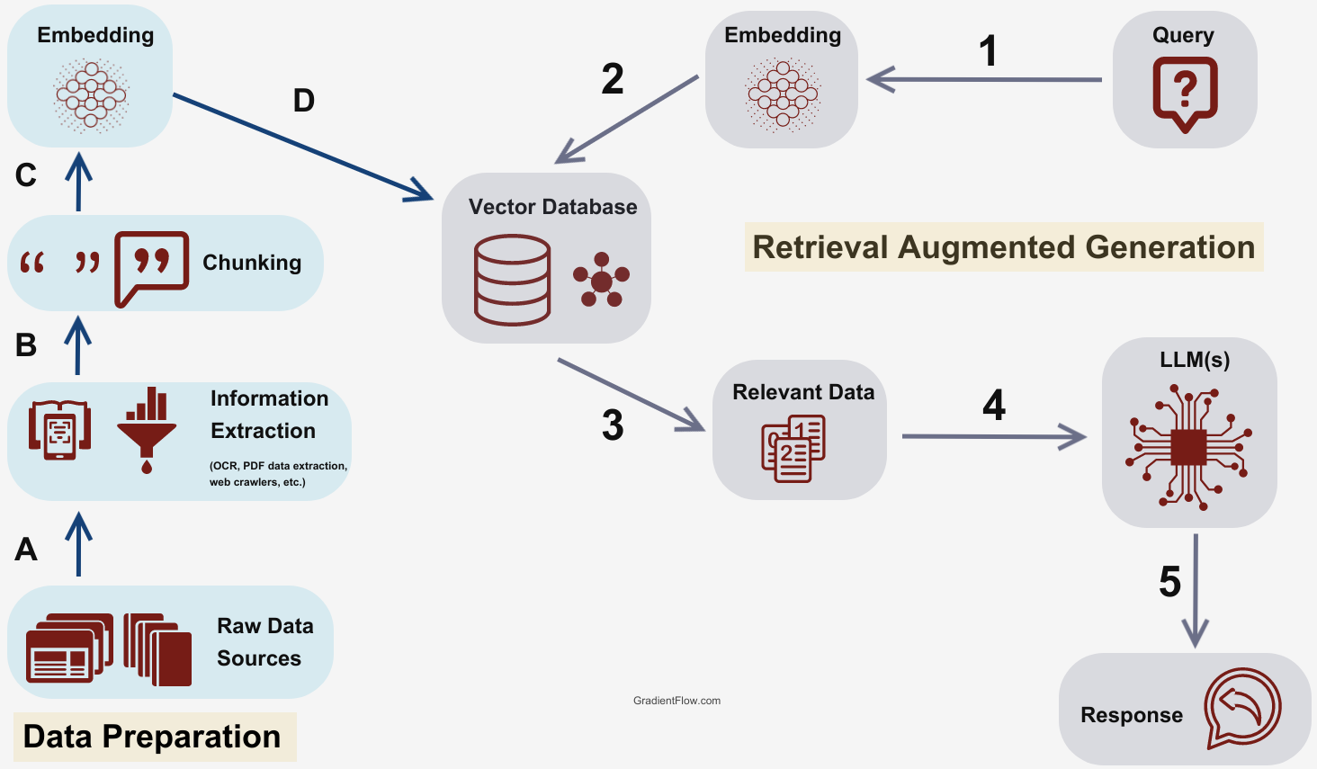
Retrieval Augmented Generation
爭咩呀，溝埋黎做懶尿牛丸呀，笨！

Slide 13
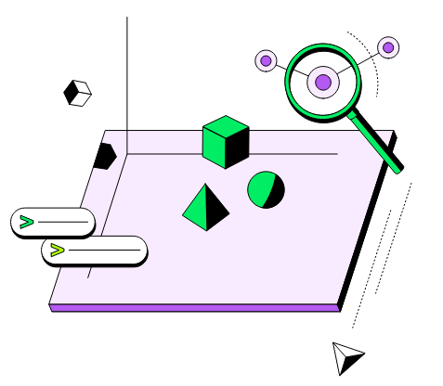
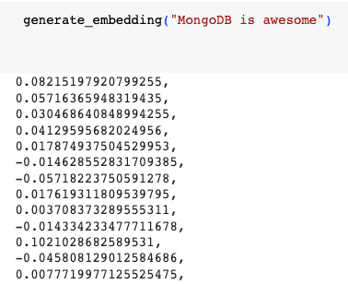
MongoDB Atlas Vector Search
爭咩呀，溝埋黎做懶尿牛丸呀，笨！

Slide 14
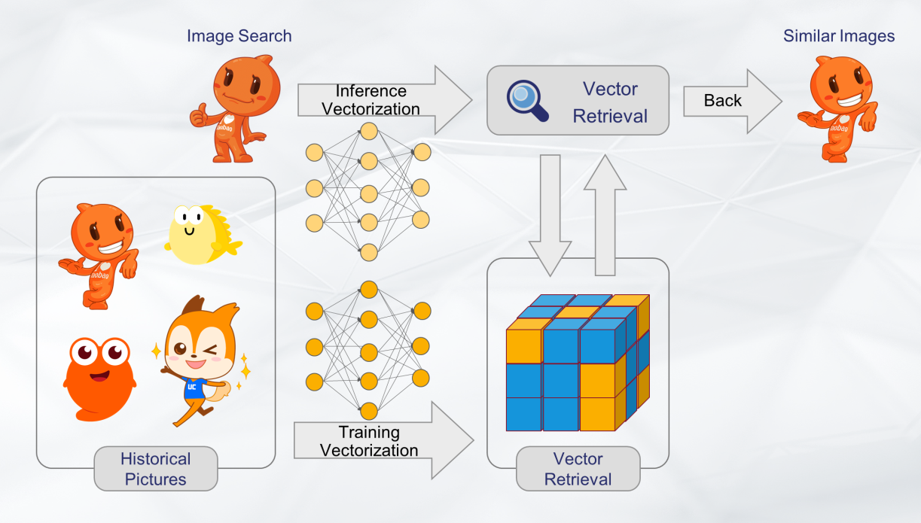
Vector Embedding - Images
爭咩呀，溝埋黎做懶尿牛丸呀，笨！
Proxima: A Vector Retrieval Engine independently developed by Alibaba DAMO Academy

Slide 15
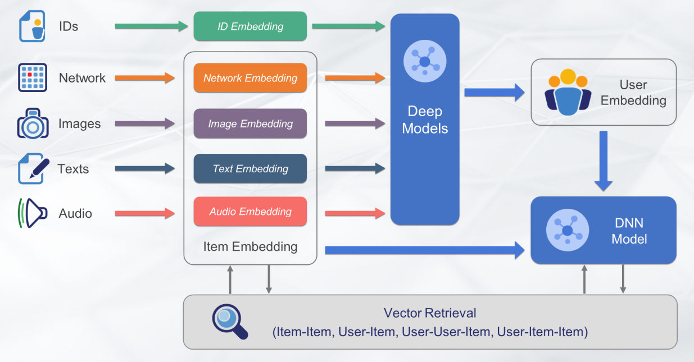
Vector Embedding - Everything
爭咩呀，溝埋黎做懶尿牛丸呀，笨！
Proxima: A Vector Retrieval Engine independently developed by Alibaba DAMO Academy

Slide 16



Some Other Applications
LLaMA Sing
LLaMA

