Slide 1
PRODUCT PITCH
PDF Word Editor
Edit any word in a PDF — without installing anything,
without uploading anything, without paying anything.
Zero install
Zero upload
Zero cost
PDF Word Editor
1

Slide 2


Editing a PDF shouldn't be this hard
Two problems, one root cause: today's tools were never built to keep your document on your own device.
Even paid tools give up
“Free” online editors aren't free
Adobe Acrobat Pro — a paid subscription — still can't cleanly edit many real-world PDFs: scanned forms, government templates, documents with embedded fonts.
The fallback: retype the whole page by hand.
Real editing sits behind a subscription — and every file you touch gets uploaded to a server you don't control.
For contracts, HR records, or client data, that's a leak waiting to happen.
PDF Word Editor
2

Slide 3


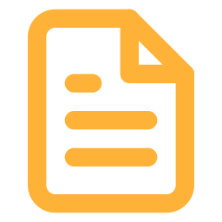

A different starting point
Built around one rule: your file never leaves your device.
Runs entirely in your browser
Nothing is ever uploaded — not to us, not to anyone.
Click any word to edit it in place
Or use Find & Replace to change something across the whole document at once.
Reuses the PDF's own fonts, colours and layout
Edits blend into the page — this is an exact match, not an approximation.
No install, no account, no subscription
Open a web page and go.
PDF Word Editor
3

Slide 4
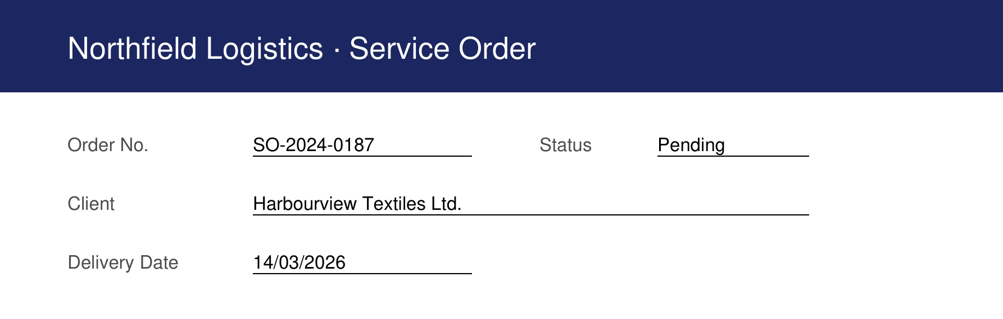
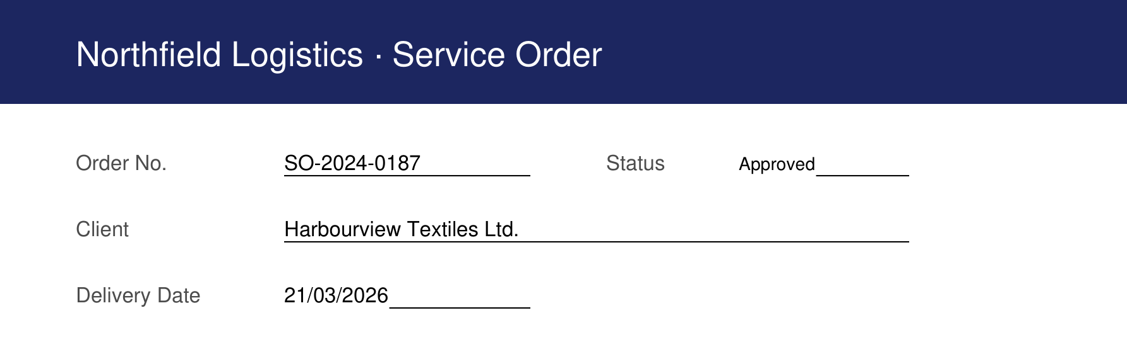

See it, don't take our word for it
Two fields, edited directly in the browser. Same font. Same spacing. Same document.
BEFORE
AFTER
Status: Pending → Approved · Delivery Date updated — both edits keep the original underline and font.
Font — exact match
Position — exact match
Colour — exact match
PDF Word Editor
4

Slide 5

Four steps. No install.
The website version only — open it in any modern browser.
1
2
3
4
Open the website
Drop in your PDF
Click any word to edit
Click Download
Or double-click the offline file. Works in any modern browser.
It loads instantly and never leaves your device.
Or use Find & Replace for changes across the document.
Get your edited PDF immediately.
PDF Word Editor
5

Slide 6
The maths
$0
forever — no subscription, no per-seat licence, no trial that expires
Adobe Acrobat Pro
Online PDF editor subscriptions
PDF Word Editor
~US$240 / yr
~US$150 / yr
$0
per seat — and still can't edit every PDF
plus your files sit on their servers
nothing to install, nothing uploaded
PDF Word Editor
6

Slide 7
Try it today
Open the website, or grab the single offline file. No sign-up. No trial. No catch.
Built for teams who can't afford to leak a document — or a subscription fee.
PDF Word Editor
7

