Slide 1







Shifting Technology Trends
Ken Woon
12/08/24

Slide 2



OUTLINE
Executive Summary
Introduction
Methodology
Results
Visualization – Charts
Dashboard
Discussion
Findings & Implications
Conclusion
Appendix

Slide 3

EXECUTIVE SUMMARY
Objective: Analyze the most in-demand programming skills and databases to identify emerging trends and future skill requirements in the IT industry.
Key Findings: Modern languages like Python and TypeScript are gaining popularity, while PostgreSQL, MongoDB, and Redis are emerging as preferred database solutions.
Implications: Organizations need to invest in upskilling their workforce in these emerging technologies and adapt their tech stack to stay competitive.
Conclusion: Embracing these trends and focusing on continuous learning and strategic technology investments will be crucial for maintaining industry leadership and driving future success.

Slide 4

INTRODUCTION
Objective: Help the organization stay competitive by identifying emerging skill requirements through data analysis
Data Collection: The initial phase of this project involved gathering data on the most in-demand programming skills from various sources, including job postings, training portals, and industry surveys
Data Analysis: Applied data wrangling and statistical techniques to prepare the data for analysis, focusing on identifying trends in programming languages, database skills, and popular Integrated Development Environments (IDEs)
Insights and Reporting: Synthesizing the insights into a comprehensive report, visualized using IBM Cognos Analytics, and preparing a presentation to effectively communicate these findings

Slide 5

METHODOLOGY
Data Collection: Gathered data from multiple sources, including job postings, training portals, and industry surveys, to identify the top programming skills and databases currently in demand
Data Wrangling: Cleaned and organized the collected data, converting it into usable formats, and ensured consistency and accuracy for analysis
Statistical Analysis: Applied statistical techniques to analyze the prepared data, focusing on identifying trends in programming languages, database usage, and popular IDEs
Visualization and Reporting: Used IBM Cognos Analytics to create visual dashboards that highlight key insights and trends, which were then synthesized into a coherent report and presentation

Slide 6
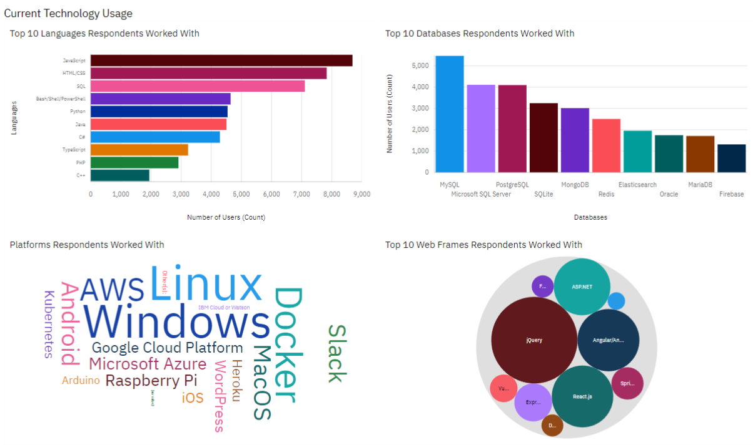
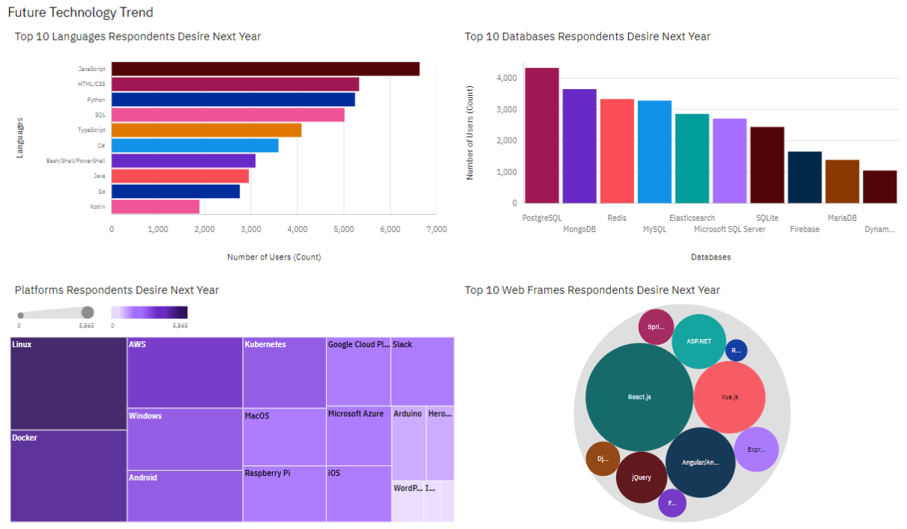
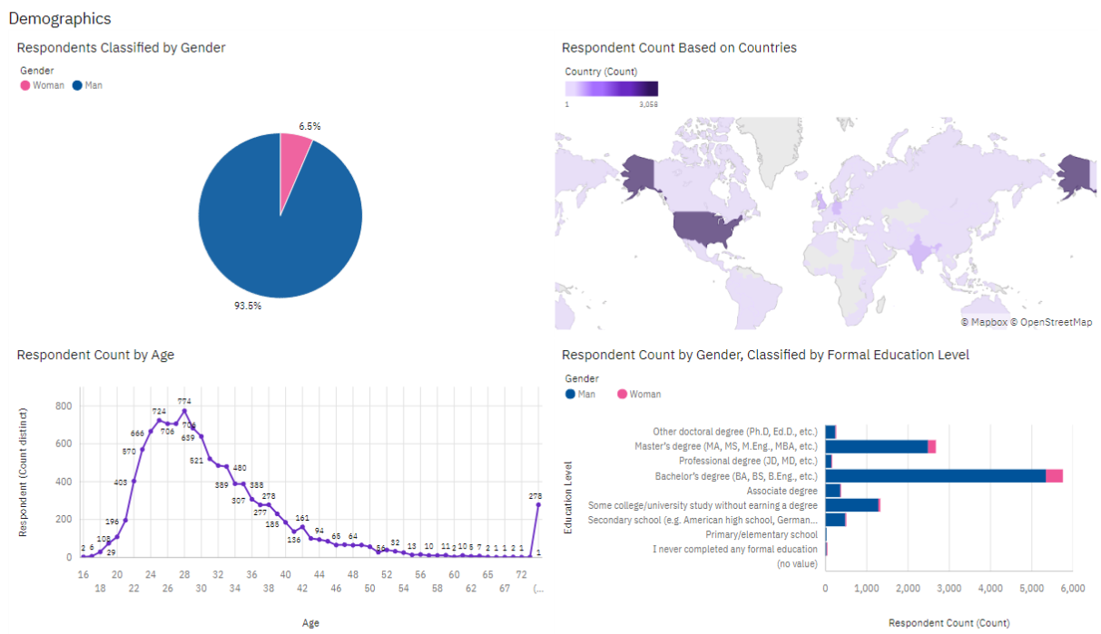
RESULTS

Slide 7
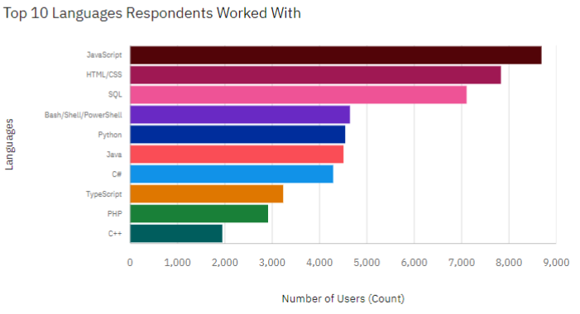
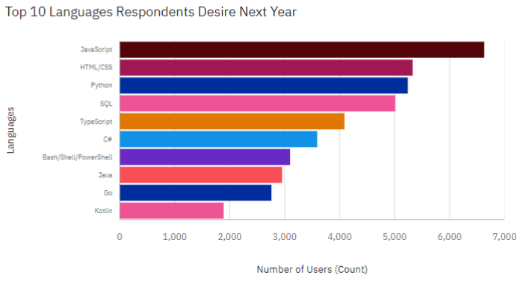
PROGRAMMING LANGUAGE TRENDS
Current Year
Next Year
<Bar chart of top 10 programming languages for the current year goes here.>
< Bar chart of top 10 programming languages for the next year goes here.>

Slide 8
PROGRAMMING LANGUAGE TRENDS - FINDINGS & IMPLICATIONS
Findings
JavaScript and HTML/CSS remain the most popular
JavaScript, HTML/CSS, TypeScript, and Python have the most gain in popularity
Python, TypeScript, Go, and Kotlin has gained more popularity
Implications
Suggesting a strong demand for full-stack development skills
Indicates a shift towards languages that offer versatility, modern syntax, and efficiency
Continuous learning and adaptability are crucial for IT professionals

Slide 9
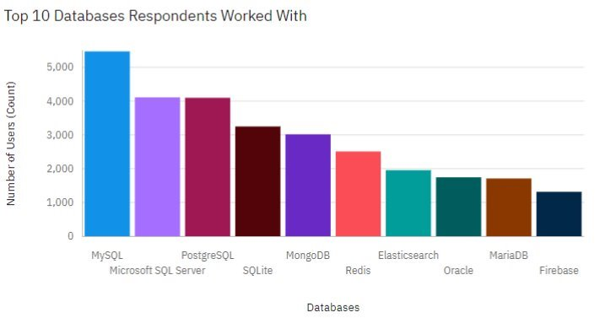
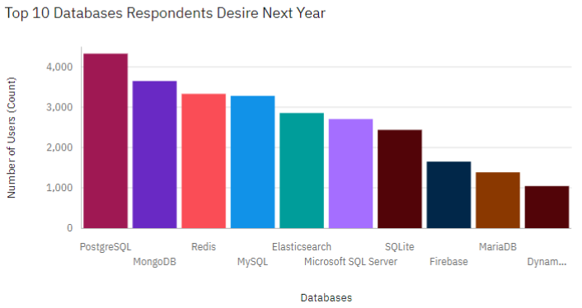
DATABASE TRENDS
Current Year
Next Year
< Bar chart of top 10 databases for the current year goes here >
< Bar chart of top 10 databases for the next year goes here.>

Slide 10
DATABASE TRENDS - FINDINGS & IMPLICATIONS
Findings
Rising popularity in PostgreSQL, NoSQL databases, Firebase, and DynamoDB
Declining interest for MySQL, Microsoft SQL Server, SQLite, and Oracle
MySQL's Consistent Usage but Declining Interest
Implications
People are moving towards databases that offer better scalability, flexibility, and performance
Organizations that have heavily relied on these older technologies might need to consider transitioning to more modern databases to stay competitive, which could lead to increased investment in database migration and upskilling of their technical teams
As data becomes more complex and unstructured, databases should be able to handle these new challenges more effectively

Slide 11

DASHBOARD
GitHub link of the IBM Cognos Studio dashboard

Slide 12
DASHBOARD TAB 1

Slide 13
DASHBOARD TAB 2

Slide 14
DASHBOARD TAB 3

Slide 15
DISCUSSION
Shifting Landscape in Technology Preferences: The data indicates a clear shift towards modern, versatile technologies. This trend suggests that organizations are increasingly prioritizing flexibility, scalability, and performance in their tech stacks, which may be driven by the growing demand for more complex, data-intensive applications.
Implications for Workforce Development: Opportunity for both organizations and educational institutions to focus on training and development programs that equip employees with these in-demand skills, ensuring they remain competitive in the job market.
Potential Decline of Legacy Technologies: Older technologies may face reduced adoption in the coming years. Organizations relying on these legacy systems may need to evaluate the potential benefits of transitioning to newer database solutions to stay aligned with industry trends.
Strategic Recommendations: To stay ahead of these emerging trends, it is recommended that organizations invest in upskilling their teams in the latest programming languages and databases, particularly focusing on the growing areas of cloud-based solutions. Additionally, staying attuned to the evolving preferences in IDEs and development tools will be crucial for maintaining developer productivity and satisfaction.

Slide 16
OVERALL FINDINGS & IMPLICATIONS
Findings
Rising Popularity of Modern Languages and Frameworks
Transition to Scalable Database Solutions
Increased Focus on Developer Tools and IDEs
Implications
Need for Continuous Learning
Strategic Investments in Technology
Workforce Development Focus

Slide 17

CONCLUSION
Technological Evolution
Strategic Adaptation
Continuous Learning
Future Focus

Slide 18

APPENDIX
Relevant additional charts or tables

Slide 19
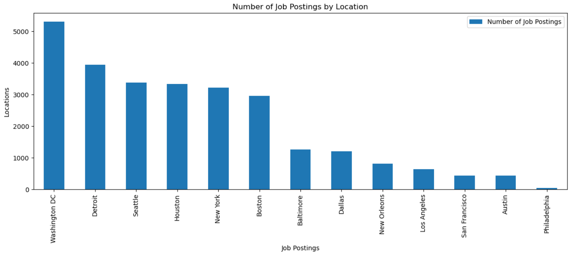
JOB POSTINGS

Slide 20
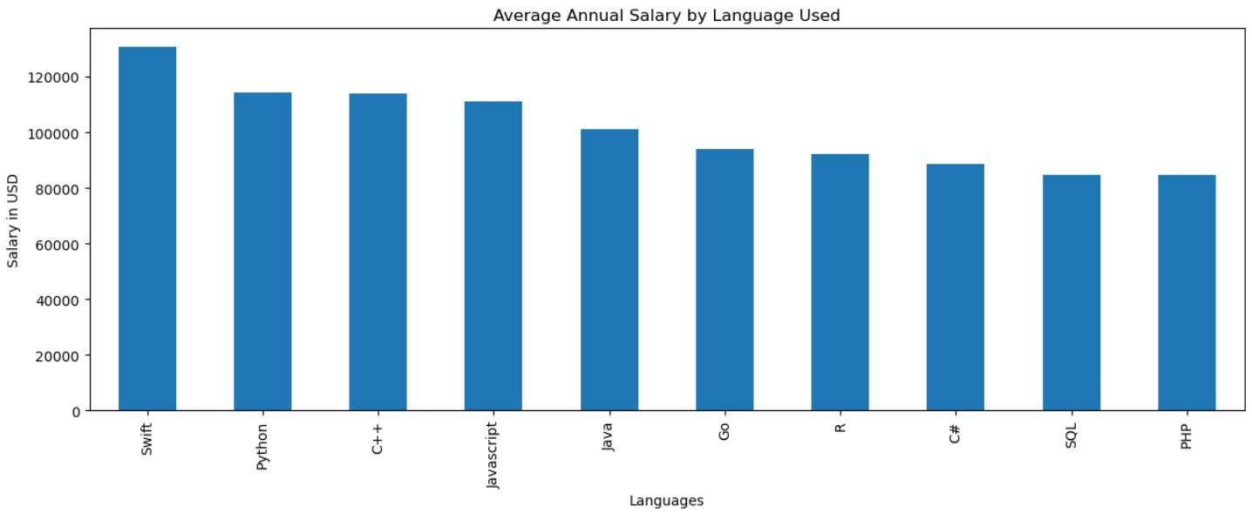
POPULAR LANGUAGES

